Slide 1
LESSON 8. Graphs Algorithms

Slide 2
CONTENT
Introduction to graphs
Graph representation method
DFS and BFS search algorithms
Application of DFS and BFS
Euler and Hamilton
Minimum spanning tree
Find the shortest path

Slide 3
1. Representation by adjacency matrix:
0 1 0 0 0 0
0 0 1 1 1 0
1 0 0 0 0 0
0 0 1 0 1 0
0 0 0 0 0 1
0 0 0 1 0 0
2
5
first
6
3
4
Advantages of adjacency matrix:
Simple
It is easy to check two adjacent vertices through a comparison.
Disadvantages of adjacency matrix:
Memory consuming
Cannot be represented with graphs with a large number of vertices
There may be unnecessary comparisons when the graph is sparse.
Notes:
3

Slide 4
2. Represented by edge list
Use arrays, or linked lists
2
5
Vertex Last peak
twelfth
1 3
2 3
2 4
2 5
3 4
4 5
forty six
5 6
first
6
3
4
Pros point belong to name book edge :
In school fit thing market sir will period thrifty Okay No time remember ;
Pros profit give one number art maths only mandarin heart arrive the edge belong to thing town .
Cons point belong to name book edge :
When need Browser the top adjacent with top u right Browser socks chief the edge belong to thing town .
Notes:
4

Slide 5
3. Representation by adjacency list
Use arrays, or linked lists
2
5
List(1) = {2, 3 }
List(2) = {1, 3, 4, 5 }
List(3) = {1, 2, 4 }
List(4) = {2, 3 , 5, 6}
List(5) = {2, 4, 6 }
List(6) = {4, 5 }
first
6
3
4
Pros point belong to name book adjacent :
Easy easy Browser socks chief the top belong to one name book adjacent ;
Time time Browser thing market fast more .
Cons point belong to name book adjacent :
Difficult install put with the post maths judge physical edge .
Notes:
5

Slide 6
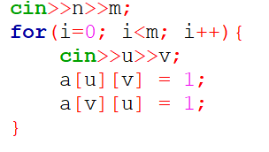
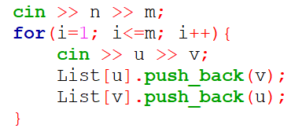
CONVERT EDGE LIST TO MATRIX
Using vectors

Slide 7
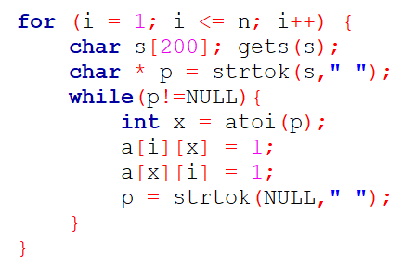
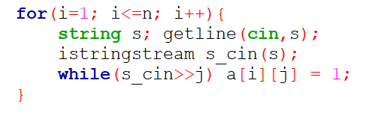

Slide 8
Depth-first search algorithm
DFS(u) Recursive Algorithm
void DFS ( u) {
<visit u vertex>;
sourxet[u] = False;
for (v=1; v<=n; v++)
if ( v ∈Ke(u) and sourxet[v])
DFS(v);
}
Notes:
8

Slide 9
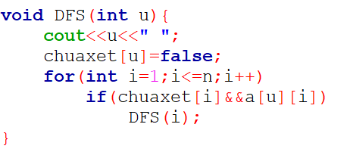
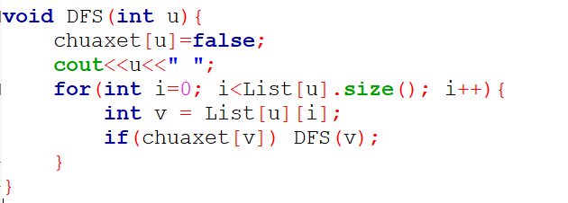
DFS recursively – Use adjacency matrix
DFS recursively – Use adjacency list

Slide 10
DFS(u) algorithm is based on stack
DFS(u) algorithm:
Begin
Step 1 (Initialization):
stack = ∅ ; // Initialize the stack as
push(stack, u); // Put vertex u on the stack
<Visit u vertex>; // Browse vertex u
sourxet[u] = False; // Confirm the vertex u has been browsed
Step 2 (Iteration):
( stack ) do
s = Pop(stack); // Type of vertex at the top of the stack
for each t Ke (s) do // Get each vertex t Ke (s)
if ( chuxet[t] ) then // If t is correct, it is unverified
<visit vertex t>; // Browse the vertex ht
sourxet[t] = False; // Confirm the vertex t has been checked
push(stack, s); // Put s on the stack
push(stack, t); // Put t on the stack
break; // Take only one vertex t
EndIf;
EndFor;
EndWhile;
Step 3 (Return Result): Return(<Checked vertex set >);
End.
Notes:
10

Slide 11
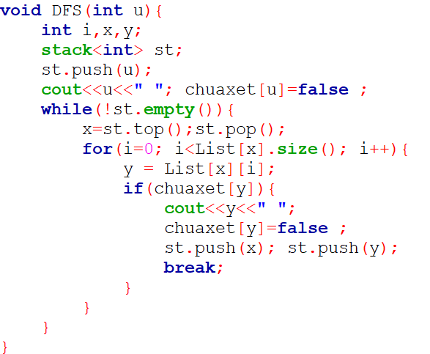
DFS USING STACK

Slide 12
Breadth-first search (BFS)
Algorithm BFS(u):
Step 1(Initialization):
Queue = ; // Initialize empty queue
push(Queue,u); // Put u in the queue
chuaxet[u] = False; // Record the considered vertex
Step 2 (Iteration):
( Queue ∅ ) do // Loop until the queue is empty
s = Pop(Queue); // Get s out of the queue
<Visit vertex s>; // Visit vertex s
for each t ∈ Ke(s) do // Iterate over the adjacency list of s
if ( chuaxet[t] ) then //If t has not been considered
push(Queue, t); // Put t in the queue
chuaxet[t] = False; // Note that t has been considered
EndIf ;
EndFor ;
EndWhile ;
Step 3 (Return results):
Return(<Checked vertex set>) ;
End.
Notes:
12

Slide 13
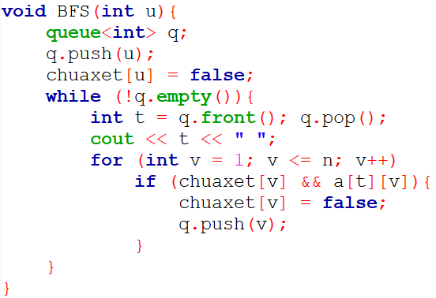
BFS INSTALLATION – With adjacency matrix

Slide 14
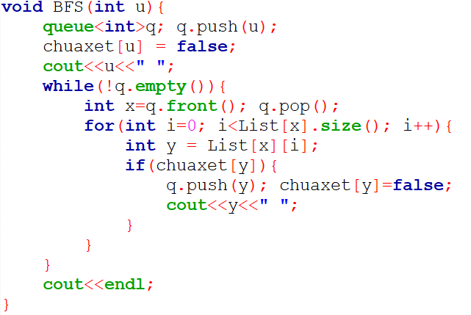
BFS INSTALLATION – With adjacency list

Slide 15
Algorithm to traverse all vertices of a graph
Display-Graph:
begin
Step 1 (Initialization):
for (u=1; u<=n; u++) do { // set all vertices to be unvisited
chuxet[u] = True;
Endfor;
Step 2 (Iteration):
for ( u =1; u n ; u++) do { // iterate over the vertex set V
if (chuacet[u] ) then
BFS (u); //DFS(u); //
endif;
endfor;
end.

Slide 16
Algorithm for browsing connected components
begin
Step 1 (Initialization):
Solt =0; //set the initial number of connected components to 0
for (u=1; u<=n; u++) do { // set all vertices to be unvisited
chuxet[u] = True;
Endfor;
Step 2 (Iteration):
for ( u =1; u n ; u++) do { // iterate over the vertex set V
if (chuacet[u] ) then
Solt++; // increase the connected component
<record vertices with the same connected component>;
BFS (u); //DFS(u);
endif;
endfor;
Step 3 (return results):
Return(Solt);
end.

Slide 17
Algorithm to find the path from vertex s to vertex t
Trace-DFS(s, t):
Begin
Step 1 (Initialization):
stack = ∅ ; // Initialize the stack as
push(stack, s); // Put vertex s on the stack
sourxet[s] = False; // Confirm the vertex u have checked
Step 2 (Iteration):
( stack ) do
u = Pop(stack); // Type of vertex at the top of the stack
for each v Ke(u) do // Take each vertex u Ke (v)
if ( chuxet[v] ) then // If v is correct, it has not been checked
sourxet[v] = False; // Confirm vertex v has been checked
push(stack, u); // Put u on the stack
push(stack, v); // Put v on the stack
before[v] = u; // Record before[v] as u
break; // Take only one vertex t
EndIf;
EndFor;
EndWhile;
Step 3 (Return Result):
Return(prec[]); // returns an array of the traversed DFS vertices
End .

Slide 18
Algorithm to find the path from vertex s to vertex t
Trace-BFS(s, t):
Step 1(Initialization):
Queue = ; // Don't create an empty queue
push(Queue,s); // Put s in the queue
sourxet[s] = False; // Enable vertex state s
Step 2 (Iteration):
( Queue ∅ ) do { // loop until the queue is empty
u = Pop(Queue); // take u out of the queue
for each v ∈ Ke(u) do { // iterate over the vertices v adjacent to u
if ( chuxet[v] ) { // if vertex v is correct
push(Queue, v); // put v in the queue
sourxet[v]=False; // record v considered
before[v]=u ; // Note that if you want to go to v, you have to go through u
EndIf ;
EndFor ;
EndWhile ;
Step 3 (Return results):
Return(before[]>) ; // return an array of BFS vertices that have been traversed
End .

Slide 19
Art maths take note take Street go are from peak s to peak t
Record-Nhan-Duong-Di (s, t) {
if ( before[t] == 0 ) {
< There is no path from s to t >;
}
else {
<Give vertex t>; // Given before vertex t
u = front[t]; // u is the vertex before reaching t
while (u ≠ s ) { // Loop if u is not s
<Give vertex u>; // Give vertex u
u = front[u]; // Reverse the previous vertex[u] .
}
<Give the vertex note s>;
}
}

Slide 20
Euler Graph- Semi-Eulerian Graph
Cycle _ single in thing market G passes through each edge belong to thing market correct one time Okay call to be chu Eulerian program .
Street go single in G passes through each edge belong to it correct one time Okay call to be Street Go Euler.
Thing market Okay call to be thing show Euler if it yes chu Eulerian program .
Thing market yes Street Let 's go to Euler call to be half Euler.
Wallet example :
Thing indicates that G1 is Euler because G1 has Street go to Euler: 1-2-3-4-5-2-4-6-5-3-1
Thing G2 market is half Euler because G1 has Street Go Euler: 2-1-3-2-5-3-4-6-5-4.
2
5
2
5
first
6
first
6
3
4
3
4
Graph G1
Graph G2
Notes:
20

Slide 21
Euler
boolean Check-Euler( A[][], n ) { // A is the adjacency matrix, n is the number of vertices of the graph
int H; // H is the row sum ;
int dem1=0, dem2=0; // dem1 is the number of vertices of even degree; dem2 is the number of vertices of odd degree
for (int u=1; u<=n; u++){ // iterate u ∈V .
H = 0; //set H=0;
for (int v=1; v<=n; v++) { // traverse v ∈V .
H = H + A[u][v]; // sum of the elements of row u .
}
if ( H % 2 ==0) dem1 ++; // increase the number of vertices of even degree by 1 .
else {
dem2++; // increase the number of vertices of odd degree by 1 .
x = u; // record odd degree vertices .
}
}
if (dem1==n ) return(1); // if all vertices have even degree .
else if (dem2 ==2) return (-1); // if there are only two vertices of odd degree .
return (0);
}
Notes:
21

Slide 22
Euler
boolean Check-Euler( A[][], n ) { // A is the adjacency matrix, n is the number of vertices of the graph
int H, C; // H is the row sum ; C is the column sum
int dem1=0, dem2=0, dem3;
for (int u=1; u<=n; u++){ // iterate u ∈V .
H = 0; C =0; //set H=0; C=0
for (int v=1; v<=n; v++) { // traverse v ∈V .
H = H + A[u][v]; // sum of the elements of row u .
C = C + A[v][u]; // sum of the elements of row u .
}
if ( H ==C) dem1++; // If selling the output vertex is equal to selling the input vertex .
else if (HC ==1) { // if the semi vertex of the output minus the semi vertex of the input is 1
dem2++; // increase the number of vertices of odd degree by 1 .
x = u; // record the vertex u .
}
else if ((CH ==1) { // if semi vertex of entry minus semi vertex of output is 1
dem3++; // increase the number of vertices of odd degree by 1 .
y = u; // record the vertex v .
}
}
if (dem1==n ) return(1); // if all vertices have deg+(u)=deg-(u) .
else if (dem2 ==1 && dem3==1) return (-1); // if only u and v exist .
return (0);
}
Notes:
22

Slide 23
Hamilton graph
Street go through all chief the top belong to thing market every top correct one time Okay call to be Street Go Hamilton.
Cycle _ start head in one top v any that 's all chief the top still again every top correct one time after that 's back again v Okay call to be chu Hamilton program .
Thing market yes chu Hamilton 's equation is call to be thing Hamilton town .
Thing market yes Street let's go to Hamilton call to be thing market half Hamilton.
Art Hamilton math ( int k) {
/* List the Hamiltonian cycles of the graph by growing the sequence of vertices
(X[1], X[2], . . ., X[k-1] ) of thing display G = (V, E) */
for y Ke (X[k-1]) {
if (k==n+1) and (y == v0) then
Ghinhan(X[1], X[2], . . ., X[n], v0);
else {
X[k]=y; chuxet [y] = false;
Hamilton(k+1);
chuxet [y] = true;
}
}
}
Notes:
23

Slide 24
Building a spanning tree of a graph based on DFS
Algorithm Tree-DFS(u) {
Step 1 (initialization):
Stack = φ; sc =0; T = ; // Initialize stack, number of edges, and set of tree edges
push(Stack, u); sourxet[u] = False;
Step 2 (Iteration):
While (Stack≠φ ) do { // loop until the stack is empty
s = Pop(Stack); // Get s off the stack
For t∈Ke(s) do { // Traverse the vertices t adjacent to s
If ( chuxet[s] ) { // if t is true is not considered
T= T∪(s,t); sc++; sourxet[t] = False;
push(Stack, s); push(Stack, t); break;
}
}
}
Step 3 (Return Result):
if ( sc<n-1) <Unconnected Graph>;
else return (T);
}
Notes:
24

Slide 25
Building a spanning tree of a graph based on BFS
Algorithm Tree-BFS(u) {
Step 1 (initialization):
Queue = φ; sc =0; T = ; // Initialize queue, number of edges, and tree edge set
push(Queue, u); sourxet[u] = False;
Step 2 (Iteration):
While (Queue≠φ ) do { // loop until the queue is empty
s = Pop(Queue); // Get s out of the queue
For t∈Ke(s) do { // Traverse the vertices t adjacent to s
If ( chuxet[s] ) { // if t is true is not considered
T= T∪(s,t); // Add edge (s,t) to tree
sc++; // Increase the number of edges by 1
push(Queue, t); sourxet[t] = False;
}
}
}
Step 3 (Return Result):
if ( sc<n-1) <Unconnected Graph>;
else return (T);
}
Notes:
25

Slide 26
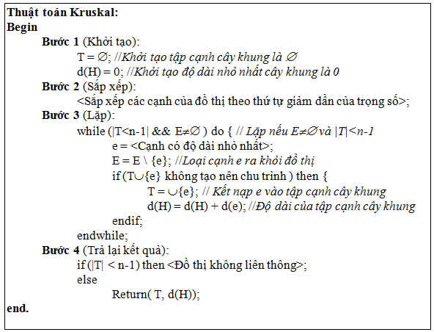
Kruskal . Algorithm
Notes:
26

Slide 27
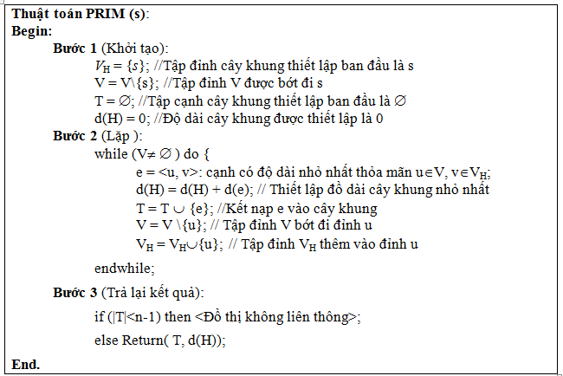
PRIM . Algorithm
Notes:
27

Slide 28
SHORTEST PATH PROBLEM
Notes:
28

Slide 29
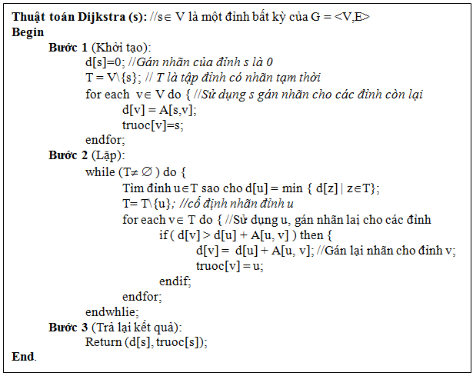
Dijkstra .'s algorithm
Notes:
29

Slide 30
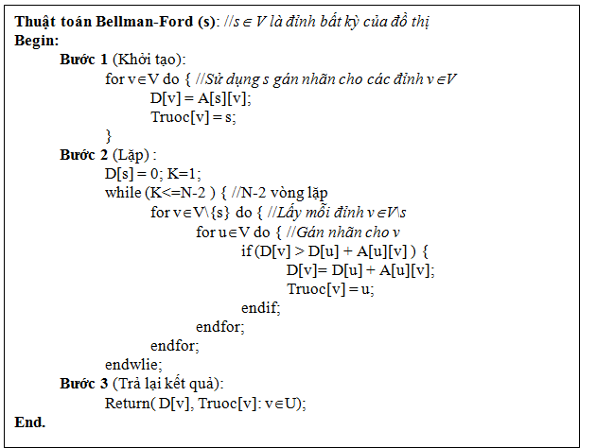
Bellman-Ford . Algorithm
Notes:
30

Slide 31
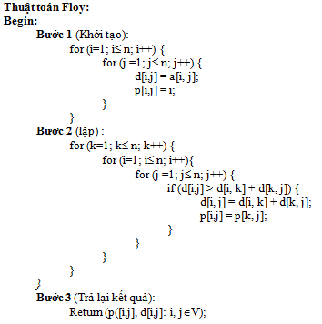
Floyd's algorithm
Notes:
31

