Slide 1
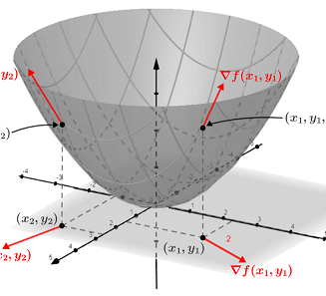
Calculus
Partial Derivatives and Gradients

Slide 2
Topic for Discussion
1. Partial Derivatives
2. Gradients
3. Chain Rule

Slide 3
1. Partial Derivatives
Thus far, we have been differentiating functions of just one variable. In deep learning, we also need to work with functions of many variables. We briefly introduce notions of the derivative that apply to such multivariate functions.
A partial derivative of a function of several variables is its derivative with respect to one of those variables, with the others held constant. Partial derivatives are used in vector calculus and differential geometry
Denote of Partial Derivatives:

Slide 4
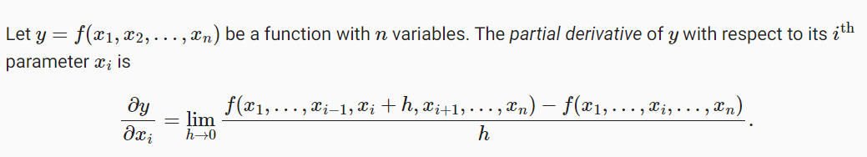
1.Partial Derivatives

Slide 5
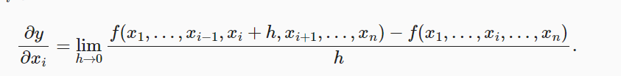
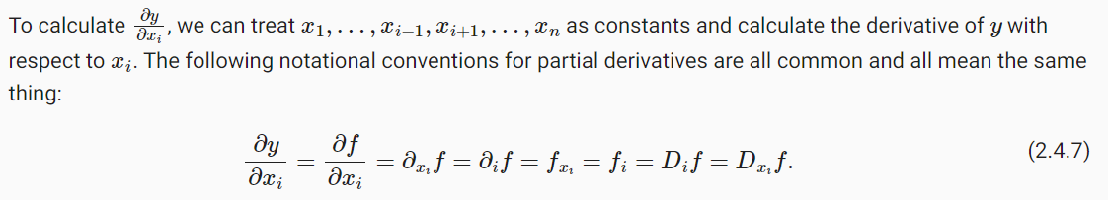
1.Partial Derivatives

Slide 6
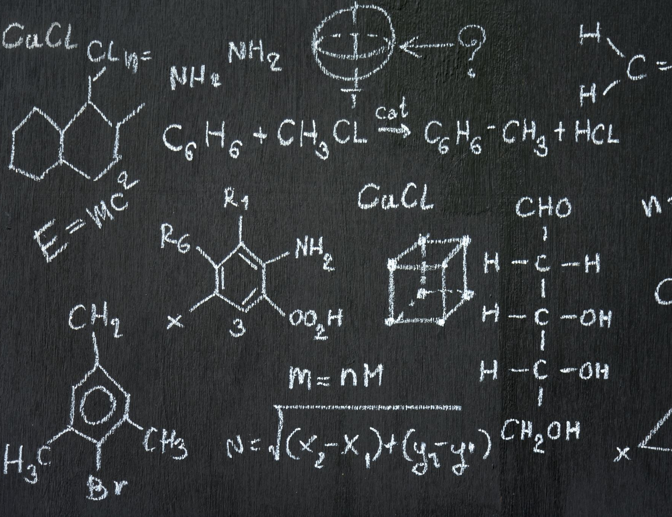
Exercise
Calculate the Partial Derivative of function:
F(x,y) = 2sin(x) + 3cos(xy)
We will do it with 2 ways: by solving math problems like in your class and coding

Slide 7

SymPy
SymPy is a Python library for symbolic mathematics. It aims to become a full-featured computer algebra system (CAS) while keeping the code as simple as possible in order to be comprehensible and easily extensible. SymPy is written entirely in Python.

Slide 8

2. Gradients
The gradients is a vector that is made of all the partial derivatives of the function.
Notation:
Suppose that the input of function f: R^n -> R is an n- dimensional vector x = [x1,x2,…,xn]^T and the output is scalar. The gradient of the function f with respect to x is a vector of n partial derivatives:

Slide 9
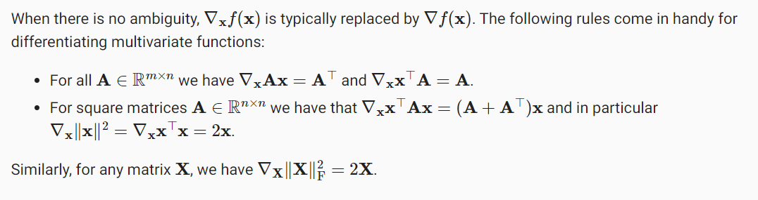
2. Gradients

Slide 10
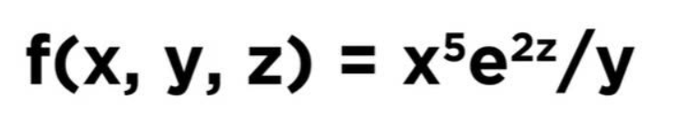
Exercises
Finding the Gradient of a Function
We will do it with 2 ways: by solving math problems like in your class and coding.

Slide 11

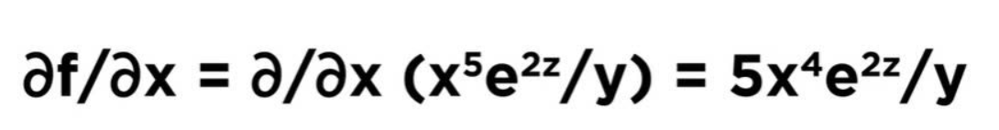
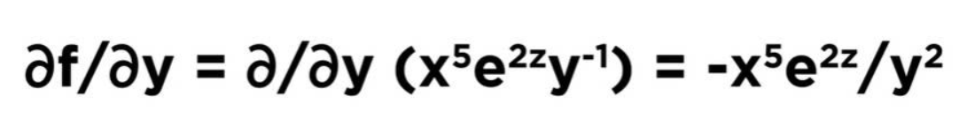
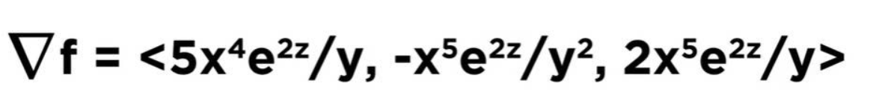

Slide 12

3. Chain Rule
In deep learning, the gradients of concern are often difficult to calculate because we are working with deeply nested functions (of functions (of functions…)). Fortunately, the chain rule takes care of this. Returning to functions of a single variable, suppose that
Y = f(g(x)) and that the underlying functions y = f(u) and u = g(x) are both differentiable.
The chain rule states that

Slide 13
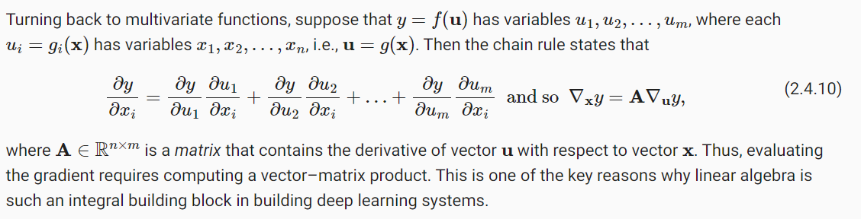
3. Chain Rule

Slide 14

Exersise

Slide 15

Thank You

