Slide 1


Professional Ethics
R. Subramanian

Slide 2
Chapter 3
Ethical Theories

Slide 3
OBJECTIVES
List and explain the basic ethical principles.
Explain the moral development theories of Kohlberg, Turien, & Gilligan.
Classify ethical theories and explain the concepts involved in utilitarianism and rights and duty theories.
Explain the uses of ethical theories with examples.

Slide 4
ETHICAL PRINCIPLES
BENEFICENCE
The beneficence principle states that our decisions and actions must be taken ensuring that it does good to others. One consciously looks for and avoids harm to others. Your concern for the welfare of others is a cardinal ethical principle.

Slide 5
ETHICAL PRINCIPLES
2. LEAST HARM
A decision taken or action implemented based on ethical principles is essentially for the good of the society. An action may, while causing good, also harm some people. This principle urges you to take a very considerate decision so that any such harm is minimal

Slide 6
ETHICAL PRINCIPLES
3. AUTONOMY/RESPECT FOR OTHERS
    Respect the rights of others.
    Do not impose your view on others.
    People have a right to hold to their value system.
    Respecting rights of others will prevent many conflict situations.

Slide 7
ETHICAL PRINCIPLES
4. NON-VIOLENCE OR PEACE
    It is a universal principle.
    Dictated by all religions.
    Peace is what every one aspires for.
    Resolve conflicts by peaceful means.
    Violence in society is a sign of ethical vacuum.

Slide 8
ETHICAL PRINCIPLES
5. JUSTICE
  Our decisions and actions must be fair to everyone concerned.
  Principle of fairness or justice is at the core of ethical actions.
  Conflicting situations must be analyzed and justified before deciding an action on the principle of fairness.

Slide 9
ETHICAL PRINCIPLES
6. TRUTHFULNESS
Truthfulness is considered a universal value.
Truth prevails at the end.
Mahatma Gandhi embodied this principle as Satyagraha.
As an ethical principle, it exhorts us to take decisions and act based on truth and follow this value while reacting to situations.

Slide 10
MORAL DEVELOPMENT THEORIES
Piaget’s Theory
Kohlberg’s Theory
Domain Theory
Gilligan’s Theory

Slide 11
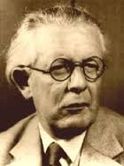
JEAN PIAGET
Born in Switzerland
9th Aug 1896 to 17th Sep 1980
Developmental psychologist & Epistemologist
Known for theory of cognitive development

Slide 12
PIAGET’S THEORY
JEAN PIAGET (1896 – 1980)
One of the first psychologists to study moral development in children.
He hypothesized that children learn moral values by interacting with the environment.
Heteronomous stage of moral development.
Egocentrism among children.
He developed a two-stage theory.

Slide 13
PIAGET’S THEORY
MORALITY OF CONSTRAINT (Typical 6 year olds)
Point of View The child has a single, absolute, moral perspective (he/she believes that a particular behavior is right or wrong and that everyone sees it the same way).
Rules The child sees rules as sacred and unchangeable or ‘carved in stone’.
Intention The child is under the impression that the extent of guilt is determined by the amount of damage done by an act and not by the motivation behind the action.

Slide 14
PIAGET’S THEORY
MORALITY OF CONSTRAINT (Typical 6 year olds)
Punishment The child tends to define moral wrong in terms of what is forbidden or punishable. He/She expects severe punishment in case of wrongdoing. The child feels that punishment itself defines the wrongness of the act. An act is perceived to be bad if it leads to punishment.
Respect for Authority The child thinks that peer aggression must be punished by an external authority. The external authority is normally a parent. The child has a tendency to run to one of the parents for protection or justice. Unilateral respect leads to a feeling of obligation to conform to standards and rules set by adults.

Slide 15
PIAGET’S THEORY
MORALITY OF CONSTRAINT (Typical 6 year olds)
Concept of justice The child thinks he/she should obey laws because they are established by those in authority. The rule is in effect because an authoritative figure—mother, father, or teacher—has set the rule. The child confuses moral laws with physical laws and believes that any physical accident or misfortune that occurs after a misdeed is a punishment willed by God or some other supernatural force.

Slide 16
PIAGET’S THEORY
MORALITY OF COOPERATION (Typical 12 year olds)
Point of View The child is aware of the differing viewpoints regarding rules. Children put themselves in the place of others. They are not absolute in their judgments but know that more than one point of view is possible.
Rules The child understands that rules are made by people and can be altered by people. Children consider themselves just as capable of changing rules as anyone else.

Slide 17
PIAGET’S THEORY
MORALITY OF COOPERATION (Typical 12 year olds)
Intention The child judges actions by intentions and not by consequences. He/She knows that the wrongdoer’s intention will be considered while evaluating guilt.
Punishment The child expects milder punishment. He/She is of the view that punishment must compensate the victim and help the culprit recognize why the act is wrong, thus leading to reform. Punishment should involve restitution or suffering the same fate as the victim of someone’s wrongdoing. Peer aggression should be punished by retaliatory behavior by the victim.

Slide 18
PIAGET’S THEORY
MORALITY OF COOPERATION (Typical 12 year olds)
Respect for Authority Mutual respect for authority and peers allows children to value their own opinions and judge other people realistically. Children should obey rules because of mutual concern for the rights of others.
Concept of Justice The child does not confuse natural misfortune with punishment.

Slide 19
PIAGET’S THEORY
Guide to Moral Education
Emphasis on discovery learning
Not to impose moral values in children
Provide opportunities for problem solving and cooperative decision making
Learn from experience and make common rules based on fairness.

Slide 20
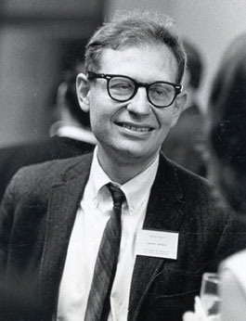
LAWRENCE KOHLBERG
25th October, 1927 -19th January, 1987.
Nationality – American.
Worked as Professor at the University of Chicago and at the Graduate School of Education at Harvard University.

Slide 21
KOHLBERG’S THEORY
Lawrence Kohlberg (1969) extended & improved on Piaget’s theory :
Children form different ways thinking through experiences and form ideas about justice, rights, equality, and human welfare
Moral maturity takes more time
Developed a moral reasoning theory and classified it into three levels and six stages.

Slide 22
KOHLBERG’S THEORY
LEVELS | STAGES | ESSENTIAL FEATURES
Pre-conventional | 1 2 | Obedience and punishment oriented Individualism and exchange
Conventional | 1 2 | Good interpersonal relationships Maintaining social order
Post-conventional | 1 2 | Social contract and individual rights Universal Principles

Slide 23
KOHLBERG’S THEORY
Pre-conventional, Level 1, Stage 1
Heteronomous orientation
The focus is on attempts to avoid breaking rules that are followed by punishment
One opts for obedience for its own sake and to avoid the physical consequences of an action on individuals and property.

Slide 24
KOHLBERG’S THEORY
Pre-conventional, Level 1, stage 2
Early emergence of moral reciprocity
Moral orientation focuses on the instrumental, pragmatic value of an action.
Follows the rules or norms only when it is of
immediate interest to the self
Concept of something being right is based on a fair sense of an equal exchange, a deal
The concept of right is relative

Slide 25
KOHLBERG’S THEORY
Conventional, Level 2
Shift in the moral perspective.
Realization of need for norms and conventions to uphold order in society.
Individual interests become secondary.
Consciously becomes aware of shared thoughts, vision and agreements.

Slide 26
KOHLBERG’S THEORY
Conventional Level 2, Stage 1
Maintaining good relationships.
Being loyal, honest, grateful, and respecting others.
Limited to family and close relations or local community.
Morality in a generalized social system is yet to evolve.

Slide 27
KOHLBERG’S THEORY
Conventional level, Level 2, stage 2
There is a shift from what is expected in terms of local norms and role expectations to defining what is right in a larger social context.
Understanding of larger social context.
Realization of social objectives and responsibilities.
A system of laws and the need for everyone to respect them is considered important.

Slide 28
KOHLBERG’S THEORY
Post-conventional, Level 3, stage 1
Social perspectives take deeper root.
Decisions and actions based upon social norms and conventions.
No support for uniform application of rules.

Slide 29
KOHLBERG’S THEORY
Post-conventional, Level 3, stage 2
Transformation of the individual from a local domain to a universal domain.
Individuals develop a much wider perspective and imbibe ethical principles that can be said to be universal.
Moral judgment calls for reasoning based on the ethical fairness.
Develops an understanding that the elements of ethics, such as regard for life and human welfare, transcend particular cultures and geographical boundaries.

Slide 30
MORAL EDUCATION
Kohlberg was critical of traditional moral education based on ‘a bag of virtues’.
Teachers inculcate such virtues and values and let the students practice and experience.
No guiding principles to define the set of values.
Moral education depends upon the social, cultural and personal beliefs of teacher.
Gave rise to the concept of ethical relativity.

Slide 31
MORAL EDUCATION
To account for ethical relativity, suggested method is value-clarification.
Students made to realize that there is no unique solution or universal answers to ethical problems.
Need to be tolerant towards divergent views.

Slide 32
MORAL EDUCATION
Alternative Approach
Teachers not to impose a set of values.
Inform students about divergent views and the reasons.
Act as a moderator during discussion by students.
Teacher may also give his/her views and suggestions.

Slide 33
MORAL EDUCATION
Kohlberg’s Approach to Moral Education
Moral development is not gaining more knowledge but a qualitative change in thinking.
As the student faces new situations, there is conflict with prior understanding.
Student is forced to rethink and make adjustments and rearrange moral reasoning.

Slide 34
MORAL EDUCATION
Kohlberg’s Approach to Moral Education
This adjustment is called moral equilibration.
Development occurs during moral equilibration stage.
Problems posed to students should force students to think about contradictions.
This enables them to rethink and make adjustments in moral reasoning.

Slide 35

DOMAIN THEORY
Elliot Turiel
American psychologist
Ph.D from Yale University
Colleague of Lawrence Kohlberg
Worked at the University of California
Moral reasoning theory

Slide 36
DOMAIN THEORY
Further research on Kohlberg’s stage theory revealed anomalies in stage sequence and goals.
Attempts to make small, cosmetic changes in stage goals did not succeed.
Need felt for comprehensive review of stage sequences and their goals.
Substantial adjustments in the theory was needed to remove anomalies.
This led to the Domain theory.

Slide 37
DOMAIN THEORY
Elliot Turiel and his team evolved the Domain theory.
Development takes place in two domains – Moral & Social.
Distinction is made between moral development & developing social skills.
Social convention is the term used for development of social skills.

Slide 38
DOMAIN THEORY
Morality domain has different norms for judging behavior.
Concept of morality based on harm, welfare and fairness.
Existence of rules have limited influence on moral issues.
Moral actions are judged by the effect on well-being and fairness.

Slide 39
DOMAIN THEORY
Social conventions are based on different set of rules.
Right actions decided by socially accepted norms.
Social norms are conventions accepted as right by the local community.
Conventions have no intrinsic value but are necessary for conducive environment in society.
Social conventions are important to regulate the behavior of members of the community.

Slide 40
DOMAIN THEORY
Research by the Domain theory team found the inadequacy of the single stage framework developed by Kohlberg.
Two parallel, distinct domains of development were established.
To decide the right course of action, a person has to understand both the domains – Moral Values & Social Conventions.

Slide 41
DOMAIN THEORY
Coordinated consideration of moral standards and social conventions form a better framework to decide the right action.
The domain theory is thus supposed to give a better framework and provide a better chance to youngsters for making morality-based decisions.

Slide 42
MORAL EDUCATION
Based on Domain Theory :
Moral development is the recognition that moral cognition is inherently tied to the realm of human social interaction.
Principles of fairness and human welfare should form the basis of moral education and should not be limited to any specific social convention or norm.

Slide 43
MORAL EDUCATION
Moral education should foster morality among children by focusing on universal principles, without being biased against particular religious edicts and emphasizing basic, core moral norms for all religious systems.
While dealing with a moral issue, students would be asked to focus on the underlying justice or human welfare aspects of the situation.
While dealing with social conventions, students will be required to focus on the role of social norms and expectations and the importance of social organizational functions of such social norms.

Slide 44
MORAL EDUCATION
Many social convention issues also relate to the domain of morality. Teachers should take cognizance of this and stimulate discussion on such issues that develop moral values from social conventions also.
Elementary discussions on the two independent domains followed by issues that cover elements from both domains is a good way to develop understanding of moral rules and their interaction with social convention.
Teachers should facilitate the students’ understanding of social conventions and their role in the larger context of morality.
An understanding of interaction between the two domains develops the comprehension of the role of social convention, making it easier to discuss complex moral issues viewing them in the light of social convention.

Slide 45
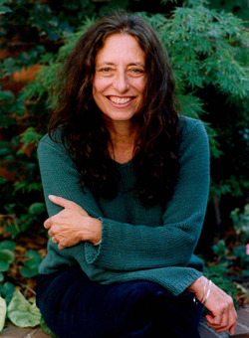
CAROL GILLIGAN
Born November 1936
American feminist, ethicist & psychologist
Taught at Harvard University before shifting to New York University
Best known for her work – ‘In a different Voice’

Slide 46
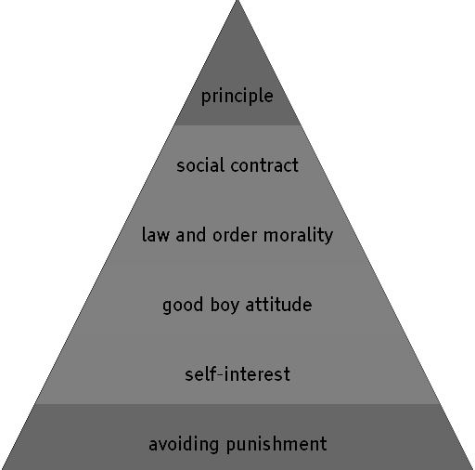
GILLIGAN’S THEORY
Carol Gilligan was a student and colleague of Kohlberg
She disagreed with Kohlberg’s theory on two counts –
one, his theory is biased against women as he used only boys for his experiments;
second, she opposed Kohlberg’s theory of rules and rights, which are again biased against women.

Slide 47
GILLIGAN’S THEORY
She conducted exhaustive studies on girls and came up with her own theory, which she called the morality of care. By listening to women’s experiences, Gilligan offered that the morality of care can serve in the place of the morality of justice and rights espoused by Kohlberg.

Slide 48
GILLIGAN’S THEORY
The morality of caring and responsibility is founded on non-violence, while the morality of justice and rights is based on equality. Perhaps one can look at these two moralities as providing two distinct injunctions—the injunction to not treat others unfairly (justice) and the injunction to not turn away from someone in need (care). She considers these moralities as distinct, although potentially connected.

Slide 49
STAGES IN GILLIGAN’S THEORY
STAGE | GOALS
Pre-conventional | Individual survival
Transition from selfishness to responsibility to others
Conventional | Self sacrifice is goodness
Transition from goodness to truth that she is a person too
Post-conventional | Principle of non-violence; do not hurt others or self

Slide 50
GILLIGAN’S THEORY
Gilligan emphasized the gender differences thought to be associated with the two orientations—care and justice.
The morality of care emphasizes relationship and presumably is found to a greater degree in girls owing to their early identification with their mothers and continuance of that attachment.

Slide 51
GILLIGAN’S THEORY
A moral orientation based on justice was proposed to be more prevalent among boys because their attachment with their mothers, which goes away afterwards.
Enhanced awareness of the difference in power relations between themselves and adults. This creates an intense set of concerns over inequalities.

Slide 52
GILLIGAN’S THEORY
Further research have found that moral reasoning does not necessarily have such a distinct impact due to gender differences. The evidence shows that both boys and girls base their reasons on justice and care. Gilligan’s theory possibly suggests that girls are more concerned about care, while boys are more concerned about justice.

Slide 53
COMPARISON
Moral development theories are based on the pioneering work done by Jean Piaget. Kohlberg’s work was a landmark in the area of moral development. His stage theory was a commendable attempt to put things in some perspective.
The domain theory extended Kohlberg’s approach by adding the domain of social conventions to the paradigm.

Slide 54
COMPARISON
Both these theories have helped in the evolution of methods and approaches for moral education among children.
Kohlberg’s work was extended in Gilligan’s theory by adding the concept of care in moral development, which helped to eliminate gender bias.

Slide 55
ETHICAL THEORIES
Major theories:
Deontology (Duty Theory)
Utilitarianism
Virtue Theory
Rights theory
Casuist theory
Moral Absolutism
Moral Relativism
Moral Pluralism
Ethical Egoism
Feminist Consequentialism

Slide 56
CLASSIFICATION
(Due to Rosalind Hurst)
Theory Particulars | Consequentialism | Deontology | Virtue theory
Example | Mill’s Utilitarianism | Kantian Ethics | Aristotle’s moral theory
Abstract description | An action is right if it promotes best consequences | An action is right if it is in accordance with a moral rule | An action is right if it is what a virtuous agent would do
More concrete specification | The best consequences are those maximising happiness | Moral rule is one that is required by rationality | A virtuous agent is one who acts virtuously

Slide 57
Ethical Theories
Ethics of conduct
What sort of actions should we perform?
Ethics of Character
What sort of people should we be?
Consequentialism
The right action is the one producing the most intrinsic good
Deontology
The good is defined independently of the right
Aristotleianism:
Virtue is a mean between extremes of action or passion
Kantianism:
Actions must satisfy the categorical imperative
For the agent:
Ethical egoism
For every one affected:
Utilitarianism

Slide 58
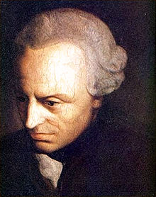
DEONTOLOGY
Deontology defined as duty ethics by CD Broad
The theory is credited to Immanuel Kant
(1724 to 1804)
German philosopher
Interest in Epistemology, Metaphysics and Ethics

Slide 59
DEONTOLOGY
Duty Ethics or Kantian theory
Kant considered that an act is good if it is in accordance with some cardinal principles that govern our duties.
An action that is performed according to the duties prescribed is considered to be ethical.
Consequences of the action are not the most important thing.

Slide 60
DEONTOLOGY
Act only according to that maxim by which you can also will that it would become a universal law.
Act in such a way that you always treat humanity, whether in your own person or in the person of any other, never simply as a means, but always at same time as an end.
Act as though you were, through your maxims, a law-making member of a kingdom of ends.

Slide 61
DUTY ETHICS
William David Ross stated the duties of people as –
Duty of beneficence A duty to help other people (increase pleasure, improve character)
Duty of non-maleficence A duty to avoid harming other people
Duty of justice A duty to ensure people get what they deserve
Duty of self-improvement A duty to improve ourselves
Duty of reparation A duty to recompense someone if we have acted wrongly towards them
Duty of gratitude A duty to be of benefit to people who have benefited us
Duty of promise keeping A duty to act according to explicit and implicit promises, including the implicit promise to tell the truth.

Slide 62
DUTY ETHICS
  Immanuel Kant’s categorical imperative:
  Act in such a way that you treat humanity, whether in your own person or in the person of another, always at the same time as an end and never simply as a means.
  Act only according to that maxim by which you can at the same time will that it should become a universal law.
  The principle of autonomy requires people to recognize the right of others to act autonomously and means that, as moral laws must be universalisable, what is required of one person is required of all.

Slide 63
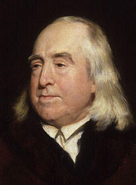
UTILITARIANISM
Jeremy Bentham 1748 – 1832
English philosopher
Greatest happiness principle
Utilitarianism
Political philosophy, Philosophy of law, ethics and economics

Slide 64
UTILITARIANISM
Jeremy Bentham
Based on utilitarianism, an action is judged by the consequences of the action.
Maximum good to maximum number of people.
Consequences of an action is pain or pleasure; as pleasure is a more desirable state, an action is good if it gives pleasure.
Criticism – How to measure the good?
As consequences happen after the action, there is predictive element in the theory.

Slide 65
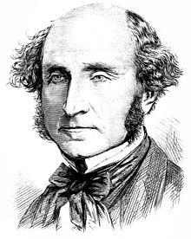
UTILITARIANISM
John Stuart Mill(1806 –1873)
British Philosopher
Utilitarianism
Interest areas – political philosophy, ethics, economics and inductive logic

Slide 66
UTILITARIANISM
John Stuart Mill : Extended Bentham’s theory.
The doer should seek higher levels of pleasure.
Lower levels of pleasure like eating or exercising is not the judging criteria.
Maximum good comes if we attain higher pleasures like creativity, appreciation and love.

Slide 67
UTILITARIANISM
A consequentialist theory – actions are judged by results produced.
Mill proposed act-utilitarianism which stipulates that an act is ethical if it produces maximum good.
Richard Brandt supported rule-utilitarianism which states that one should act within general rules and maximize good.

Slide 68
UTILITARIANISM
Critics of utilitarianism contested that the concept of maximum good is vague and its measurement is also not possible.
Consequences occur afterwards and there is a predictive element in the theory.
Predicting and judging consequences is difficult before taking action.

Slide 69
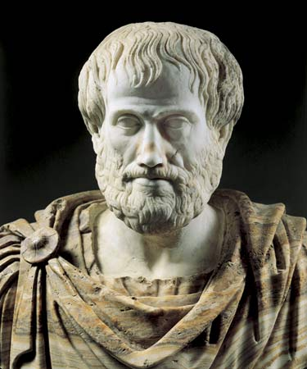
VIRTUE THEORY
Due to Aristotle Values are acquired habits.
Wisdom and good judgment are at the core of rational life.
Along with truthfulness, courage, generosity, comradeship.

Slide 70
VIRTUE THEORY
Moral values are virtues acquired to exhibit balanced behavior or the golden mean between extremes.
An action is considered ethical if it is what a virtuous agent would have done.
The character of the person performing the action, not the action itself, decides the morality of the action.
One criticism – the virtues are not permanent.

Slide 71
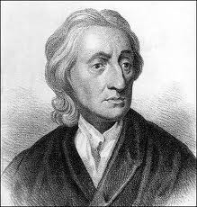
RIGHTS THEORY
John Locke
People have rights and these forms the basis for deciding the morality of actions.
Rights also decides the duties of people.
Acting on the basis of ones rights has to respect the rights of others.

Slide 72
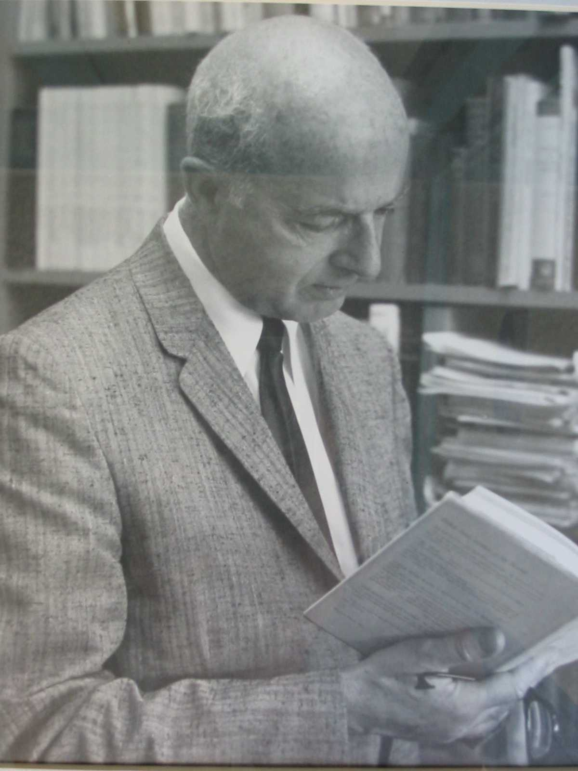
RIGHTS THEORY
A I Melden
Rights come with responsibilities.
Bestowing rights pre-supposes the person’s ability to respect others’ rights
Individual rights cannot be at variance with those of others in a moral community

Slide 73
CASUIST THEORY
Compare a present ethical problem with a similar problem of the past to find solution.
Criticism of the theory.
One may not find an identical problem for finding acceptable solution.
A current situation and its solution may differ due to contextual and other differences in the time periods.

Slide 74
MORAL ABSOLUTISM
Moral absolutism is a kind of dogmatism.
Moral absolutists believe in one correct perspective which is the one held by them.
The theory lacks rationalism and does not respect moral autonomy.
The theory does not accept that the issue may have a contextual bearing.
This leads to a kind of fanaticism.

Slide 75
MORAL RELATIVISM
No action can be absolutely moral.
Actions to be judged by context and individual rights.
Moral rules and codes of conduct cannot be set.
Criticism – No free-for-all moral actions.
Universal laws and codes can be made accepting that there are always exceptions.

Slide 76
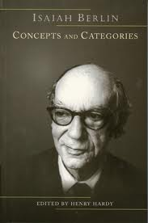
MORAL PLURALISM
Isaiah Berlin
Human values are many and good and can come into conflict in a situation.
There is no hierarchy of values and cannot be reduced to an over-riding system.
Individual liberty cannot override public order.
Impartial justice can come into conflict with mercy and compassion.

Slide 77
ETHICAL EGOISM
This theory deals with self interest.
An action is morally correct if it promotes self interest.
Obviously, does not respect the rights of others.
Critics point out that selfishness in actions is not acceptable.
Self interest should include also larger public interest.

Slide 78
FEMINIST CONSEQUENTIALISM
Propounded by feminist ethicists due to gender bias in other theories.
Support consequentialism but do not accept utilitarian model of computation.
Consequences also to be evaluated on the effect it has on relationships and feelings.
Morally correct actions tend to foster comradeship and harmony among people.

Slide 79
COMPARISON
No single theory can tackle all situations.
Duty ethics, Utilitarianism and rights ethics are commonly employed to analyze situations.
Every theory has some attractive features but lack in universality.
Best of these theories or a combination can be selected in a given situation.

Slide 80
MORAL ISSUES
There are a variety of moral issues that come up and have to be solved.
Micro-ethical issues are those that are faced in day to day situations and need solutions. These are generally faced by individuals.
Macro-ethical issues are those that have a bearing on society. Initial neglect makes them big later on. Individuals are not generally responsible for these and have to be tackled by teams and generally categorized as societal issues.

Slide 81
MORAL DILEMMAS
Moral dilemmas are problems with a moral bearing, either of individual or a community.
Conflict of interest situations or situations where the actions based on moral principles can also lead to harm result in dilemmas.
Conflict of moral principles, lack of clarity and difference of opinion on the right course of action can lead to moral dilemmas.
Considering all options and arriving at an acceptable solution is the difficult task here.

Slide 82
RESOLVING MORAL DILEMMAS
STEPS IN RESOLVING MORAL DILEMMAS
Formulate some cardinal ethical principles that you would like to follow, if you have not done so already.
Collect all relevant facts of the case.
Perform an ethical analysis of the given situation wherein you analyze the ethical factors that predominate the problem and the ones that tend to conflict.
While it may be difficult, prioritize the ethical factors in the order that you think should take precedence.
Having formulated your ideas, it may be desirable to discuss with some people close to you about the case and the implications you think any decision or action would have.
Having received inputs from them, you can now formulate your plan of action, noting down all the moral implications of the solution.

Slide 83
MORAL AUTONOMY
Freedom and self reliance of individuals to take moral decisions or hold on to moral points of view.
Comes from inherent strength for rational thinking based on moral values.
Rationale and basis on which decisions are based reflect moral autonomy.
Professionals to develop skills required to practice moral autonomy.

Slide 84
MORAL AUTONOMY – SKILL SETS
Develop skills to identify problems of a moral nature in professional work. A problem may have many dimensions but recognizing the moral aspects of the problem and relating these to other dimensions of the problem is important.
Develop the ability to critically analyze a moral issue or situation

Slide 85
MORAL AUTONOMY – SKILL SETS
Develop sensitivity to genuine difficulties. Some moral issues may call for taking actions, which at first sight may go against some moral principles held by the individual as sacrosanct. In such cases, some flexibility in thinking and taking decisions for the overall good of the people concerned may be called for.
Develop ingenuity, creativity, and imagination to find alternative solutions to complex problems.

Slide 86
MORAL AUTONOMY – SKILL SETS
Develop consistency in thinking on moral issues. Consistency comes from knowledge and understanding of similar situations and comparison of facts in a given situation with those of others.
Develop the ability to express your perception on moral issues clearly to others. An understanding of ethical principles and theories will enable one to make a comprehensive expression of one’s views.

Slide 87
MORAL AUTONOMY – SKILL SETS
Develop moral integrity and credibility.
Develop tolerance and try to understand other people’s views on moral conflicts.
Develop the ability to assimilate moral issues and solutions even in cases where you are not directly concerned.

Slide 88
RELIGION & ETHICS
All religions fundamentally and inherently speak of ethical conduct.
If religion is practiced in the right way, there will be no conflict with ethics.
Religion has great influence as it shapes the ethical behavior of individuals.
Religion followed by individuals will have no conflict with ethics if the two are properly understood.

Slide 89
MORAL CONDUCT
TYPES OF ENQUIRY
Descriptive or factual enquiry
How have the practices in the particular profession developed over the years?
What are the basic concepts and principles that guide the current practices in the profession?
What is the ethical and psychological profile of the professionals in the system?
Do the professionals have enough guidelines and mechanisms to undertake an analysis of the safety and risk factors in the practice of the profession?
How much is the influence or effectiveness of the professional societies in guiding ethical practices among its member professionals?
How much care is taken by the employers or professional societies to sensitize the professionals about ethical issues in the profession?
How effective are the codes of conduct or punitive measures for professional misconduct?

Slide 90
MORAL CONDUCT
Conceptual Enquiry
What is a profession?
Who is a professional?
What is meant by professionalism?
What are the concepts and principles having bearing on professional ethics that need to be defined and clarified?
What kind of control or monitoring mechanism should be put in place to ensure ethical conduct by professionals?

Slide 91
MORAL CONDUCT
Normative Enquiry
What are the rights and responsibilities of a professional?
When and how should a professional exercise his/her rights?
What are the obligations of professionals to the public as they perform their duties?
What rules, regulations, and procedures can be called morally warranted in a professional organization?

Slide 92
USE OF THEORIES
Morally correct decision making is important to professionals.
Ethical theories help us to identify the considerations that should go into making decisions.
No theory can be applied universally.
There are technical and moral considerations in taking decisions.

Slide 93
USE OF THEORIES
Justify Decisions & Actions
The engineering product is useful and beneficial to a large group of people.
The product is safe for public use.
The rights of the public are not violated.
One performs one’s duty keeping these three conditions in mind.

