Slide 1

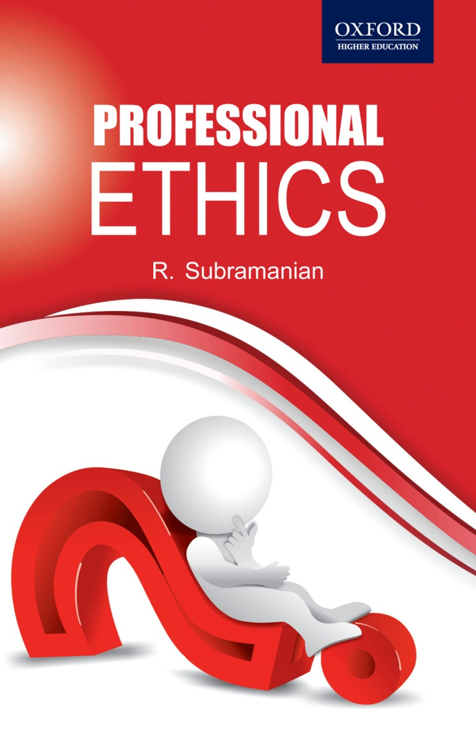
Professional Ethics
R. Subramanian

Slide 2
Chapter 5
Engineers Responsibility for Safety

Slide 3
OBJECTIVES
Define and explain the terms safety and risk
Explain the procedure for risk assessment
Discuss the methods of risk management
Discuss safety standards for engineering products and services
Analyze cases highlighting engineering safety
Understand the responsibility of engineers towards safety

Slide 4
TERMINOLOGY
Safety - An action is considered safe when the risks associated with it are known and are considered acceptable. There is an element of judgment involved in considering the safety of something.
Risk - It is the possibility of something bad happening at some time in the future. Risk is thus something that is expected to happen in the future, with which an element of probability and uncertainty is associated.

Slide 5
TERMINOLOGY
Hazard It is something that can be dangerous or cause damage. Something is hazardous if it has the potential to cause harm or ill effects.
Risk–benefit Analysis is a method by which, while determining the cost of projects to compare with benefits, the risk is also included.

Slide 6
CONCEPT OF SAFETY
Safety, as also risk, do not fall under deterministic realm but are probabilistic.
Three states – underestimating, overestimating and indifferent to risk.
Safety and risk happen in future when a product is used by customers; But there is a need to estimate the risk and provide for it.
Nothing can be made absolutely safe. The degree of safety proposed to be attained depends upon product, perception and cost of risk.

Slide 7
RISK ASSESSMENT
Risk assessment is not accurate due to many uncertain factors.
Risk assessment is more common in infrastructure projects and much less in manufactured goods.
While many projects improve the quality of life of people, unless the risks are assessed and provided for to the extent possible, the benefits may be only short term.

Slide 8
RISK ASSESSMENT
Any decision about risk assessment and management has to depend upon the time frame in which the decision is taken. Many things are in the control of the designers before the project is undertaken. Once these decisions are made and the project completed, the situation and context for decision making changes.
When a risk event occurs, the decision-making would involve looking back to see where the deficiencies occurred, what caused the accident, and was it possible to have prevented them in any way.
This soul-searching, though necessary, should be avoided by taking control measures in the design stage itself. Learning from past experience is a good way to avoid further damage and economic loss.

Slide 9
RISK ASSESSMENT
Due to economic considerations, many loopholes (which could be dangerous) may not be addressed while working on engineering projects. Providing solutions for the likely risks may be considered an unwarranted escalation in costs by many, particularly the company owners.
A thorough analysis of the risks and the measures to be taken to avoid them is probably the best way to deal with potentially risky situations.

Slide 10
RISK ASSESSMENT
One major hindrance in risk assessment and management is the question of uncertainty in the occurrence of any anticipated risk. Both the severity of the risk and the frequency of occurrence vary considerably across projects.
It is essentially a study in probability. Such uncertainties definitely make it impossible for the designers to provide solutions to all anticipated risks in big projects.
Risk assessment and management have to go beyond this minimum expectation. One has to go into the uncertainties and probabilities of various occurrences and provide solutions for them in the best possible ways.

Slide 11
FACTORS IN RISK ASSESSMENT
Many assumptions made in the design and detailing of the project may all not be valid. Some risk factors may develop if such assumptions are proved to be invalid.
Natural disasters, which may not be anticipated in the design, may cause a higher risk than provided for. Many natural disasters cannot be anticipated, thus leading to much higher risks.

Slide 12
FACTORS IN RISK ASSESSMENT
A product should not be designed without anticipating misuse or wrong use by consumers.
Misuse or inappropriate use by literate consumers is also common. Designers and manufacturers must anticipate such misuse and abuse by consumers.

Slide 13
SAFETY & COST
Designing for safety adds to the cost. Perception about safety and cost needs to be clarified. Providing safe products is ethical and mandatory. Manufacturer cannot compromise safety considering the expenses involved in providing for it.
As the safety of the product is not known beforehand, it can be ascertained only during the testing stage. Proper testing as per standard practice should be done even if it adds to the cost.
We have to take into account the customer while designing the product. In addition to proper documentation for the use of a consumer, the product is so designed and help lines are provided so that the consumer does not find it difficult to use.

Slide 14
PRODUCT SAFETY
Warnings against possible misuse;
Being aware of and meeting industry and mandatory standards;
Developing product recall plans and procedures including effective communication strategies to the public (e.g., advertisements in papers);
Incorporating safety into product design;
Developing appropriate safety standards through product improvement;
Implementing a quality assurance program, which includes consumer feedback; and responding quickly to safety concerns that arise

Slide 15
DESIGNING FOR SAFETY
In the realization of a product, the point at which the question of safety must be considered is the design stage. It is at this stage that the product takes a physical form and many of the intricacies of the practical aspects of the conceived product are seriously considered. This involves product detailing, analysis and design, prediction or assessment of possible risks, and incorporating safety features in the product. In assessing the possible risks, the consumers of the product need to be considered.
Engineers are responsible for ensuring that the product is safe for the consumer. Safety does cost more but will be worth it, and so cost should not be a prime consideration at this stage.

Slide 16
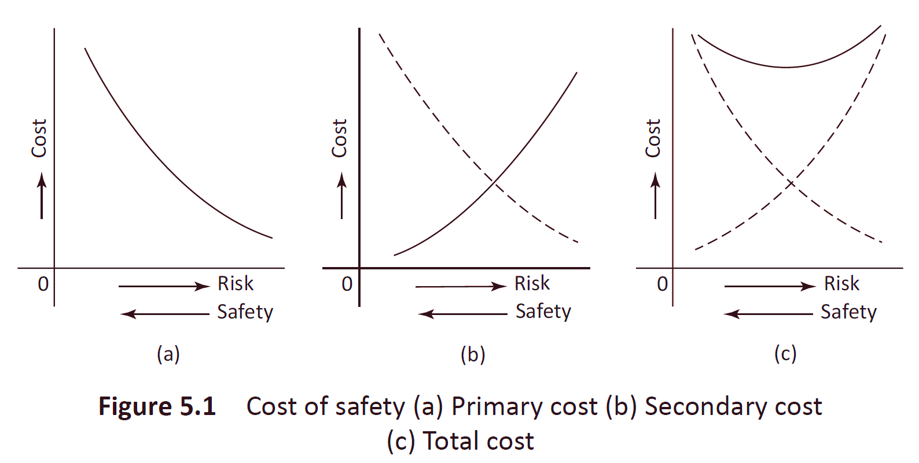
PRODUCT COSTS

Slide 17
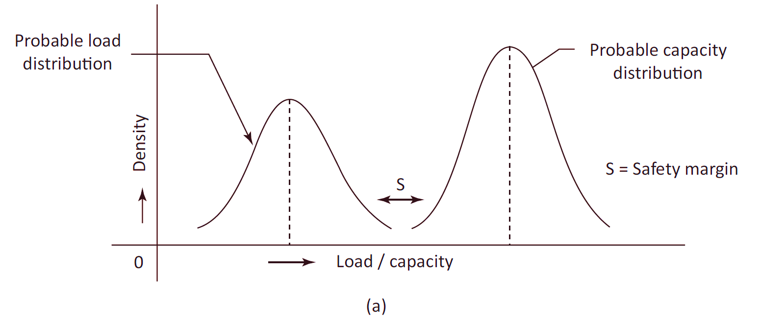
PROBABILITY OF SAFETY AND RISK

Slide 18
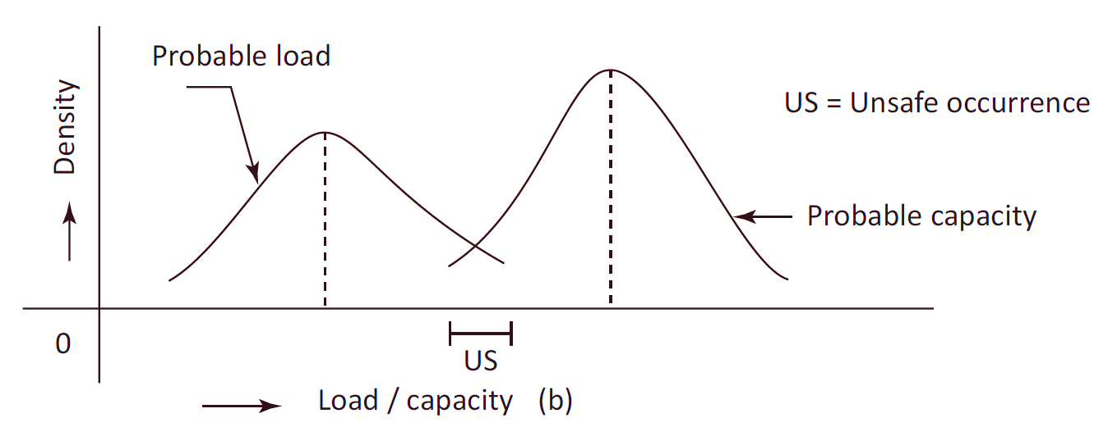
PROBABILITY OF SAFETY AND RISK

Slide 19
RISK-BENEFIT ANALYSIS
What can go wrong?
What is the probability that it will go wrong?
What are the consequences if it indeed goes wrong?
What options are available to reduce risk?
What is the organization’s trade-off in terms of all costs, benefits, and risks?
What is the highest acceptable risk and how can it be incorporated in the design?

Slide 20
RISK MANAGEMENT
Risk management can be defined as the identification, assessment, and prioritization of risks (which in turn can be defined as the effect of uncertainty on project outcomes). Risk management also involves systematic application of all possible measures to monitor and reduce the probability and impact of unfortunate events, and to put in place relief measures in the quickest possible time.

Slide 21
DEALING WITH RISK
Accepting some of the risks involved and providing for the others. The risks accepted must be manageable risks, in case there are liabilities arising out of them.
Attempts can be made to reduce the negative impact of risks by proper management of various aspects of production, distribution, and consumer care.
Complete avoidance of the risk may be a little costlier, but may prove to be worthwhile.
Another option may be to transfer the risks to a third party.

Slide 22
PRINCIPLES OF RISK MANAGEMENT
Create value;
Be an integral part of organizational processes;
Be a part of decision-making;
Explicitly address uncertainty;
Be systematic and structured:
Be based on the best available information;
Be tailored;
Take into account human factors;
Be transparent and inclusive;
Be dynamic, iterative, and responsive to change; and
Be capable of continual improvement and enhancement.

Slide 23
ISO - 31000
Identifying risk in a selected domain of interest
Planning the remainder of the process
Mapping out the following:
  Social scope of risk management
  Identity and objectives of stakeholders
  Basis upon which risks will be evaluated
Defining a framework for the activity and an agenda for identification
Developing an analysis of risks involved in the process
Mitigating or solving risks using available technological, human, and organizational resources

Slide 24
STRATEGIES
Avoid risks altogether (e.g., by closing down a particular high-risk business area).
Design a new business process with adequate built-in risk control and containment measures from the start.
Periodically re-assess risks that are accepted in ongoing processes as a normal feature of business operations and modify mitigation measures.
Transfer risks to an external agency (e.g., an insurance company).

Slide 25
CASE STUDIES

Slide 26
CHALLENGER SHUTTLE DISASTER
Space disaster – Happened on January 28, 1986
Shuttle disintegrated 73 seconds after launch
All seven crew members died.
Main cause was a sealing ring which malfunctioned in cold weather
Roger commission made many recommendations regarding space program.
Negligence on the part of equipment suppliers and NASA officials was found to be a major cause

Slide 27
THREE MILE ISLAND CASE
Nuclear plant disaster at Pennsylvania on March 28, 1979.
There were no casualties in the event
Laxity on the part of equipment manufacturers and owners of the plant
Resulted in a serious relook at safety requirements of nuclear power plants and frequency and scale of periodic inspections

Slide 28
BHOPAL GAS TRAGEDY
Happened on December 3, 1984 at Bhopal at the Union Carbide India limited plant.
Leak of methyl isocyanate gas from a storage tank; the poisonous gas spread due to prevailing winds.
Lack of proper design, not adhering to regulations, lack of disaster preparedness.
Death toll estimated at about 4000 but may be higher
Many thousands suffered from various ailments.

Slide 29
UPHAAR CINEMA TRAGEDY
Fire due to explosion in a transformer on June 13, 1997 at Uphaar cinema, New Delhi
59 people lost their lives and more than 100 people seriously injured
Faulty design of exit signs, negligence on the part of the owners, licensing authorities and power department officials were found to be the major cause for the tragedy.

Slide 30
CHERNOBYL
Nuclear disaster; happened on April 26, 1986 at Chernobyl nuclear power plant in Ukraine
50 people lost their lives and many more died later and suffered from various ailments
Design faults in the reactor and components, Lack of operator training, communication gaps and slow response system were found to be the major causes for the accident

Slide 31
FUKUSHIMA NUCLEAR POWER PLANT CASE
Happened on March 11, 2011
Cause – Tohoku undersea earthquake resulting in tsunami
The earthquake intensity was higher than the design intensity
Tsunami waves of 15 m height; sea wall height was only 5.7 m
Negligence and lack of safety consciousness and preparedness

Slide 32
Disaster Management

Slide 33
DISASTERS
Natural disasters
Man-made disasters
Some natural disasters like floods and land slides can also be due to human activities like deforestation
Disasters cause havoc, the social cost in terms of lives lost and property damage is very high
Some natural disasters like epidemics can be the aftermath of other natural disasters.
Rehabilitation and recovery is long-drawn and costly

Slide 34
NATURAL DISASTERS
Earthquakes – result of sudden burst of energy due to movement of earth’s crust causing seismic waves.
Volcanic eruptions – Dormant volcanoes erupt releasing hot material like lave from within the earth causing extensive damage
Tsunami – Due to undersea earthquakes causing strong and very high sea waves
Floods – Overflow of water in water bodies due to excessive rains or breach of dams etc.

Slide 35
NATURAL DISASTERS
Limnic Eruptions caused by release of carbon dioxide from deep lake water.
Blizzards caused during winter due to heavy snow fall and powerful winds
Cyclones & Tornadoes Generally coming from sea; violent and dangerous rotating column of air causing extensive damage.
Droughts cause by dryness in soil due to scanty rainfall
Wild Fires cause extensive damage to flora and fauna
Epidemic Outbreak of contractable disease; Epidemics can also be caused in the aftermath of other disasters

Slide 36
MAN-MADE DISASTERS
Hazardous materials
Nuclear materials and waste
Oil spills
Chemical and biological materials
Building and bridge collapse
Severe traffic accidents
Floods and landslides due to deforestation

Slide 37
PHASES
Mitigation is of two types. The first is before the disaster, when it is possible to lessen the impact of any disaster using proper designs. The second aspect of mitigation is after the disaster has occurred when, by proper management of resources and available facilities, we can reduce the impact, thus saving lives and reducing damage to property.

Slide 38
PHASES
Preparedness - includes planning for any disaster, forecasting likely disasters, keeping a disaster management plan ready, training personnel and members of the society to manage disasters, and having alternative communication systems ready for coordination. Natural disasters can be expected to damage vital links and these must be provided for.

Slide 39
PHASES
Response - Once a disaster occurs, two types of actions will be required. The first action is the response to emergency needs. This will include limiting the impact of the disaster by relocating people, providing food and shelter, preventing diseases, and ensuring the establishment of vital links such as communication, road, and rail networks. This phase of disaster management is known as response. This is a vital phase as this is when the management of disaster calls for speedy and timely actions.

Slide 40
PHASES
Recovery - Recovery is the second phase of the response to disaster. This, in many situations, is a long-term process. Depending upon the disaster type, it may take months or years to achieve recovery. This is the process of bringing the area to its earlier state, which may not be fully attainable. In the case of a nuclear disaster, for example, the danger from exposure to radiations continues for a long period of time. The process of bringing the neighborhood to its former state would take a very long time and continuous monitoring of the area would be required.

Slide 41
SAFE EXIT
Safe exit is the provision for people to escape with minimum damage when something untoward happens.
Products are designed with low probability of failure, and, if at all fails, the consequent damages are minimum and people have an escape route.
In the case of challenger & Uphaar cinema, safe exit was not properly provided for.

Slide 42
ETHICAL ISSUES
Public safety and welfare must be the prime concern of professionals. These should not be compromised while designing and manufacturing products and services.
Loyalty to employers must not come in the way of a professional resisting an attempt to compromise on safety for the purpose of cutting costs or increasing profits. Many engineers, like Roger Boisjoly, showed that they would not hesitate to place their concerns on record in spite of being employees of the erring company.

Slide 43
ETHICAL ISSUES
The professional must use his/her right of whistle-blowing in case he/she has to fight attempts to compromise on safety.
Employers/Owners must also realize that compromising on safety for short term gains will not help. The economic loss coupled with loss of credibility, brand value, and market share will be costlier in the long run in case something untoward happens.

Slide 44
ETHICAL ISSUES
Building safety measures in the beginning is cheaper and much more sensible than correcting something later after a mishap has occurred.
Owners and employees are morally bound to keep public safety in focus at all times.
Engineers have to be sensitive to safety issues and all decisions must ensure public safety.

Slide 45
SUMMARY
Safety is a very important aspect of engineering. Engineers have to keep in mind the safety of the public, which should hold a paramount position in all their dealings. Risk analysis and risk management are essential to avoid risks that endanger public lives. The many case studies described in the chapter show a lack of concern among the people involved in maintaining safety. Commercial consideration should not overshadow safety aspects in any activity.

