Slide 1


Professional Ethics
R. Subramanian

Slide 2
Chapter 7
Global Issues

Slide 3
OBJECTIVES
List the major ethical issues arising out of globalization
Explain ethical issues in business, environment, media, information technology, warfare, and life sciences
List and explain the ethical issues related to research
Explain the concept and major dimensions of intellectual property rights
List the major ethical issues arising out of globalization
Explain ethical issues in business, environment, media, information technology, warfare, and life sciences
List and explain the ethical issues related to research
Explain the concept and major dimensions of intellectual property rights

Slide 4
RECENT DEVELOPMENTS
Technology Revolution – Communication technologies, information technology, nano technology etc.
Globalization – Living in a global village; global economy; no insulated economies.
Outsourcing – Outsourcing of various types of tasks; India is a leading player in this area.
International Trade agreements – WTO; GATT & IPR.
World summits – Many world summits to discuss international issues.

Slide 5
ISSUES
The impact of globalization, privatization, and economic interdependence are evident today. We live in a global village and there is no escape from that fact. We have to prepare ourselves to live a life in a globalized economy.
People work not only for Indian companies but also for many multinational corporations. The work ethics and skill sets required have to be suitably matched.
Work culture is undergoing major changes in that one may work from home and need not be physically present in his/her office at all. Professional integrity will play a major part in such cases.
Professionals work in many countries and have to contend with the local political environment in their dealings. Great tact and business acumen are needed to work ethically in such situations.
While working in other countries, one has to take care of the sociocultural aspects of the population one is working with.
Ethical conduct, rules, and conventions may differ from country to country.
Professionals have to consider this while performing their duties in other countries.

Slide 6
BUSINESS ETHICS

Slide 7
CORPORATE GOVERNANCE
Gross misconception that business and ethics are poles apart.
Corporate governance to be based on ethical policies for good, successful business
Companies having good business practices and strong ethical policies do well by gaining investor confidence.

Slide 8
ISSUES
All business practices must be based on corporate social responsibility. Doing business and making profit are not the only important objectives. Corporate bodies must be aware of their responsibilities to the society.
Every corporate entity should formulate an ethical policy for its own functions and those of its employees, covering various issues related to its business and social responsibility. This must be known to all the clients and stakeholders.

Slide 9
ISSUES
Corporate governance must stand scrutiny in terms of transparency in its dealings, business policies, plans, and actions.
Communication mechanisms must be present for lateral, top-down, and bottom-up communication to ensure transparent functioning. This goes well with integrity of business practices and extracting unbiased loyalty from employees.
The business must ensure equity and justice to all stakeholders. This will enhance credibility of corporate governing boards and managements.

Slide 10
FINANCE & ACCOUNTING
There are well laid-out norms for accounting practices. Businesses must follow such practices scrupulously.
Transparency in accounting is important. No attempt must be made to manipulate accounts to hide the financial health of the company.
There are well laid-out norms for reporting
financial aspects of a company. These must be scrupulously followed and reported to stakeholders during the annual general meeting (AGM).

Slide 11
FINANCE & ACCOUNTING
There should be no dealings that cannot be reported in the accounts or reported in a different way in the accounts. All expenses must be legitimate and promotional expenses must be shown as such without recourse to fudging of accounts.
Financial audit is like a watchdog for the financial practices of a company. This is a great social responsibility as well, as it informs the stakeholders of the true financial health of a company.

Slide 12
CORPORATE SOCIAL RESPONSIBILITY

Slide 13
CORPORATE SOCIAL RESPONSIBILITY
Views About CSR
CSR is an inherent responsibility of business and in fact makes good business sense. Businesses take from the society and create wealth, jobs, and prosperity, and so they have an equal responsibility to see that the society as a whole prospers.
Doing good and ethical business itself is CSR. Business results in wealth creation, it provides jobs, caters to the needs of people in the society, and makes their life easier. If these are done in an ethical way following the rules and regulations stipulated by the society or the government, this in itself is the shouldering of social responsibility by business.
Focusing on CSR distracts businesses from the main economic goals of business.

Slide 14
CORPORATE SOCIAL RESPONSIBILITY
Definitions
‘It refers to the obligations of businessmen to pursue those policies, to make those decisions, or to follow those lines of action which are desirable in terms of the objectives and values of our society.’ (H.R. Bowen 1953)
‘The idea of social responsibilities supposes that the corporation has not only economic and legal obligations but also certain responsibilities to society which extend beyond these obligations.’ (McGuire 1963)
‘Social responsibility, therefore, refers to a person’s obligation to consider the effects of his decisions and actions on the whole social system. Businessmen apply social responsibility when they consider the needs and interest of others who may be affected by business actions. In so doing, they look beyond their firm’s narrow economic and technical interests.’ (Davis and Blomstrom 1966)
CSR is the moral obligation of the corporate entity, while doing ethical business with excellent business acumen to achieve the goals of business in terms of economic gains, technical excellence, and strategies, to look beyond the bottom line and share its prosperity with the society at large for its own good.

Slide 15
CONCEPT OF CSR
Earlier, CSR was considered philanthropy
Later as broader commitment to all stake holders including community.
CSR reports now cover a variety of issues such as governance, ethics, worker welfare, purchase and supply chain management, energy audit and environmental impact.
CSR is no longer a ‘may do’ option.
Sustainability has been defined as “‘meeting the needs of the present generation without compromising the ability of the future generation to meet their needs.’
CSR is one strategy for sustainability of business.

Slide 16
ISO & CSR
ISO 26000 – Guidance on Social Responsibility
According to the standard, the perception and reality of an organization’s performance on social responsibility can influence, among other things, the following:
Competitive advantage
Reputation
Ability to attract and retain workers or members, customers, clients, or users
Maintenance of employees’ morale, commitment, and productivity
View of investors, owners, donors, sponsors, and the financial community
Relationship with companies, governments, the media, suppliers, peers, customers, and the community in which it operates.

Slide 17
ISO 26000
ISO 26000 provides guidance for all types of organizations, regardless of their size or location, on
Concepts, terms, and definitions related to social responsibility
Background, trends, and characteristics of social responsibility
Principles and practices relating to social responsibility
Core subjects and issues of social responsibility
Integrating, implementing, and promoting socially responsible behavior throughout the organization and through its policies and practices, within its sphere of influence
Identifying and engaging with stakeholders
Communicating commitments, performance, and other information related to social responsibility.

Slide 18
ENVIRONMENTAL ETHICS

Slide 19
MAJOR ISSUES
Conservation of biodiversity in the biosphere
Energy conservation including nuclear energy
Global climate changes
Overpopulation and destruction of forests or animal habitats
Exponentially increasing depletion of natural resources
Genetic engineering, cloning, genetically modified foods
Waste disposal and e-waste
Intensive farming and overuse of pesticides
Ozone depletion

Slide 20
ENVIRONMENT
Environmental ethics is ‘the discipline that studies the moral relationships of human beings to, and also the values and moral status of, the environment and its non-human contents’.
Unique nature of planet earth
Biosphere and biodiversity
A major ethical problem concerned with the environment is the concept that human beings are the only life forms having a right to live and prosper and other elements, living or otherwise, are for them to exploit and use for their own well-being.
Challenging this philosophy is the genesis for environmental ethics as a discipline.

Slide 21
CHALLENGES
Anthropocentrism
Sustainable development
Ecosystem
Food chain and food web
Biodiversity
Climate changes
Greenhouse effect
Global warming

Slide 22
CHALLENGES
Energy Crisis
Ozone Depletion
Pollution – Land, Air & Water
Excessive use of natural resources
Excessive use of chemical fertilizers
Developmental initiatives that are not sustainable

Slide 23
ETHICAL ISSUES
Should we do away with the paradigm of human-centred development and consider that all life forms have intrinsic value? What specific actions are required to show that we have indeed changed our view?
What should be the responsibilities of the developed world, which is considered to be the main cause of the present environmental crisis, to develop, adopt, and transfer environment-friendly technologies to the poor, developing societies?
There are a plethora of conventions and agreements on various aspects of the environment. Is there an efficient mechanism to monitor unethical actions by member countries?
What about the view that nature will take care and balance things by itself? Is environmental crisis a myth?
How can countries, corporate entities, and individuals contribute to mitigate the crisis we face today?

Slide 24
COMPUTER ETHICS

Slide 25
COMPUTER ETHICS
Computers have become ubiquitous tools immensely benefitting humanity.
Developments in information technology has brought the world closer.
Computers are very useful tools but also have raised many ethical issues.
Internet, a network of computers worldwide has become a very powerful tool.
Computers are used to act like media, communicate, entertain, educate and interact.

Slide 26
COMPUTER ETHICS
Manufacturing & Marketing
Software Development
Cybercrimes
Unsolicited mails and promotional materials
Illegal Hacking
Data Stealing
Invading Privacy
Hacking computers in vehicles and home security systems

Slide 27
ETHICAL ISSUES
Use of computers for invasion of privacy.
Large number crunching machines used to snoop on a large scale on people and other systems.
Hacking to steal credit cards.
Hacking for embezzlement.
Sensitive information being extracted from computer systems.
As many systems get automated, real danger of harm to people and security apparatus from hackers.

Slide 28
MEDIA ETHICS

Slide 29
ROLES OF MEDIA
Information Role – inform people of happening around them locally and globally
Entertainment Role – Many types of media like television and films play this role
Education Role – Properly used, all types of media can educate people about a variety of things
Analysis Role – Embedded in the first role of media is the power to analyze situations in unbiased manner and enlighten people about any event

Slide 30
ASPECTS OF MEDIA
Positive Aspects
  Media forms the fourth estate and true pillar of democracy.
  Power to influence people and initiate right thinking and social actions.
  Act as opinion maker, bring out injustice and awaken authorities to take action.
Negative Aspects
  Biased and dishonest reporting.
  Paparazzi and tabloids invading privacy of celebrities
  Reporting military secrets and information not in public interest

Slide 31
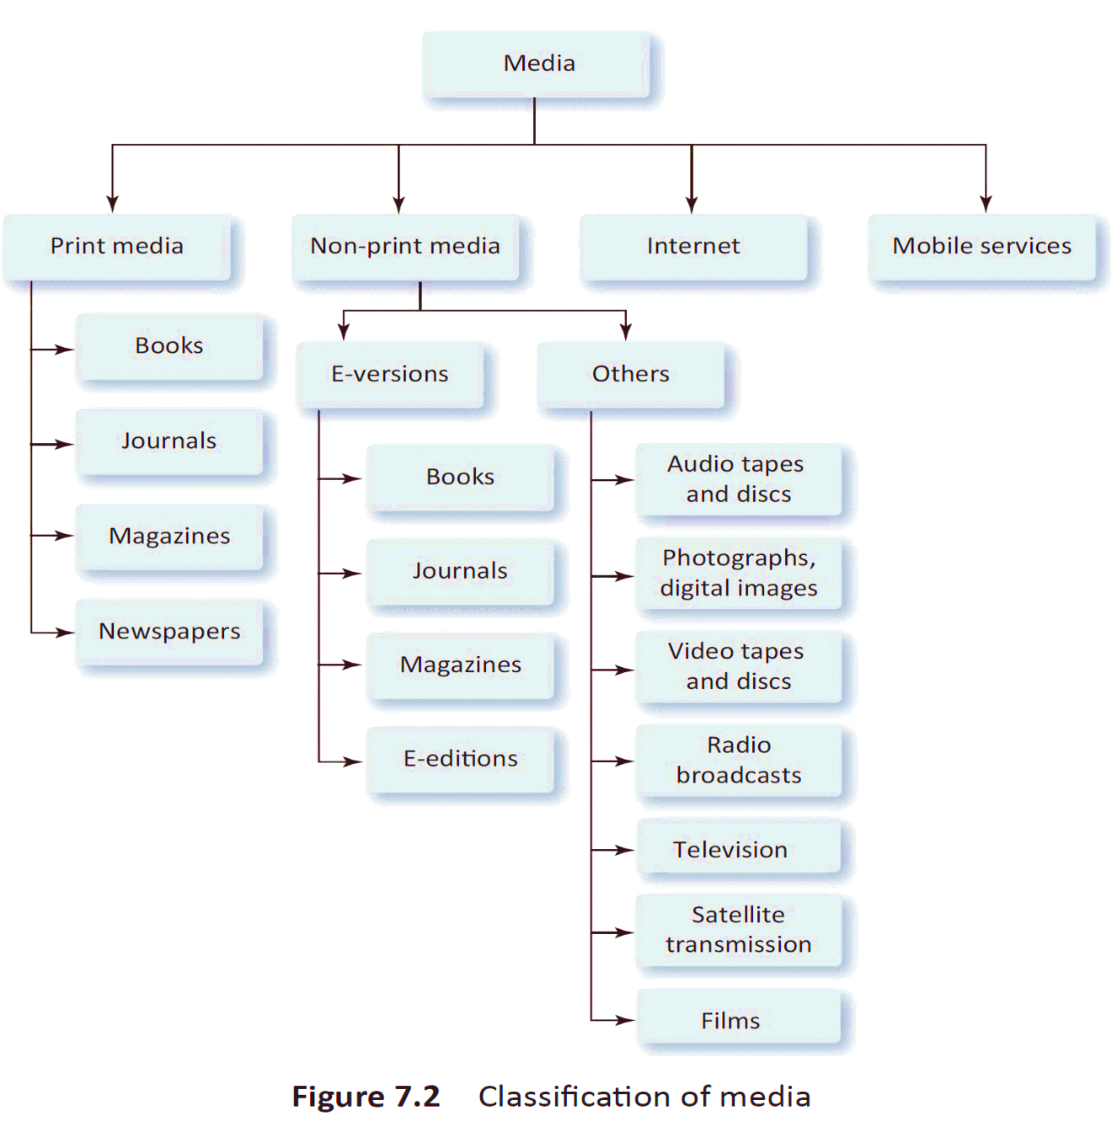
CLASIFICATION OF MEDIA

Slide 32
MEDIA FUNCTIONING
Media plays important roles in a democracy
Freedom of press
Freedom from disclosing information
Accountability of media
Strong self-regulatory mechanisms
Code of ethics for media and personnel
Media’s role as a watch dog to be promoted

Slide 33
MEDIA ETHICS
Ethics in Journalism
Respect the privacy of individuals. Any invasion of privacy by sting operations, recordings of conversations, etc., must be avoided, except where they are needed in public interest.
Avoid recording interviews and phone conversations.
Avoid sensationalizing news.
Avoid giving gory and gruesome details and pictures of disturbing news.
With a view to being the first and exclusive, do not publish unauthenticated news.
Avoid publishing suggestive guilt.
Respect the right to reply of individuals.
Avoid glorifying violence and social evils.
Do not publish advertisements that malign or hurt religious sentiments.

Slide 34
MEDIA ETHICS
As the media grew in terms of numbers, reach, types, and power, the business had to employ a large number of people to run the show. With the number of journalists and other people involved, there is a greater probability of some bad elements getting into this field.
Today, the media is big business and a huge investment is required to run a newspaper publishing house or a television channel. Non-print mass media used to be the monopoly of the government in earlier times. Nowadays, many private corporations are in the business and many of them are really huge entities. The competition is very high and in order to make profits and to remain in the business, unscrupulous practices by the ownership firms are bound to creep in.

Slide 35
ADVERTISING ETHICS
Advertising should be truthful and reflect the true character and features of the item being advertised.
It should be impartial, that is, it should not highlight only the favorable features and hide facts that show the product in poor light.
Advertising should not be against social norms and pubic decency, hurting the sensitivity of people.
Advertisements should not hurt the religious sentiments of people.
Advertisements should not incite people to violence or cause public disorder, etc.

Slide 36
WAR ETHICS

Slide 37
WAR
Wars can never be justified
Wars only bring harm to humanity
Wars are just fought to increase jurisdiction or power over people
Wars cause immense harm to civilian population and completely ravaging the country
In present day times, a war will leave no winner.

Slide 38
JUST WAR
Just Cause A war should be fought with only a just and pious objective. This could be to avoid immense harm or great tragedy to some group. Wars can be waged only to avert some great peril, aggression, or massive violation of rights of people.
Right Intention The objective of the war must be correct with respect to intention. It must be to help people and only for that purpose, and not to grab land or subjugate people of another country.
Last Resort The country going to war must convince itself and others that all other options have been exhausted before the decision to wage war was arrived at. Waging a war must be the last option after all other available options have been sincerely and seriously tried.
Legitimate Authority Only a legitimate authority can fight war. In the present circumstance, the United Nations Security Council resolution can be sought to legitimize the war effort.
Comparative Justice In a war situation, there is most probably a justify able cause on both sides to fight the war. Comparative justice would mean that there must be a considerably higher justification on one side for that country to wage war against the other.
Probability of Success The probability of success must be high, otherwise waging a war will not achieve the purpose and there will be immense harm to innocent people.

Slide 39
MODERN WARFARE
The world spends trillions of dollars to develop and make lethal weapons.
Millions of dollars are spent in research to develop more and more fatal weapons.
Modern warfare may use many unethical weapons like chemical and biological weapons and nuclear war heads.
The technology is very dangerous if it falls into wrong hands as in the case of terrorists.
Terrorism in its various forms is taking away a lot of resources which otherwise could had fed millions of starving people.

Slide 40
ETHICAL ISSUES
Is war ethical, is the first question that comes to our mind. If at all a war is waged, can we fight it ethically?
If you are a research scientist working in a laboratory that has a project on developing chemical or biological weapons, what is your moral responsibility in case of a war that kills thousands with the same weapon that you helped to develop?
If you were part of a project that developed cluster bombs that killed thousands of innocent people, where do you stand ethically?
You are a weapons engineer specialized in developing delivery systems for missiles. You have published many papers that have brought you laurels for your expertise. The missiles when delivered can destroy all life forms in an area. Where do you morally stand?
As an electronics engineer, you have the responsibility to develop systems to spy into other communications and jam communication systems. What is your judgment on the morality of your actions?

Slide 41
BIO ETHICS

Slide 42
BIOETHICS
Bioethics deals with ethical issues in medicine and biology.
Bioethics is defined as the philosophical study of ethical questions arising out of developments in biology and medicine. More specifically, it studies ethical arising out of the relationship among life sciences, medicine, law, politics and religion.
Bioethics covers a wide range of areas such as abortion, euthanasia, surrogacy, genetic engineering, suicide, cloning, and health-care issues.

Slide 43
MAJOR ISSUES
Abortion - Abortion, also called medical termination of pregnancy, is ending the life of a fetus before birth.
Euthanasia - Euthanasia or mercy killing is the termination of life for a variety of reasons.
Surrogacy - Surrogacy, meaning substitute, is a term used to refer to the concept of someone substituting for the mother and taking the burden of pregnancy and delivery.
Cloning - Cloning is a very complex process. In simple terms, cloning is biological photocopying.
Genetics - Genetics or genetic engineering deals with genes, their transplantation and creation of new life forms, and crossing species boundaries.

Slide 44
ABORTION
Does one have the right to take the life of a child?
Can abortion be ethical? What mitigating circumstances can make this practice legal?
How does one deal with this menace? Is the law a sufficient deterrent?
Which is more desirable, legal protection for the child or a mass movement to educate the parents?

Slide 45
EUTHANASIA
Can the quality of life be a sufficient reason to allow a person or his/her relatives to end his/her life?
Can suffering from pain eternally be a reason for allowing mercy killing?
What mitigating circumstances should be there to allow a person to end his/her life?
To what extent should the quality of life deteriorate for one to decide that life is not worth living?

Slide 46
SURROGACY
There are genuine cases where the biological parents are not able to conceive and bear a child. However, as in many other cases, there is the exploitation of poverty among people in poor countries who take to surrogate motherhood for very meager fees. There is also the question of middlemen who earn a lot of money in the process.
The relation between the surrogate mother and the child who will be brought up by the biological parents needs to be considered, both on legal aspects, and social and emotional considerations.
Surrogate motherhood as a contract between the biological parents and the surrogate mother needs legal protection for both the parties. It should not lead to claims and counterclaims at a later stage.
The child’s feelings towards the parents and to the surrogate mother could be a tricky issue in some cases.

Slide 47
CLONING
Are we playing God when we use cloning to reproduce humans? If such an objection arises about this process, what about similar reproductive procedures such as hormone treatments and in vitro fertilization (IVF)? Should they also be banned?
When we use an embryo to obtain stem cells, thereby destroying it, are we violating the rights of a human being? Does an embryo at any stage have the same rights as human beings?
The many procedures developed to help infertile couples have children have been in use for many years. Are they ethical? Is cloning one such procedure?
In the future, it is possible that humans will be cloned successfully. What are a cloned being’s rights vis-à-vis the original human being from whom he/ she was cloned?

Slide 48
CLONING
Do we have the right to take organs from a cloned individual to help a normal human being survive? Can cloned humans be used as resources to help normal humans survive?
Can cloning become a failed procedure or result in a product with unexpected results? Can it create a monster with immense powers? Can it be done purposefully to dominate others?
Can cloning be used to create manpower for fighting wars?
The parentage of a cloned individual can also become an ethical issue.
What about the status of cloned children in society? Will they have to face social ire or be social outcasts?
Is research in cloning an ethical process? If this is allowed to continue, who should regulate it?

Slide 49
GENETICS
The ethicality of research that transcends the boundary between species;
The lack of knowledge about risks associated with such research and the difficulty of predicting them;
A new research area that has little control by way of social and legal regulatory framework;
The effect on the biosphere (environment) where such genetically modified life forms are introduced;
The unpredictability of genetic interventions on humans;
The issue of whether technology can be misused by unscrupulous elements to create social and cultural mayhem by creating unknown life forms.

Slide 50
RESEARCH ETHICS

Slide 51
FEATURES OF RESEARCH
The outcome of research is not always certain. One may do a lot of work, spending time, effort, and money, without getting anything tangible in return.
Research requires specially skilled people. A university degree or a PhD alone cannot make one a researcher. Qualifications can help, but are not a guarantee. Research requires people with different skill sets.
Research is quite expensive in terms of elaborate instrumentation and experimentation and the risk of ‘no result’ involved.
Research must lead to some product useful to society and must result in a business proposition for investing money.

Slide 52
RESEARCH OBJECTIVES
Objectives of Research are:
Create new knowledge.
Use the created knowledge to develop products and services that are useful to society.
Understand yourselves and the world around you so that you can easily and sensibly negotiate and overcome problems.

Slide 53
RESEARCH SKILLS
Critical Thinking - ability to analyze any given situation without accepting anything at face value.
Problem Solving - ability to define and analyze problems, find multiple solutions if they exist, and select a solution after optimizing
Analysis - ability to obtain useful information from observed data, representing them appropriately, reduction of data, and deduction from the patterns of data.
Dissemination – ability to communicate research findings to the scientific community; abilities such as summarizing information, report writing, and the ability to present the information in a variety of formats for easy understanding by the target group.

Slide 54
RESEARCH SKILLS
Sub-skill Sets
Imagination and creativity include identifying alternative approaches, finding alternatives to commonly accepted methodologies, and examining issues from different points of view.
Logic and reasoning mean logical thinking, deductive and inductive reasoning, evaluating the reasons given, and drawing conclusions from analysis.
Data collection includes collecting data through a variety of methods including scientific experimentation, design experiments and data collection tools, and formats for data entry.
Data analysis includes identifying and applying appropriate data analysis tools, use of different mathematical tools, forming appropriate conclusions, and appreciating the limitations of data analysis.

Slide 55
RESEARCH SKILLS
Sub-skill Sets
Conceptual thinking includes breaking the whole process into smaller parts for analysis, identifying and synthesizing concepts for finding solutions, and making value judgments from the available data.
Reflection and feedback is the ability to look back upon the research methodology and tools and make improvements for the next solution.
Scientific experimentation requires the ability to design experimental procedure, identify limitations, and use appropriate tools for research.

Slide 56
ETHICAL ASPECTS
To promote the aims of research, the researcher should follow the norms of research, written or otherwise. Any fabrication, falsification, or misrepresentation of research data is unethical and must be scrupulously avoided.
Most research work today involves cooperation and collaboration b different people from different disciplines, institutions, and even countries. Values that are essential in such collaborative research work include trust, accountability, mutual respect, and fairness. Ethical standards must be spelt out for conducting research. Ethical standards for research include guidelines for authorship, copyright, patenting, data sharing, and confidentiality of reviews. These are intended to protect the intellectual property rights (IPR) of people.
Research guidelines also include the researcher’s accountability to the public in terms of misconduct, conflict of interest, human and animal subjects’ protection, and usefulness of research to the public, particularly when public money is spent on research projects.

Slide 57
ETHICAL ASPECTS
Ethical standards in research also garner public support for further funding based on the usefulness, quality, and integrity of research.
Ethics in research also helps to promote moral and social values in general.

Slide 58
ETHICAL PRINCIPLES
The researcher has to faithfully observe some fundamental principles. Honesty, objectivity, integrity, alertness, transparency, respect for others, respect for IPR, confidentiality, cooperation and collaboration, scrupulously obeying the laid-down laws, competence, and an understanding of ethical norms for research.
Informed Consent – In medical and clinical research, where human subjects are used, it is imperative that the human subject gives an informed consent after being fully made aware of the research and its implications.

Slide 59
ETHICAL ISSUES
Research is a double-edged sword. While research is absolutely essential to understand and exploit nature sensibly, it can also lead to unwanted and unexpected results.. Many research areas in biosciences are banned in various countries as the results could be dangerous to the society. Researchers must ensure that research is done in approved areas only. He/She should be well aware of the likely results, benefits, and dangers.
Research results must eventually be brought to the public domain. The publication of research findings is thus important. Of course, a lot of research work done by business enterprises have commercial value and are reported only after they have the right to exploit it commercially. This is legitimate and in the interest of the society.
The researcher has to have a high level of honesty and integrity. Reporting research findings has to be very transparent, indicating the limitations of the study and its application.
Plagiarism should be avoided. Since research is an innovative work, due credit must be given to the original researcher. Taking someone else’s work and publishing as one’s own is a criminal act.

Slide 60
INTELLECTUAL PROPERTY RIGHTS

Slide 61
IPR
Intellectual property right can be defined as the right to the creation of one’s mind or intellect.
The creations can be in many forms in terms of artistic or literary works, scientific inventions, designs, etc.
IPR, once established, enables the individual to claim exclusive right to exploit his/her creation commercially.
Essentially, IPR ensures that others cannot exploit somebody’s creation without his/her consent or by making some financial or other arrangements with him/ her to use that invention.

Slide 62
IPR
IPR is a Global Issue
It is basically an incentive for the innovators. It promotes innovation because IPR makes it possible for the innovator to commercially and exclusively exploit the innovation, even if for a limited period of time.
IPR helps many companies invest in research and innovation because once IPR is granted, the company finds it possible to recover the investment and make
profits. It makes investment in research a commercially viable proposition.
Many IPR categories protect the long traditions and rich heritage associated with famous products and geographical territories such as Kancheepuram silk or Darjeeling tea.

Slide 63
TRIPS
WTO adopted the trade-related TRIPS agreement at Uruguay round in 1994.
Based on Berne convention on literary and artistic works and Paris convention on patents.
TRIPS agreement signed in morocco, 1994.
An exhaustive document covering all aspects of protection of intellectual property rights .

Slide 64
DOMAINS OF IPR
The following Categories of IPR are Presently Covered.
Patents – are granted for original inventions or improvement of existing products
Trademarks – Verbal, visual or combination symbol that identifies distinctly a product or service
Copyright – protection of artistic and literary works
Industrial Designs – something that makes the product attractive and appealing to the consumer
Geographical Indication – Quality and territorial identity of products like basmati rice, Darjeeling tea etc.

Slide 65
SUMMARY
Globalization has been a major development all over the world in recent years. This has brought with it a number of issues of concern for business enterprises. It has resulted in major challenges on many fronts. Business ethics relates to business practices such as corporate governance, accounting practices, and social responsibility.
The sustainability of the environment leads to many issues in environmental ethics.
Many ethical issues arise in areas such as computers, media, wars, and research.
Intellectual property rights and respect for such rights is a major ethical issue in the present times.
Most of these issues are global in nature as they have a wide impact across the world.

