Slide 1


Professional Ethics
R. Subramanian

Slide 2
Chapter 9
Ethics Audit

Slide 3
OBJECTIVES
Appreciate the importance of ethics audit
State the objectives of an ethics audit
Suggest ethical policies and codes of conduct for organizations
Define and explain the terms audit brief, benchmarking, and transparency
Describe procedures for conducting an ethics audit

Slide 4
ETHICS AUDIT
Many types of audits like financial, social, environmental, energy, water, safety, ethics etc.
Ethics audit is like other forms of audit but with a focus on the values of the organization.
To conduct an ethics audit, the values must be clearly documented for the purpose of comparison and evaluation.

Slide 5
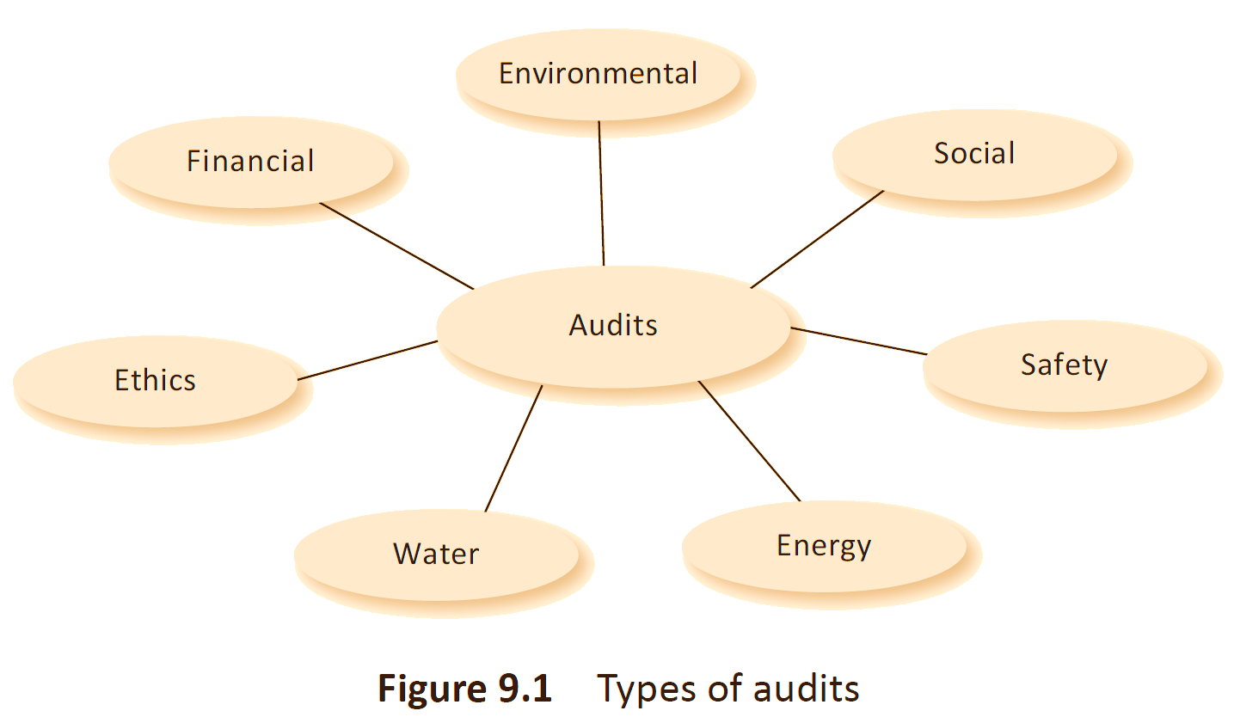
TYPE OF AUDITS

Slide 6
ETHICS AUDIT
Ethics audit focuses on the values of the organization;
Existence of documented policies and norms for ethical functioning;
Decisions and actions within and while dealing with stakeholders;
Strategies and procedures for compliance;
Dealing with unethical behavior;
Collection of information as required
Fair review and presentation of ethics of company
Suggestions for improvement

Slide 7
NEED FOR ETHICS AUDIT
Focus on ethics of business, and even other organizations, due to the many scams reported exhaustively
Business has become global; Investors look for companies with clean record for investing their money.
Business practices vary at home base and in other countries; people have to be sensitized about business ethics and influence of culture and community on business practices.
Everyone wants to keep their house in order; An ethics audit can enhance the image.
Ethics audit will force business houses to clearly state their policies and practices with a focus on ethics in a fully documented form.

Slide 8
ETHICS AUDIT
Having Ethics Audit Helps the Organizations To -
  Create a healthy work environment;
  Ensure that individuals of the organization live up to the expectations of the stakeholders in terms of their ethical behavior;
  Generate a workable ethical policy;

Slide 9
ETHICS AUDIT
Benchmark the ethical standards of the organizations;
Acquire the trust and confidence of the stakeholders;
Balance economic compulsions and ethical policies;
Avoid litigations, costly legal procedures, and stricter government regulations; and
Acquire brand equity for its products and services.

Slide 10
ETHICS PROFILE
Work out an ethics profile detailing out what exists.
A number of internal and external factors need to be considered.
Profile is what exists, not necessarily what is desired.
Starting from this, one can detail out an ethics audit program.

Slide 11
ETHICS PROFILE
Drug Manufacturing Unit
Internal factors
Ethical policy The existence of an ethical policy for the organization is very important. Such a document not only gives the auditor a framework to work with but can also be compared with those of similar organizations for improvement.
Ethical management practices Goo management practices include informing the employees about the ethical policy, paying correct wages and not taking advantage of rising unemployment, having a vision for the organization and working towards achieving that vision, not compromising on the quality of products and services, setting up a pricing policy, and putting in place mechanisms for many aspects such as employee welfare, safety, and grievance redressal.
Communication channels Existence of communication channels for top to bottom, bottom-up, and lateral communications is important to bring about transparency and to also get information about any unethical practices. Employees must also have whistle-blowing rights.

Slide 12
DRUG MANUFACTURING UNIT
Internal factors
Ethical conduct of employees Many professionals, craftsmen, and other staff for administration and finance work in an organization. Their conduct, both within and outside, affect the image and credibility of the organization. A code of conduct for all categories of employees needs to be made and they should be informed about it. In addition, a mechanism to detect unethical behavior and initiate action against employees indulging in such activities must exist.
Technical processes The selection and procurement of raw materials, manufacturing processes, quality consciousness among employees, quality checking and assurance, and uncompromising attitude with respect to quality all have an ethical aspect. Research and innovation to improve processes and products to make them safe and useful must be carried out.
Finance and accounting practices Correct and transparent accounting practices must be followed. Financial statements and projections must be accurate and inform the investors and public about the true financial health and prospects of the company.

Slide 13
DRUG MANUFACTURING UNIT
Internal Factors
Payment of taxes and duties Payment of taxes and duties as per government regulations must be strictly followed. Taking advantage of loopholes in the law should be avoided.
Employee welfare Employee satisfaction is a major contributor to an organization’s sustainability. A proper mechanism should be available to look into their welfare, and any grievances must be promptly taken care of. Employee harassment should be avoided.
Safety aspects The safety of employees and workers in the shop floor must be taken care of. A mechanism to deal with accidents and compensation to employees must be put in place.

Slide 14
DRUG MANUFACTURING UNIT
External Factors
Product information Product information given to the public and clients must be accurate and complete for them to make decisions about the product. False information and promises of performance must be avoided. Mandatory information in the case of certain products, such as manufacturing and expiry dates, must be clearly mentioned.
Marketing practices Marketing practices must be ethically correct. Undercutting in prices, bribing for sale, etc., should be avoided.
After-sales service Appropriate mechanism for after-sales service must be in place. Servicing must be fast and to the satisfaction of the clients. Warranty promised at the time of sale must be honored.
Dealing with clients and public Employees and management must have appropriate training to ethically deal with clients and the public. Their complaints and grievances must be heard and taken care of swiftly.

Slide 15
DRUG MANUFACTURING UNIT
External Factors
Conforming to government regulations/industry standards There are many government regulations and standards set by industry organizations such as Chambers of Commerce for the functioning of the unit. These must be understood and abided by. Intellectual property rights (IPR) and patent violations are serious offences and can result in costly litigation.
Information to clients, investors, and stakeholders An ethics audit report must be prepared and made public. What action is proposed to be taken for any lapse in the ethical aspects of the organization must be declared to the public.
Social responsibility All organizations have a social responsibility to make the life of people in the neighborhood worth living. Though it is not mandatory or binding, organizations need to do some things to make the life of people easier and better.
Taking care of the environment All manufacturing units have some impact on the environment. How this is taken care of by waste management and the other steps taken must be declared and made clear to the public.

Slide 16
EDUCATIONAL INSTITUTION
Internal Factors
Ethical Policy
Does an ethical policy for the institution exist?
Is it appropriately and accurately documented?
Are the employees and public aware of its existence?
Management Practices
Does the management collect fees as per norms set by the government?
Is the management quota for admission misused?
Does the management collect donations for admission?
Do they pay appropriate wages to the faculty and staff as per norms?
Have appropriate resources been made available as per curriculum?
Communication Channels
Are there free communication channels for employers and employees to communicate?
Does the management encourage free bottom-up communication?
Does the management encourage whistle-blowing?

Slide 17
EDUCATIONAL INSTITUTION
Internal Factors
Ethical conduct of employees
Is there an ethical code of conduct in place for employees, faculty, and staff?
Are the employees aware of such a code?
Are there mechanisms in place to detect unethical conduct and take appropriate action?
Financial and accounting practices
Does the institution follow correct and appropriate accounting norms?
Are the financial and accounting procedures and practices transparent?
Are there mechanisms created to ensure that the correct rules and procedures are followed?
What checks and balances exist to ensure ethical practices in financial matters?
Educational practices and availability of resources
Has the institution provided infrastructure and resources as per the norms prescribed by the government or regulatory agencies?
If there is a shortfall in resources, how is it taken care of?
Is there sufficient faculty to take care of the educational processes?
If there is a shortfall in faculty numbers, are processes conducted using visiting faculty?

Slide 18
EDUCATIONAL INSTITUTION
Internal Factors
Employee Welfare
  Are there sufficient facilities for faculty and staff to do their job?
  What mechanisms exist to take care of faculty grievances and complaints?
  What other benefits, in addition to salary, such as medical benefits and pension, are available to the employees?

Slide 19
EDUCATIONAL INSTITUTION
External Factors
Conforming to government regulations
Are the management and employees aware of the regulations set by the government for their functioning?
Are they being followed?
Conforming to university and other controlling agencies’ regulations
Are the management and employees aware of the regulations governing their functioning by the university and other regulatory bodies?
Do they follow these regulations?
Information to students and parents
Does the institution provide correct and sufficient information to students and parents about the institution by way of prospectus and other instruments?
Does the institution make tall claims about the quality of education, placements, wages, etc., which are not true?
Does an academic calendar exist? If yes, to what extent is it followed?

Slide 20
EDUCATIONAL INSTITUTION
External Factors
Dealing with students and parents
Do mechanisms exist to deal with students and parents?
Does the management take decisions ethically in dealing with students and parents?
Societal obligations
Is the institution aware of social obligations, even though it is not mandatory?
Are there mechanisms and activities that promote social work by employees and students?
Is a social audit conducted?
Environmental concerns
Does the institution have an environment protection plan?
If such a plan exists, is it being followed?
What activities are performed to promote environmental health?
Information to employers
Does the institution provide accurate information to employers about the students?

Slide 21
OBJECTIVES OF ETHICS AUDIT
To evaluate the ethical policy documents of the organization for adequacy and completeness.
To assess whether the value-linked policy statements are being followed by all in all their functions.
To compare the ethical standards set by the organization with that of other leading organizations of comparable nature and size.
To suggest steps to ensure that the organization remains a leader in the group of ethically tuned organizations.
To detect any pitfalls in implementing ethical policies and suggest remedial actions.

Slide 22
SETTING ETHICS STANDARDS
Ethics standards and ethical policies
Engage a consultant
Train the staff to frame ethical policies
Brain storming sessions
Bench marking

Slide 23
BENCH MARKING
The problem area needs to be identified. The problem area in this case is the setting of ethical standards or improving upon an existing ethical standards document and its implementation.
Then, other organizations having similar processes of comparable nature and size are identified. For example, a manufacturing unit looks at companies doing similar activities in terms of nature and size, and studies their ethical standards.
The next step is to identify the leading organizations in the area to be improved. This would mean identifying entities of similar nature and size and having leadership in the area of ethical standards.

Slide 24
BENCH MARKING
A survey of such leading-edge companies is then undertaken to study their practices in terms of ethical policies, standards, their implementation, etc.
The next task is to visit leading companies and collect data about their functioning.
Finally, the areas for improvement are identified and new practices for ethical functioning are implemented.

Slide 25
ETHICS ASSURANCE
Taking steps to see that ethical aspects of the organization are flawless
Assurance to stakeholders on ethical standing
Impeccable ethical standards
Adequate steps taken to implement
Inspires implementation
All people aware of standards and their responsibilities
Accountability and transparency

Slide 26
AUDIT BRIEF
Study the ethical policy documents and code of conduct rules for sufficiency and exhaustiveness.
Compare the documents with those of comparable, leading-edge entities to suggest improvements.
Study the ethical aspects of the functioning of the organization in fulfilling its mission and mandate.
Point out any lapse in ethical functioning of any of the functionaries and suggest suitable action so that such lapses do not recur.
Suggest a road map for the organization to become a leading-edge entity in ethical functioning.

Slide 27
PROCEDURE FOR ETHICS AUDIT
Study the ethical policy documents presented by the organization. These should be compared with those of similar organizations to suggest improvements.
Study documented cases of unethical behavior on the part of management and employees at all levels. The management’s impartiality and honesty in dealing with such cases should be studied.
Obtain feedback from employees on the ethical aspects of the organization. In cases where the employee strength is quite large, a sampling can be done by selecting employees and other stakeholders randomly.

Slide 28
PROCEDURE FOR ETHICS AUDIT
Feed back from all stakeholders
Through questionnaire
Through personal interviews
Encouraging employees to provide information through a variety of ways, even anonymously

Slide 29
ETHICS AUDIT PROGRAMME
Starting an Ethics Audit Program
All organizations must voluntarily frame ethical policies and set ethical standards for the functioning of the management and employees. They should clearly indicate their responsibility to all stakeholders.
Organizations should have elaborate and exhaustive information dissemination mechanisms to inform all stakeholders of the organizations’ ethical standards.
There should be a system for maintaining records of ethical functioning of the organization and employing preventive and detection procedures.

Slide 30
ETHICS AUDIT PROGRAMME
Staring an Ethics Audit program…
Along with a financial audit, an organization must conduct an ethics audit. (The procedures outlined earlier can be employed with suitable modifications.)
The ethics audit report may form a part of the
financial audit and must invariably inform the stakeholders about its ethical standing. Compliance to ethical standards set by the organization must be vetted by the auditors.
The organization must conduct an annual review of its ethical standing after the audit.

Slide 31
SUMMARY
Ethics audit is a new field of study. Ethics audit requires companies to form ethical policies, conduct their activities ethically, and generally perform keeping in mind the ethical principles for public good.
Conforming to ethical standards is not only a sensible policy but is also good for the image of the company and future business prospects.
The companies should be audited according to laid out criteria that they themselves set after benchmarking from existing companies. The ethics profile of a company is worked out from these criteria and efforts made to reach the benchmark set.

