Slide 1
Static is a keyword in C++ used to give special characteristics to an element. Static elements are allocated storage only once in a program lifetime in static storage area. And they have a scope till the program lifetime. Static Keyword can be used with following,
Static variable in functions
Static Class Objects
Static member Variable in class
Static Methods in class

Slide 2
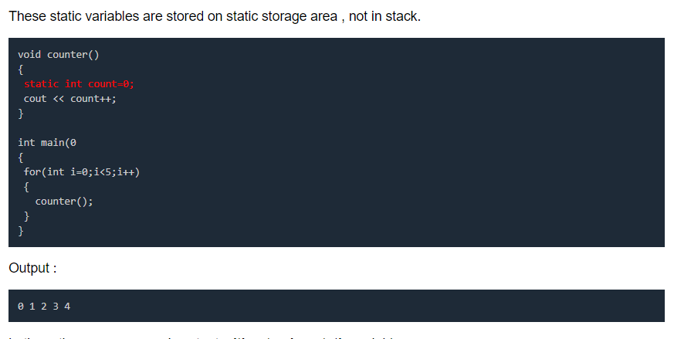

Slide 3
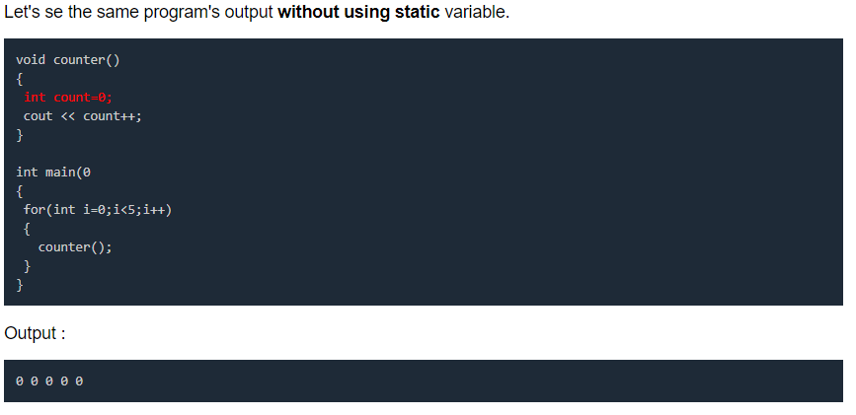

Slide 4
Static data member in class
Static data members of class are those members which are shared by all the objects.
Static data member has a single piece of storage, and is not available as separate copy with each object, like other non-static data members.
Static member variables (data members) are not initialized using constructor, because these are not dependent on object initialization.
Also, it must be initialized explicitly, always outside the class. If not initialized, Linker will give error.

Slide 5
Special member functions
Default constructor
copy constructor
copy assignment operator
move constructor
move assignment operator
destructor

Slide 6
Using Constructors
C++ provides two ways to initialize an object by using a constructor.The first is to call the constructor explicitly: Stock food = Stock("World Cabbage", 250, 1.25); This sets the company member of the food object to the string "World Cabbage", the shares member to 250, and so on.
The second way is to call the constructor implicitly: Stock garment("Furry Mason", 50, 2.5); This more compact form is equivalent to the following explicit call: Stock garment = Stock("Furry Mason", 50, 2.5)); C++ uses a class constructor whenever you create an object of that class, even when you use new for dynamic memory allocation. Here’s how to use the constructor with new: Stock *pstock = new Stock("Electroshock Games", 18, 19.0);

