Slide 1
The Network Layer
Chapter 5

Slide 2
Network Layer Design Issues
Store-and-forward packet switching
Services provided to transport layer
Implementation of connectionless service
Implementation of connection-oriented service
Comparison of virtual-circuit and datagram networks

Slide 3
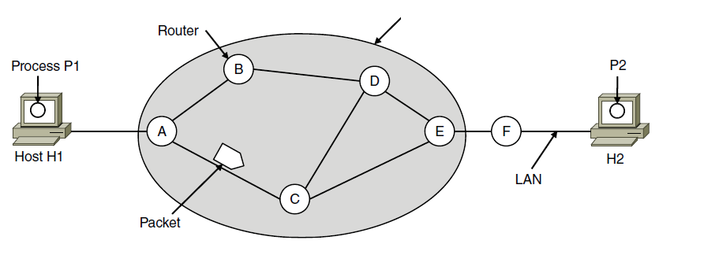
Store-and-Forward Packet Switching
ISP’s equipment
The environment of the network layer protocols.

Slide 4
Services Provided to the Transport Layer
Services independent of router technology.
Transport layer shielded from number, type, topology of routers.
Network addresses available to transport layer use uniform numbering plan
  even across LANs and WANs

Slide 5
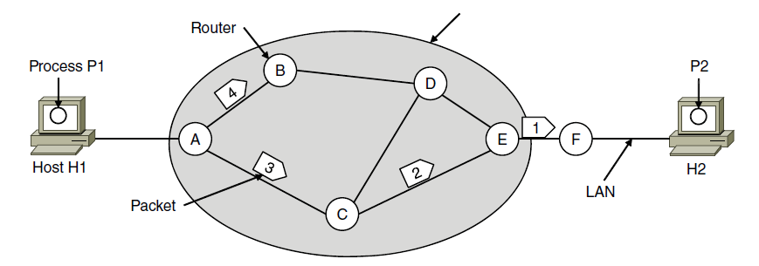
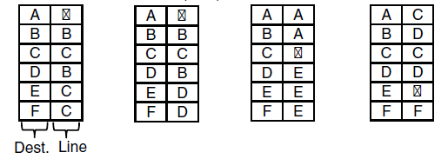
Implementation of Connectionless Service
ISP’s equipment
A’s table (initially) A’s table (later) C’s Table E’s Table
Routing within a datagram network

Slide 6
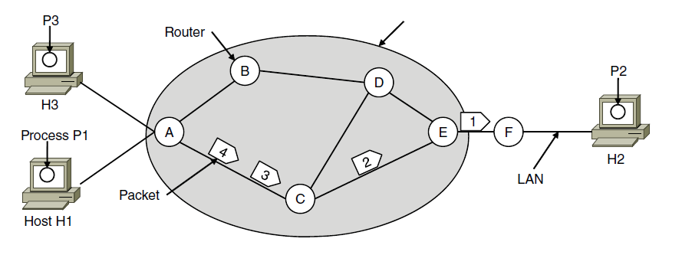

Implementation of
Connection-Oriented Service
ISP’s equipment
A’s table C’s Table E’s Table
Routing within a virtual-circuit network

Slide 7
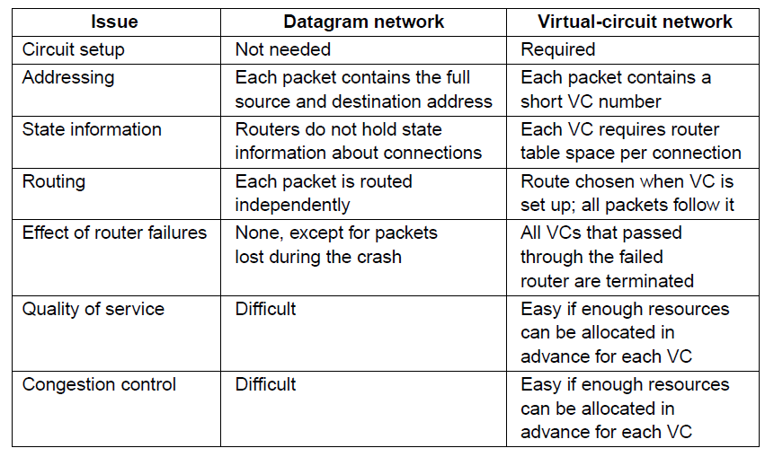
Comparison of Virtual-Circuit and Datagram Networks
Comparison of datagram and virtual-circuit networks

Slide 8
Routing Algorithms (1)
Optimality principle
Shortest path algorithm
Flooding
Distance vector routing
Link state routing
Routing in ad hoc networks

Slide 9
Routing Algorithms (2)
Broadcast routing
Multicast routing
Anycast routing
Routing for mobile hosts
Routing in ad hoc networks

Slide 10
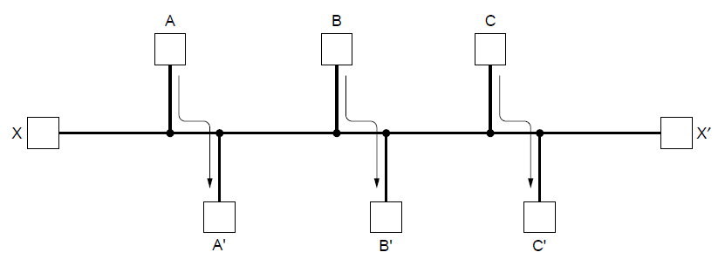
Fairness vs. Efficiency
Network with a conflict between fairness and efficiency.

Slide 11
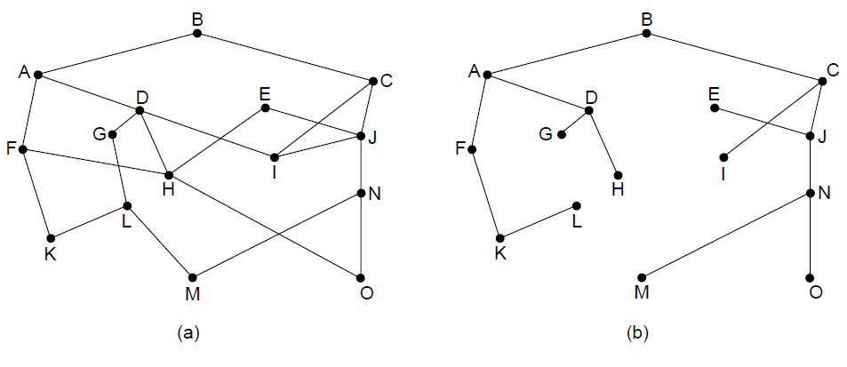
The Optimality Principle
(a) A network. (b) A sink tree for router B.

Slide 12
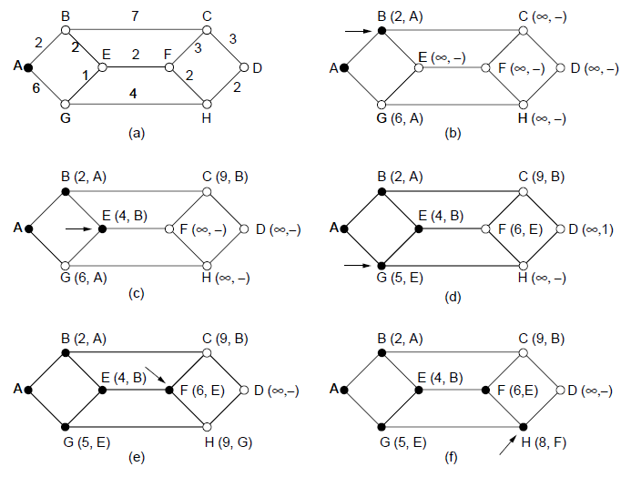
Shortest Path Algorithm (1)
The first five steps used in computing the shortest path from A to D. The arrows indicate the working node

Slide 13
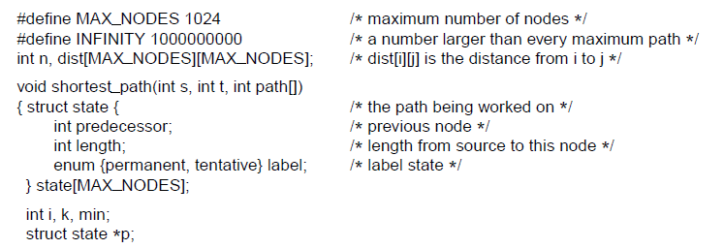
Shortest Path Algorithm (2)
. . .
Dijkstra’s algorithm to compute the shortest path through a graph.

Slide 14
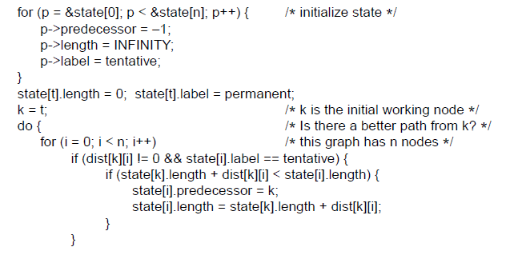
Shortest Path Algorithm (3)
. . .
. . .
Dijkstra’s algorithm to compute the shortest path through a graph.

Slide 15
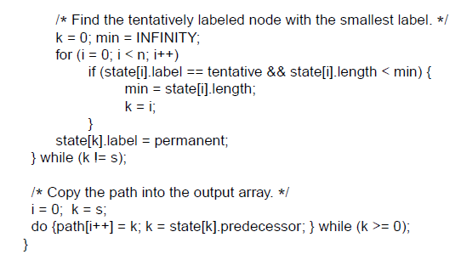
Shortest Path Algorithm (4)
. . .
Dijkstra’s algorithm to compute the shortest path through a graph.

Slide 16
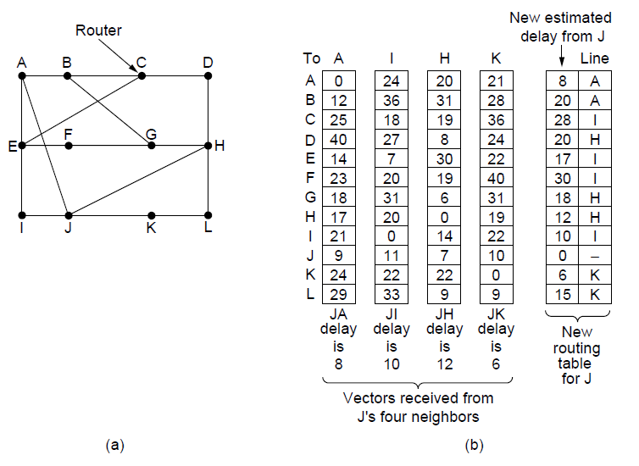
Distance Vector Routing
(a) A network.
(b) Input from A, I, H, K, and the new routing table for J.

Slide 17
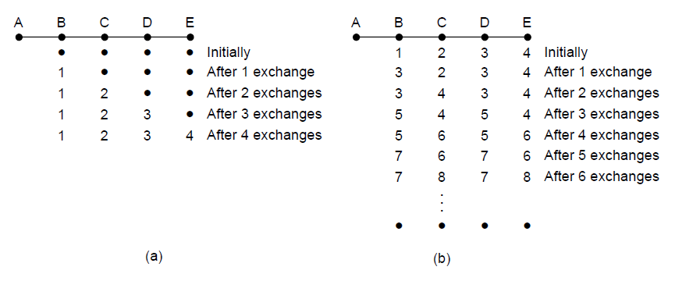
The Count-to-Infinity Problem
The count-to-infinity problem

Slide 18
Link State Routing
Discover neighbors, learn network addresses.
Set distance/cost metric to each neighbor.
Construct packet telling all learned.
Send packet to, receive packets from other routers.
Compute shortest path to every other router.

Slide 19
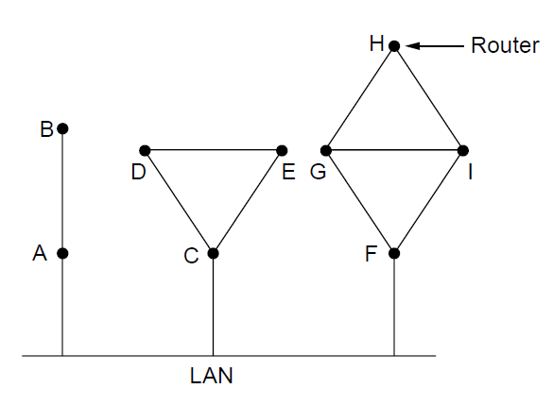
Learning about the Neighbors (1)
Nine routers and a broadcast LAN.

Slide 20
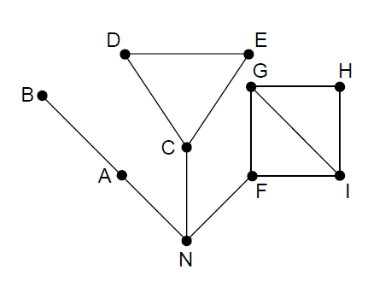
Learning about the Neighbors (2)
A graph model of previous slide.

Slide 21
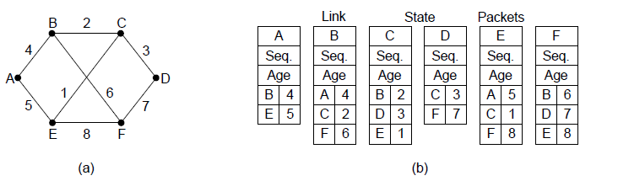
Building Link State Packets
(a) A network. (b) The link state packets for this network.

Slide 22
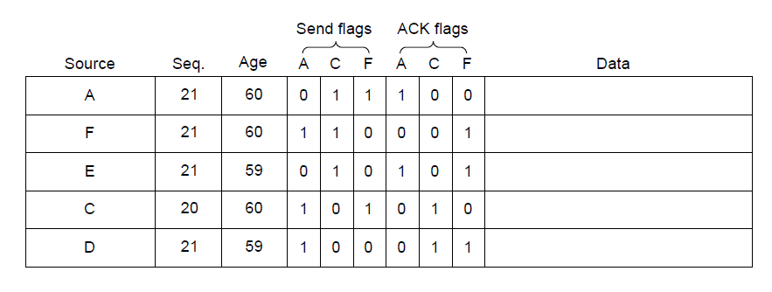
Distributing the Link State Packets
The packet buffer for router B in previous slide

Slide 23
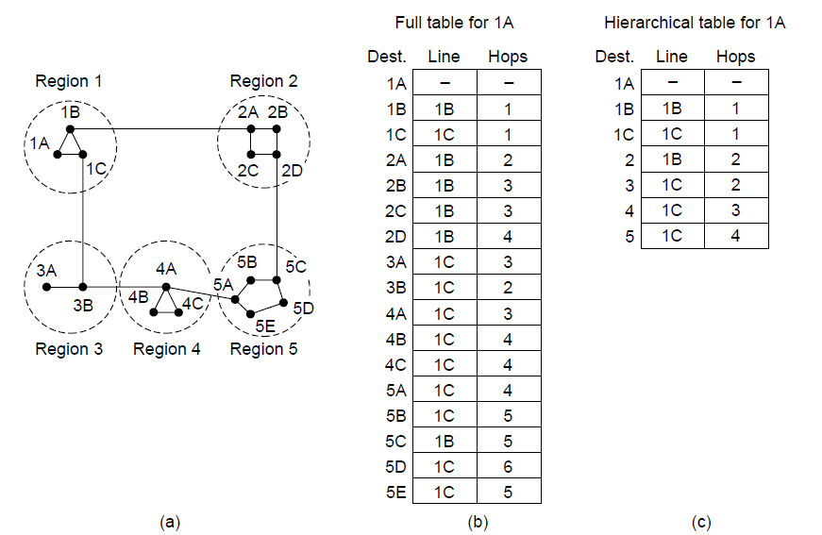
Hierarchical Routing
Hierarchical routing.

Slide 24
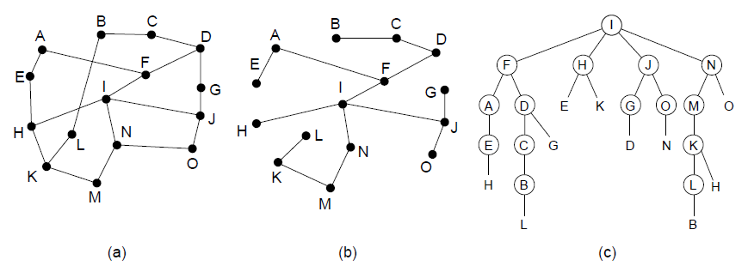
Broadcast Routing
Reverse path forwarding. (a) A network. (b) A sink tree.
(c) The tree built by reverse path forwarding.

Slide 25
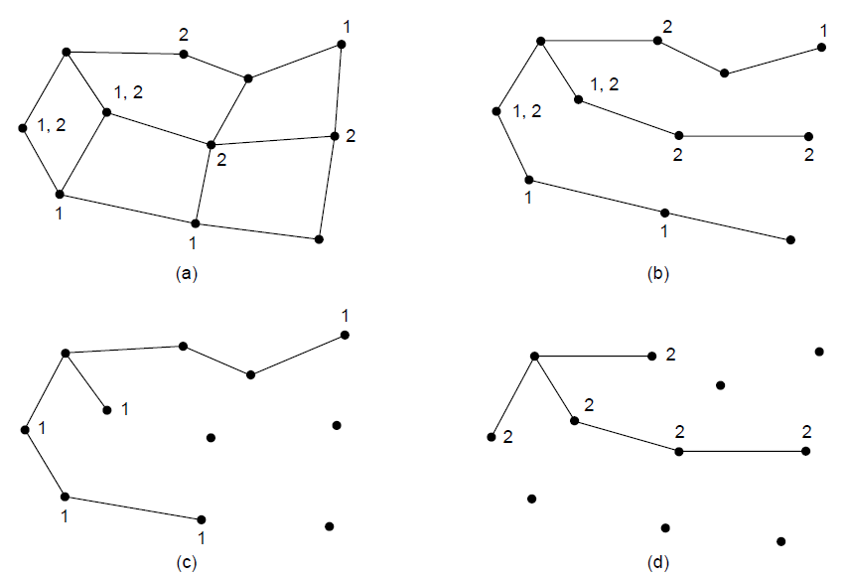
Multicast Routing (1)
(a) A network. (b) A spanning tree for the leftmost router. (c) A
multicast tree for group 1. (d) A multicast tree for group 2.

Slide 26
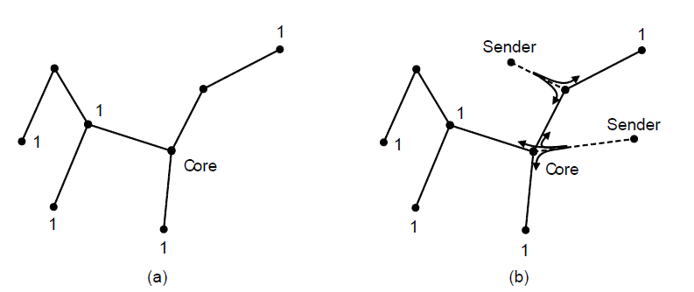
Multicast Routing (2)
Core-based tree for group 1.
Sending to group 1.

Slide 27
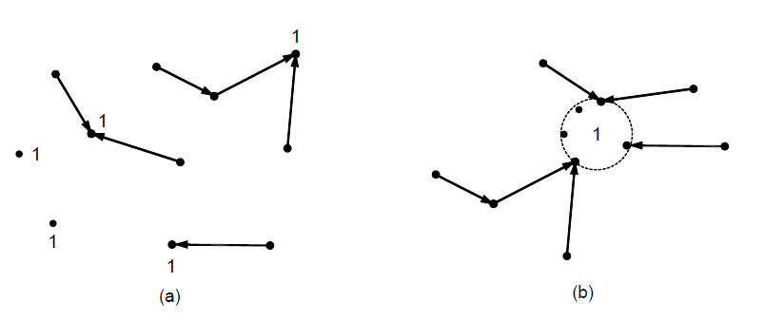
Anycast Routing
Anycast routes to group 1.
Topology seen by the routing protocol.

Slide 28
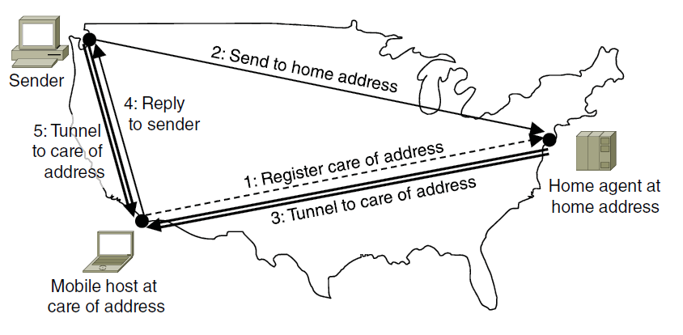
Routing for Mobile Hosts
Packet routing for mobile hosts

Slide 29
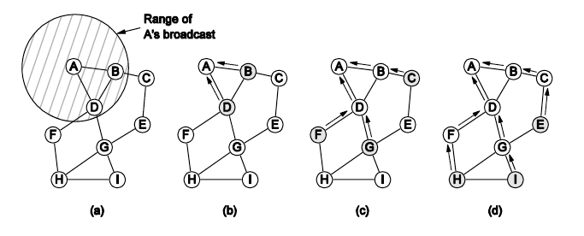
Routing in Ad Hoc Networks
The shaded nodes are new recipients. The dashed lines show possible reverse routes. The solid lines show the discovered route.
Range of A’s broadcast.
After B and D receive it.
After C, F, and G receive it.
After E, H, and I receive it.

Slide 30
Congestion Control Algorithms (1)
Approaches to congestion control
Traffic-aware routing
Admission control
Traffic throttling
Load shedding

Slide 31
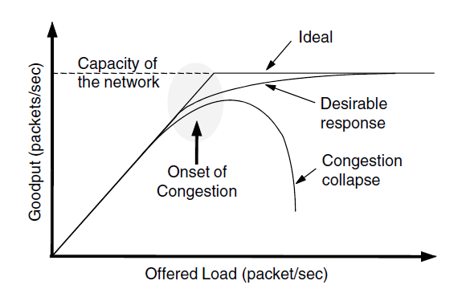
Congestion Control Algorithms (2)
When too much traffic is offered, congestion sets in and performance degrades sharply.

Slide 32
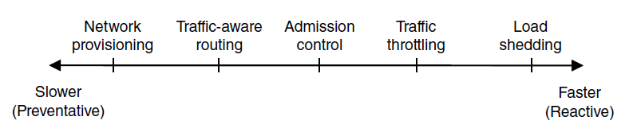
Approaches to Congestion Control
Timescales of approaches to congestion control

Slide 33
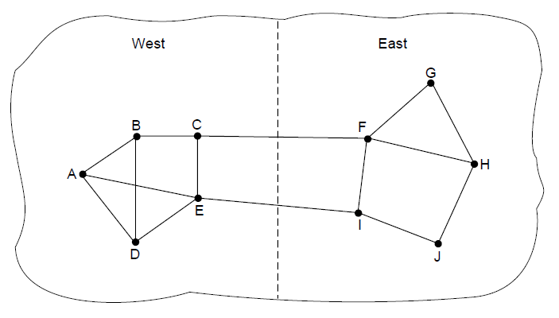
Traffic-Aware Routing
A network in which the East and West parts
are connected by two links.

Slide 34
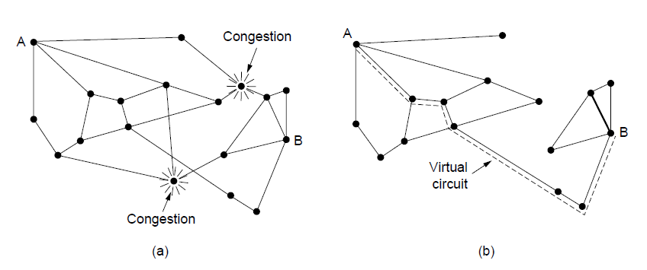
Traffic Throttling (1)
(a) A congested network. (b) The portion of the network that is not congested. A virtual circuit from A to B is also shown.

Slide 35
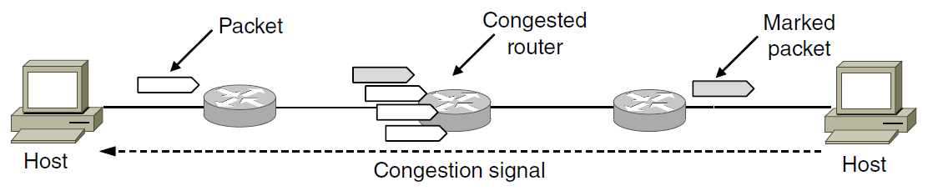
Traffic Throttling (2)
Explicit congestion notification

Slide 36
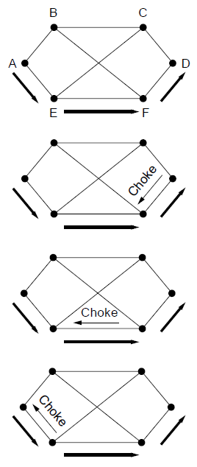
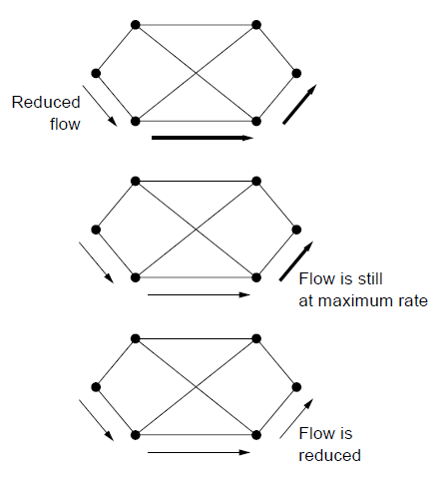
Load Shedding (1)
A choke packet that affects only the source..

Slide 37
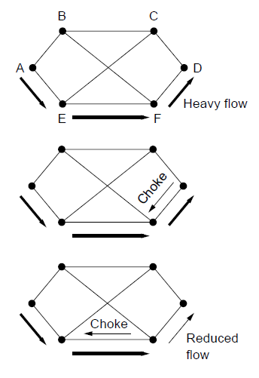
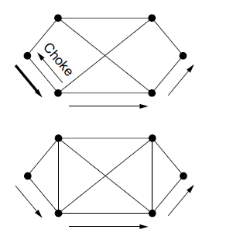
Load Shedding (2)
A choke packet that affects each hop it passes through.

Slide 38
Quality of Service
Application requirements
Traffic shaping
Packet scheduling
Admission control
Integrated services
Differentiated services

Slide 39
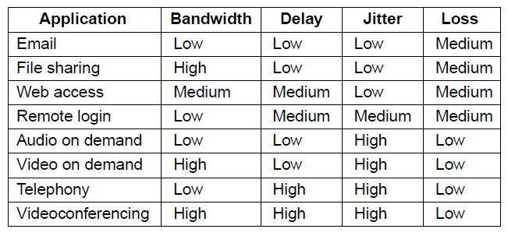
Application Requirements (1)
How stringent the quality-of-service requirements are.

Slide 40
Categories of QoS and Examples
Constant bit rate
  Telephony
Real-time variable bit rate
  Compressed videoconferencing
Non-real-time variable bit rate
  Watching a movie on demand
Available bit rate
  File transfer

Slide 41
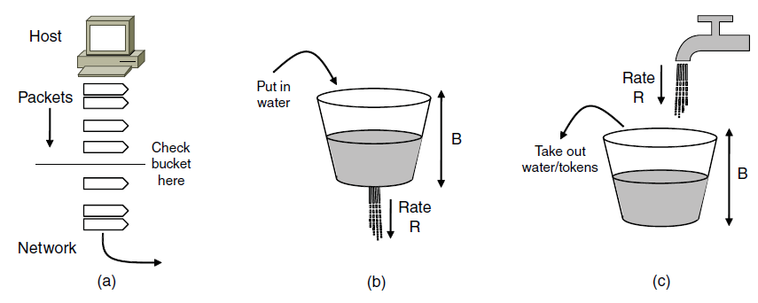
Traffic Shaping (1)
(a) Shaping packets. (b) A leaky bucket. (c) A token bucket

Slide 42
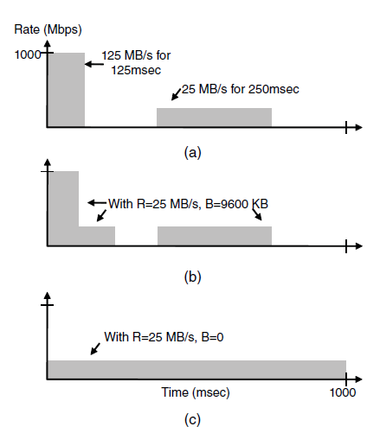
Traffic Shaping (2)
(a) Traffic from a host. Output shaped by a token bucket of rate 200 Mbps and capacity (b) 9600 KB, (c) 0 KB.

Slide 43
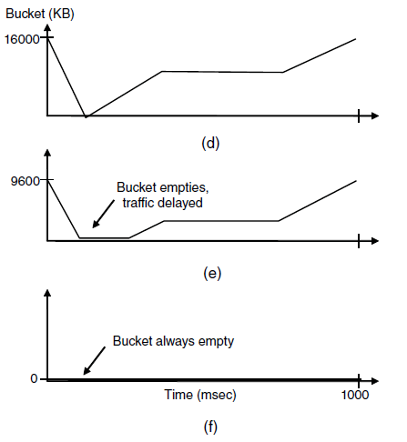
Traffic Shaping (3)
Token bucket level for shaping with rate 200 Mbps and capacity (d) 16000 KB, (e) 9600 KB, and (f) 0KB..

Slide 44
Packet Scheduling (1)
Kinds of resources can potentially be reserved for different flows:
Bandwidth.
Buffer space.
CPU cycles.

Slide 45
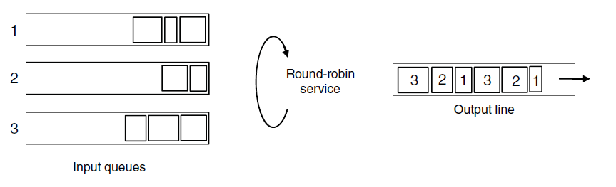
Packet Scheduling (2)
Round-robin Fair Queuing

Slide 46
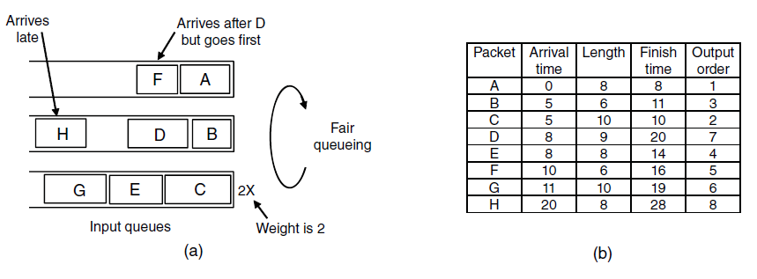
Packet Scheduling (3)
Weighted Fair Queueing.
Finishing times for the packets.

Slide 47
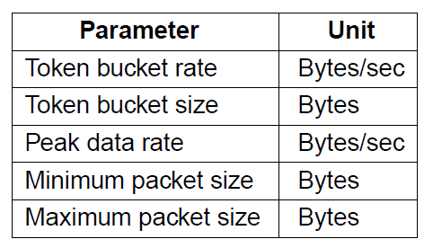
Admission Control (1)
An example flow specification

Slide 48
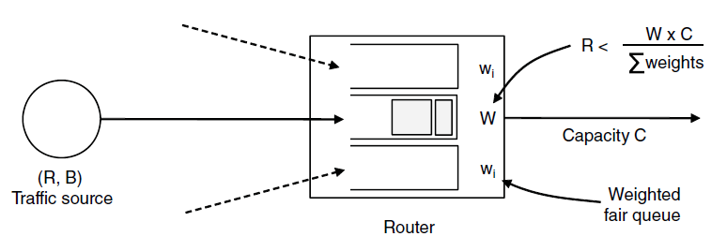
Admission Control (2)
Bandwidth and delay guarantees with token buckets and WFQ.

Slide 49
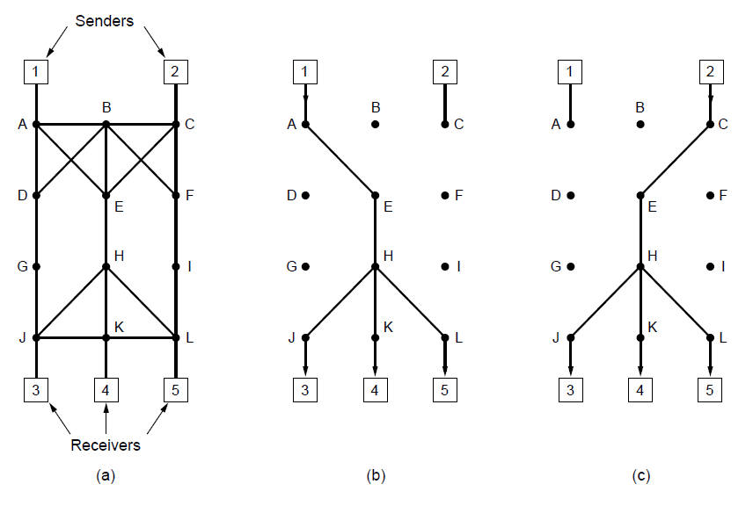
Integrated Services (1)
(a) A network. (b) The multicast spanning tree for host 1.
(c) The multicast spanning tree for host 2.

Slide 50
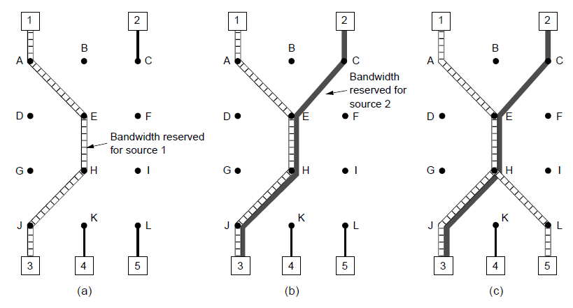
Integrated Services (2)
(a) Host 3 requests a channel to host 1. (b) Host 3 then requests a second channel, to host 2.
(c) Host 5 requests a channel to host 1.

Slide 51
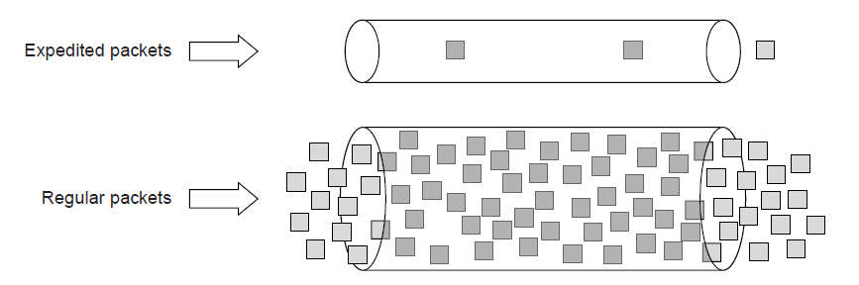
Differentiated Services (1)
Expedited packets experience a traffic-free network

Slide 52
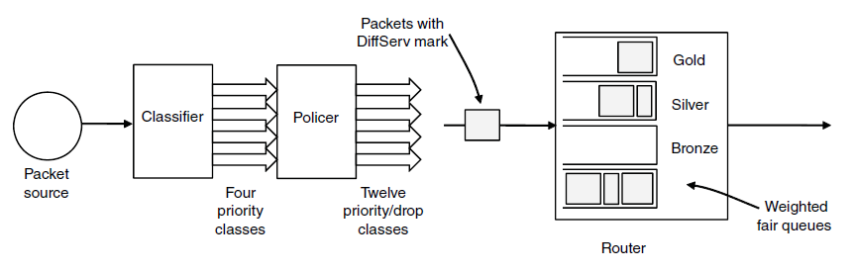
Differentiated Services (2)
A possible implementation of assured forwarding

Slide 53
Internetworking
How networks differ
How networks can be connected
Tunneling
Internetwork routing
Packet fragmentation

Slide 54
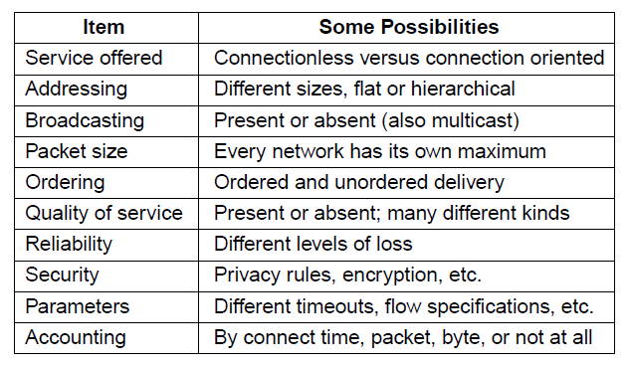
How Networks Differ
Some of the many ways networks can differ

Slide 55
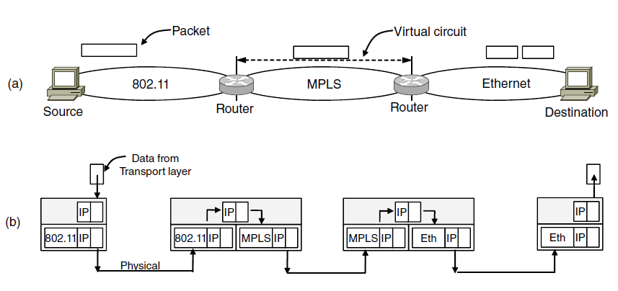
How Networks Can Be Connected
A packet crossing different networks.
Network and link layer protocol processing.

Slide 56
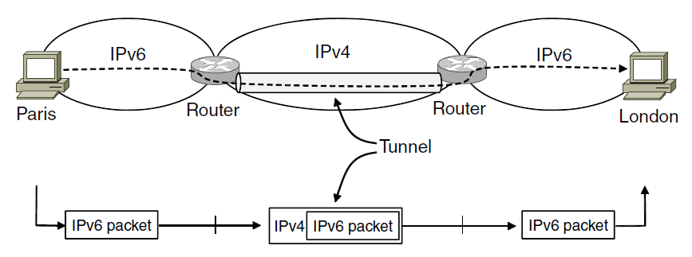
Tunneling (1)
Tunneling a packet from Paris to London.

Slide 57
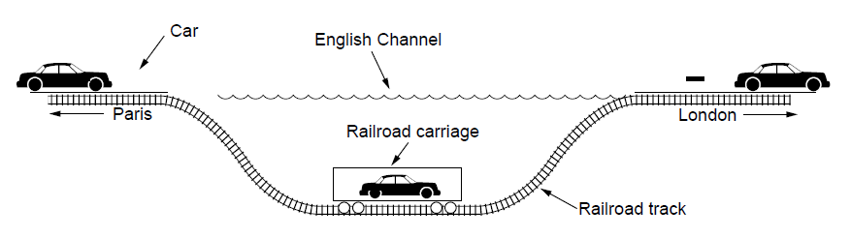
Tunneling (2)
Tunneling a car from France to England

Slide 58
Packet Fragmentation (1)
Packet size issues:
Hardware
Operating system
Protocols
Compliance with (inter)national standard.
Reduce error-induced retransmissions
Prevent packet occupying channel too long.

Slide 59
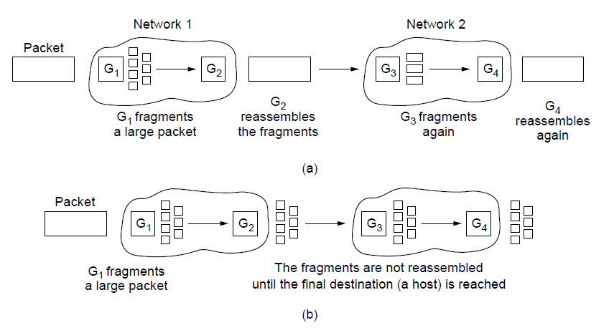
Packet Fragmentation (2)
Transparent fragmentation.
Nontransparent fragmentation

Slide 60

Packet Fragmentation (3)
Fragmentation when the elementary data size is 1 byte.
(a) Original packet, containing 10 data bytes.

Slide 61

Packet Fragmentation (4)
Fragmentation when the elementary data size is 1 byte
(b) Fragments after passing through a network
with maximum packet size of 8 payload bytes plus header.

Slide 62



Packet Fragmentation (5)
Fragmentation when the elementary data size is 1 byte
(c) Fragments after passing through a size 5 gateway.

Slide 63

Packet Fragmentation (6)
Path MTU Discovery

Slide 64
The Network Layer Principles (1)
Make sure it works
Keep it simple
Make clear choices
Exploit modularity
Expect heterogeneity
. . .

Slide 65
The Network Layer Principles (2)
. . .
Avoid static options and parameters
Look for good design (not perfect)
Strict sending, tolerant receiving
Think about scalability
Consider performance and cost

Slide 66
The Network Layer in the Internet (1)
The IP Version 4 Protocol
IP Addresses
IP Version 6
Internet Control Protocols
Label Switching and MPLS
OSPF—An Interior Gateway Routing Protocol
BGP—The Exterior Gateway Routing Protocol
Internet Multicasting
Mobile IP

Slide 67

The Network Layer in the Internet (2)
The Internet is an interconnected collection of many networks.

Slide 68

The IP Version 4 Protocol (1)
The IPv4 (Internet Protocol) header.

Slide 69

The IP Version 4 Protocol (2)
Some of the IP options.

Slide 70

IP Addresses (1)
An IP prefix.

Slide 71

IP Addresses (2)
Splitting an IP prefix into separate networks with subnetting.

Slide 72

IP Addresses (3)
A set of IP address assignments

Slide 73

IP Addresses (4)
Aggregation of IP prefixes

Slide 74

IP Addresses (5)
Longest matching prefix routing at the New York router.

Slide 75

IP Addresses (6)
IP address formats

Slide 76

IP Addresses (7)
Special IP addresses

Slide 77

IP Addresses (8)
Placement and operation of a NAT box.

Slide 78
IP Version 6 Goals
Support billions of hosts
Reduce routing table size
Simplify protocol
Better security
Attention to type of service
Aid multicasting
Roaming host without changing address
Allow future protocol evolution
Permit coexistence of old, new protocols. . .

Slide 79

IP Version 6 (1)
The IPv6 fixed header (required).

Slide 80

IP Version 6 (2)
IPv6 extension headers

Slide 81

IP Version 6 (3)
The hop-by-hop extension header for
large datagrams (jumbograms).

Slide 82

IP Version 6 (4)
The extension header for routing.

Slide 83

Internet Control Protocols (1)
The principal ICMP message types.

Slide 84

Internet Control Protocols (2)
Two switched Ethernet LANs joined by a router

Slide 85

Label Switching and MPLS (1)
Transmitting a TCP segment using IP, MPLS, and PPP.

Slide 86

Label Switching and MPLS (2)
Forwarding an IP packet through an MPLS network

Slide 87

OSPF—An Interior Gateway
Routing Protocol (1)
An autonomous system

Slide 88

OSPF—An Interior Gateway
Routing Protocol (2)
A graph representation of the previous slide.

Slide 89

OSPF—An Interior Gateway
Routing Protocol (3)
The relation between ASes, backbones, and areas in OSPF.

Slide 90

OSPF—An Interior Gateway
Routing Protocol (4)
The five types of OSPF messages

Slide 91
BGP—The Exterior Gateway
Routing Protocol (1)
Examples of routing constraints:
No commercial traffic for educat. network
Never put Iraq on route starting at Pentagon
Choose cheaper network
Choose better performing network
Don’t go from Apple to Google to Apple

Slide 92

BGP—The Exterior Gateway
Routing Protocol (2)
Routing policies between four Autonomous Systems

Slide 93

BGP—The Exterior Gateway
Routing Protocol (3)
Propagation of BGP route advertisements

Slide 94
Mobile IP
Goals
Mobile host use home IP address anywhere.
No software changes to fixed hosts
No changes to router software, tables
Packets for mobile hosts – restrict detours
No overhead for mobile host at home.

Slide 95
End
Chapter 5

