Slide 1
Digital Image Processing
Chapter 2:
Digital Image Fundamental
6 June 2007

Slide 2
What is Digital Image Processing ?
Processing of a multidimensional pictures by a digital computer
การประมวลผลสัญญาณรูปภาพโดยใช้ดิจิตอลคอมพิวเตอร์
Why we need Digital Image Processing ?
เพื่อบันทึกและจัดเก็บภาพ
เพื่อปรับปรุงภาพให้ดีขึ้นโดยใช้กระบวนการทางคณิตศาสตร์
เพื่อช่วยในการวิเคราะห์รูปภาพ
เพื่อสังเคราะห์ภาพ
เพื่อสร้างระบบการมองเห็นให้กับคอมพิวเตอร์

Slide 3

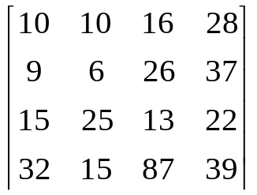
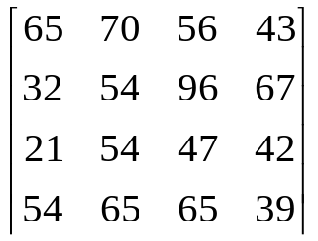
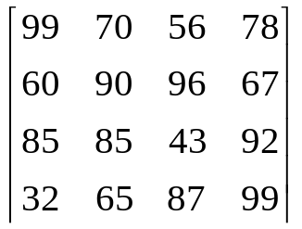
Digital Image
Digital image = a multidimensional
array of numbers (such as intensity image)
or vectors (such as color image)
Each component in the image
called pixel associates with
the pixel value (a single number in
the case of intensity images or a
vector in the case of color images).

Slide 4
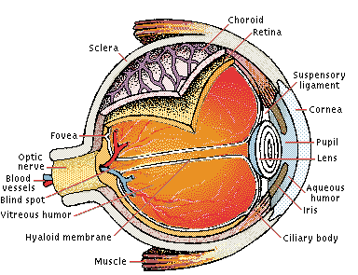
Visual Perception: Human Eye
(Picture from Microsoft Encarta 2000)

Slide 5
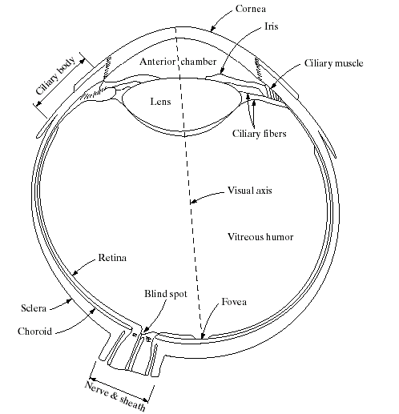
Cross Section of the Human Eye
(Images from Rafael C. Gonzalez and Richard E.
Wood, Digital Image Processing, 2nd Edition.

Slide 6
Visual Perception: Human Eye (cont.)
The lens contains 60-70% water, 6% of fat.
The iris diaphragm controls amount of light that enters the eye.
Light receptors in the retina
- About 6-7 millions cones for bright light vision called photopic
  - Density of cones is about 150,000 elements/mm².
  - Cones involve in color vision.
  - Cones are concentrated in fovea about 1.5x1.5 mm².
  - About 75-150 millions rods for dim light vision called scotopic
  - Rods are sensitive to low level of light and are not involved
  color vision.
4. Blind spot is the region of emergence of the optic nerve from the eye.

Slide 7
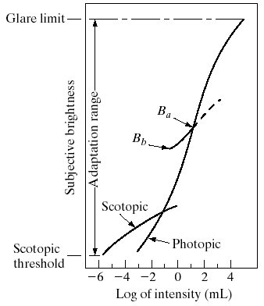
Range of Relative Brightness Sensation
Simutaneous range is smaller than
Total adaptation range
(Images from Rafael C. Gonzalez and Richard E.
Wood, Digital Image Processing, 2nd Edition.

Slide 8
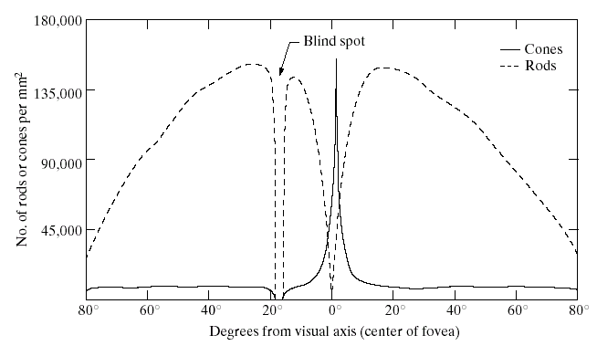
Distribution of Rods and Cones in the Retina
(Images from Rafael C. Gonzalez and Richard E.
Wood, Digital Image Processing, 2nd Edition.

Slide 9
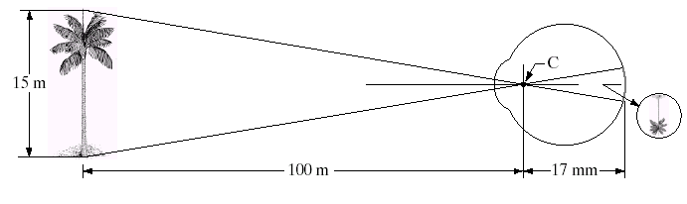
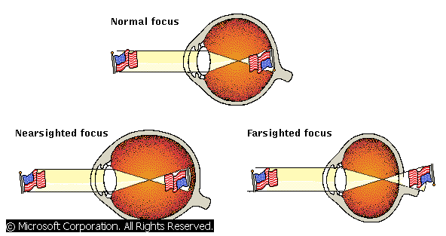
Image Formation in the Human Eye
(Images from Rafael C. Gonzalez and Richard E.
Wood, Digital Image Processing, 2nd Edition.
(Picture from Microsoft Encarta 2000)

Slide 10

Brightness Adaptation of Human Eye : Mach Band Effect
Intensity
Position

Slide 11
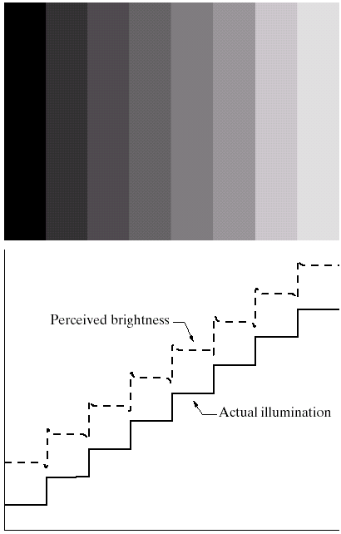
Mach Band Effect
Intensities of surrounding points effect perceived brightness at each point.
In this image, edges between bars appear brighter on the right side and darker on the left side.
(Images from Rafael C. Gonzalez and Richard E.
Wood, Digital Image Processing, 2nd Edition.

Slide 12

Mach Band Effect (Cont)
A
B
Intensity
Position
In area A, brightness perceived is darker while in area B is
brighter. This phenomenon is called Mach Band Effect.

Slide 13




Brightness Adaptation of Human Eye : Simultaneous Contrast
Simultaneous contrast. All small squares have exactly the same intensity
but they appear progressively darker as background becomes lighter.

Slide 14
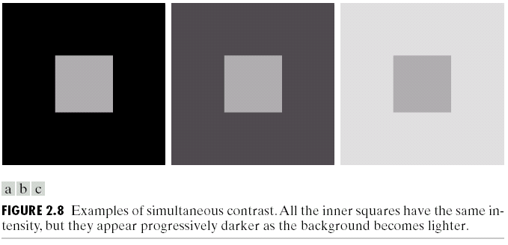
Simultaneous Contrast
(Images from Rafael C. Gonzalez and Richard E.
Wood, Digital Image Processing, 2nd Edition.

Slide 15
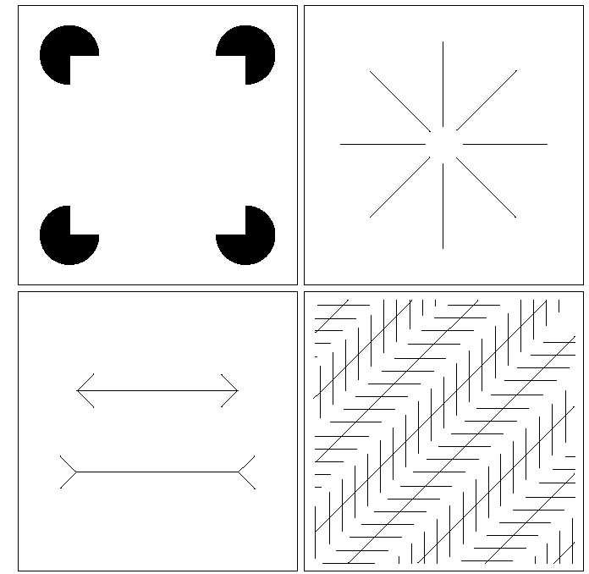
Optical illusion
(Images from Rafael C. Gonzalez and Richard E.
Wood, Digital Image Processing, 2nd Edition.

Slide 16
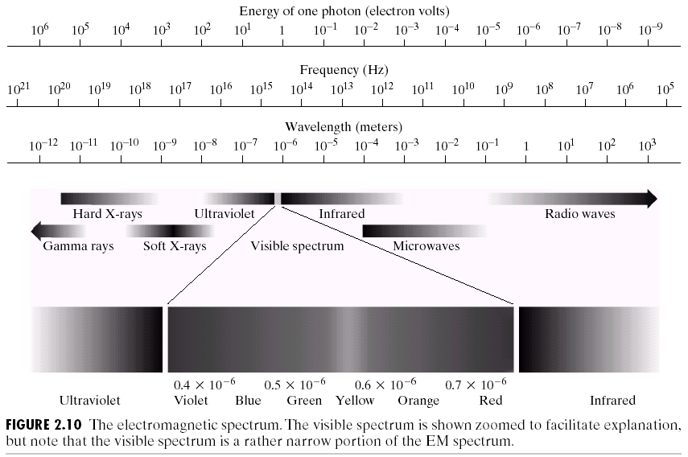
Visible Spectrum
(Images from Rafael C. Gonzalez and Richard E.
Wood, Digital Image Processing, 2nd Edition.

Slide 17
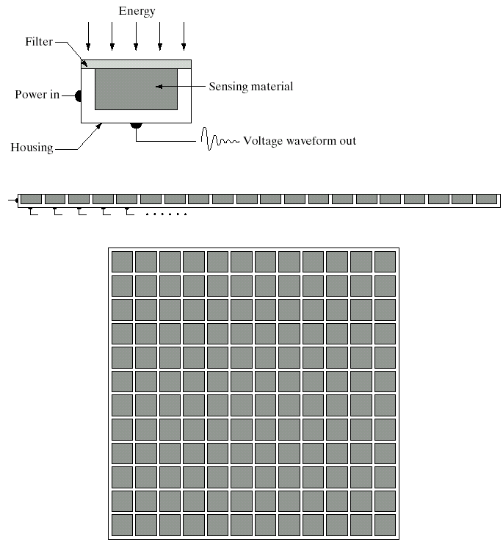
Image Sensors
Single sensor
Line sensor
Array sensor
(Images from Rafael C. Gonzalez and Richard E.
Wood, Digital Image Processing, 2nd Edition.

Slide 18
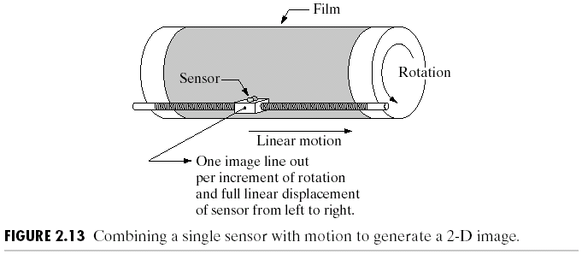
Image Sensors : Single Sensor
(Images from Rafael C. Gonzalez and Richard E.
Wood, Digital Image Processing, 2nd Edition.

Slide 19
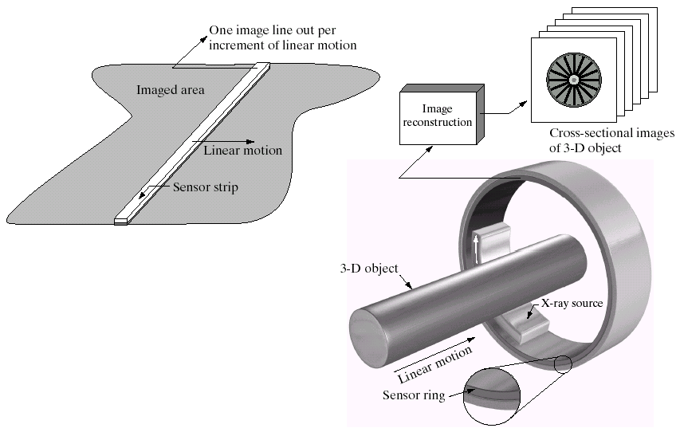
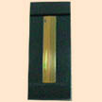
Image Sensors : Line Sensor
Fingerprint sweep sensor
Computerized Axial Tomography
(Images from Rafael C. Gonzalez and Richard E.
Wood, Digital Image Processing, 2nd Edition.

Slide 20
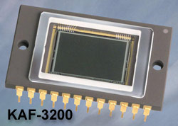
Image Sensors : Array Sensor
Charge-Coupled Device (CCD)
⬥ Used for convert a continuous
image into a digital image
⬥ Contains an array of light sensors
⬥ Converts photon into electric charges
accumulated in each sensor unit
CCD KAF-3200E from Kodak.
(2184 x 1472 pixels,
Pixel size 6.8 microns²)

Slide 21
Image Sensor: Inside Charge-Coupled Device
Horizontal Transportation Register
Output Gate
Vertical Transport Register
Vertical Transport Register
Gate
Gate
Vertical Transport Register
Gate
Amplifier
Photosites
Output

Slide 22
Image Sensor: How CCD works
i
h
g
Image pixel
f
e
d
c
b
a
i
h
g
f
e
d
i
h
g
Horizontal transport
register
c
b
a
f
e
d
Vertical shift
c
b
a
Output
Horizontal shift

Slide 23
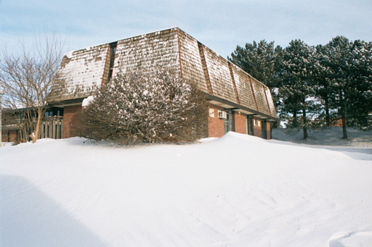
Fundamentals of Digital Images
x
Origin
y
Image “After snow storm”
f(x,y)
⬥ An image: a multidimensional function of spatial coordinates.
⬥ Spatial coordinate: (x,y) for 2D case such as photograph,
(x,y,z) for 3D case such as CT scan images
(x,y,t) for movies
⬥ The function f may represent intensity (for monochrome images)
or color (for color images) or other associated values.

Slide 24
Digital Images
Digital image: an image that has been discretized both in
Spatial coordinates and associated value.
 Consist of 2 sets:(1) a point set and (2) a value set
 Can be represented in the form
I = {(x,a(x)): x ∈X, a(x) ∈ F}
where X and F are a point set and value set, respectively.
 An element of the image, (x,a(x)) is called a pixel where
- x is called the pixel location and
- a(x) is the pixel value at the location x

Slide 25
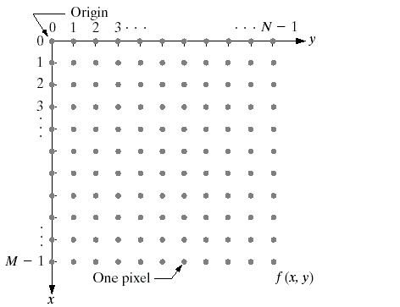
Conventional Coordinate for Image Representation
(Images from Rafael C. Gonzalez and Richard E.
Wood, Digital Image Processing, 2nd Edition.

Slide 26
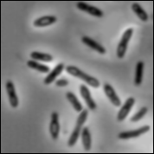
Digital Image Types : Intensity Image
Intensity image or monochrome image
each pixel corresponds to light intensity
normally represented in gray scale (gray
level).
Gray scale values

Slide 27
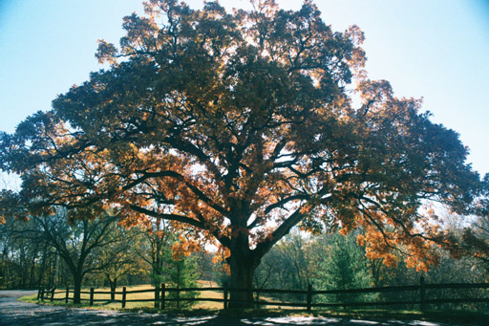
Digital Image Types : RGB Image
Color image or RGB image:
each pixel contains a vector
representing red, green and
blue components.
RGB components

Slide 28

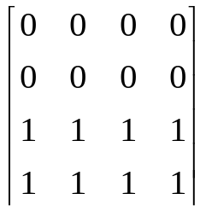
Image Types : Binary Image
Binary image or black and white image
Each pixel contains one bit :
1 represent white
0 represents black
Binary data

Slide 29
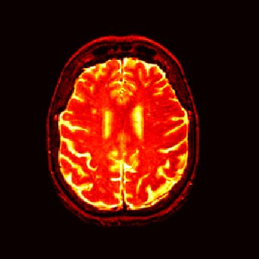
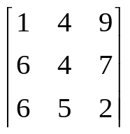
Image Types : Index Image
Index image
Each pixel contains index number
pointing to a color in a color table
Color Table
Index No. | Red component | Green component | Blue component
1 | 0.1 | 0.5 | 0.3
2 | 1.0 | 0.0 | 0.0
3 | 0.0 | 1.0 | 0.0
4 | 0.5 | 0.5 | 0.5
5 | 0.2 | 0.8 | 0.9
… | … | … | …
Index value

Slide 30

Digital Image Acquisition Process
(Images from Rafael C. Gonzalez and Richard E.
Wood, Digital Image Processing, 2nd Edition.

Slide 31

Generating a Digital Image
(Images from Rafael C. Gonzalez and Richard E.
Wood, Digital Image Processing, 2nd Edition.

Slide 32

Image Sampling and Quantization
Image sampling: discretize an image in the spatial domain
Spatial resolution / image resolution: pixel size or number of pixels
(Images from Rafael C. Gonzalez and Richard E.
Wood, Digital Image Processing, 2nd Edition.

Slide 33
How to choose the spatial resolution
Spatial resolution
= Sampling locations
Original image
Sampled image
Under sampling, we lost some image details!

Slide 34
How to choose the spatial resolution : Nyquist Rate
Sampled image
Original image
2mm
1mm
No detail is lost!
Minimum
Period
Nyquist Rate:
Spatial resolution must be less or equal
half of the minimum period of the image
or sampling frequency must be greater or
Equal twice of the maximum frequency.
Spatial resolution
(sampling rate)
= Sampling locations

Slide 35

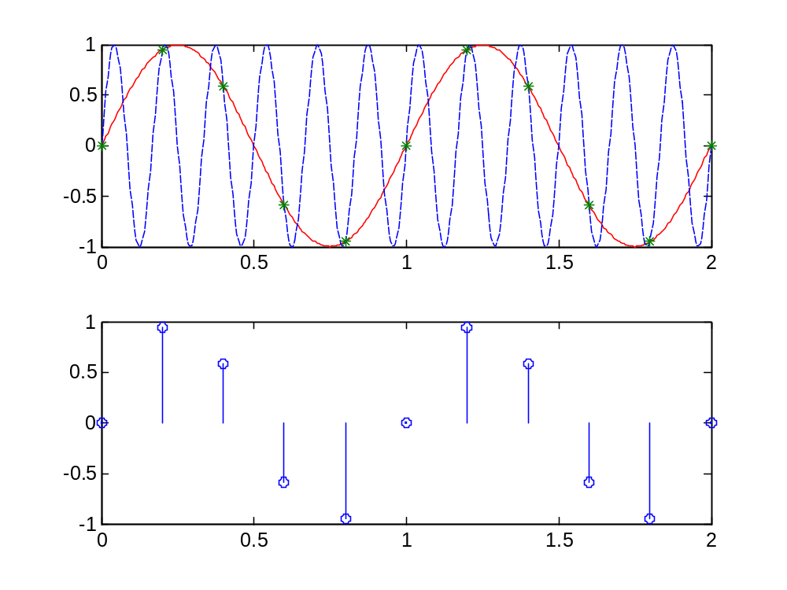

Aliased Frequency
Sampling rate:
5 samples/sec
Two different frequencies but the same results !

Slide 36
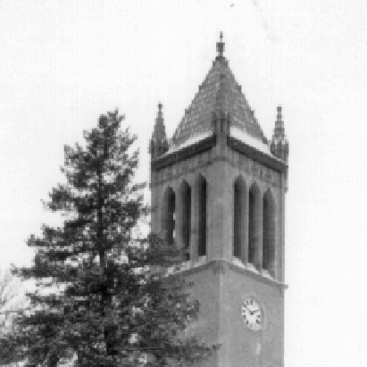
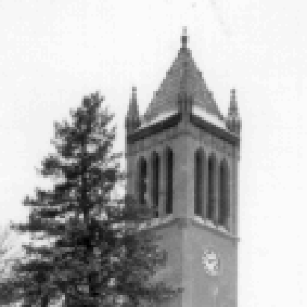

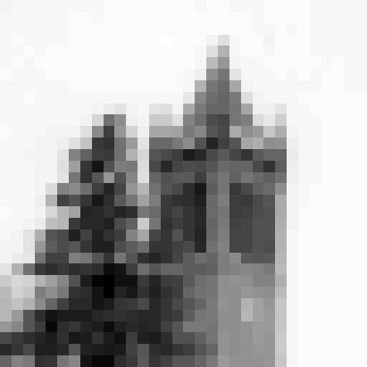
Effect of Spatial Resolution
256x256 pixels
128x128 pixels
64x64 pixels
32x32 pixels

Slide 37
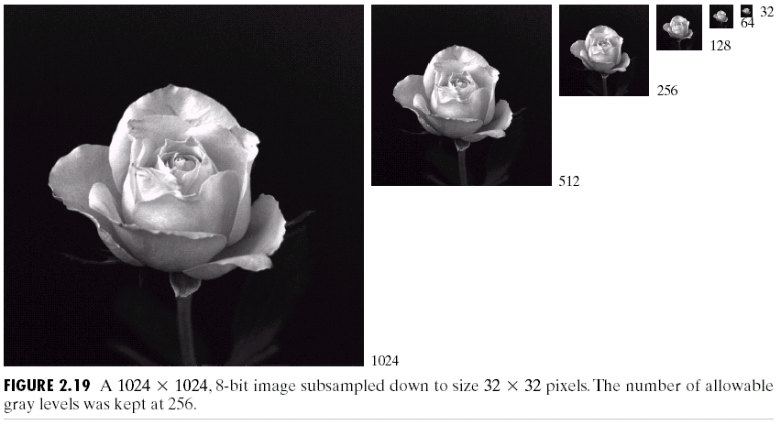
Effect of Spatial Resolution
(Images from Rafael C. Gonzalez and Richard E.
Wood, Digital Image Processing, 2nd Edition.

Slide 38
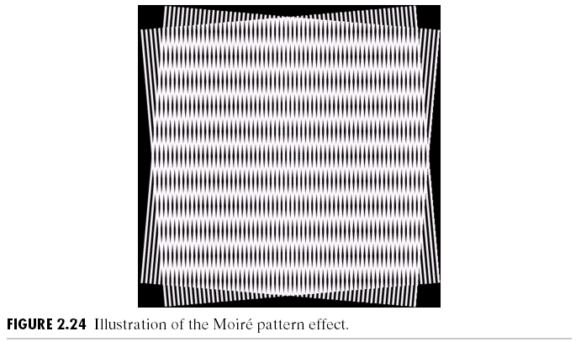
Moire Pattern Effect : Special Case of Sampling
Moire patterns occur when frequencies of two superimposed
periodic patterns are close to each other.
(Images from Rafael C. Gonzalez and Richard E.
Wood, Digital Image Processing, 2nd Edition.

Slide 39
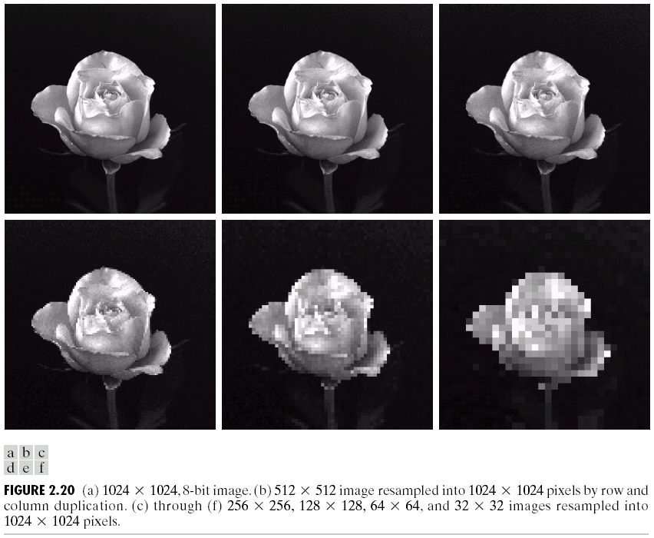
Effect of Spatial Resolution
(Images from Rafael C. Gonzalez and Richard E.
Wood, Digital Image Processing, 2nd Edition.

Slide 40
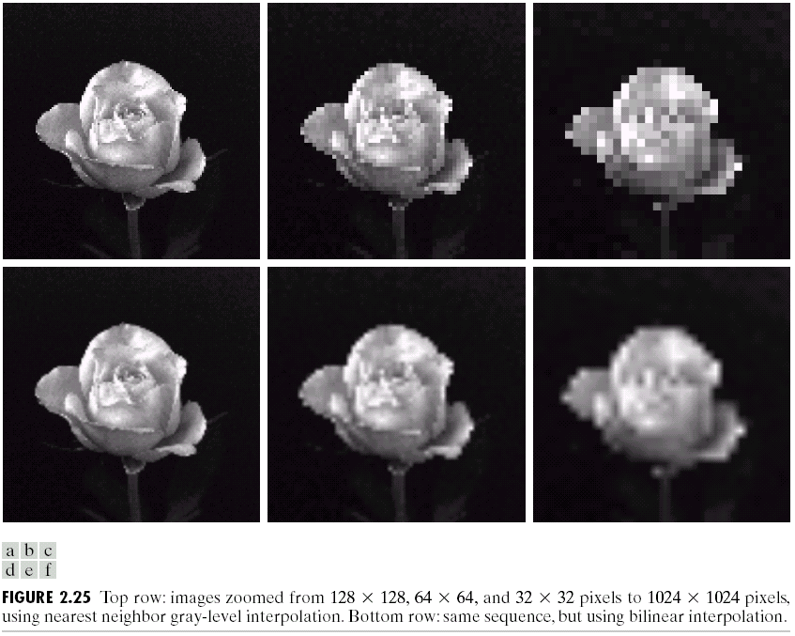
Can we increase spatial resolution by interpolation ?
Down sampling is an irreversible process.
(Images from Rafael C. Gonzalez and Richard E.
Wood, Digital Image Processing, 2nd Edition.

Slide 41
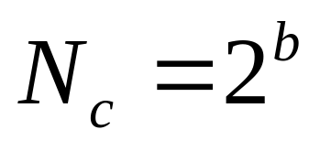
Image Quantization
Image quantization:
discretize continuous pixel values into discrete numbers
Color resolution/ color depth/ levels:
- No. of colors or gray levels or
- No. of bits representing each pixel value
- No. of colors or gray levels N_{c} is given by
where b = no. of bits

Slide 42
Quantization function
N_{c}-1
N_{c}-2
Quantization level
2
1
0
Light intensity
Darkest
Brightest

Slide 43



Effect of Quantization Levels
256 levels
128 levels
64 levels
32 levels

Slide 44


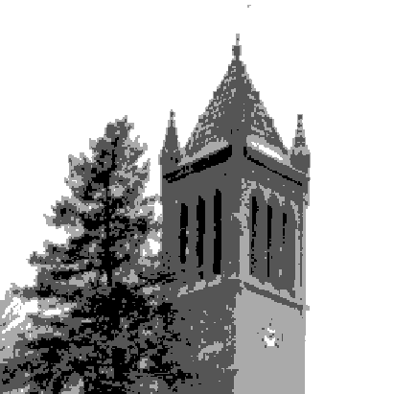

Effect of Quantization Levels (cont.)
16 levels
8 levels
In this image,
it is easy to see
false contour.
4 levels
2 levels

Slide 45
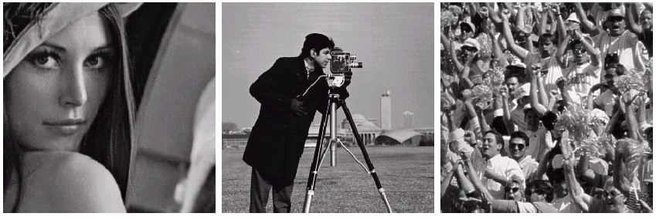
How to select the suitable size and pixel depth of images
The word “suitable” is subjective: depending on “subject”.
Low detail image
Medium detail image
High detail image
Lena image
Cameraman image
To satisfy human mind
1. For images of the same size, the low detail image may need more pixel depth.
2. As an image size increase, fewer gray levels may be needed.
(Images from Rafael C. Gonzalez and Richard E.
Wood, Digital Image Processing, 2nd Edition.

Slide 46
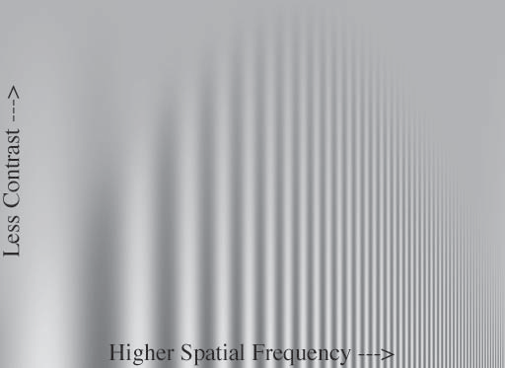
Human vision: Spatial Frequency vs Contrast

Slide 47



Human vision: Distinguish ability for Difference in brightness
Regions with 5% brightness difference

Slide 48
Basic Relationship of Pixels
(0,0)
x
(x-1,y-1)
(x,y-1)
(x+1,y-1)
(x-1,y)
(x,y)
(x+1,y)
y
(x-1,y+1)
(x,y+1)
(x+1,y+1)
Conventional indexing method

Slide 49
Neighbors of a Pixel
Neighborhood relation is used to tell adjacent pixels. It is
useful for analyzing regions.
4-neighbors of p:
(x,y-1)
(x−1,y)
(x+1,y)
(x,y−1)
(x,y+1)
(x-1,y)
p
(x+1,y)
N₄(p) =
(x,y+1)
4-neighborhood relation considers only vertical and
horizontal neighbors.
Note: q ∈ N₄(p) implies p ∈ N₄(q)

Slide 50
Neighbors of a Pixel (cont.)
8-neighbors of p:
(x-1,y-1)
(x,y-1)
(x+1,y-1)
(x−1,y−1)
(x,y−1)
(x+1,y−1)
(x−1,y)
(x+1,y)
(x−1,y+1)
(x,y+1)
(x+1,y+1)
(x-1,y)
p
(x+1,y)
(x-1,y+1)
(x,y+1)
(x+1,y+1)
N₈(p) =
8-neighborhood relation considers all neighbor pixels.

Slide 51
Neighbors of a Pixel (cont.)
Diagonal neighbors of p:
(x-1,y-1)
(x+1,y-1)
(x−1,y−1)
(x+1,y−1)
(x−1,y+1)
(x+1,y+1)
p
N_{D}(p) =
(x-1,y+1)
(x+1,y+1)
Diagonal -neighborhood relation considers only diagonal
neighbor pixels.

Slide 52
Connectivity
Connectivity is adapted from neighborhood relation.
Two pixels are connected if they are in the same class (i.e. the
same color or the same range of intensity) and they are
neighbors of one another.
For p and q from the same class
⬥ 4-connectivity: p and q are 4-connected if q ∈ N₄(p)
⬥ 8-connectivity: p and q are 8-connected if q ∈ N₈(p)
⬥ mixed-connectivity (m-connectivity):
p and q are m-connected if q ∈ N₄(p) or
q ∈ N_{D}(p) and N₄(p) ∩ N₄(q) = ∅

Slide 53
Adjacency
A pixel p is adjacent to pixel q is they are connected.
Two image subsets S₁ and S₂ are adjacent if some pixel
in S₁ is adjacent to some pixel in S₂
S₁
S₂
We can define type of adjacency: 4-adjacency, 8-adjacency
or m-adjacency depending on type of connectivity.

Slide 54
Path
A path from pixel p at (x,y) to pixel q at (s,t) is a sequence
of distinct pixels:
(x₀,y₀), (x₁,y₁), (x₂,y₂),…, (x_{n},y_{n})
such that
(x₀,y₀) = (x,y) and (x_{n},y_{n}) = (s,t)
and
(x_{i},y_{i}) is adjacent to (x_{i-1},y_{i-1}), i = 1,…,n
q
p
We can define type of path: 4-path, 8-path or m-path
depending on type of adjacency.

Slide 55
Path (cont.)
8-path
m-path
p
p
p
q
q
q
m-path from p to q
solves this ambiguity
8-path from p to q
results in some ambiguity

Slide 56
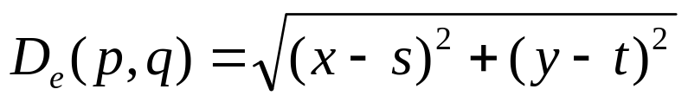
Distance
For pixel p, q, and z with coordinates (x,y), (s,t) and (u,v),
D is a distance function or metric if
⬥ D(p,q) ≥ 0 (D(p,q) = 0 if and only if p = q)
⬥ D(p,q) = D(q,p)
⬥ D(p,z) ≤ D(p,q) + D(q,z)
Example: Euclidean distance

Slide 57
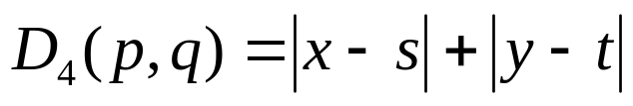
Distance (cont.)
D₄-distance (city-block distance) is defined as
2
2
1
2
2
1
0
1
2
2
1
2
2
Pixels with D₄(p) = 1 is 4-neighbors of p.

Slide 58
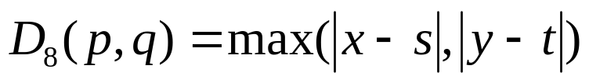
Distance (cont.)
D₈-distance (chessboard distance) is defined as
2
2
2
2
2
2
1
1
1
2
2
1
0
1
2
2
1
1
1
2
2
2
2
2
2
Pixels with D₈(p) = 1 is 8-neighbors of p.

