Slide 1
Chapter 4
Image Enhancement in the
Frequency Domain

Slide 2
Background
Any function that periodically repeats itself can be expressed as the sum of sines and/or cosines of different frequencies, each multiplied by a different coefficient (Fourier series).
Even functions that are not periodic (but whose area under the curve is finite) can be expressed as the integral of sines and/or cosines multiplied by a weighting function (Fourier transform).

Slide 3
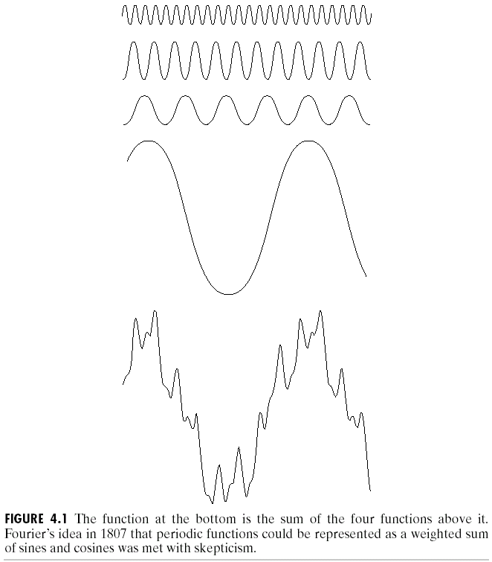
Background
The frequency domain refers to the plane of the two dimensional discrete Fourier transform of an image.
The purpose of the Fourier transform is to represent a signal as a linear combination of sinusoidal signals of various frequencies.

Slide 4
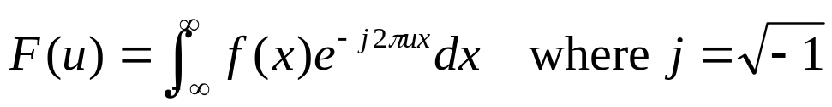

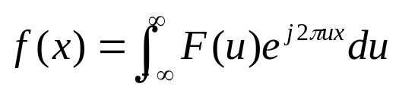
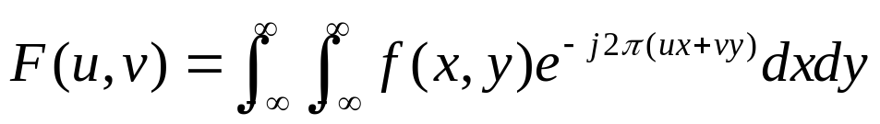
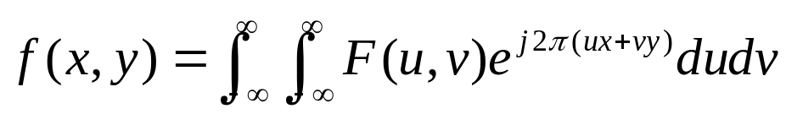
Introduction to the Fourier Transform
and the Frequency Domain
The one-dimensional Fourier transform and its inverse
  Fourier transform (continuous case)
  Inverse Fourier transform:
The two-dimensional Fourier transform and its inverse
  Fourier transform (continuous case)
  Inverse Fourier transform:

Slide 5
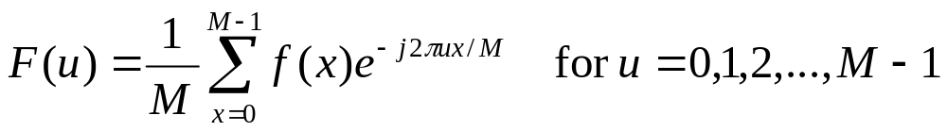
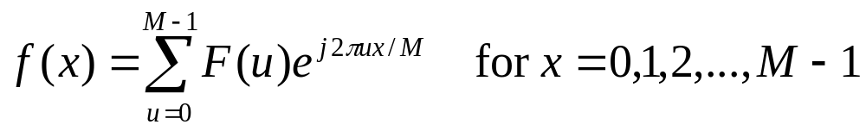
Introduction to the Fourier Transform
and the Frequency Domain
The one-dimensional Fourier transform and its inverse
  Fourier transform (discrete case) DTC
  Inverse Fourier transform:

Slide 6

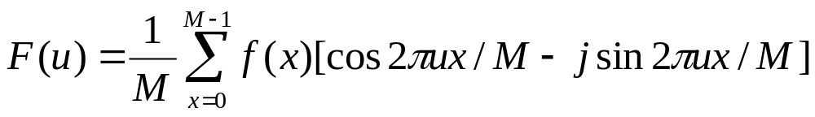

Introduction to the Fourier Transform
and the Frequency Domain
Since and the fact
  then discrete Fourier transform can be redefined
  Frequency (time) domain: the domain (values of u) over which the values of F(u) range; because u determines the frequency of the components of the transform.
  Frequency (time) component: each of the M terms of F(u).

Slide 7
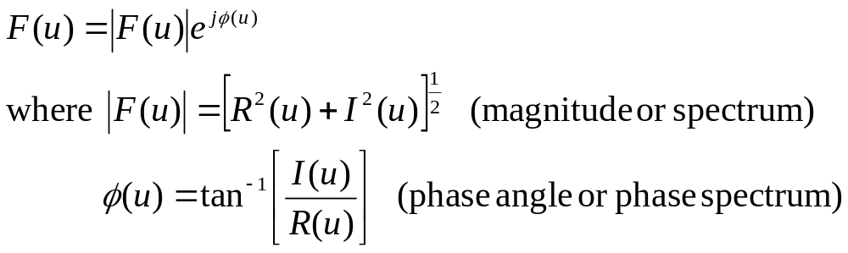
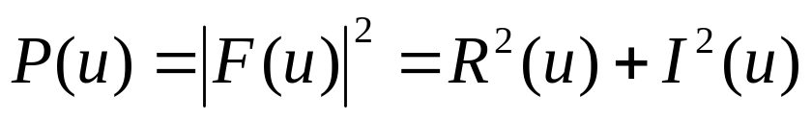
Introduction to the Fourier Transform
and the Frequency Domain
F(u) can be expressed in polar coordinates:
  R(u): the real part of F(u)
  I(u): the imaginary part of F(u)
Power spectrum:

Slide 8
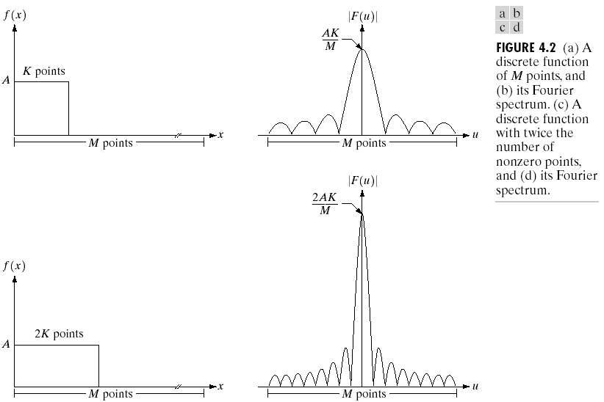
The One-Dimensional Fourier Transform
Example

Slide 9


The One-Dimensional Fourier Transform
Some Examples
The transform of a constant function is a DC value only.
The transform of a delta function is a constant.

Slide 10


The One-Dimensional Fourier Transform
Some Examples
The transform of an infinite train of delta functions spaced by T is an infinite train of delta functions spaced by 1/T.
The transform of a cosine function is a positive delta at the appropriate positive and negative frequency.

Slide 11


The One-Dimensional Fourier Transform
Some Examples
The transform of a sin function is a negative complex delta function at the appropriate positive frequency and a negative complex delta at the appropriate negative frequency.
The transform of a square pulse is a sinc function.

Slide 12
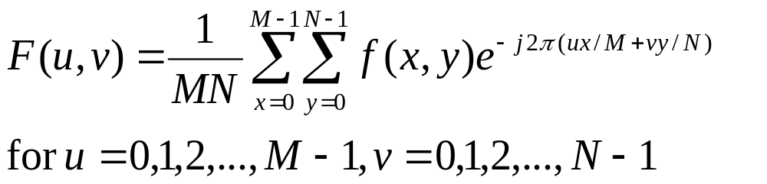
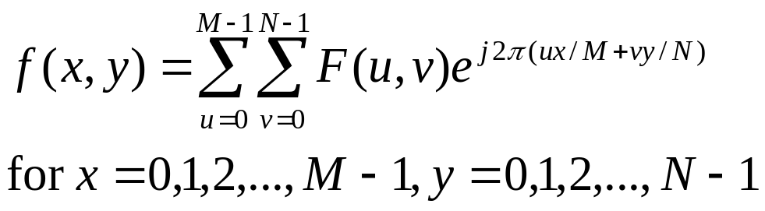
Introduction to the Fourier Transform
and the Frequency Domain
The two-dimensional Fourier transform and its inverse
  Fourier transform (discrete case) DTC
  Inverse Fourier transform:
    u, v : the transform or frequency variables
    x, y : the spatial or image variables

Slide 13
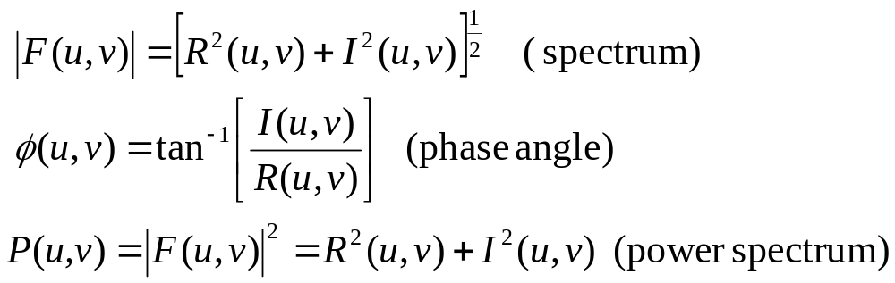
Introduction to the Fourier Transform
and the Frequency Domain
We define the Fourier spectrum, phase anble, and power spectrum as follows:
  R(u,v): the real part of F(u,v)
  I(u,v): the imaginary part of F(u,v)

Slide 14
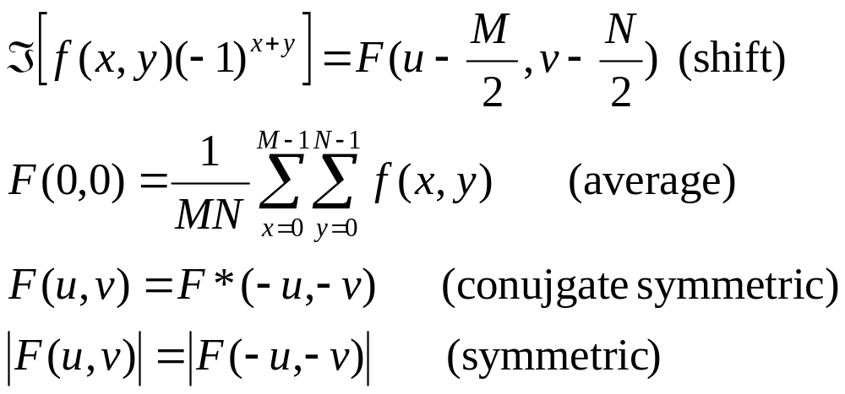
Introduction to the Fourier Transform
and the Frequency Domain
Some properties of Fourier transform:

Slide 15

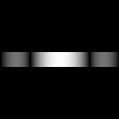
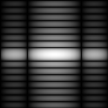
The Two-Dimensional DFT and Its Inverse
The 2D DFT F(u,v) can be obtained by
taking the 1D DFT of every row of image f(x,y), F(u,y),
taking the 1D DFT of every column of F(u,y)
(a)f(x,y) (b)F(u,y) (c)F(u,v)

Slide 16
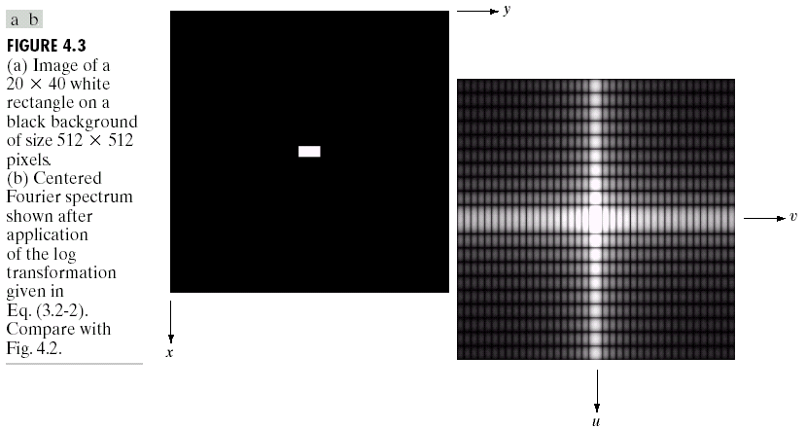
The Two-Dimensional DFT and Its Inverse
shift

Slide 17
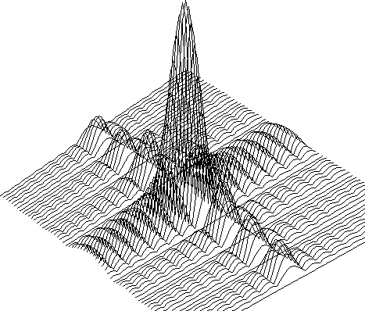
The Two-Dimensional DFT and Its Inverse

Slide 18

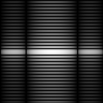

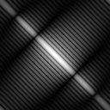
The Property of Two-Dimensional DFT
Rotation
DFT
DFT

Slide 19

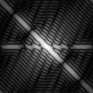
The Property of Two-Dimensional DFT
Linear Combination
A
DFT
B
DFT
0.25 * A
+ 0.75 * B
DFT

Slide 20


The Property of Two-Dimensional DFT
Expansion
A
DFT
B
DFT
Expanding the original image by a factor of n (n=2), filling the empty new values with zeros, results in the same DFT.

Slide 21

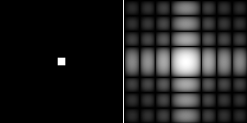
Two-Dimensional DFT with Different Functions
Sine wave
Its DFT
Rectangle
Its DFT

Slide 22

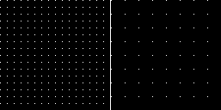
Two-Dimensional DFT with Different Functions
2D Gaussian
function
Its DFT
Impulses
Its DFT

Slide 23
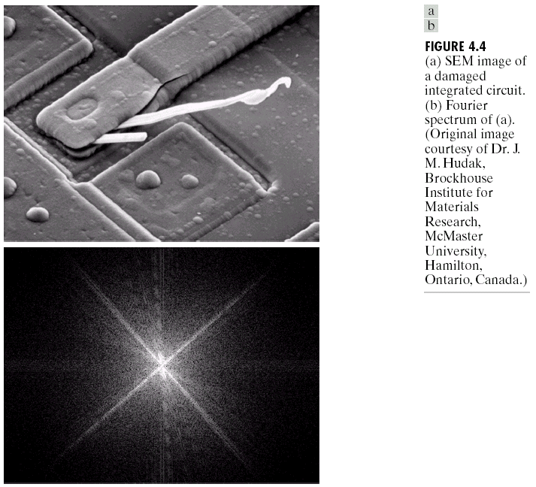
Filtering in the Frequency Domain

Slide 24
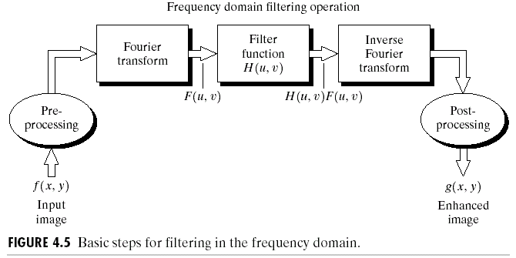
Basics of Filtering in the Frequency Domain

Slide 25
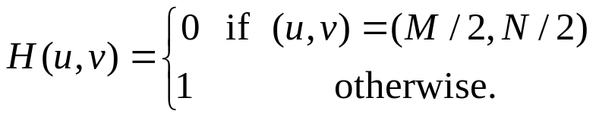
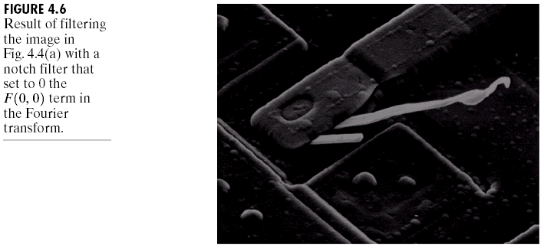
Some Basic Filters and Their Functions
Multiply all values of F(u,v) by the filter function (notch filter):
  All this filter would do is set F(0,0) to zero (force the average value of an image to zero) and leave all frequency components of the Fourier transform untouched.

Slide 26
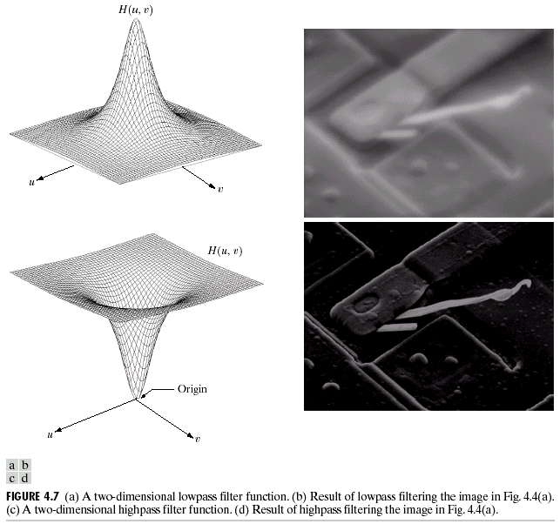
Some Basic Filters and Their Functions
Lowpass filter
Highpass filter

Slide 27
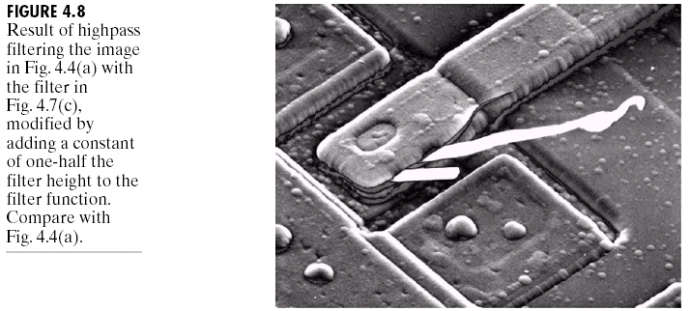
Some Basic Filters and Their Functions

Slide 28
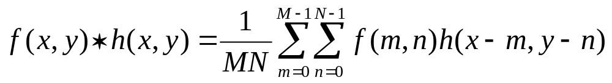
Correspondence between Filtering in
the Spatial and Frequency Domain
Convolution theorem:
  The discrete convolution of two functions f(x,y) and h(x,y) of size MXN is defined as
  Let F(u,v) and H(u,v) denote the Fourier transforms of f(x,y) and h(x,y), then
  Eq. (4.2-31)
  Eq. (4.2-32)

Slide 29

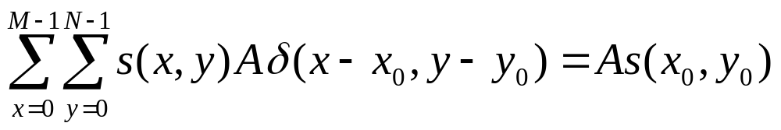
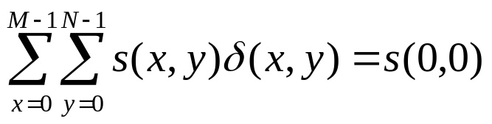

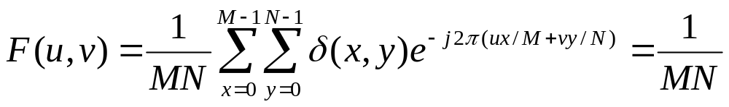
Correspondence between Filtering in
the Spatial and Frequency Domain
:an impulse function of strength A, located at coordinates (x₀,y₀)
where : a unit impulse located at the origin
The Fourier transform of a unit impulse at the origin (Eq. (4.2-35)) :

Slide 30

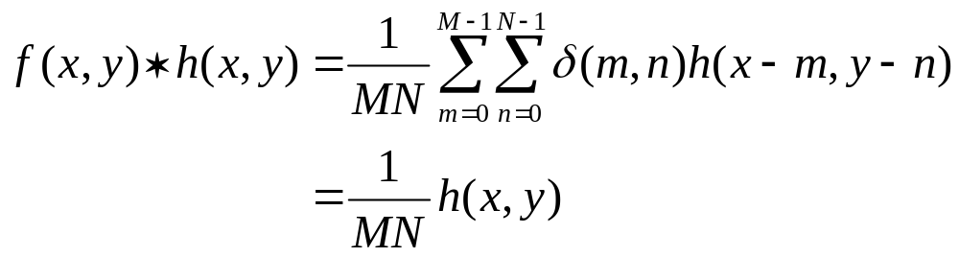
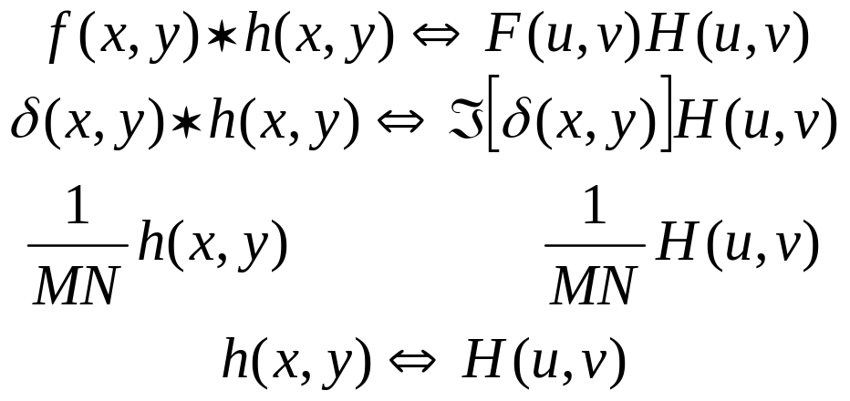
Correspondence between Filtering in
the Spatial and Frequency Domain
Let , then the convolution (Eq. (4.2-36))
Combine Eqs. (4.2-35) (4.2-36) with Eq. (4.2-31), we obtain

Slide 31
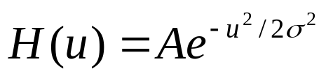

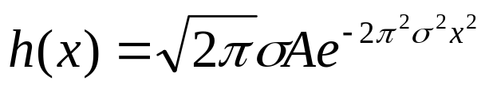
Correspondence between Filtering in
the Spatial and Frequency Domain
Let H(u) denote a frequency domain, Gaussian filter function given the equation
where : the standard deviation of the Gaussian curve.
The corresponding filter in the spatial domain is
Note: Both the forward and inverse Fourier transforms of a Gaussian function are real Gaussian functions.

Slide 32
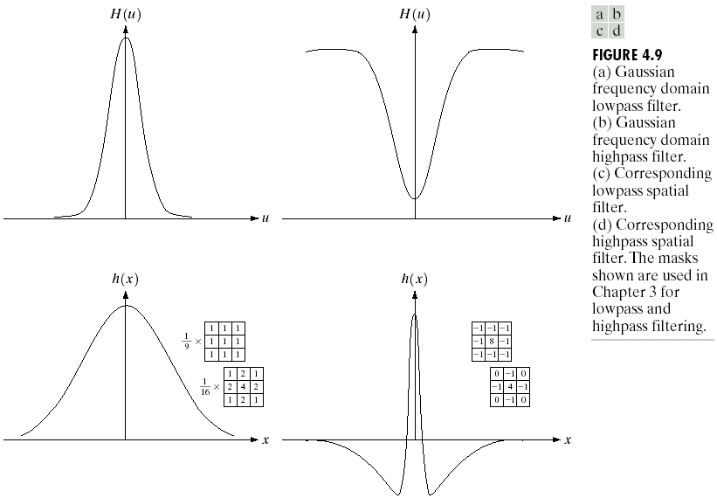
Correspondence between Filtering in
the Spatial and Frequency Domain

Slide 33
Correspondence between Filtering in
the Spatial and Frequency Domain
One very useful property of the Gaussian function is that both it and its Fourier transform are real valued; there are no complex values associated with them.
In addition, the values are always positive. So, if we convolve an image with a Gaussian function, there will never be any negative output values to deal with.
There is also an important relationship between the widths of a Gaussian function and its Fourier transform. If we make the width of the function smaller, the width of the Fourier transform gets larger. This is controlled by the variance parameter σ² in the equations.
These properties make the Gaussian filter very useful for lowpass filtering an image. The amount of blur is controlled by σ². It can be implemented in either the spatial or frequency domain.
Other filters besides lowpass can also be implemented by using two different sized Gaussian functions.

Slide 34

Smoothing Frequency-Domain Filters
The basic model for filtering in the frequency domain
where F(u,v): the Fourier transform of the image to be smoothed
H(u,v): a filter transfer function
Smoothing is fundamentally a lowpass operation in the frequency domain.
There are several standard forms of lowpass filters (LPF).
  Ideal lowpass filter
  Butterworth lowpass filter
  Gaussian lowpass filter

Slide 35
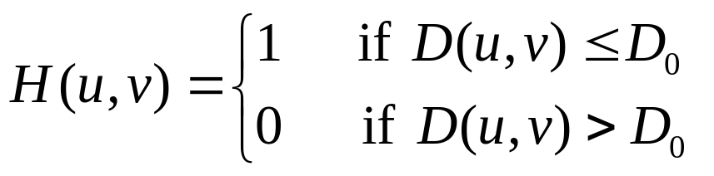
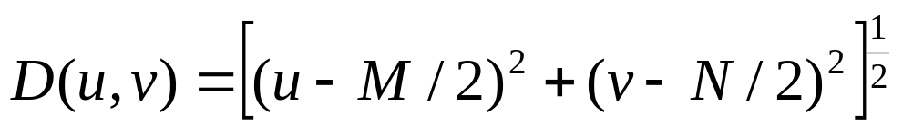
Ideal Lowpass Filters (ILPFs)
The simplest lowpass filter is a filter that “cuts off” all high-frequency components of the Fourier transform that are at a distance greater than a specified distance D₀ from the origin of the transform.
The transfer function of an ideal lowpass filter
where D(u,v) : the distance from point (u,v) to the center of ther frequency rectangle

Slide 36
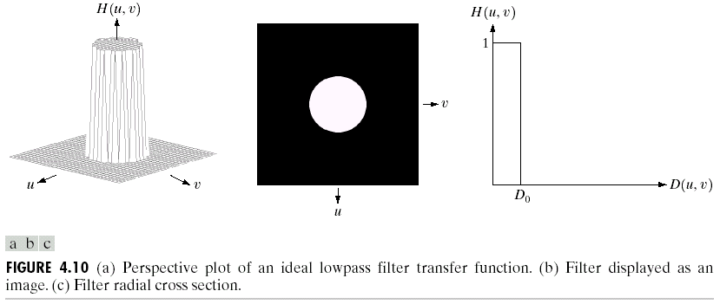
Ideal Lowpass Filters (ILPFs)

Slide 37
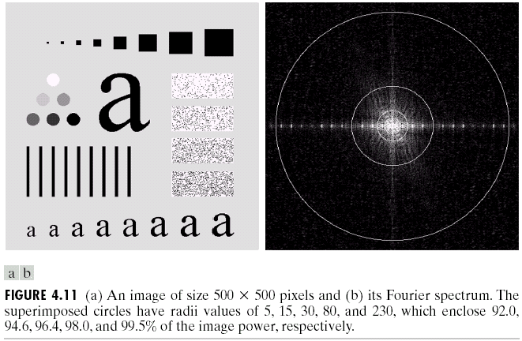
Ideal Lowpass Filters (ILPFs)

Slide 38
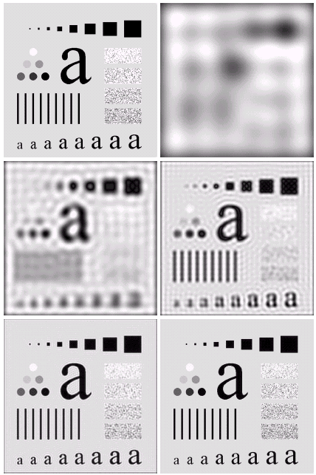

Ideal Lowpass Filters

Slide 39
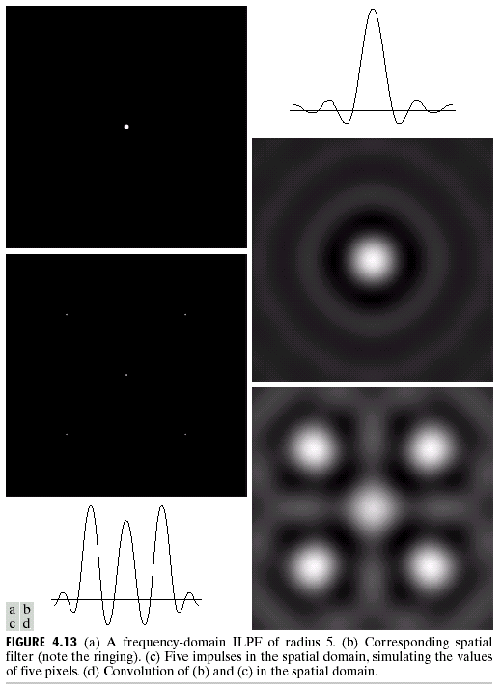
Ideal Lowpass Filters
Another Example
frequency
Figure 4.13 (a) A frequency-domain
ILPF of radius 5. (b) Corresponding
spatial filter. (c) Five impulses in the
spatial domain, simulating the values
of five pixels. (d) Convolution of (b)
and (c) in the spatial domain.
spatial
spatial
spatial

Slide 40
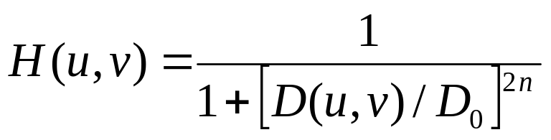
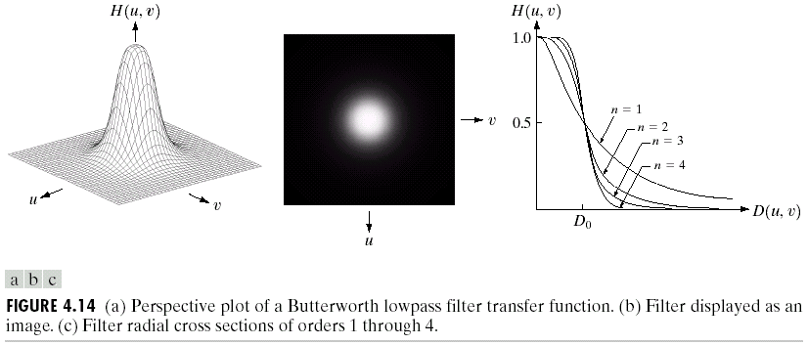
Butterworth Lowpass Filters (BLPFs)
With order n

Slide 41
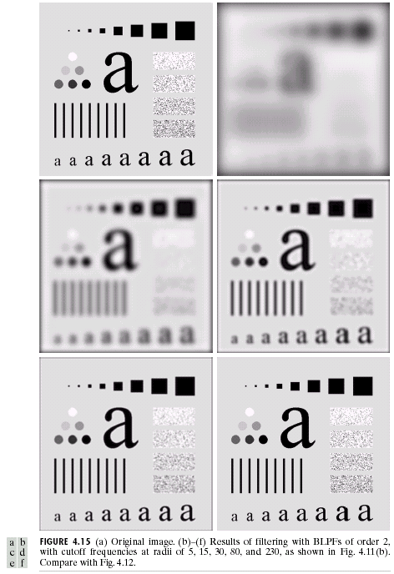
Butterworth Lowpass
Filters (BLPFs)
n=2
D₀=5,15,30,80,and 230

Slide 42
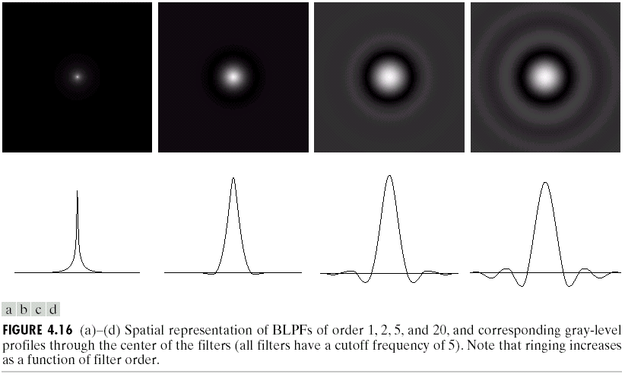
Butterworth Lowpass Filters (BLPFs)
Spatial Representation
n=1
n=2
n=5
n=20

Slide 43
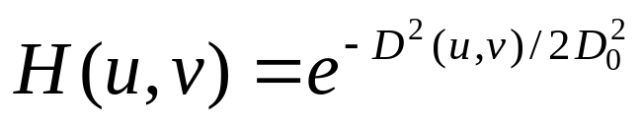

Gaussian Lowpass Filters (FLPFs)

Slide 44

Gaussian Lowpass
Filters (FLPFs)
D₀=5,15,30,80,and 230

Slide 45

Additional Examples of Lowpass Filtering

Slide 46

Additional Examples of Lowpass Filtering

Slide 47





Sharpening Frequency Domain Filter
Ideal highpass filter
Butterworth highpass filter
Gaussian highpass filter

Slide 48

Highpass Filters
Spatial Representations

Slide 49


Ideal Highpass Filters

Slide 50

Butterworth Highpass Filters

Slide 51

Gaussian Highpass Filters

Slide 52



The Laplacian in the Frequency Domain
The Laplacian filter
Shift the center:
Frequency
domain
Spatial domain

Slide 53


For display purposes only

Slide 54

Implementation
Some Additional Properties of the 2D Fourier Transform
Periodicity, symmetry, and back-to-back properties
shift

Slide 55

Implementation
Some Additional Properties of the 2D Fourier Transform
Separability

Slide 56


Implementation
More on Periodicity

Slide 57

extend
extend

Slide 58

Summary of Some Important Properties
of the 2-D Fourier Transform

Slide 59


Summary of Some Important Properties
of the 2-D Fourier Transform

Slide 60

Summary of Some Important Properties
of the 2-D Fourier Transform

Slide 61

Summary of Some Important Properties
of the 2-D Fourier Transform

