Slide 1
Chapter 11
Representation & Description

Slide 2
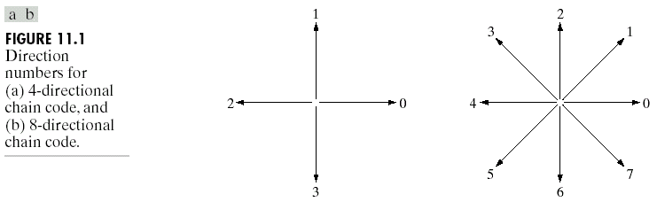
Representation
Image regions (including segments) can be represented by either the border or the pixels of the region. These can be viewed as external or internal characteristics, respectively.
Chain codes: represent a boundary of a connected region.

Slide 3
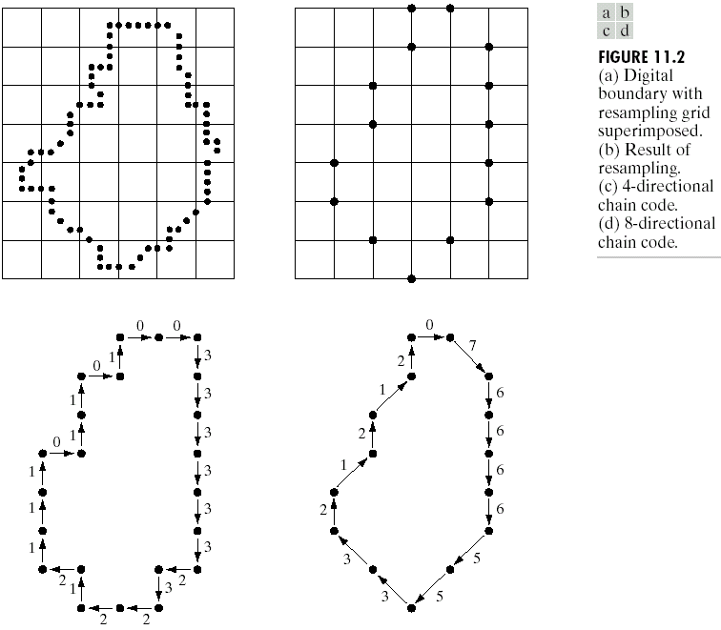
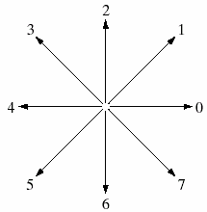
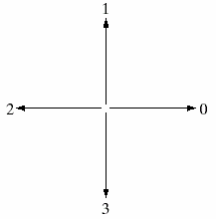
Representation
Chain Codes

Slide 4
Representation
Chain Codes
Chain codes can be based on either 4-connectedness or 8-connectedness.
The first difference of the chain code:
  This difference is obtained by counting the number of direction changes (in a counterclockwise direction)
  For example, the first difference of the 4-direction chain code 10103322 is 3133030.
Assuming the first difference code represent a closed path, rotation normalization can be achieved by circularly shifting the number of the code so that the list of numbers forms the smallest possible integer.
Size normalization can be achieved by adjusting the size of the resampling grid.

Slide 5
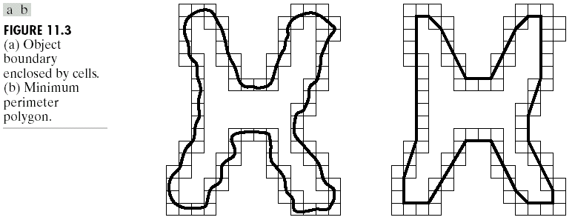
Representation
Polygonal Approximations
Polygonal approximations: to represent a boundary by straight line segments, and a closed path becomes a polygon.
The number of straight line segments used determines the accuracy of the approximation.
Only the minimum required number of sides necessary to preserve the needed shape information should be used (Minimum perimeter polygons).
A larger number of sides will only add noise to the model.

Slide 6
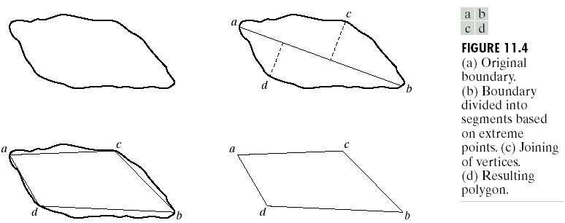
Representation
Polygonal Approximations
Minimum perimeter polygons: (Merging and splitting)
  Merging and splitting are often used together to ensure that vertices appear where they would naturally in the boundary.
  A least squares criterion to a straight line is used to stop the processing.

Slide 7
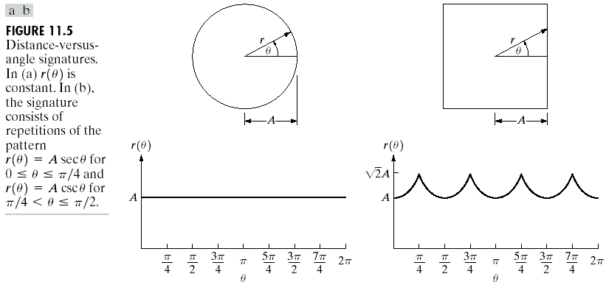
Representation
Signature
The idea behind a signature is to convert a two dimensional boundary into a representative one dimensional function.

Slide 8
Representation
Signature
Signatures are invariant to location, but will depend on rotation and scaling.
  Starting at the point farthest from the reference point or using the major axis of the region can be used to decrease dependence on rotation.
  Scale invariance can be achieved by either scaling the signature function to fixed amplitude or by dividing the function values by the standard deviation of the function.

Slide 9
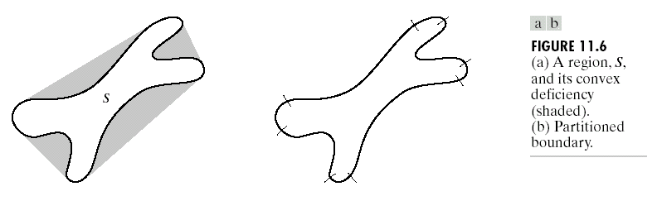
Representation
Boundary Segments
Boundary segments: decompose a boundary into segments.
Use of the convex hull of the region enclosed by the boundary is a powerful tool for robust decomposition of the boundary.

Slide 10
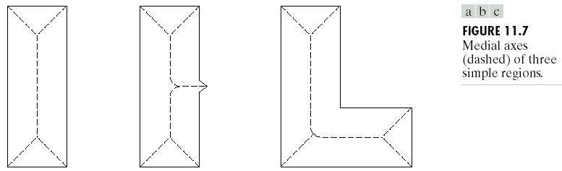
Representation
Skeletons
Skeletons: produce a one pixel wide graph that has the same basic shape of the region, like a stick figure of a human. It can be used to analyze the geometric structure of a region which has bumps and “arms”.

Slide 11
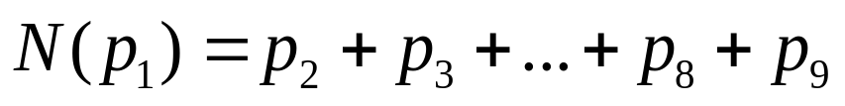
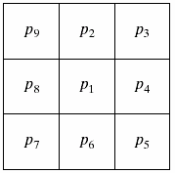
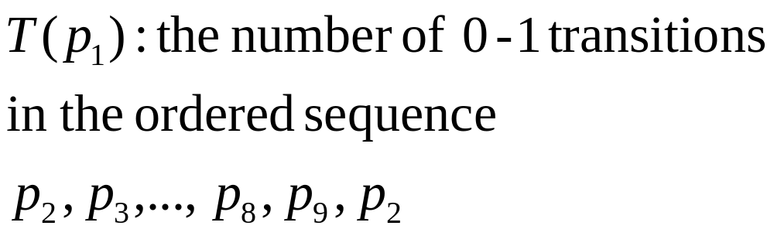
Representation
Skeletons
Before a thinning algorithm:
  A contour point is any pixel with value 1 and having at least one 8-neighbor valued 0.
  Let

Slide 12
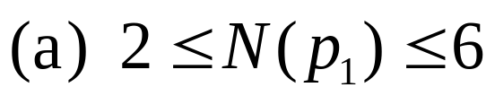
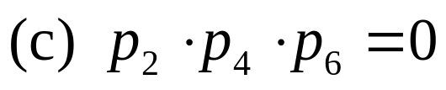
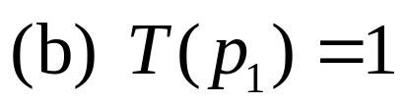
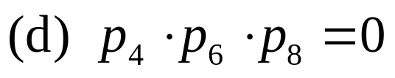
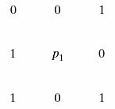
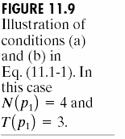
Representation
Skeletons
Step 1: Flag a contour point p₁ for deletion if the following conditions are satisfied

Slide 13
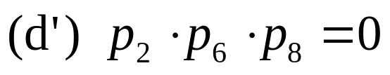
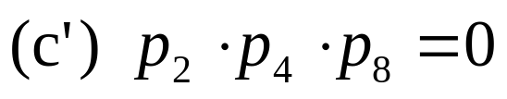
Representation
Skeletons
Step 2: Flag a contour point p₁ for deletion again. However, conditions (a) and (b) remain the same, but conditions (c) and (d) are changed to

Slide 14
Representation
Skeletons
A thinning algorithm:
  (1) applying step 1 to flag border points for deletion
  (2) deleting the flagged points
  (3) applying step 2 to flag the remaining border points for deletion
  (4) deleting the flagged points
  This procedure is applied iteratively until no further points are deleted.

Slide 15
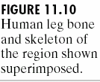
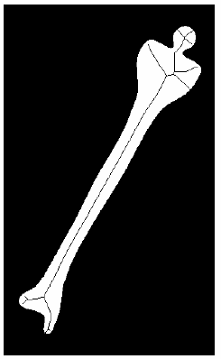
Representation
Skeletons: Example
One application of skeletonization is for character recognition.
A letter or character is determined by the center-line of its strokes, and is unrelated to the width of the stroke lines.

Slide 16
Boundary Descriptors
There are several simple geometric measures that can be useful for describing a boundary.
  The length of a boundary: the number of pixels along a boundary gives a rough approximation of its length.
  Curvature: the rate of change of slope
    To measure a curvature accurately at a point in a digital boundary is difficult
    The difference between the slops of adjacent boundary segments is used as a descriptor of curvature at the point of intersection of segments

Slide 17
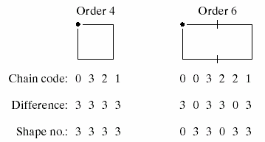
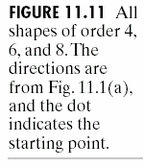
Boundary Descriptors
Shape Numbers
First difference
The shape number of a boundary is defined as the first difference of smallest magnitude.
The order n of a shape number is defined as the number of digits in its representation.

Slide 18
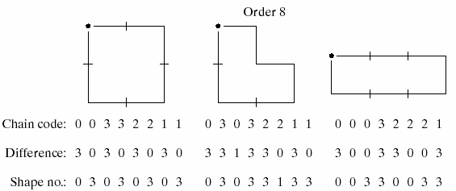
Boundary Descriptors
Shape Numbers

Slide 19
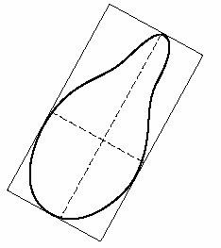
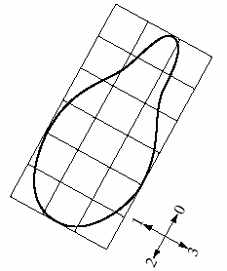
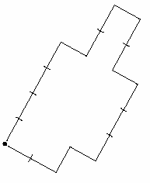
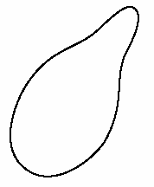

Boundary Descriptors
Shape Numbers

Slide 20
Boundary Descriptors
Fourier Descriptors
This is a way of using the Fourier transform to analyze the shape of a boundary.
  The x-y coordinates of the boundary are treated as the real and imaginary parts of a complex number.
  Then the list of coordinates is Fourier transformed using the DFT (chapter 4).
  The Fourier coefficients are called the Fourier descriptors.
  The basic shape of the region is determined by the first several coefficients, which represent lower frequencies.
  Higher frequency terms provide information on the fine detail of the boundary.

Slide 21
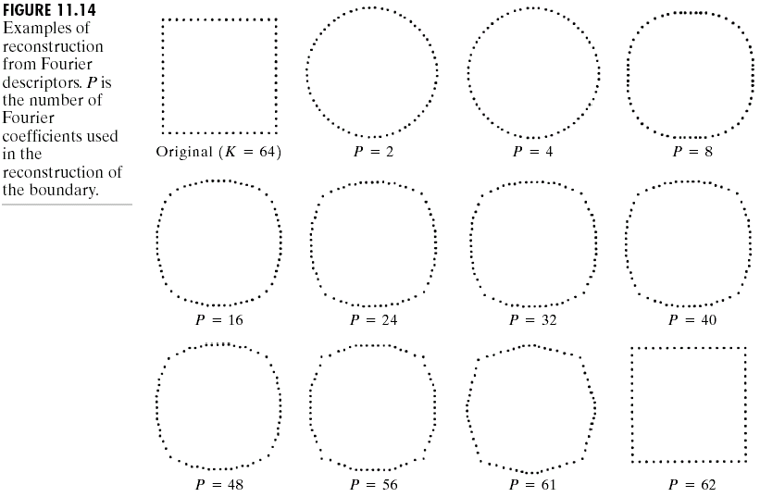
Boundary Descriptors
Fourier Descriptors

Slide 22
Boundary Descriptors
Statistical Moments
Moments are statistical measures of data.
  They come in integer orders.
  Order 0 is just the number of points in the data.
  Order 1 is the sum and is used to find the average.
  Order 2 is related to the variance, and order 3 to the skew of the data.
  Higher orders can also be used, but don’t have simple meanings.

Slide 23
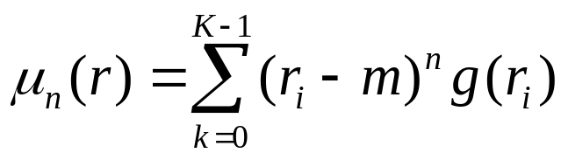
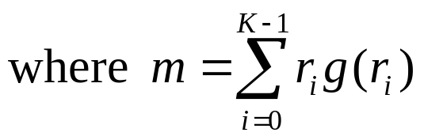
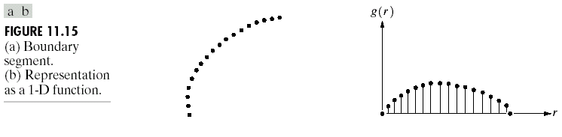
Boundary Descriptors
Statistical Moments
Let r be a random variable, and g(r_{i}) be normalized (as the probability of value r_{i} occurring), then the moments are

Slide 24
Regional Descriptors
Some simple descriptors
  The area of a region: the number of pixels in the region
  The perimeter of a region: the length of its boundary
  The compactness of a region: (perimeter)²/area
  The mean and median of the gray levels
  The minimum and maximum gray-level values
  The number of pixels with values above and below the mean

Slide 25
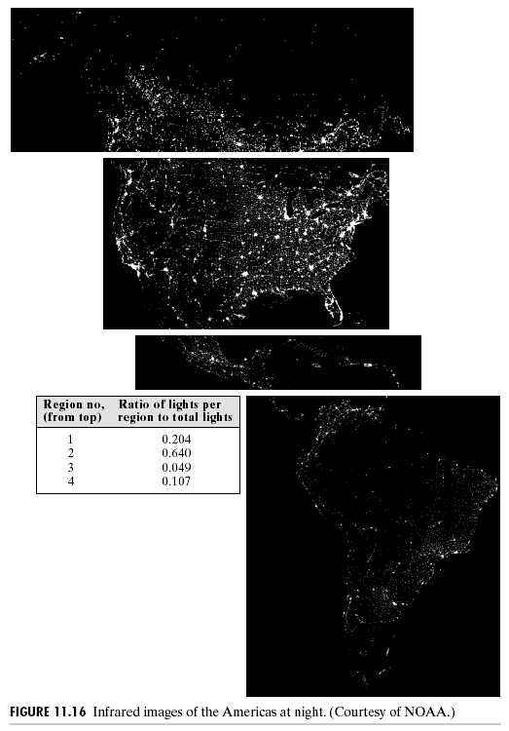
Regional Descriptors
Example

Slide 26
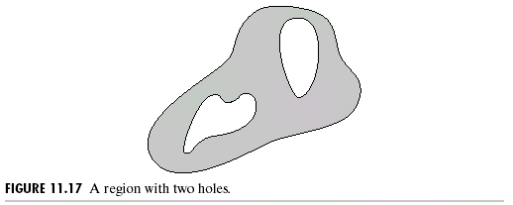
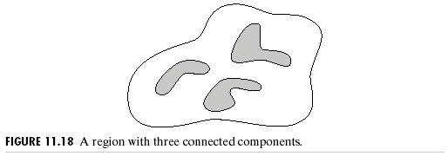
Regional Descriptors
Topological Descriptors
Topological property 1:
the number of holes (H)
Topological property 2:
the number of connected
components (C)

Slide 27
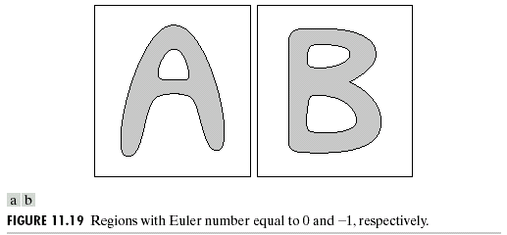
Regional Descriptors
Topological Descriptors
Topological property 3:
Euler number: the number of connected components subtract the number of holes
E = C - H
E=0
E= -1

Slide 28
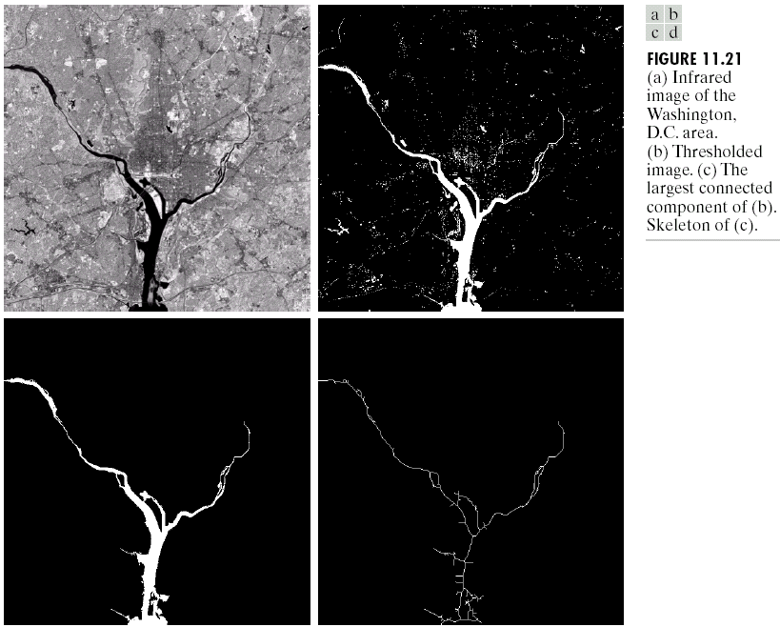
Regional Descriptors
Topological Descriptors
Topological
property 4:
the largest
connected
component.

Slide 29
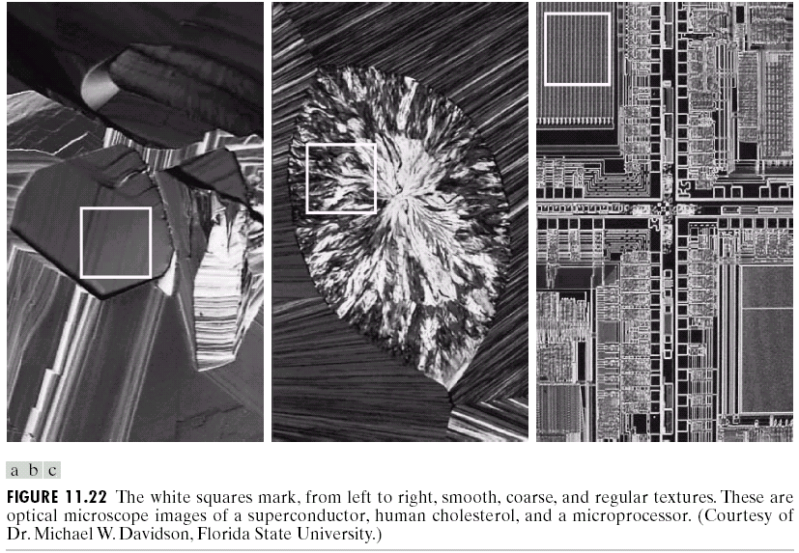
Regional Descriptors
Texture

Slide 30
Regional Descriptors
Texture
Texture is usually defined as the smoothness or roughness of a surface.
In computer vision, it is the visual appearance of the uniformity or lack of uniformity of brightness and color.
There are two types of texture: random and regular.
  Random texture cannot be exactly described by words or equations; it must be described statistically. The surface of a pile of dirt or rocks of many sizes would be random.
  Regular texture can be described by words or equations or repeating pattern primitives. Clothes are frequently made with regularly repeating patterns.
  Random texture is analyzed by statistical methods.
  Regular texture is analyzed by structural or spectral (Fourier) methods.

Slide 31
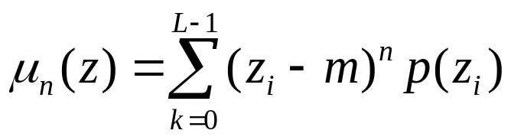
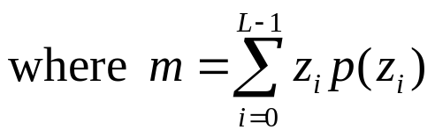
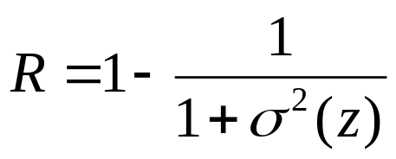
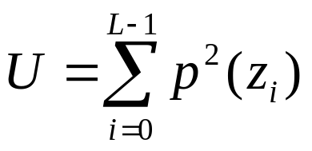
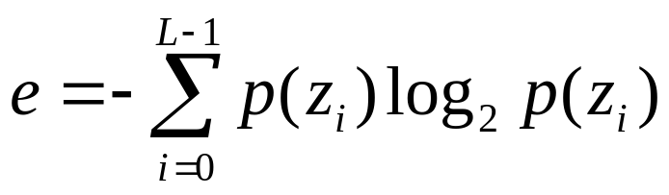
Regional Descriptors
Statistical Approaches
Let z be a random variable denoting gray levels and let p(z_{i}), i=0,1,…,L-1, be the corresponding histogram, where L is the number of distinct gray levels.
  The nth moment of z:
  The measure R:
  The uniformity:
  The average entropy:

Slide 32



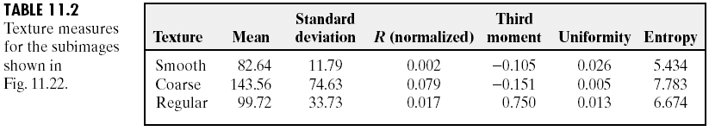
Regional Descriptors
Statistical Approaches
Smooth
Coarse
Regular

Slide 33
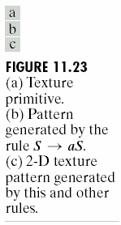
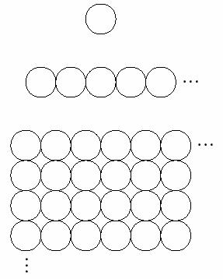
Regional Descriptors
Structural Approaches
Structural concepts:
  Suppose that we have a rule of the form S→aS, which indicates that the symbol S may be rewritten as aS.
  If a represents a circle [Fig. 11.23(a)] and the meaning of “circle to the right” is assigned to a string of the form aaaa… [Fig. 11.23(b)] .

Slide 34




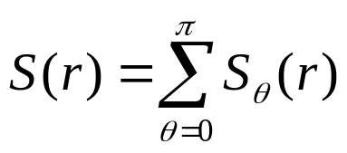
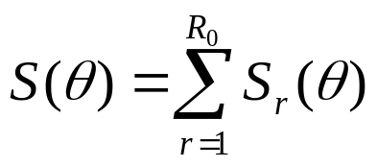
Regional Descriptors
Spectral Approaches
For non-random primitive spatial patterns, the 2-dimensional Fourier transform allows the patterns to be analyzed in terms of spatial frequency components and direction.
It may be more useful to express the spectrum in terms of polar coordinates, which directly give direction as well as frequency.
Let is the spectrum function, and r and are the variables in this coordinate system.
  For each direction , may be considered a 1-D function .
  For each frequency r, is a 1-D function.
  A global description:

Slide 35
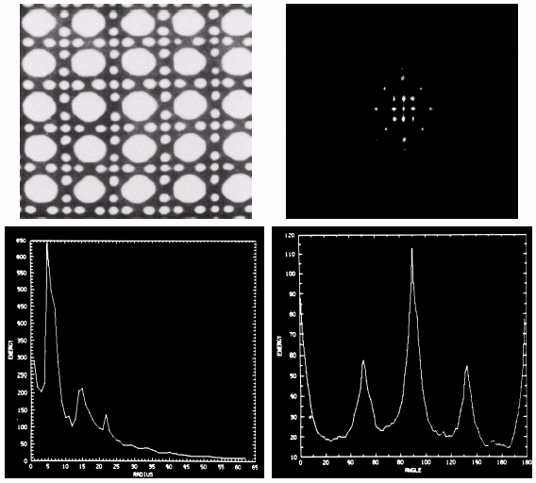

Regional Descriptors
Spectral Approaches

Slide 36

Regional Descriptors
Spectral Approaches

Slide 37



Regional Descriptors
Moments of Two-Dimensional Functions
For a 2-D continuous function f(x,y), the moment of order (p+q) is defined as
The central moments are defined as

Slide 38





Regional Descriptors
Moments of Two-Dimensional Functions
If f(x,y) is a digital image, then
The central moments of order up to 3 are

Slide 39




Regional Descriptors
Moments of Two-Dimensional Functions
The central moments of order up to 3 are

Slide 40


Regional Descriptors
Moments of Two-Dimensional Functions
The normalized central moments are defined as

Slide 41

Regional Descriptors
Moments of Two-Dimensional Functions
A seven invariant moments can be derived from the second and third moments:

Slide 42

Regional Descriptors
Moments of Two-Dimensional Functions
This set of moments is invariant to translation, rotation, and scale change.

Slide 43



Regional Descriptors
Moments of Two-Dimensional Functions

Slide 44

Regional Descriptors
Moments of Two-Dimensional Functions
Table 11.3 Moment invariants for the images in Figs. 11.25(a)-(e).

