Slide 1
Ch.3 The Multidimensional Data Model
Ch. 3.1 Introduction to MDD Model
Requirements: must support typical analyses, queries like
Sales of a product group digital cameras in Nov, Dec Jan Feb in Munich area
sorted by sales of each product in €
sorted by sales in numbers
sorted by shops

Slide 2
Operations:
aggregation
slice
dice (würfeln)
rollup to coarser level
drill down to more detailed level
grouping
sorting

Slide 3
Model
need abstract model with above operations
suitable datastructures
very large databases
Relational Model?
one-dimensional access via primary key
n*m „relationships“ are 2-dimensional: (FK1, FK2)

Slide 4
OLAP is inherently multidimensional:
See e.g. above query with dimensions:
  procucts
  time
  geographic region
Additional dimensions might be:
  customer group
  age group
  type of payment { cash, credit, cheque, ...}
  outlet { Kaufhof, Quelle, Internet,...}

Slide 5
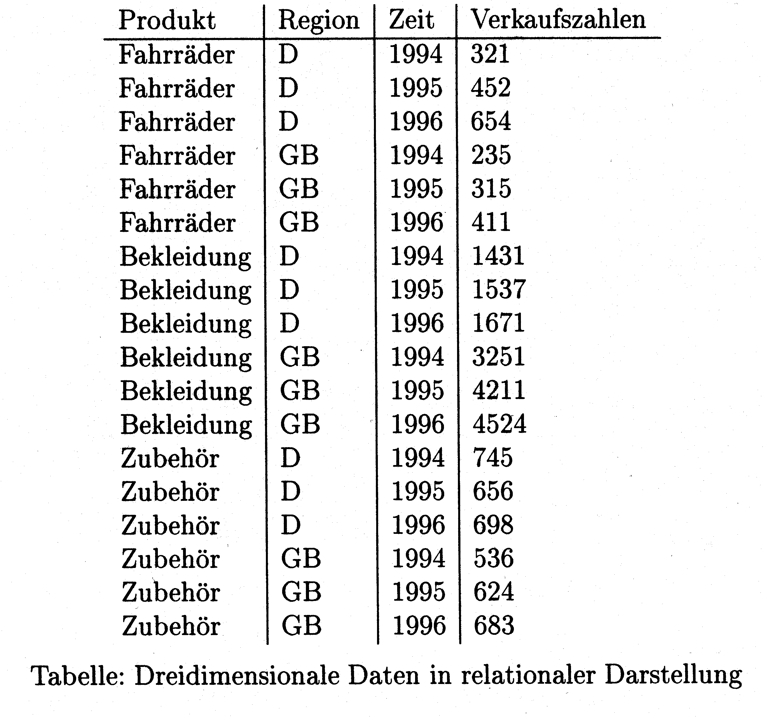
Relational Representation of Multidimensional Data

Slide 6
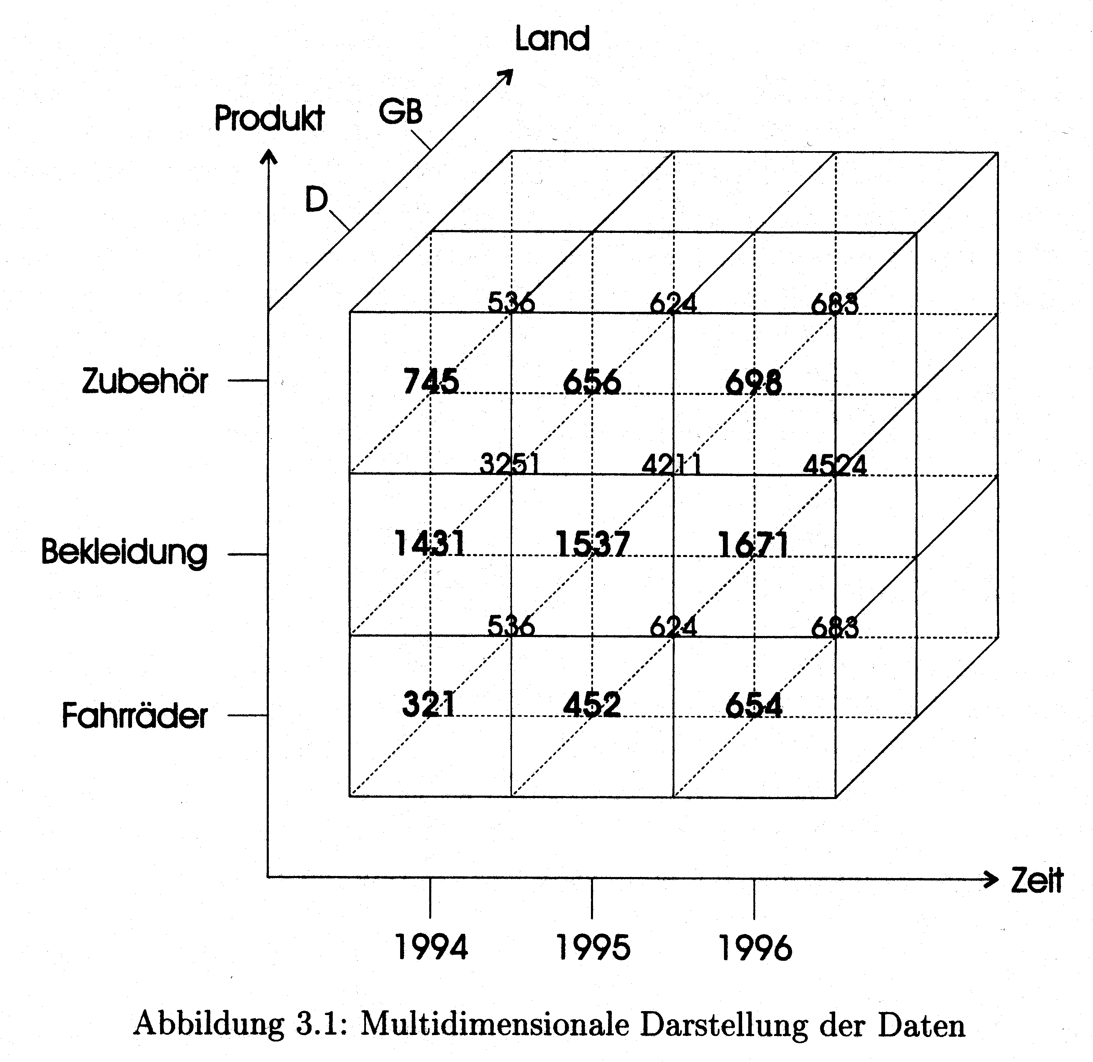
Multidimensional Representation of 3-dim Data: Dimensions with Measures or Facts

Slide 7
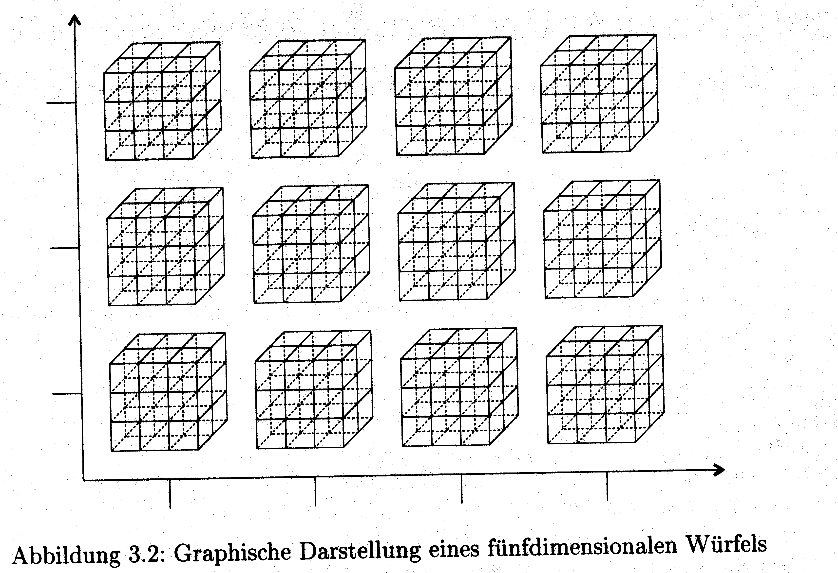
Representation of 5-dim Data

Slide 8
Logical and Physical Aspects of MD Models
logical view: easy understanding for user, e.g. to formulate queries or to understand result presentation
physical view: storage in computer memory, access methods sparse vs. dense?
Problem:
extremely sparse data at lowest level of granularity, GfK 99.99995 sparsity
dense at higher aggregation levels

Slide 9
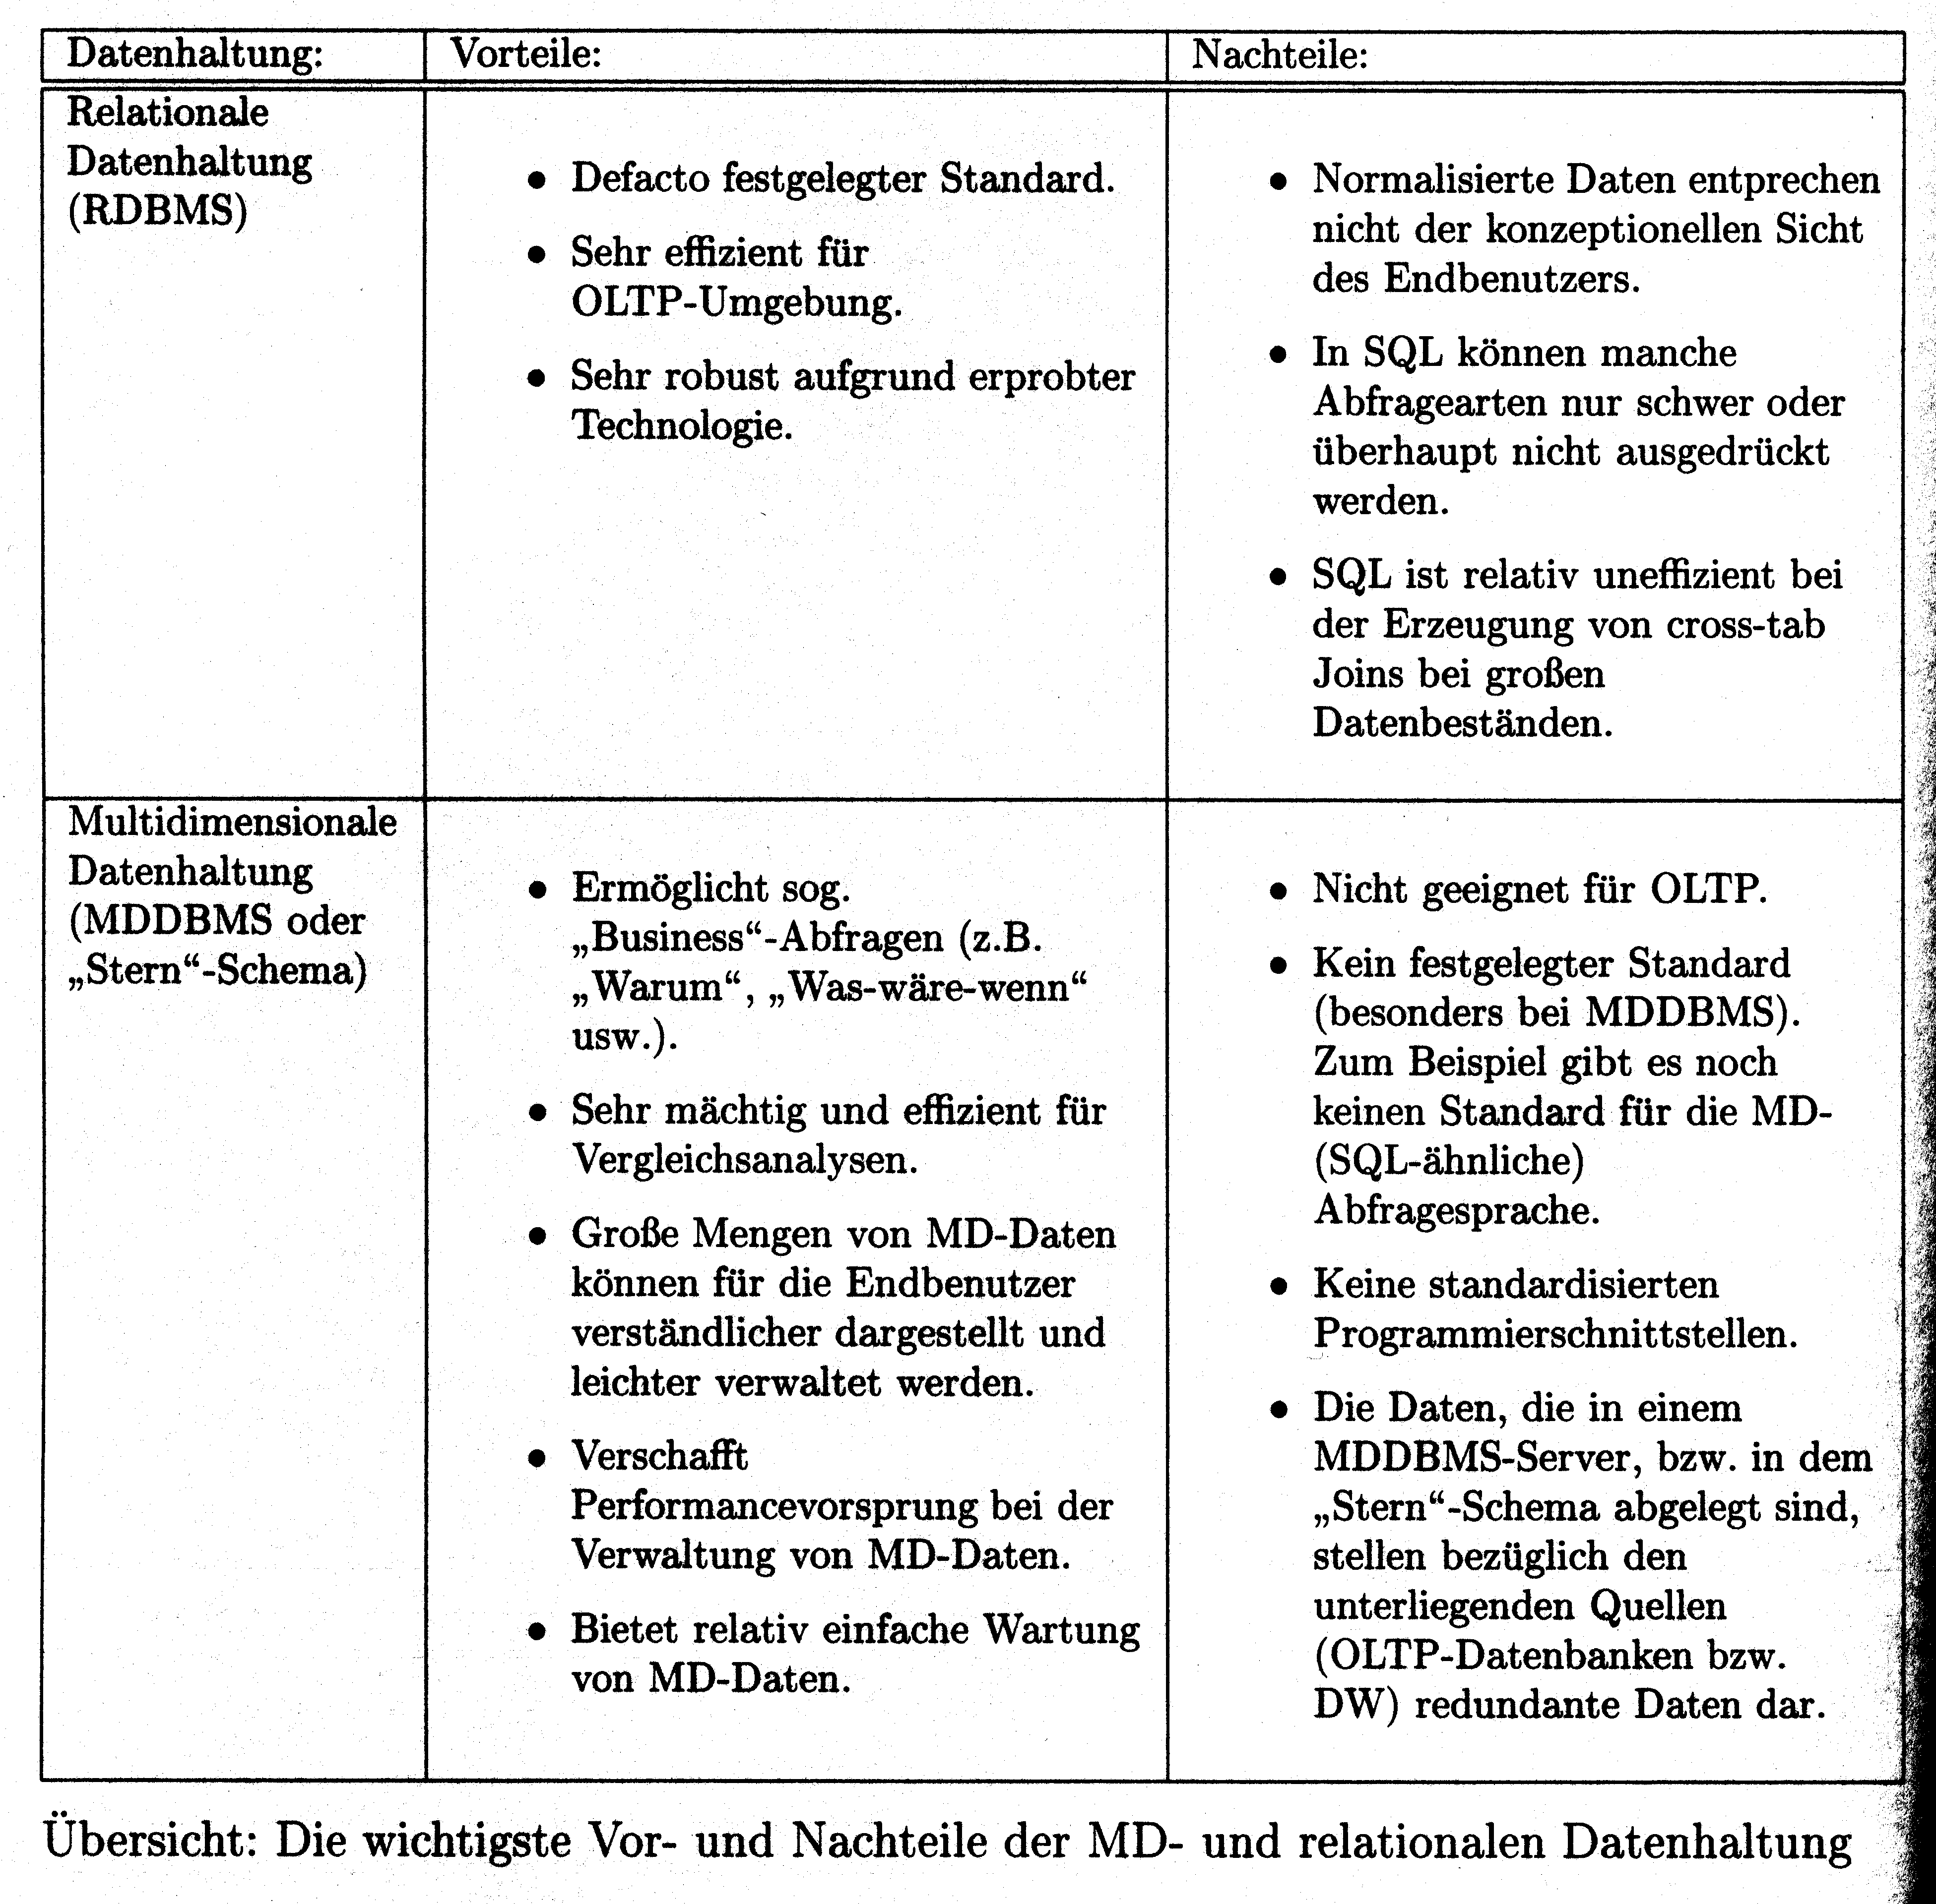
Comparison of both Models

Slide 10
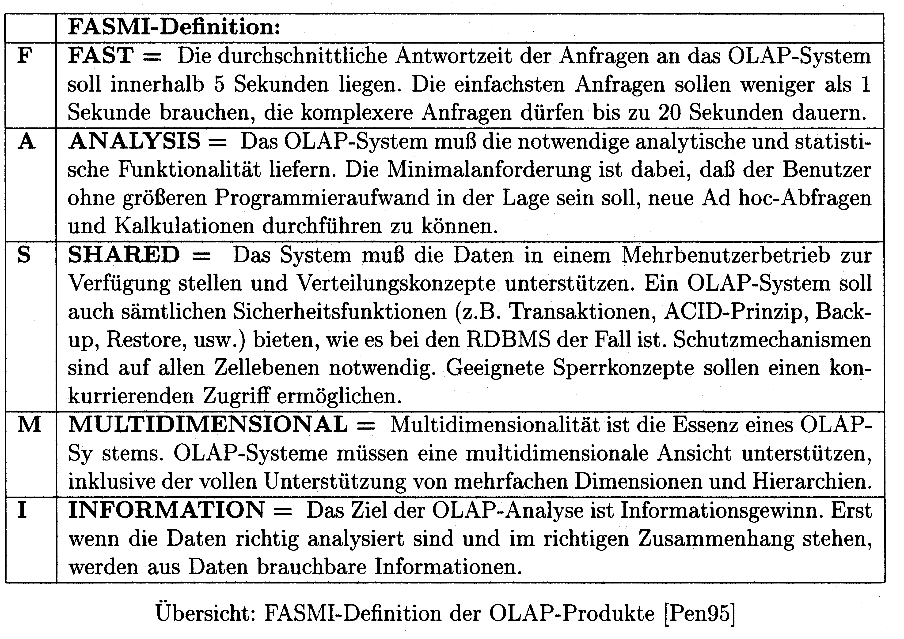
FASMI Definition

