Slide 1
Digital Image Processing
Image Restoration:
Noise Removal

Slide 2
Contents
In this lecture we will look at image restoration techniques used for noise removal
  What is image restoration?
  Noise and images
  Noise models
  Noise removal using spatial domain filtering
  Periodic noise
  Noise removal using frequency domain filtering

Slide 3
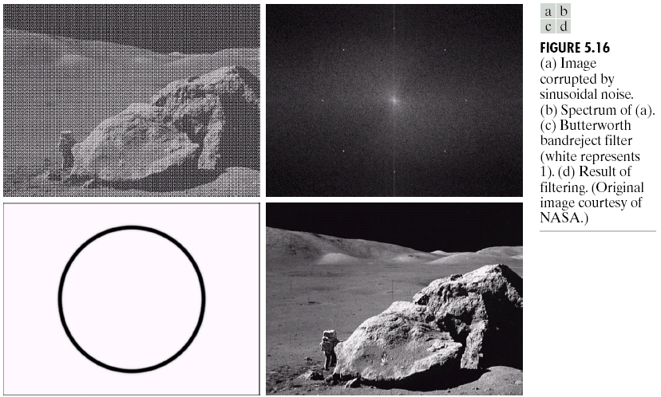
What is Image Restoration?
Image restoration attempts to restore images that have been degraded
  Identify the degradation process and attempt to reverse it
  Similar to image enhancement, but more objective

Slide 4
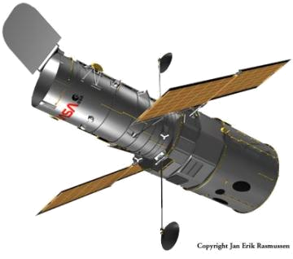
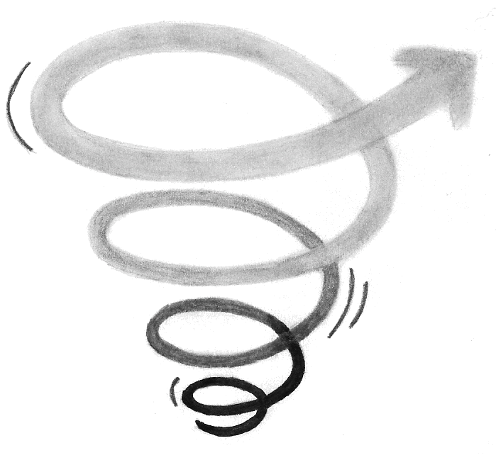

Noise and Images
The sources of noise in digital images arise during image acquisition (digitization) and transmission
  Imaging sensors can be affected by ambient conditions
  Interference can be added
  to an image during transmission

Slide 5
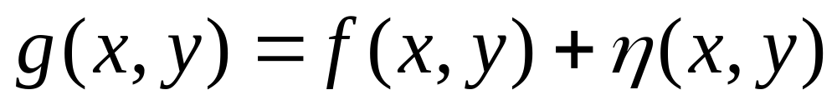
Noise Model
We can consider a noisy image to be modelled as follows:
where f(x, y) is the original image pixel, η(x, y) is the noise term and g(x, y) is the resulting noisy pixel
If we can estimate the model the noise in an image is based on this will help us to figure out how to restore the image

Slide 6

Noise Corruption Example
Original Image
x
Noisy Image
x
54
52
57
55
56
52
51
50
49
51
50
52
53
58
51
51
52
52
56
57
60
48
50
51
49
53
59
63
49
51
52
55
58
64
67
148
154
157
160
163
167
170
151
155
159
162
165
169
172
Image f (x, y)
Image f (x, y)
y
y

Slide 7
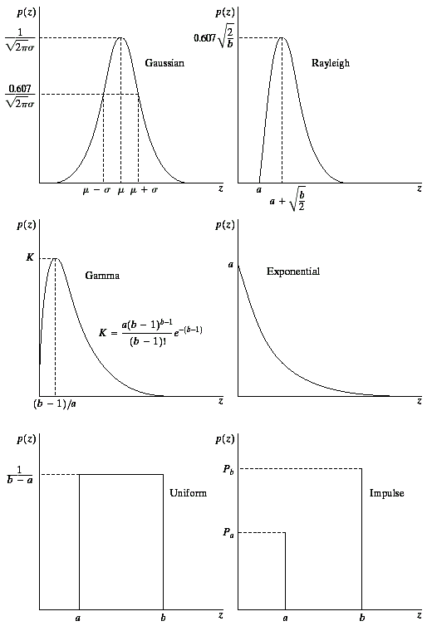

Noise Models
There are many different models for the image
noise term η(x, y):
  Gaussian
    Most common model
  Rayleigh
  Erlang
  Exponential
  Uniform
  Impulse
    Salt and pepper noise
Gaussian
Rayleigh
Erlang
Exponential
Images taken from Gonzalez & Woods, Digital Image Processing (2002)
Uniform
Impulse

Slide 8
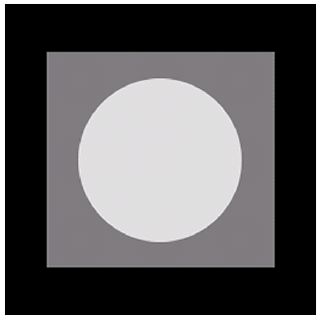
Noise Example
The test pattern to the right is ideal for demonstrating the addition of noise
The following slides will show the result of adding noise based on various models to this image
Image
Images taken from Gonzalez & Woods, Digital Image Processing (2002)
Histogram to go here
Histogram

Slide 9
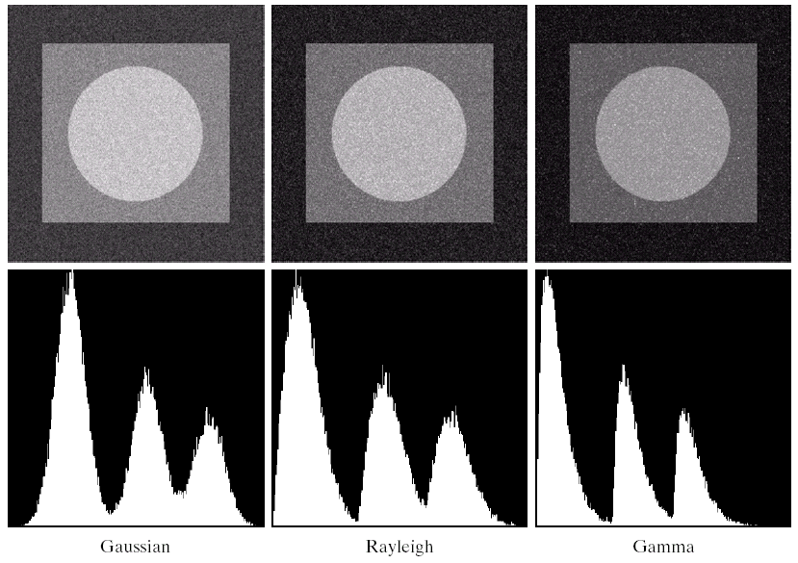
Noise Example (cont…)
Images taken from Gonzalez & Woods, Digital Image Processing (2002)
Gaussian
Rayleigh
Erlang

Slide 10
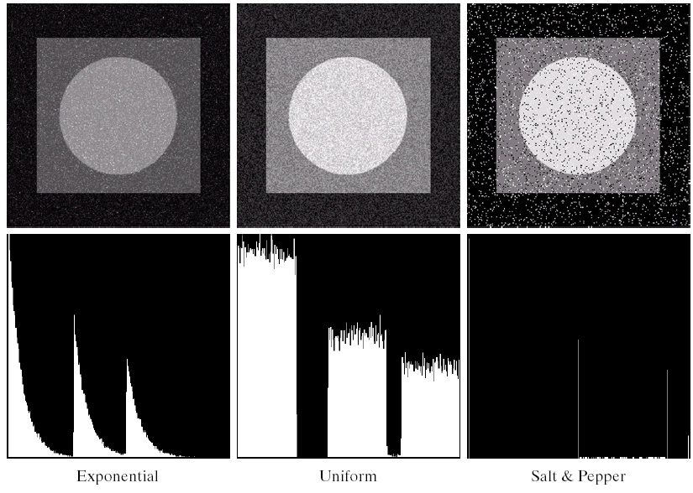
Noise Example (cont…)
Images taken from Gonzalez & Woods, Digital Image Processing (2002)
Histogram to go here
Exponential
Uniform
Impulse

Slide 11
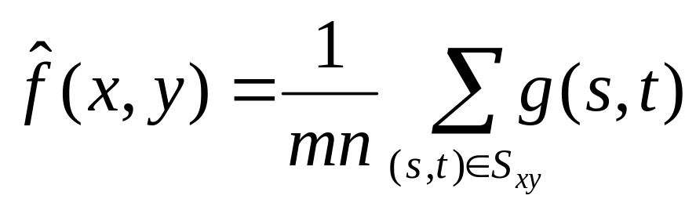
Filtering to Remove Noise
We can use spatial filters of different kinds to remove different kinds of noise
The arithmetic mean filter is a very simple one and is calculated as follows:
This is implemented as the
simple smoothing filter
Blurs the image to remove
noise
¹/₉ | ¹/₉ | ¹/₉
¹/₉ | ¹/₉ | ¹/₉
¹/₉ | ¹/₉ | ¹/₉

Slide 12
Noise Removal Example
Original Image
x
Filtered Image
x
54
52
57
55
56
52
51
50
49
51
50
52
53
58
51
204
52
52
0
57
60
48
50
51
49
53
59
63
49
51
52
55
58
64
67
148
154
157
160
163
167
170
151
155
159
162
165
169
172
Image f (x, y)
Image f (x, y)
y
y

Slide 13
Other Means
There are different kinds of mean filters all of which exhibit slightly different behaviour:
  Geometric Mean
  Harmonic Mean
  Contraharmonic Mean

Slide 14
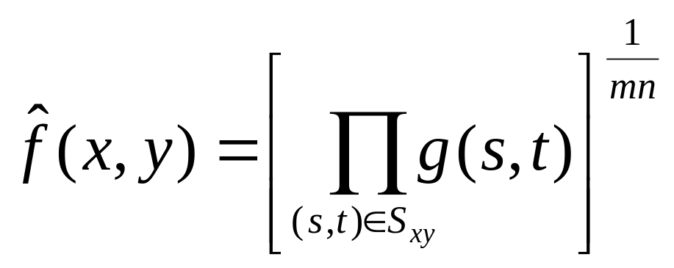
Other Means (cont…)
There are other variants on the mean which can give different performance
Geometric Mean:
Achieves similar smoothing to the arithmetic mean, but tends to lose less image detail

Slide 15
Noise Removal Example
Original Image
x
Filtered Image
x
54
52
57
55
56
52
51
50
49
51
50
52
53
58
51
204
52
52
0
57
60
48
50
51
49
53
59
63
49
51
52
55
58
64
67
148
154
157
160
163
167
170
151
155
159
162
165
169
172
Image f (x, y)
Image f (x, y)
y
y

Slide 16
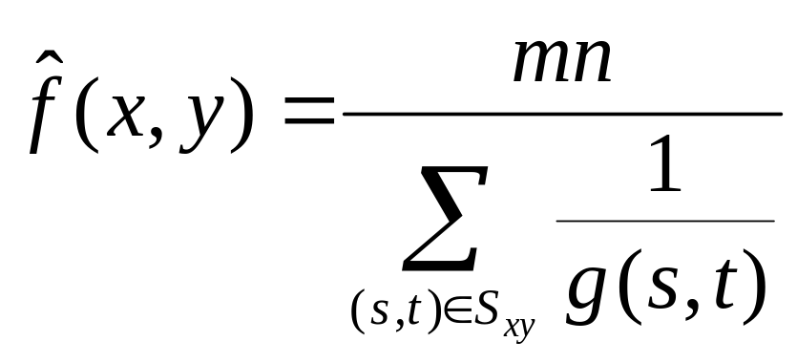
Other Means (cont…)
Harmonic Mean:
Works well for salt noise, but fails for pepper noise
Also does well for other kinds of noise such as Gaussian noise

Slide 17
Noise Corruption Example
Original Image
x
Filtered Image
x
54
52
57
55
56
52
51
50
49
51
50
52
53
58
51
204
52
52
0
57
60
48
50
51
49
53
59
63
49
51
52
55
58
64
67
50
54
57
60
63
67
70
51
55
59
62
65
69
72
Image f (x, y)
Image f (x, y)
y
y

Slide 18
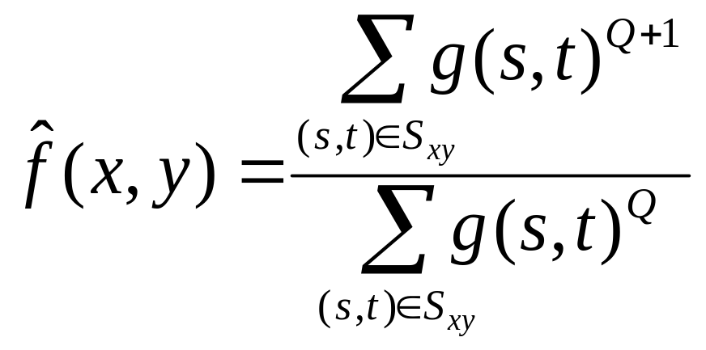
Other Means (cont…)
Contraharmonic Mean:
Q is the order of the filter and adjusting its value changes the filter’s behaviour
Positive values of Q eliminate pepper noise
Negative values of Q eliminate salt noise

Slide 19
Noise Corruption Example
Original Image
x
Filtered Image
x
54
52
57
55
56
52
51
50
49
51
50
52
53
58
51
204
52
52
0
57
60
48
50
51
49
53
59
63
49
51
52
55
58
64
67
50
54
57
60
63
67
70
51
55
59
62
65
69
72
Image f (x, y)
Image f (x, y)
y
y

Slide 20
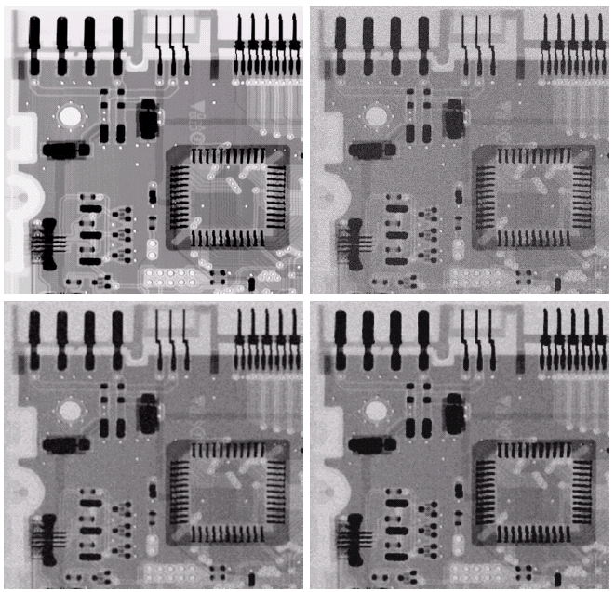
Noise Removal Examples
Image
Corrupted
By Gaussian
Noise
Original
Image
Images taken from Gonzalez & Woods, Digital Image Processing (2002)
After A 3*3
Arithmetic
Mean Filter
After A 3*3
Geometric
Mean Filter

Slide 21
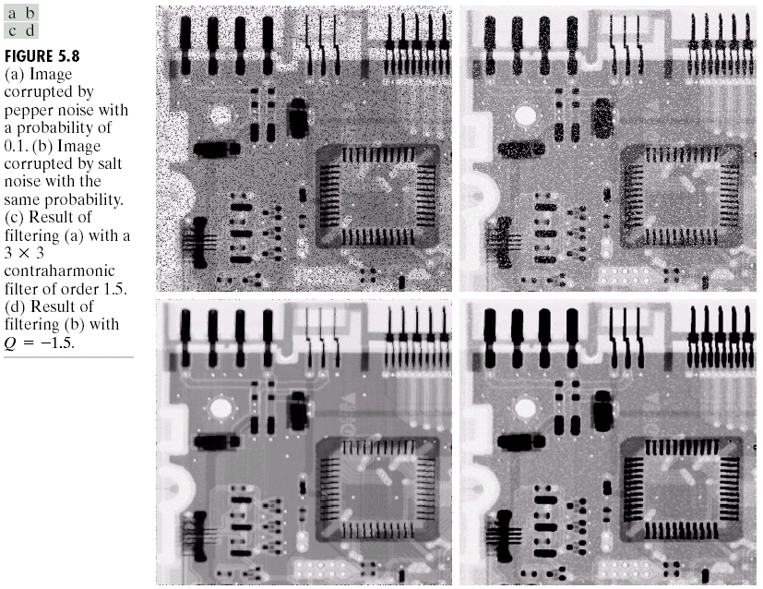
Noise Removal Examples (cont…)
Image
Corrupted
By Pepper
Noise
Images taken from Gonzalez & Woods, Digital Image Processing (2002)
Result of
Filtering Above
With 3*3
Contraharmonic
Q=1.5

Slide 22
Noise Removal Examples (cont…)
Image
Corrupted
By Salt
Noise
Images taken from Gonzalez & Woods, Digital Image Processing (2002)
Result of
Filtering Above
With 3*3
Contraharmonic
Q=-1.5

Slide 23
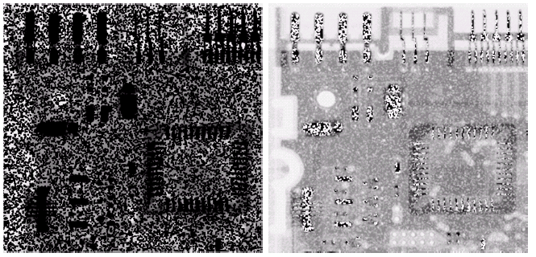
Contraharmonic Filter: Here Be Dragons
Choosing the wrong value for Q when using the contraharmonic filter can have drastic results
Images taken from Gonzalez & Woods, Digital Image Processing (2002)

Slide 24
Order Statistics Filters
Spatial filters that are based on ordering the pixel values that make up the neighbourhood operated on by the filter
Useful spatial filters include
  Median filter
  Max and min filter
  Midpoint filter
  Alpha trimmed mean filter
Images taken from Gonzalez & Woods, Digital Image Processing (2002)

Slide 25
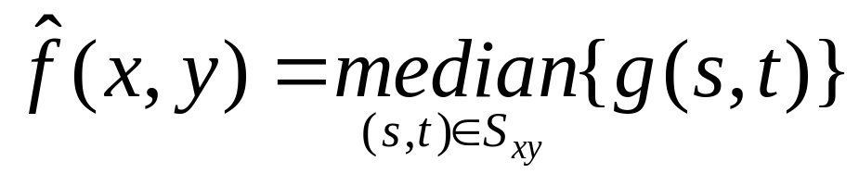
Median Filter
Median Filter:
Excellent at noise removal, without the smoothing effects that can occur with other smoothing filters
Particularly good when salt and pepper noise is present

Slide 26
Noise Corruption Example
Original Image
x
Filtered Image
x
54
52
57
55
56
52
51
50
49
51
50
52
53
58
51
204
52
52
0
57
60
48
50
51
49
53
59
63
49
51
52
55
58
64
67
50
54
57
60
63
67
70
51
55
59
62
65
69
72
Image f (x, y)
Image f (x, y)
y
y

Slide 27
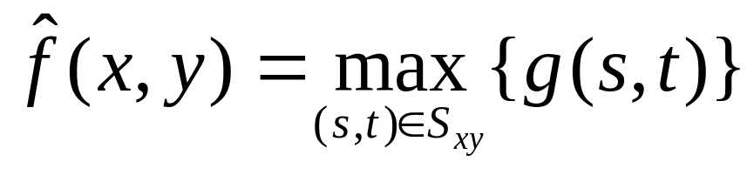
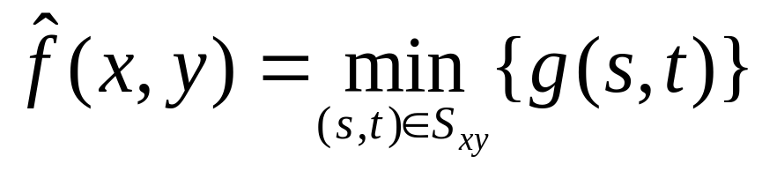
Max and Min Filter
Max Filter:
Min Filter:
Max filter is good for pepper noise and min is good for salt noise

Slide 28
Noise Corruption Example
Original Image
x
Filtered Image
x
54
52
57
55
56
52
51
50
49
51
50
52
53
58
51
204
52
52
0
57
60
48
50
51
49
53
59
63
49
51
52
55
58
64
67
50
54
57
60
63
67
70
51
55
59
62
65
69
72
Image f (x, y)
Image f (x, y)
y
y

Slide 29
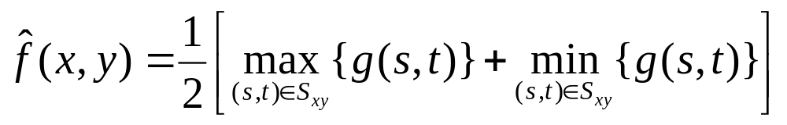
Midpoint Filter
Midpoint Filter:
Good for random Gaussian and uniform noise

Slide 30
Noise Corruption Example
Original Image
x
Filtered Image
x
54
52
57
55
56
52
51
50
49
51
50
52
53
58
51
204
52
52
0
57
60
48
50
51
49
53
59
63
49
51
52
55
58
64
67
50
54
57
60
63
67
70
51
55
59
62
65
69
72
Image f (x, y)
Image f (x, y)
y
y

Slide 31
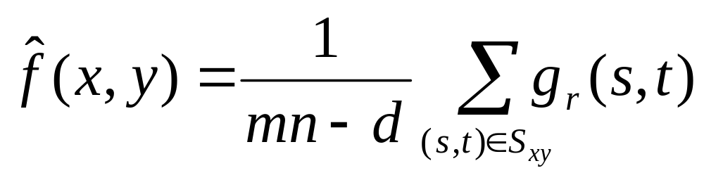
Alpha-Trimmed Mean Filter
Alpha-Trimmed Mean Filter:
We can delete the d/2 lowest and d/2 highest grey levels
So g_{r}(s, t) represents the remaining mn – d pixels

Slide 32
Noise Corruption Example
Original Image
x
Filtered Image
x
54
52
57
55
56
52
51
50
49
51
50
52
53
58
51
204
52
52
0
57
60
48
50
51
49
53
59
63
49
51
52
55
58
64
67
50
54
57
60
63
67
70
51
55
59
62
65
69
72
Image f (x, y)
Image f (x, y)
y
y

Slide 33
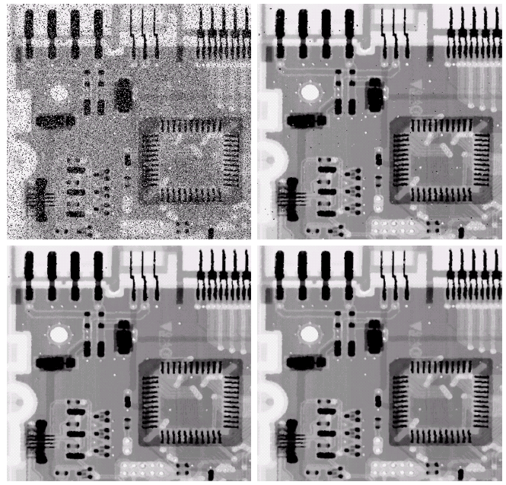
Noise Removal Examples
Image
Corrupted
By Salt And
Pepper Noise
Result of 1
Pass With A
3*3 Median
Filter
Images taken from Gonzalez & Woods, Digital Image Processing (2002)
Result of 2
Passes With
A 3*3 Median
Filter
Result of 3
Passes With
A 3*3 Median
Filter

Slide 34
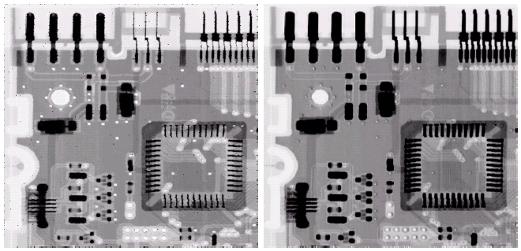
Noise Removal Examples (cont…)
Image
Corrupted
By Pepper
Noise
Image
Corrupted
By Salt
Noise
Images taken from Gonzalez & Woods, Digital Image Processing (2002)
Result Of
Filtering
Above
With A 3*3
Max Filter
Result Of
Filtering
Above
With A 3*3
Min Filter

Slide 35
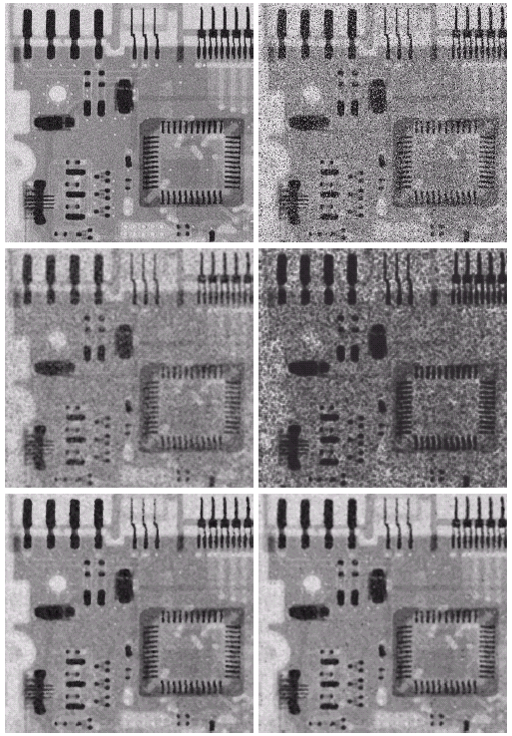
Noise Removal Examples (cont…)
Image
Corrupted
By Uniform
Noise
Image Further
Corrupted
By Salt and
Pepper Noise
Filtered By
5*5 Arithmetic
Mean Filter
Filtered By
5*5 Geometric
Mean Filter
Images taken from Gonzalez & Woods, Digital Image Processing (2002)
Filtered By
5*5 Median
Filter
Filtered By
5*5 Alpha-Trimmed
Mean Filter

Slide 36
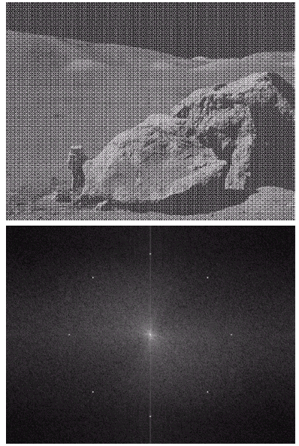
Periodic Noise
Typically arises due to
electrical or electromagnetic
interference
Gives rise to regular noise
patterns in an image
Frequency domain techniques in the Fourier domain are most effective at removing periodic noise
Images taken from Gonzalez & Woods, Digital Image Processing (2002)

Slide 37
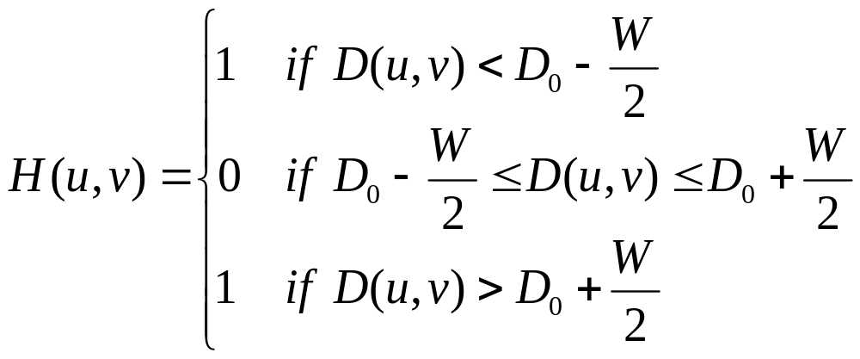
Band Reject Filters
Removing periodic noise form an image involves removing a particular range of frequencies from that image
Band reject filters can be used for this purpose
An ideal band reject filter is given as follows:

Slide 38
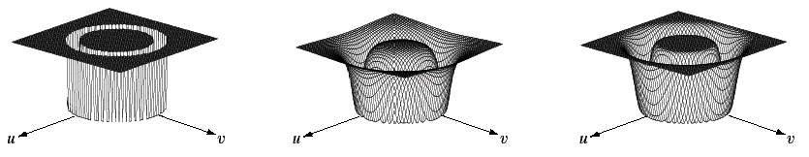
Band Reject Filters (cont…)
The ideal band reject filter is shown below, along with Butterworth and Gaussian versions of the filter
Images taken from Gonzalez & Woods, Digital Image Processing (2002)
Ideal Band
Reject Filter
Butterworth
Band Reject
Filter (of order 1)
Gaussian
Band Reject
Filter

Slide 39
Band Reject Filter Example
Image corrupted by sinusoidal noise
Fourier spectrum of corrupted image
Images taken from Gonzalez & Woods, Digital Image Processing (2002)
Butterworth band reject filter
Filtered image

Slide 40
Summary
In this lecture we will look at image restoration for noise removal
Restoration is slightly more objective than enhancement
Spatial domain techniques are particularly useful for removing random noise
Frequency domain techniques are particularly useful for removing periodic noise

Slide 41
Adaptive Filters
The filters discussed so far are applied to an entire image without any regard for how image characteristics vary from one point to another
The behaviour of adaptive filters changes depending on the characteristics of the image inside the filter region
We will take a look at the adaptive median filter

Slide 42
Adaptive Median Filtering
The median filter performs relatively well on impulse noise as long as the spatial density of the impulse noise is not large
The adaptive median filter can handle much more spatially dense impulse noise, and also performs some smoothing for non-impulse noise
The key insight in the adaptive median filter is that the filter size changes depending on the characteristics of the image

Slide 43
Adaptive Median Filtering (cont…)
Remember that filtering looks at each original pixel image in turn and generates a new filtered pixel
First examine the following notation:
  z_{min} = minimum grey level in S_{xy}
  z_{max} = maximum grey level in S_{xy}
  z_{med} = median of grey levels in S_{xy}
  z_{xy} = grey level at coordinates (x, y)
  S_{max} =maximum allowed size of S_{xy}

Slide 44
Adaptive Median Filtering (cont…)
Level A: A1 = z_{med} – z_{min}
A2 = z_{med} – z_{max}
If A1 > 0 and A2 < 0, Go to level B
Else increase the window size
If window size ≤ repeat S_{max} level A
Else output z_{med}
Level B: B1 = z_{xy} – z_{min}
B2 = z_{xy} – z_{max}
If B1 > 0 and B2 < 0, output z_{xy}
Else output z_{med}

Slide 45
Adaptive Median Filtering (cont…)
The key to understanding the algorithm is to remember that the adaptive median filter has three purposes:
  Remove impulse noise
  Provide smoothing of other noise
  Reduce distortion

Slide 46
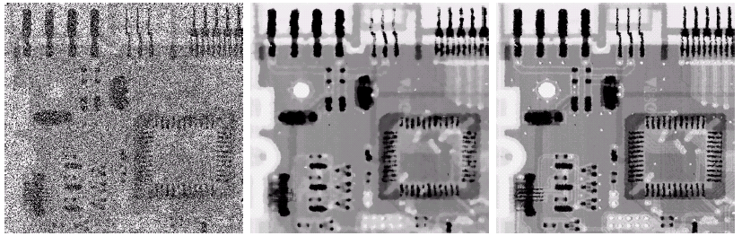
Adaptive Filtering Example
Images taken from Gonzalez & Woods, Digital Image Processing (2002)
Image corrupted by salt and pepper noise with probabilities P_{a} = P_{b}=0.25
Result of filtering with a 7 * 7 median filter
Result of adaptive median filtering with i = 7

