Slide 1
Image Representation and Description – Boundary and Region Descriptors
Dr. Jiajun Wang
School of Electronics and Information Engineering
Soochow University

Slide 2
Image Descriptors
Outline
Simple boundary descriptor
Simple region descriptor

Slide 3
Image Descriptors
Tasks in image descriptor
Chose a representation scheme
  Chain codes (4- and 8-directional chain codes)
  Signature (1-D functional representation)
  Skeleton of a region – morphological operator
Describe the region based on the scheme
  Boundary descriptors
    Length, diameter, shape numbers, Fourier descriptors
    Moments of signatures
  Region descriptors
    Area, compactness, principal axes
    Texture
    Moment

Slide 4
Image Descriptors
Simple boundary descriptor
Length
  For a chain-coded curve with unit spacing
  Length = the number of vertical and horizontal components + the number of diagonal components * 2^{1/2}
Diameter
  Maximum distance between any two points on the boundary
  The line formed by this two points is called the major axis of the boundary
Shape numbers

Slide 5
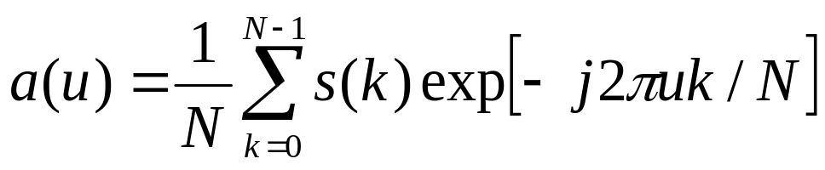
Image Descriptors
Fourier descriptors
Points on the boundary can be treated as a complex number s(k)=x(k)+jy(k)
Fourier descriptor : the discrete Fourier transform (DFT) of the s(k):
Usually, only the first few coefficients are used to reprsent the shape (k=0:M, M<N)

Slide 6
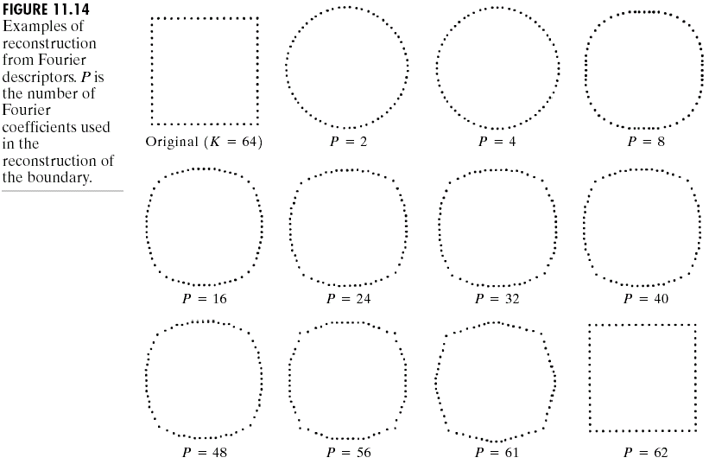
Image Descriptors
Fourier descriptors - example

Slide 7
Image Descriptors
Simple region descriptor
Area
  The number of pixels contained within its boundary
Perimeter
  The length of its boundary
Compactness
  perimeter * perimeter / area
  Insensitive to scale changes
  Insensitive to orientation

Slide 8
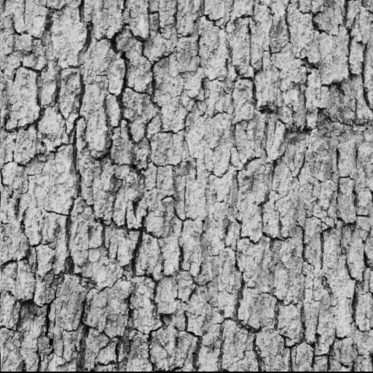
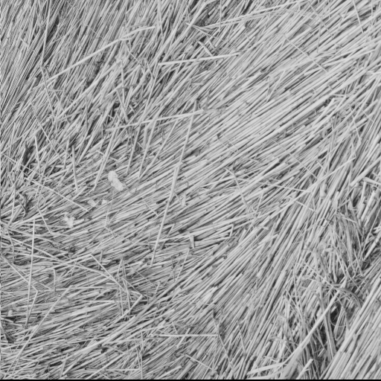
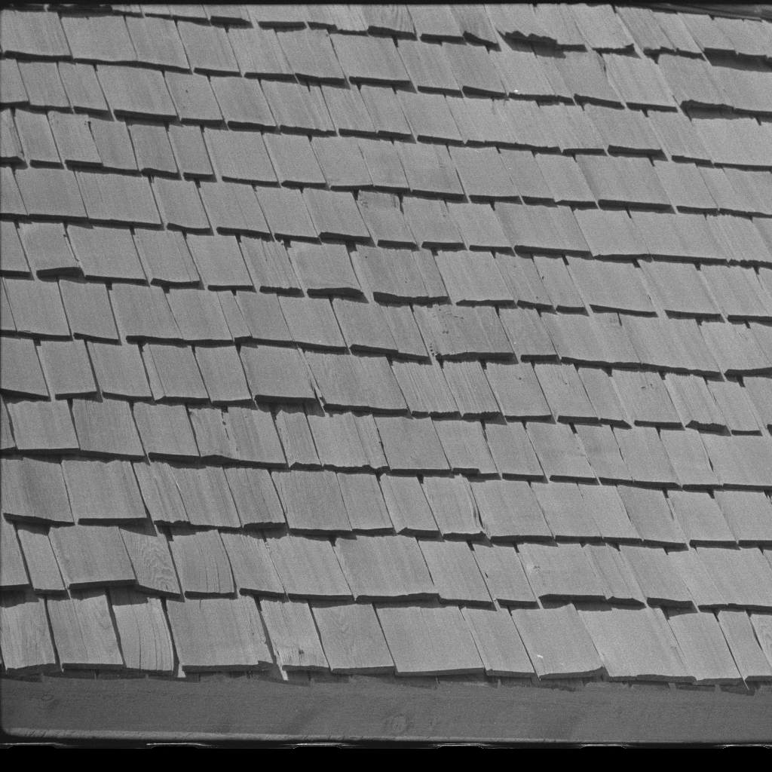
Image Descriptors
Texture descriptor
Statistical approach
  Describe the smoothness, coarseness, and graininess of the of region
Structural approach
  Describe the arrangement
Spectral approach
  Use Fourier spectrum to detect global periodicity

Slide 9
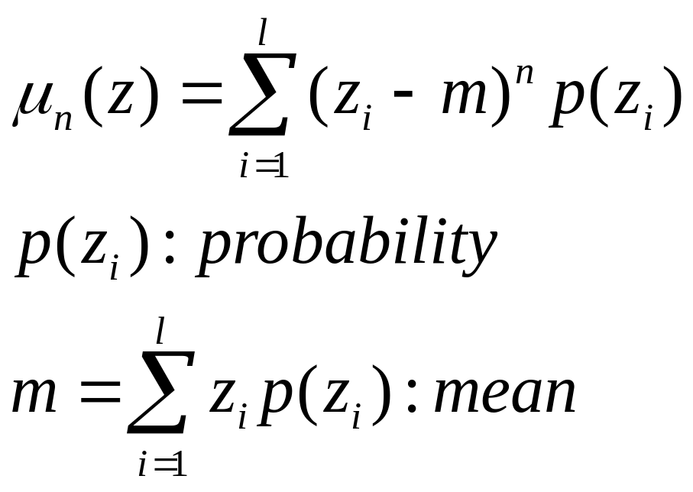
Image Descriptors
Statistical approach
Use the moment of gray-level histogram to describe the texture

Slide 10
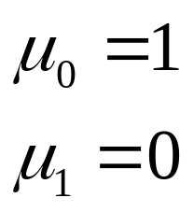
Image Descriptors
Special moments
The second moment is the variance and can be used to describe the smoothness
The third moment (skewness): measure skewness of the histogram
The fourth moment (kurtosis): measure the flatness of the histogram

Slide 11
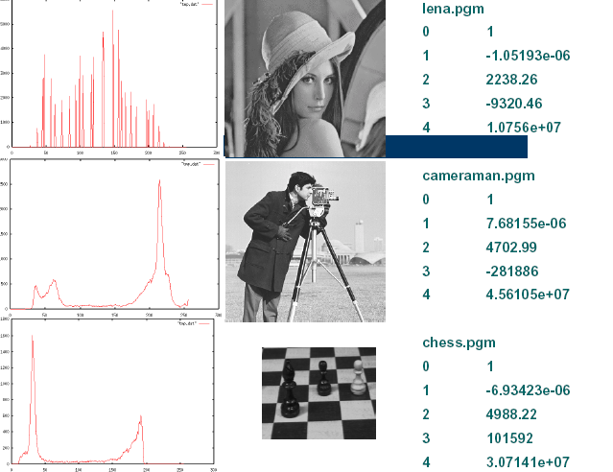
Image Descriptors
Moments - examples

Slide 12
Image Descriptors
Spectral approach
Fourier spectrum is ideally suited for describing the directionality of periodic or almost periodic 2-D patterns in an image
Global texture patterns can be easily distinguishable as concentrations of high-energy bursts in the spectrum
  Prominent peaks give the principal direction of the texture patterns
  The location of the peaks give the fundamental spatial period of the patterns
  Eliminating any periodic components via filtering leaves nonperiodic image elements which can then be described by statistical techneques

Slide 13
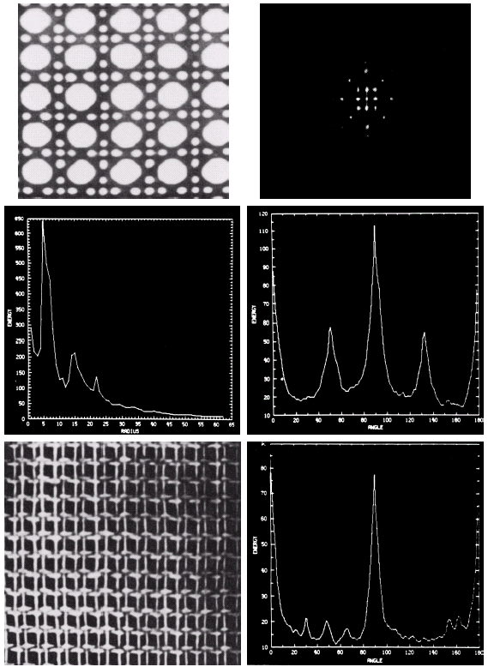
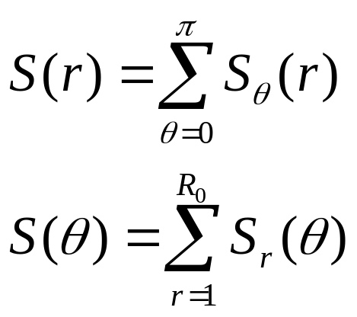

Image Descriptors
Spectral approaches - examples

Slide 14
Image Representation and Description – Representation Schemes
Dr. Jiajun Wang
School of Electronics and Information Engineering
Soochow University

Slide 15
Image Representation
Outline
Tasks in image representation / description
Representation scheme

Slide 16
Image Representation
Tasks in image representation / description
Choose a representation scheme
  Using external characteristics – Shape properties
    Boundary
      Chain codes
      signatures
  Using internal characteristics – Regional properties (color, texture, etc.)
    Pixels comprise the region
      Skeleton (medial axis)
Describe the region based on the scheme
  Scaling (size) invariant
  Translation invariant
  Rotation invariant

Slide 17
Image Representation
Representation scheme
Chain codes
Signatures
Skeleton of region

Slide 18
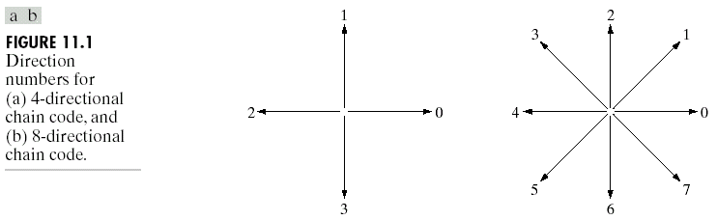
Image Representation
Chain codes
Represent a boundary by a connected sequence of straight-line segments of specified length and direction
4-directional chain codes
8-directional chain codes

Slide 19
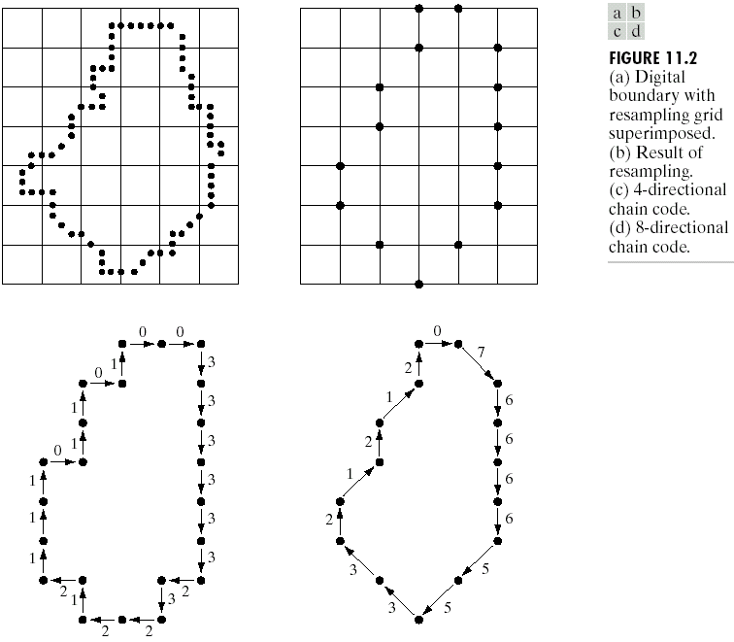
Image Representation
Chain codes - example

Slide 20
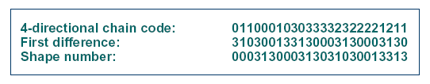
Image Representation
Chain codes normalization
Normalization for rotation – first difference
  Counting (counterclockwise) the number of direction changes that separate two adjacent element of the code
Normalization for starting position – shape number
  The first difference of smallest magnitude
Normalization for size
  Multi-scaling resampling

Slide 21
Image Representation
Signatures
A 1-D functional representation of a boundary
Basic idea : reduce the boundary representation to a 1-D function, which might be easier to describe than a 2-D boundary
One simple approach : use the distance from the centroid to the boundary as a function of angle. It is invariant to translation, but not to rotation and scaling.
  Rotation : select the farthest point from the centroid as the starting point
  Scaling : normalize the function by variance

Slide 22
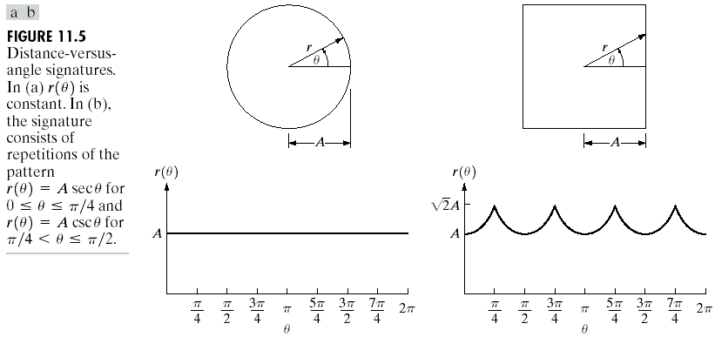
Image Representation
Signatures - example

Slide 23
Image Representation
Skeleton of a region
Use skeleton to represent a region
Skeletonizing (thinning) a region
  Medial axis transformation (MAT) : for each point (p) in a region R, find its closest neighbor in the boundary (B). If it has more than one closest neighbor in B, then this point belongs to the medial axis of the region (skeleton)
  Computationally expensive
  Refer to pp.651 for a fast MAT algorithm for binary image

Slide 24
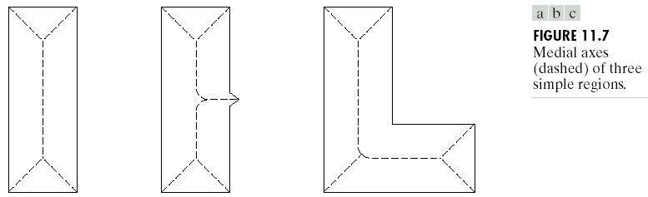
Image Representation
Skeleton of a region - example

