Slide 1
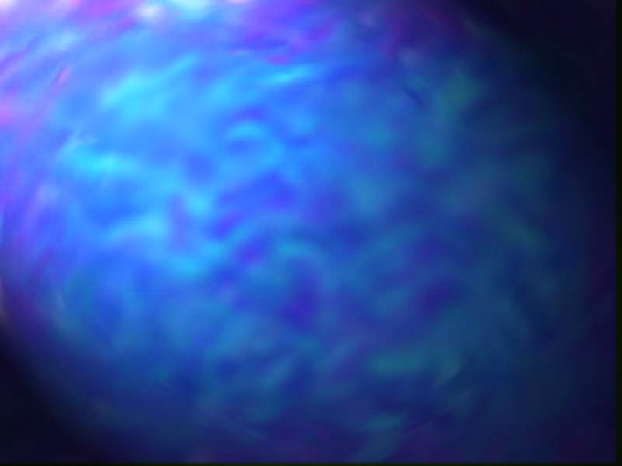
Chapter 8
Content-Based Image Retrieval

Slide 2
Image Database Queries
Query By Keyword: Some textual attributes (keywords) should be maintained for each image. The image can be indexed according to these attributes, so that they can be rapidly retrieved when a query is issued. This type of query can be expressed in Structured Query Language (SQL).
Query By Example (QBE): User just show the system a sample image, then the system should be able to return similar images or images containing similar objects.

Slide 3
Image Distance & Similarity Measures
Color Similarity
Texture Similarity
Shape Similarity
Object & Relationship similarity

Slide 4
Color Similarity
Color percentages matching: R:20%, G:50%, B:30%
Color histogram matching
D_{hist}(I,Q)=(h(I)-h(Q))^{T}A(h(I)-h(Q))
  A is a similarity matrix ➔ colors that are very similar should have similarity values close to one.

Slide 5
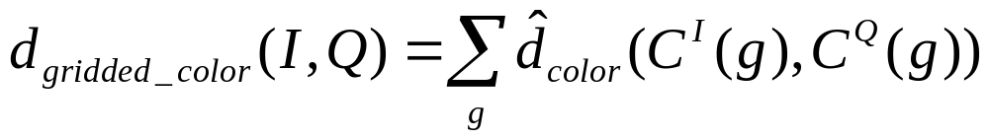
Color Similarity
Color layout matching: compares each grid square of the query to the corresponding grid square of a potential matching image and combines the results into a single image distance ➔
where C^{I}(g) represents the color in grid square g of a database image I and C^{Q}(g) represents the color in the corresponding grid square g of the query image Q. some suitable representations of color are
    Mean
    Mean and standard deviation
    Multi-bin histogram

Slide 6
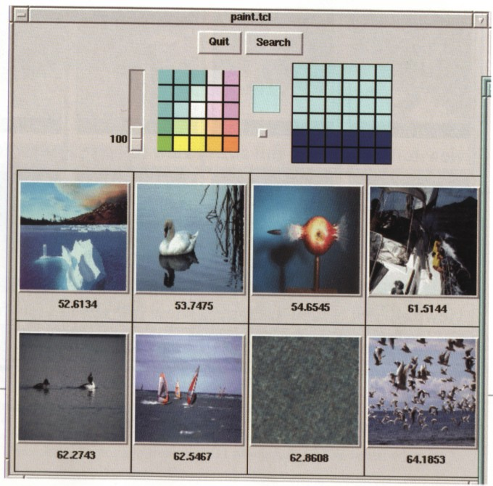
IQ based on Color Layout

Slide 7
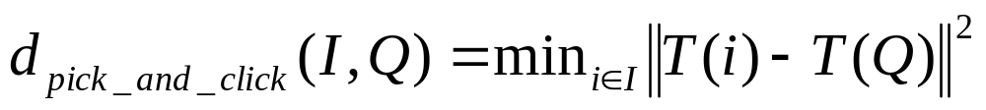
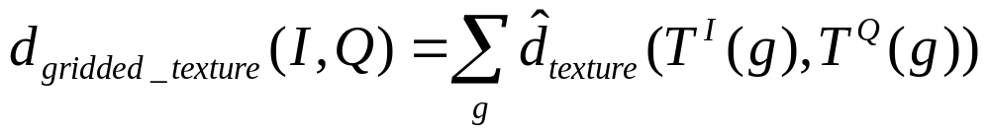
Texture Similarity
Pick and click
  Suppose T(I) is a texture description vector which is a vector of numbers that summarizes the texture in a given image I (for example: Laws texture energy measures), then the texture distance measure is defined by
Texture layout

Slide 8
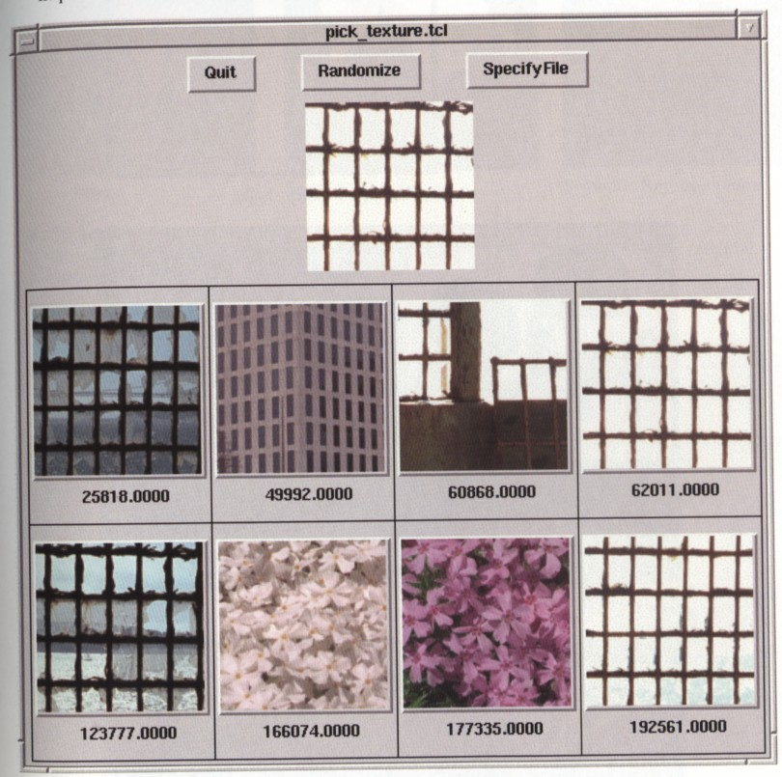
IQ based on Pick and Click

Slide 9
Shape Similarity
Shape Histogram
Boundary Matching
Sketch Matching

Slide 10
1. Shape Histogram
Projection matching
  Horizontal & vertical projection: Each row and each column become a bin in the histogram. The count that is stored in a bin is the number of 1-pixels that appear in that row or column.
  Diagonal projection: An alternative is to define the bins from the top left to the bottom right of the shape.
  Size invariant ➔ the number of row bins and the number of column bins in the bounding box can be fixed, histograms can be normalized before matching.
  Translation invariant
  Rotation invariant ➔ compute the axis of the best-fitting ellipse and rotate the shape

Slide 11
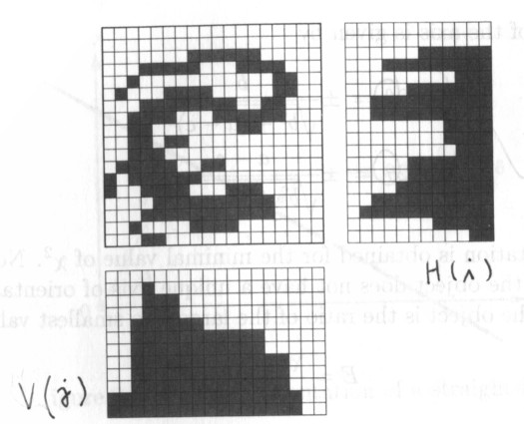
Horizontal and vertical projections

Slide 12
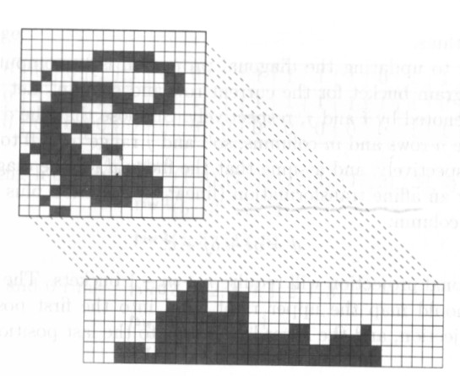
Diagonal projection

Slide 13
1. Shape Histogram
Orientation histogram
  Construct a histogram over the tangent angle at each pixel on the boundary of the shape.
  Size invariant ➔ histograms can be normalized before matching.
  Translation invariant
  Rotation invariant ➔ choosing the bin with the largest count to be the first bin.
  Starting point invariant

Slide 14
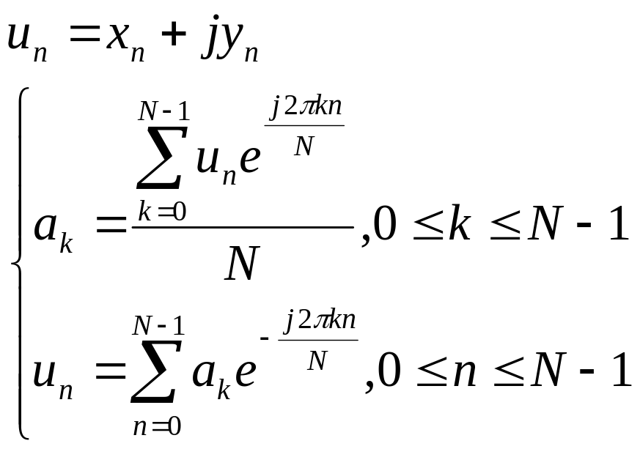
2. Boundary Matching
1D Fourier Transform on the boundary

Slide 15
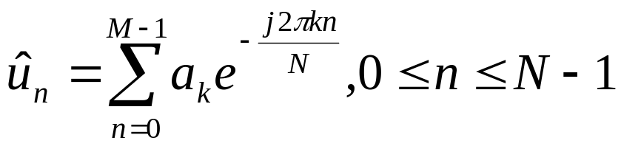
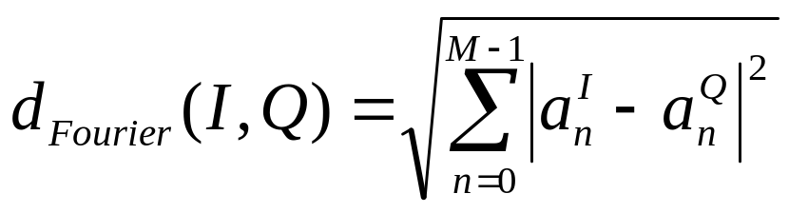
Fourier Descriptors
If only the first M coefficients (a₀, a₁, …, a_{M-1}) are used, then
is an approximation of u_{n}
the coefficients (a₀, a₁, …, a_{M-1}) is called Fourier Descriptors
The Fourier distance measure is defined as:

Slide 16
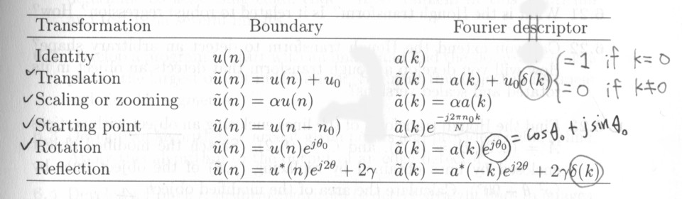
Properties of Fourier Descriptors
Simple geometric transformations of a boundary, such as translation, rotation, and scaling, are related to simple operations of the boundary’s Fourier descriptors.

Slide 17
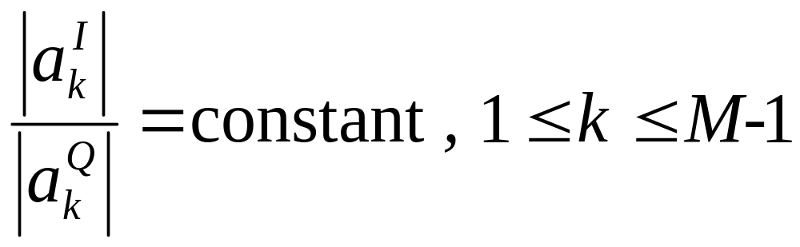
A secret formula
A formula for Fourier Descriptor that is invariant to translation, scaling, rotation, and starting point.

Slide 18
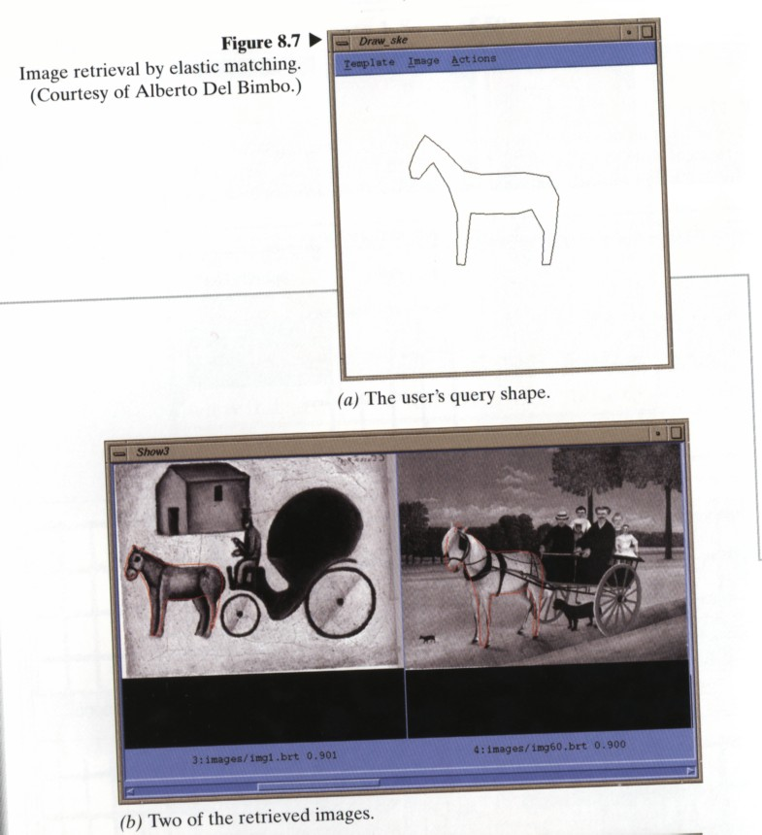
IQ based on Boundary Matching

Slide 19
3. Sketch Matching
Affine transformation to specified size and applying median filter.
Edge detection using a gradient-based edge-finding algorithm ➔ Refined edge image
Thinning and shrinking ➔ Abstract image
The images are divided into grid squares and matching is performed based on local correlation.

Slide 20
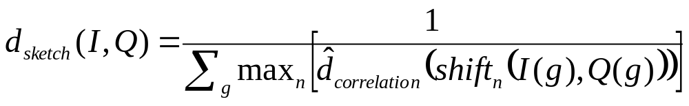
3. Sketch Matching
The sketch distance measure is the inverse of the sum of each of the local correlations ➔
where I(g) refres to grid square g of the abstract image I, Q(g) refers to grid square g of the linear sketch resulting from query image Q.

Slide 21
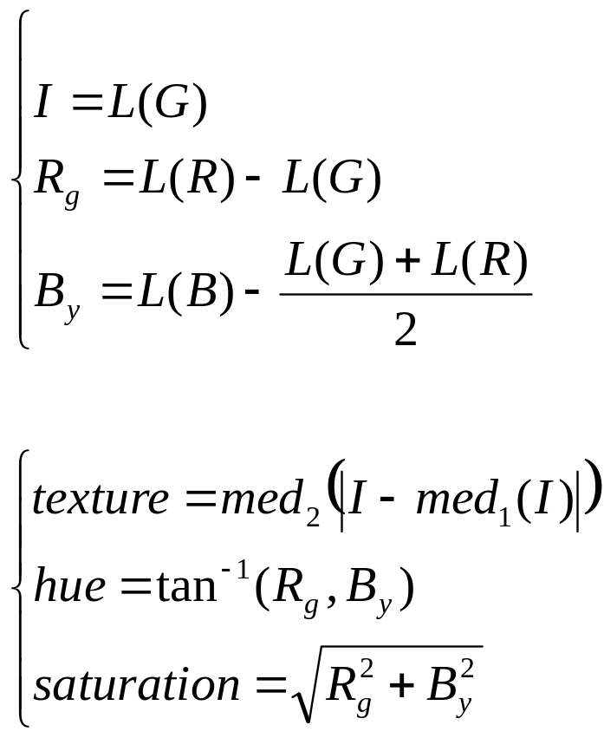
Object and Relational Similarity
Face finding: Neural net classifier
Flesh finding:
then threshold based on

