Slide 1
SE-565
Software System Requirements
More UML Diagrams
Notes:
SWE 2623 - Software Systems Requirements
August 2002

Slide 2
More UML Diagrams
Activity diagrams
Deployment diagrams
Interaction diagram
  Sequence diagrams
  Collaboration diagrams
Package diagrams
State diagrams

Slide 3
Activity Diagrams - Topics
What is an Activity?
Activity Diagrams – Notation
Activity Diagrams – 5 Examples

Slide 4
What is an Activity?
Two definitions
  In a conceptual diagram, an activity is some task that needs to be done, whether by a human or a computer
  In a specification-perspective diagram or an implementation-perspective diagram, an activity is a method on a class
Activity arrangement
  Sequential – one activity is followed by another
  Parallel – two or more sets of activities are performed concurrently, and order is irrelevant
    Interleaving is permitted – we can jump between the parallel flows

Slide 5
What is an Activity? (concluded)
Activity Diagrams are used to describe activities
  Activity Diagrams are useful for describing complicated methods
  Activity Diagrams are useful for describing use cases, since, after all, a use case is an interaction, which is a form of activity
Using Activity Diagrams with Use Cases
  Start with a coarse-grained use case, which is composed of subordinate use cases
  For the complicated subordinate use cases, use Activity Diagrams rather than Use Case Diagrams
Activity Diagrams are like Flow Charts, but Flow Charts are usually limited to sequential activities while Activity Diagrams can show parallel activities as well

Slide 6
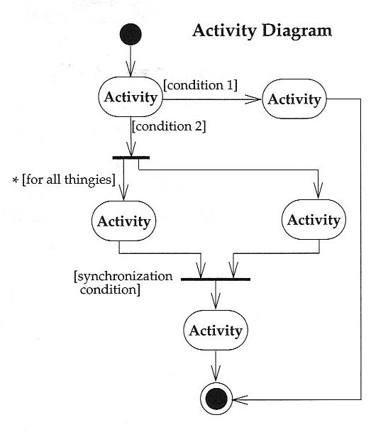
Activity Diagrams - Notation
Start at the top black circle
If condition 1 is TRUE, go right; if condition 2 is TRUE, go down
At first bar (a synchronization bar), break apart to follow 2 parallel paths
At second bar, come together to proceed only when both parallel activities are done

Slide 7
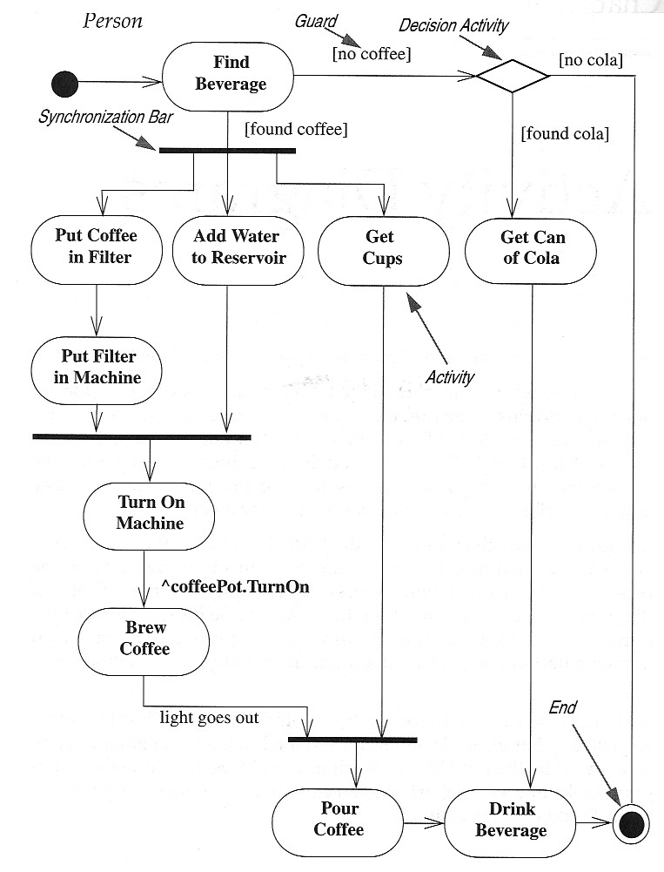
Activity Diagrams – Notation (concluded)
Activity – an oval
Trigger – path exiting an activity
Guard – each trigger has a guard, a logical expression that evaluates to “true” or “false”
Synchronization Bar – can break a trigger into multiple triggers operating in parallel or can join multiple triggers into one when all are complete
Decision Diamond – used to describe nested decisions (the first decision is indicated by an activity with multiple triggers coming out of it)

Slide 8
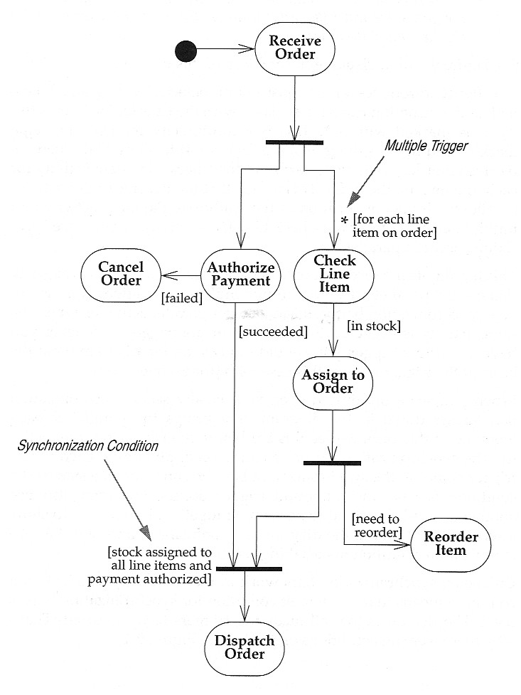
Activity Diagrams – Example 1 of 5
Use Case: Receiving an Order

Slide 9
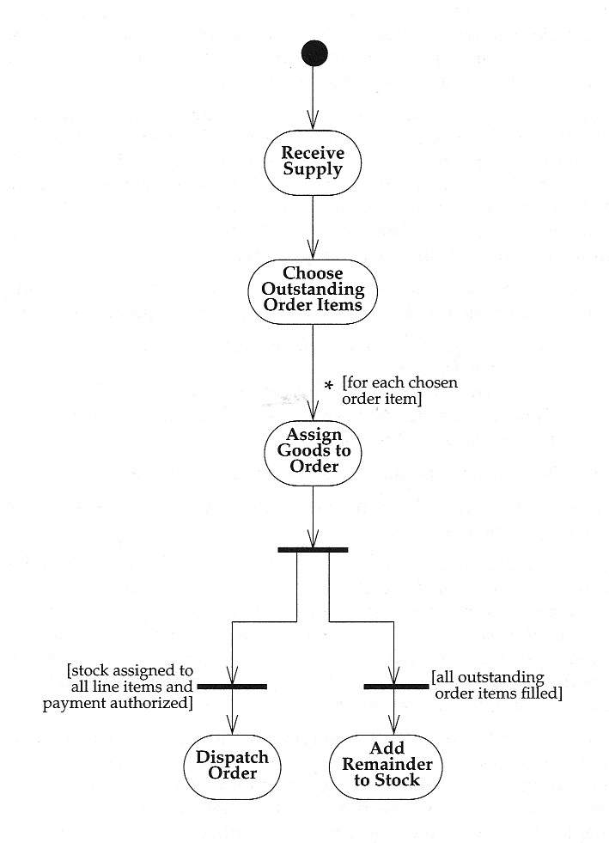
Activity Diagram – Example 2 of 5
Use Case: Receiving a Supply

Slide 10
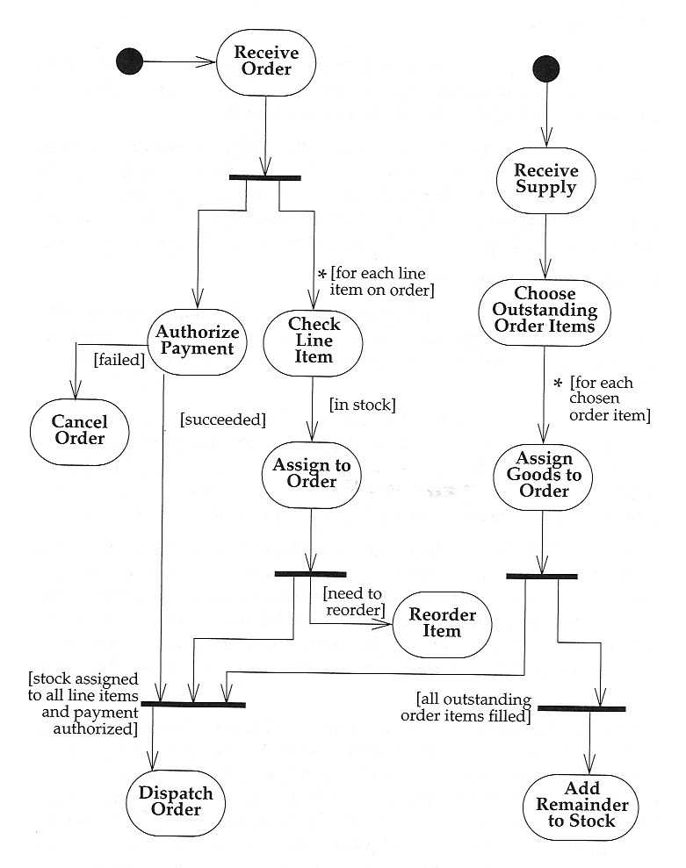
Activity Diagram – Example 3 of 5
Use Case: Receiving an Order and Receiving a Supply

Slide 11
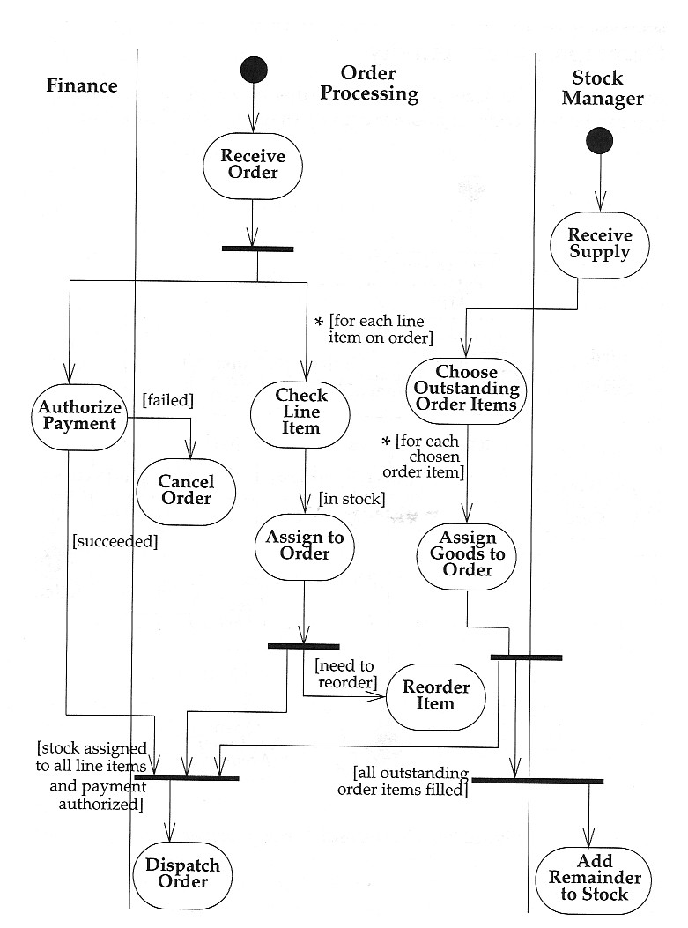
Activity Diagram – Example 4 of 5
Swimlanes - Activity Diagrams that show activities by class
Arrange activity diagrams into vertical zones separated by lines
Each zone represents the responsibilities of a particular class (in this example, a particular department)

Slide 12
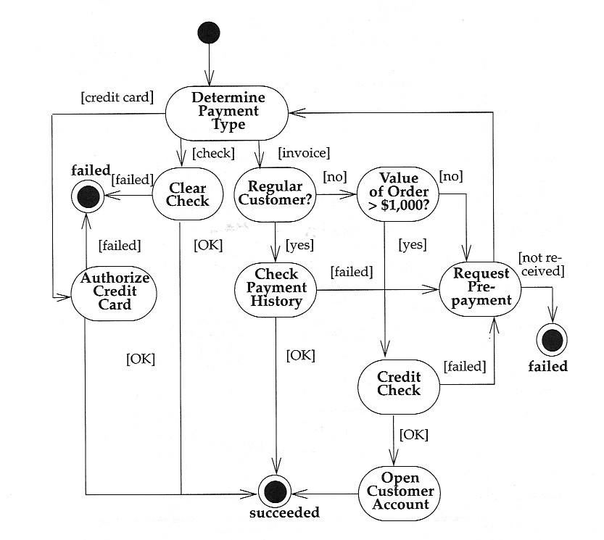
Activity Diagram – Example 5 of 5
Decomposing an Activity
An activity can be decomposed into a further Activity Diagram
When an Activity Diagram represents a decomposition of a higher-level activity, there can be only one start point

Slide 13
Deployment Diagrams - Topics
What is a Deployment Diagram?
Deployment Diagrams – Notation and Example

Slide 14
What is a Deployment Diagram?
Deployment Diagram – a diagram that shows the physical relationships among software and hardware components in a system
  Components – physical modules of code
  Connections – show communication paths
  Dependencies – show how components communicate with other components
  Nodes – computational units, usually a pieces of hardware

Slide 15
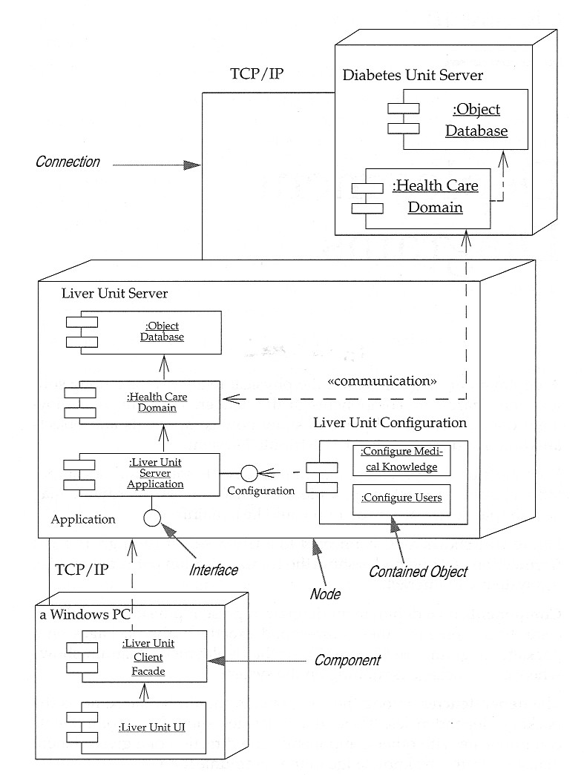
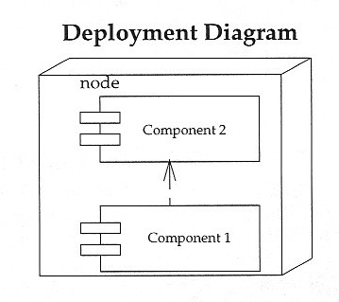
Deployment Diagrams – Notation and Example

Slide 16
Interaction Diagrams - Topics
What is an Interaction Diagram?
What is a Sequence Diagram?
Sequence Diagrams – Notation
Sequence Diagrams – 2 Examples
What is a Collaboration Diagram?
Collaboration Diagrams – Notation
Collaboration Diagrams – 2 Examples

Slide 17
What is an Interaction Diagram?
Interaction Diagrams – models that describe how groups of objects collaborate in some behavior
  Typically, an Interaction Diagram captures the behavior of a single use case
  The Interaction Diagram shows a number of objects and the messages that are passed between these objects within the use case
2 kinds of Interaction Diagrams
  Sequence Diagrams
  Collaboration Diagrams

Slide 18
What is a Sequence Diagram?
Sequence Diagram – shows object interactions
  Contains 2 or more objects
    Some objects are static (shown in boxes at the top)
    Some objects are created dynamically (shown in boxes lower in the diagram)
  Contains each object’s lifeline (shown as a dashed line extending down from the objects’ boxes)
  Show messages passed from one object to another, and the conditions which trigger messages to be sent
  Show self-delegations (messages sent from an object to itself)
  Show returns from messages

Slide 19
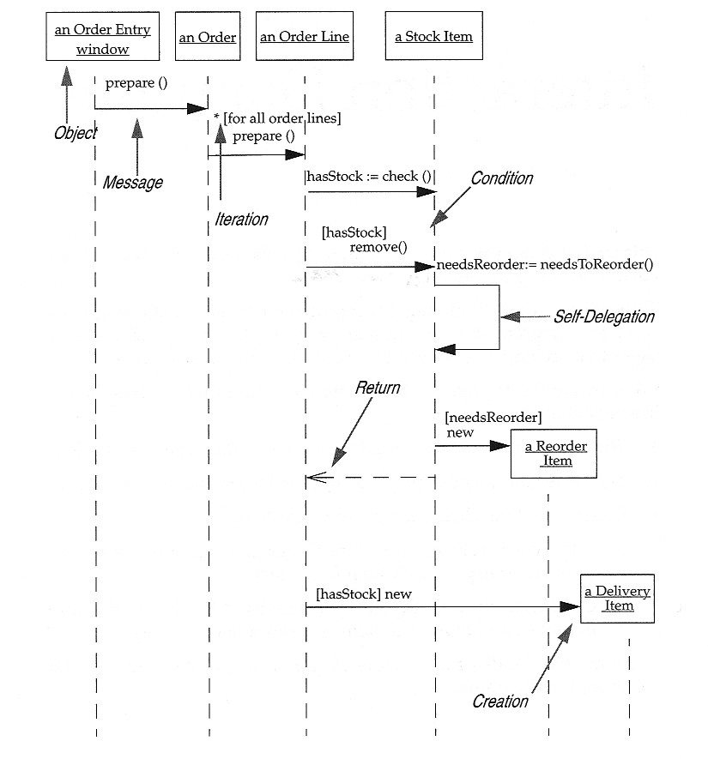
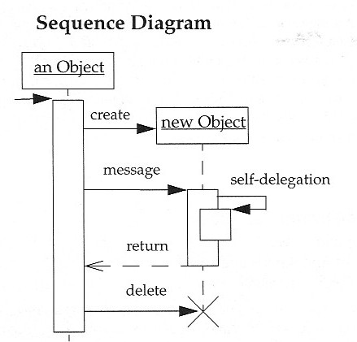
Sequence Diagrams - Notation

Slide 20
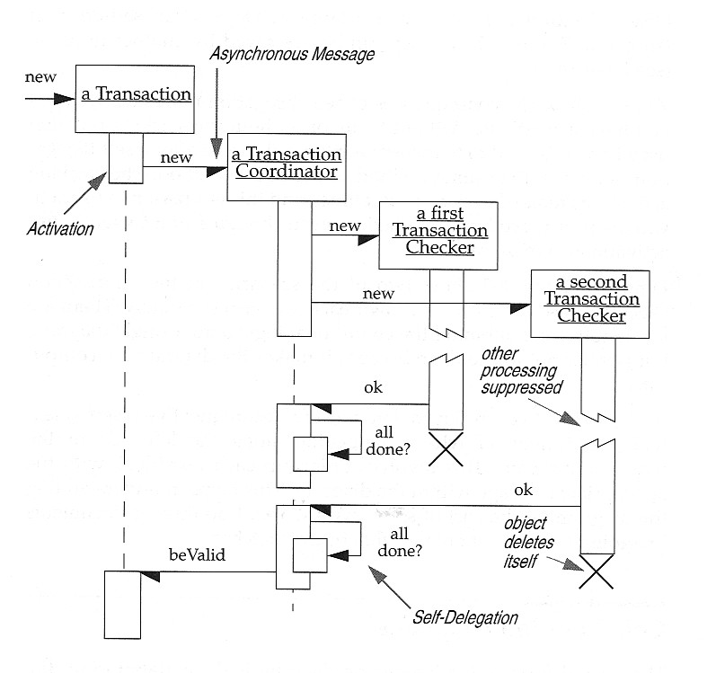
Sequence Diagrams – Example 1 of 2
Concurrent Processes
Activations - show when a method is active – either executing or waiting for a subroutine to return
Asynchronous Message – (half arrow) a message which does not block the caller, allowing the caller to carry on with its own processing; asynchronous messages can:
  Create a new thread
  Create a new object
  Communicate with a thread that is already running
Deletion – an object deletes itself
Synchronous Message – (full arrow) a message that blocks the caller

Slide 21
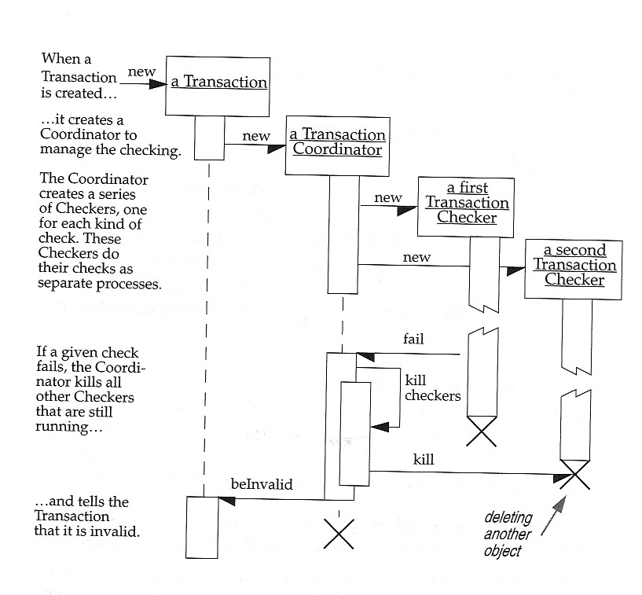
Sequence Diagrams – Example 2 of 2

Slide 22
What is a Collaboration Diagram?
Collaboration Diagrams – show objects as icons (rectangular boxes) with numbers on the messages to show their sequence; 2 numbering schemes:
  Simple (e.g., 1, 2, 3, …)
  Decimal (e.g., 1.1.1, 1.1.2, 1.2, …)
Objects are named using the syntax
ObjectName : ClassName
Sequence versus Collaboration Diagrams
  Sequence Diagrams emphasize sequence
  Collaboration Diagrams emphasize how objects are connected

Slide 23
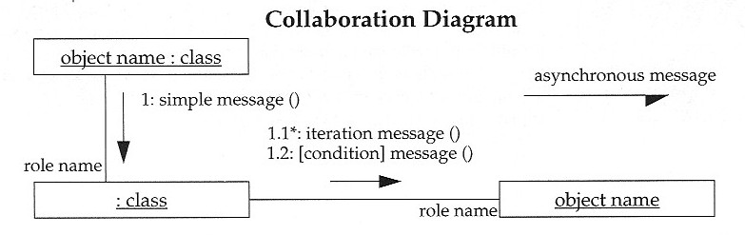
Collaboration Diagrams - Notation

Slide 24
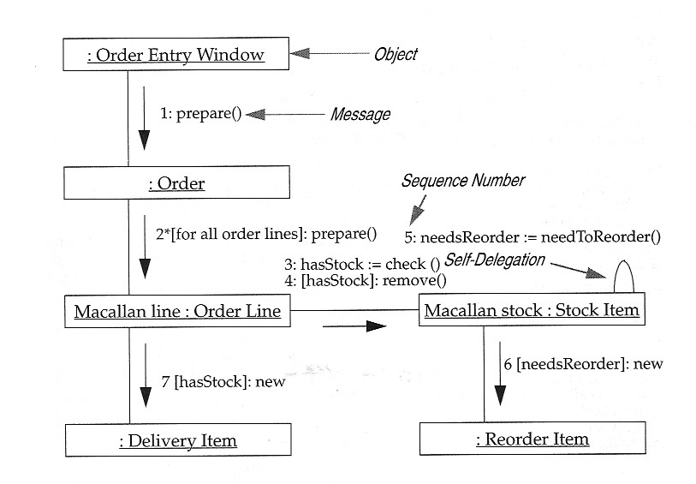
Collaboration Diagrams – Example 1 of 2
Simple
Numbering

Slide 25
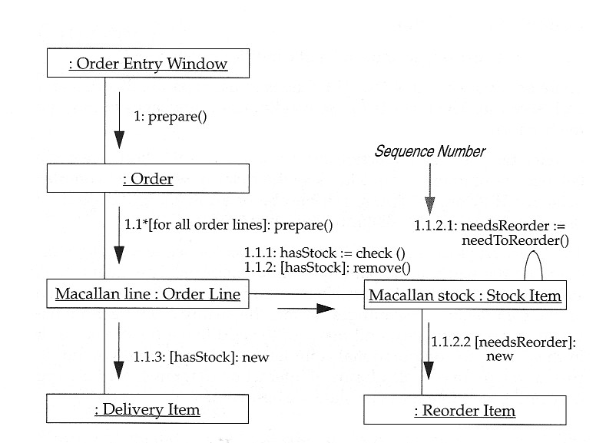
Collaboration Diagrams – Example 2 of 2
Decimal
Numbering

Slide 26
Package Diagrams - Topics
What is a Package?
Package Diagrams – Notation
Package Diagrams – 2 Examples

Slide 27
What is a Package?
Package – a grouping of classes (a conventional Package - a unit above a class in the abstraction hierarchy) and other packages (a Domain Package)
Package Diagram – a UML diagram that shows packages of classes and the dependencies among them
  A dependency exists between two elements if changes to the definition of one element may cause changes to the other
Classes have dependencies for several reasons, including:
  One class sends a message to another
  One class has another as part of its data
  One class mentions another as a parameter to an operation

Slide 28
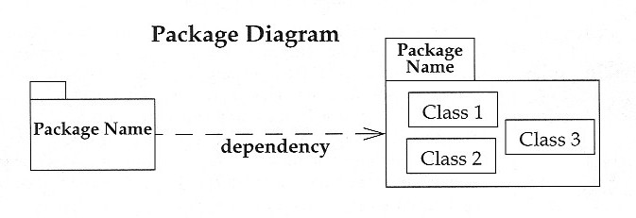
Package Diagrams - Notation
Package – contains classes
Dependency – changes to the definition (interface) of one package may cause changes in the other package
Reference: UML Distilled, Inside Cover

Slide 29
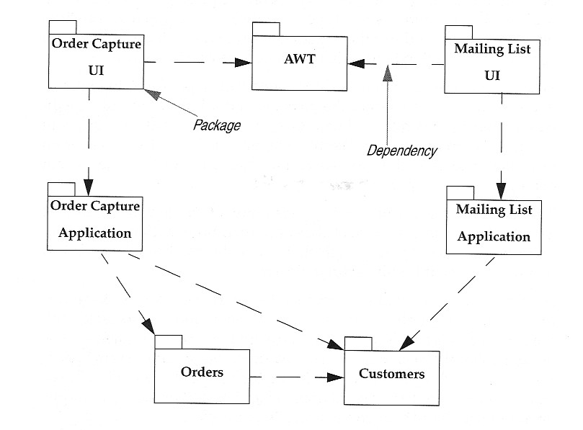
Package Diagrams – Example 1 of 2

Slide 30
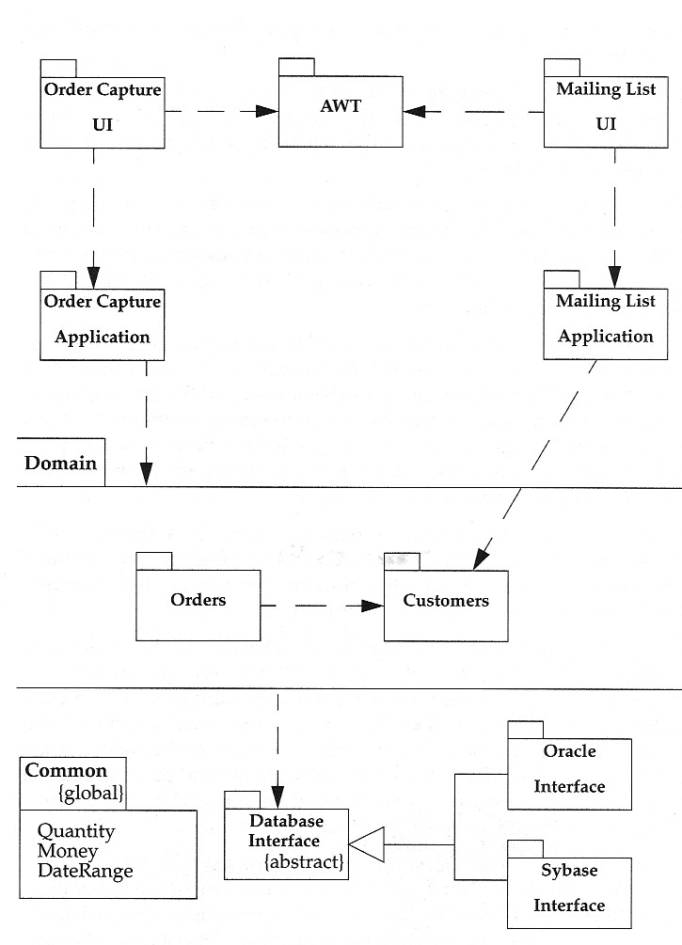
Package Diagrams – Example 2 of 2
Domain Package – a collection of related packages

Slide 31
State Diagrams - Topics
What are State Diagrams?
State Diagrams – Notation
State Diagrams – 3 Examples

Slide 32
What are State Diagrams?
State Diagrams – describe all the possible states an object can assume and how the object’s state changes as a result of events that affect the object
  State Diagrams are drawn for a single class to show the lifetime behavior of a single object
  State Diagrams are good for describing the behavior of an object across several use cases
In UML, State Diagrams
  Support superstates (states which contain other states)
  Support concurrency

Slide 33
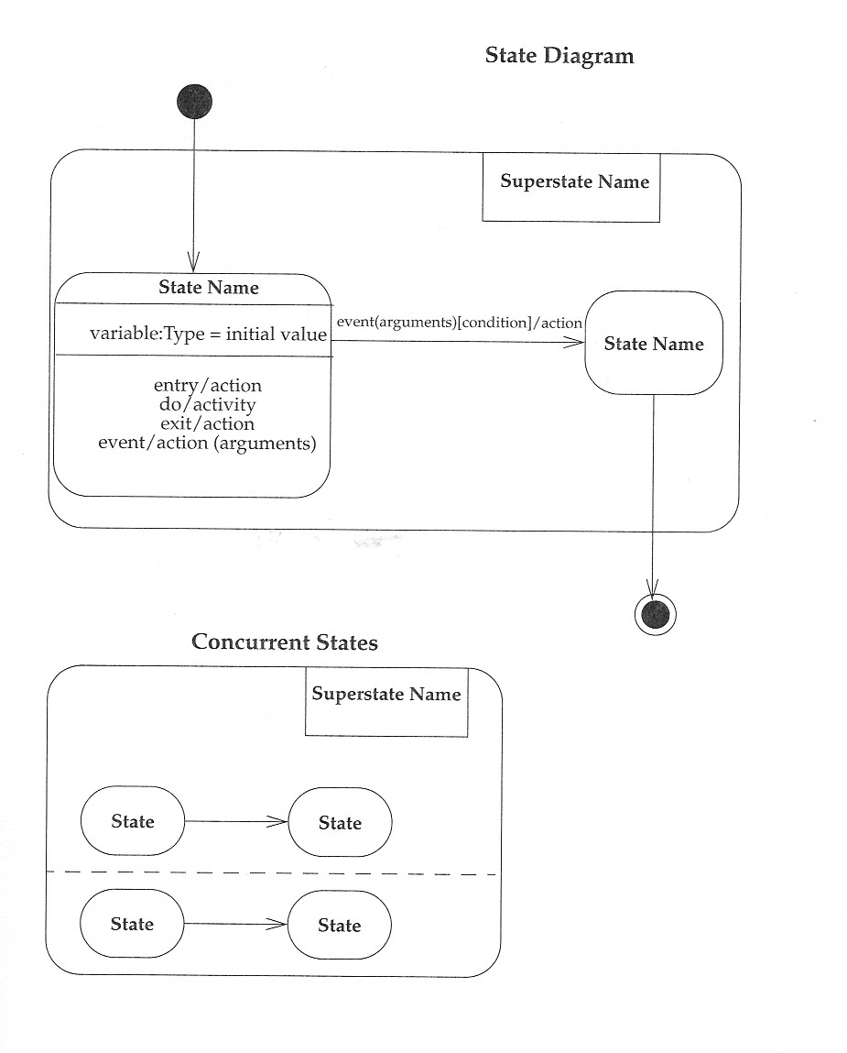
State Diagrams - Notation
Action – processes associated with transitions that occur quickly and are not interruptible
Activity – processes associated with states that may take a while and my be interrupted by events
Event – a stimulus that causes a transition or a self-transition to take place from one state to another
Guard – a logical condition that returns “true” or “false”
Superstate – a state that is itself a collection of states
Reference: UML Distilled, Inside Cover

Slide 34
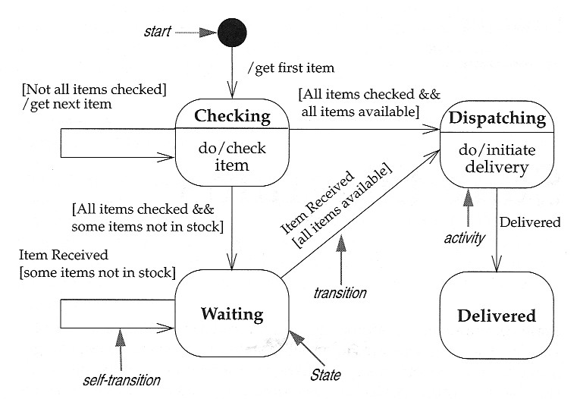
State Diagrams – Notation (concluded)

Slide 35
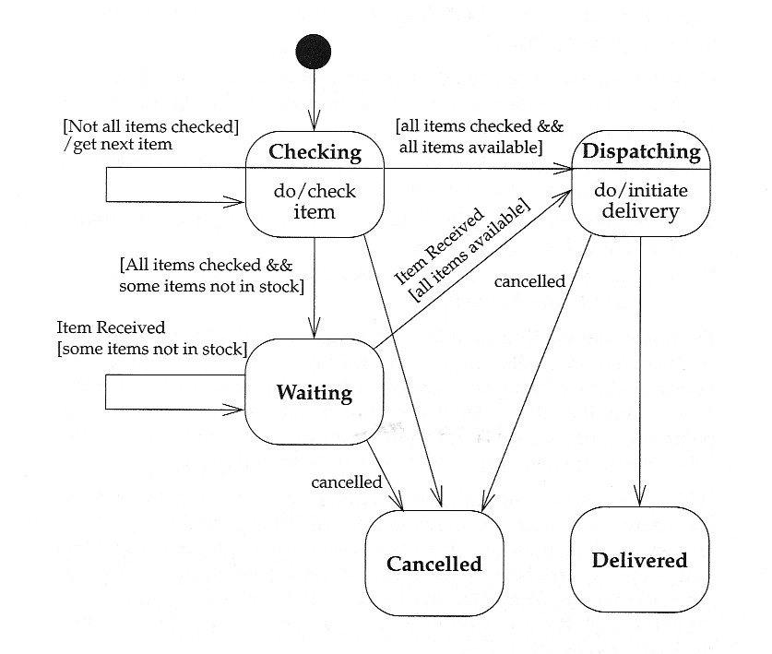
State Diagrams – Example 1 of 3
State Diagram without Superstates

Slide 36
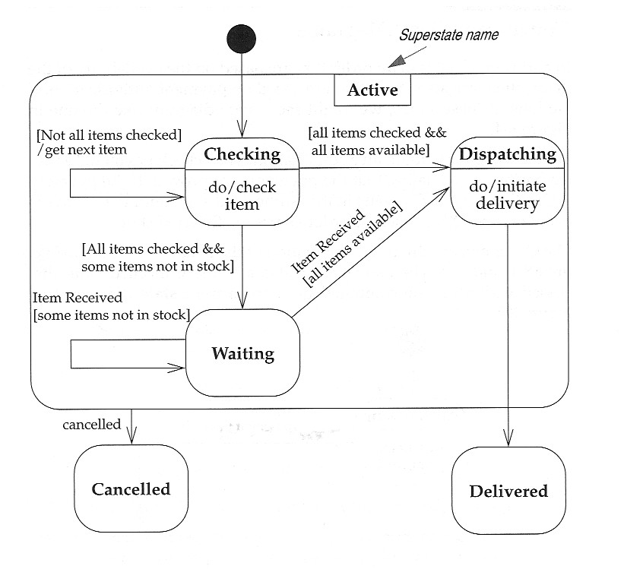
State Diagrams – Example 2 of 3
State Diagram with a Superstate

Slide 37
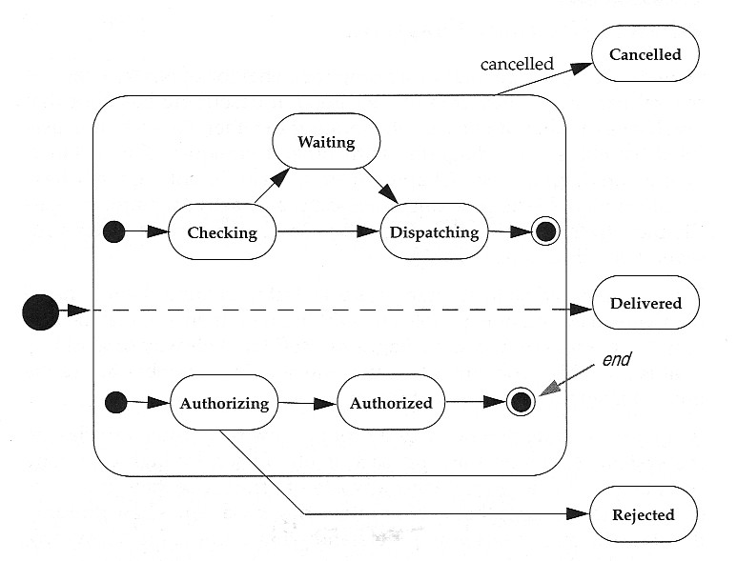
State Diagrams – Example 3 of 3
Concurrent State Diagram

Slide 38
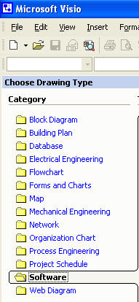
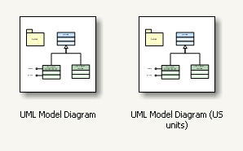
Using Microsoft Visio
Visio can be used to draw UML diagrams
  It is component of Microsoft Office

Slide 39
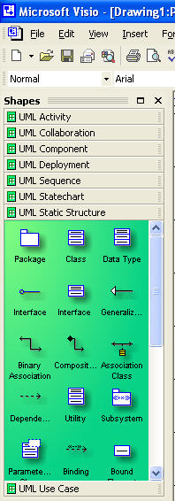
Using Microsoft Visio (continued)
Available Sets of Shapes in the UML Collection
Activity Diagrams
Collaboration Diagrams
Components
Deployment Diagrams
Sequence Diagrams
State Diagrams (Statecharts)
Static Structures (shown) – include Packages and Classes
Use Case Diagrams

Slide 40
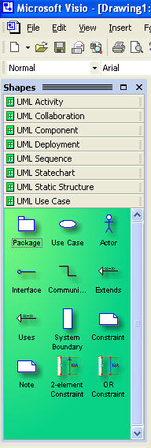
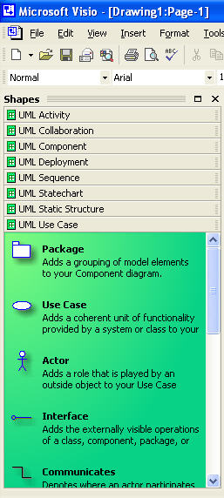
Using Microsoft Visio (concluded)
UML symbols can be displayed as icons with names or icons with descriptions
Both forms of display for the Use Case shape set are shown
Now, on to the demo!

