Slide 1
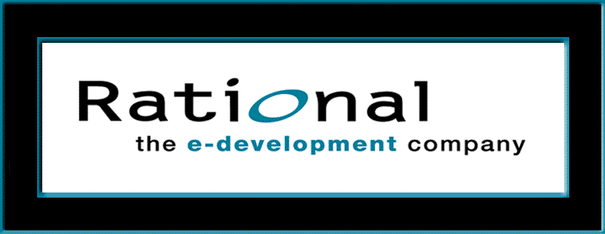
Fundamentals of Visual Modeling with UML
Module 2: Principles of Visual Modeling
Notes:
Fundamentals of Visual Modeling – Instructor Notes
Module 2 – Principles of Visual Modeling

Slide 2
Objectives
Describe the importance of visual modeling.
Define the four principles of visual modeling.
Explain what the Unified Modeling Language (UML) represents.
Define the type of process that best relates to the UML.
Notes:
Fundamentals of Visual Modeling – Instructor Notes
Module 2 – Principles of Visual Modeling
Introduce the objectives for this module.

Slide 3

Where Are We?
What is modeling?
Four principles of visual modeling
The UML
Process and visual modeling
Notes:
Fundamentals of Visual Modeling – Instructor Notes
Module 2 – Principles of Visual Modeling
Explore the student’s knowledge of modeling.

Slide 4
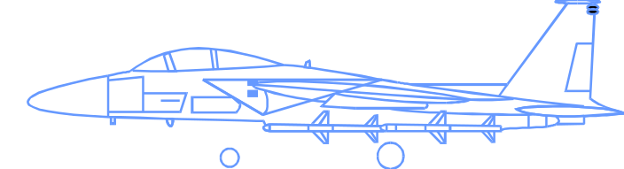

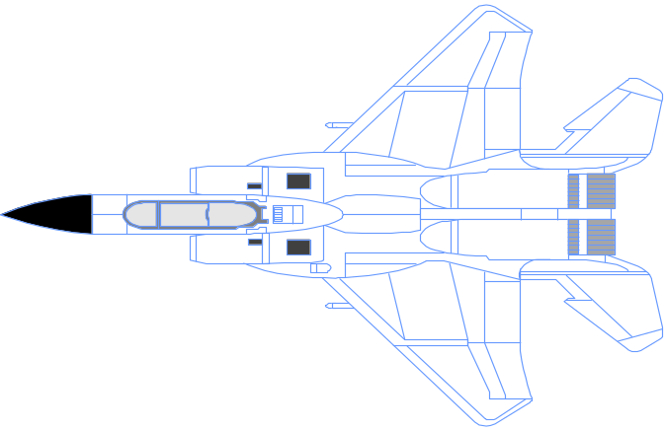
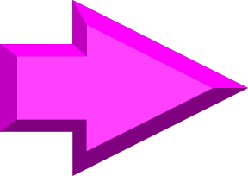
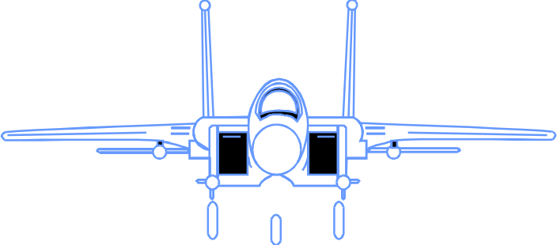
What Is a Model?
A model is a simplification of reality.
Notes:
Fundamentals of Visual Modeling – Instructor Notes
Module 2 – Principles of Visual Modeling
According to Grady Booch, a model provides the blueprints of a system. Models may encompass detailed plans, as well as more general plans that give a 30,000-foot view of the system under construction. A good model includes those elements that are not relevant to the given level of abstraction. Every system may be described from different aspects using different models, and each model is therefore a semantically closed abstraction of the system. A model may be structural, emphasizing the organization of the system, or it may be behavioral, emphasizing the dynamics of the system.
Define what is meant by the term “model.”

Slide 5
Why Do We Model?
Modeling achieves four aims:
  Helps us to visualize a system as we want it to be.
  Permits us to specify the structure or behavior of a system.
  Gives us a template that guides us in constructing a system.
  Documents the decisions we have made.
We build models of complex systems because we cannot comprehend such a system in its entirety.
We build models to better understand the system we are developing.
Notes:
Fundamentals of Visual Modeling – Instructor Notes
Module 2 – Principles of Visual Modeling
According to Booch in The Unified Modeling Language Use Guide, modeling achieves four aims:
1. Models help you to visualize a system, as you want it to be. A model helps the software team communicate the vision for the system being developed. It is very difficult for a software team to have a unified vision of a system that is only described in specification and requirement documents. Models bring about understanding of the system.
2. Models permit us to specify the structure of behavior of a system. A model allows us to document system behavior and structure before coding the system.
3. Models give us a template that guides us in constructing a system. A model is an invaluable tool during construction. It serves as a road map for a developer. Have you experienced a situation where a developer coded incorrect behavior because he/she was confused over the wording in a requirements document? Modeling helps alleviate that situation.
4. Models document the decisions you’ve made. Models are valuable tools long term because they give “hard” information on design decisions. You don’t need to rely on someone’s memory.
Sell the students on the value of visual modeling.
Clarify that you are discussing formal modeling, not modeling written on a white board or on the back of a napkin at lunch.

Slide 6
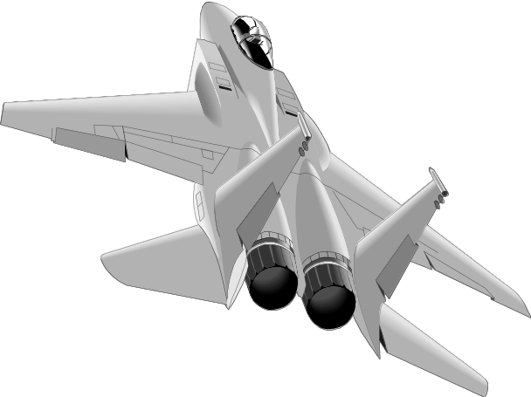
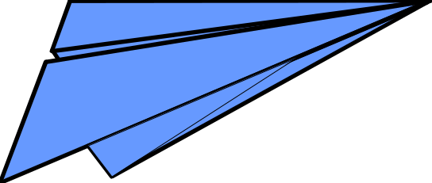
The Importance of Modeling
Less Important
More Important
Paper Airplane
Fighter Jet
Notes:
Fundamentals of Visual Modeling – Instructor Notes
Module 2 – Principles of Visual Modeling
You can take a piece of paper and a paper clip, and, in a few minutes, have a paper airplane that entertains your kids. If it isn’t built just right, you can always start over and build another airplane.
Would it be smart for you to build a fighter jet in the same way? That is, start with some steel, nuts, bolts, and wiring and go right to work. Of course not. You’re building an airplane that costs millions of dollars, and the cost of failure is high. You’re also be part of a much larger team, needing blueprints and models to effectively communicate with one another. (The Unified Modeling Language User Guide, Booch, 1999.)
Emphasize that complex projects outside of the software industry require models.
It’s inconceivable that a defense contractor would build an airplane as complex as a fighter jet without modeling the airplane first. Why? Because unlike building paper airplanes, the cost of failure is significant.
As a general rule, modeling becomes more important as the complexity and expense rises.

Slide 7
Software Teams Often Do Not Model
Many software teams build applications approaching the problem like they were building paper airplanes
  Start coding from project requirements
  Work longer hours and create more code
  Lacks any planned architecture
  Doomed to failure
Modeling is a common thread to successful projects.
Notes:
Fundamentals of Visual Modeling – Instructor Notes
Module 2 – Principles of Visual Modeling
Point out that a major problem with software development is that we often fail to model complex systems before construction.
Software engineering is an engineering discipline.
Why is it that so many of our projects don’t use models like other engineering disciplines such as electrical, civil, and so on?
Would anyone work in a high rise that was put together without the benefit of a well thought- out design?
Would you drive an automobile that had not been modeled first?
Ask the class why they think that software teams don’t always model.
Note these ideas and address them through the course.
If a defense contractor wants to build fighter jets for the government, they need to achieve a certain balance between the desires of the military with the realities of aerospace engineering. They also want to treat their employees professionally, never placing them at risk or driving them so hard that they burn out.
Curiously, many software development organizations begin wanting to build complex software systems, but approach the problem as though they were building a paper airplane.
With the increasing demand to build more complex software in shorter time, development teams often retreat to the only thing they know how to do well – pound out lines of code. Developers start working longer hours and frequently produce code with a requirements document as their only source of input. However, there eventually comes a time when the application collapses due to the lack of a well thought-out architecture. Consequently, many of these software projects result in failure.

Slide 8
Where Are We?
What is modeling?
Four principles of visual modeling
The UML
Process and visual modeling
Notes:
Fundamentals of Visual Modeling – Instructor Notes
Module 2 – Principles of Visual Modeling
Transition to the next subject.

Slide 9
Four Principles of Modeling
The model you create influences how the problem is attacked.
Every model may be expressed at different levels of precision.
The best models are connected to reality.
No single model is sufficient.
Notes:
Fundamentals of Visual Modeling – Instructor Notes
Module 2 – Principles of Visual Modeling
Modeling has a rich history in all the engineering disciplines.
The four basic principles of modeling are derived from this history.
The models you create profoundly influence how a problem is attacked and how a solution is shaped.
Every model may be expressed at different levels of precision.
The best models are connected to reality.
No single model is sufficient. Every non-trivial system is best approached through a small set of nearly independent models.
Demonstrate that there are guiding principles for visual modeling. It is not chaotic activity.
The four modeling principles are described in detail on the next four slides.
See the “UML User Guide” for a more detailed discussion on these four principles.

Slide 10
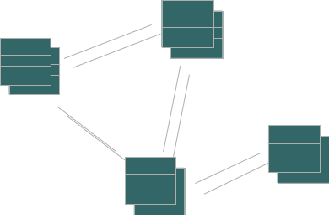
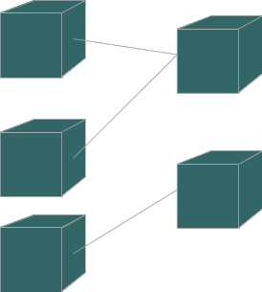
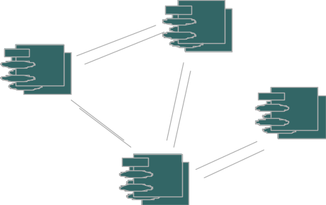
Principle 1: The Choice of Model Is Important
The models you create profoundly influence how a problem is attacked and how a solution is shaped.
  In software, the models you choose greatly affect your world view.
  Each world view leads to a different kind of system.
Design Model
Deployment Diagram
Process Model
Notes:
Fundamentals of Visual Modeling – Instructor Notes
Module 2 – Principles of Visual Modeling
The right models illuminate the most wicked development problems, offering insight that you could not gain otherwise. The wrong models mislead you, causing you to focus on irrelevant issues.
In software, the models you choose can greatly affect your world view. If you build a system through the eyes of a database developer, you’ll likely end up with entity-relationship models that push behavior into stored procedures and triggers. If you build a system through the eyes of an object-oriented developer, you’ll end up with a system that has its architecture centered around many classes and patterns of interaction that direct how those classes work together.
Each world view leads to a different kind of system with different costs and benefits. (The Unified Modeling Language User Guide, Booch, 1999.)
Remind students that each model should reflect the problem that they are trying to solve.
The model of a system comprises many different views of that system.
Refer students to the “4+1 Views of Architecture” by Phillipe Kruchten. You can find the white paper at www.rational.com.
Discuss the views later in this module.
Supplement this slide with the following example. To build a home, you would use different models to resolve structural and electrical problems.

Slide 11
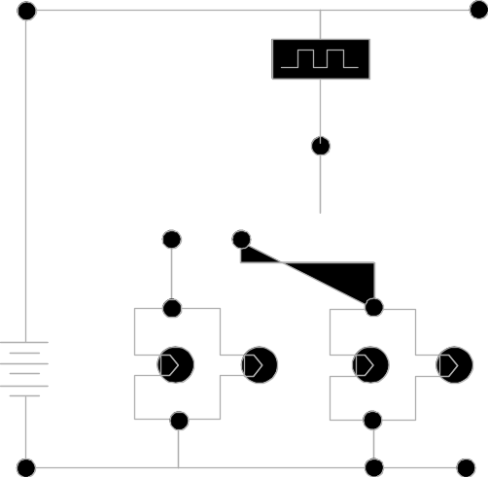
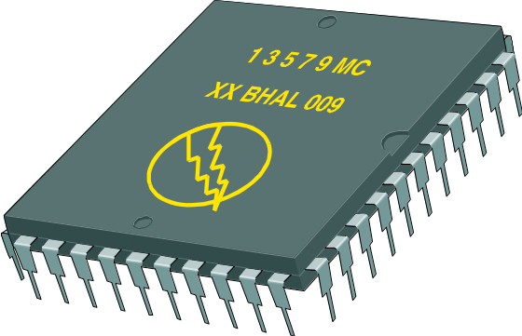
Principle 2: Levels of Precision May Differ
Every model may be expressed at different levels of precision.
  The best kinds of models let you choose your degree of detail, depending on:
    who is viewing the model.
    why they need to view it.
View for Designers
View for Customers
Notes:
Fundamentals of Visual Modeling – Instructor Notes
Module 2 – Principles of Visual Modeling
If you are building computer chips, sometimes you need a 30,000-foot view. For example, you need your investors to visualize the end product. Other times, you need to get down to the level of the circuits.
When developing a GUI system, a quick and dirty executable model of the user interface may be all you need to communicate your intentions. Other times, when you are dealing with cross-system interfaces of network bottlenecks, you need to model down to the bit level. In either case, the best models are those that let you choose your degree of detail, depending on who is doing the viewing and why they need to view it. (The Unified Modeling Language User Guide, Booch, 1999.)
Remember, there are many different ways to view a model of a solution.
Again, point out that there is no one mega-model that displays everything about a system.
Additional examples from building a home may include examples that the homebuyer may be interested only in the elevation and the floor plan.
Obviously, the construction foreman is going to need a more detailed view of the home.

Slide 12
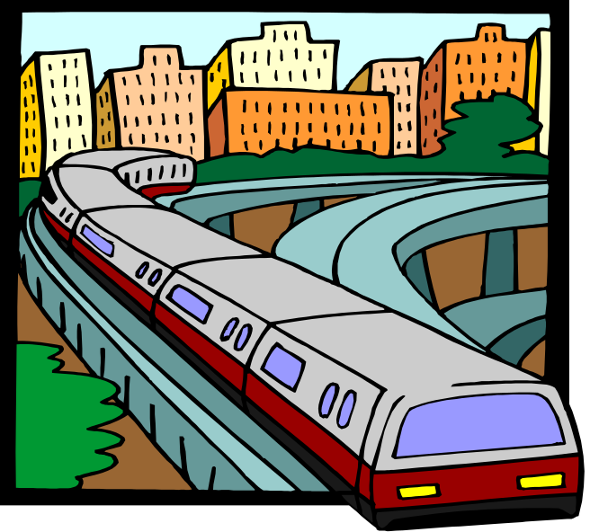
Principle 3: The Best Models Are Connected to Reality
All models simplify reality.
A good model reflects potentially fatal characteristics.
Notes:
Fundamentals of Visual Modeling – Instructor Notes
Module 2 – Principles of Visual Modeling
A physical model of a building that doesn’t respond the same way as the real materials has limited value. It’s best to have models that have a clear connection to reality. Where that connection is weak, you need to know exactly how those models are divorced from the real world.
All models simplify reality. The trick is to be sure that your simplifications don’t mask any important details. A good model reveals any potentially fatal flaws in design. (The Unified Modeling Language User Guide, Booch, 1999.)
A model should accurately reflect the real world.

Slide 13
Principle 4: No Single Model Is Sufficient
No single model is sufficient. Every non-trivial system is best approached through a small set of nearly independent models.
  Create models that can be built and studied separately, but are still interrelated.
Logical View
Implementation View
Analysts/Designers
End-user
Programmers
Structure
Functionality
Software management
Use-Case View
Process View
Deployment View
System integrators
System engineering
Performance
System topology
scalability
delivery, installation
throughput
communication
Notes:
Fundamentals of Visual Modeling – Instructor Notes
Module 2 – Principles of Visual Modeling
The key phrase is “nearly independent,” meaning that models can be built and studied separately, but are still interrelated.
To understand the architecture of object-oriented systems, you need several complementary and interlocking views. An architectural view can be defined as a simplified description (an abstraction) of a system from a particular perspective or vantage point, covering particular concerns, and omitting entities that are not relevant to this perspective. Views are “slices” of models.
Each of the views below may have structural and behavioral aspects. Together, they represent the blueprints of a software system.
Use-case view exposing the requirements of the system
Logical view capturing the vocabulary of the problem space and the solution space
Process view modeling the distribution of the system’s processes and threads
Implementation view addressing the physical realization of the system
Deployment view focusing on system engineering issues. To address these different needs, Rational has defined the “4+1 view” architecture model.
Remember that not all systems require all views. The number of views is dependent on the system you’re building. For example, a single processor does not require a deployment view or a small program does not require an implementation view and so on.
Many interrelated models are needed to accurately describe a system.
Introduce the 4+1 views of architecture first.
It’s important that they understand from the beginning that the models created/read represent a specific view of the system.

Slide 14
Where Are We?
What is modeling?
Four principles of visual modeling
The UML
Process and visual modeling
Notes:
Fundamentals of Visual Modeling – Instructor Notes
Module 2 – Principles of Visual Modeling

Slide 15

What Is the UML?
The UML is a language for
    Visualizing
    Specifying
    Constructing
    Documenting
the artifacts of a software-intensive system.
Notes:
Fundamentals of Visual Modeling – Instructor Notes
Module 2 – Principles of Visual Modeling
The software systems that you develop today are more complex than the human mind can comprehend. This is why you model systems. The creation of the models which you choose, has a profound influence on how you attack the problem and shape the solution.
No single model is sufficient. Every complex system is best approached through a small set of nearly independent models.
Therefore, to increase comprehension, a common language like the Unified Modeling Language (UML) is used to express models.
A modeling language is a language whose vocabulary and rules focus on the conceptual and physical representation of a system. A modeling language like the UML is a standard language for software blueprints.
Introduce the UML. Remember many of your students have no idea what the UML really is.
The next four slides explain how the UML is a language for visualizing, specifying, constructing and documenting.

Slide 16
The UML Is a Language for Visualizing
Communicating conceptual models to others is prone to error unless everyone involved speaks the same language.
There are things about a software system you can’t understand unless you build models.
An explicit model facilitates communication.
Notes:
Fundamentals of Visual Modeling – Instructor Notes
Module 2 – Principles of Visual Modeling
Typically, projects and organizations develop their own language for modeling systems, making it difficult for outsiders and new team members to understand what is going on.
Communicating these conceptual models to others is prone to error unless everyone involved speaks the same language. The UML offers a set of symbols that represents well-defined semantics. One developer can write a model in the UML, and another developer can interpret that model unambiguously.
There are things about a software system you can’t understand unless you build models that transcend the textual programming language. For example, the meaning of a class hierarchy can be inferred, but not directly grasped, by staring at the code for all the classes in the hierarchy. The UML is a graphical language that addresses this problem.
If the developer who cut the code never wrote down the models, the information would be lost forever. At best, the information would only be partially recoverable from the implementation after the developer has moved on. Writing models in the UML addresses this issue. An explicit model facilitates communication. (The Unified Modeling Language User Guide, Booch, 1999.)
Stress how the UML is designed to promote communication using pictures rather than text.
Using the UML allows the “light bulb” to go on in the minds of many people. Rather than trying to interpret a textual description of a system design, the UML offers a graphical representation of that same description.
In this case, a picture is truly worth a thousand words.

Slide 17
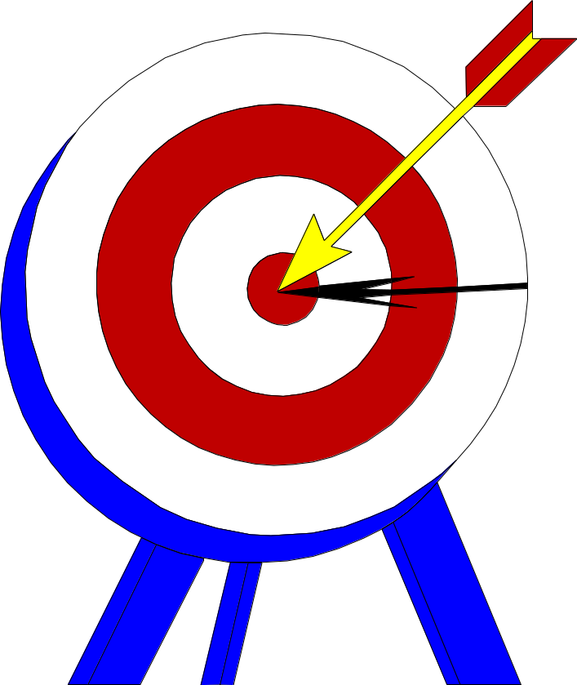
The UML Is a Language for Specifying
The UML builds models that are precise, unambiguous, and complete.
Notes:
Fundamentals of Visual Modeling – Instructor Notes
Module 2 – Principles of Visual Modeling
In this context, specifying means to build models that are precise, unambiguous, and complete. In particular, the UML addresses the specification of all the important analysis, design, and implementation decisions that must be made to develop and deploy software-intensive systems. (The Unified Modeling Language User Guide, Booch, 1999.)
The UML can be used to specify detailed or general models.
Anyone who has worked on a project where miscommunication occurred appreciates this feature of the UML.
The UML allows the modeler to specify their intentions in a clear, unmistakable manner.

Slide 18
The UML Is a Language for Constructing
UML models can be directly connected to a variety of programming languages.
  Maps to Java, C++, Visual Basic, and so on
  Tables in a RDBMS or persistent store in an OODBMS
  Permits forward engineering
  Permits reverse engineering
Notes:
Fundamentals of Visual Modeling – Instructor Notes
Module 2 – Principles of Visual Modeling
The UML is not a visual programming language. However, models using the UML can be directly connected to a variety of programming languages, making it possible to map from a model in the UML to a programming language or even to a database.
If it is best expressed graphically, it is done graphically in the UML. If it is best expressed textually, it is done in the programming language.
This mapping permits forward engineering: the generation of code from a UML model to a programming language. Reverse engineering is also possible: the reconstruction of a model from implementation back into the UML.
The UML was designed with forward and reverse engineering in mind.
Rational Rose supports round-trip engineering (forward and reverse engineering) for Java, C++, and Visual Basic.
Rational has partners who provide round-trip engineering for other languages.

Slide 19


The UML Is a Language for Documenting
The UML addresses documentation of system architecture, requirements, tests, project planning, and release management.
Use Case
Diagram
Activity Diagram
Actor A
Actor B
State Transition
Diagram
Domain
Use Case 1
[yes]
add file
Deployment
Diagram
add file [ numberOffile==MAX ] /
Writing
Expert
Actor A
Use Case 2
Actor B
Openning
flag OFF
close file
Use Case 3
Reading
close file
Closing
ºÐ»ê È¯°æÀÇ ÇÏµå¿þ¾î¹× ³×Æ®¿÷À¸·ÎÀÇ Á¤º¸ ½Ã½ºÅÛ ¿¬°á ¸ðµ¨
- À©µµ¿ì 95 : Å¬¶óÀÌ¾ðÆ®
- À©µµ¿ì NT: ÀÀ¿ë¼­¹ö
- À¯´Ð½º ¸Ó½Å: ÀÀ¿ë ¼­¹ö ¹× µ¥ÀÌÅ¸ ¼­¹ö, Åë½Å ¼­¹ö
- IBM ¸ÞÀÎÇÁ·¹ÀÓ: µ¥ÀÌÅ¸ ¼­¹ö, Åë½Å ¼­¹ö
¹®¼­°ü¸®
Window95
Windows95
Windows95
Class Diagram
Å¬¶óÀÌ¾ðÆ®.EXE
Windows
¹®¼­°ü¸® ¾ÖÇÃ¸´
9: sortByName ( )
NT
Solaris
¹®¼­°ü¸® ¿£Áø.EXE
Alpha
FileMgr
DocumentList
Document
Windows
ÀÀ¿ë¼­¹ö.EXE
UNIX
mainWnd : MainWnd
add( )
name : int
NT
fetchDoc( )
delete( )
docid : int
IBM
1: Doc view request ( )
L
sortByName( )
get( )
numField : int
read() fill the
Mainframe
open( )
code..
2: fetchDoc( )
close( )
Repository
gFile : GrpFile
FileList
read( )
4: create ( )
fList
sortFileList( )
µ¥ÀÌÅ¸º£ÀÌ½º¼­¹ö
create( )
8: fillFile ( )
add( )
fillDocument( )
delete( )
1
User Interface
Definition
user : »ç¿ëÀÚ
fileMgr : FileMgr
3: create ( )
1
FileManager
6: fillDocument ( )
Repository
rep
File
Document
(from Persistence)
read( )
GrpFile
7: readFile ( )
name : char * = 0
read( )
5: readDoc ( )
document : Document
readDoc( )
open( )
readFile( )
create( )
repository : Repository
fillFile( )
GraphicFile
File
FileList
Collaboration Diagram
Source Code
edit, compile,
debug, link
Component Diagram
mainWnd
fileMgr :
document :
gFile
repository
Æ¯Á¤¹®¼­¿¡ ´ëÇÑ º¸±â¸¦
user
1: Doc view request ( )
FileMgr
Document
»ç¿ëÀÚ°¡ ¿äÃ»ÇÑ´Ù.
2: fetchDoc( )
3: create ( )
4: create ( )
Model
space
È­ÀÏ°ü¸®ÀÚ´Â ÀÐ¾î¿Â
6: fillDocument ( )
5: readDoc ( )
¹®¼­ÀÇ Á¤º¸¸¦ ÇØ´ç ¹®¼­
°´Ã¼¿¡ ¼³Á¤À» ¿äÃ»ÇÑ´Ù.
8: fillFile ( )
7: readFile ( )
È­¸é °´Ã¼´Â ÀÐ¾îµéÀÎ
9: sortByName ( )
°´Ã¼µé¿¡ ´ëÇØ ÀÌ¸§º°·Î
Á¤·ÄÀ» ½ÃÄÑ È­¸é¿¡
º¸¿©ÁØ´Ù.
Sequence Diagram
Forward Engineering
(Code Generation) and
Reverse Engineering
Forward Engineering
(Code Generation) and
Reverse Engineering
Executable System
19
Notes:
Fundamentals of Visual Modeling – Instructor Notes
Module 2 – Principles of Visual Modeling
Project artifacts are critical in controlling, measuring, and communicating about a system during its development and after its deployment.
The UML addresses the documentation of a system’s architecture and all of its details. The UML also provides a language for expressing requirements and for tests. Finally, the UML provides a language for modeling the activities of project planning and release management. (The Unified Modeling Language User Guide, Booch, 1999.)
UML diagrams should be treated as formal project artifacts.
Each diagram created by a project team should be treated as an artifact.
The UML can help alleviate some of the paper crunch that many software teams experience.

Slide 20
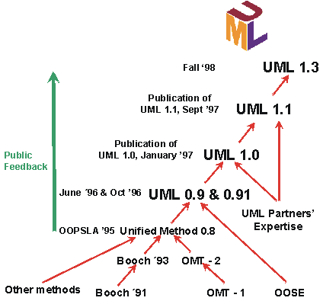
History of the UML
Notes:
Fundamentals of Visual Modeling – Instructor Notes
Module 2 – Principles of Visual Modeling
Identifiable object-oriented modeling languages began to appear between the mid 1970s and the late 1980s as various methodologists experimented with different approaches to object-oriented analysis and design.
Several other techniques influenced these languages, including entity-relationship modeling, SDL, and other techniques. The number of identified modeling languages increased from less than 10 to more than 50 during the period between 1989 -1994. Many users of object methods had trouble finding complete satisfaction in any one modeling language, fueling the “method wars.” By the mid-1990s, new iterations of these methods began to appear, most notably Booch ’93, the continued evolution of OMT, and Fusion.
UML development began in October of 1994, when Grady Booch and Jim Rumbaugh of Rational Software Corporation began their work on unifying the Booch and OMT (Object Modeling Technique) methods. A draft version 0.8 of the Unified Method was released in October of 1995. During 1996, it became clear that several organizations saw the UML as strategic to their business. A Request for Proposal issued by the Object Management Group (OMG) galvanized these organizations to produce a joint RFP response. The UML is non-proprietary. It addresses the needs of user and scientific communities, as established by experience with the underlying methods on which it is based. Although the UML defines a precise language, it’s not a barrier to future improvements in modeling concepts. The UML can be extended without redefining the UML core.The UML is expected to be the basis for many tools, including those for visual modeling, simulation, and development environments. As tool integrations develop, implementation standards based on the UML become increasingly available.
Provide some background on how the UML came to be and why a need for UML arose in the first place.
In many cases, the students are already familiar with this history. Therefore, it is not necessary to spend a lot of time on this slide. Simply make these points.
Rational led the way in establishing the UML as an industry standard.
Rational did not do this in a secret or proprietary way. Many companies contributed significantly.
UML is a standard and evolves under the supervision of the Object Management Group (OMG).

Slide 21

Inputs to the UML
Booch
Rumbaugh
Jacobson
Fusion
Meyer
Fusion
Meyer
Operation descriptions,
Before and after
Operation descriptions,
conditions
message numbering
Embley
Embley
Harel
Harel
Singleton classes,
Singleton classes,
State charts
State charts
high
-
-
level view
level view
Gamma, et.al
Gamma, et.al
Wirfs
Wirfs
-
-
Brock
Brock
Frameworks, patterns,
Frameworks, patterns,
Responsibilities
Odell
Responsibilities
notes
Odell
notes
Shlaer
Shlaer
-
-
Mellor
Mellor
Classification
Object lifecycles
Classification
Notes:
Fundamentals of Visual Modeling – Instructor Notes
Module 2 – Principles of Visual Modeling
UML development included incorporating ideas from numerous other methodologists. The main challenge was to construct an approach that was simple, yet allowed the modeling of a broad range of systems. The conceptual framework was established quickly, but the notational semantics took more time.
Active collaboration with other industry leaders has brought unique expertise and experience into the UML effort. The UML effort was supported by a cross-section of the industry. Partners in the UML effort included HP, ICON Computing, IBM, I-Logix, Intellicorp, MCI Systemhouse, Microsoft, ObjecTime, Oracle, Platinum Technology, Ptech, Reich Technologies, Softeam, Sterling Software, Taskon, and Unisys. These partners provided contributors, reviewers, and advocates for the standardization efforts.
In the end, a modeling language was created that has already withstood the test of widespread use in the industry and the scrutiny of international standardization efforts.
Demonstrate that UML was developed as an industry standard with many influences. The UML is not owned and written by Rational.
Do not spend a lot of time on this slide. Simply point out one or two contributors of special interest to your audience.
For example, for a telephony audience, you might point out Harel and his state charts.

Slide 22
Where Are We?
What is modeling?
Four principles of visual modeling
The UML
Process and visual modeling
Notes:
Fundamentals of Visual Modeling – Instructor Notes
Module 2 – Principles of Visual Modeling

Slide 23
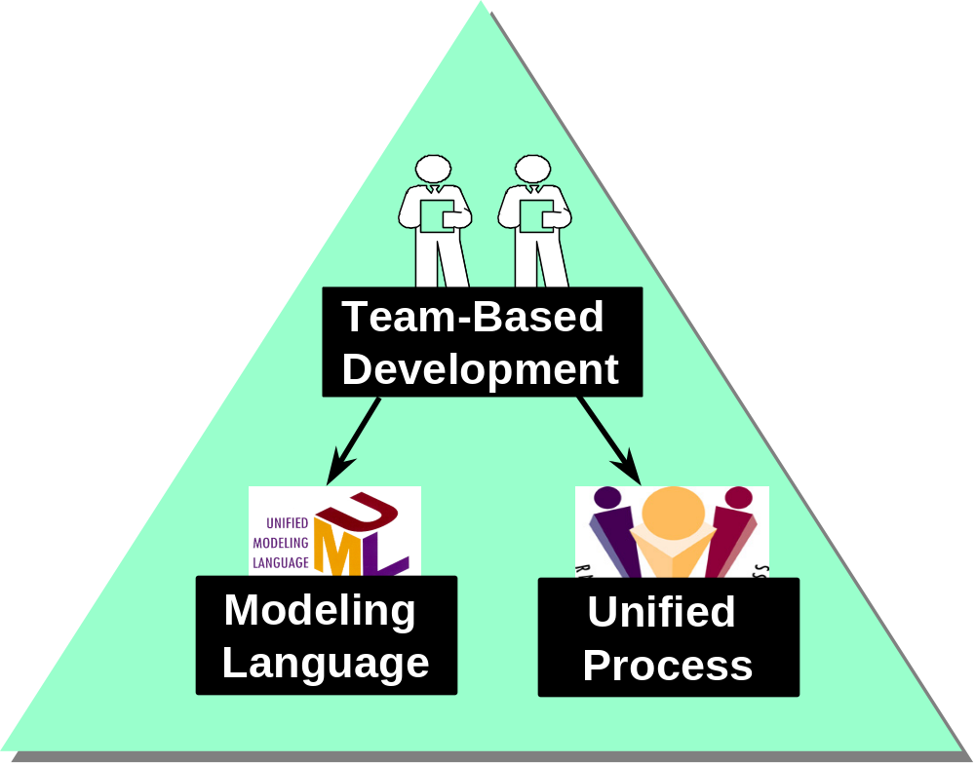
A Language Is Not Enough to Build a System
Notes:
Fundamentals of Visual Modeling – Instructor Notes
Module 2 – Principles of Visual Modeling
The UML provides a standard for the artifacts of development (semantic models, syntactic notation, and diagrams) that must be controlled and exchanged. But the UML is not a standard for the development process.
Despite all its value, you cannot achieve successful development of today’s complex systems solely by using the UML. Successful development also requires employing an equally robust development process.
Emphasize here that the UML was not designed to stand alone, a process is also needed.
This slide establishes the need for more than the UML.
Some students may think that, if they know the UML, they’re done. They don’t need a process.
Establish that the UML, while a good and necessary first step, is not enough.
Just knowing the UML would be analogous to learning English by using a dictionary. Sure, all the words are there, but you still need to understand how the English language is structured before one can effectively speak.

Slide 24
What Type of Process Most Benefits the UML?
The UML is largely process independent. A process fully benefits from the UML when the process is:
  Use-case driven
  Architecture-centric
  Iterative and incremental
Notes:
Fundamentals of Visual Modeling – Instructor Notes
Module 2 – Principles of Visual Modeling
UML designers had a specific type of process in mind when the UML was first built.

Slide 25
A Use-Case Driven Process
Use cases defined for a system are the basis for the entire development process.
Benefits of use cases:
  Concise, simple, and understandable by a wide range of stakeholders.
  Help synchronize the content of different models.
Check Balance
Check Balance
Customer
Customer
Withdraw Money
Withdraw Money
Notes:
Fundamentals of Visual Modeling – Instructor Notes
Module 2 – Principles of Visual Modeling
Use cases are one recommended method for organizing your requirements. Instead of a bulleted list of requirements, you organize them in a way that shows how someone can use the system. By doing so, a requirement is more complete and consistent. You can also better understand the importance of a requirement from a user perspective.
It’s often difficult to tell how a system does what it is supposed to do from a traditional object-oriented system model. This stems from the lack of a "red thread" through the system when it performs certain tasks. Use cases are that thread because they define the behavior performed by a system.
Use cases are not part of "traditional" object orientation, but their importance has become more and more apparent, further emphasized that use cases are part of the UML.
Use cases are the cornerstone of the type of process that works best with UML. UML diagrams can be used to model a use case.
Use cases are defined later in the course.

Slide 26
An Architecture-Centric Process
A system’s architecture is used as a primary artifact for conceptualizing, constructing, managing, and evolving the system under development.
Benefits:
  Intellectual control over a project to manage its complexity and to maintain system integrity.
  Effective basis for large-scale reuse.
  A basis for project management.
  Assistance in component-based development.
Notes:
Fundamentals of Visual Modeling – Instructor Notes
Module 2 – Principles of Visual Modeling
Use cases drive the process end-to-end over the entire lifecycle. The design activities are centered around architecture-centric architecture, or for software-intensive systems, software architecture. The main focus of the early iterations of a architecture-centric process is to produce and validate a software architecture, which in the initial development cycle takes the form of an executable architectural prototype that gradually evolves to become the final system in later iterations.
A complex system is more than the sum of its parts, more than a succession of small independent tactical decisions. It must have some unifying, coherent structure to organize those parts systematically, and provide precise rules on how to grow the system without having its complexity “explode” beyond human understanding. Architecture provides this structure and these rules.
By clearly articulating the major components and the critical interfaces among them, architecture lets you reason about reuse, both internal reuse (the identification of common parts), and external reuse (the incorporation of ready-made, off-the-shelf components). Architecture can also help reuse on a larger scale. That is, the reuse of the architecture itself in the context of a product line that addresses different functionality in a common domain.
Architecture should drive the design rather than the other way around. UML diagrams allow you to reflect this.
The “Object-Oriented Analysis” and “Object-Oriented Design” courses explore this topic in detail.

Slide 27
An Iterative and Incremental Process
Critical risks are resolved before making large investments.
Initial iterations enable early user feedback.
Testing and integration are continuous.
Objective milestones focus on the short term.
Progress is measured by assessing implementations.
Partial implementations can be deployed.
Notes:
Fundamentals of Visual Modeling – Instructor Notes
Module 2 – Principles of Visual Modeling
An iterative approach allows users to be involved in a meaningful way throughout the project life cycle. Since each iteration produces an executable release, users can observe the partially executing system and provide meaningful feedback to their level of satisfaction. This ensures that the final system delivered to users is acceptable.
Continuous testing and integration ensures that, at every iteration, the pieces all fit together and that the system-level requirements (for example, performance and capacity) are being met.
The short-term focus of an iteration is an objective measure of “doneness.” Either a class is included in the build or it’s not. It can’t be 90 percent done. Either a test is executed successfully or it’s not. There is very little room for subjective estimates.
In spite of the best efforts of the development team, not all system features may be complete on the original delivery date. With a waterfall approach, this would usually mean that nothing was ready to be delivered (everything is 90 percent done).
With an iterative approach, most of the system is already fully tested and operational. In many cases, there is value in delivering the partial system on the promised date with the remaining features incorporated at a later time. This can be important when a user has a critical need for some of the new functionality provided by the system (think Y2K), or it may help the training and installation process to proceed on schedule. An iterative approach can avoid inconvenient re-planning and re-assignment of resources.
Design the system in small digestible pieces. UML diagrams can enable one to design in an iterative fashion.
Developing iteratively means developing in small pieces that we call use-case realizations.

Slide 28
Iterative Development
Iteration 1
Iteration 2
Iteration 3
R
R
R
D
D
D
C
C
C
I
I
I
T
T
T
T I M E
Earliest iterations address greatest risks.
Each iteration produces an executable release, an additional increment of the system.
Each iteration includes integration and test.
Notes:
Fundamentals of Visual Modeling – Instructor Notes
Module 2 – Principles of Visual Modeling
In the diagram above, the following abbreviations are used.
R Requirements analysis
D Design
C Coding, unit testing
I Implementation
T Subsystem and system test
Iterative processes were developed in response to these waterfall characteristics. With an iterative process, apply the waterfall steps iteratively. Instead of developing the whole system at once, select and develop an increment (a subset of system functionality), then another increment, and so on.
Develop the first increment based on risk, with the highest priority risks to be developed first.
To address the selected risk(s), choose a subset of use cases.
Develop the smallest number of use cases that allow objective verification (like a set of executable tests) of the risks that you’ve chosen.
Select the next increment to address the next highest risk, and so on. Thus, you apply the waterfall within each iteration and the system evolves incrementally.
Define iterative development for the students. It is not necessary to go into great detail at this time. The Object-Oriented Analysis class discusses this topic.
In the iterative approach, the waterfall is applied to a single increment of the system at a time. Each iteration produces an executable.
Verify that the waterfall concept is understood by the students.

Slide 29
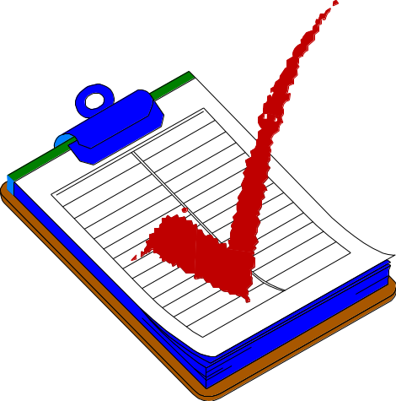
Review
What is a model?
What are the four principles of modeling? Describe each one.
What is the UML? Describe each of its four benefits.
What process characteristics best fit the UML? Describe each characteristic.
What is an iteration?
Notes:
Fundamentals of Visual Modeling – Instructor Notes
Module 2 – Principles of Visual Modeling
Check to see if the students comprehended the material.
A. A model is a simplification of reality.
B. The four modeling principles of modeling are:
The models you create profoundly influence how a problem is attacked and how a solution is shaped.
Every model may be expressed at different levels of precision.
The best models are connected to reality.
No single model is sufficient. Every non-trivial system is best approached through a small set of nearly independent models.
C. The UML is a language for visualizing, specifying, constructing, and documenting the artifacts of a software-intensive system.
D. The UML is largely process independent. However, to get the most benefit from the UML, consider a process that is: use-case driven, architecture-centric, and iterative and incremental.
E. An iteration encompasses the development activities that lead to a product release - a stable, executable versions of product, together with any other peripheral elements necessary to use this release.

Slide 30
Notes:
Fundamentals of Visual Modeling – Instructor Notes
Module 2 – Principles of Visual Modeling

