Slide 1
CASE STUDY (GROUP 4)
TSE Initializr
Tunir Chaudhuri
Akash Ranjan
Goutham Suresh
Rahul
Sunny Kumar
15/09/2023

Slide 2


INTRODUCTION
Tunir Chaudhuri
Akash Ranjan
Goutham Suresh
Rahul
Sunny Kumar

Slide 3
OBJECTIVES
The aim of our project is to simulate the functioning of Spring Initializr on localhost with some added dependencies and other special features.
User stories:
The application should allow us to add dependencies.
The application should allow to choose options between war and jar.
The application should allow us to choose the appropriate jdk version.
The application should allow us to mention the domain, artifact, name of project and the description of a project.
The application should allow us to choose Maven or Gradle.
REST response should be successful to get the accurate dependencies from Maven or Gradle.
ZIP file should be created properly and saved on system.
We should be able to load the project in Intellij or Eclipse or any IDE.

Slide 4
SCOPE
Included:
Custom TSE Initializr
Custom dependencies
Custom front end user interface
Not Included:
Complete backend configuration
Complete frontend configuration

Slide 5
METHODOLOGY
We are following a step-by-step approach as follows:

Slide 6
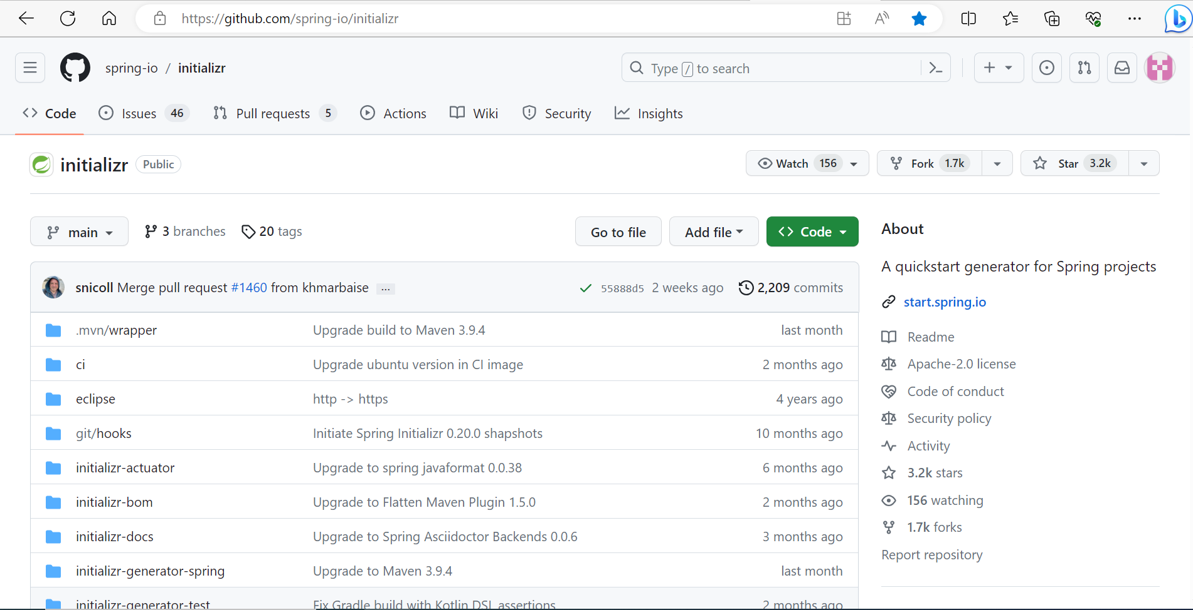
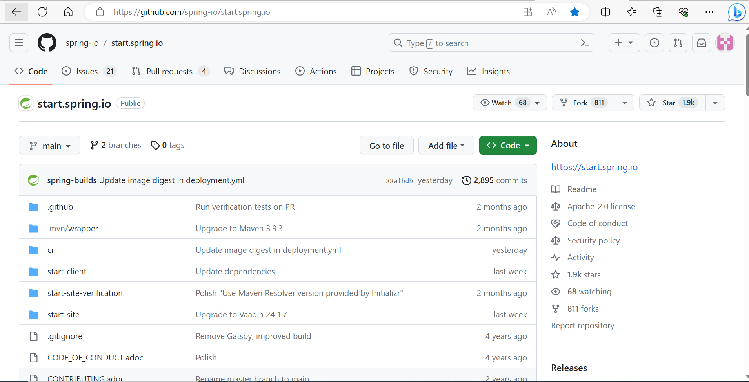
STEP 1

Slide 7
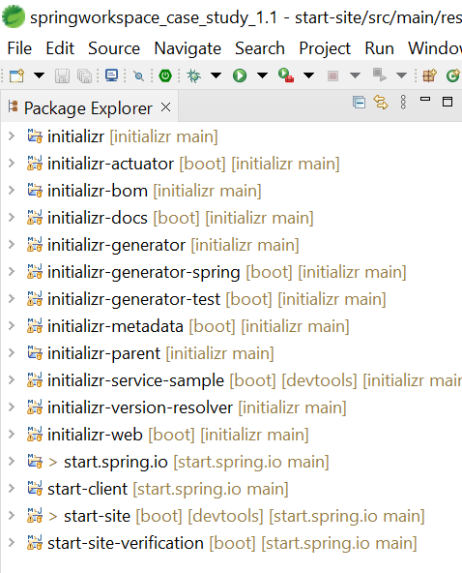
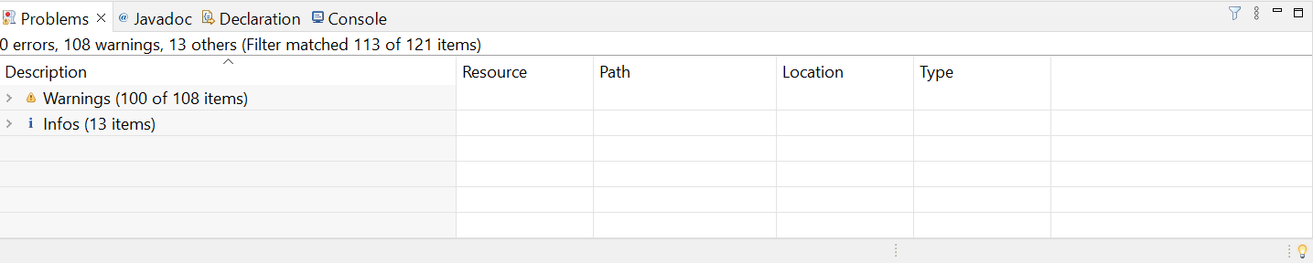
STEP 2

Slide 8
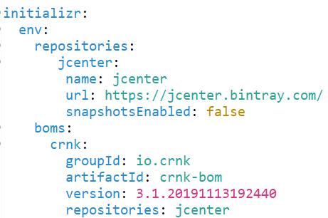
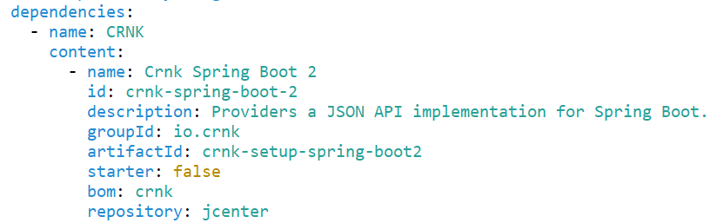
STEP 3

Slide 9
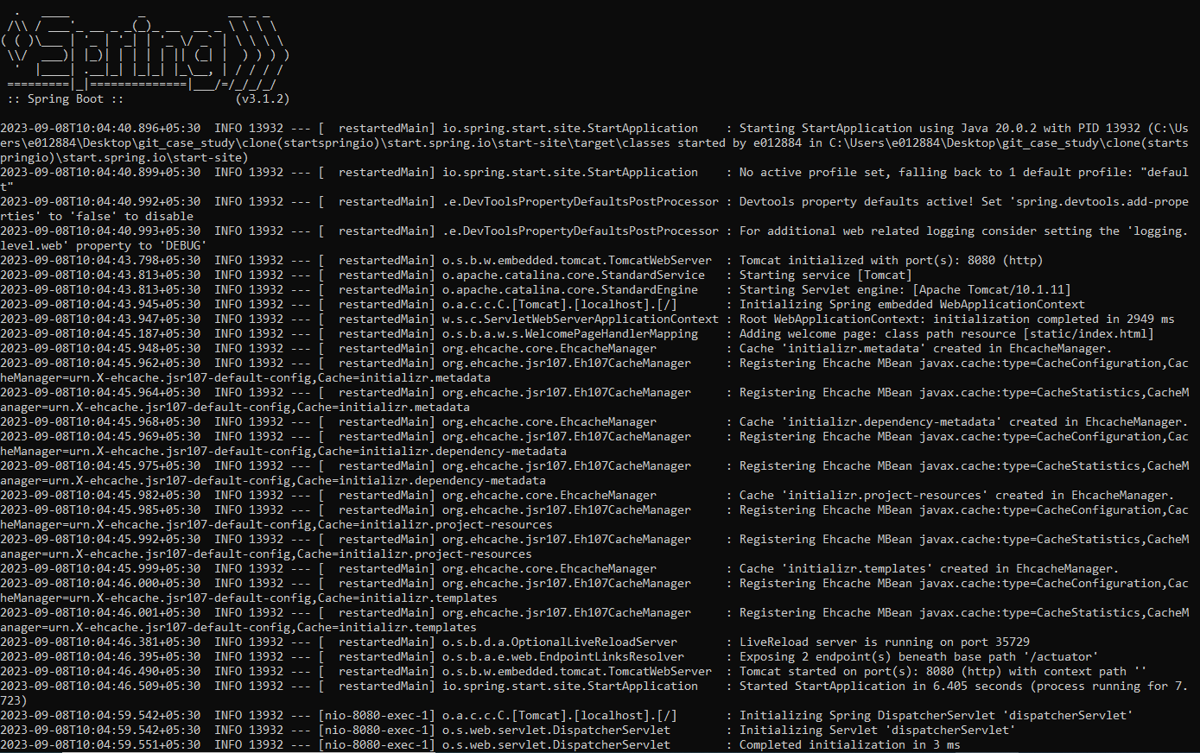
STEP 4

Slide 10
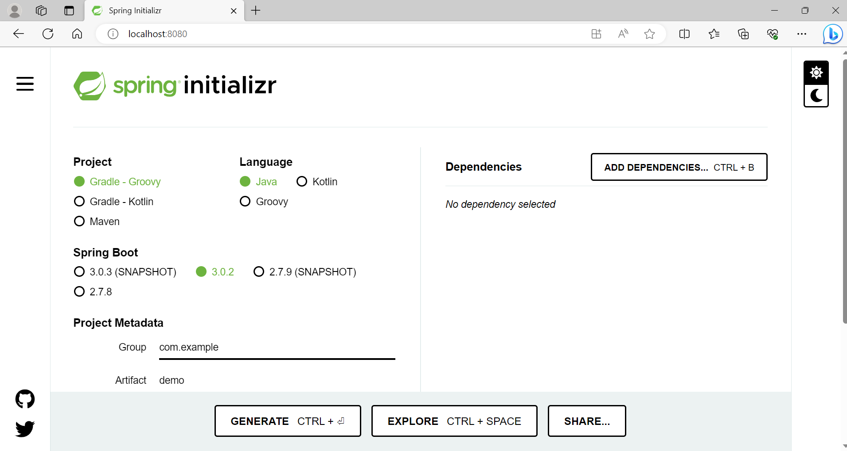

Slide 11
LIVE DEMONSTRATION

Slide 12
CHALLENGES
Spring version conflicts
System configuration problems
Maven build errors
Workspace issues

Slide 13
FUTURE WORK
Adding a useful custom user defined dependency that is not currently available
Adding test cases for testing our application
Modifying our front-end user interface according to the requirements
Resolving custom Maven plugin, dependency and configuration issues

Slide 14
THANK YOU

