Slide 1
CASE STUDY (GROUP 4)
TSE Initializr
Tunir Chaudhuri
Akash Ranjan
Goutham Suresh
Rahul
Sunny Kumar

Slide 2
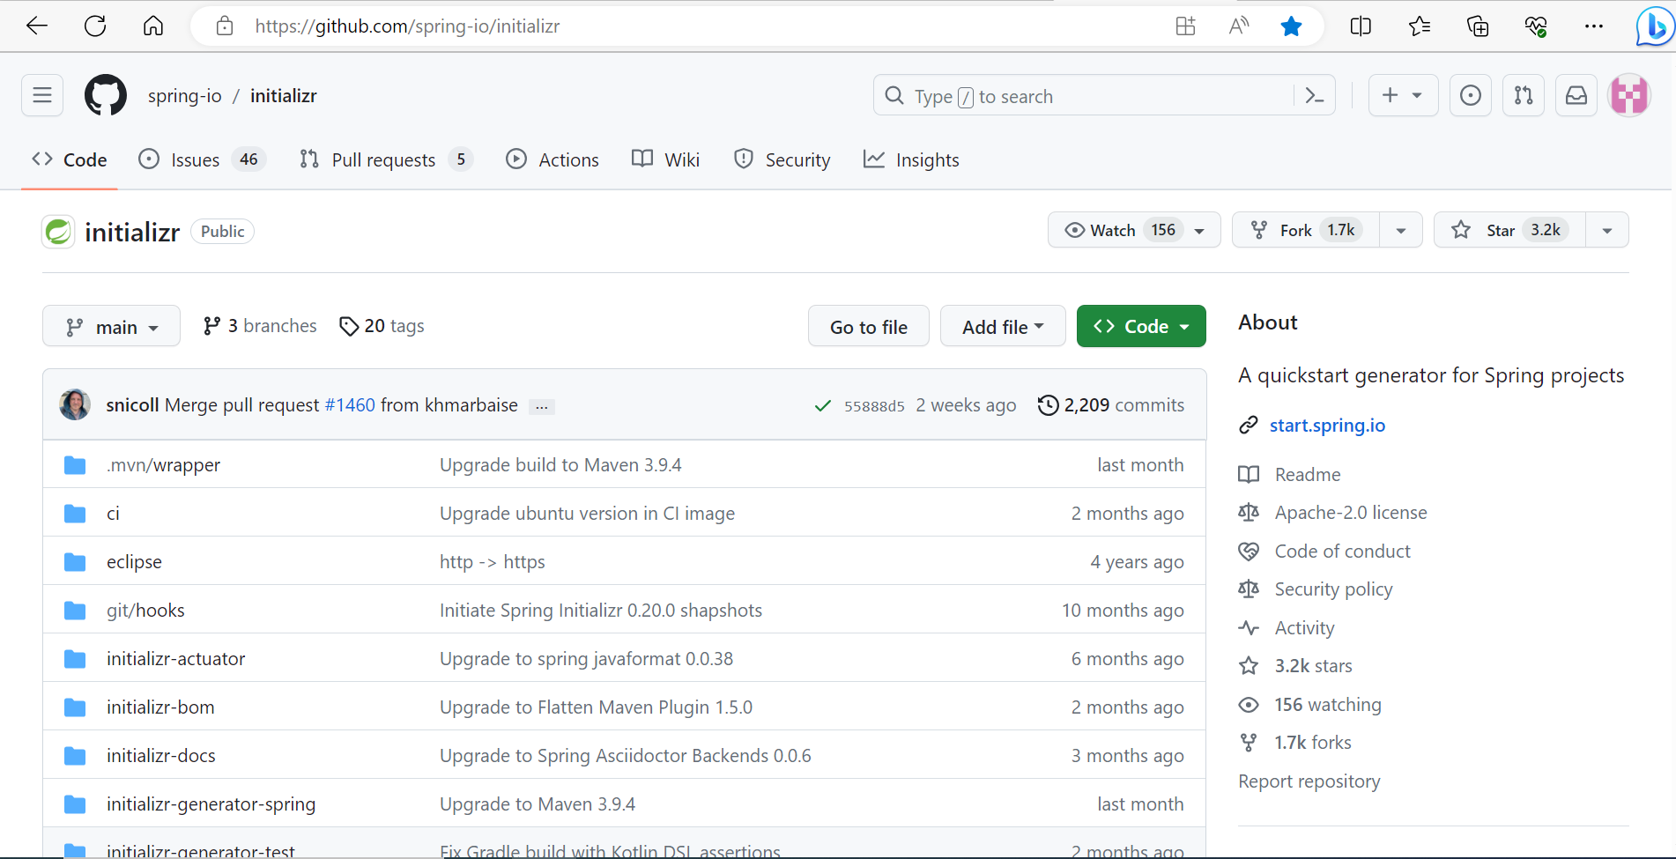
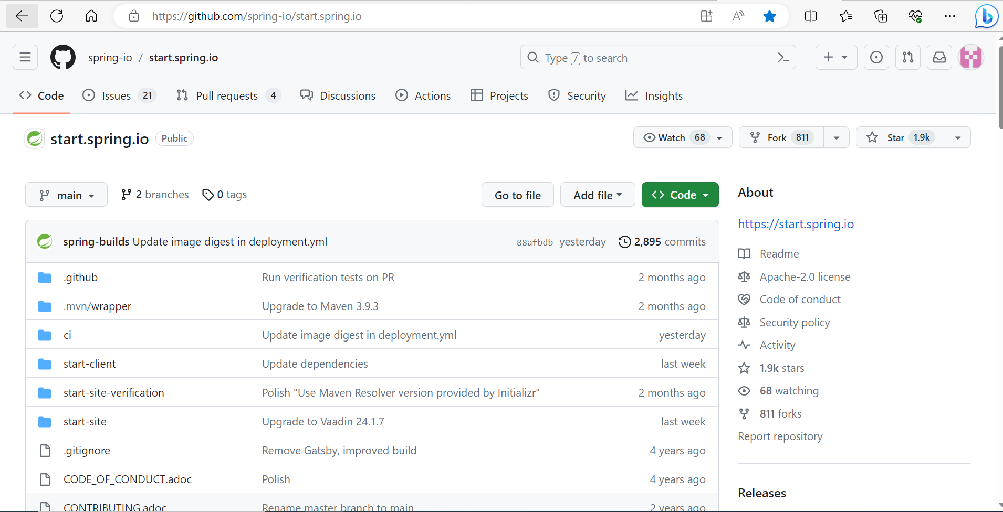
STEP 1

Slide 3
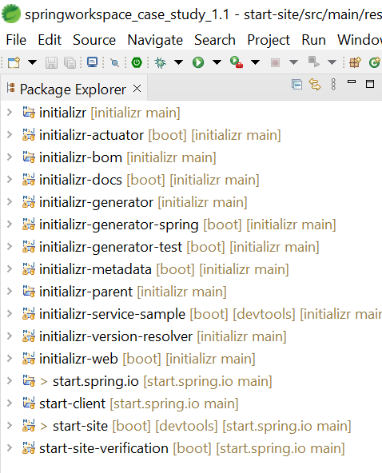
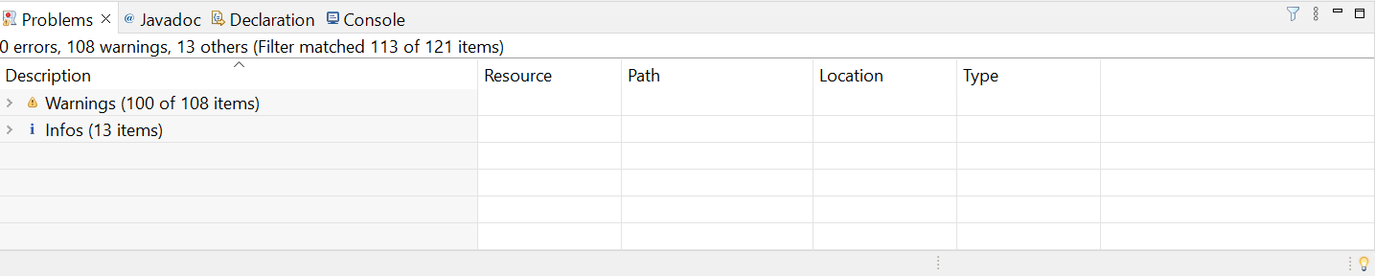
STEP 2

Slide 4
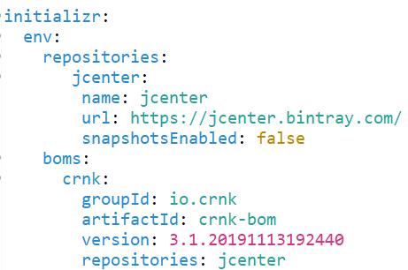
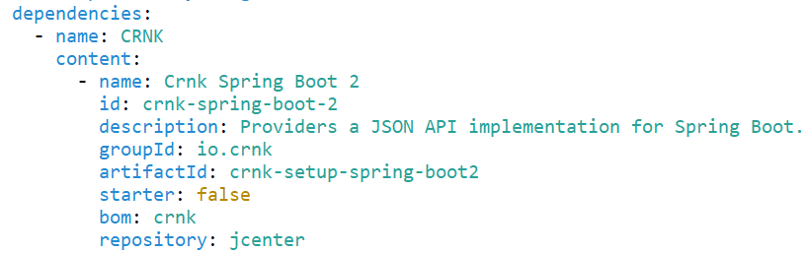
STEP 3

Slide 5
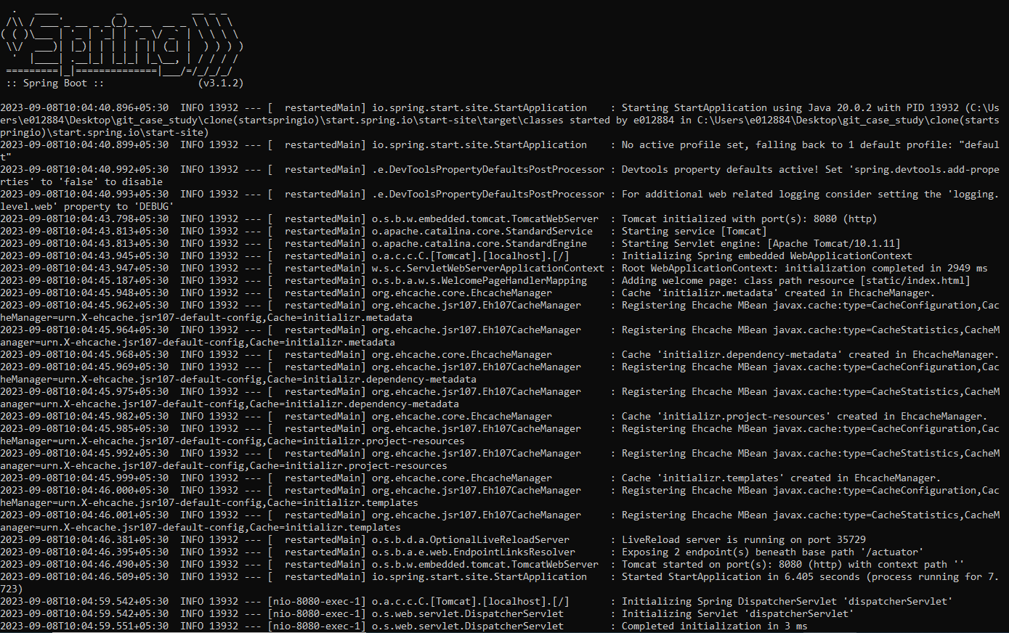
STEP 4

Slide 6
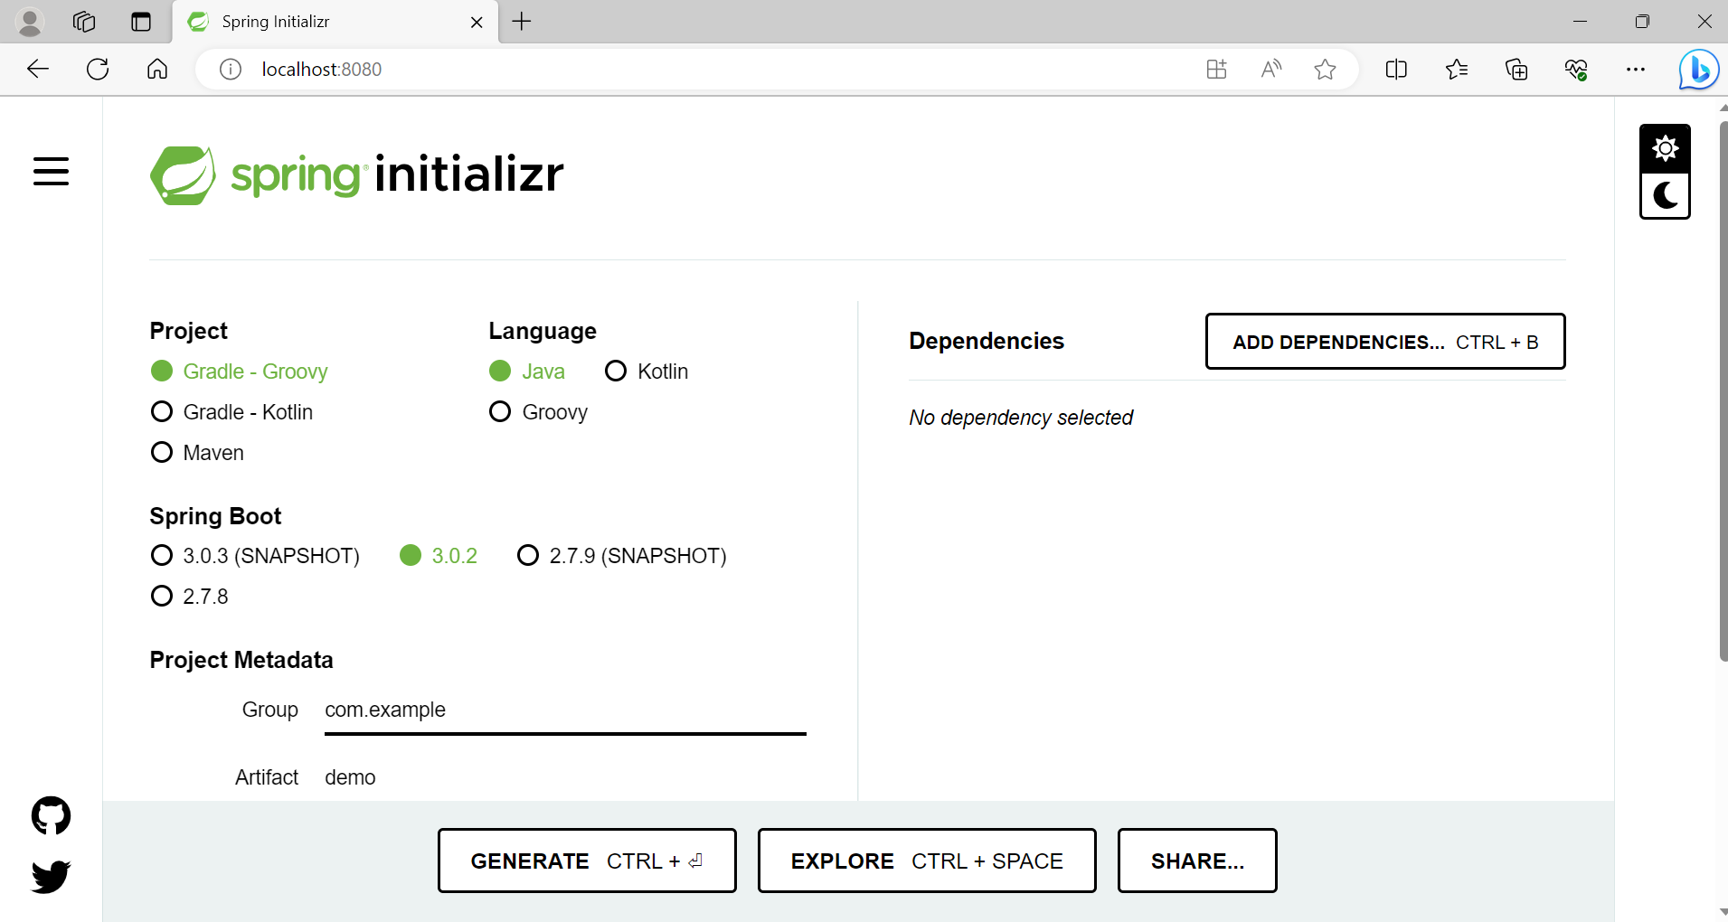

Slide 7
THANK YOU

