Slide 1



TSE CUSTOM INITIALIZR
GROUP 4:
Tunir Chaudhuri, Akash Ranjan, Goutham Suresh, Rahul, Sunny Kumar

Slide 2
INTRODUCTION
The Custom Spring Initializr is a tailored version of the Spring Initializr, a web-based tool that simplifies and accelerates the bootstrapping of Spring-based projects. It offers a personalized development experience by allowing developers to define custom project templates, dependencies, and metadata.
While https://start.spring.io/ is an excellent start for your next Spring Boot project, sometimes it may be necessary to customize it to your own needs e.g., for the following reasons:
You may be required to provide a self-hosted instance of the Spring Initializr within your company e.g., due to network restrictions when downloading archives from the web.
You may want to tweak or brand the UI or even build your own UI from scratch.
You may want to provide your own project configurations and/or dependencies e.g., company internal Spring Boot starters that are not publicly available on the web.

Slide 3
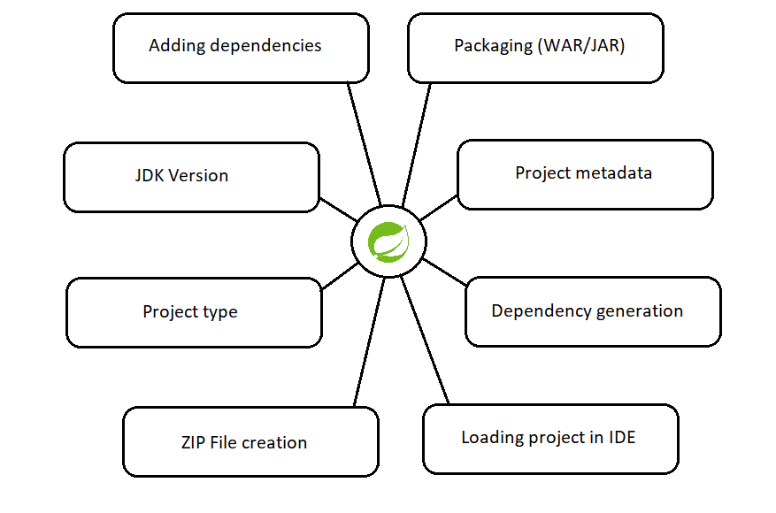
OBJECTIVES
The aim of our project is to simulate an instance of the Spring Initializr on localhost with added custom dependencies and other special features along with all the features in the user stories.

Slide 4




DEVELOPMENT TOOLS
Front-End :
React: to efficiently manage state and UI updates and to perform front-end testing.
Back-End :
Spring Tools 4
Spring Boot Starter
Spring-Core: Initializr-generator
Spring Initializr Metadata: Initializr-metadata
Dependencies: spring-web, starter-actuator
Embedded Web Server: Apache Tomcat

Slide 5


TESTING
Testing Tools:
JMeter
React-Testing
Mocking
J Unit
Dependencies:
spring-boot-starter-test
initializr-generator-test

Slide 6
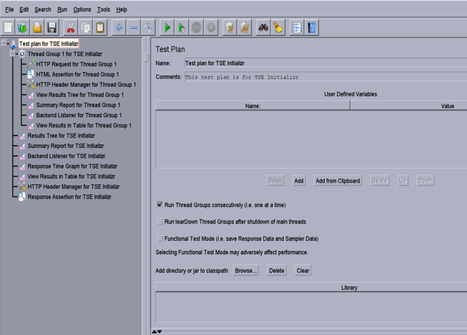

Slide 7

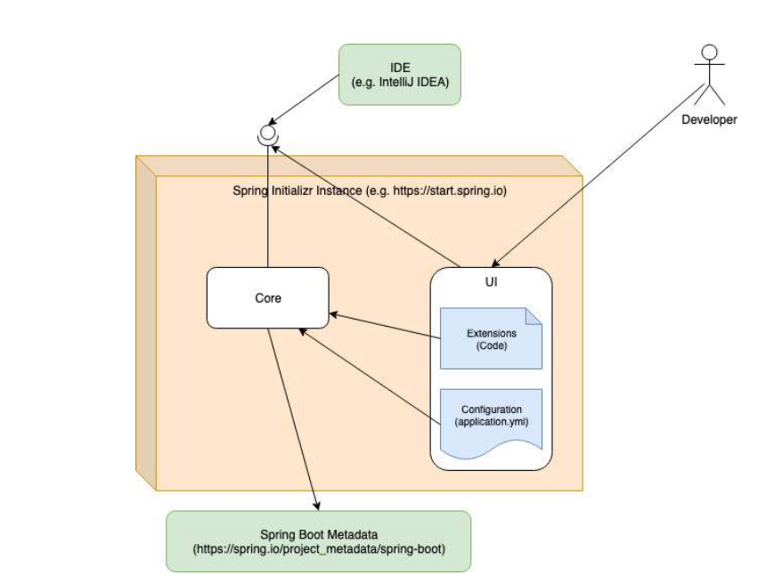
INITIALIZR WORKFLOW

Slide 8
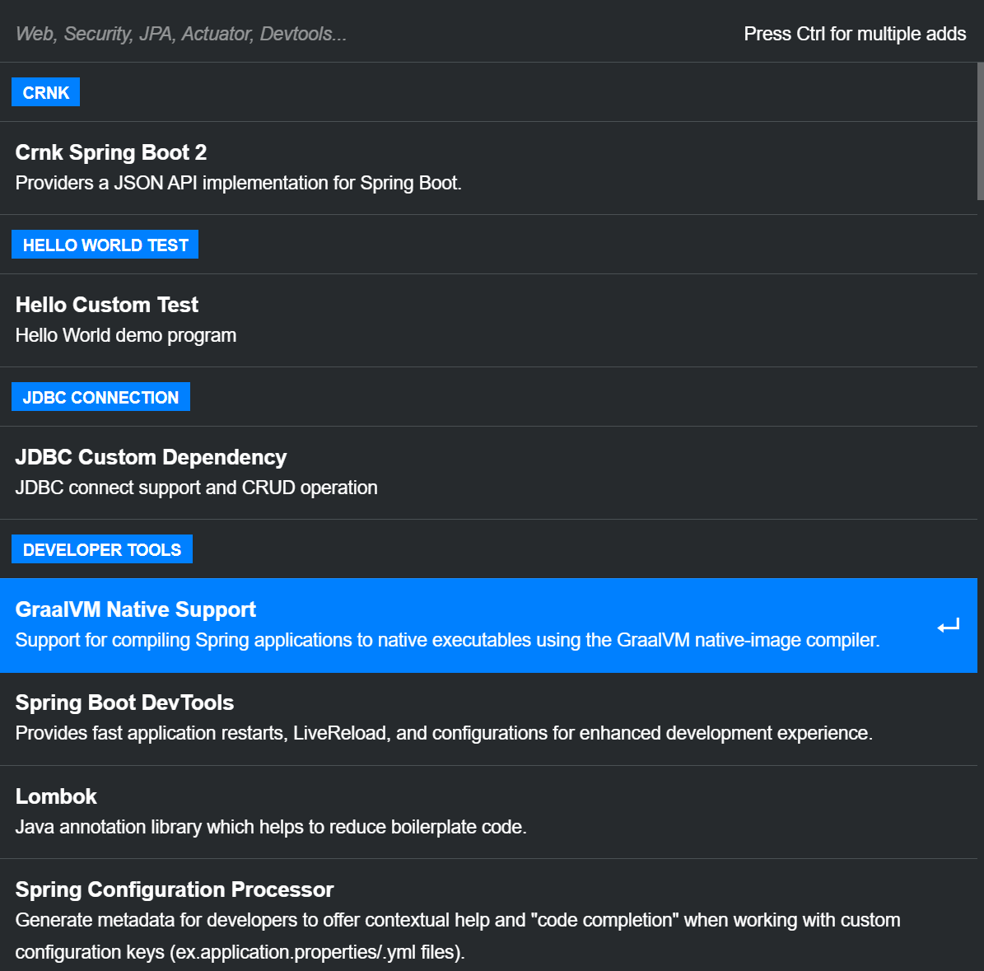
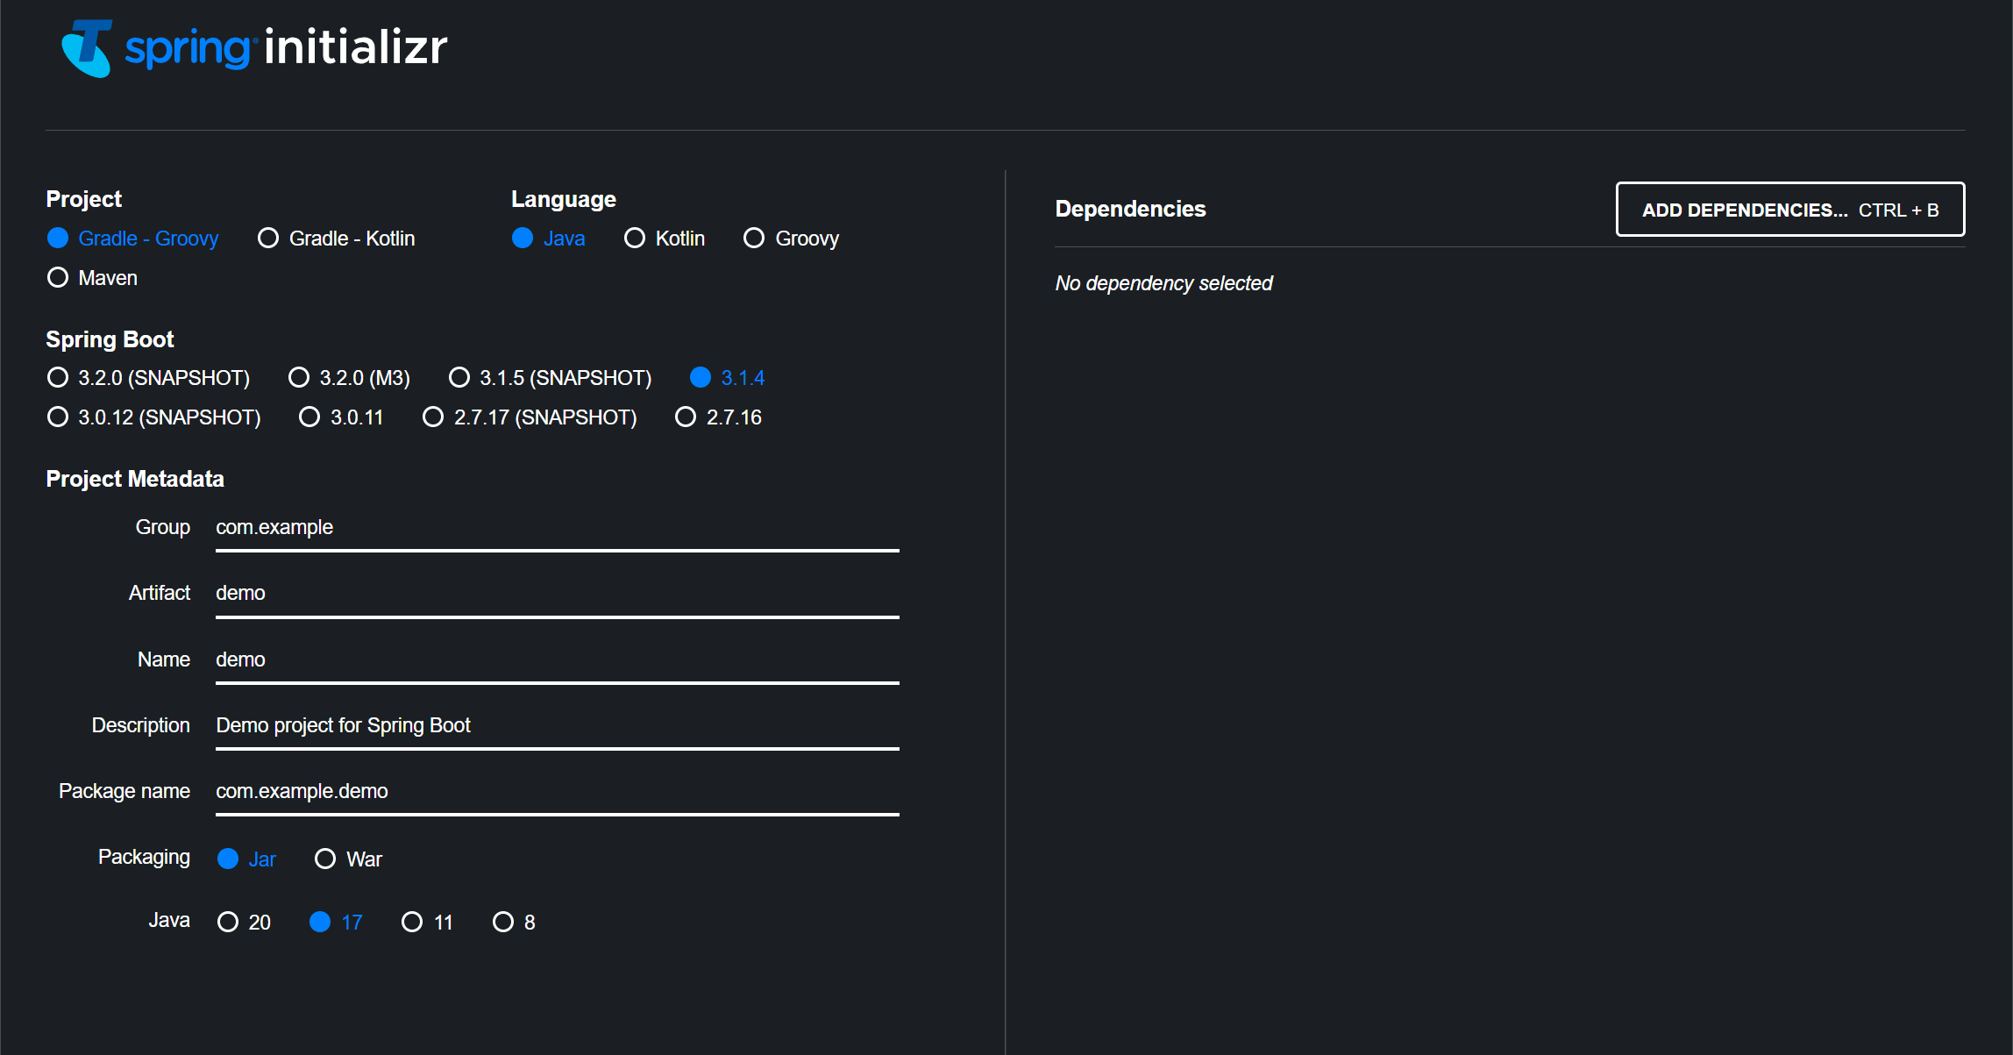
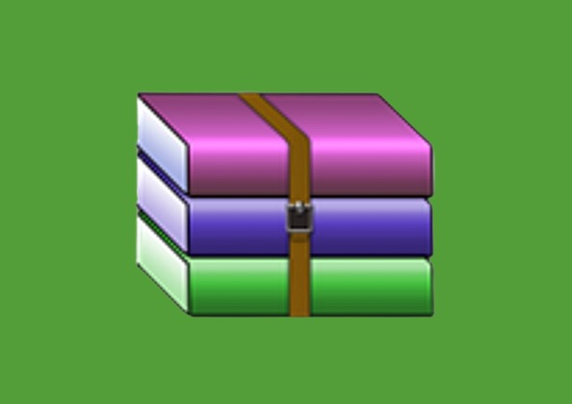
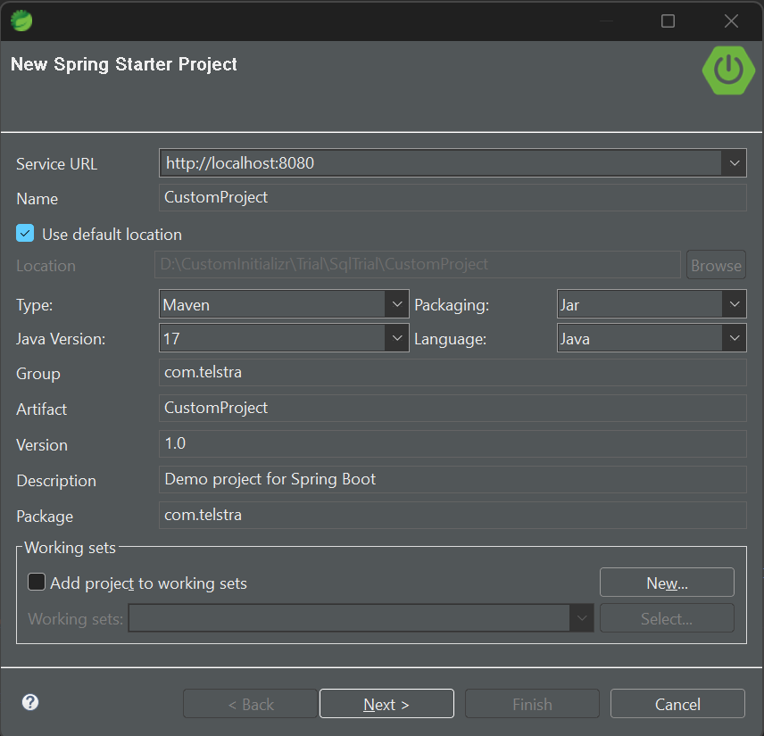
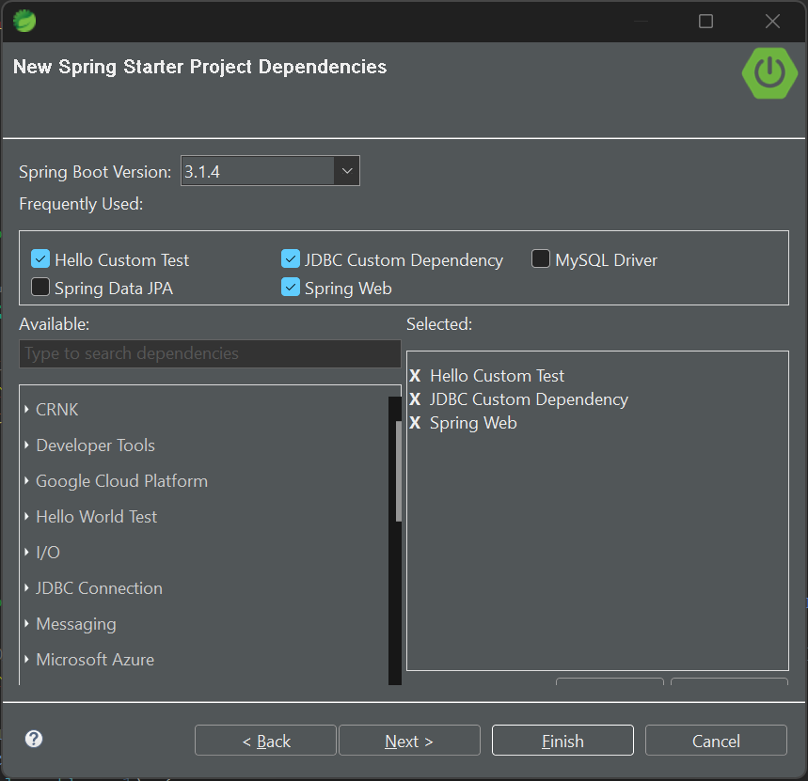
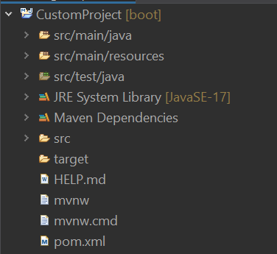
USER INTERFACE:
Project.zip

Slide 9
LIVE DEMONSTRATION

Slide 10
SUMMARY
Custom Spring Initializr enables developers to quickly bootstrap and tailor their Spring-based projects. It provides a web-based interface for generating project templates with the specific dependencies, features, and settings you need. By customizing your project's metadata, you can streamline your development process, enforce coding standards, and maintain consistency across your organization's projects.

Slide 11
FUTURE WORK
Enhanced Customization: Offering more granular customization options and allowing developers to fine-tune
Security and Compliance: Integrating security and compliance checks during project generation
Machine Learning and AI: Implementing AI and machine learning algorithms and assisting developers in making better choices regarding project configurations and dependencies.
Cloud Integration: Offering cloud-specific templates and configurations for platforms like AWS, Azure, or Google Cloud.

Slide 12
TEAM:
Tunir Chaudhuri - Software Engineering - Associate
Akash Ranjan - Software Engineering - Associate
Goutham Suresh - Software Engineering - Associate
Rahul - Software Engineering - Associate
Sunny Kumar - Software Engineering – Associate

Slide 13
THANK YOU

