Slide 1
CASE STUDY (GROUP 4)
TSE Initializr
Tunir Chaudhuri
Akash Ranjan
Goutham Suresh
Rahul
Sunny Kumar
20/09/2023

Slide 2


INTRODUCTION
While https://start.spring.io/ is an excellent start for your next Spring Boot project, sometimes it may be necessary to customize it to your own needs e.g., for the following reasons:
You may be required to provide a self-hosted instance of the Spring Initializr within your company e.g., due to network restrictions when downloading archives from the web.
You may want to tweak or brand the UI or even build your own UI from scratch.
3. You may want to provide your own project configurations and/or dependencies e.g., company internal Spring Boot starters that are not publicly available on the web.

Slide 3
OBJECTIVES
The aim of our project is to simulate the functioning of Spring Initializr on localhost with some added dependencies and other special features.
User stories:
The application should allow us to add dependencies.
The application should allow to choose options between war and jar.
The application should allow us to choose the appropriate jdk version.
The application should allow us to mention the domain, artifact, name of project and the description of a project.
The application should allow us to choose Maven or Gradle.
REST response should be successful to get the accurate dependencies from Maven or Gradle.
ZIP file should be created properly and saved on system.
We should be able to load the project in Intellij or Eclipse or any IDE.

Slide 4
SCOPE
Included:
Custom TSE Initializr
Custom dependencies
Custom front end user interface
Not Included:
Complete backend configuration
Complete frontend configuration

Slide 5
METHODOLOGY
We are following a step-by-step approach as follows:

Slide 6
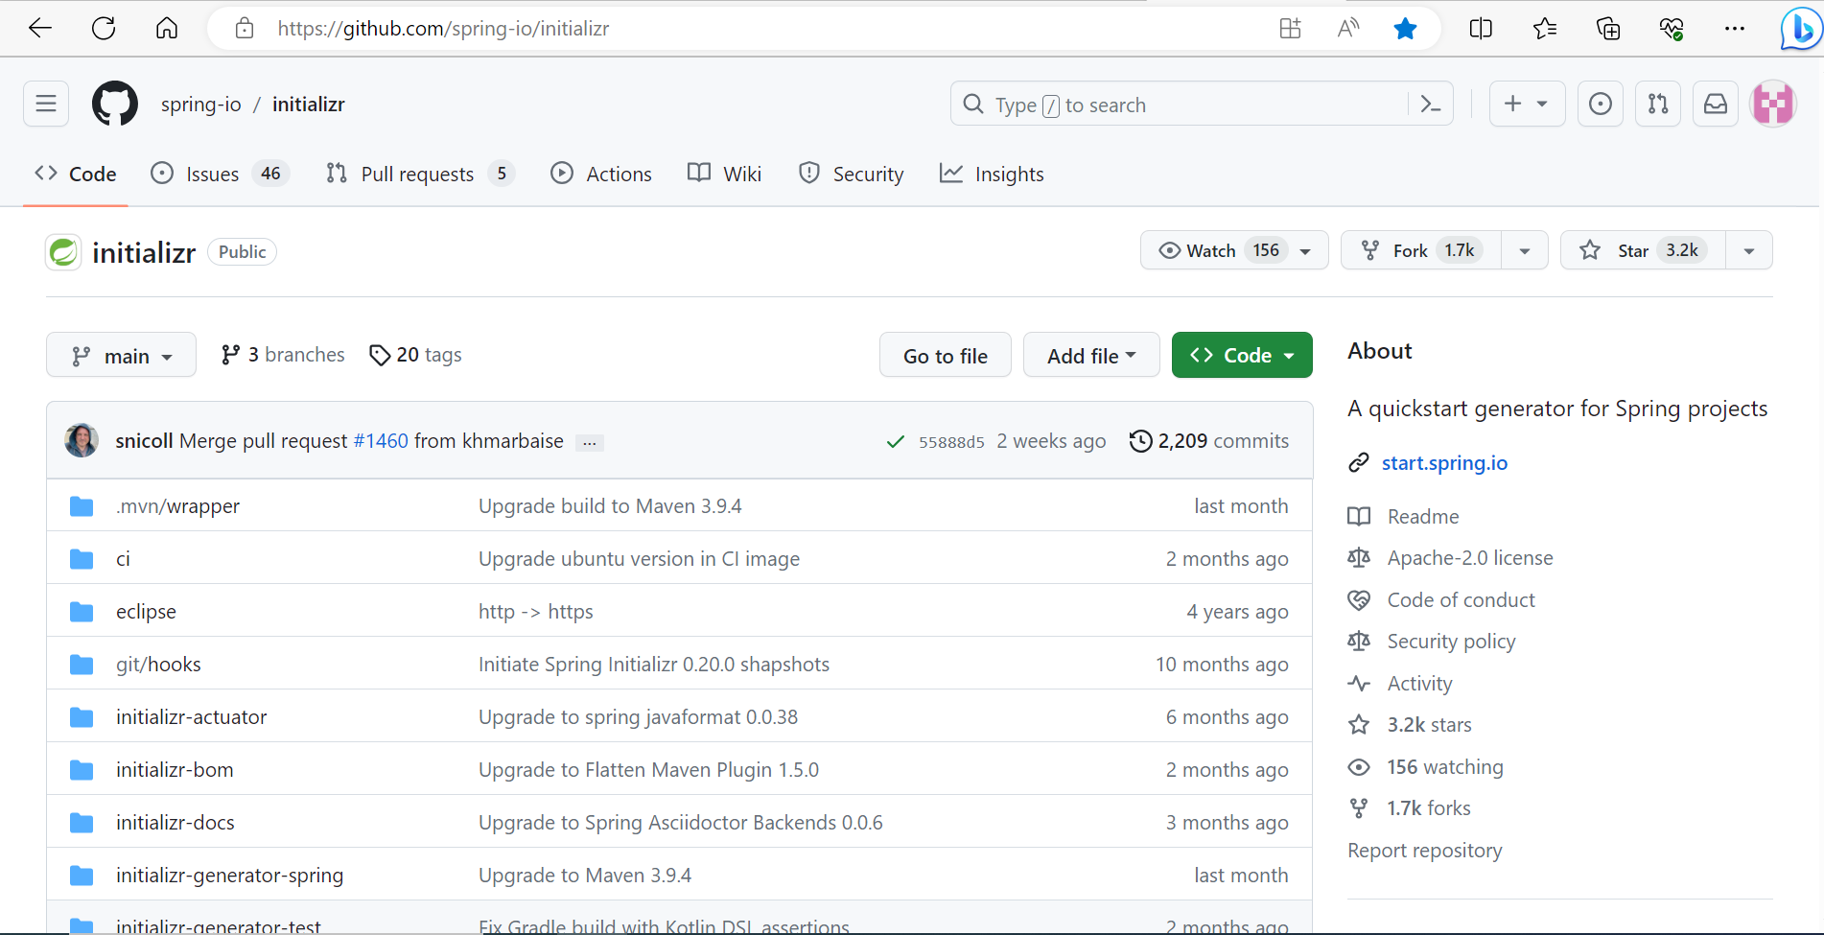
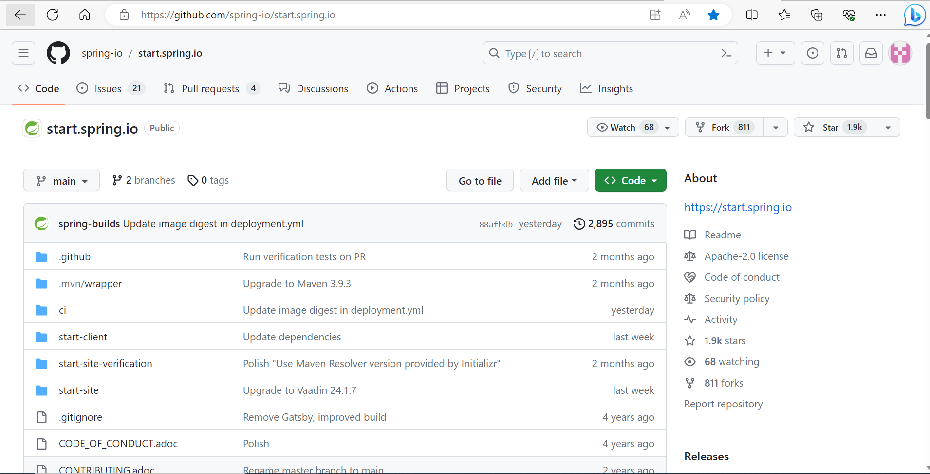
STEP 1

Slide 7
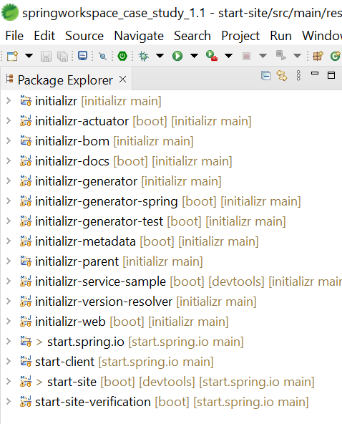
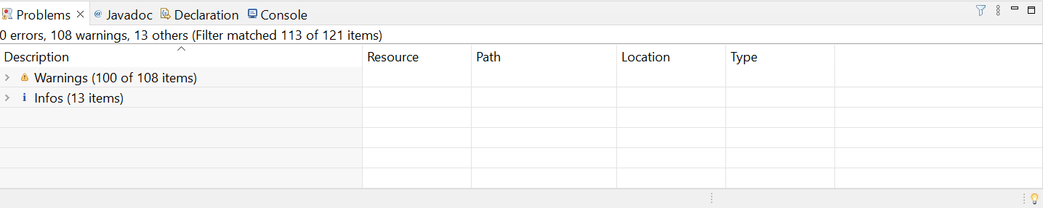
STEP 2

Slide 8
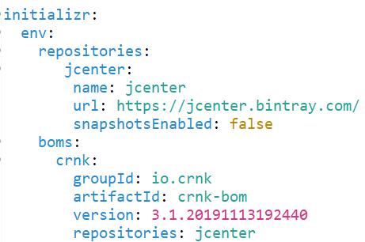
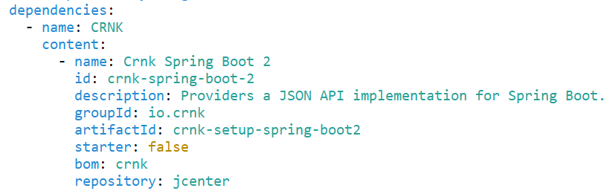
STEP 3

Slide 9
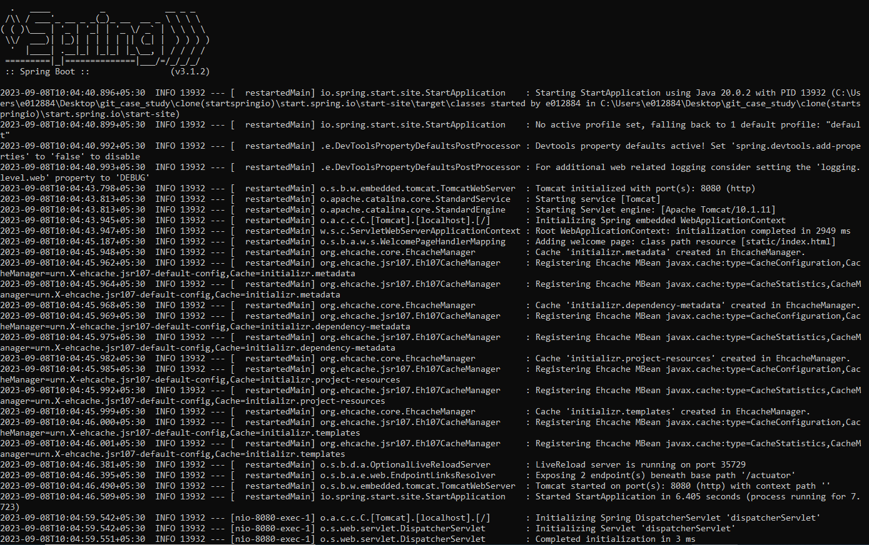
STEP 4

Slide 10
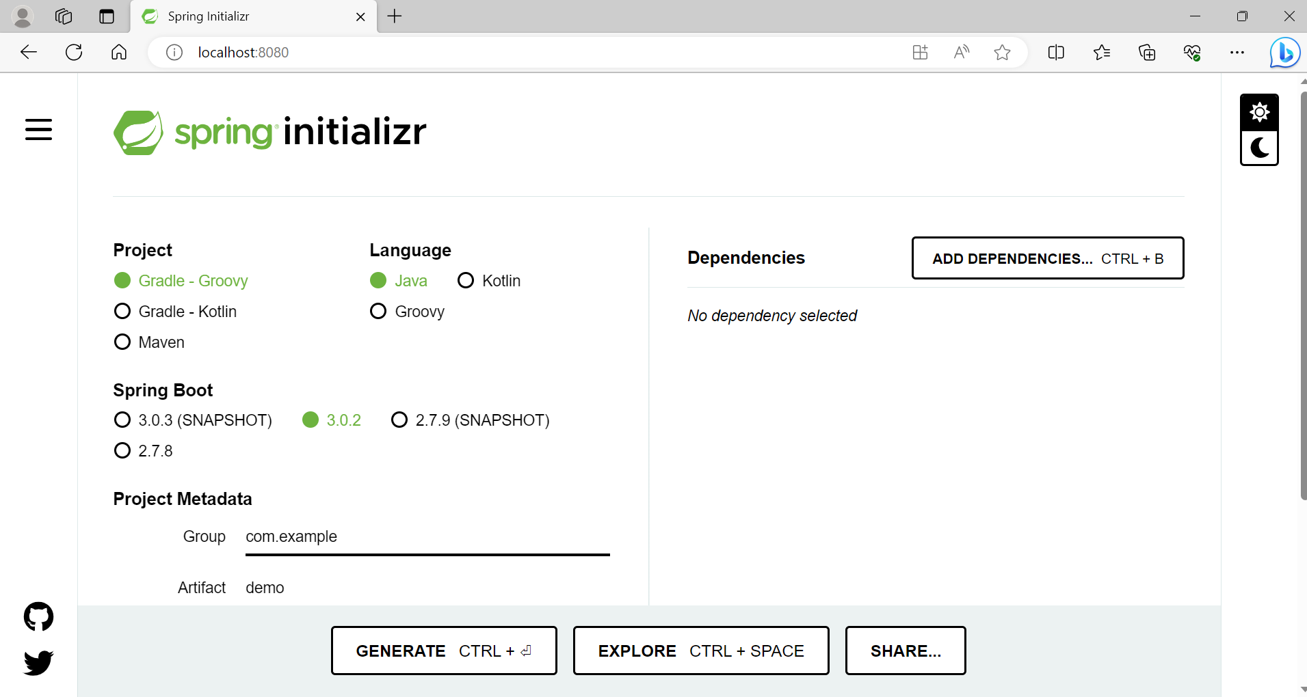

Slide 11
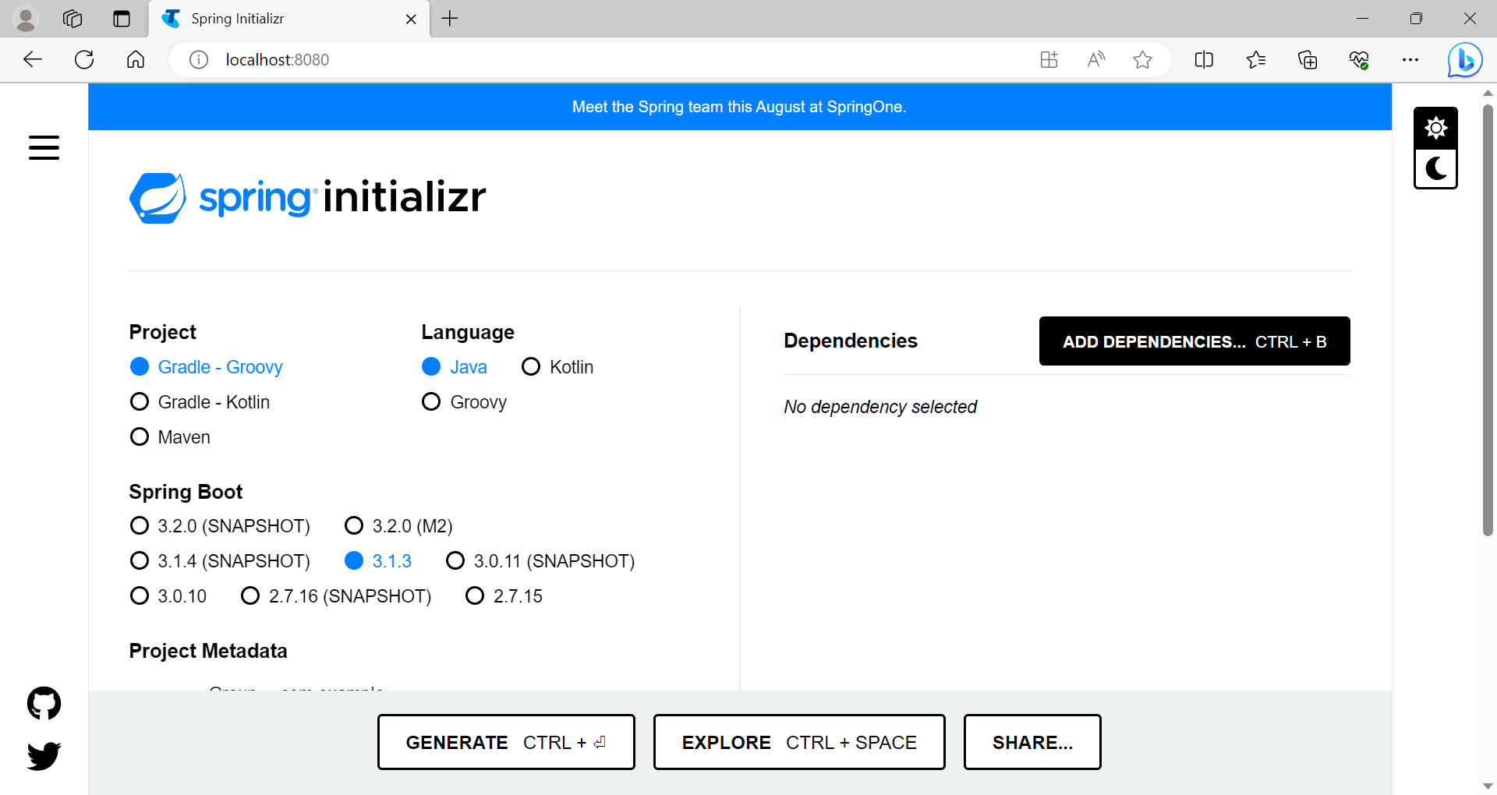

Slide 12
LIVE DEMONSTRATION

Slide 13
CHALLENGES
Spring version conflicts
System configuration problems
Maven build errors
Workspace issues

Slide 14
FUTURE WORK
React test cases
Building own TSE Instance

Slide 15
THANK YOU

