Slide 1


TSE CUSTOM INITIALIZR
GROUP 4:
Tunir Chaudhuri, Akash Ranjan, Goutham Suresh, Rahul, Sunny Kumar

Slide 2
INTRODUCTION
The Custom Spring Initializr is a tailored version of the Spring Initializr, a web-based tool that simplifies and accelerates the bootstrapping of Spring-based projects. It offers a personalized development experience by allowing developers to define custom project templates, dependencies, and metadata.
While https://start.spring.io/ is an excellent start for your next Spring Boot project, sometimes it may be necessary to customize it to your own needs e.g., for the following reasons:
You may be required to provide a self-hosted instance of the Spring Initializr within your company e.g., due to network restrictions when downloading archives from the web.
You may want to tweak or brand the UI or even build your own UI from scratch.
You may want to provide your own project configurations and/or dependencies e.g., company internal Spring Boot starters that are not publicly available on the web.

Slide 3
Objectives
The aim of our project is to simulate an instance of the Spring Initializr on localhost with added custom dependencies and other special features along with all the features in the user stories.
The application should allow us to add dependencies.
The application should allow to choose options between war and jar.
The application should allow us to choose the appropriate jdk version.
The application should allow us to mention the domain, artifact, name of project and the description of a project.
The application should allow us to choose Maven or Gradle.
REST response should be successful to get the accurate dependencies from Maven or Gradle.
ZIP file should be created properly and saved on system.
We should be able to load the project in Intellij or Eclipse or any IDE.

Slide 4

Development Tools
Front-End :
HTML & CSS: HTML is used for structuring & Styling the web page and defining its elements.
JavaScript: JavaScript is often used for adding interactivity to the Initializr's user interface.
React: to efficiently manage state and UI updates and to perform front-end testing.
Back-End :
JDK-17 or Above & Maven
Spring Boot Starter
Spring-Core: Initializr-generator
Spring Initializr Metadata: Initializr-metadata
Other Spring-Tools: spring-web, starter-actuator
Embedded Web Server: Apache Tomcat

Slide 5

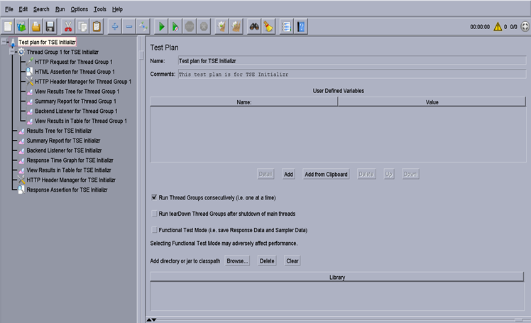
Testing
Testing Tools:
JMeter
React-Testing
Auto-Test:
spring-boot-starter-test
initializr-generator-test

Slide 6

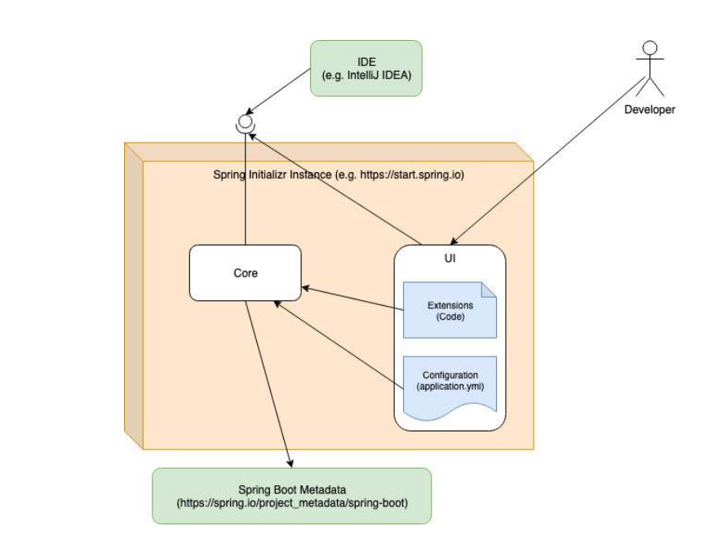
Initializr Workflow

Slide 7
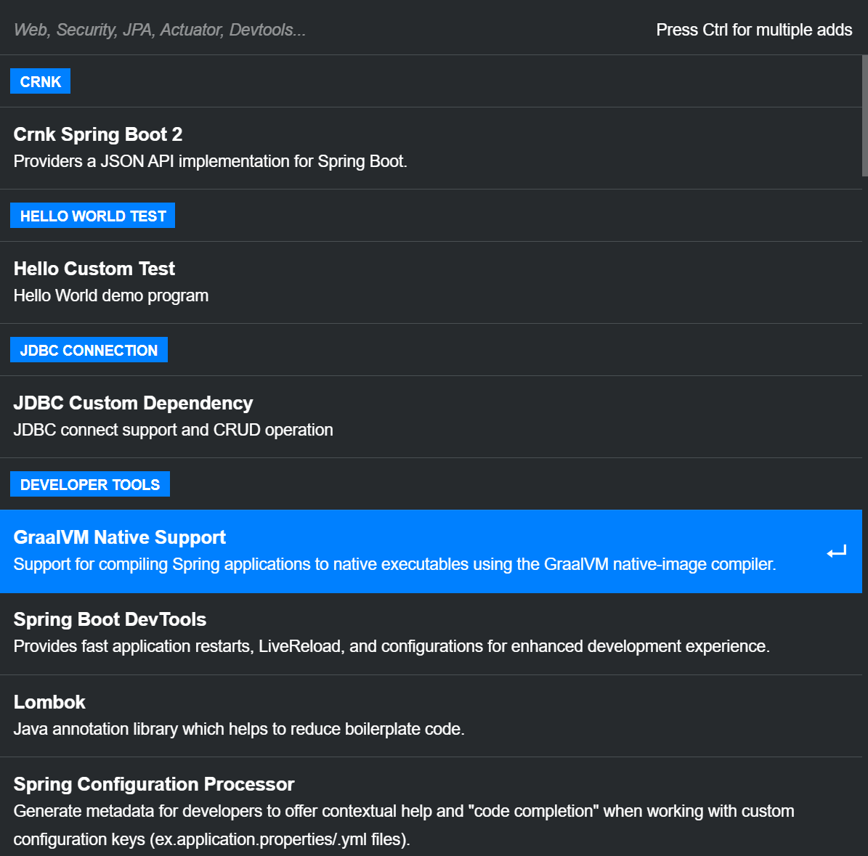
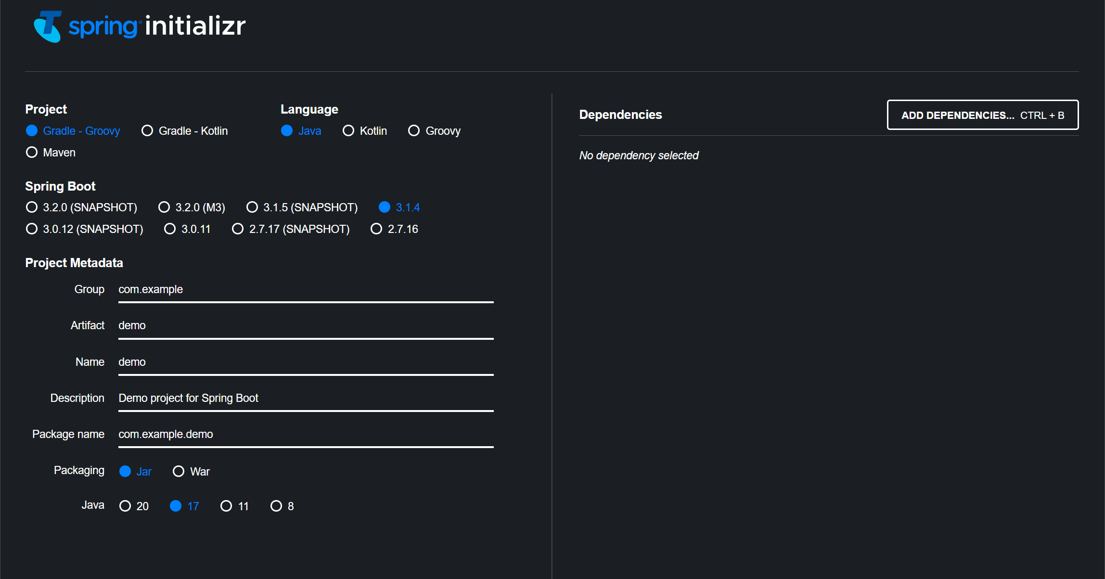

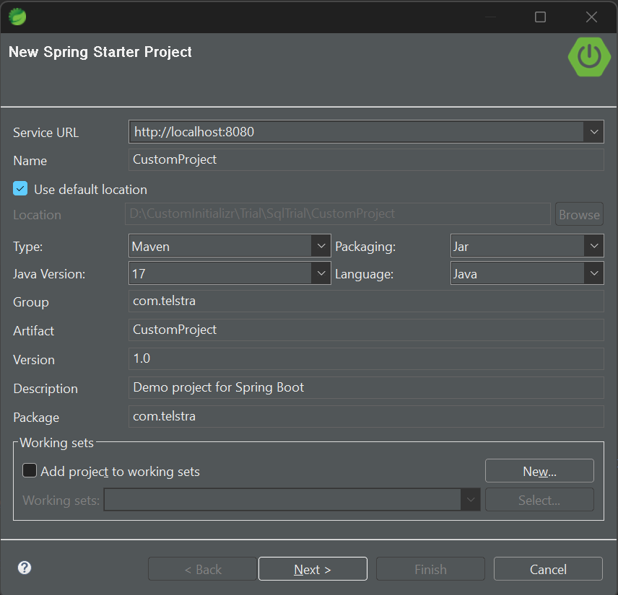
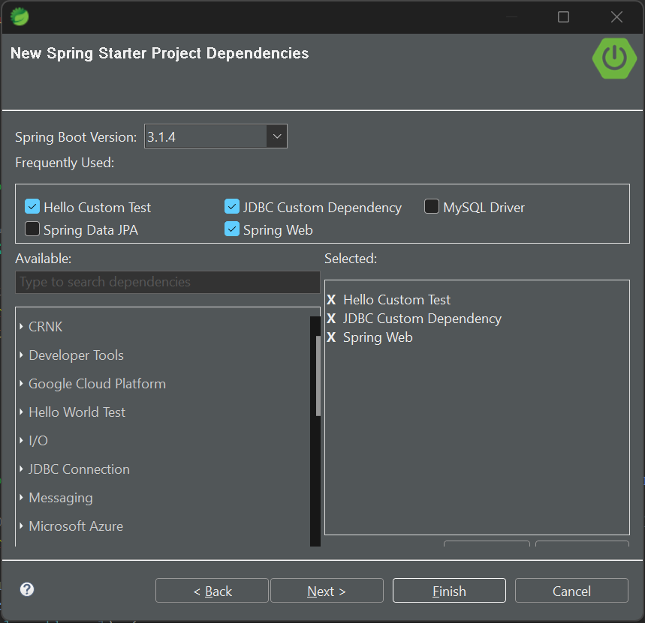
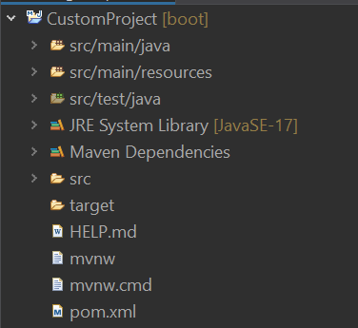
User Interface:
Project.zip

Slide 8
LIVE DEMONSTRATION

Slide 9
Summary & Future Works:
Custom Spring Initializr enables developers to quickly bootstrap and tailor their Spring-based projects. It provides a web-based interface for generating project templates with the specific dependencies, features, and settings you need. By customizing your project's metadata, you can streamline your development process, enforce coding standards, and maintain consistency across your organization's projects.
Future Works:
Enhanced Customization: Custom Initializr can offer even more granular customization options, allowing developers to fine-tune their project configurations
Security and Compliance: Integrating security and compliance checks during project generation can help developers adhere to best practices and organizational guidelines.
Machine Learning and AI: Implementing AI and machine learning algorithms can assist developers in making better choices regarding project configurations and dependencies.
Cloud Integration: Custom Initializr can offer cloud-specific templates and configurations for platforms like AWS, Azure, or Google Cloud.

Slide 10
About Team :

Slide 11
THANK YOU

