Slide 1
Photo Background Removal
Supervisor: Dr. Petru Radu
Student: Adrian-Ioan Tuns

Slide 2
Introduction
The need for background removal
Semantic Image segmentation
DeepLab v3 from TensorFlow, Google
20 categories supported, from objects to animals and humans

Slide 3
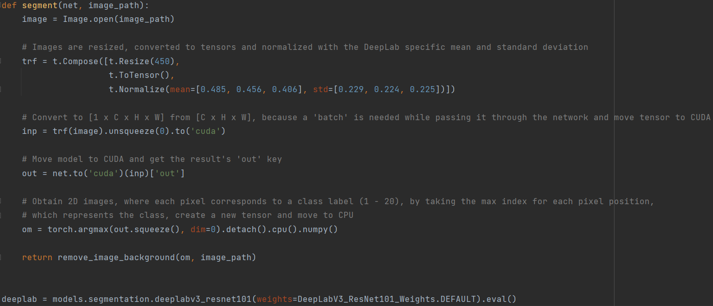

Slide 4
Background Removal
Load foreground image
Create white background image
Binary thresholding is applied on the 3D rgb image obtained previously
The binary mask is stored in the “alpha” variable
Blur alpha mask with GaussianBlur
Alpha blending foreground with background

Slide 5
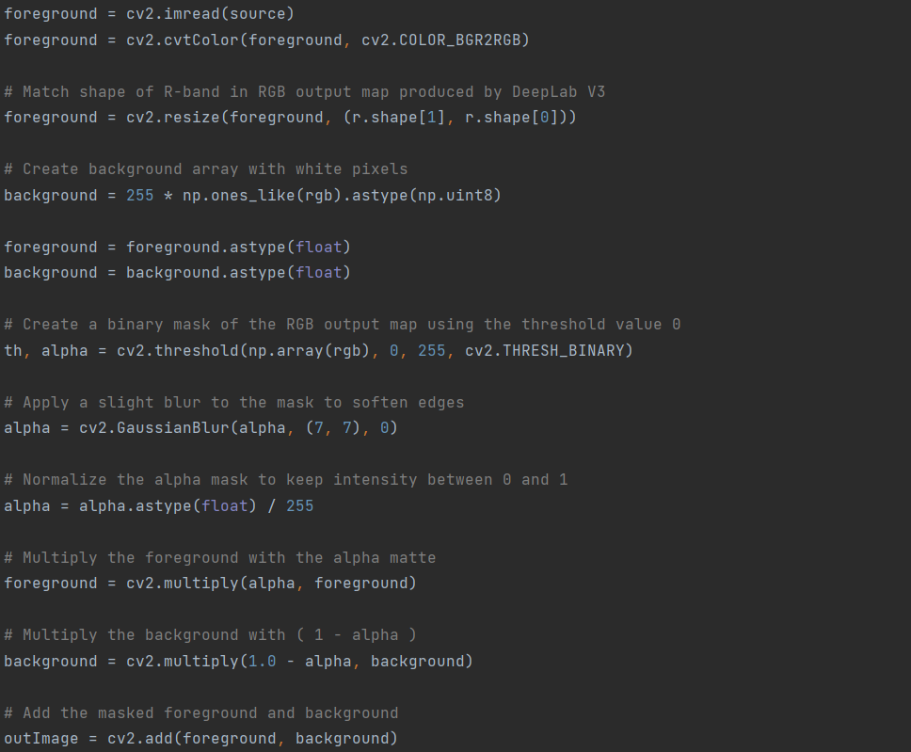

Slide 6


Example of Background Removal

Slide 7
Thank you for your attention!

