Slide 1

Seshadri Rao Gudlavalleru Engineering College Department of CSE (Artificial Intelligence & Machine Learning)
A Hybrid AI-Powered Framework for Real-Time Fake News Detection with Multi-Modal Verification
By
Batch No:07
Student Name (Roll Number)
YARAMALA KARTHIK REDDY 22481A42C4
TUNUGUNTLA GOURI NITEESHA 22481A42B4
VALLAPURAM BHARGAV 22481A42B6
NUNE BHUVANESWAR REDDY 22481A4282
Under the guidance of
Dr. Y. Adilakshmi, M. Tech, Ph.D
Professor & Head of the Dept of CSE (Artificial Intelligence and Machine Learning)

Slide 2
Contents:
Abstract
Introduction
Objectives
Existing System
Proposed System
Implementation
Results

Slide 3
ABSTRACT :
The proliferation of misinformation in digital media poses significant threats to social stability, public health, and democratic processes worldwide. Existing fake news detection systems typically rely on static machine learning models that cannot adapt to evolving misinformation tactics, or on manual fact-checking processes that lack scalability. This paper presents FakeGuard, a novel hybrid framework that integrates a fine tuned BERT-based transformer model with a large language model (Google Gemini 2.5 Flash) and real-time news aggregation for accurate, explainable, and scalable fake news detection. The system architecture comprises three core components: a text classification pipeline using a pre-trained BERT model fine tuned on fake news datasets; a social media analysis module leveraging Gemini AI for contextual understanding and multi factor reasoning; and a real-time news verification engine that aggregates live articles from NewsAPI and GNews, performs source credibility scoring, and applies ML-based content analysis. A confidence-based fallback mechanism ensures system robustness by dynamically switching between the LLM and BERT model during service degradation. Experimental evaluation on the ISOT Fake News Dataset demonstrates that the BERT component achieves 98.7% accuracy and an F1-score of 0.987, while the hybrid system maintains average inference latency of 1.42 seconds for text analysis under steady-state conditions. The complete system is deployed as a production-ready web application with FastAPI backend and React frontend, demonstrating practical viability for real-world misinformation detection.

Slide 4
Introduction:
The digital information ecosystem has grown rapidly in recent years, with social media platforms and online news sources becoming the primary means of information consumption for billions of users worldwide. This widespread accessibility has transformed how people access, share, and interpret news on a daily basis.
Along with this growth, there has been a significant rise in misinformation, disinformation, and fake news, which spreads quickly across digital platforms. The ease of content creation and sharing has made it difficult to control the authenticity of information.
The impact of fake news is severe and far-reaching, leading to reduced public trust in media, increased societal polarization, misinformation during critical events such as pandemics, and threats to democratic systems and decision-making processes
Traditional approaches to fake news detection mainly include manual fact-checking by experts and automated machine learning systems. Manual methods provide high accuracy but are time-consuming and cannot scale to handle the massive volume of daily content generated online.
Automated machine learning-based systems offer scalability and faster processing but suffer from several limitations, such as reliance on static datasets, inability to adapt to evolving misinformation strategies, lack of explainability, and limited contextual understanding of content.

Slide 5
Introduction:
Existing fake news detection systems often operate in isolation without incorporating real-time verification or cross-checking with live news sources, which reduces their effectiveness in identifying newly emerging false information.
There is a strong need for an advanced and integrated solution that combines the strengths of multiple technologies, including accurate classification, contextual reasoning, explainability, and real-time validation of information.
The proposed system introduces a hybrid AI-powered framework that integrates transformer-based models (such as BERT), large language models, and real-time news verification mechanisms to overcome the limitations of traditional approaches.
By combining these components into a unified architecture, the system aims to deliver a more reliable, scalable, and explainable solution for fake news detection, making it suitable for real-world applications and practical deployment

Slide 6
OBJECTIVE :
To develop a robust system for automatic Fake News Detection (FND) to identify misleading information in digital media.
To capture semantic relationships between news content, including headlines, body text, and user comments, for better contextual understanding.
To leverage advanced deep learning models such as BERT (Bidirectional Encoder Representations from Transformers) for effective text representation and classification.
To design a cross-level and cross-modality attention network, enabling the model to extract rich features from multiple data sources.
To incorporate user-posting behavioral features, such as sharing patterns and engagement, to enhance detection accuracy.
To evaluate the system using benchmark datasets like FakeNewsNet (Fake News Network dataset) and PG (PolitiFact and GossipCop datasets) for reliable performance assessment.
To demonstrate improved performance and effectiveness compared to existing state-of-the-art (SOTA) models.

Slide 7
Existing System:
Paper Title: Semantic Deep Learning Approach for Fake News Detection
Objectives:
Detect fake news using deep learning techniques
Analyze news content, headlines, and user comments
Capture semantic relationships between different components
Use BERT model for text representation
Incorporate user posting behavior features
Findings:
Deep learning models improve detection accuracy
Combining content and context gives better results
Attention mechanisms help in understanding relationships
Achieves better performance than traditional ML models

Slide 8
Existing System:
Paper Title: Knowledge-Guided Semantic Fake News Detection Framework
Objectives:
Detect fake news using semantic analysis and external knowledge
Compare news content with real-world knowledge graphs
Identify inconsistencies between facts and claims
Use BERT-based embeddings for semantic representation
Enhance detection using knowledge-guided reasoning
Findings:
Incorporating external knowledge improves detection reliability
Semantic inconsistency detection helps identify false claims
BERT-based models provide strong contextual understanding
Hybrid approaches outperform traditional content-only models

Slide 9
Limitations of Existing System:
Most models focus only on text content, ignoring full context
Limited ability to capture semantic relationships between news, headlines, and comments
Many systems use static models that cannot adapt to new fake news patterns
Lack of real-time verification using live news sources
Limited use of user behavior features for better detection
Some models act as black-box, reducing explainability
Performance may decrease on real-world dynamic data

Slide 10
Proposed System:
System Name: FakeGuard – Hybrid AI-Based Fake News Detection
Approach:
Combines Machine Learning + Large Language Models + Real-time APIs
Uses BERT (Bidirectional Encoder Representations from Transformers) for text classification
Uses Gemini 2.5 Flash (LLM) for contextual understanding and reasoning
Integrates NewsAPI & GNews for real-time news verification
Key Features:
Hybrid model for high accuracy and scalability
Captures both text content and contextual meaning
Performs real-time fact verification
Provides explainable results
Uses fallback mechanism for reliability

Slide 11
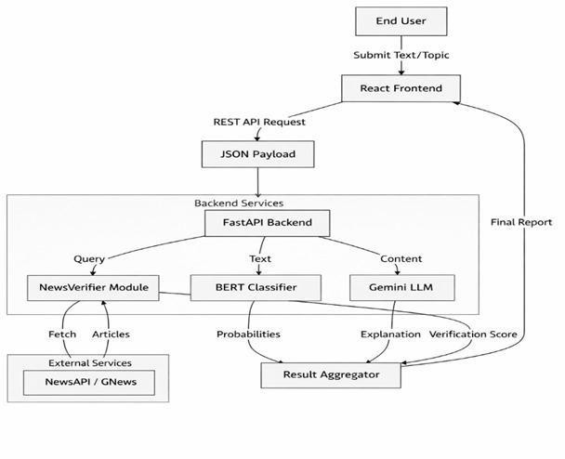
Methodology:

Slide 12
Methodology:
The system follows a multi-stage deep learning pipeline for fake news detection.
Input Data: News articles, headlines, and user comments are collected from datasets.
Data Preprocessing:
Text cleaning (removal of stopwords, punctuation, noise)
Tokenization and normalization
Feature Extraction:
Semantic features extracted using BERT embeddings
Contextual relationships captured across content components
Behavioral Features:
User posting patterns and engagement signals are incorporated

Slide 13
Methodology:
Model Architecture:
BERT-based encoder for deep contextual understanding
Attention mechanism to focus on important text segments
Feature Fusion:
Combines content features + user behavior features
Classification Layer:
Fully connected layers classify news as Fake or Real
Output:
Final prediction with improved accuracy and reliability
Evaluation:
Performance measured using accuracy, precision, recall, and F1-score

Slide 14
Implementation:
Data Collection: Collected news articles and social media content from datasets and APIs
Backend Development: Developed using FastAPI (Python) for handling requests and processing
Frontend Development: Built using React.js and Tailwind CSS for user interface
Model Integration: Integrated BERT model for text classification Integrated Gemini API for contextual analysis
Real-time Verification: Used NewsAPI and GNews APIs to fetch live news data
System Deployment: Deployed as a web-based application for real-time usage

Slide 15
Implementation (Working):
User enters news text or content
System processes input through models
Performs classification and verification
Displays result as Fake or Real
Shows confidence score and explanation

Slide 16
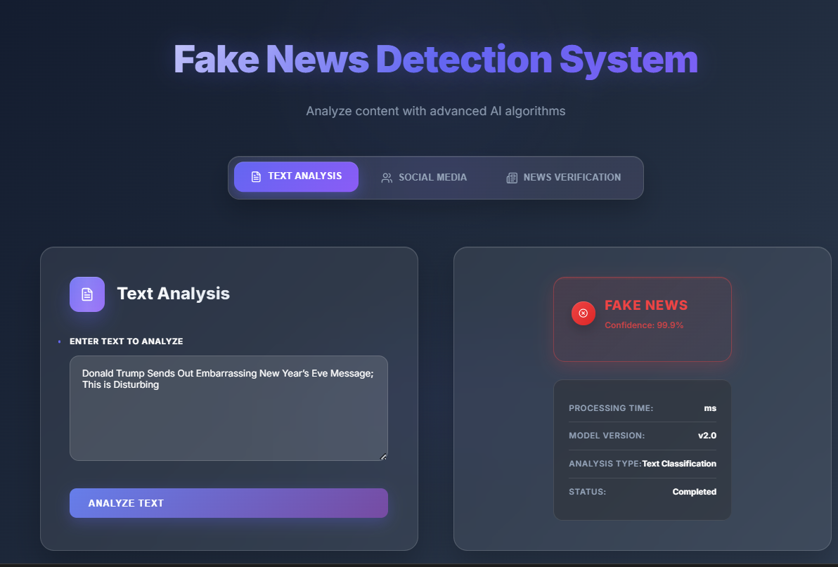
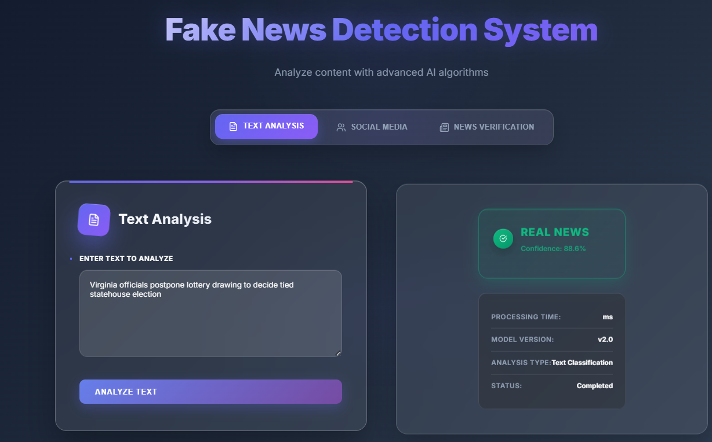
RESULTS:

Slide 17
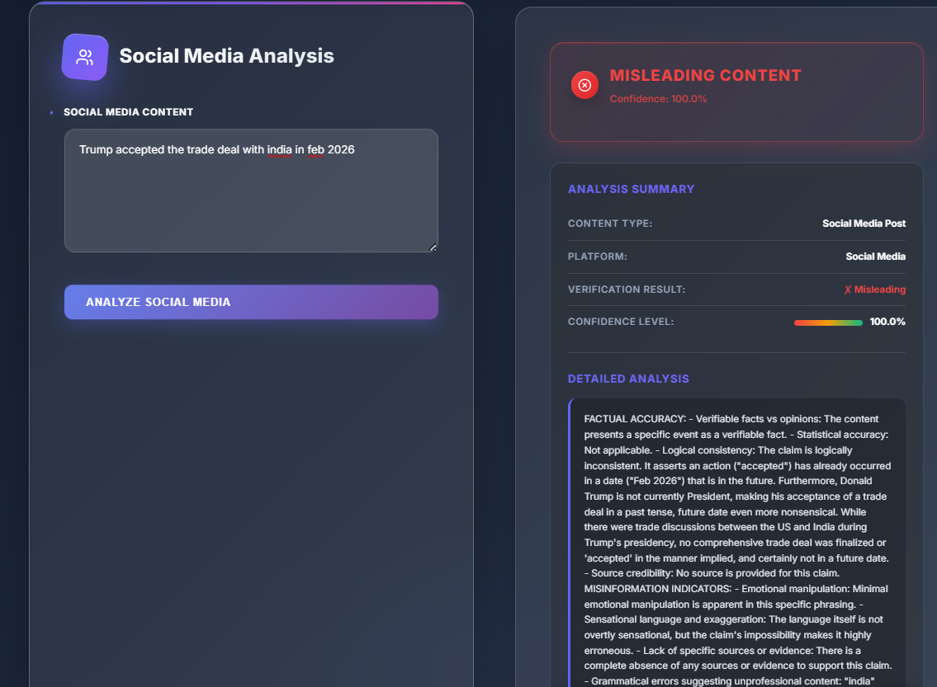
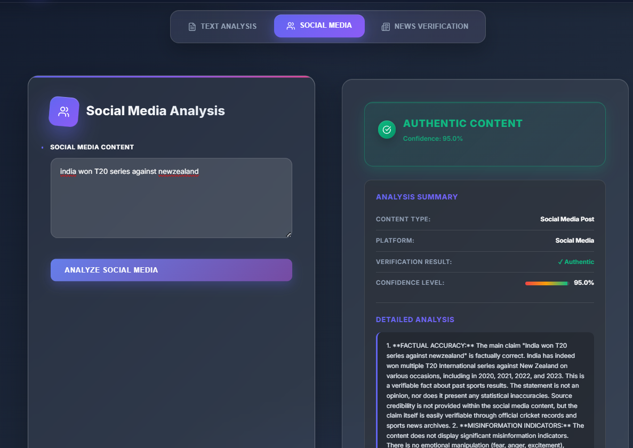

Slide 18
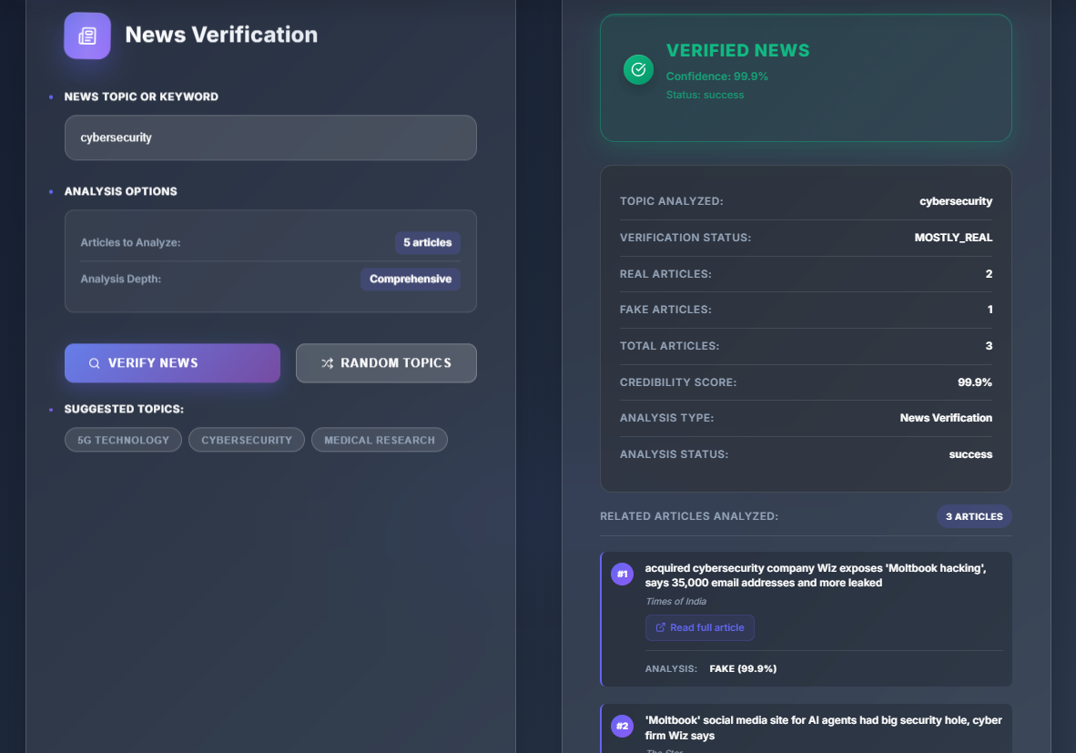


Slide 19


Slide 20
Thank You

