Slide 1
Deployment of Image classification web application in cloud

Slide 2
Description
In this project we are going to use the machine learning technique in the web application where we can classify the image uploaded and to make this application accessible to everyone we are going to host it in cloud services and make it public.

Slide 3
Use cases
How to discrete and analyse both the air traffic and the road traffic?
The satellite and aerial images are captured by the cameras on satellites and aircrafts.
Image classification is the key solution for the differentiation of the aerial and road traffic.
These images are classified into various types.

Slide 4
Limitations
This is a prototype where we are classifying cars in the road traffic and aeroplanes in the aerial region. But there are various types of vehicles and aircrafts.
This is a dynamically increasing dataset it requires high storage.
As the data is increasing in high rate. The model needs to be updated frequently.
In this machine learning project we are using tensorflow where the requirement of CPU is high. This leads to more consumption of CPU i.e we need higher horizontal scalability.

Slide 5
Our Idea
The main idea underlying in this project is classifying an image given using machine learning to the web application and in return the application predicts whether the image contains the car or aeroplane so that we can distinguish and analyse the traffic respectively.

Slide 6
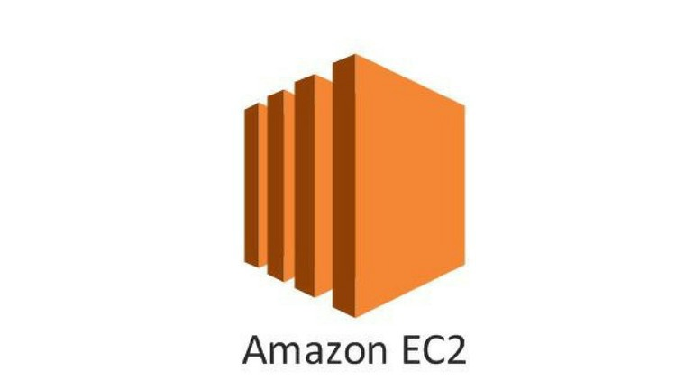


Services
Lambda

Slide 7
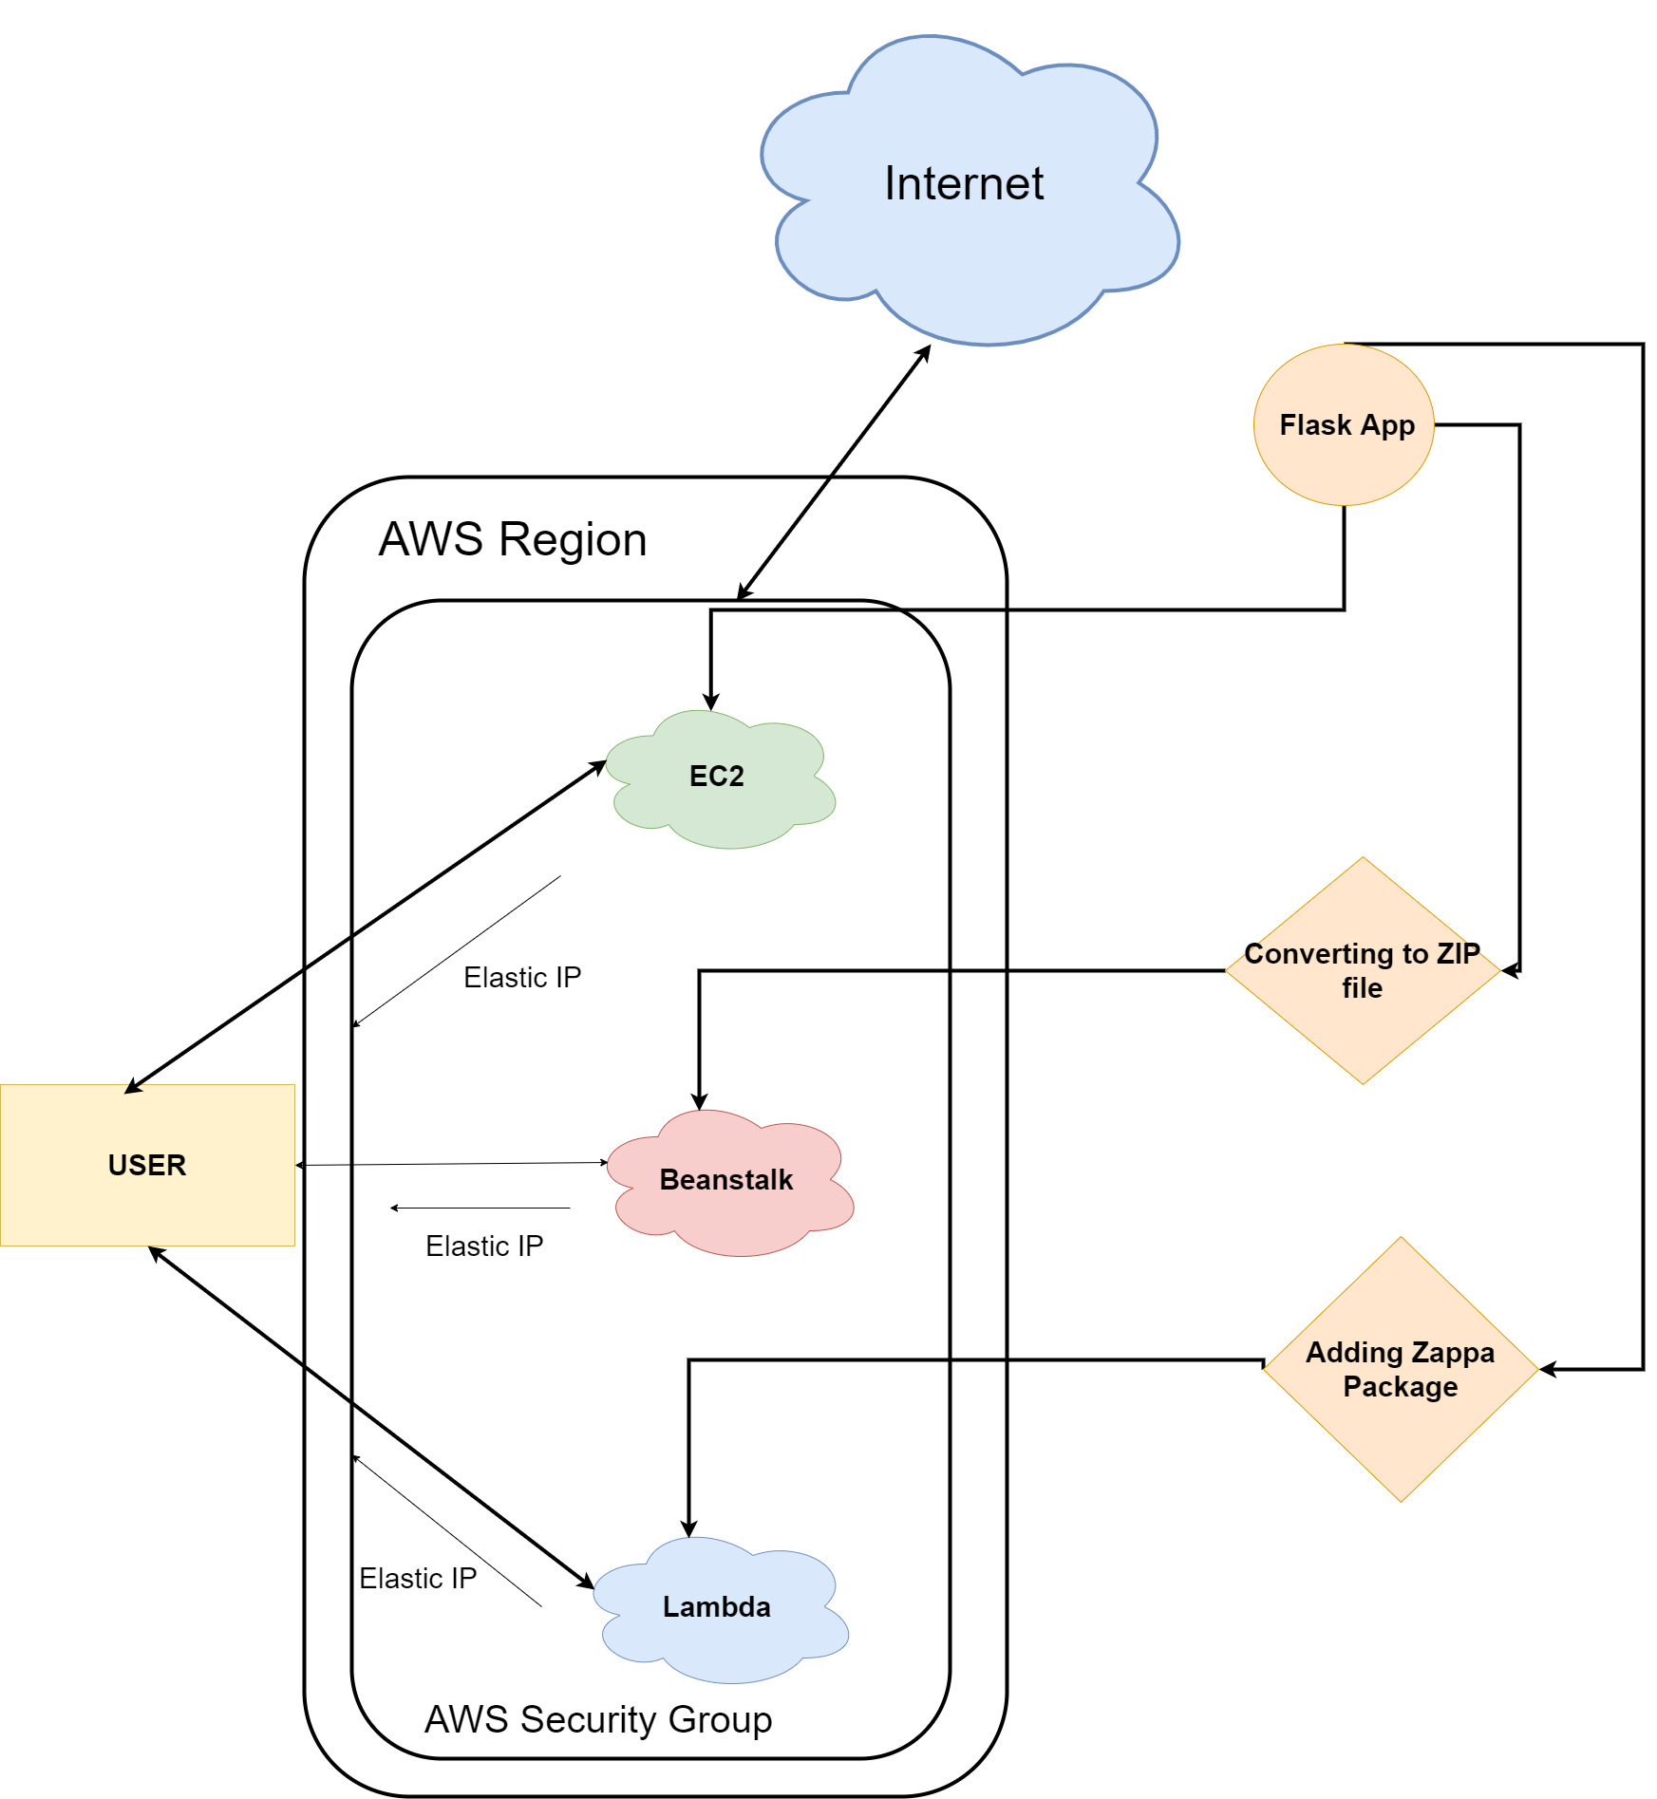
Architecture

Slide 8
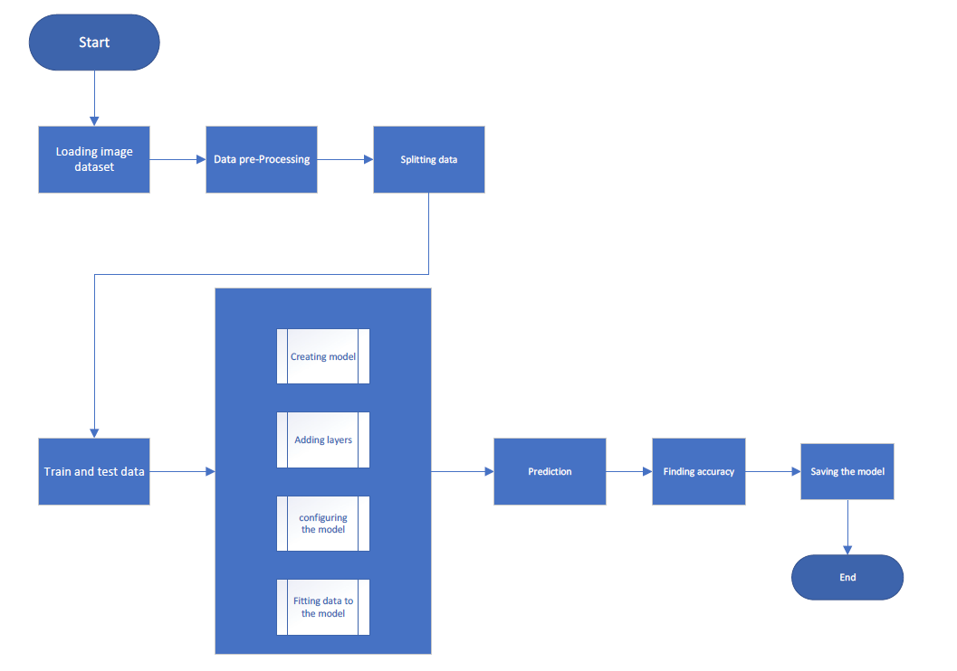
ML Architecture

Slide 9
Brief description about Services
AWS EC2 instance is a virtual server in Amazon's Elastic Compute Cloud (EC2) for running applications on the Amazon Web Services (AWS) infrastructure. EC2 is a service that enables customers to run application programs in the computing environment.
AWS Elastic Beanstalk is a compute service that makes it easier for the developers to quickly deploy and manage applications that you upload to the AWS cloud. Developers simply upload their application to the AWS cloud, and then let the AWS Beanstalk provision and handle the configuration for you. Your application will be provided with capacity provisioning, load balancing, auto-scaling, and health monitoring.
AWS Lambda is an event-driven, serverless computing platform provided by Amazon as a part of Amazon Web Services. Therefore you don’t need to worry about which AWS resources to launch, or how will you manage them. Instead, you need to put the code on Lambda, and it runs.

Slide 10
Presented By
T. GuruTheja Reddy (19BCD7034)
V. Manikanta Bhuvanesh (19BCD7088)

Slide 11
Thank You

