Slide 1
Working with Elements

Slide 2
Agenda
Automating textboxes, text areas, and buttons.
Checking an element's text.
Checking an element's attribute and CSS values.
Automating dropdowns and lists.
Checking options in the Select element
Checking selected options in dropdowns and lists.
Automating radio buttons and radio groups.
Automating checkboxes.
Working with WebTables.

Slide 3

Automating textboxes, text areas, and buttons
The textbox and button elements are the most common elements used in any web application. Selenium WebDriver's WebElement interface provides methods to simulate keyboard entry into textboxes or text areas and perform clicks on a button control.

Slide 4

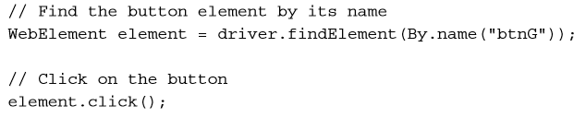
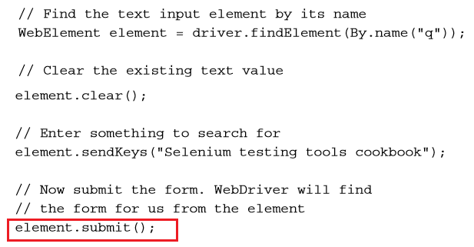
Automating textboxes, text areas, and buttons

Slide 5
Checking an element's text
While testing a web application, we need to verify that elements are displaying the correct values or text on the page.
Selenium WebDriver's WebElement interface provides methods to retrieve and verify text from an element.
Sometimes we need to retrieve text or values from an element into a variable at runtime and later use it at some other place in the test flow.
getText()
getAttribute()

Slide 6
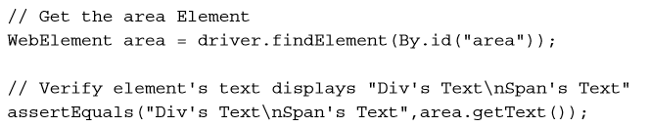
Checking an element's text
The getText() method of the WebElement interface returns the visible innerText of the element, including sub-elements, without any leading or trailing whitespace.

Slide 7

Checking an element's text
The WebElement.getText() method does not work on hidden or invisible elements. Retrieval of text from such elements is possible through the getAttribute() method using the innerText or textContent attribute.

Slide 8
Checking an element's attribute and CSS values
Developers configure various attributes of elements displayed on the web page during design or at runtime to control the behavior or style of elements when they are displayed in the browser.
For example, the <input> element can be set to read-only by setting the readonly attribute.
getAttribute()
getCSSValue()

Slide 9
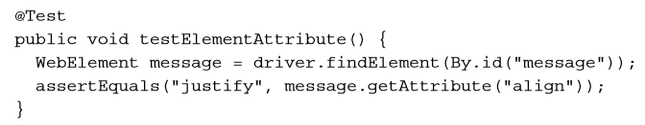
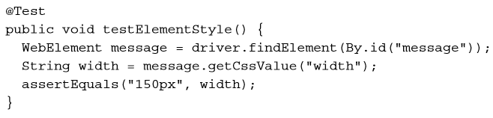
Checking an element's attribute and CSS values

Slide 10
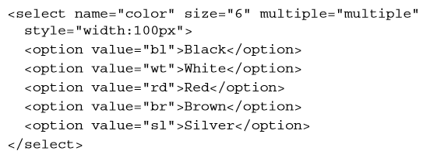
Automating dropdowns and lists
Selenium WebDriver supports testing dropdown and list elements using a special Select class.
The Select class provides various methods and properties to interact with dropdowns and lists created with the HTML <select> element.

Slide 11
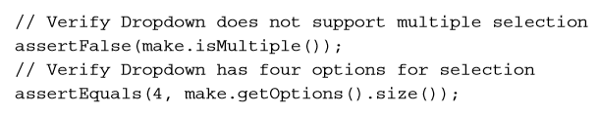
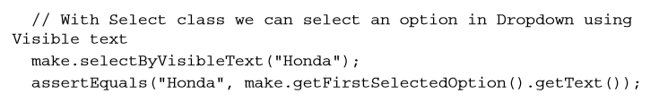
Automating dropdowns and lists

Slide 12


Automating dropdowns and lists

Slide 13
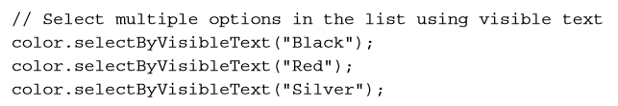
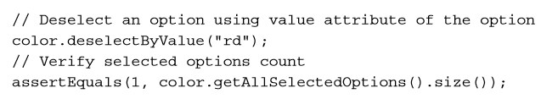
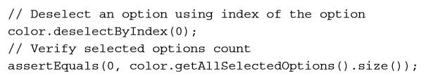
Automating dropdowns and lists

Slide 14

Checking options in the Select element
While testing the dropdowns and lists created with the <select> element, there will be a need to check to see that correct options are displayed for user selection.
These options may be static or populated from a database via AJAX calls.

Slide 15
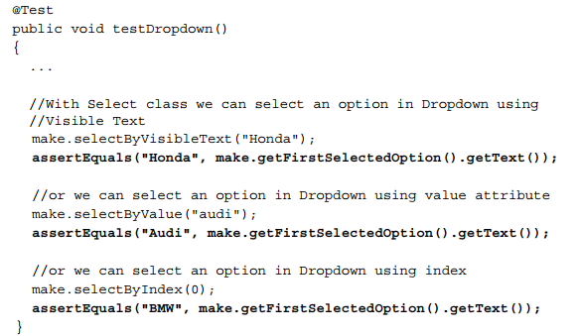
Checking selected options in dropdowns and lists

Slide 16
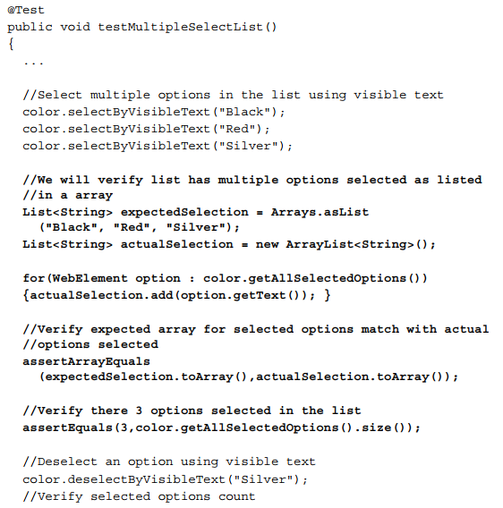
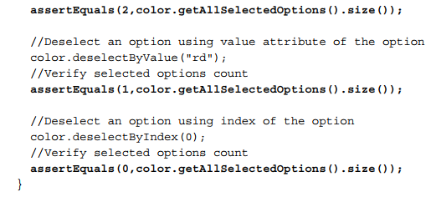
Checking selected options in dropdowns and lists

Slide 17

Automating radio buttons and radio groups
The Selenium WebDriver supports radio buttons and radio group elements using the WebElement interface.
We can select and deselect the radio buttons using the click() method of the WebElement class, and check whether a radio button is selected or deselected using the isSelected() method.

Slide 18
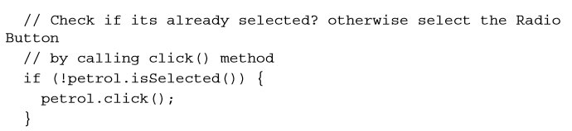

Automating radio buttons and radio groups

Slide 19
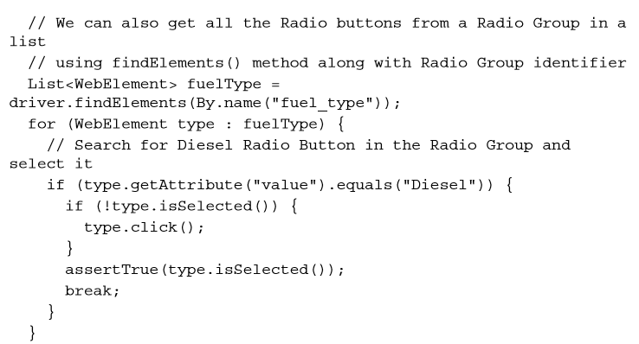
Automating radio buttons and radio groups

Slide 20


Automating checkboxes
Selenium WebDriver supports the checkbox element using the WebElement interface. We can select or deselect a checkbox using the click() method and check whether a checkbox is selected or deselected using the isSelected() method.

Slide 21

Working with WebTables
Similar to other element types that we have seen in earlier sections, an HTML table is represented as WebElement. However, there are no table-specific methods that are available with the WebElement interface.
While working with tables, we can find the rows and cells effectively by using a set of the By class methods.

Slide 22
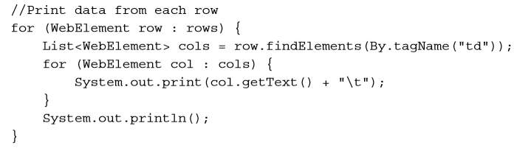
Working with WebTables

Slide 23
Fresher Academy
Happy Coding!

