Slide 1
Working with Selenium API

Slide 2
Agenda
Checking for an element's presence
Checking for an element's state
Using Advanced User Interactions API for mouse and keyboard events
Performing double-click on an element
Performing drag-and-drop operations
Working with context menus
Executing the JavaScript code
Capturing screenshots with Selenium WebDriver
Maximizing the browser window
Handling session cookies
Working with browser navigation

Slide 3
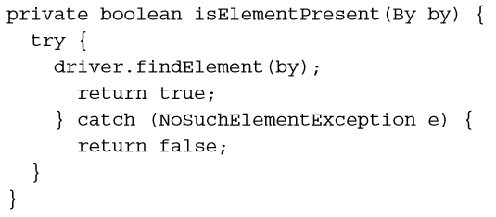
Checking for an element's presence
The Selenium WebDriver does not implement Selenium RC's isElementPresent() method to check if an element is present on a page.

Slide 4
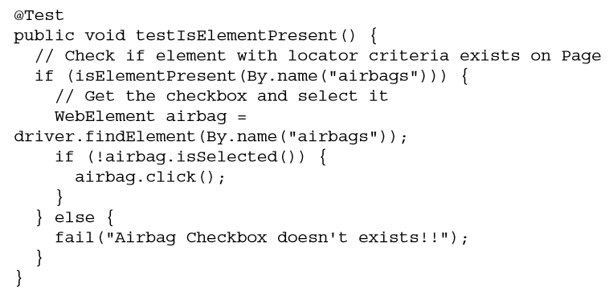
Checking for an element's presence
Now, implement a test that calls the isElementPresent() method. It will check if the desired element is present on a page. If found, it will click on the element; else it fails the test

Slide 5
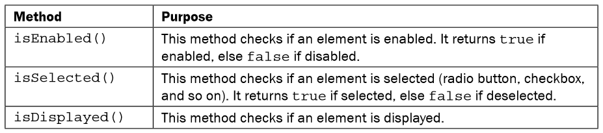
Checking an element's state
Many a time a test fails to click on an element or enter text in a field, as the element is disabled or exists in the DOM but is hidden on the page. This will result in an error being thrown and the test resulting in failure. To build reliable tests that can run unattended, a robust exception and error handling is needed in the test flow.

Slide 6
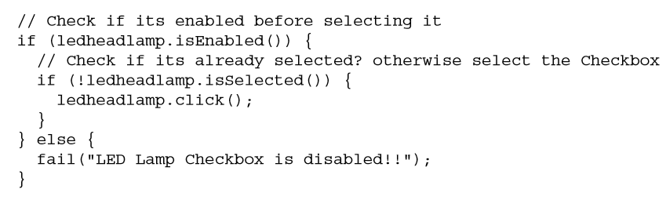
Checking an element's state
We can handle these problems by checking the state of elements. The WebElement interface provides the following methods to check the state of an element:

Slide 7
Using Advanced User Interactions API for mouse and keyboard events
The Selenium WebDriver's Advanced User Interactions API allows us to perform operations from keyboard events and simple mouse events to complex events such as dragging-anddropping, holding a key and then performing mouse operations using the Actions class, and building a complex chain of events exactly like a user doing these manually.

Slide 8

Using Advanced User Interactions API for mouse and keyboard events
We need to create an instance of the Actions class by passing the instance of the driver class to the constructor in the following way:
We will build a chain of events that we need to perform to select the rows. This will require performing a click() operation on the first row, then holding the Ctrl key (Command key on Mac) using the keyDown() operation, clicking on the end row, and then releasing the Ctrl key (Command key on Mac) by calling keyUp(). The Actions class provides various methods to perform keyboard and mouse operations:

Slide 9

Performing double-click on an element
There will be elements in a web application that need double-click events fired to perform some actions.
For example, double-clicking on a row of a table will launch a new window.
To perform a double-click on an element, the doubleClick() method of the Actions class is called. To call this method, we need to create an instance of the Actions class, as shown in the following code:

Slide 10
Performing double-click on an element
The doubleClick() method needs the element on which the double-click event will be fired. We can call the doubleClick() method by passing the element, as follows:

Slide 11
Performing drag-and-drop operations
The dragAndDrop() method needs the source element and target element, where the source element will be dragged and dropped. We can call the dragAndDrop() method in the following way:

Slide 12
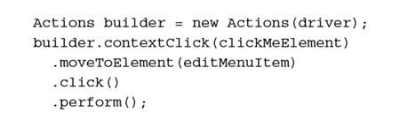
Working with context menus
A context menu (also known as a shortcut, a popup, or a pop-up menu) is a menu displayed on a web page that appears when a user performs a right-click mouse operation.
The Selenium WebDriver Actions class provides the contextClick() method to perform a right-click operation.

Slide 13
Executing the JavaScript code
Selenium WebDriver provides a JavascriptExecutor interface that can be used to execute arbitrary JavaScript code within the context of the browser.
By casting the WebDriver instance to a JavascriptExecutor interface, we can execute the JavaScript code in Selenium WebDriver:

Slide 14
Executing the JavaScript code
Selenium WebDriver provides a JavascriptExecutor interface that can be used to execute arbitrary JavaScript code within the context of the browser.
In the following example, a single line of JavaScript code is executed to return the title of the page displayed in the driver. The JavascriptExecutor interface provides the executeScript() method to which we need to pass the JavaScript code:

Slide 15
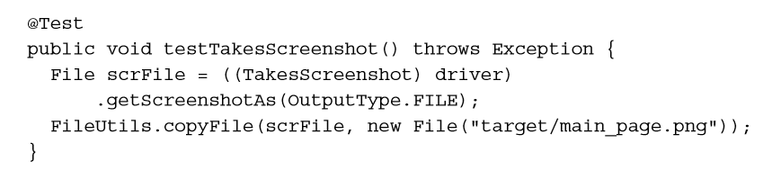
Capturing screenshots with Selenium WebDriver
Selenium WebDriver provides the TakesScreenshot interface to capture a screenshot of a web page.
This helps in test runs, showing exactly what happened when an exception or error has occurred during execution, and so on.
We can also capture screenshots during verification of element state, values displayed in elements, or state after an action is completed.

Slide 16

Maximizing the browser window
To maximize a browser window, we need to call the maximize() method of the Window interface of the driver class. Add the second line of code from the following code; this is where you define an instance of FirefoxDriver:

Slide 17
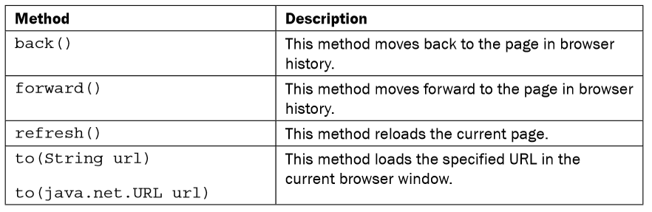
Working with browser navigation
Browsers provide various navigation methods to access web pages from the browser history or by refreshing the current page with the back, forward, and refresh/reload buttons on the browser window's toolbar.
The Selenium WebDriver API provides access to these buttons with various methods of WebDriver.Navigation interface.

Slide 18
Working with browser navigation
Forward Command
forward() : void – This method does the same operation as clicking on the Forward Button of any browser. It neither accepts nor returns anything.
Command – driver.navigate().forward();
Back Command
back() : void – This method does the same operation as clicking on the Back Button of any browser. It neither accepts nor returns anything.
Command – driver.navigate().back();

Slide 19
Working with browser navigation
Refresh Command
refresh() : void – This method Refresh the current page. It neither accepts nor returns anything.
Command – driver.navigate().refresh();
Navigate To Command
to(String arg0) : void – This method Loads a new web page in the current browser window. It accepts a String parameter and returns nothing.
Command – driver.navigate().to(appUrl);

Slide 20
Fresher Academy
Happy Coding!

