Slide 1
Cross-Browser Testing

Slide 2
Agenda
Setting up Selenium Grid Server for parallel execution
Adding nodes to Selenium Grid for cross-browser testing
Creating and executing the Selenium script in parallel with TestNG
Running tests in headless mode with PhantomJS

Slide 3
Setting up Selenium Grid Server for parallel execution
Organizations are adopting virtualization and cloud-based technologies to reduce costs and increase efficiency. Virtualization and cloud-based infrastructure can also be used to scale the test automation by reducing investment in physical hardware needed to set up the test environment.
Using these technologies, web applications can be tested on a variety of browser and operating system combinations.
Selenium WebDriver has unmatched support for testing applications in virtual environment, executing tests in parallel, reducing costs, and increasing speed and coverage.
Running tests in parallel requires two things: an infrastructure to distribute the tests, and a framework that will run these tests in parallel in the given infrastructure.

Slide 4
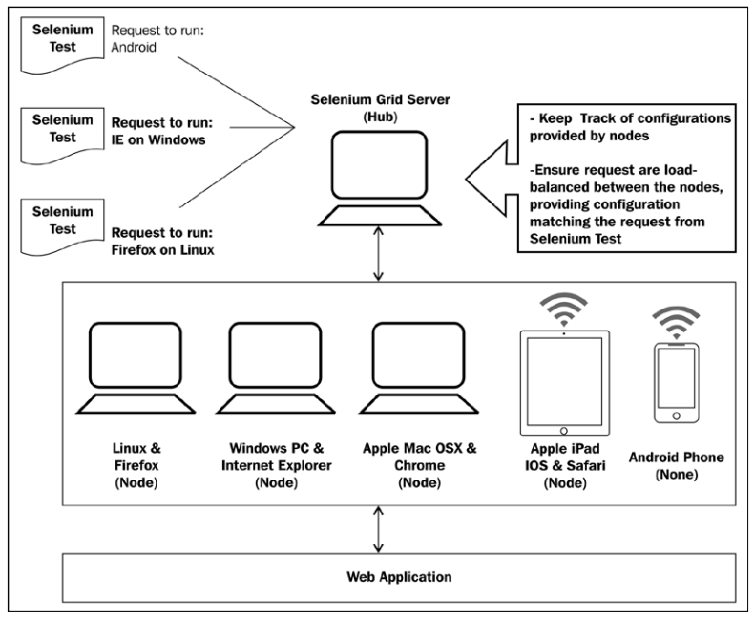
Setting up Selenium Grid Server for parallel execution
Selenium Grid transparently distributes our tests across multiple physical or virtual machines so that we can run them in parallel, cutting down the time required to run tests. This dramatically speeds up testing, giving us quick and accurate feedback
With Selenium Grid, we can leverage our existing computing infrastructure. It allows us to easily run multiple tests in parallel, on multiple nodes or clients, in a heterogeneous environment where we can have a mixture of OS and browser support.
Here is an example of the Selenium Grid architecture with the capabilities to run tests on Linux, Windows, Mac, iOS, and Android platforms.
Selenium Grid allows us to run multiple instances of WebDriver or Selenium Remote Control in parallel. It makes all these nodes appear as a single instance, so tests do not have to worry about the actual infrastructure. Selenium Grid cuts down on the time required to run Selenium tests to a fraction of the time that a single instance of Selenium would take to run, and it is very easy to set up and use.

Slide 5
Setting up Selenium Grid Server for parallel execution
The Selenium Server standalone
The Hub
WebDriver
Selenium RC

Slide 6
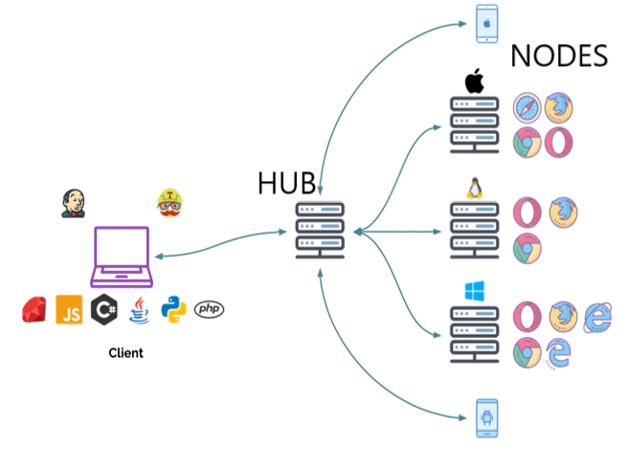
Setting up Selenium Grid Server for parallel execution
Setup Selenium Hub
To run Selenium WebDriver tests in parallel, we need to
set up the Selenium Grid Server as a Hub. The Selenium
Server hub will provide the available configurations or
capabilities to the Selenium WebDriver tests. The slave
machines, also called node, connect to the hub for
parallel execution. Selenium WebDriver tests use
the JSON wire protocol to talk to the Hub to execute
Selenium commands.
The Hub acts like the central point that will receive
the entire test request and distribute it to the right nodes.

Slide 7

Setting up Selenium Grid Server for parallel execution
Setup Selenium Hub
Download the latest Selenium Server standalone JAR file from http://docs.seleniumhq.org/download/

Slide 8
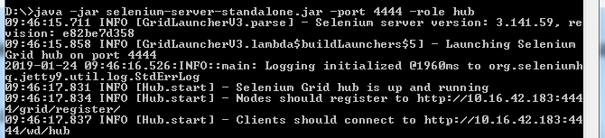
Setting up Selenium Grid Server for parallel execution
Setup Selenium Hub
Setting up a Hub is a fairly simple job. Launch the Selenium Server using the following command:
java -jar selenium-server-standalone.jar -port 4444 -role hub

Slide 9
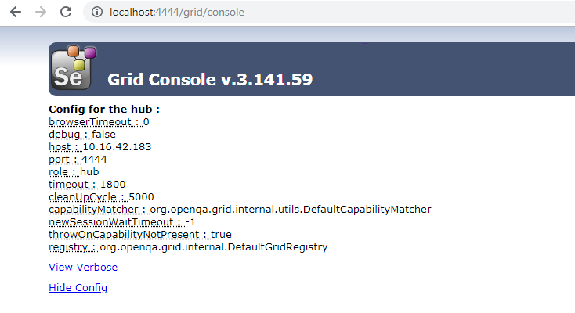
Setting up Selenium Grid Server for parallel execution
Setup Selenium Hub
When we launch the Selenium Standalone Server in Hub role, it starts listening to nodes and Selenium tests on port 4444. If you browse to http://localhost:4444/grid/console on the Hub machine, it will display the following information in the browser:

Slide 10


Setting up Selenium Grid Server for parallel execution
Setup Selenium Hub
To run tests with Selenium Grid, Selenium WebDriver tests need to use the instance of the RemoteWebDriver and DesiredCapabilities classes to define which browser, version, and platform tests will be executed.
Based on preferences set in the DesiredCapabilities instance, the Hub will point the test to a node that matches these preferences.
These preferences are set using the setBrowserName(), setVersion(), and setPlatform() methods of the DesiredCapabillities class.
An instance of the DesiredCapabilities class is passed to RemoteWebDriver:

Slide 11



Adding nodes to Selenium Grid for crossbrowser testing

Slide 12

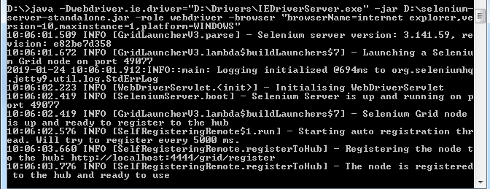
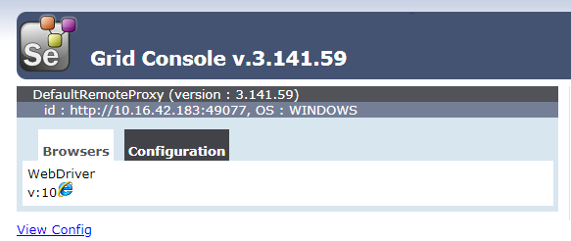
Adding nodes to Selenium Grid for crossbrowser testing
java -Dwebdriver.ie.driver="IEDriverServer.exe" -jar selenium-server-standalone.jar -role webdriver -hub http://localhost:4444/grid/register -port 5588

Slide 13
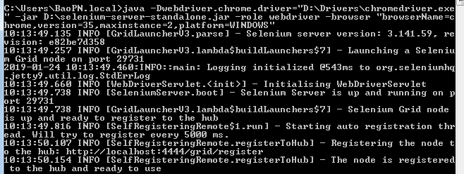
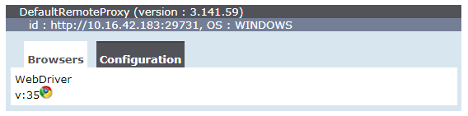
Adding nodes to Selenium Grid for crossbrowser testing
java -Dwebdriver.chrome.driver="chromedriver.exe" -jar selenium-server-standalone.jar -role webdriver -hub http://localhost:4444/grid/register -port 5566

Slide 14

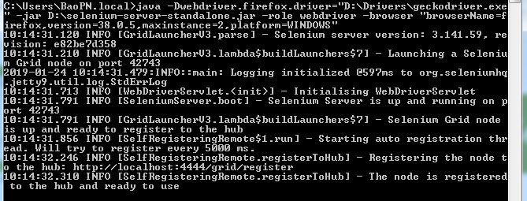
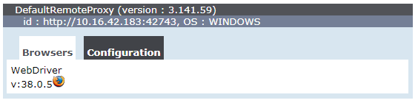
Adding nodes to Selenium Grid for crossbrowser testing
java -Dwebdriver.gecko.driver="geckodriver.exe" -jar selenium-server-standalone.jar -role webdriver -hub http://localhost:4444/grid/register -port 5577

Slide 15
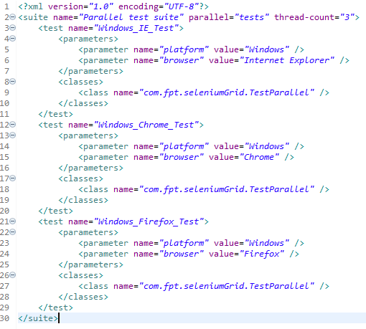
Creating and executing the Selenium script in parallel with TestNG
Before we create a test for parallel execution, we need to first create a configuration file, which TestNG will need to run the tests in parallel. We will provide four parameters for the platform, browser.
Create a new conf.xml file in your projects source directory and add the following code to this file.

Slide 16
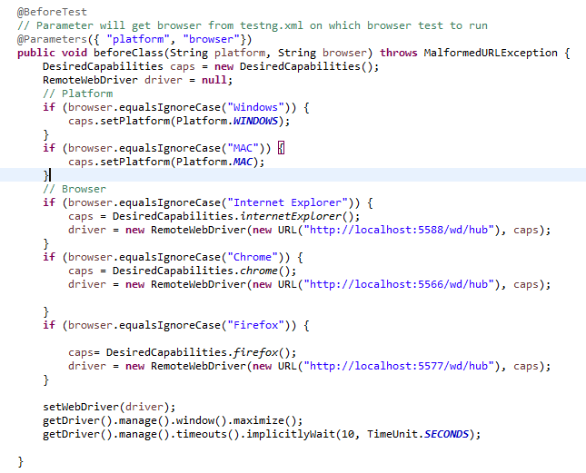
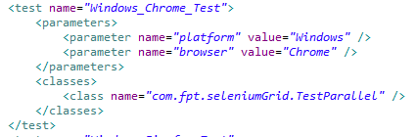
Creating and executing the Selenium script in parallel with TestNG
We need to create a test using TestNG. We will create a parameterized test using TestNG's parameterization features. We will create a test for the Google website.

Slide 17
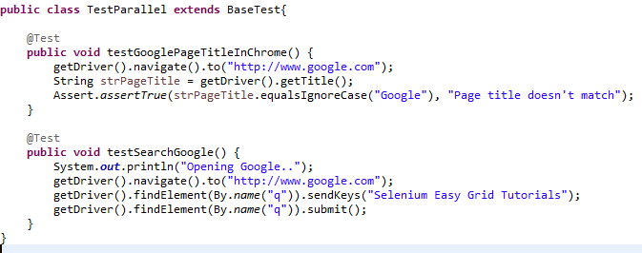
Creating and executing the Selenium script in parallel with TestNG

Slide 18
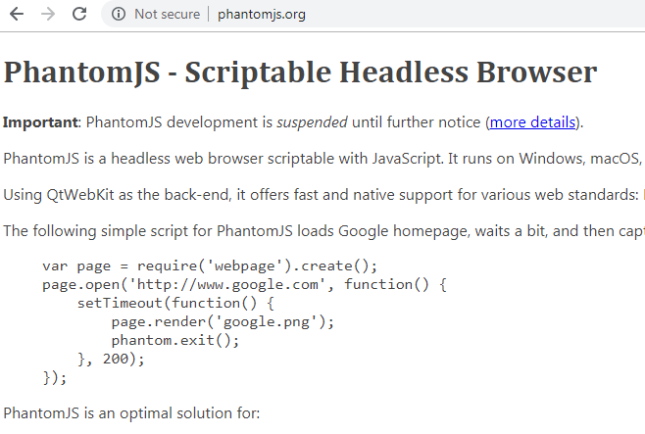
Running tests in headless mode with PhantomJS
A headless browser is a web browser without Graphical User Interface (GUI). It accesses and renders web pages but doesn't show them to any human being. A headless browser should be able to parse JavaScript. Currently, most of the systems encourage tests against headless browsers due to their efficiency and time-saving properties.
PhantomJS is a headless WebKit scriptable with the JavaScript API. It is generally used for the headless testing of web applications that come with GhostDriver built-in. Tests on PhantomJS are obviously fast since it has fast and native support for various web standards, such as DOM handling, CSS selector, JSON, canvas, and SVG. In general, WebKit is a layout engine that allows web browsers to render web pages. Some browsers, such as Safari and Chrome, use WebKit.

Slide 19
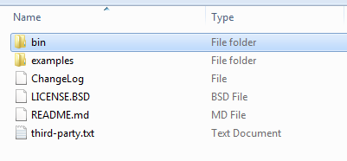
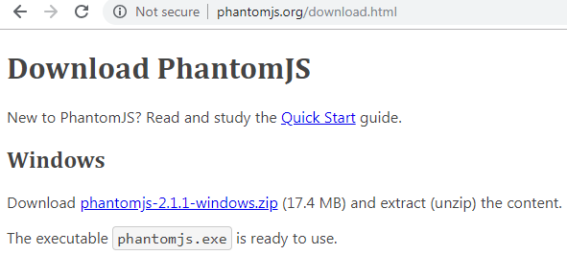
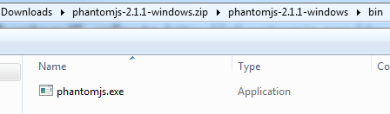
Running tests in headless mode with PhantomJS
To download PhantomJS, refer to http://phantomjs.org/download.html
Download PhantomJS, extract the zipped file (for example, phantomjs-1.x.xwindows.zip for Windows) and locate the phantomjs.exe folder.

Slide 20
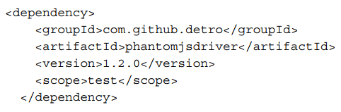
Running tests in headless mode with PhantomJS
Add a dependency in the maven pom.xml file

Slide 21
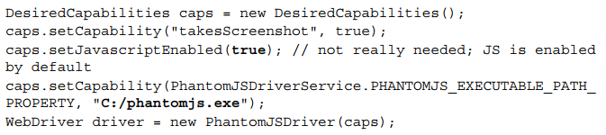

Running tests in headless mode with PhantomJS
PhantomJSDriver using capabilities to enable or disable JavaScript or to locate the phantomjs executable file path
PhantomJS supports screen capture as well. Since PhantomJS is a WebKit and a real layout and rendering engine, it is feasible to capture a web page as a screenshot. It can be set as follows:

Slide 22
Fresher Academy
Happy Coding!

