Slide 1
Data-Driven Testing and Using the Page Object Model

Slide 2
Agenda
Benefits of data-driven testing
Creating a data-driven test using TestNG
Reading test data from an Excel file using TestNG and Apache POI
Using the PageFactory class for exposing the elements on a page
Using the PageFactory class for exposing an operation on a page

Slide 3
Benefits of data-driven testing
With data-driven tests, we can get greater test coverage while minimizing the amount of test code we need to write and maintain.
Data-driven testing makes creating and running a lot of test conditions very easy.
Test data can be designed and created before the application is ready for testing.
Data tables can also be used in manual testing.

Slide 4
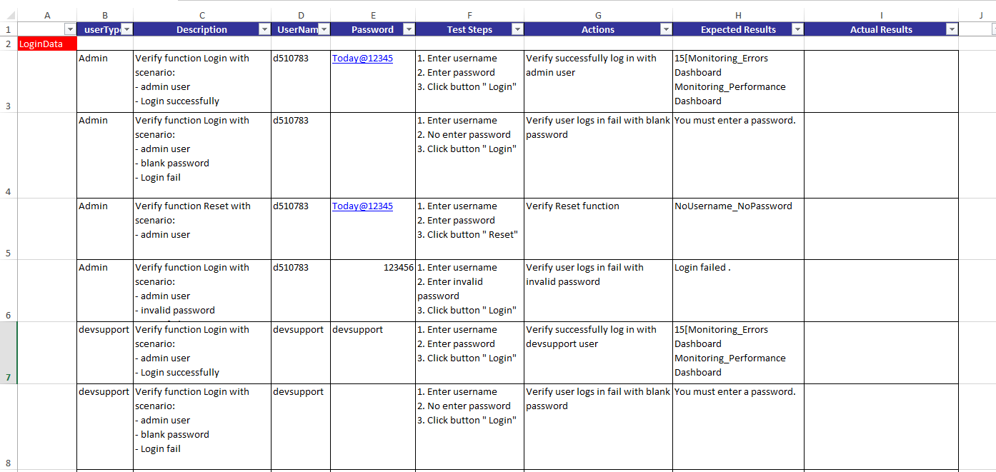
Creating a data-driven test using TestNG
The data-driven testing approach is a widely used methodology in software test automation. We can use the same test script to check different test conditions by passing set of data to the test script.

Slide 5

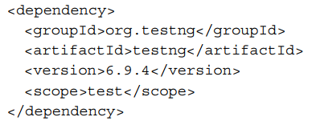
Creating a data-driven test using TestNG
TestNG is another widely used testing framework with Selenium WebDriver. It is very similar to JUnit. TestNG has rich features for testing, such as parameterization, parallel test execution, and so on.
TestNG provides the DataProvider feature to create data-driven tests. In this recipe, we will use the DataProvider feature to create a simple test. Creating data-driven tests in TestNG is fairly easy when compared with JUnit.

Slide 6
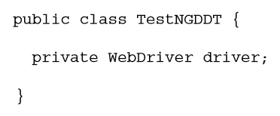
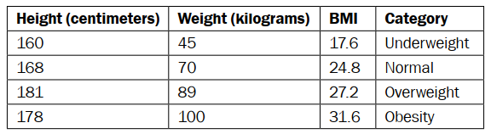
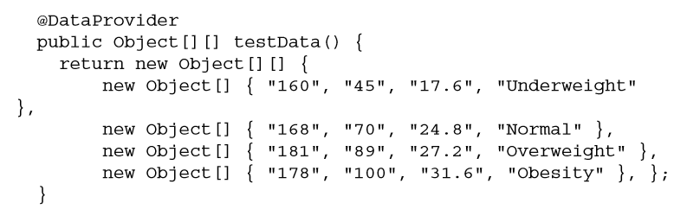
Creating a data-driven test using TestNG
Steps 1: Create a new TestNG test
Steps 2: Define a method that will return the collection of parameters to the TestNGDDT class by using the @DataProvider annotation:

Slide 7
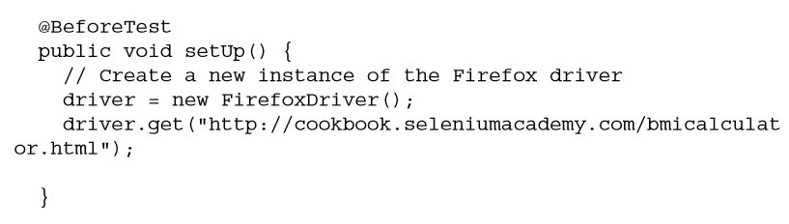
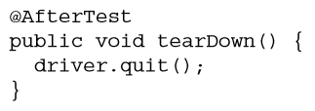
Creating a data-driven test using TestNG
Steps 3: Define a method open Browser
Steps 4: Define a method quit Browser

Slide 8
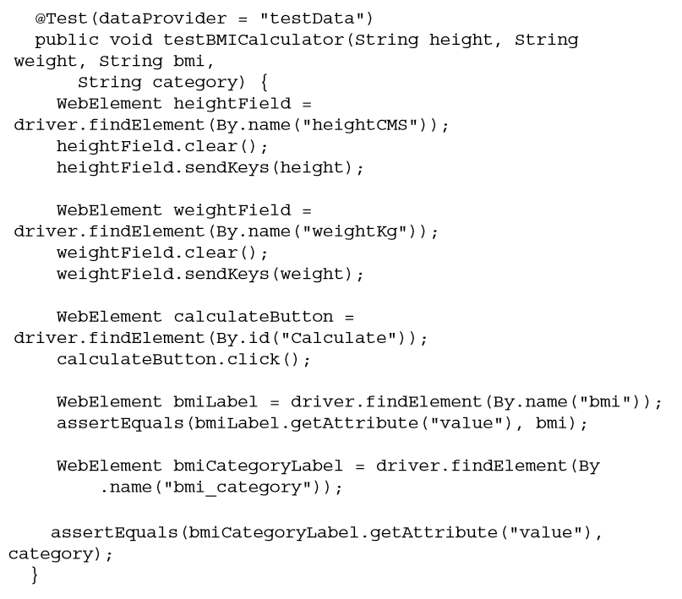
Creating a data-driven test using TestNG
Steps 5: Finally, add the test case method testBMICalculator() that uses parameterized variables.

Slide 9

Reading test data from an Excel file using TestNG and Apache POI
To maintain test cases and test data, Microsoft Excel is the favorite tool used by testers. Compared to the CSV file format, Excel gives numerous features and a structured way to store data. A tester can create and maintain tables of test data in an Excel spreadsheet easily.

Slide 10
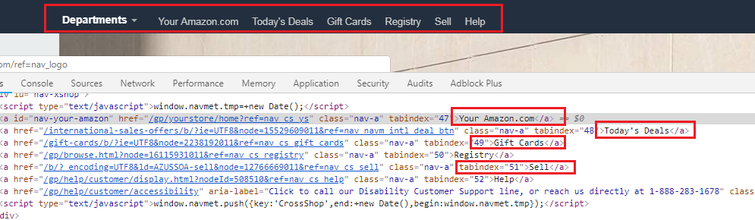
Page Object Model
Page Object Model is a design pattern which has become popular in test automation for enhancing test maintenance and reducing code duplication. A page object is an object-oriented class that serves as an interface to a page of your AUT.

Slide 11
Advantages of Page Object Model
According to Page Object Model, we should keep our tests and element locators separately, this will keep code clean and easy to understand and maintain.
The Page Object approach makes test automation framework programmer friendly, more durable and comprehensive.
Another important advantage is our Page Object Repository is Independent of Automation Tests. Keeping separate repository for page objects helps us to use this repository for different purposes with different frameworks like, we are able to integrate this repository with other tools like JUnit/NUnit/PhpUnit as well as with TestNG/Cucumber/etc.
Test cases become short and optimized as we are able to reuse page object methods in the POM classes.
Any change in UI can easily be implemented, updated and maintained into the Page Objects and Classes.

Slide 12
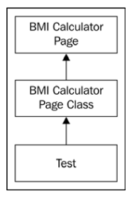
Using the PageFactory class for exposing the elements on a page
To implement the Page Object model in tests, we need to create a Page Object class for each page that is being tested.

Slide 13
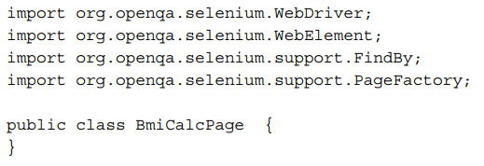
Using the PageFactory class for exposing the elements on a page
Steps 1: Define and create a package for all the page objects from the application for logical grouping. For example, fpt.tests.pageobjects is created to define all the page objects.
Steps 2: Create a new Java class file. Give the name of the page we will be testing from the application to this class.

Slide 14
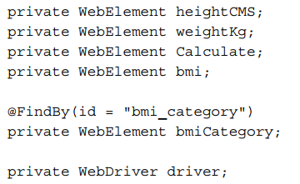
Using the PageFactory class for exposing the elements on a page
Steps 3: Define elements from the BMI Calculator page as instance variables in the BmiCalcPage class created in step 1. Use the name or id attributes to name these variables, as follows:

Slide 15
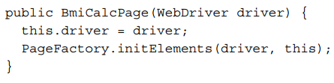
Using the PageFactory class for exposing the elements on a page
Steps 4: Add a constructor to the BmiCalcPage class, which will call the PageFactory.initElements() method to initialize the elements in the class. In other words, map the elements to the variables in the BmiCalcPage class, as follows:

Slide 16
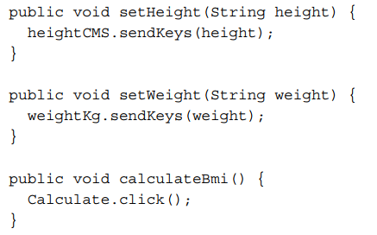
Using the PageFactory class for exposing the elements on a page
Steps 5: We will add the accessor methods for Height, Weight, and Calculate button felds so we can set values or perform operation like clicking a button:

Slide 17
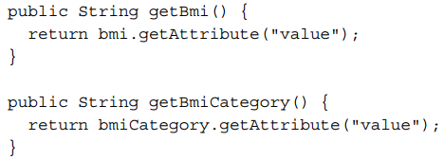
Using the PageFactory class for exposing the elements on a page
Steps 6: Also, add the accessor method to read the values from the Bmi and Bmi Category fields, as shown in the following code:

Slide 18
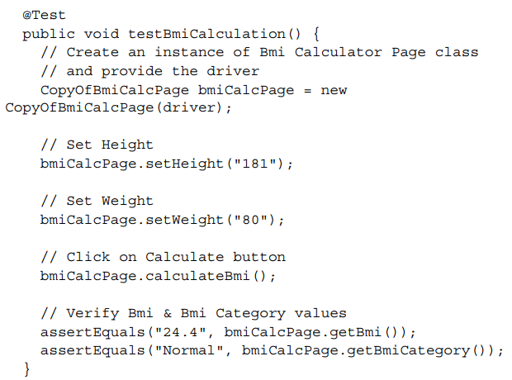
Using the PageFactory class for exposing the elements on a page
Steps 7: Finally, create a test that will use the BmiCalcPage class to test the BMI Calculator page, as follows:

Slide 19


Using the PageFactory class for exposing the elements on a page
FindBy annotations
CacheLookUp attribute

Slide 20
Using the PageFactory class for exposing the elements on a page
FindBy annotations
When identifying webElements in your PageObject class, you are using @FindBy by providing it the elements’ unique identifiers. This annotation looks for all the elements having the identifier you provided, and it can return as many elements as it finds on the page, that have that same identifier. The only restriction is what type of a variable you assign the result of @FindBy to.
CLASS_NAME: @FindBy(className = "classname")
CSS: @FindBy(css = "css")
ID: @FindBy(id = "id")
ID_OR_NAME: @FindBy(how = How.ID_OR_NAME, using ="idOrName")
LINK_TEXT: @FindBy(linkText= "text")
NAME: @FindBy(name= "name")
PARTIAL_LINK_TEXT: @FindBy(partialLinkText= "text")
TAG_NAME: @FindBy(tagName="tagname")
XPATH: @FindBy(xpath="xpath")

Slide 21
Using the PageFactory class for exposing the elements on a page
CacheLookUp attribute
PageFactory also provide CacheLookup attribute to cache the WebElements. This attribute helps scripts to instruct the InitElements method to cache the element once its located. In other words, any attribute marked [CacheLookup] will not be searched over and over again – this is especially useful for elements that are always going to be there (not always true for AJAX apps)
This tells the PageFactory.initElements() method to cache the element once it's located. Tests work faster with cached elements when these elements are used repeatedly.

Slide 22
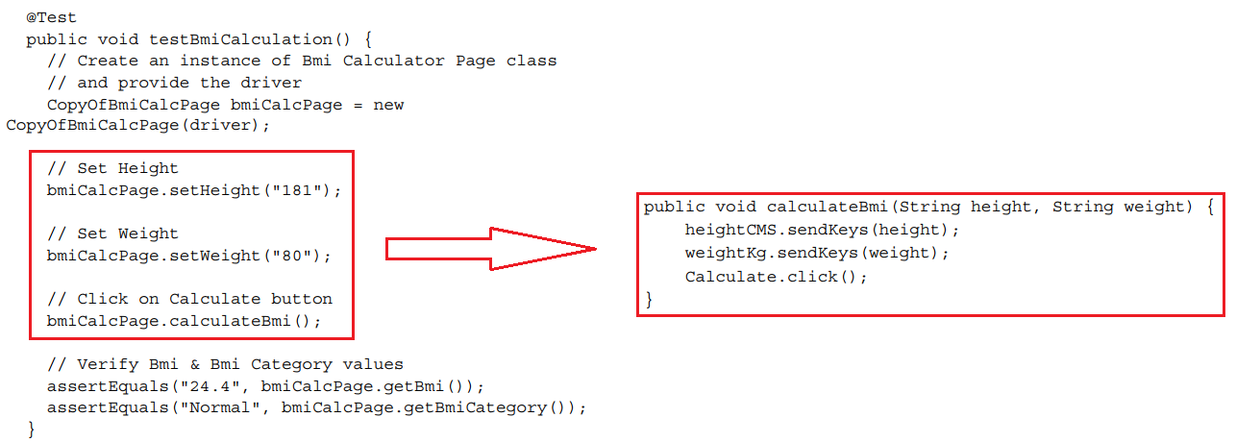
Using the PageFactory class for exposing an operation on a page

Slide 23
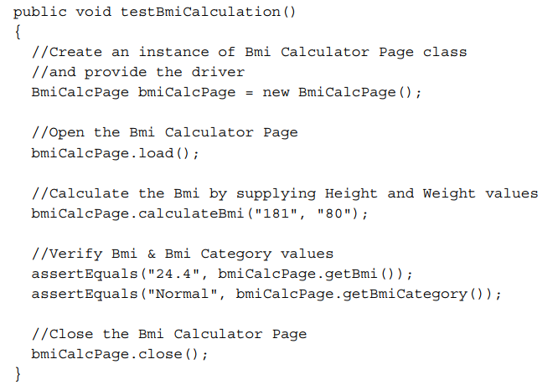
Using the PageFactory class for exposing an operation on a page

Slide 24
Fresher Academy
Happy Coding!

