Slide 1
Superhumps
Ilia Kosenkov 2018-03-09, Tuorla

Slide 2
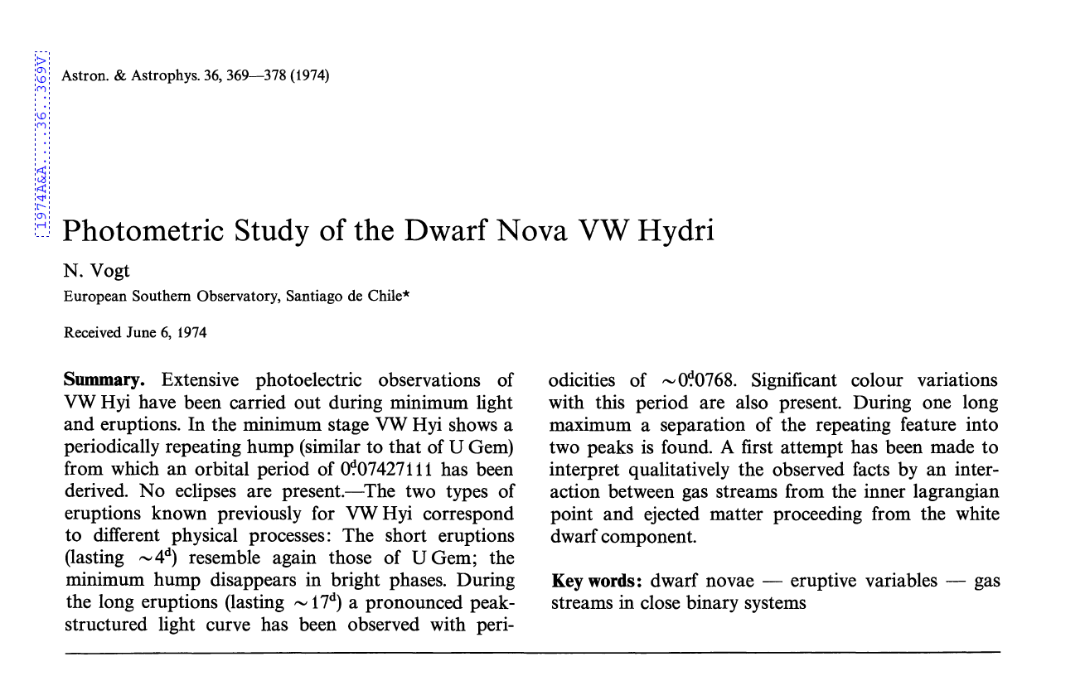

Slide 3
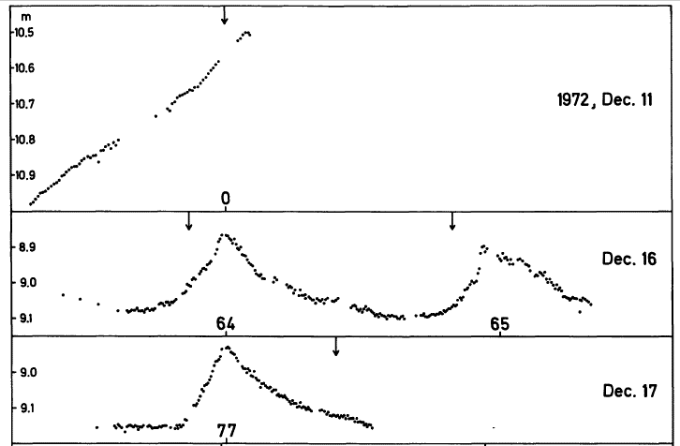
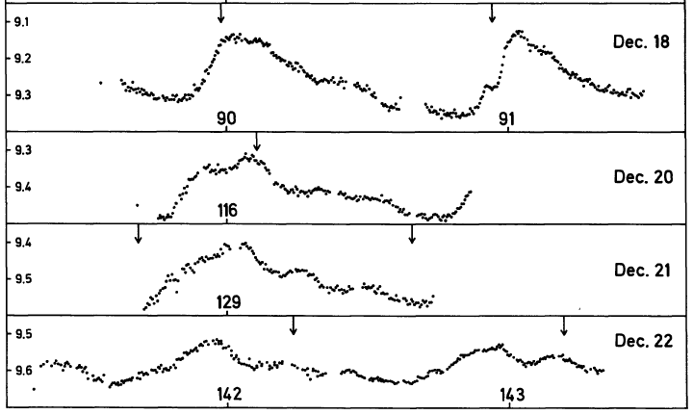

Slide 4
So what was observed?
Dwarf novae (SU UMa) with very small orbital periods (< 0.1 d)
Additional periodic variations of brightness during long superoutbursts
No such variability during short-term outbursts
Detected periods are slightly (up to few per cent) larger than the orbital periods of those systems

Slide 5
Instability mechanisms
Originally two theories were suggested:
Mass-transfer bursts
Disk instabilities
Later they transformed into inside-out disk instability outbursts that allow alterations of short and long outbursts
What about those variabilities with non-orbital periods?

Slide 6
Superhumps
A phenomenological explanation was suggested that superhumps can be explained by tidal instabilities that lead to disk distortion into eccentric form.
Later simulations showed that accretion disks in SU Uma-like systems can develop eccentric instabilities, causing disks to slowly precess.
Simulations also imposed an empirical limit onto mass ratios. Superhumps developed predominately in systems with q < 0.25
It is also possible for a disk to precess in opposite direction, creating “negative superhumps” with periods slightly smaller that the orbital.

Slide 7
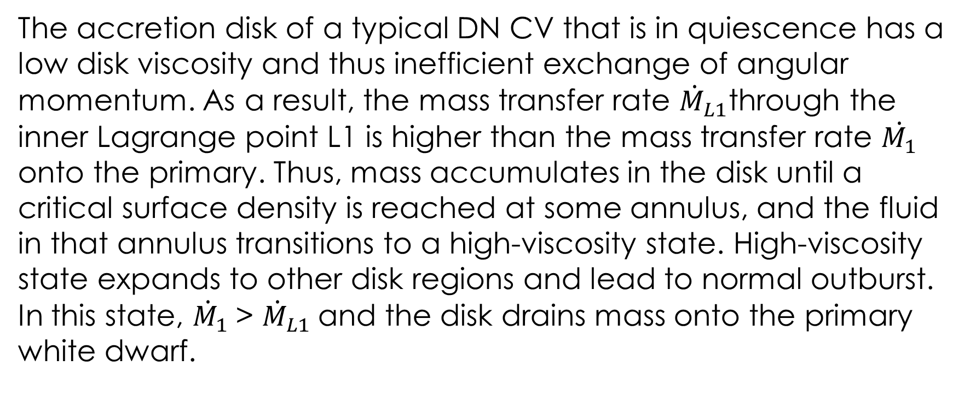
Superhumps
The accretion disk of a typical DN CV that is in quiescence has a low disk viscosity and thus inefficient exchange of angular momentum. As a result, the mass transfer rate ${\dot{M}}_{L1}$through the inner Lagrange point L1 is higher than the mass transfer rate $\dot{M_{1}}$ onto the primary. Thus, mass accumulates in the disk until a critical surface density is reached at some annulus, and the fluid in that annulus transitions to a high-viscosity state. High-viscosity state expands to other disk regions and lead to normal outburst. In this state, ${\dot{M}}_{1}$> ${\dot{M}}_{L1}$and the disk drains mass onto the primary white dwarf.

Slide 8
Superhumps
During each Dwarf Novae outburst, however, the angular momentum transport acts to expand the outer disk radius slightly, and after a few to several of these, an otherwise normal DN outburst can expand the outer radius of the disk to the inner Lindblad resonance (near the 3:1 corotation resonance).
While viscous dissipation within the periodically flexing disk provides the dominant source of the superhump modulation, the accretion stream bright spot also provides a periodic photometric signal when sweeping around the rim of a non-axisymmetric disk. The bright spot will be most luminous when it impacts most deeply in the potential well of the primary, and fainter when it impacts the rim further from the white dwarf primary.

Slide 9
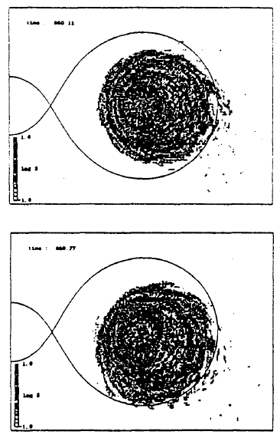
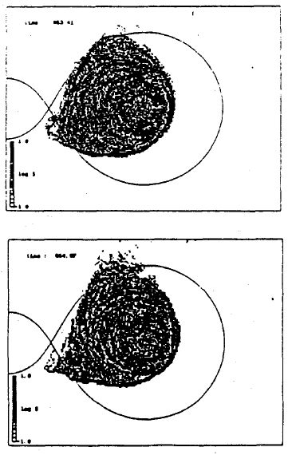
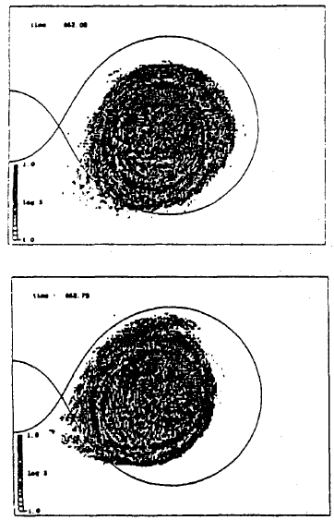

Slide 10
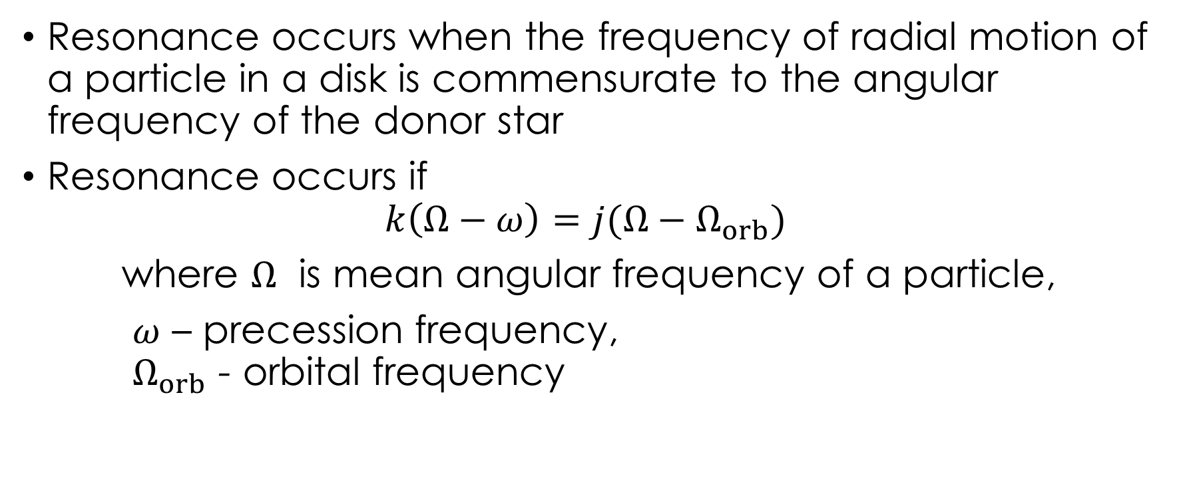
Superhumps
Resonance occurs when the frequency of radial motion of a particle in a disk is commensurate to the angular frequency of the donor star
Resonance occurs if
$$k\left(Ω−ω\right)=j(Ω−Ω_{orb})$$
where $Ω$ is mean angular frequency of a particle,
$ω$ – precession frequency, $Ω_{orb}$ - orbital frequency

Slide 11
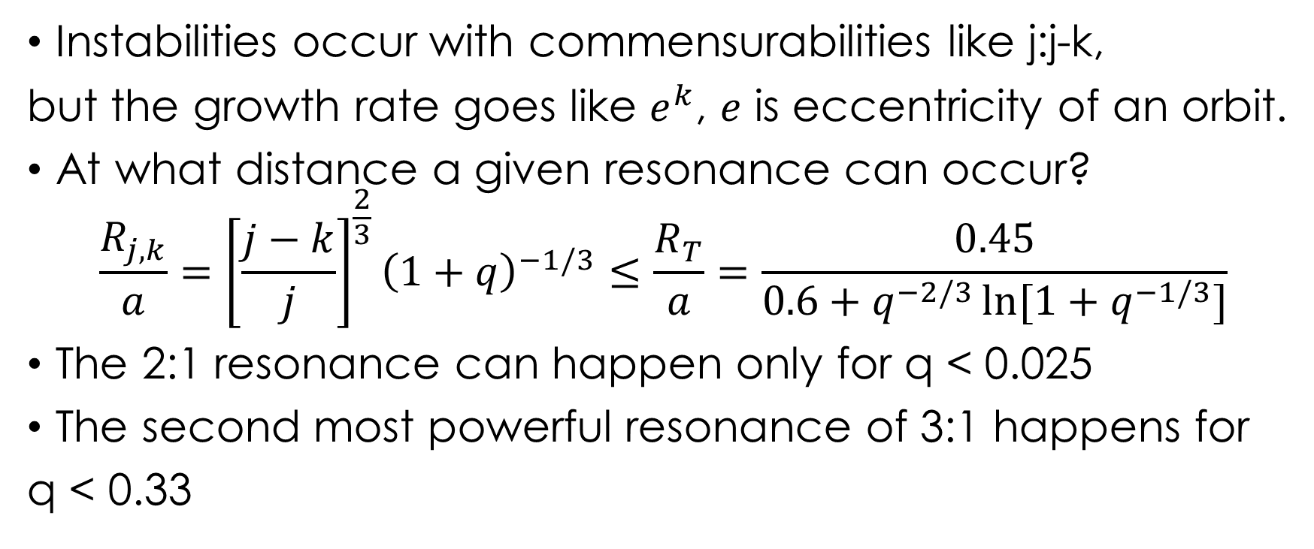
Superhumps
Instabilities occur with commensurabilities like j:j-k,
but the growth rate goes like $e^{k}$, $e$ is eccentricity of an orbit.
At what distance a given resonance can occur?
$$\frac{R_{j,k}}{a}={\left[\frac{j−k}{j}\right]}^{\frac{2}{3}}{\left(1+q\right)}^{−1/3}≤\frac{R_{T}}{a}=\frac{0.45}{0.6+q^{−2/3}\ln{[1+q^{−1/3}]}}$$
The 2:1 resonance can happen only for q < 0.025
The second most powerful resonance of 3:1 happens for
q < 0.33

Slide 12
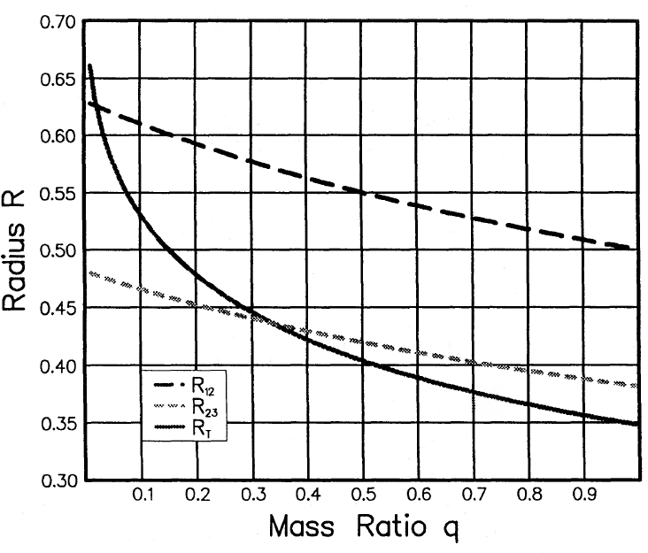

Slide 13
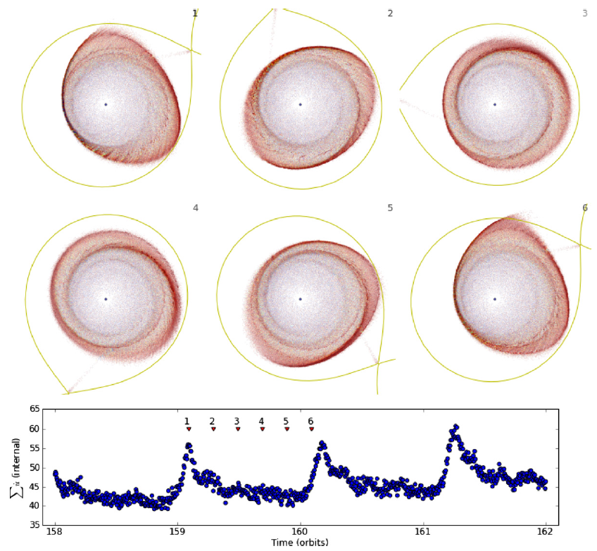
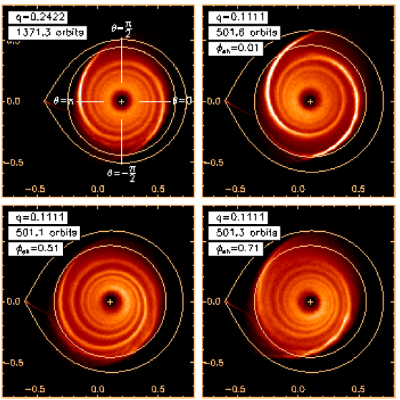

Slide 14
What about low-mass X-ray binaries?
LMXBs in some sense are similar to dwarf novae, but the accreting object is a BH or a NS.
Due to the significant mass of an accretor (especially when it is a BH), the mass ratio q is usually quite low, allowing tidal instabilities to develop in the disk.
However, significant contribution of irradiation in case of LMXBs renders applied to the CVs explanation of superhumps invalid.
This theory can be “rescued” if we consider that efficiency of radiation reprocessing by disk varies with superhump period, which can be achieved by varying disk surface area

Slide 15
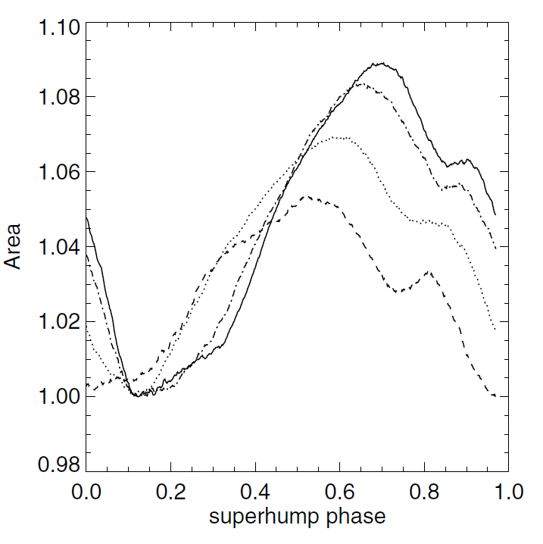
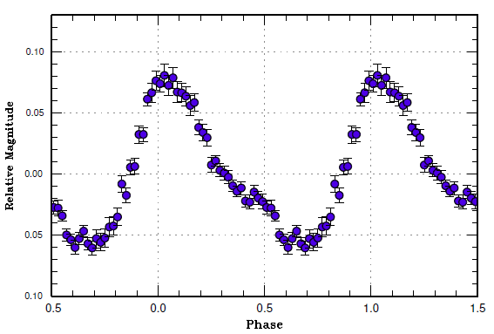
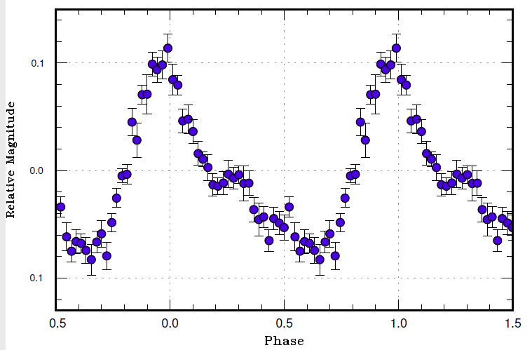
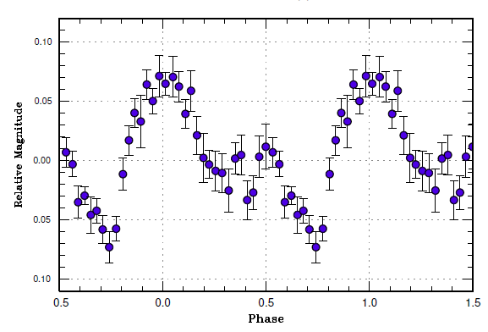

Slide 16
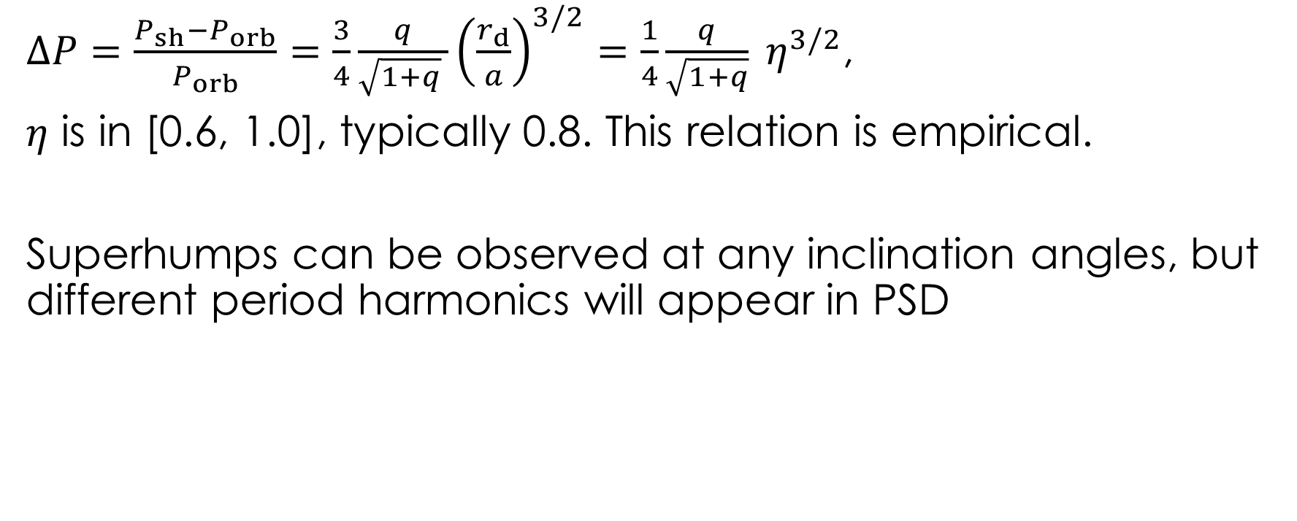
Superhump period excess
$ΔP=\frac{P_{sh}−P_{orb}}{P_{orb}}=\frac{3}{4}\frac{q}{\sqrt{1+q} }{\left(\frac{r_{d}}{a}\right)}^{3/2}=\frac{1}{4}\frac{q}{\sqrt{1+q}} η^{3/2}$,
$η$ is in [0.6, 1.0], typically 0.8. This relation is empirical.
Superhumps can be observed at any inclination angles, but different period harmonics will appear in PSD

Slide 17
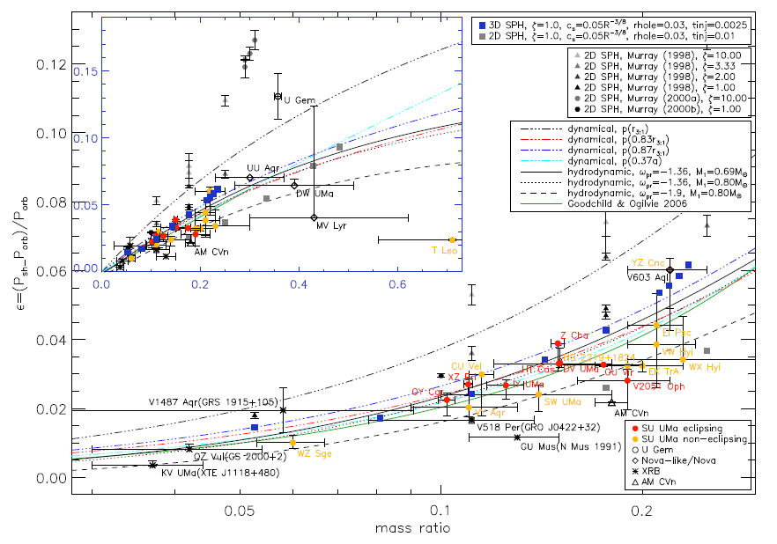

Slide 18
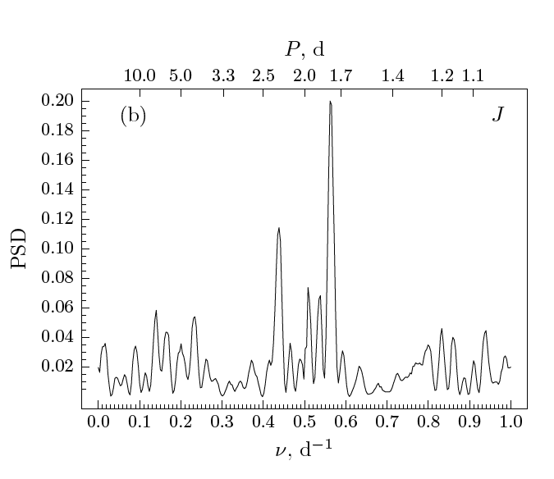
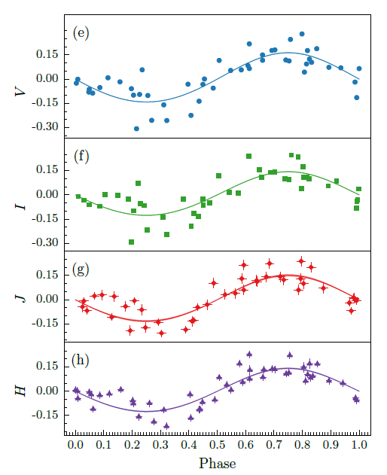
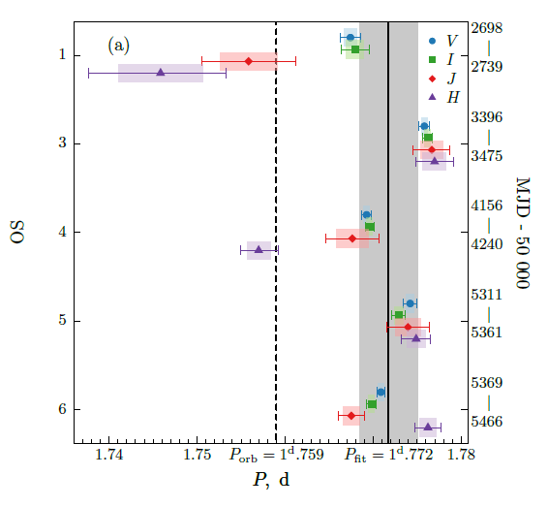
GX 339-4 exhibiting superhumps?

Slide 19
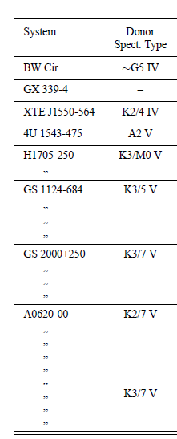
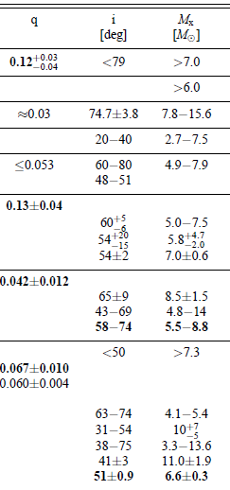
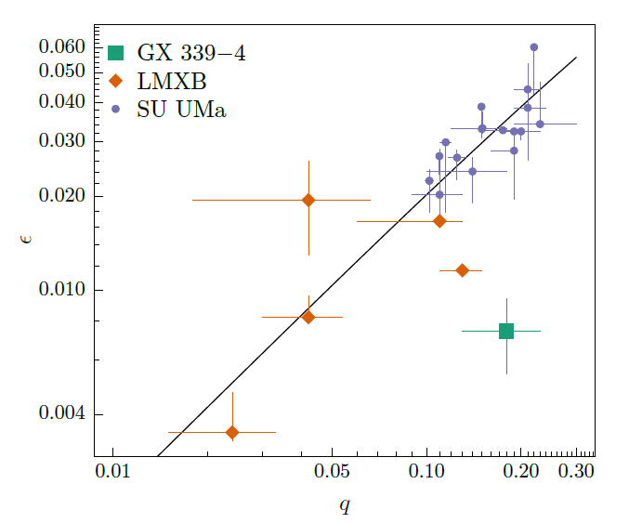

Slide 20
Thank you!

