Slide 1

Domain: DL
Technology: Python
DETECTION OF PLANT DISEASE USING MACHINE LEARNING AND DEEP LEARNING ALGORITHMS

Slide 2
INDEX
Abstract
Objective of project
Problem Statement
Scope & Motivation
Introduction
Literature survey
Existing Method
Disadvantages
Proposed method
Advantages
Project Flow
Hardware and Software Requirements
Architecture
Modules
Methodology/algorithm
UMLS
References

Slide 3
ABSTRACT
Agriculture plays a crucial role in the Indian economy. Early detection of plant diseases is very much essential to prevent crop loss and further spread of diseases. Most plants such as apple, tomato, cherry, grapes show visible symptoms of the disease on the leaf. These visible patterns can be identified to correctly predict the disease and take early actions to prevent it. This can be overcome by the use of machine learning and deep learning algorithms. Hence, we are proposing a method that which is detecting the disease of a tomato plant from their leaf images. Here the process is performed with the Support Vector Machine (SVM), Random Forest algorithms of machine learning along with deep learning algorithms Convolutional Neural Network (CNN), Recurrent Neural Network (RNN) and ResNet, which is a one of the transfer learning method of CNN. Once after training the dataset with the algorithms, the accuracy of algorithms is compared and the images are classified. And the precautions are also provided for the classified plant.
Keywords: Plant diseases, machine learning, deep learning, CNN, MobileNet, ResNet, SVM.

Slide 4
OBJECTIVE OF THE PROJECT
power of machine learning and deep learning algorithms promises to revolutionize agriculture by enabling early and accurate disease identification, leading to timely intervention, reduced crop losses, and sustainable agricultural practices. This research aims to contribute to a more resilient and food-secure future.
Control of plant diseases is crucial to the reliable production of food, and it provides significant problems in agricultural use of land, water, fuel and other inputs. Plants in both natural and cultivated populations carry inherent disease resistance, but there are numerous examples of devastating plant disease impacts, such as the Great Famine of Ireland and chestnut blight, as well as recurrent severe plant diseases like rice blast, soybean cyst nematode, and citrus canker.

Slide 5
PROBLEM STATEMENT
Plant diseases pose a substantial threat to global agriculture, resulting in significant crop damage and economic losses. Traditional methods of disease detection are often time-consuming and require expertise, making early intervention difficult. This research addresses the need for an automated, reliable, and efficient plant disease detection system using machine learning and deep learning algorithms. The primary challenge is to develop a model capable of accurately identifying diseases from images of plant leaves, thereby enabling timely interventions to mitigate crop.

Slide 6
SCOPE AND MOTIVATION
SCOPE
The project aims to develop a system for the early detection of plant diseases using machine learning and deep learning algorithms. It involves image analysis of plant leaves to identify disease symptoms, providing a cost-effective and efficient way to monitor and manage crop health, ultimately enhancing agricultural productivity and food security.

Slide 7
MOTIVATION
The motivation behind the research on "DETECTION OF PLANT DISEASE USING MACHINE LEARNING AND DEEP LEARNING ALGORITHMS" stems from the critical need to safeguard global food security. With the world's population continuously increasing, ensuring healthy crop yields is paramount. Traditional methods of disease detection are often time-consuming and labor-intensive. Leveraging the losses and secure food supplies.

Slide 8
INTRODUCTION
Control of plant diseases is crucial to the reliable production of food, and it provides significant problems in agricultural use of land, water, fuel and other inputs. Plants in both natural and cultivated populations carry inherent disease resistance, but there are numerous examples of devastating plant disease impacts, such as the Great Famine of Ireland and chestnut blight, as well as recurrent severe plant diseases like rice blast, soybean cyst nematode, and citrus canker.
However, disease control is reasonably successful for most crops. Disease control is achieved by use of plants that have been bred for good resistance to many diseases, and by plant cultivation approaches such as crop rotation, use of pathogen-free seed, appropriate planting date and plant density, control of field moisture, and application of pesticides. Continuing advances in the science of plant pathology are needed to improve disease control, to keep up with the ongoing evolution and movement of plant pathogens, and to keep pace with changes in agricultural practices.

Slide 9
INTRODUCTION
Plant diseases cause major economic losses for farmer’s worldwide Economic impact. Across large regions and many crop species, it is estimated that diseases typically reduce plant yields by 10% every year in more developed settings, but yield loss to diseases often exceeds 20% in less developed settings. The Food and Agriculture Organization estimates that pests and diseases are responsible for about 25% of crop loss. To solve this, new methods are needed to detect diseases and pests early, such as novel sensors that detect plant odours and spectroscopy and biophotonics that are able to diagnose plant health and metabolism.
In most pathosystems, virulence is dependent on hydrolases - and the wider class of cell wall degrading proteins - that degrade the cell wall. The vast majority of CWDPs are pathogen-produced and pectin-targeted (for example, pectinesterase, pectate lyase, and pectinases). For microbes the cell wall polysaccharides are themselves a food source, but mostly just a barrier to be overcome. Many pathogens also grow opportunistically when the host breaks down its own cell walls, most often during fruit ripening.

Slide 10
LITERATURE REVIEW
S. No | Journal Type with year | Authors | Title | Outcomes
1 | Journal of Hospital Medicine. 7, 294–298 (2012) https://doi.org/10.1002/jhm.955 PMID: 22009855 | Monica Jhuria, Ashwini Kumar, Rushikesh Borse | Image Processing for Smart Farming: Detection of Disease and Fruit Grading | Fruit disease detection
2 | International Conference on Contemporary Computing and Information, 2014. | Sudhir Rao Rupanagudi, Ranjani B.S., Prathik Nagaraj, Varsha G. Bhat | A Cost Effective Tomato Maturity Grading System using Image Processing | Effective Tomato Maturity Grading System
3 | International Journal of Computer Science and Information Technologies, Vol. 6 (1), 2015, 92-94. | Manisha A. Bhange, Prof. H. A. Hingoliwala | A Review of Image Processing for Pomegranate Disease Detection | Pomegranate Disease Detection Review
4 | International Journal of Computer Applications (0975 – 8887), Volume 13– No.2, January 2011 | Hetal N. Patel, Dr. M. V. Joshi | Fruit Detection using Improved Multiple Features based Algorithm | Fruit Detection

Slide 11
EXISTING METHOD
This model emphasizes an existing method where the disease prediction is performed manually by farmers. It is very difficult for the farmers to manually identify many diseases accurately with their limited knowledge. This difficulty can be overcome by using deep learning techniques.

Slide 12
DISADVANTAGES
More Expensive: Costlier Implementation of Plant Disease Detection through Advanced Machine Learning and Deep Learning Techniques
Difficult to scale up: Scaling up plant disease detection with ML and DL is challenging due to data, hardware, and model complexities, limiting widespread adoption.
Time consuming: Efficient Plant Disease Detection with Machine and Deep Learning, Reducing Time Consumption

Slide 13
PROPOSED METHOD
In our proposed method we are performing the prediction of the plant diseases. Here, we are proposing a method that which is detecting the disease of a tomato plant from their leaf images. Here the process is performed with the Support Vector Machine (SVM) algorithm of machine learning along with deep learning algorithms Convolutional Neural Network (CNN), MobileNet and ResNet, which is a one of the transfer learning method of CNN. Once after training the dataset with the algorithms, and the precautions are also provided for the classified plant. Block diagram of proposed method is shown below.

Slide 14
ADVANTAGES
1. Accurate classification: Machine learning and deep learning algorithms ensure precise identification of plant diseases, improving diagnosis and treatment decisions.
2. Less complexity: Streamlined processes and automated detection reduce the need for manual intervention, making the system user-friendly and efficient.
3. High performance: These algorithms offer fast and reliable results, enhancing plant disease management and crop yield optimization.

Slide 15
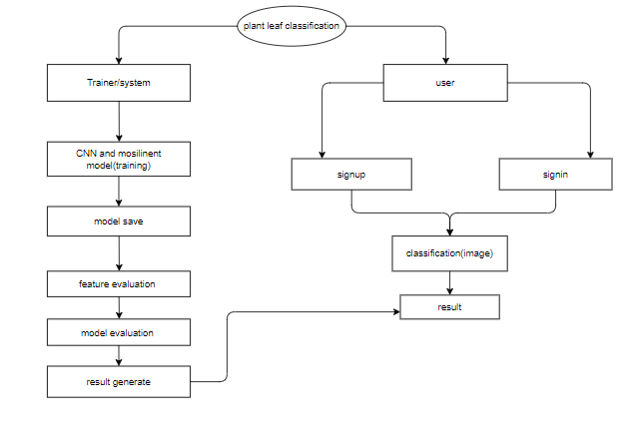
PROPOSED METHOD

Slide 16
HARDWARE & SOFTWARE REQUIREMENTS
H/W CONFIGURATION:
• Processor - I3/Intel Processor
• Hard Disk -160GB
• RAM - 8Gb
S/W CONFIGURATION:
• Operating System : Windows 7/8/10 .
• IDE : Pycharm.
• Libraries Used : Numpy, IO, OS, Flask, keras.
• Technology : Python 3.6+.

Slide 17
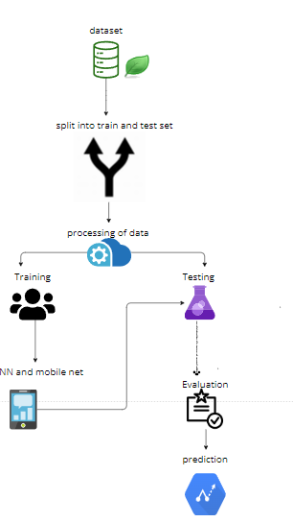
ARCHITECTURE

Slide 18
IMPLEMENTATION
Firstly, we have collected the dataset of the plant images which are effected with disease and normal.
Necessary pre-processing steps will be completed with the dataset before training with our algorithm.
Once after training the model will be saved for testing and classifying.
User can upload the images of which to be classified and by using the saved model the images will be classified and predicted.

Slide 19
MODULES
System
User
1. System:
1.1 Create Dataset:
The dataset containing images of the plant leaf images which are normal and effected with disease are split into training and testing dataset with the test size of 30-20%.
1.2 Pre-processing:
Resizing and reshaping the images into appropriate format to train our model.
1.3 Training:
Use the pre-processed training dataset is used to train our model using machine learning (SVM) and deep learning (CNN, MobileNet, ResNet) algorithms
1.4 Classification:
The results of our model is predicted output along with the accuracy comparison.

Slide 20
MODULES
2. User:
2.1 View training accuracy
User can check the trained algorithms accuracy
2.2 Upload Image
The user has to upload an image which needs to be classified.
2.3 View Results and precautions
The classified image results are viewed by user along with precautions.

Slide 21
ALGORITHM
Convolutional Neural Network(CNN)
Step1: convolutional operation
The first building block in our plan of attack is convolution operation. In this step, we will touch on feature detectors, which basically serve as the neural network's filters. We will also discuss feature maps, learning the parameters of such maps, how patterns are detected, the layers of detection, and how the findings are mapped out.

Slide 22
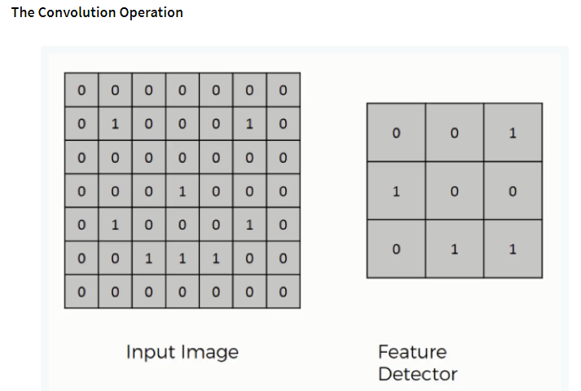
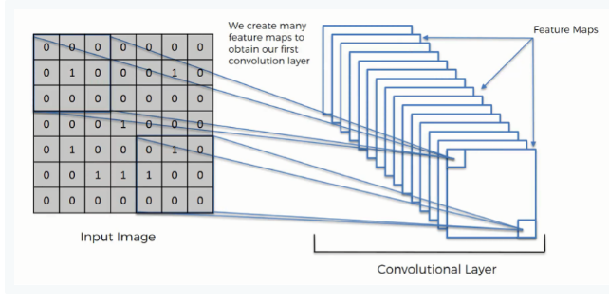

Slide 23
MOBILE NET
The utilization of Mobile Net algorithm in the detection of plant diseases through machine learning and deep learning is a groundbreaking approach. Mobile Net, known for its efficiency and lightweight architecture, proves to be instrumental in developing robust models for plant disease detection on mobile devices. By leveraging the power of convolutional neural networks (CNNs) within the Mobile Net framework, this technology enables real-time analysis of plant health through image processing. Mobile Net's capacity to efficiently handle computational tasks on resource-constrained platforms, such as smartphones, facilitates the deployment of portable and accessible plant disease detection solutions. The algorithm's ability to balance accuracy and computational efficiency is crucial in ensuring timely and accurate identification of diseases, empowering farmers and agricultural professionals to take swift corrective actions. Through the amalgamation of Mobile Net and advanced image recognition techniques, this research strives to enhance the efficacy and accessibility of plant disease detection, contributing to sustainable agriculture and food security.

Slide 24
UML DIAGRAMS
A use case diagram in the Unified Modeling Language (UML) is a type of behavioral diagram defined by and created from a Use-case analysis. Its purpose is to present a graphical overview of the functionality provided by a system in terms of actors, their goals (represented as use cases), and any dependencies between those use cases. The main purpose of a use case diagram is to show what system functions are performed for which actor. Roles of the actors in the system can be depicted.

Slide 25
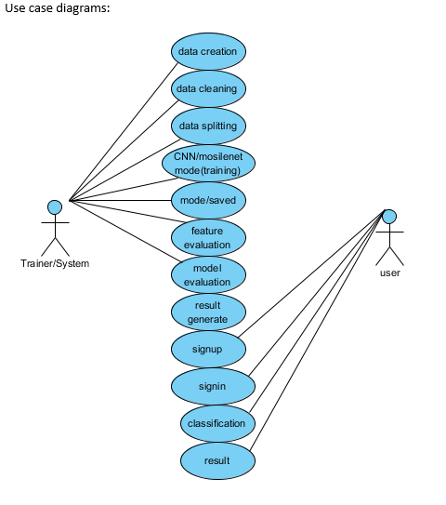

Slide 26
CLASS DIAGRAM
In software engineering, a class diagram in the Unified Modeling Language (UML) is a type of static structure diagram that describes the structure of a system by showing the system's classes, their attributes, operations (or methods), and the relationships among the classes. It explains which class contains information.

Slide 27
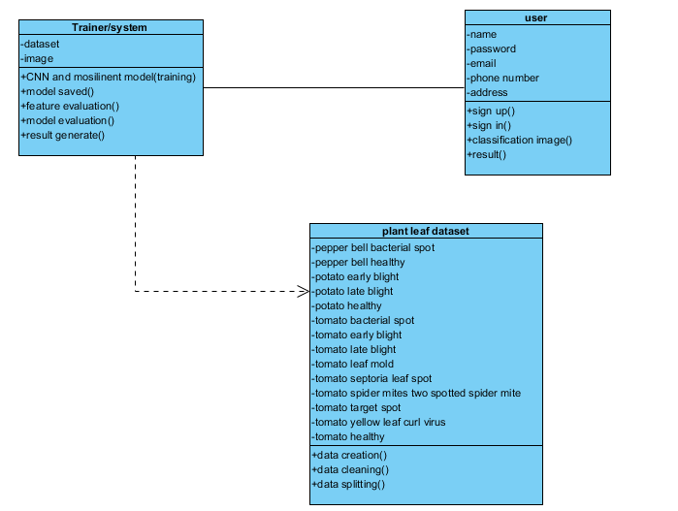

Slide 28
SEQUENCE DIAGRAM
A sequence diagram in Unified Modeling Language (UML) is a kind of interaction diagram that shows how processes operate with one another and in what order. It is a construct of a Message Sequence Chart. Sequence diagrams are sometimes called event diagrams, event scenarios, and timing diagrams.

Slide 29
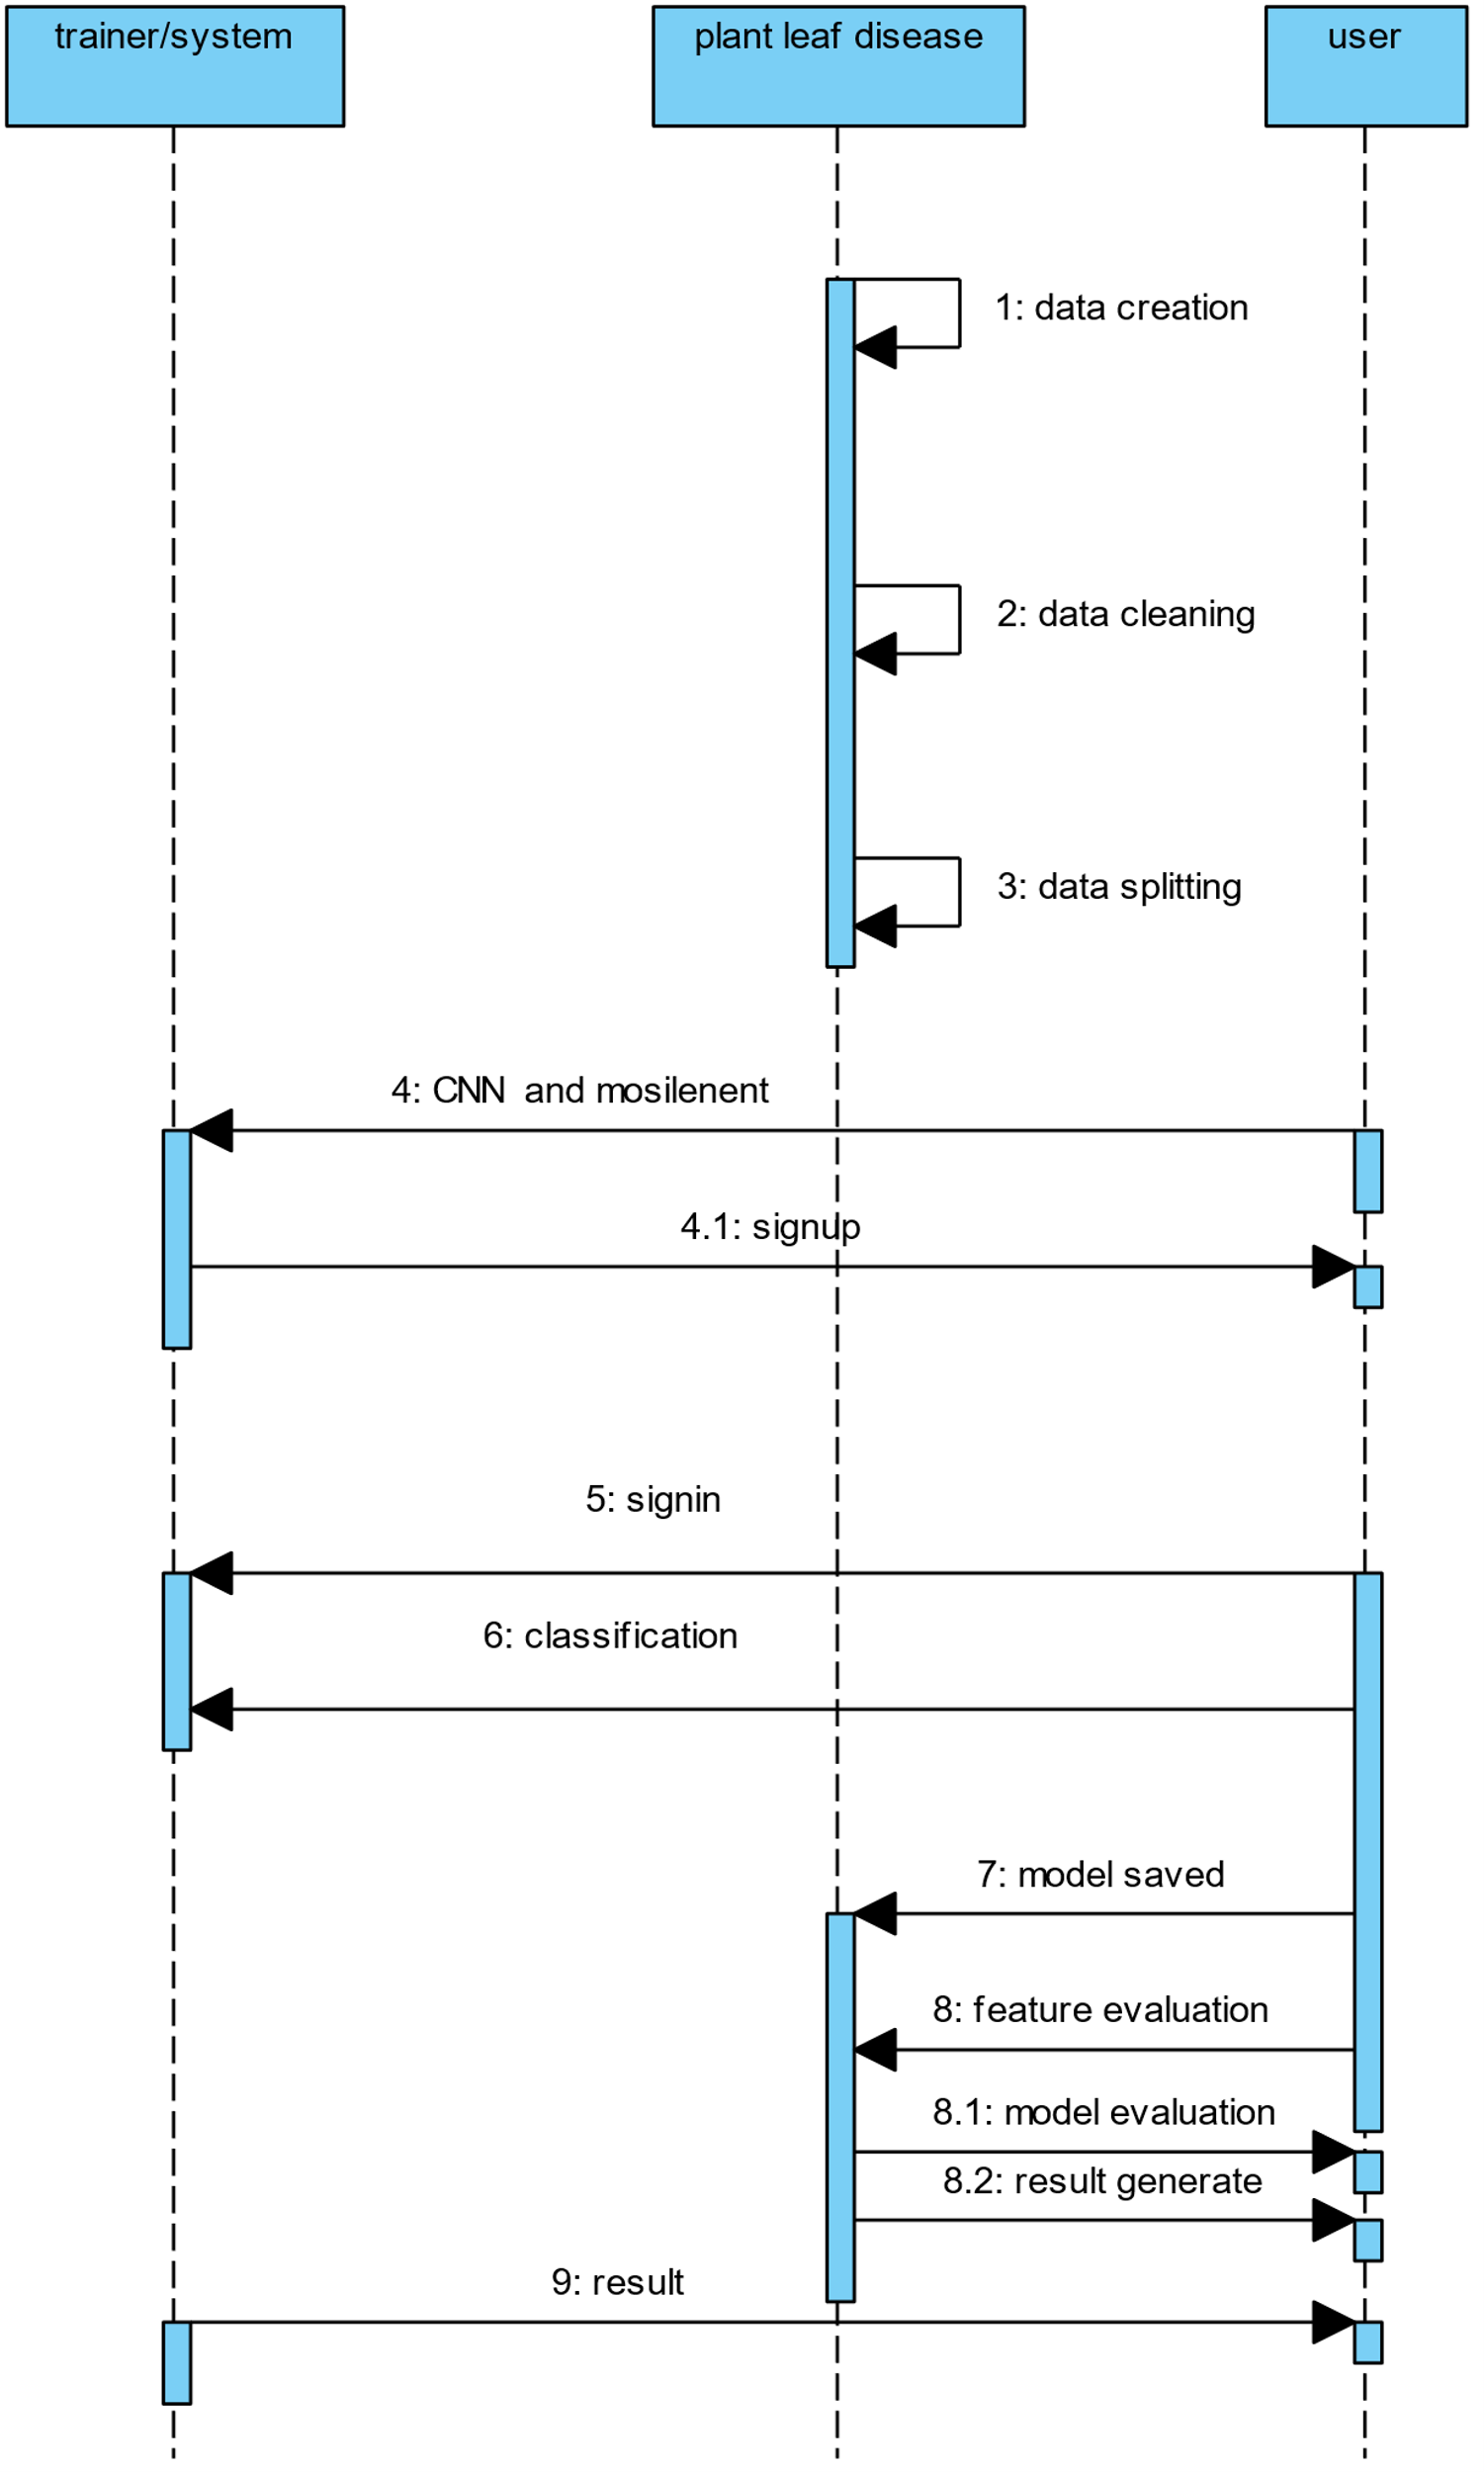

Slide 30
COLLABORATION DIAGRAM
In collaboration diagram the method call sequence is indicated by some numbering technique as shown below. The number indicates how the methods are called one after another. We have taken the same order management system to describe the collaboration diagram. The method calls are similar to that of a sequence diagram. But the difference is that the sequence diagram does not describe the object organization where as the collaboration diagram shows the object organization.

Slide 31
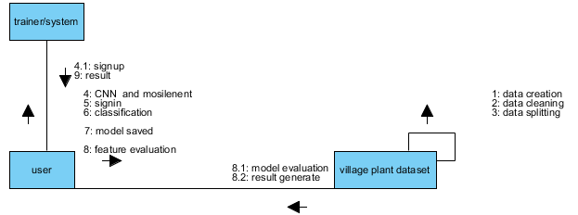

Slide 32
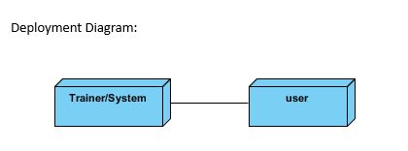
DEPLOYMENT DIAGRAM
Deployment diagram represents the deployment view of a system. It is related to the component diagram. Because the components are deployed using the deployment diagrams. A deployment diagram consists of nodes. Nodes are nothing but physical hardware used to deploy the application.

Slide 33
ACTIVITY DIAGRAM
Activity diagrams are graphical representations of workflows of stepwise activities and actions with support for choice, iteration and concurrency.
In the Unified Modeling Language, activity diagrams can be used to describe the business and operational step-by-step workflows of components in a system.
An activity diagram shows the overall flow of control.

Slide 34
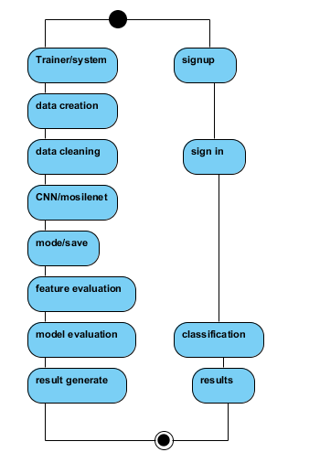

Slide 35
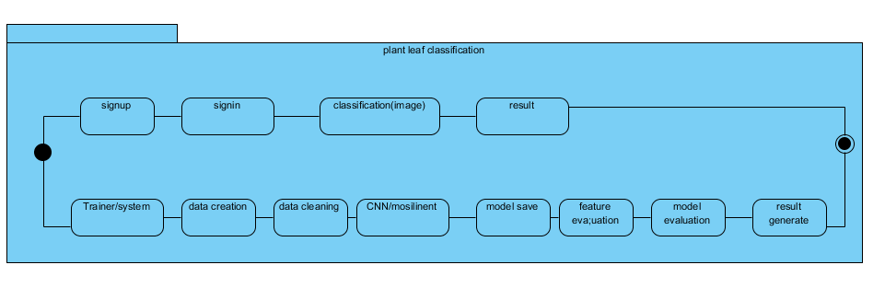
STATE MACHINE DIAGRAM

Slide 36
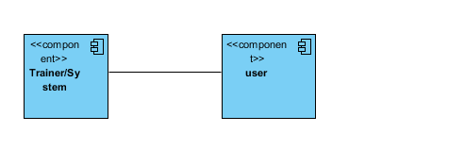
COMPONENT DIAGRAM
A component diagram, also known as a UML component diagram, describes the organization and wiring of the physical components in a system.
Component diagrams are often drawn to help model implementation details and double-check that every aspect of the system's required functions is covered by planned development.

Slide 37
ER DIAGRAM
An Entity–relationship model (ER model) describes the structure of a database with the help of a diagram, which is known as Entity Relationship Diagram (ER Diagram).
An ER diagram shows the relationship among entity sets. An entity set is a group of similar entities and these entities can have attributes.
In terms of DBMS, an entity is a table or attribute of a table in database, so by showing relationship among tables and their attributes, ER diagram shows the complete logical structure of a database.

Slide 38
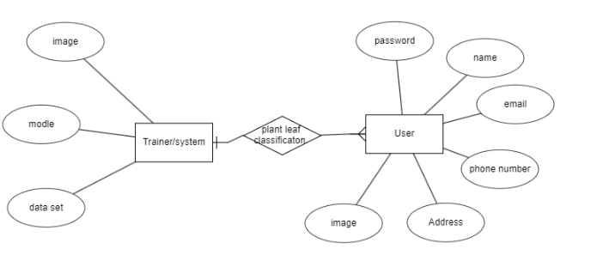

Slide 39
DFD DIAGRAM
A Data Flow Diagram (DFD) is a traditional way to visualize the information flows within a system.
A neat and clear DFD can depict a good amount of the system requirements graphically. It can be manual, automated, or a combination of both.
It shows how information enters and leaves the system, what changes the information and where information is stored.
The purpose of a DFD is to show the scope and boundaries of a system as a whole.
It may be used as a communications tool between a systems analyst and any person who plays a part in the system that acts as the starting point for redesigning a system.

Slide 40
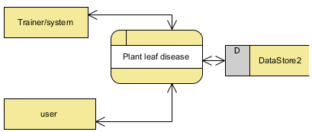

Slide 41
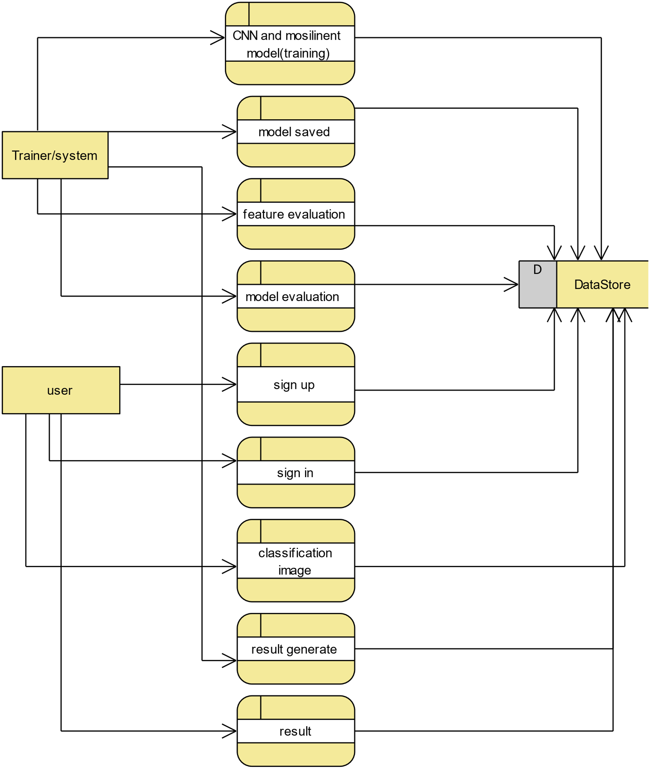

Slide 42
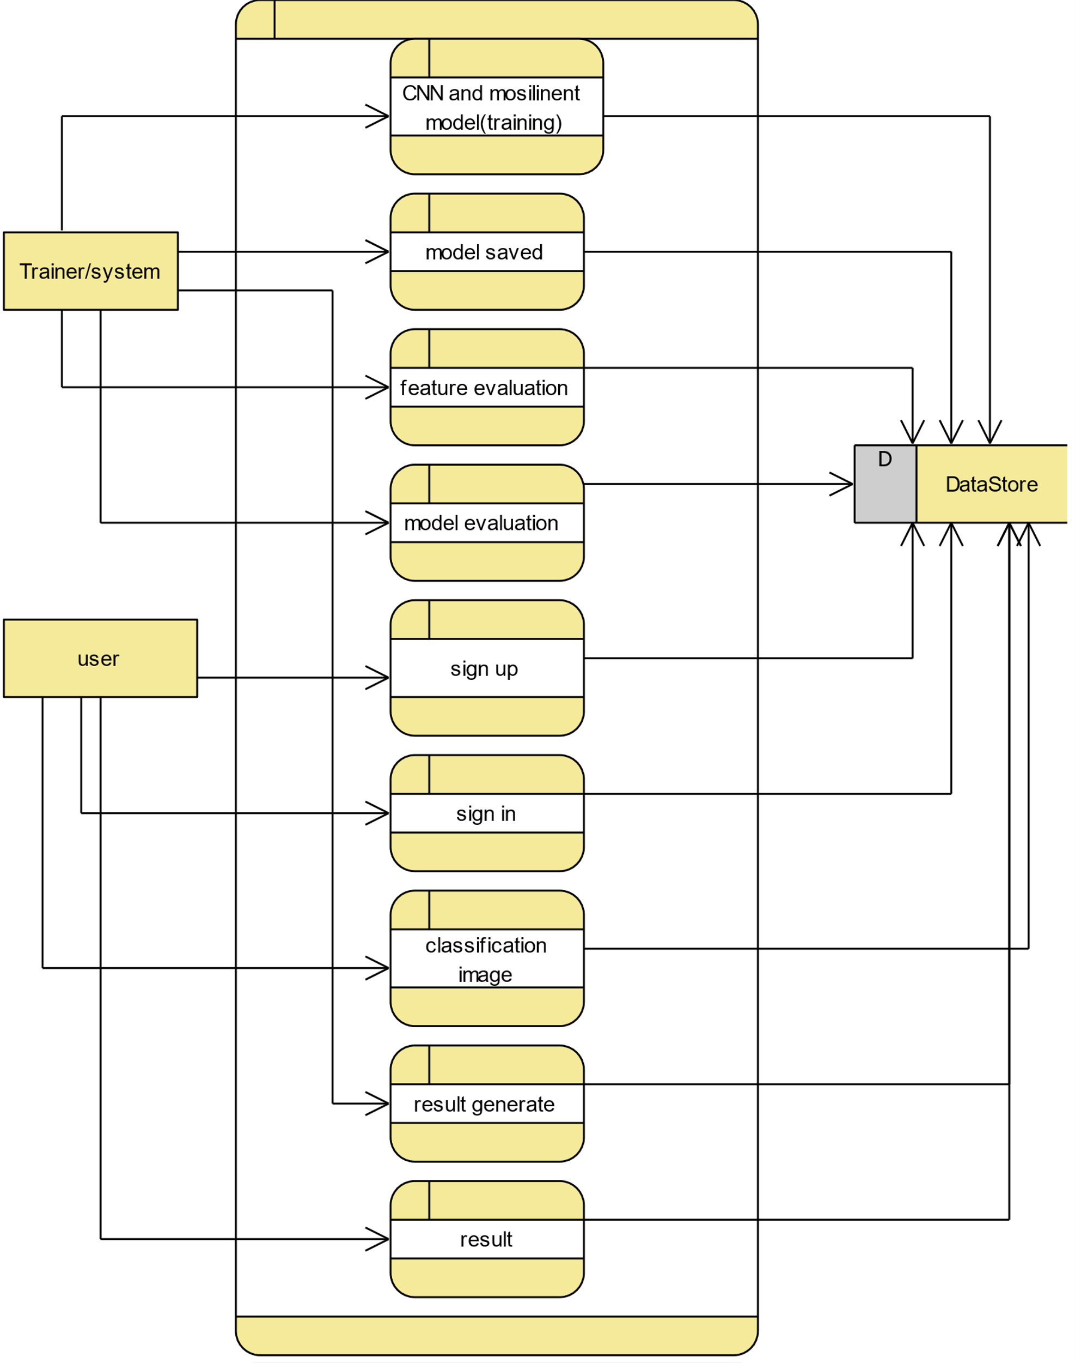

Slide 43
REFERENCES
[1] Monica Jhuria, Ashwini Kumar, Rushikesh Borse “Image Processing for Smart Farming: Detection of Disease and Fruit Grading” Proceeding of the 2013 IEEE Second International Conference on Image Processing.
[2] Sudhir Rao Rupanagudi, Ranjani B.S., Prathik Nagaraj, Varsha G. Bhat “A Cost Effective Tomato Maturity Grading System using Image Processing for 974 2015 International Conference on Green Computing and Internet of Things (ICGCIoT) Farmers” International Conference on Contemporary Computing and Information, 2014.
[3] Shiv Ram Dubey, Anand Singh Jalal “Adapted Approach for Fruit Disease Identification using Images”.
[4] Manisha A. Bhange, Prof. H. A. Hingoliwala “A Review of Image Processing for Pomegranate Disease Detection” International Journal of Computer Science and Information Technologies, Vol. 6 (1), 2015, 92-94.
[5] Hetal N. Patel, Dr. M. V. Joshi “Fruit Detection using Improved Multiple Features based Algorithm” International Journal of Computer Applications (0975 – 8887), Volume 13– No.2, January 2011.

