Slide 1
Agile and Waterfall Methodology

Slide 2
Agile vs Waterfall Project Management
In Project management, two methodologies that stand out for their distinct approaches are Agile and Waterfall. These methods represent contrasting approach in how projects are planned, executed, and delivered.
Waterfall is a traditional, linear approach, where each phase of the project is completed in a sequence before moving on to the next.
In contrast, Agile is iterative and flexible, allowing for continuous improvement and adaptation throughout the project lifecycle.

Slide 3
Project Management
Project management is the application of knowledge, skills, tools, and techniques to project activities to meet the project requirements.
Project management is a crucial discipline that ensures projects are planned, executed, and completed effectively.
It involves organizing resources, setting goals, and managing timelines to achieve specific objectives.

Slide 4
Waterfall methodology
The Waterfall methodology is one of the earliest and most straightforward approaches to software development and project management.
It is based on a linear and sequential design process where progress flows in one direction—like a waterfall.
This model is widely used in software development, construction, and manufacturing, where each phase of the project must be completed before the next one begins.

Slide 5
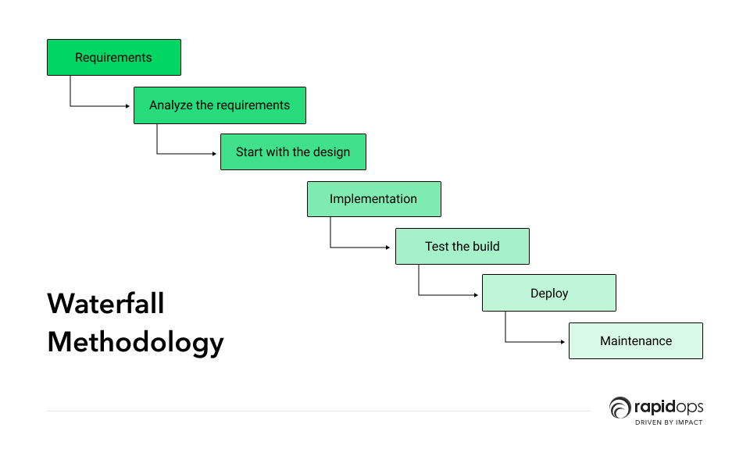

Slide 6
1.Requirements Gathering and Analysis
In this initial phase, all project requirements are gathered, defined, and documented in detail.
Stakeholders, users, and developers collaborate to ensure a comprehensive understanding of the project needs.
The goal is to gather all the information needed for the design phase.
2.System and Software Design
Based on the requirements gathered, the system's architecture and design are created.
This includes both high-level system design (how the system will function) and low-level design (detailed specifications for each component or module).
The design should be thorough to avoid changes later.

Slide 7
3.Implementation (Coding)
In this phase, the actual code is written based on the previously defined design.
Development teams build and integrate the various components of the system.
This is typically the longest phase in the waterfall model.
4.Testing
After coding is complete, the system undergoes rigorous testing.
The aim is to find defects or issues in the system and fix them.
Testing is usually done in a controlled environment before the system is deployed.

Slide 8
5.Deployment
Once the system is tested and approved, it is deployed to a live environment.
Users start interacting with the system.
This phase also includes user training and documentation.
6.Maintenance
After deployment, the system enters the maintenance phase.
This phase involves fixing any issues that arise, applying patches, and updating the system as necessary.
It ensures the system continues to meet user needs over time.

Slide 9
Agile process
Agile methodologies emphasize short, repetitive cycles known as sprints or iterations, which usually last between 1-4 weeks.
At the end of each sprint, a working product increment is delivered, providing tangible progress that can be reviewed and improved.
The main Agile frameworks include Scrum, Kanban, and Extreme Programming (XP), but they all share a common focus on delivering value through iterative development, continuous feedback, and collaboration.

Slide 10
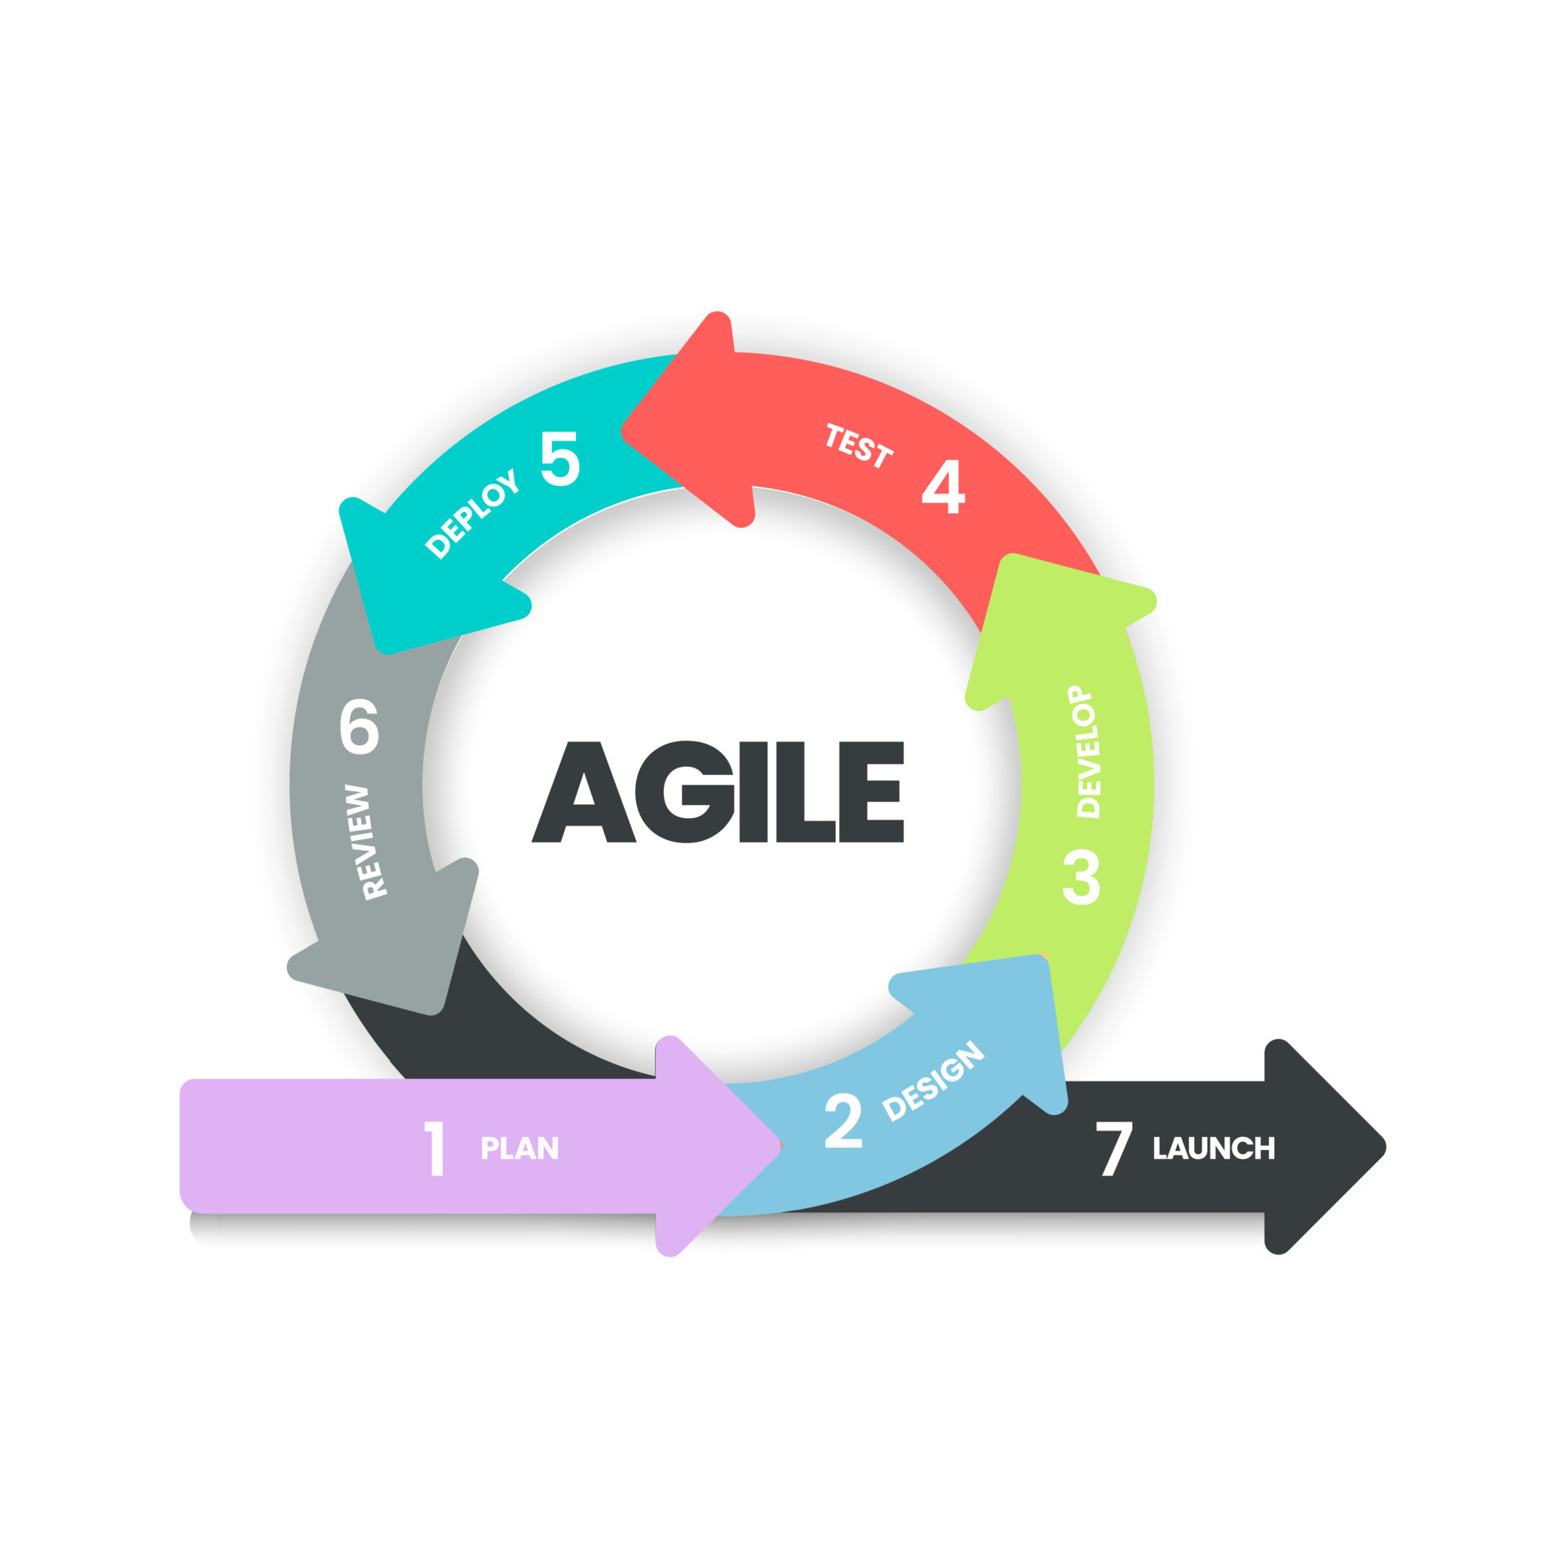
Agile process
Agile methodologies emphasize short, repetitive cycles known as sprints or iterations, which usually last between 1-4 weeks.
The main Agile frameworks include Scrum, Kanban, and Extreme Programming (XP), but they all share a common focus on delivering value through iterative development, continuous feedback, and collaboration.

Slide 11
1.Plan
What Happens: In Agile, planning occurs at multiple levels. Initially, high-level planning happens in the form of Release Planning, where broad goals and features (epics) are defined. The team will create a Product Backlog, which is a prioritized list of features, user stories, and tasks needed for the product.
During Each Sprint: A more detailed plan is created during the Sprint Planning meeting, where the team decides which items from the Product Backlog will be worked on during the upcoming sprint. The team sets a goal for the sprint and breaks down user stories into smaller tasks.
2.Design
What Happens: While Agile emphasizes iterative and incremental development, design still plays a key role but is done just-in-time (JIT) and continuously throughout the process. Instead of a big upfront design, teams design and refine features as they go.
During Each Sprint: Design happens on a smaller scale within each sprint. Teams might design the UI, system architecture, or database models for specific features. User stories should have enough detail for the team to understand how the feature should behave, often supported by wireframes or mockups.

Slide 12
3.Develop
What Happens: In Agile, development is carried out in iterative cycles (sprints), where each iteration delivers a working product increment.
During Each Sprint: Developers write code, implement features, and integrate the code with the existing product. The development is driven by the Sprint Backlog—a list of tasks for the sprint. Each sprint should result in a potentially shippable product increment, meaning the code is functional and ready to be tested.
4.Test
What Happens: Testing is integrated throughout the Agile process. In traditional approaches, testing often happens after development is complete. In Agile, testing is done continuously, from unit testing to system testing, and automated tests are encouraged.
During Each Sprint: Testing starts as soon as development begins. Testers and developers collaborate closely to ensure features meet acceptance criteria. Automated testing is frequently used for unit tests, regression tests, and integration tests. Acceptance testing happens at the end of the sprint to ensure that the product increment meets the user story's requirements.

Slide 13
5.Deploy
What Happens: Agile promotes continuous delivery where code is deployed as frequently as possible, often in small increments.
During Each Sprint: At the end of the sprint, the potentially shippable product increment is deployed to a staging environment for final verification. The code is then pushed to production when it is deemed ready.
6.Review
What Happens: At the end of each sprint, a Sprint Review is held to review the work done during the sprint. This allows the team to present the completed features to stakeholders for feedback and validate the product increment.
During Each Sprint: The team demonstrates the working product (or features) to stakeholders in a demo session. Feedback is gathered to assess whether the delivered product meets expectations and if any changes are required.

Slide 14
7.Launch
What Happens: Launch refers to the final release or delivery of the product to end users. While Agile allows for frequent releases, a larger product launch may happen at the end of the project or after several smaller releases.
During Each Sprint: A soft launch or pilot release might occur before the final public launch, allowing the team to test the product with a smaller user base. Once the product is fully developed and tested, it is deployed to production.

Slide 15
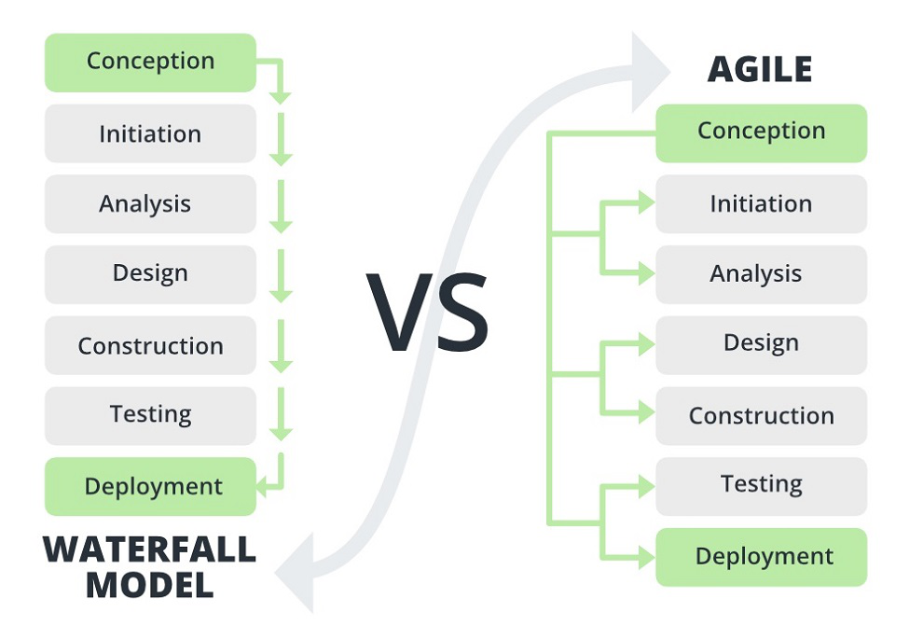
Waterfall Model vs Agile

