Slide 1
Predictive Incident Classification for the TTC Streetcar Operations
From Reactive Response to Proactive Management
Member list and roles
Hossein : Data Acquisition & Cleaning Lead
Aman : Exploratory Data Analysis & Feature Engineering Lead
Antonio: Model Development & Optimization Lead
Janice: Evaluation, Visualization & Reporting Lead

Slide 2
The Problem & Business Context
Problem
TTC experiences recurring streetcar delays impacting reliability and passenger satisfaction
Operations are reactive with limited insight into which incident types cause disruptions
Project goal: Predict and classify incident types using historical data (2014–2025)
Key Challenges
Inefficient deployment of crews and resources
Limited visibility into high-risk routes, times, and locations
Recurring delays and customer dissatisfaction
Business Value
Better scheduling and targeted maintenance based on predicted incident patterns
Data-driven decisions on where to invest (infrastructure, track, signals)
Reduced downtime and improved on-time performance
Expected Impact
10–15% faster incident response
Improved resource utilization and service reliability
Clearer insights for planning, leadership, and passenger communication

Slide 3
Data & Methodology Overview
Dataset Summary
2014–2024 TTC streetcar delay data (11 years, all routes)
93,274 incident records consolidated from 12 CSV/Excel files
Key features: time (date/hour/day), route/vehicle/location, incident type (target), delay duration
Data Quality & Prep
Standardized columns across years; merged all files into one dataset
Missing values imputed (numeric → 0, categorical → “Unknown”)
Final dataset: 93k rows × 11 features, sorted chronologically
Risks & Limitations
Class imbalance: Mechanical/general delays dominate
Missing data assumptions may affect temporal/vehicle patterns
Inconsistent data collection over 11 years
Methodology (High-Level)
Phase 1 – Consolidation: Merge files, clean data, assess quality
Phase 2 – EDA: Identify top incident types, rush-hour peaks, winter seasonality, high-incident routes (501/504)
Phase 3 – Feature Engineering: Add time-based, delay-severity, and encoded categorical features → 22 total features

Slide 4
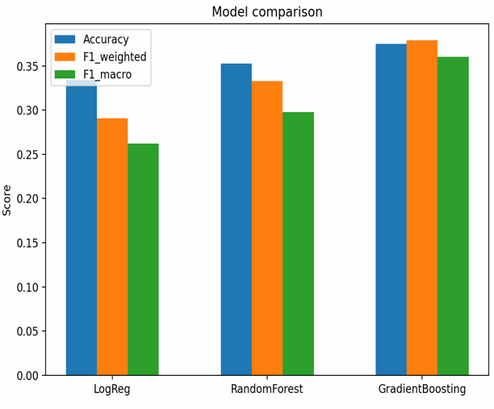
We tested three classification algorithms: Logistic Regression as our baseline, Random Forest, and Gradient Boosting.
We also performed hyperparameter tuning using GridSearchCV and Randomized SearchCV, which improved stability and F1-scores.
Gradient Boosting achieved the best performance with 37.9% weighted F1-score, outperforming the other approaches.

Slide 5
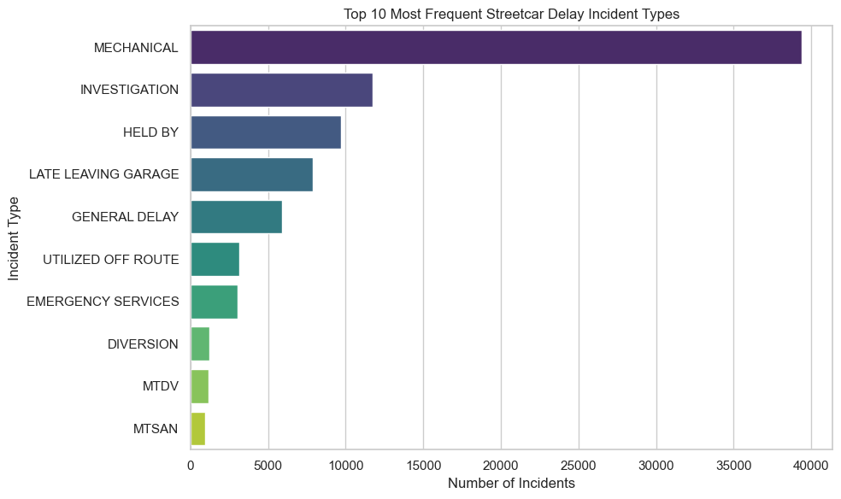
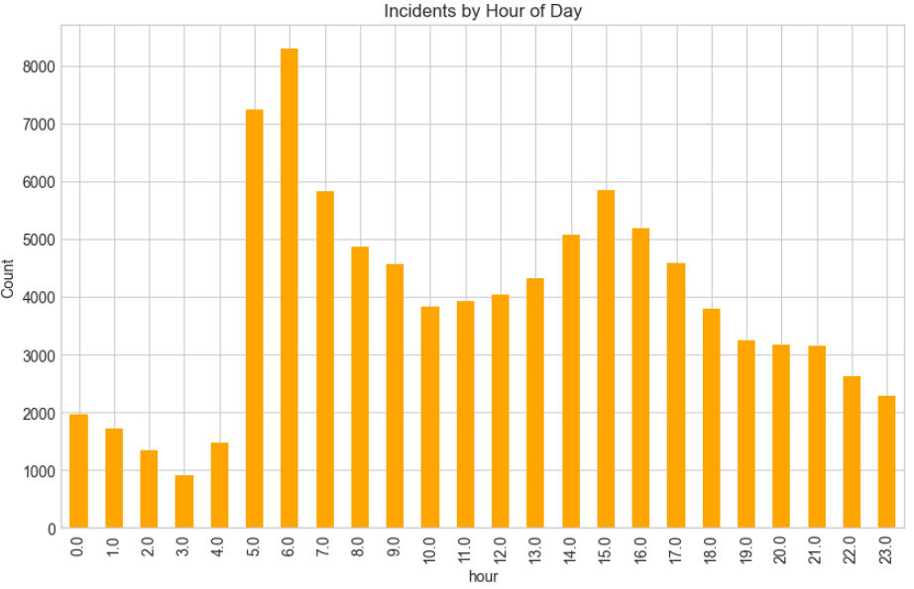
Results - Key Insights
This bar chart ranks incidents types, Mechanical incidents dominate with 40,000+ cases, while other types like Investigation, Held By, and Late Leaving Garage occur far less frequently, showing clear class imbalance.
In the bottom left chart showing hourly distribution, delay incidents peak sharply during the morning (5–7 AM) and evening (2–4 PM) rush hours, confirming strong time-of-day effects that are critical for predictive modeling.

Slide 6
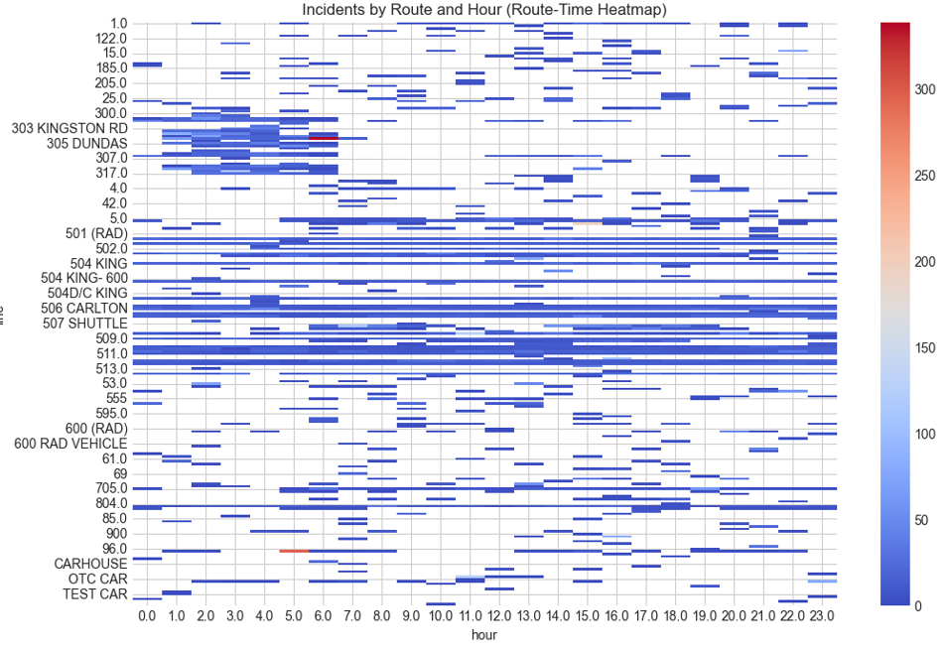
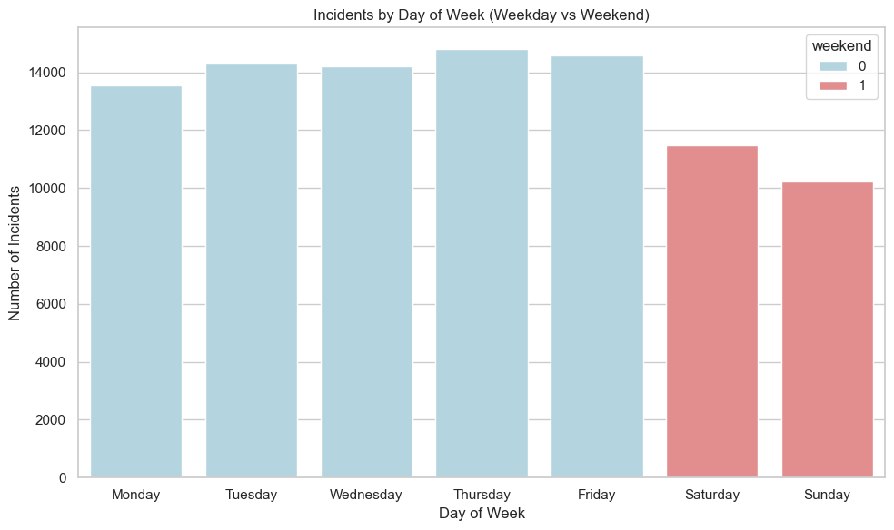
Results - Key Insights
• Incidents cluster by route and hour, with major routes like 501, 504, and 506 showing the highest activity.
• Clear time-route patterns emerge, helping identify when and where targeted interventions are needed.
This chart comparing days of the week, weekdays show significantly higher incident counts than weekends, indicating heavier operational load and stronger patterns during the workweek.

Slide 7
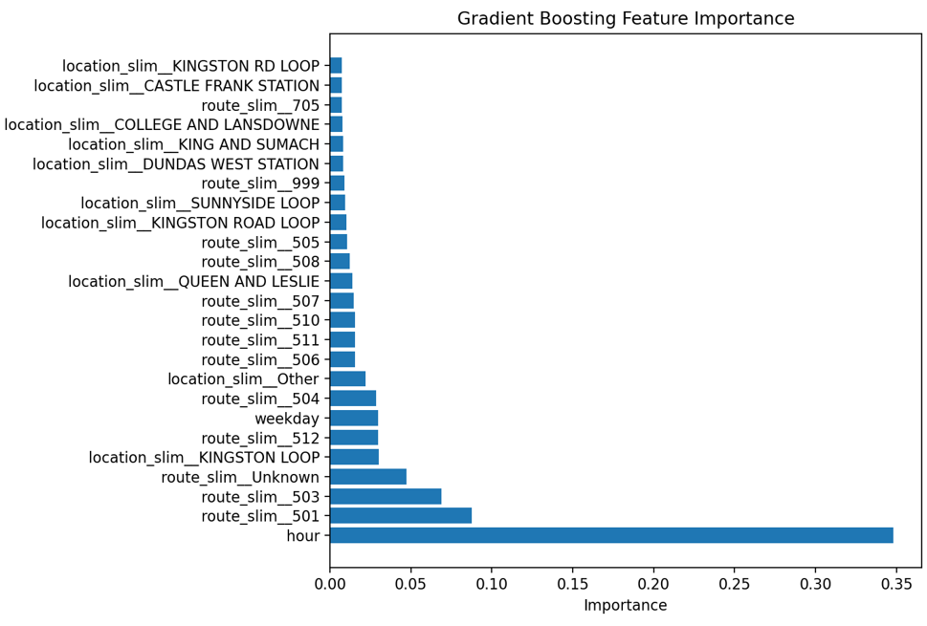
Feature importance analysis reveals what drives incident severity predictions.
Hour of day dominates at 0.35 importance - more than three times the next feature. Route 501 and Route 503 follow at 0.09 and 0.075 importance respectively.

Slide 8
Recommendations
Infrastructure Investment
Prioritize Routes 501 and 504 for targeted infrastructure assessment and upgrades.
Include maintenance facilities in capital planning—not just passenger-service locations.
Operational Enhancements
Strengthen vehicle maintenance and pre-service inspection protocols to reduce mechanical failures.
Allocate staff and resources during high-incident periods (5–7 AM and 2–4 PM).

Slide 9
Limitations
Model Limitations
Moderate accuracy: Weighted F1 = 0.379, leaving substantial room for improvement.
Poor rush-hour performance: Especially weak on Severe incidents (F1 = 0.02 during rush hours).
Class imbalance persists: Minority incident types remain difficult to predict reliably.
Data Limitations
Historical-only data: Model may fail on new or shifting operational patterns.
Missing external factors: Weather, special events, construction, and traffic conditions not included.
Limited geographic granularity: Station/route data lacks detailed intersection- or segment-level context.
Temporal scope: Dataset may not reflect the most recent procedural or infrastructure changes.
Operational Limitations
Not yet real-time: Current version is a proof-of-concept; integration required for live use.
Human oversight needed: Intended to support—not replace—operations staff judgment.
Model drift risk: Requires periodic monitoring and retraining as transit conditions evolve.

Slide 10

Thank you for your attention

