Slide 1
Predictive Incident Classification for the TTC Streetcar Operations
From Reactive Response to Proactive Management
Member list and roles
Hossein : Data Acquisition & Cleaning Lead
Aman : Exploratory Data Analysis & Feature Engineering Lead
Antonio: Model Development & Optimization Lead
Janice: Evaluation, Visualization & Reporting Lead

Slide 2
The Problem & Business Context
Problem
TTC experiences recurring streetcar delays impacting reliability and passenger satisfaction
Operations are reactive with limited insight into which incident types cause disruptions
Project goal: Predict and classify incident types using historical data (2014–2025)
Key Challenges
Inefficient deployment of crews and resources
Limited visibility into high-risk routes, times, and locations
Recurring delays and customer dissatisfaction
Business Value
Better scheduling and targeted maintenance based on predicted incident patterns
Data-driven decisions on where to invest (infrastructure, track, signals)
Reduced downtime and improved on-time performance
Expected Impact
10–15% faster incident response
Improved resource utilization and service reliability
Clearer insights for planning, leadership, and passenger communication

Slide 3
Data & Methodology Overview
Dataset Summary
2014–2024 TTC streetcar delay data (11 years, all routes)
93,274 incident records consolidated from 12 CSV/Excel files
Key features: time (date/hour/day), route/vehicle/location, incident type (target), delay duration
Data Quality & Prep
Standardized columns across years; merged all files into one dataset
Missing values imputed (numeric → 0, categorical → “Unknown”)
Final dataset: 93k rows × 11 features, sorted chronologically
Risks & Limitations
Class imbalance: Mechanical/general delays dominate
Missing data assumptions may affect temporal/vehicle patterns
Inconsistent data collection over 11 years
Methodology (High-Level)
Phase 1 – Consolidation: Merge files, clean data, assess quality
Phase 2 – EDA: Identify top incident types, rush-hour peaks, winter seasonality, high-incident routes (501/504)
Phase 3 – Feature Engineering: Add time-based, delay-severity, and encoded categorical features → 22 total features

Slide 4
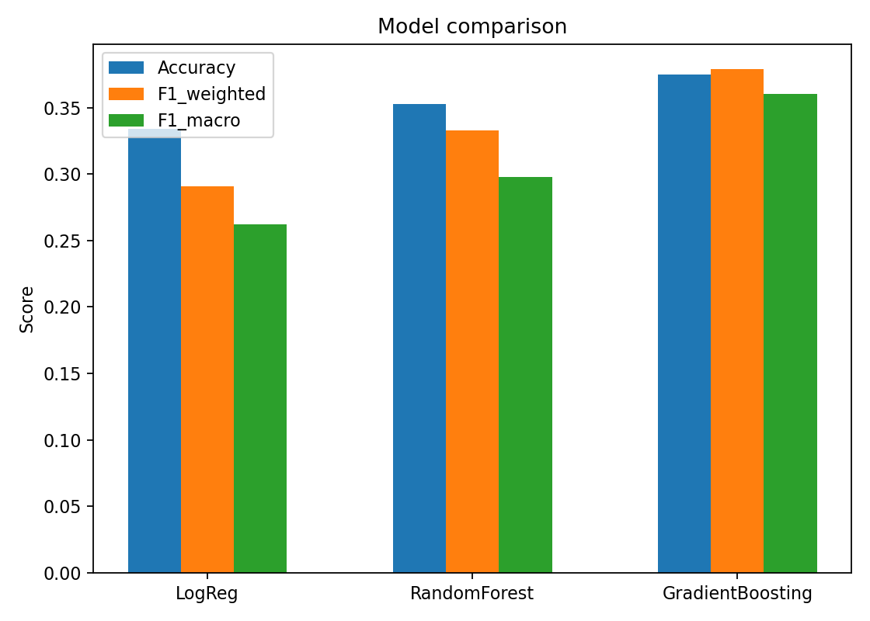
Model Performance - Overview
Objective
Build and optimize ML models to predict incident types using engineered temporal, operational, and delay-related features.
Models Evaluated
Logistic Regression (Baseline)
Random Forest (RF)
Gradient Boosting (GB)
Class Imbalance Handling
Techniques: class weights / sampling
Focus: Reduce false negatives in critical classes (Mechanical, General Delay, MTPU, Held By)
Evaluation emphasized per-class metrics and weighted averages.
Hyperparameter Tuning
Methods: GridSearchCV / RandomizedSearchCV
Tuned parameters improved model stability and overall F1-scores.
Final Selection
Gradient Boosting (GB) chosen as final model
Consistently outperformed alternatives during both rush and non-rush hour evaluations.

Slide 5
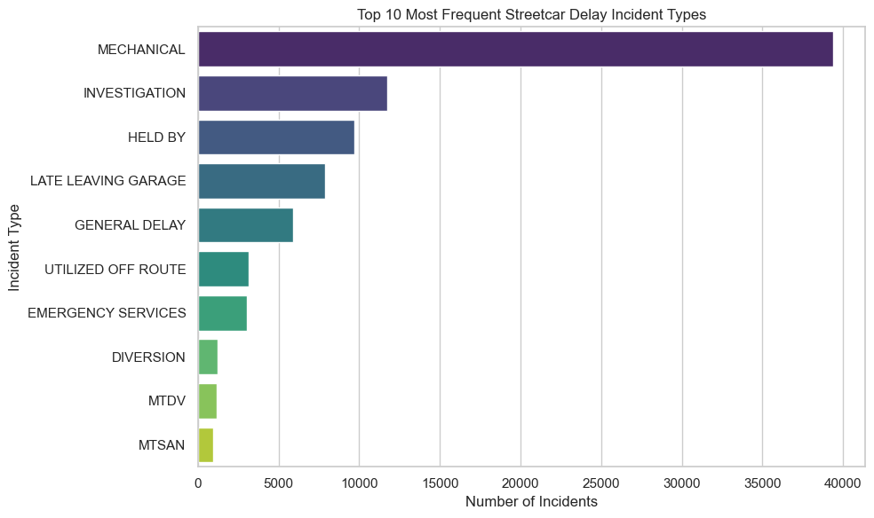
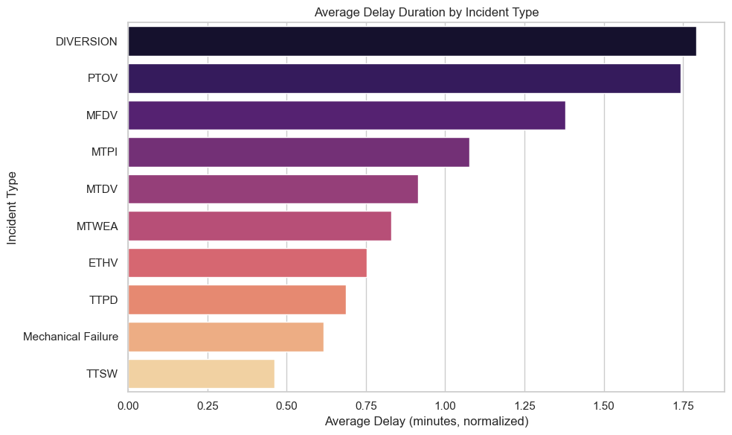
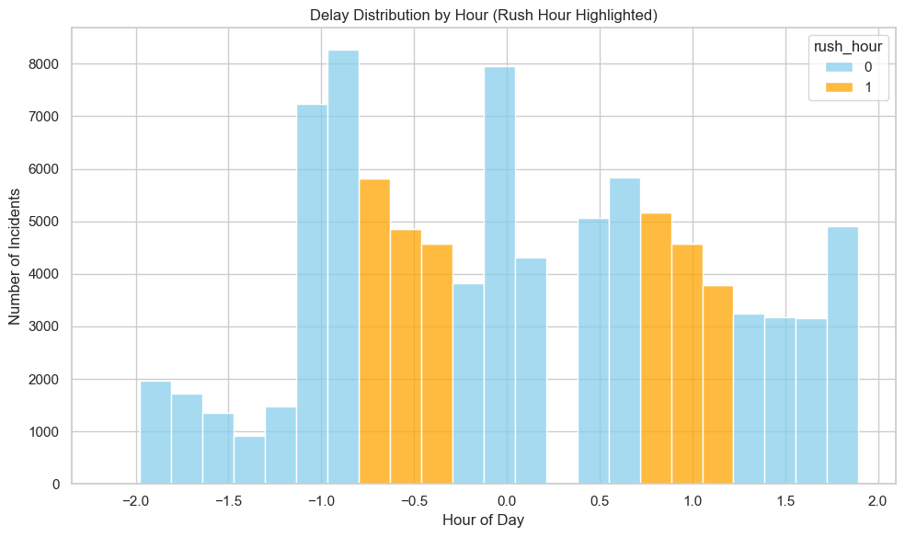
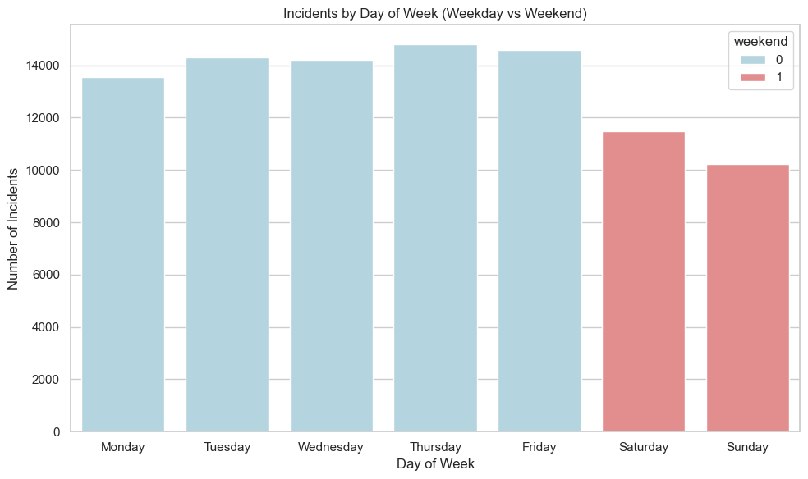
Results - Key Insights

Slide 6
Limitations
Model Limitations
Moderate accuracy: Weighted F1 = 0.379, leaving substantial room for improvement.
Poor rush-hour performance: Especially weak on Severe incidents (F1 = 0.02 during rush hours).
Class imbalance persists: Minority incident types remain difficult to predict reliably.
Data Limitations
Historical-only data: Model may fail on new or shifting operational patterns.
Missing external factors: Weather, special events, construction, and traffic conditions not included.
Limited geographic granularity: Station/route data lacks detailed intersection- or segment-level context.
Temporal scope: Dataset may not reflect the most recent procedural or infrastructure changes.
Operational Limitations
Not yet real-time: Current version is a proof-of-concept; integration required for live use.
Human oversight needed: Intended to support—not replace—operations staff judgment.
Model drift risk: Requires periodic monitoring and retraining as transit conditions evolve.

Slide 7

Thank you for your attention

