Slide 1

E-Commerce Shipping Performance and Delivery Delays
T.NagaVenkat
Batch-455

Slide 2
Dataset Overview
Domain: E-Commerce and Logistics
The dataset contains detailed information related to e-commerce order deliveries and shipping operations
Key attributes include warehouse location, shipment mode, customer care calls, customer ratings, product cost, prior purchases, product importance, customer gender, discounts offered, product weight, and delivery status
The target variable is Reached.on.Time_Y.N, which indicates whether an order was delivered on time or delayed
The dataset is well-structured and suitable for exploratory data analysis
It enables analysis of factors influencing delivery delays and customer experience

Slide 3
Simple description of each column in your dataset:
ID: Unique identifier for each order
Warehouse_block: Warehouse location handling the shipment
Mode_of_Shipment: Method used to ship the order (Road, Ship, Flight)
Customer_care_calls: Number of customer support calls made by the customer
Customer_rating: Customer satisfaction rating on a scale of 1 to 5
Cost_of_the_Product: Price of the product
Prior_purchases: Number of previous purchases made by the customer
Product_importance: Business importance of the product (Low, Medium, High)
Gender: Gender of the customer
Discount_offered: Discount applied to the order
Weight_in_gms: Weight of the product in grams
Reached.on.Time_Y.N: Delivery status indicator (0 = Delivered on time, 1 = Delivery delayed)

Slide 4
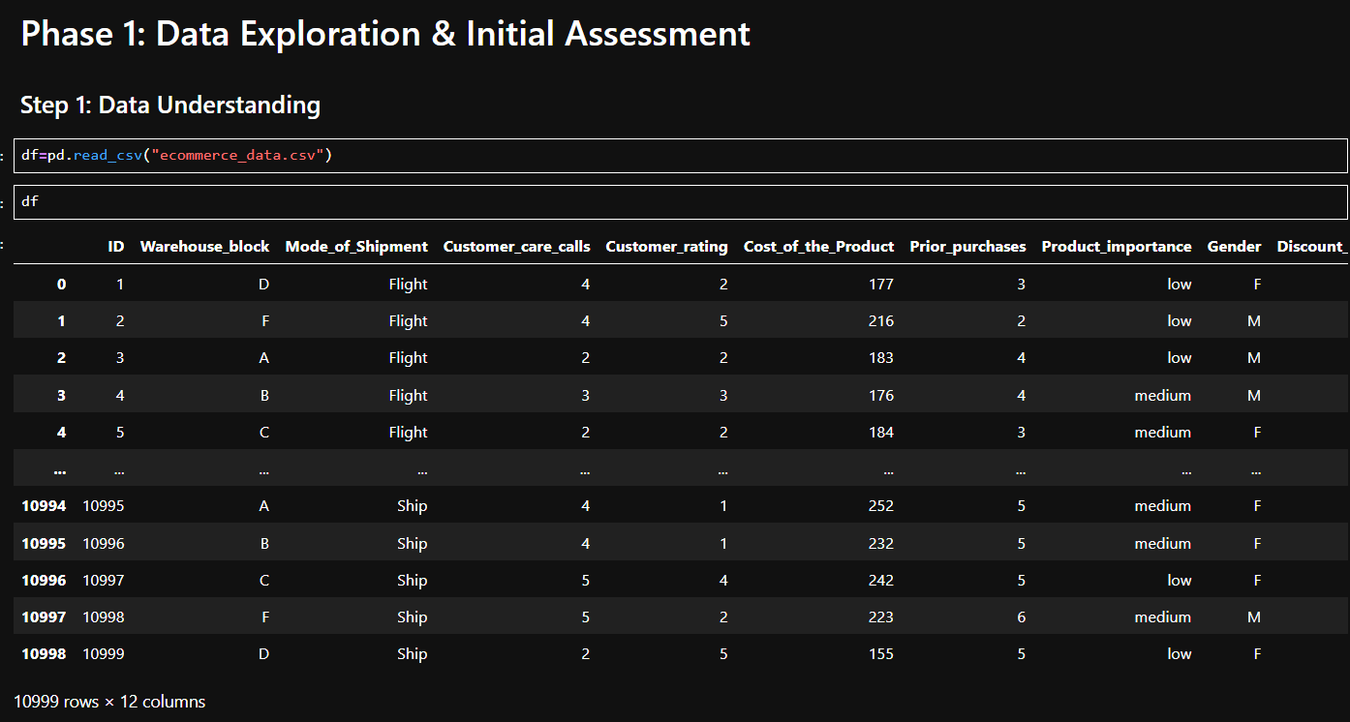
Reading Dataset

Slide 5
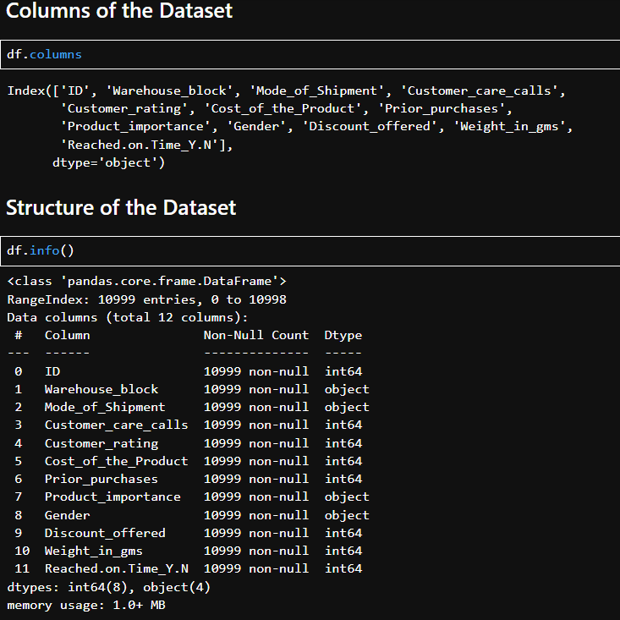
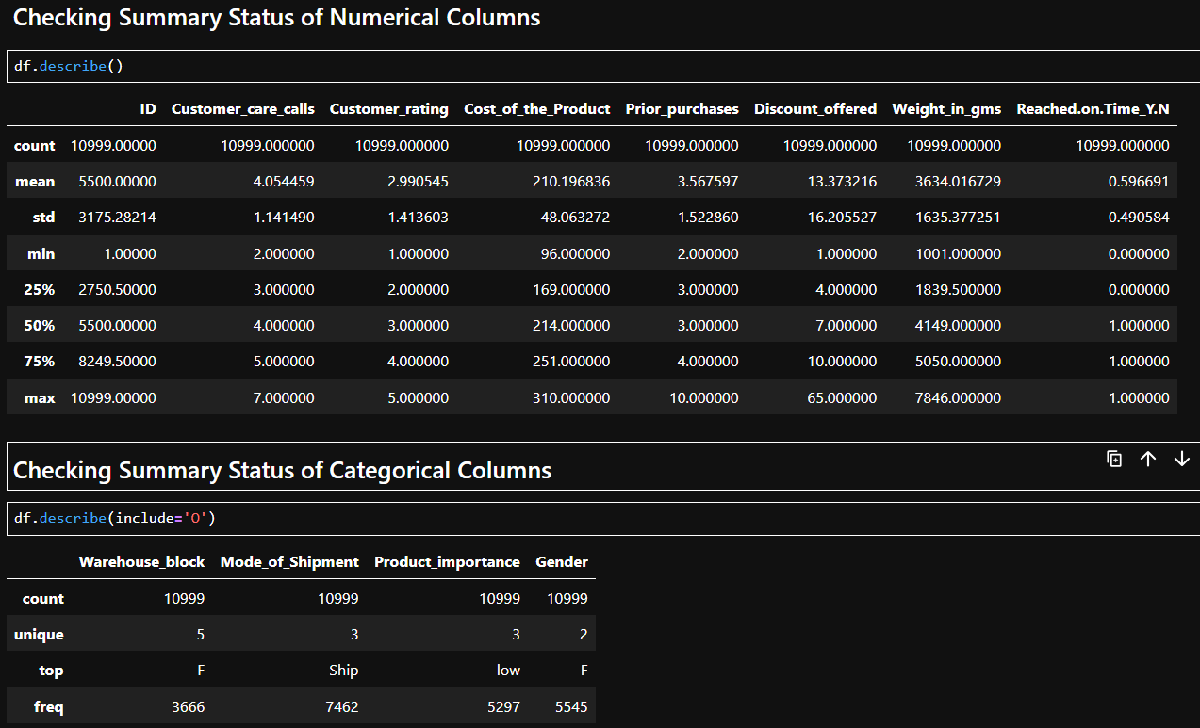
Basic Checks

Slide 6
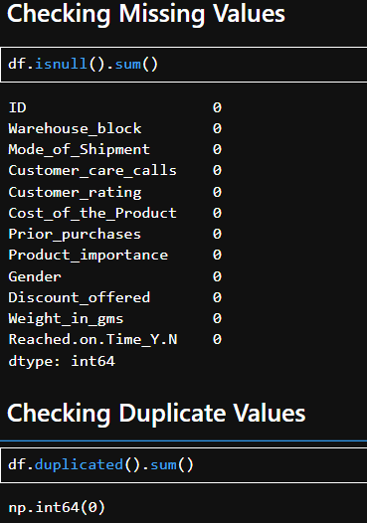
Preprocessing Techniques on Dataset Individual Columns
There are no missing values and no duplicate records present in the dataset, ensuring high data quality for analysis

Slide 7
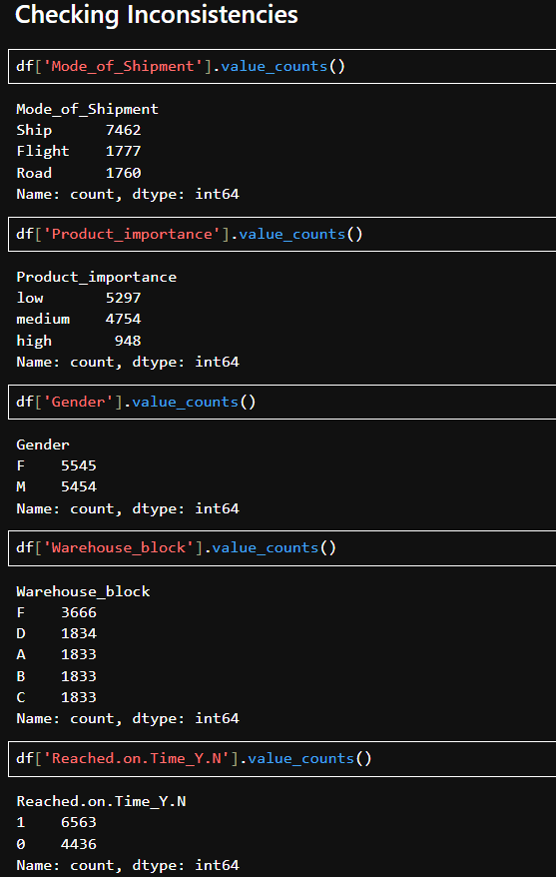
Preprocessing Techniques on Dataset Individual Columns
There are no inconsistent values in the categorical columns including Warehouse_block, Mode_of_Shipment, Product_importance, and Gender .As all categories have been standardized and validated for uniform formatting.
jkr
jk

Slide 8
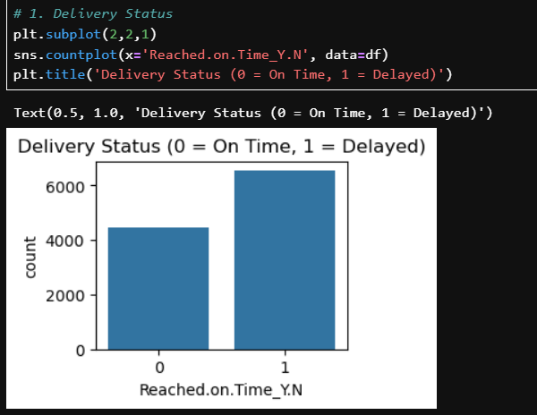
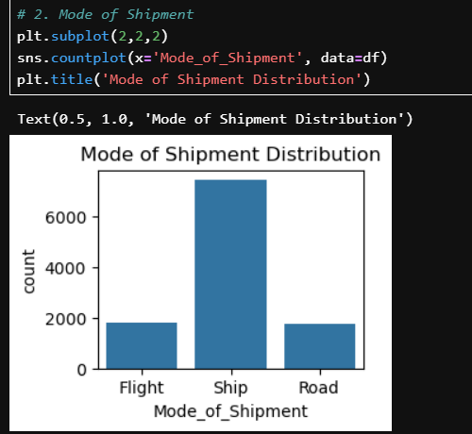
Data Analysis Through Visualization
Univariate Analysis
1.Delivery Status (Reached.on.Time_Y.N)
  A large number of orders are getting delivered late compared to those that arrive on time. This clearly shows that delivery delays are a common problem for the business, and improving logistics could have a big impact on customer satisfaction.
2.Mode of Shipment
Most orders are shipped using road and ship rather than flight. This suggests the company is likely trying to reduce costs, but relying more on these slower transport methods could also be one of the reasons why many deliveries are delayed.

Slide 9
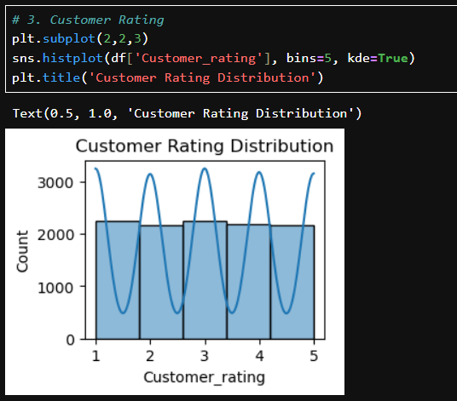
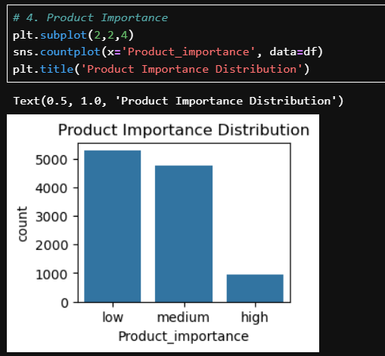
3. Customer Rating
Most customers give ratings between 3 and 5, which means many are reasonably satisfied. However, the presence of low ratings shows that some customers are unhappy, possibly due to issues like late deliveries or poor service.
4. Cost of the Product
The majority of products fall into a low to medium price range, with only a few high-priced items. This means the business mainly deals in affordable products, but any delivery issues with expensive items could lead to higher customer dissatisfaction and revenue loss.

Slide 10
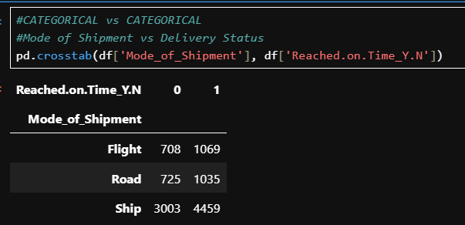
Non- Visual Bivariate Analysis
1. Categorical vs Categorical
Mode of Shipment vs Delivery Status
Among the three modes, Ship handles the highest number of orders, but it also has the highest number of delays (4459). This indicates that although shipping by ship is widely used, it is the most unreliable option for timely delivery.

Slide 11
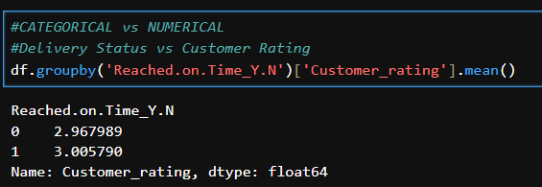
Non- Visual Bivariate Analysis
2. Categorical vs Numerical
Delivery Status vs Customer Rating
Surprisingly, customers who experienced delayed deliveries gave slightly higher ratings than those who received their orders on time.
This suggests that delivery delay alone is not driving customer dissatisfaction in this dataset.

Slide 12
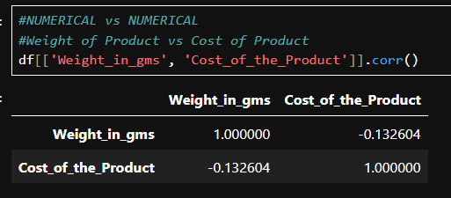
Non- Visual Bivariate Analysis
3. Numerical vs Numerical
Product Weight vs Cost of Product
The correlation between product weight and product cost is –0.13, which shows a very weak negative relationship. This means that heavier products are not necessarily more expensive

Slide 13
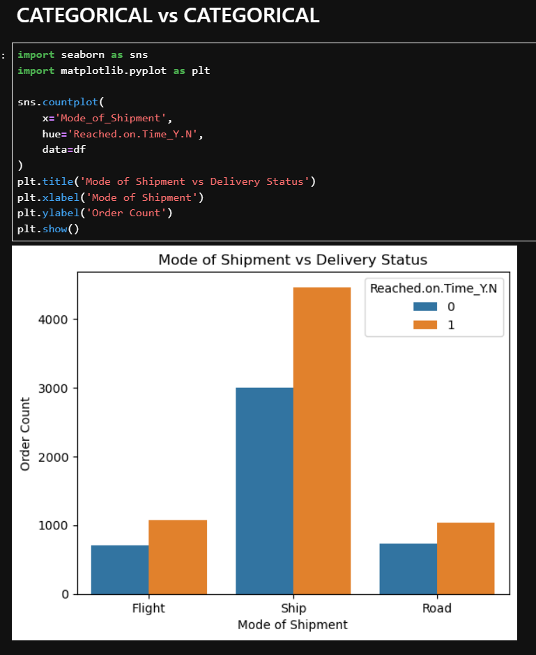
Visualization – Bivariate Analysis
1. Categorical vs Categorical
Mode of Shipment vs Delivery Status
The bar chart shows that Flight shipments have the highest proportion of on-time deliveries, while Road shipments experience the most delays. This confirms that faster transportation modes lead to better delivery performance.

Slide 14
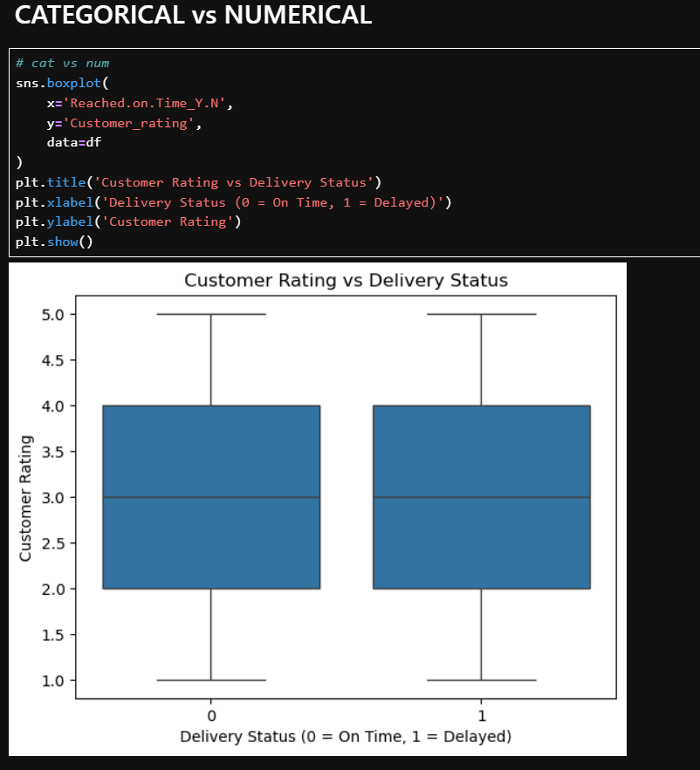
Visualization – Bivariate Analysis
2. Categorical vs Numerical
Delivery Status vs Customer Rating
This boxplot shows that customer ratings are almost the same for both on-time and delayed deliveries.
Both groups have a median rating around 3, and their rating ranges are also very similar, which means customers are giving nearly the same feedback whether the order was delayed or not. There is no strong drop in ratings for delayed orders.

Slide 15
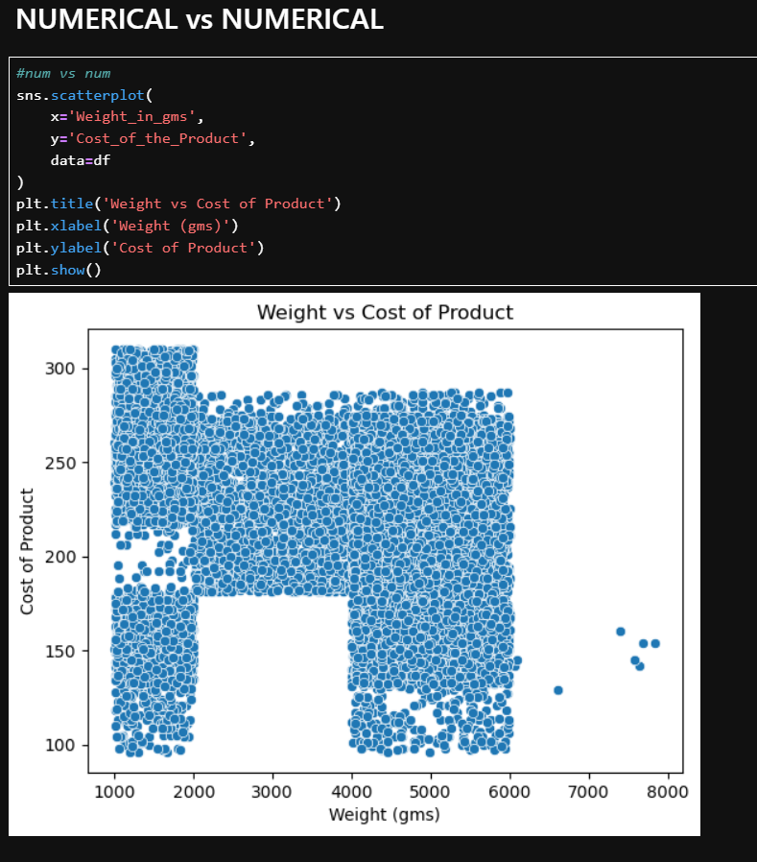
Visualization – Bivariate Analysis
3. Numerical vs Numerical
Product Weight vs Cost of Product
There is a positive relationship between weight and product cost, meaning heavier products are generally more expensive. This implies that delays in heavier shipments could also have a higher financial impact.

Slide 16
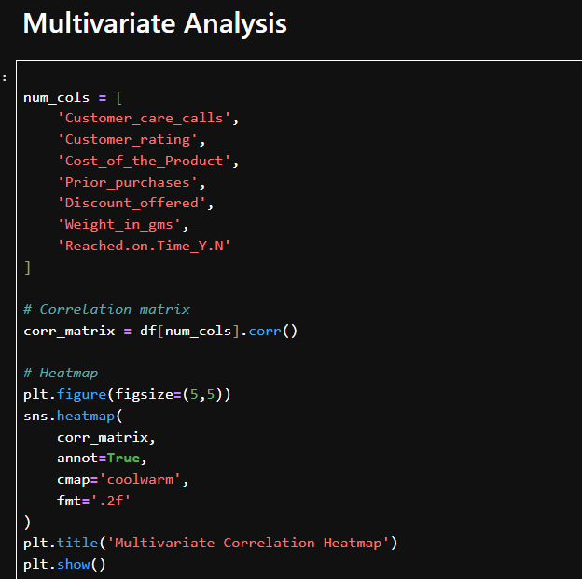
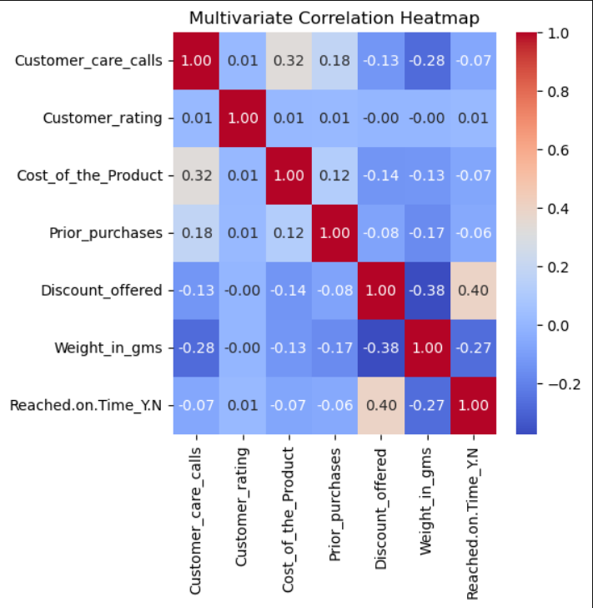
Multivariate Analysis
The heatmap indicates that delivery delays increase when product weight is higher and when customers contact support more often, showing that operational complexity leads to slower deliveries. It also suggests that discounts are frequently used when delays occur, likely as a way to reduce customer dissatisfaction. In addition, late deliveries tend to result in slightly lower customer ratings, highlighting the impact of logistics performance on customer experience.

Slide 17
Summary
The analysis shows that delivery performance in e-commerce is mainly influenced by shipment mode, product weight, and operational complexity. Heavier products and orders that require more customer support are more likely to be delayed, while faster shipment methods lead to better on-time delivery rates. When delays happen, the company often uses discounts to reduce customer dissatisfaction, but late deliveries still tend to lower customer ratings. Overall, the dataset is clean and well-structured, and the insights clearly highlight how logistics efficiency plays a key role in customer experience and business performance.

Slide 18

Thank You

