Slide 1
Intro to Anti-Forensics
K

Slide 2
DISCLAIMER
Hands-on labs and security presentations are provided for educational purposes only. Attendance at these sessions and the use of this information is not intended to promote unethical and illegal hacking, including cracking, software piracy or any other illegal activity as defined by state and federal laws. The word "hacking" in the context of these training sessions shall only refer to ethical hacking. All information provided in these sessions is for the sole purpose of providing the attendees with the tools to better understand vulnerabilities and in turn help prevent hacking attacks. Information garnered and equipment used during this session must not be used to cause damage by engaging in illegal hacking during or after the session. Any such behavior is a violation of state and federal laws and may subject to prosecution.

Slide 3
Goal of Anti-Forensics
Delay Investigation
Hide any Data
DATA IS EVIDENCE
Remove anything that may incriminate you.

Slide 4
Forensics Process
-LEO/Examiner takes the machine/image of the machine’s hard drive into custody.
-Analysis is performed.
-Files are carved out and evidence is found.
-Files are given to other parts of management or the legal system.

Slide 5
Methods of Evasion
Pre-Investigation
Use a rootkit to alter your own data.
The rookit did it, not me!
Destroy the hardware
Destroy or alter the data

Slide 6
During Investigation
Overflow Buffers
Format Strings
Take advantage of File System parsing bugs
If someone opens this up in a debugger, you’re boned.

Slide 7
Post-Investigation
Pray
Jesus
Allah
Buddha
GabeN

Slide 8
Destroy the Hardware and Data
Darik’s Boot And Nuke
Encrypt Everything, toss the key
Linux Live USB; DD /dev/null the world
A hammer
Thermite
Ask Elon Musk to shoot it into the Sun

Slide 9
Files don’t just get deleted with a Keypress
Windows just marks the space as unallocated, or empty; data can still be hiding.
There’s still records in the system for deletion.
Must be deleted to the point where there’s no proof of it even existing

Slide 10
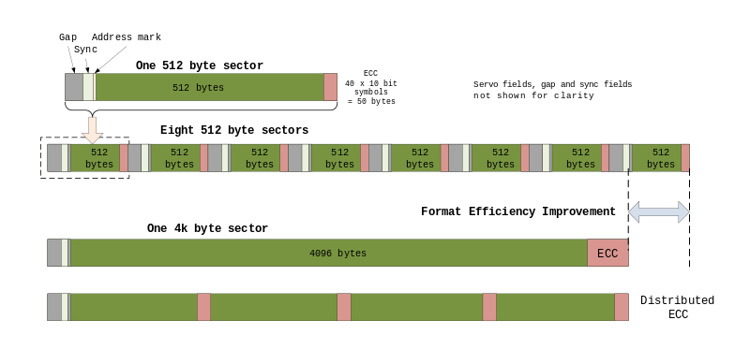
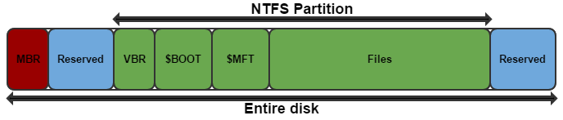
What defines a file
Metadata and File Attributes(data)

Slide 11
Example Machine
Windows 10 x64
Basic files and examples
Laptop loaded with Autopsy/Sleuth Kit

Slide 12
View before Anti-Forensics
Open up in Autopsy
Look at Downloads, Internet History, Temp files, etc.
Logs
\Windows\System32\winevt\Logs\

Slide 13
Extremely Basic Mitigation Techniques
Transmogrification - File type mismatch
MACE
Modified - the last write
Accessed - the last read
Created - the file’s creation date
Entry - the last time the MFT entry was updated
Slack space
Steganography
Hash Collisions
Logs

Slide 14
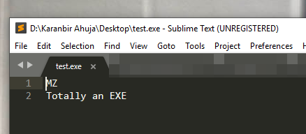
Transmogrification
Easy to Manipulate Files
Can also be easily thwarted with manual analysis or autopsy scanning tools.
Can also do a one byte edit to thwart EnCase and Hash matching tools.
Notes:
Notepad.exe
MZ Totally a .exe Save as test.exe Will show up as a .exe due to the file header.

Slide 15
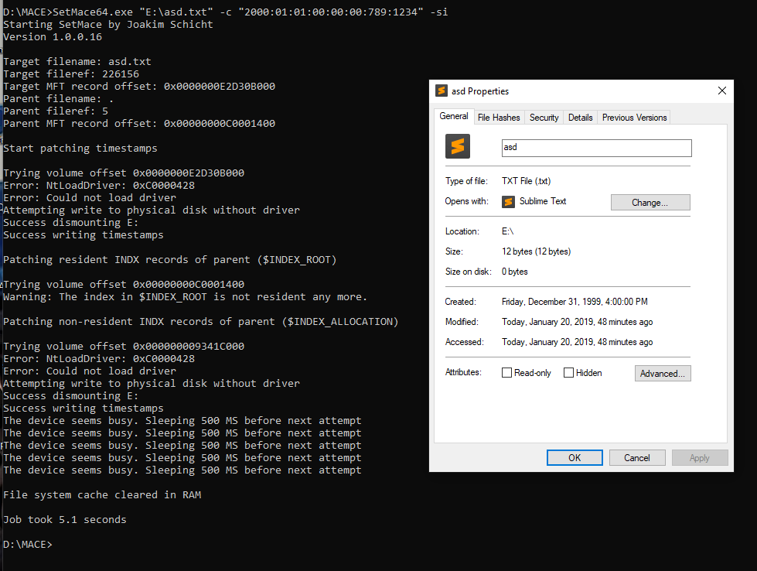
MACE
Must be on another
Drive to use some
Programs that
Alter MACE.

Slide 16
SLACK Space
Hide files in slack space.
Slacker used to exist and could use multiple slack spaces.

Slide 17
Stego
Hide data in other files
Text in a photo
Only visible via stego. Programs
Can be encrypted to data is harder/impossible to recover without the password

Slide 18
Hash Collisions
Extremely rare
Takes advantage of exploits in the MD5 hashing system
Will not stand up past a minor glance
This also takes a million years to compute

Slide 19
Logs
Everything is logged.
Logs can be wiped fairly easily in most Operating Systems.
Multiple tools to wipe logs.

Slide 20
Windows stores too much information
Registry
Event logs
Cortana
Appdata
Indexing
Windows Store
Browser Data
Email
Unified Communication
Twitter
Apps
Programs
Office
Skype
OneDrive
Maps

Slide 21
Free Space and Disk
Wipe unallocated Space
Cipher.exe
Ccleaner has a function built in
Nuke the Hard Drive because you’re paranoid
DBAN
DD

