Slide 1
That one time you want to get writers block
A crash course to Digital Forensics
Karanbir Singh Ahuja
Incident Response Consultant Forensic Lab Manager

Slide 2
About me
Incident Response Consultant at BlackBerry | Cylance.
Forensic Lab Manager for the global Incident Response Practice.
DevOps, Infrastructure Management, Compromise Assessments, Incident Response
Ex-Kaiser E-Discovery/Internal Investigations
WRCCDC Black Team Member
Red Team Liaison, Infrastructure, Memes

Slide 3
What is Digital Forensics
“Recovery and Investigation of data found on Electronic Devices.”
Phones, Tablets, Laptops/Desktops, Drones, Cameras, etc.
Tons of oversight is needed to keep evidence untainted.
Findings are presented in a court of law or handed directly to a client.
Possibly handed off to E-Discovery Specialists
Writing these sucks. Pay attention in English
This is how you’re actually supposed to CSI:Miami.

Slide 4
Forensic Process
Seizure
Imaging
Analysis
Timelining
Report and Impact

Slide 5
Seizure
Machine may be imaged or sent directly to the lab
Warrants most likely will be needed if this is a legal case.
On-Site Imaging and Analysis
Chain of Custody and proper storage procedures
Load up on evidence bags and have a nice camera

Slide 6

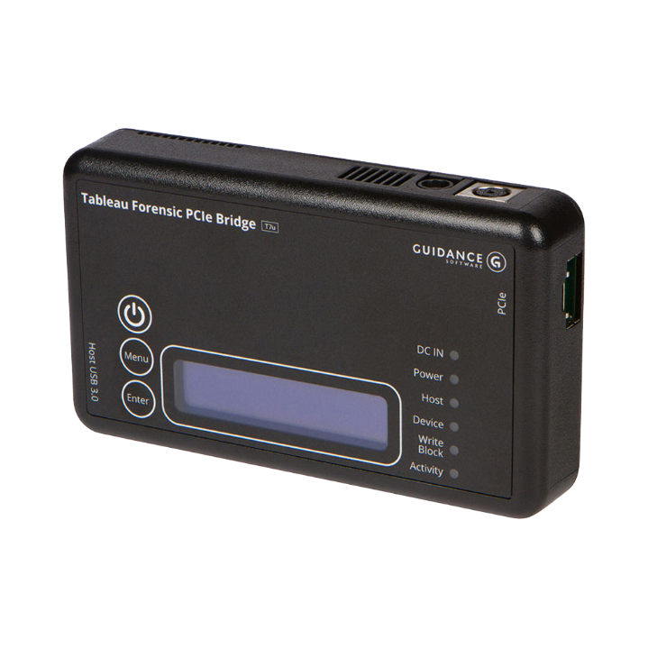
Imaging
Imaged via Write Blocker
Pre-made image provided by a client
Myriad of file types
.E01
.AFF
.RAW
Etc
Copy thrice, analyze the copy.

Slide 7
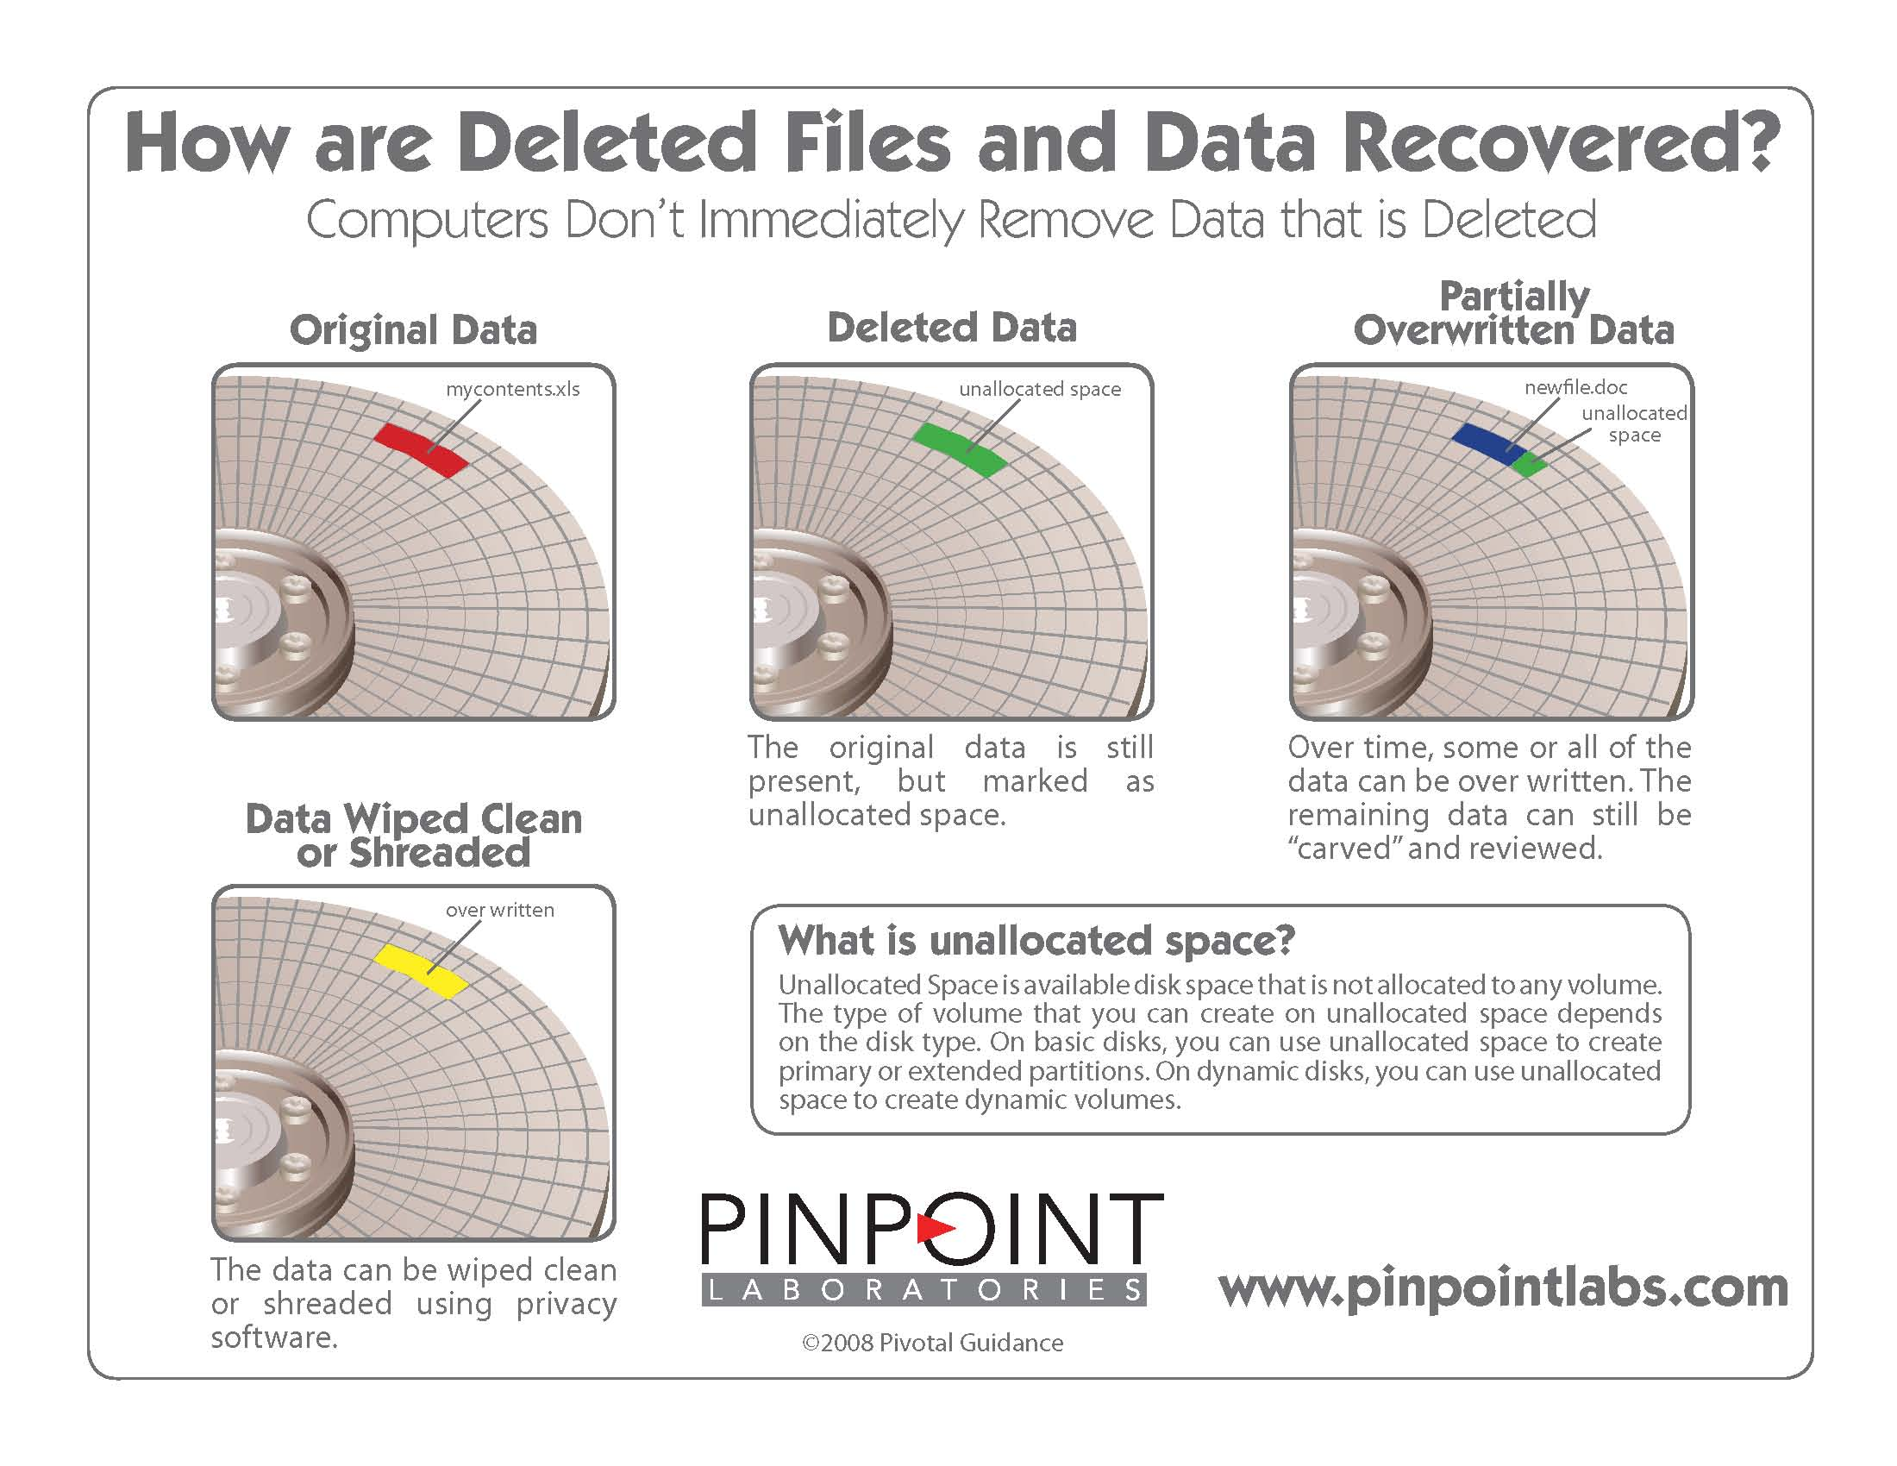
Analysis
Image tossed through software of choice
AXIOM, EnCase, FTK, X-Ways, Autopsy, etc
Findings must be verified by another tool and/or the tool true to it’s findings
Many hours spent screaming at the mismash of hex that can be seen
Files may have to be manually carved out

Slide 8
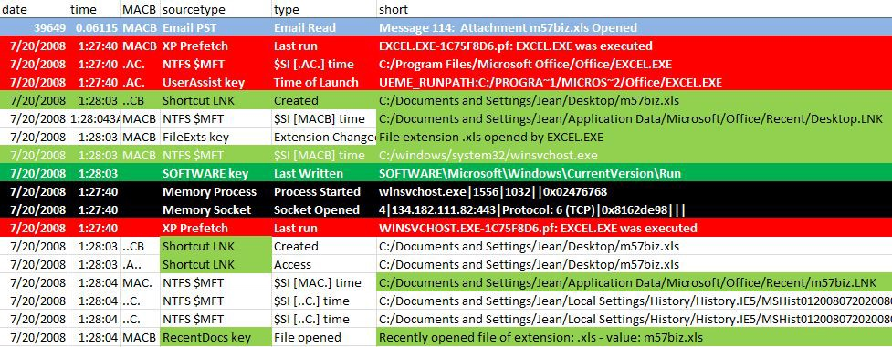
Timelining
Million line excel file made
PDF, HTML, etc also seen
Event logs, User Activity, etc
Certain events may be highlighted based on importance
Possible Exfiltration of data
Corporate Espionage

Slide 9
Report and Impact
Details exactly what the user/theat actor did.
Details impact on the organization as a whole if possible.
Contains future mitigation steps.
Report Generally consists of
Table of Contents
Executive Summary
Technical Analysis
Recommendations (if applicable)
Appendix

Slide 10
Thank you
Questions and Answers

Slide 11
Thank you
/in/ksahuja @Turb0Yoda

