Slide 1
Alice Through the Write Blocker
The Essentials of Digital Forensics
Karanbir Singh Ahuja Forensics Lab Manager | Incident Response Consultant
Notes:
IDK ramble on here

Slide 2
SAFE HARBOR
The information in this presentation is confidential and proprietary to Cylance® and may not be disclosed without the permission of Cylance. This presentation is not subject to your license agreement or any other service or subscription agreement with Cylance. Cylance has no obligation to pursue any course of business outlined in this document or any related presentation, or to develop or release any functionality mentioned therein.
This document, or any related presentation and Cylance's strategy and possible future development, product, and/or platform direction and functionality are all subject to change and may be changed by Cylance at any time for any reason without notice. The information on this document is not a commitment, promise, or legal obligation to deliver any material, code, or functionality. This document is for informational purposes and may not be incorporated into a contract. Cylance assumes no responsibility for errors or omissions in this document.
Notes:
This won’t matter for the purposes of this video but it makes me feel more professional.

Slide 3
Forensic Lab Manager
DevOps
Nothing goes here due to risk of imprisonment
Make code make other code because I'm lazy
Incident Response
Digital Forensics
Manage panicked clients while also panicking yourself
I swear I didn't see anything here OK?
Notes:
A vague overview of what I do, then transition into IR/Consulting, where you can rant about communication.

Slide 4
What is Digital Forensics?
Lots of numbers

Slide 5
“Recovery and Investigation of data found on Electronic Devices.”
Phones, Tablets, Laptops/Desktops, Drones, Cameras, etc.
Notes:
This slide shouldn’t contain more text than currently presented.

Slide 6
Oh yeah… and lots of writing
Tons of oversight is needed to keep evidence untainted.
Findings are presented in a court of law or handed directly to a client.
Possibly handed off to E-Discovery Specialists
Writing these sucks. Pay attention in English
This is how you’re actually supposed to CSI:Miami.

Slide 7
Why do we forensicate the things?
Data infiltration and exfiltration
Insider Threat
Sell to the highest bidder
Use as leverage to swap into another role
Criminal Offenses
The cool TV show stuff like murder
Incident Response (rarely)
primarily Ransomware Operators
Conti, Lockbit 2.0, Revil/Sodinokibi

Slide 8





The Laboratory
No Science Experiments here.
Security is Key
No one touches my Evidence
Secure Location
Controlled Access
Evidence Safe(s)
Encryption at Rest
Tooling
Hardware
Forensic Software
Live Acquisition
Forensic Workstations
Write Blockers

Slide 9
Forensic Process
Seizure
Imaging
Analysis
Timelining
Report & Impact
Activity | Description
Image Machines / Send to Lab | Warrants will most likely be needed if this is a legal case and involving personal devices
On-Site Imaging and Analysis | Pack your bags to a corporate office we go Mobile Toolkit needed
Chain of Custody & Proper Storage Procedures | Load up on evidence bags Have a nice camera Don’t let evidence leave your sight

Slide 10
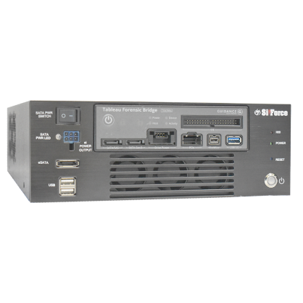
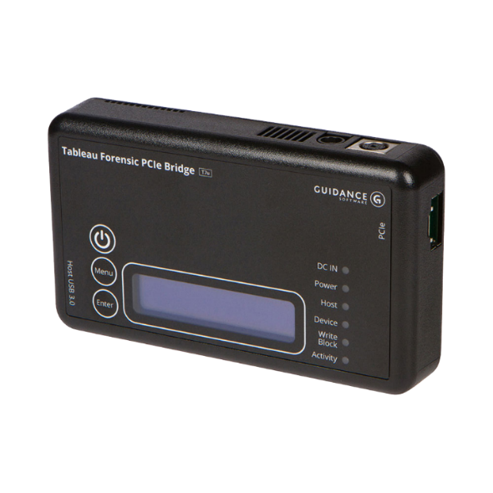
Forensic Process
Seizure
Imaging
Analysis
Timelining
Report & Impact
Imaged with a Write Blocker
OR Pre-made image provided by a client
Live imaging if the drive is soldered on
Myriad of File Types
.E01, .RAW, .AFF
Copy thrice, then analyze the data

Slide 11
Forensic Process
Seizure
Imaging
Analysis
Timelining
Report & Impact
Image tossed through software of chouse
AXIOM, EnCase, FTK, X-Ways, Autopsy/TSK, etc
Findings must be verified by another tool and/or the tool true to it’s findings
In-depth analysis may need to be done if tasks such as anti-forensics were carried out
Deleting userdata, event logs, timestomping, etc
This is when dead disk forensics comes in handy in Incident Response cases.
Files may have to be manually carved out

Slide 12
Forensic Process
Seizure
Imaging
Analysis
Timelining
Report & Impact
Different cases will require different approaches
Incident Response will focus first on technical artifacts
Event Logs(security, networking firewall, remote access), Shimcache & amcache, etc
E-Discovery cases will focus first on user actions
Shellbags, Web History, USNJRNL, Jump Lists, etc
These lists are mutually exclusive- all are looked at in a case but the order of operations may change

Slide 13
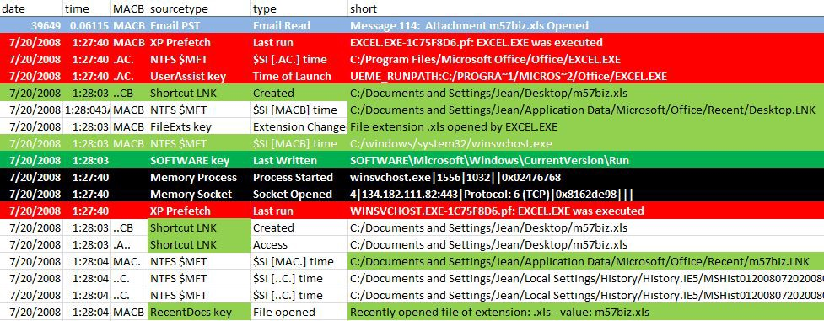
Forensic Process
Seizure
Imaging
Analysis
Timelining
Report & Impact
Million line excel file made
PDF, HTML, etc
Event Logs, User Activity, etc
Certain events may be highlighted based on importance or event type

Slide 14



Forensic Process
Seizure
Imaging
Analysis
Timelining
Report & Impact
Details what the user/threat actor did
Report Format:
Table of Contents Executive Summary Technical Analysis Recommendations (if applicable) Appendix
Details impact on the organization as a whole
Contains future mitigation steps

Slide 15
Notes:
Revert back to old layout

