Slide 1
Truth is Seldom so Pretty as Myth and Legend
Karanbir “K” Singh
Theoretically a Forensics Expert
Notes:
IDK ramble on here

Slide 2
SAFE HARBOR
The information in this presentation is confidential and proprietary to Cylance® and may not be disclosed without the permission of Cylance. This presentation is not subject to your license agreement or any other service or subscription agreement with Cylance. Cylance has no obligation to pursue any course of business outlined in this document or any related presentation, or to develop or release any functionality mentioned therein.
This document, or any related presentation and Cylance's strategy and possible future development, product, and/or platform direction and functionality are all subject to change and may be changed by Cylance at any time for any reason without notice. The information on this document is not a commitment, promise, or legal obligation to deliver any material, code, or functionality. This document is for informational purposes and may not be incorporated into a contract. Cylance assumes no responsibility for errors or omissions in this document.
Notes:
This won’t matter for the purposes of this video but it makes me feel more professional.

Slide 3
About_me.md
2018
E-Disco | Internal Investigations
Kaiser Permanente
2019
Graduation
CPP (BYE)
2019
Incident Response
Cylance
Right Now
One-Man Army
Blackberry | Cylance
Notes:
I was vaguely involved with everything that happened in the CBA/CIS department

Slide 4
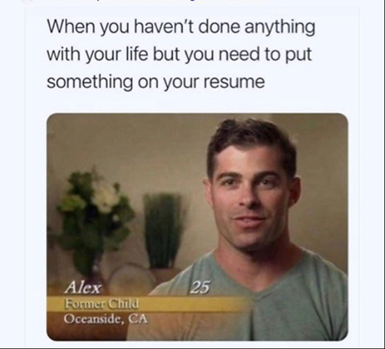
Myths and Legends
"All you need are good grades."
Only works in grade school
A sort of legacy teaching is that all you need is a solid GPA in order to get a well-paying or fulfilling job. This however, tends to rarely pay out, as employers tend to look for something that is out of the norm.
Notes:
There seems to be an old-school mindset that is still somewhat prevalent. A lot of parents and even those who have graduated say that the only thing that matters are grades. However, when looking at a job application, a recruiter needs something more than just “I did good in class”. They need to know that you have the skills to actually start off in the job with minimal training. It’s a corporate thing since the less money they spend on training you the better for the company to make more money.

Slide 5
Standing Out
The 50/50 rule

Slide 6
And no... not the slater's 50/50 rule
Trust me I'm hungry as well
Notes:
This slide shouldn’t contain more text than currently presented.

Slide 7
Dr. Dan Manson
CPP Professor Emeritus
The 50/50 Rule
Spend 50% of your time in class, and 50% doing your extracurriculars. This is what makes you stand out from the rest.
Notes:
This slide is pretty self explanatory

Slide 8
So what are extracurriculars?
Clubs, Competitions, Events, Organizations, Volunteering, Athletic Teams, etc.
They all stand out when applying to jobs.
Notes:
Almost anything outside of classes will look good to an employer. They want to see you do more than just a college student who is there only to have the degree on their application when they apply. They need to know they’re hiring a “go-getter”. You don’t necessarily have to excel or lead something, although the more you do/get involved in/accomplish, the greater the benefits you’ll have.

Slide 9






Competitions
#Biased for some of these
Notes:
These are some of the competitions that happen at CPP. Give vague story about CCDC. Note that they don’t have to be on a “winning team”, but even participation in the competitions is insanely great. Even if they don’t make the team, the training done for say, CCDC and CPTC can end up in a skills section on the resume. The same applies for the other competitions.

Slide 10




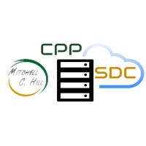

Organizations
#Biased for some of these
Notes:
These are all “great” I can sphiel for like 30 min

Slide 11



Organizations
What you thought I was done?
Notes:
These organizations outside of school are prime for networking. This is how you make industry connections which you can leverage to get a job. Honestly though, the food alone is worth it from what I hear, and it’s cheap/free as students so take advantage of that.

Slide 12
You’ve graduated!
Now what the hell do you do for work?

Slide 13
Forensic Lab Manager
DevOps
Nothing goes here due to risk of imprisonment
Make code make other code because I'm lazy
Incident Response
Digital Forensics
Manage panicked clients while also panicking yourself
I swear I didn't see anything here OK?
Notes:
A vague overview of what I do, then transition into IR/Consulting, where you can rant about communication.

Slide 14
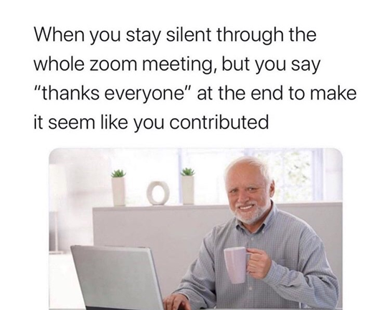
Consulting
People skills are more important than you think – interacting with clients is the number one priority, more important than any technical skills.
Notes:
Client Communication is key. One has to communicate clearly and effectively. Emails or zoom/webex/etc are the current gold standard, with a heavy reliance on emails since they provide a paper trail. Instant Messaging(slack,teams, etc) are more commonplace on internal communications.
Jenna's note: you gotta be able to hold a conversation homie – you gotta know how to parking lot questions, take back and look into those requests (even if you know they're not possible), and not lose your mind when you client has forgotten what they ask for... again. DON'T FORGET ABOUT EXPLAINING SOMETHING THAT YOU JUST SENT A DETAILED EMAIL ABOUT. PEOPLE DON'T READ THEIR EMAILS.

Slide 15
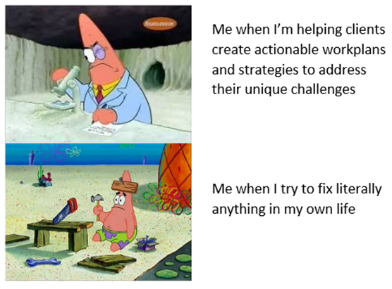
The truth and nothing but the truth
At the same time, one can’t overstep or mis-say something without a storm brewing up.
Notes:
Talk about being an expert witness. You can’t lie to your audience or they will pin you to the wall for it.

Slide 16
Notes:
Revert back to old layout

