Slide 1

turbatop
the GPU-fleet efficiency cockpit — in your terminal
A xtop-style TUI that shows what's wasted, what's about to break, and what to do, over SSH, with no browser.
$./turbatop --api-url …
turbalance Analytics · operator surface · read-only v1

Slide 2
> THE NEED
Operators live in the terminal — not the browser
SSH is the office
Air-gapped
Engineers debugging a cluster are in tmux over SSH, not flipping to a browser tab. The cockpit has to be where they already are.
Gov, defense, and sovereign GPU clouds can't send telemetry to a vendor SaaS or open a browser to one. They need a local, offline tool.
Neocloud density
Quick truth
GPU providers run thousands of hosts; a fast keyboard-driven terminal sweep beats waiting on a heavy web page.
“Is anything on fire and what do I do?” should be one command and two seconds — no login, no dashboard load.
turbatop · turbalance Analytics · Confidential
01

Slide 3
> WHAT IT IS
A read-only terminal cockpit over the product API
xtop-style TUI: neon borders, gradient gauges, colored sparklines, live refresh
Answers the operator's three questions at a glance:
• What is wasted?
• What is likely to break?
• What should I inspect next?
Four pages: Overview · Hosts · Signals · Ops — keyboard or mouse driven
Shows the same diagnose → predict → prescribe loop as the web cockpit
Same brain, new surface
turbatop is a thin client — it renders the existing analytics, predictive warnings, prescribed actions, and verified-savings ledger. No new analytics, no separate truth.
Deliberately read-only (v1)
It surfaces and explains; it does not mutate the fleet. Remediation stays gated behind the action-connector workflow. Safe to hand to anyone with API read access.
turbatop · turbalance Analytics · Confidential
02

Slide 4
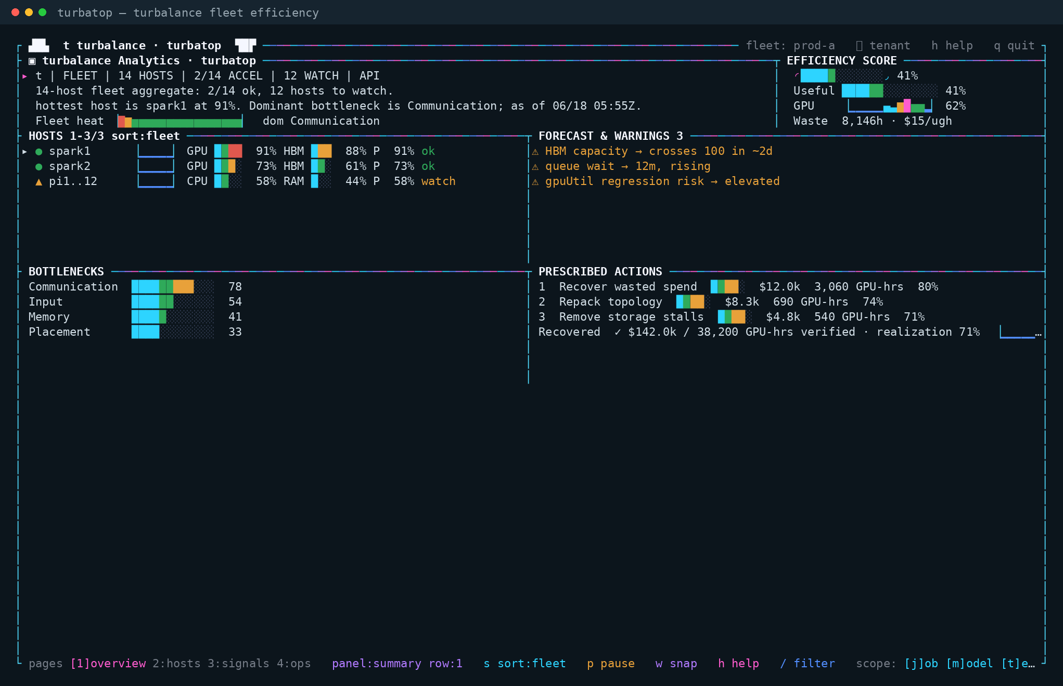
> LIVE VIEW
Overview — the whole loop on one screen
Efficiency at a glance
GPU vs useful-compute gauges and a fleet heat strip up top.
Predict + prescribe
Saturation ETAs and ranked $ / GPU-hour actions, right in the terminal.
Proof built in
The verified-savings line shows recovered $ and realization rate.
turbatop overview: efficiency score, fleet heat, hosts, forecast & warnings, prescribed actions, verified savings.
turbatop · turbalance Analytics · Confidential
03

Slide 5
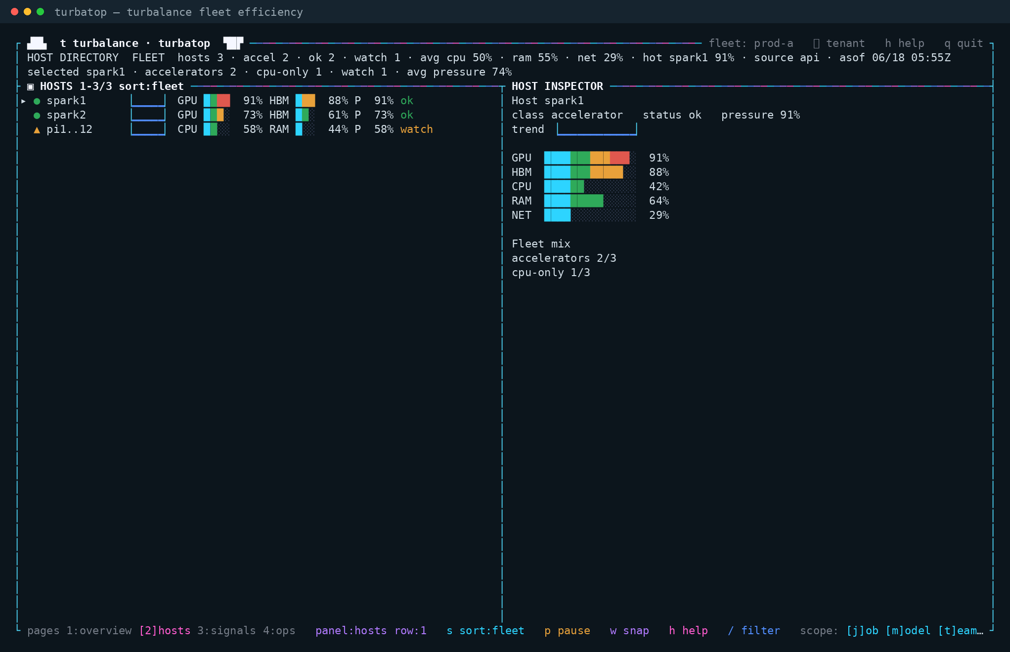
> LIVE VIEW
Hosts — directory + per-host inspector
Fast triage
Sort by pressure/GPU/status; the hottest host floats up.
Drill in
Per-host gauges and trend without leaving the keyboard.
Fleet mix
Accelerator vs CPU-only split at a glance.
Hosts page: selectable host directory with a live GPU/HBM/CPU/RAM/NET inspector.
turbatop · turbalance Analytics · Confidential
04

Slide 6
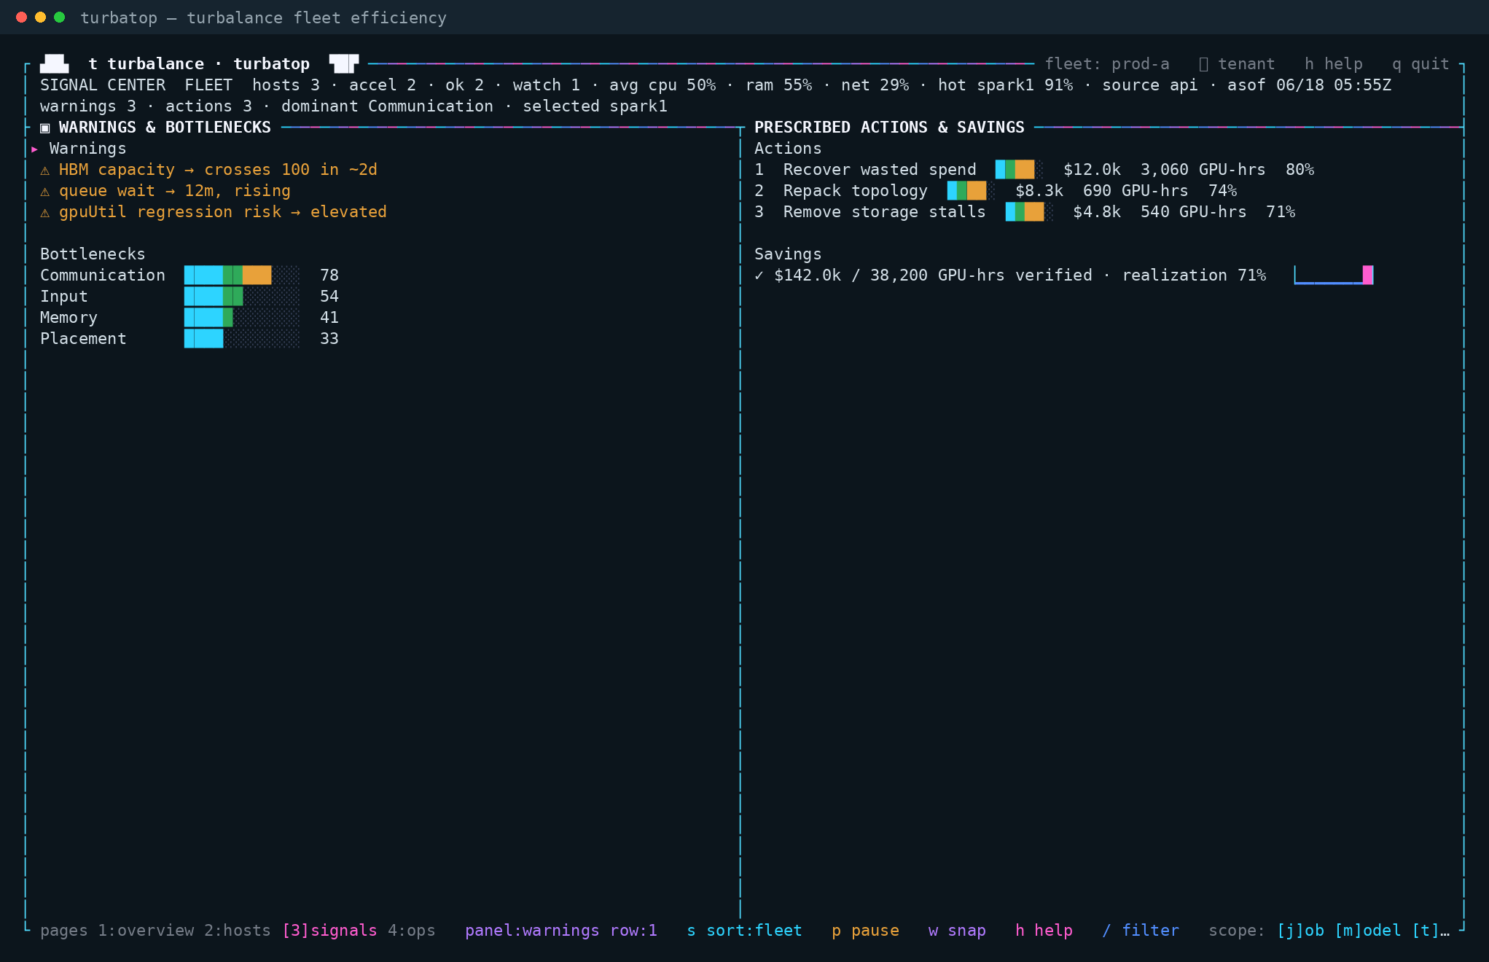
> LIVE VIEW
Signals — warnings, actions & savings
Early warning
“HBM crosses 100 in ~2d”, rising queue wait, regression risk.
What to do
Ranked actions with impact, GPU-hours, and confidence.
Banked outcome
Verified $142k / 38,200 GPU-hrs · realization 71%.
Signals page: forecast warnings and bottlenecks beside prescribed actions and the savings ledger.
turbatop · turbalance Analytics · Confidential
05

Slide 7
> BENEFITS
Why it earns a place in the operator's toolkit
Zero browser
Air-gapped ready
One static file
Runs over SSH in any terminal; no web stack, no port-forwarding.
Talks only to the configured API — no outbound calls, no telemetry leaves.
Single zipapp/binary, no third-party deps; scp it and run on Python 3.
Same loop, same truth
Fast & live
Beautiful & legible
Renders the existing engine: diagnose → predict → prescribe → prove.
Sub-second refresh, keyboard + mouse, sortable, filterable, paged.
btop-style gauges and sparklines; honors NO_COLOR and small terminals.
turbatop · turbalance Analytics · Confidential
06

Slide 8
> WHY IT MATTERS
A surface — and a wedge — the incumbents don't have
Reaches deployments SaaS dashboards structurally can't: air-gapped, sovereign, on-prem, neocloud edge
Reinforces the bare-metal / single-binary distribution story
Puts the prescriptive action plan + verified savings where operators actually work
Elite developer-marketing: a beautiful TUI travels (HN / Reddit / X), cheap top-of-funnel for technical buyers
Low marginal cost: a thin client over the existing API — no new analytics to maintain
The one-liner
“The only GPU-efficiency tool that shows you what's wasted, what's about to break, and what to do — and proves the recovery — right in your terminal, even air-gapped.”
Datadog, Cast AI, and Kubecost are browser SaaS. NVIDIA's tooling isn't this. turbatop is.
turbatop · turbalance Analytics · Confidential
07

Slide 9
> HOW IT WORKS
Thin, safe, and deterministic
Thin client
Read-only
Reads the product API (summary, opportunities, predictive warnings, savings). Caches between refreshes; keeps the last good frame on error.
Never mutates the fleet in v1. Honors the API's tenant/RBAC scoping with --token.
Resilient
Deterministic
Degrades gracefully on API errors, empty data, tiny terminals, and NO_COLOR — never crashes.
--fixture + --once render one frame for screenshots and golden-frame tests in CI.
Pages: 1 overview · 2 hosts · 3 signals · 4 ops Keys: q quit · r refresh · p pause · / filter · w snapshot · h help
$ python3 cli/turbatop/turbatop.py --api-url http://192.168.10.30:8080 --token "$TURBA_TOKEN"
turbatop · turbalance Analytics · Confidential
08

Slide 10
> DISTRIBUTION
Ship it like a binary, run it anywhere
1 Build
2 Copy
3 Run
make turbatop → a single zipapp/binary with no third-party deps.
scp turbatop user@gpu-host — one file, no install, works offline.
./turbatop --api-url … --token … against HTTP or the self-signed HTTPS edge (--insecure).
Built for the hard environments
linux amd64 + arm64 (the Pi fleet is arm64). No browser, no daemon, no outbound network beyond the configured API. The same tool a neocloud SRE, a sovereign-cloud operator, and a laptop debugging a pilot all run — which is exactly where browser SaaS can't go.
turbatop · turbalance Analytics · Confidential
09

Slide 11
turbatop
The cockpit goes where the operator goes.
Wasted, predicted, prescribed, and proven — over SSH, air-gapped, in one keystroke.
$ ./turbatop --api-url http://your-fleet:8080
Link to the repo. Review it, Fork it, Hack it, and Make it yours!
https://github.com/ahmadexp-turba/Analytics/tree/main/cli/turbatop
turbalance Analytics · Confidential

