Slide 1
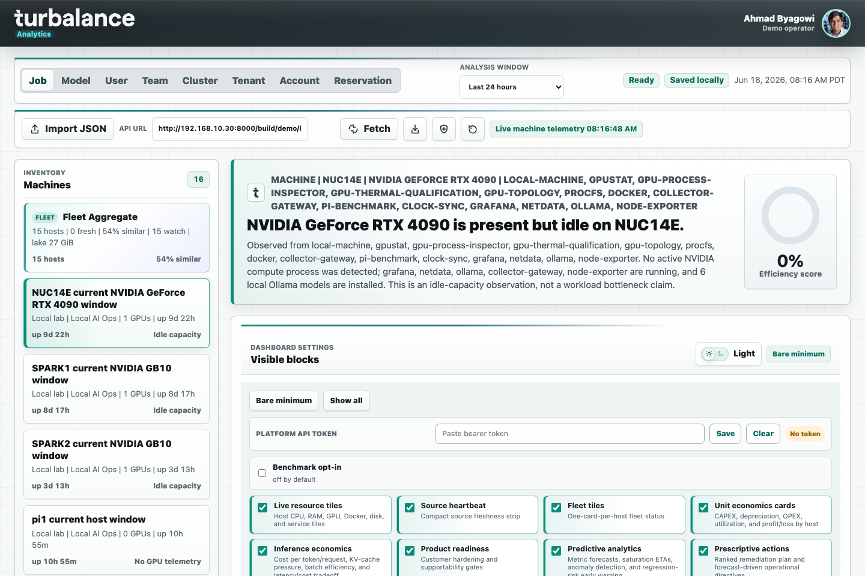
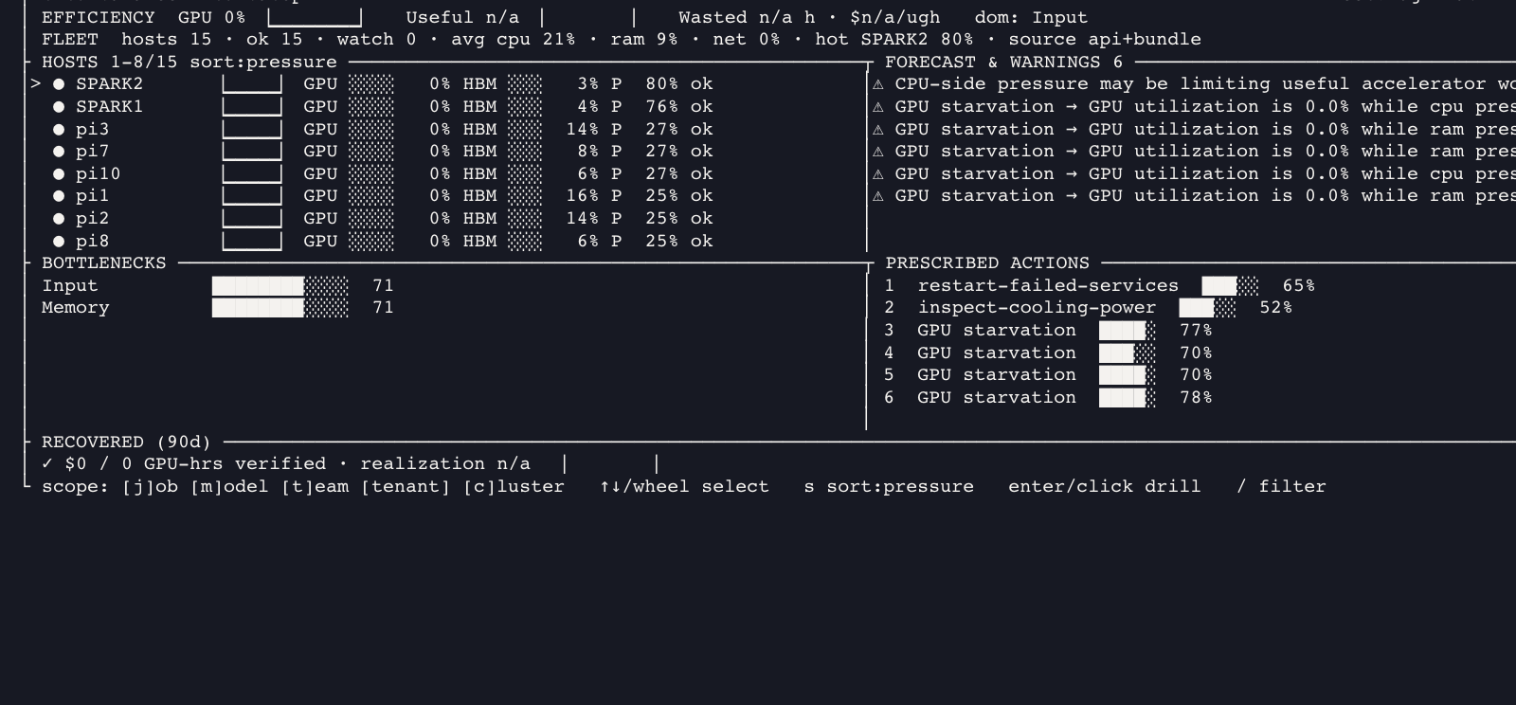
turbalance
Analytics
Current product appliance
Live browser cockpit, mouse-enabled terminal UI, secured collector/API edge, Grafana/Prometheus runtime, SPARK + Pi fleet rollout, and lakehouse production lane.
NUC14E
15+
web + TUI
controller-centered pilot
fleet hosts observed
operator surfaces
Updated Jun 18, 2026 · 1/8

Slide 2
TURBALANCE ANALYTICS
Operator surfaces are now connected
The same appliance data is visible through browser, terminal, API, observability, support, and release workflows.
Live dashboard
Product API
Observability
Profile-aware topbar, host bootstrap, fleet cards, unit economics, predictive and prescriptive panels, System ID, Benchmark Ladder, and evidence packs.
Bearer-auth product API on :8080 plus HTTPS edge path. Prometheus uses a mounted viewer token for protected metrics.
Grafana and Prometheus runtime stack with handoff URLs, target checks, dashboard coverage, and doctor validation.
turbatop
Collector edge
Support and release
Dependency-free Python zipapp for SSH: mouse controls, keyboard controls, pressure sorting, live bundle fallback, token-file auth, and no browser requirement.
Internal collector bearer+HMAC path on :8801 and mTLS collector edge on :9443 for customer-facing ingestion.
Redacted support bundles, release packages, rollback state, doctor checks, and sync/rebuild paths for NUC, SPARK, and Pi machines.
Updated Jun 18, 2026 · 2/8

Slide 3
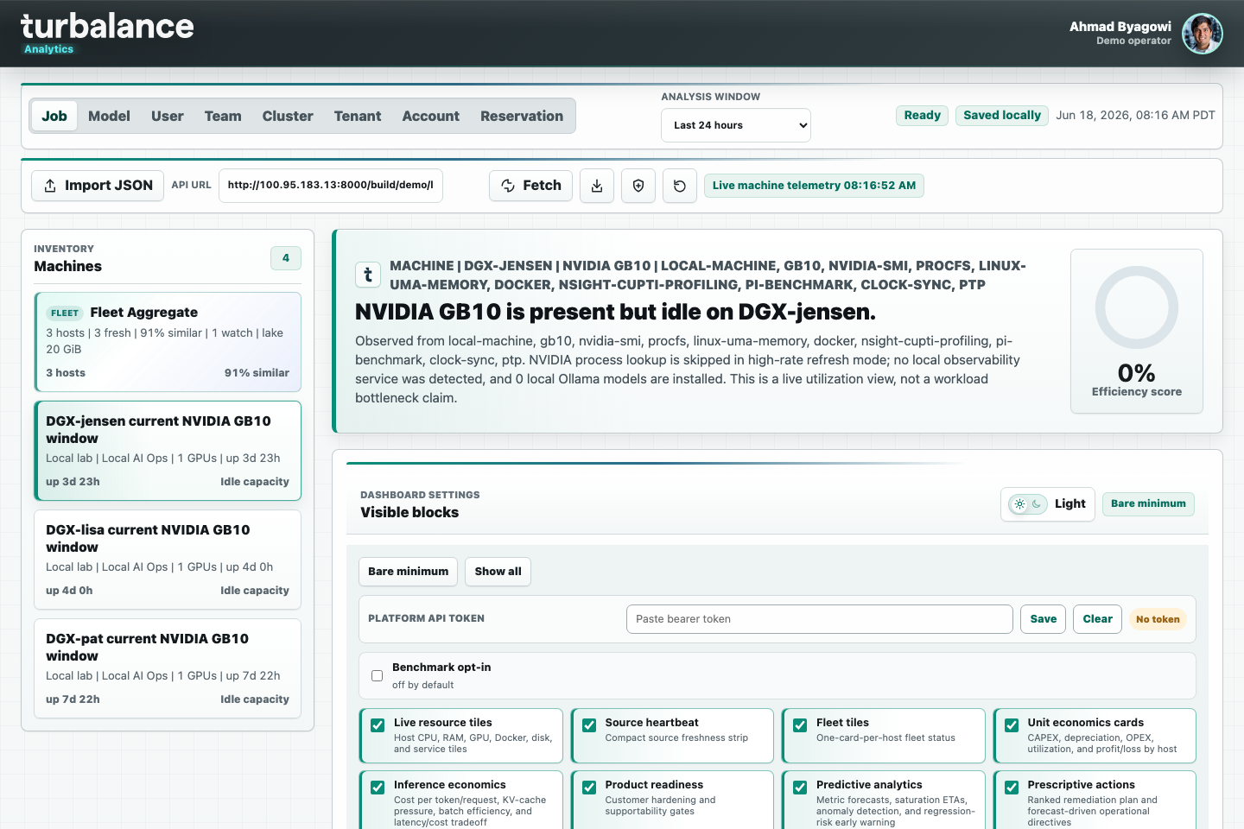
TURBALANCE ANALYTICS
Browser cockpit: live and profile-aware
README screenshots refreshed from the live NUC14E and NUC15 dashboard endpoints.
live host bootstrap
visible blocks
profile topbar
multi-machine bundles
Updated Jun 18, 2026 · 3/8

Slide 4
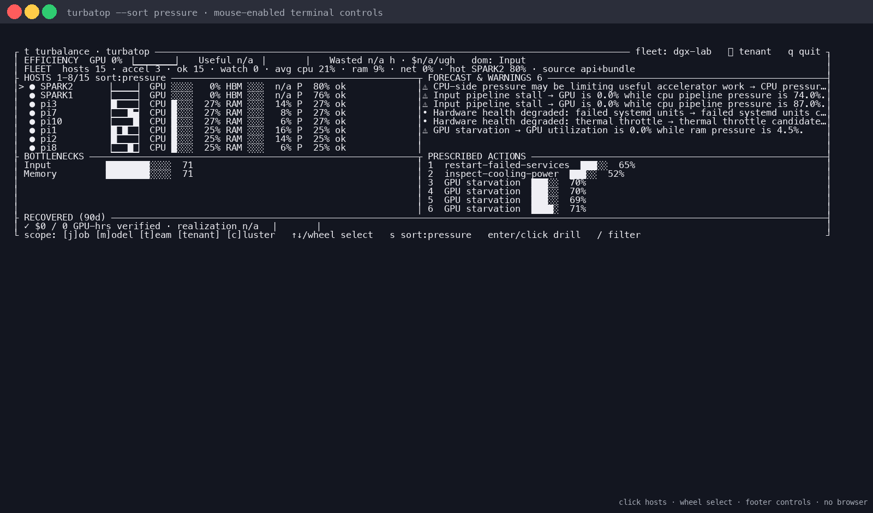
turbatop terminal UI
Mouse-enabled operator view for SSH, air-gapped labs, and fast incident checks.
Mouse controls
Click a host to select, click again or right-click to drill in, use the wheel to move selection, and click footer/header controls for sort, scope, filter, refresh, and quit.
Fleet-aware rendering
Summary strip, natural host ordering, scroll-aware ranges, pressure/GPU/CPU/RAM/network/status sorts, trend sparklines, and confidence gauges.
Graceful operations
Read-only API client, token-file support, live-bundle fallback when auth/host rows fail, tiny-terminal message, NO_COLOR, --once snapshots, and --no-mouse opt-out.
Updated Jun 18, 2026 · 4/8

Slide 5
TURBALANCE ANALYTICS
Bare-metal appliance architecture
One controller coordinates telemetry, API, dashboard, observability, support bundles, and fleet agent rollout.
SPARK1 / SPARK2
Collector gateway
:8801 + HMAC
Parquet / DuckDB
Live agents
Dashboard + turbatop
pi1..pi12
mTLS edge
:9443
Product API
:8080
Runtime services are managed by user systemd on NUC14E with lingering enabled.
SPARK and Pi source copies are synced without service restarts for TUI-only changes.
Grafana/Prometheus and product edge run as runtime containers.
Updated Jun 18, 2026 · 5/8

Slide 6
TURBALANCE ANALYTICS
Security and productization gates are explicit
Secrets, collector ingress, support bundles, and audit checks are first-class release material.
Auth and secret files
Support bundles
Credential rotation note
API auth uses generated token files; collector bearer and HMAC secrets are loaded from files rather than command-line values.
Redacted archives include diagnostics and remote checks while excluding generated secrets and TLS material.
History rewrites do not neutralize leaked material outside this repo. Rotation remains the true close-out for exposed bearer/HMAC/queue credentials.
mTLS collector edge
Audit integrity
Operator boundary
HTTPS edge on :8443 and collector mTLS edge on :9443 separate browser/API traffic from customer-ingest traffic.
Productization phase tests validate the turbatop build/docs, security posture docs, release paths, and phase gates.
The UI marks demo/live state, workspace exports carry data-boundary metadata, and production flows require validated bundles or API feeds.
Updated Jun 18, 2026 · 6/8

Slide 7
TURBALANCE ANALYTICS
Lakehouse and OCP lane remain connected
The appliance is the pilot surface; durable platform and benchmark-governance paths stay alive.
Lakehouse platform
Production Kubernetes
OCP Benchmark Commons
Collector gateway, queue/spool, raw writer, partitioned Parquet lake, DuckDB query service, transforms, alert engine, API, and Dagster checks.
Managed storage, metadata DB, ExternalSecret bindings, SPIRE/external-CA modes, OpenTelemetry, image signing, and go-live gates.
L6 export/import boundary for member-governed cross-hardware comparison with redacted turba.ocp_benchmark_commons.v1 payloads.
eBPF
Redfish/BMC
NCCL traces
provider SLO/billing
scheduler/admission
Grafana handoff
The result is one product story: evidence comes from real machines, survives into durable analytics, and can be packaged for customer pilots or community benchmark governance.
Updated Jun 18, 2026 · 7/8

Slide 8
TURBALANCE ANALYTICS
Runbook: current operator commands
Browser, terminal, validation, security, rollout, and support flows are documented in one place.
Dashboard
python3 -m http.server 8000
turbatop
make turbatop
./build/turbatop/turbatop --api-url http://192.168.10.30:8080 --sort pressure
Validation
node tests/run-all.js
node tests/productization-phases.test.js
Doctor
ssh user@192.168.10.30 'cd /home/user/turbalance-analytics && node scripts/turbalance-doctor.js --config ops/turbalance-product.example.json'
Primary references: README.md, docs/customer-productization.md, docs/turbatop.md, docs/lakehouse-operations.md, docs/security-compliance-posture.md.
Updated Jun 18, 2026 · 8/8

