Slide 1

Home Security System using IOT
-RP 9002 Team 90

Slide 2

IoT Home Security Project: Secure Your Home
Traditional home security systems are often costly, lack real-time monitoring, and cannot distinguish between authorized and unauthorized individuals. Manual intervention increases delays and errors.
Proposed Solution: An AI-powered, cost-effective, and automated home security system using IoT, AI, and Cloud technologies that:
1. Detects intruders in real-time 2. Differentiates authorized and unauthorized individuals using facial recognition
3. Sends instant alerts to homeowners 4. Stores video footage securely in the cloud 5. Enables remote monitoring through a mobile app or web dashboard
6. Detects smoke and fire to prevent hazards

Slide 3
User Classes and Characteristics
Homeowners
Primary users of the system.
They monitor security footage and manage known faces.
Specifically, Nuclear families with kids, frequent travelers, specially-abled people.
System Administrators
Responsible for maintaining the face recognition database.
They ensure system security and manage device configurations.
Guests/Visitors
Individuals detected by the system but not in the known face database.
They may be added to the system if authorized by the homeowner.

Slide 4
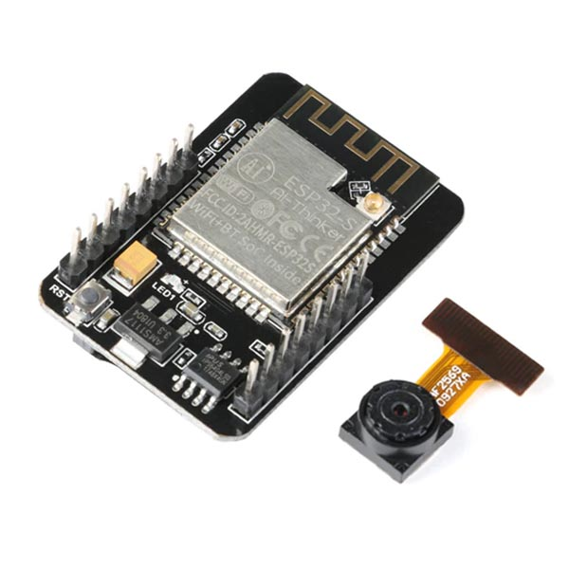
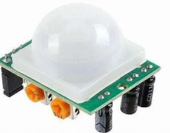
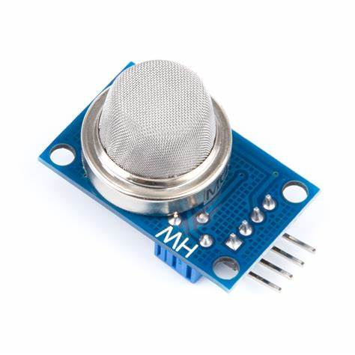
Core Components of Hardware: ESP32-CAM & Sensors
ESP32-CAM
The ESP32-CAM is a low-cost camera module with integrated Wi-Fi and Bluetooth capabilities.
It is ideal for IoT applications, enabling real-time
video streaming and image capture.
Sensor Suite
The sensor suite includes various components such as smoke detectors, fire detectors and motion sensors.
These sensors enhance the security
system by providing critical environmental
data and alerts.

Slide 5



Software modules: OpenCV & face_recognition
OpenCV Features
OpenCV is an open-source library designed for real-time computer vision applications.
It provides tools for image processing, video analysis, and face detection.
Face Recognition Techniques
The face_recognition module utilizes dlib for accurate face landmarking.
It generates face embeddings to facilitate quick and reliable identification of individuals.

Slide 6
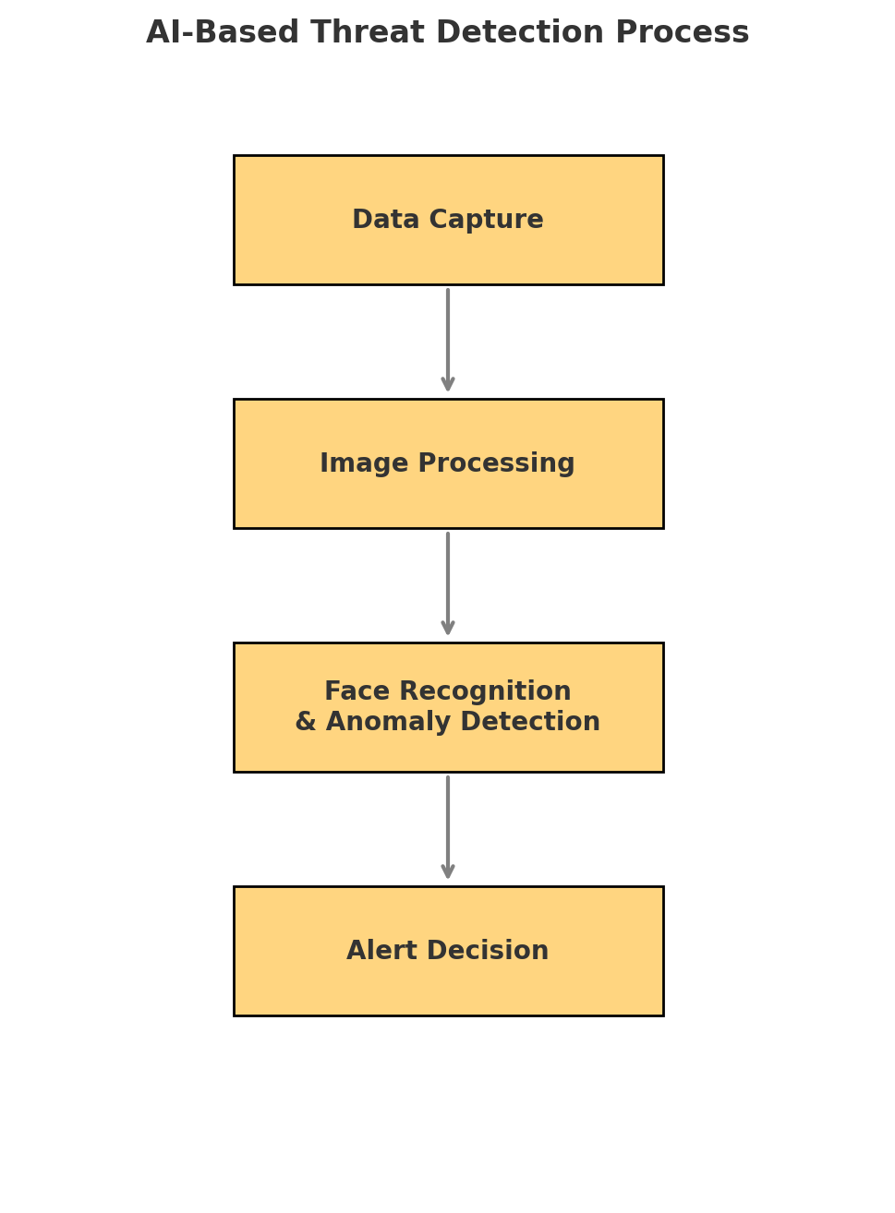
AI-Based Threat Detection Process
Data Capture:
Sensors and cameras capture real- time data.
Image Processing:
Extracts features and pre-processes the data.
Face Recognition and Anomaly Detection:
Identifies authorized and unauthorized individuals.
Alert Detection:
Triggers the appropriate response based on the analysis.

Slide 7
Web Dashboard Development: Real-Time Monitoring
Live Video Feeds:
- Displays constant live streaming from the camera.
- Marks and highlights any unknown faces for quick identification.
Recent Activity Page:
- Captures and displays images of intruders.
- Shows a timeline with date and time for each detected event.
Home Alerts Page:
- Provides color-coded alerts for quick visualizations and notifies via phone if needed.
Manage Faces page:
- Allows uploading of new faces for future recognition.
- Option to notify the system in advance if a guest is expected.

Slide 8
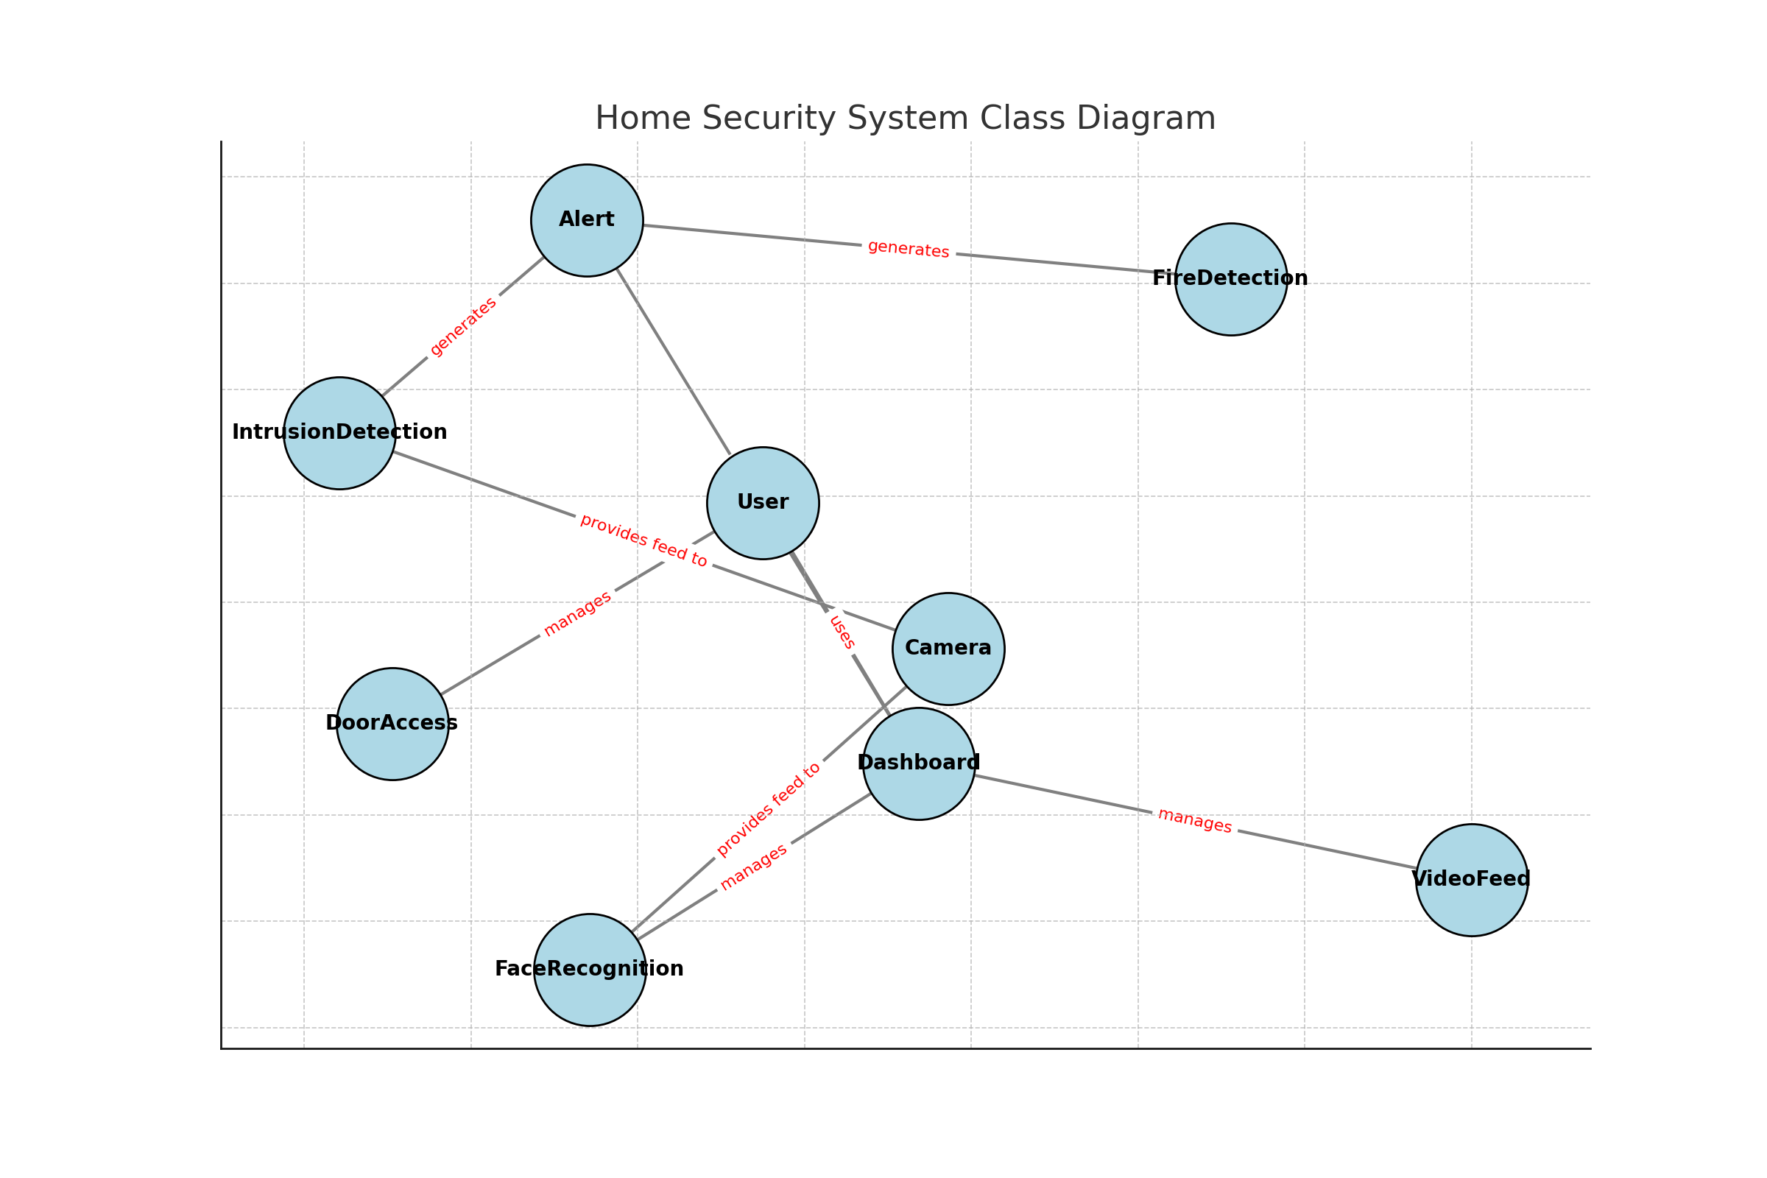
Class Diagram

Slide 9
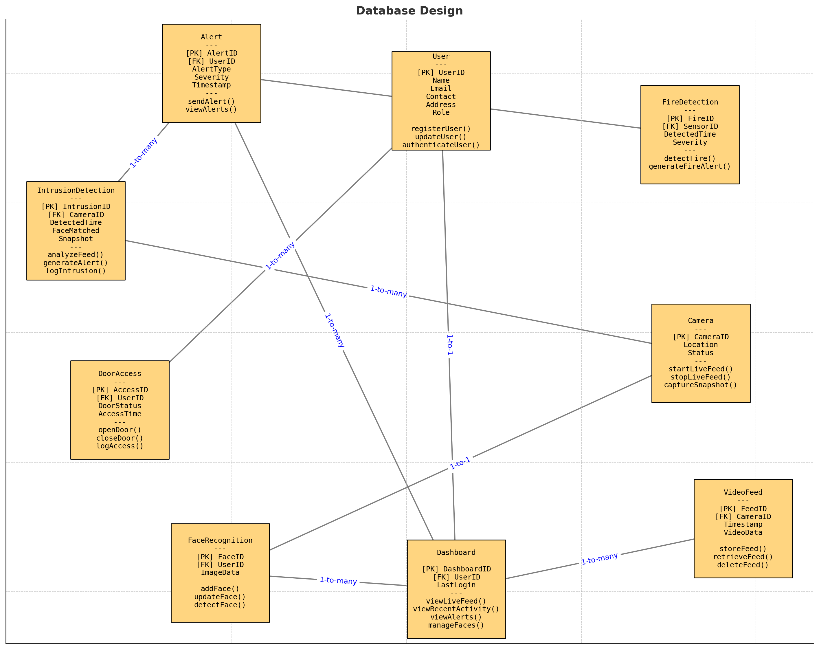
Database Design

Slide 10
Cloud Integration: Scalability & Security
Cloud Platforms
Utilize cloud services Firebase and Cloudinary for enhanced scalability.
These platforms allow for dynamic resource allocation based on system demands.
Data Management
Structured database is implemented for storing user data and event logs.
This ensures efficient retrieval and management of security information.
Encryption Methods
Employ encryption techniques to secure sensitive data during transmission and storage.
This protects user information from unauthorized access and breaches.
Access Controls
Establish strict access controls to limit user permissions based on roles.
This enhances security by ensuring only authorized personnel can modify critical settings.

Slide 11
Conclusion: Enhancements & Q&A
Real-Time Alerts
Users receive immediate notifications for any detected intrusions.
User-Friendly Dashboard
The web interface is designed for easy navigation and management.
Secure Data Management
All data is stored securely with encryption and access controls.
Performance Optimization
The system is optimized for low latency and high efficiency.

