Slide 1

Team 90 | RP 9002
Home Security System using IOT
Date:31st May, 2025.
Team Members
Kshitij Raj 23BD1A1204
Raghuram Thiguti 23BD1A1224
Vaishnavi Tera 23BD1A057E
Drushya Reddy 23BD1A0529
Charanya Pendota 23BD1A059k
Mentors
Mr. B. Ashok
Mr. Venu

Slide 2
CONTENTS
Introduction
Project Abstract
User Classes
Requirements
Hardware
Software
Process Flow
Design : Database Design, Class Diagram
Development
Expected Outcome
Conclusion

Slide 3

Introduction: IoT Home Security Project
Traditional home security systems are often costly, lack real-time monitoring, and cannot distinguish between authorized and unauthorized individuals. Manual intervention increases delays and errors.
Proposed Solution: An AI-powered, cost-effective, and automated home security system using IoT, AI, and Cloud technologies that:
1. Detects intruders in real-time 2. Differentiates authorized and unauthorized individuals using facial recognition
3. Sends instant alerts to homeowners 4. Stores video footage securely in the cloud 5. Enables remote monitoring through a mobile app or web dashboard
6. Detects smoke and fire to prevent hazards

Slide 4
Introduction: User Classes
Homeowners
Primary users of the system.
They monitor security footage and manage known faces.
Specifically, Nuclear families with kids, frequent travelers, specially-abled people.
System Administrators
Responsible for maintaining the face recognition database.
They ensure system security and manage device configurations.
Guests/Visitors
Individuals detected by the system but not in the known face database.
They may be added to the system if authorized by the homeowner.

Slide 5
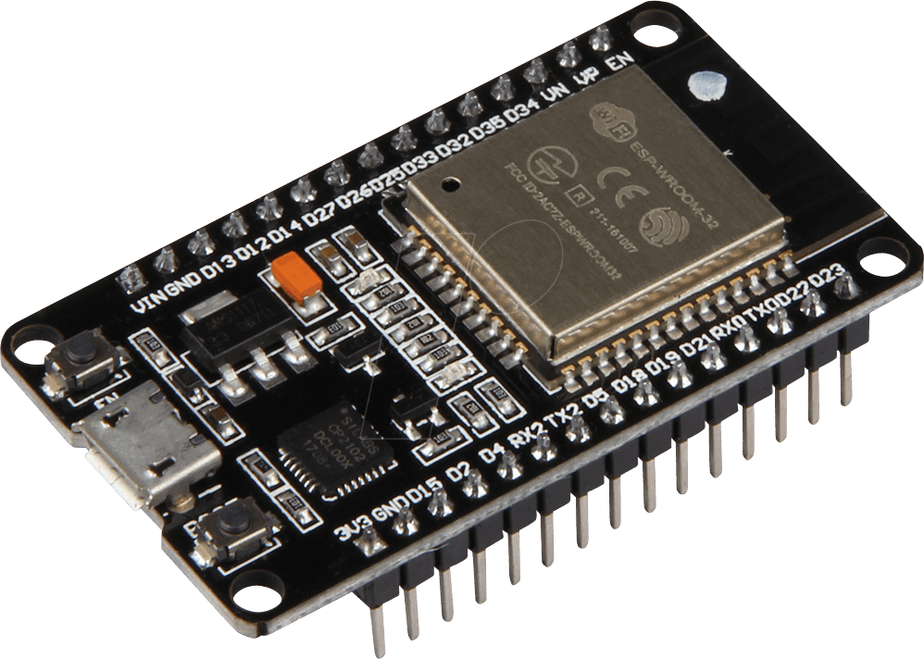
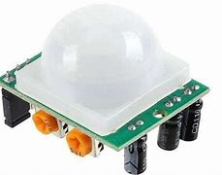
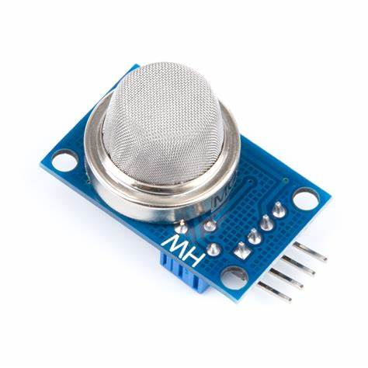
Requirements: Hardware
ESP32
The ESP32 is a low-cost micro-controller with integrated Wi-Fi and Bluetooth capabilities.
It is ideal for IoT applications, enabling real-time
communication with database.
Sensor Suite
The sensor suite includes various components such as smoke detectors, fire detectors and motion sensors.
These sensors enhance the security
system by providing critical environmental
data and alerts.

Slide 6



Requirements: Software
OpenCV Features
OpenCV is an open-source library designed for real-time computer vision applications.
It provides tools for image processing, video analysis, and face detection.
Face Recognition Techniques
The face_recognition module utilizes dlib for accurate face landmarking.
It generates face embeddings to facilitate quick and reliable identification of individuals.

Slide 7
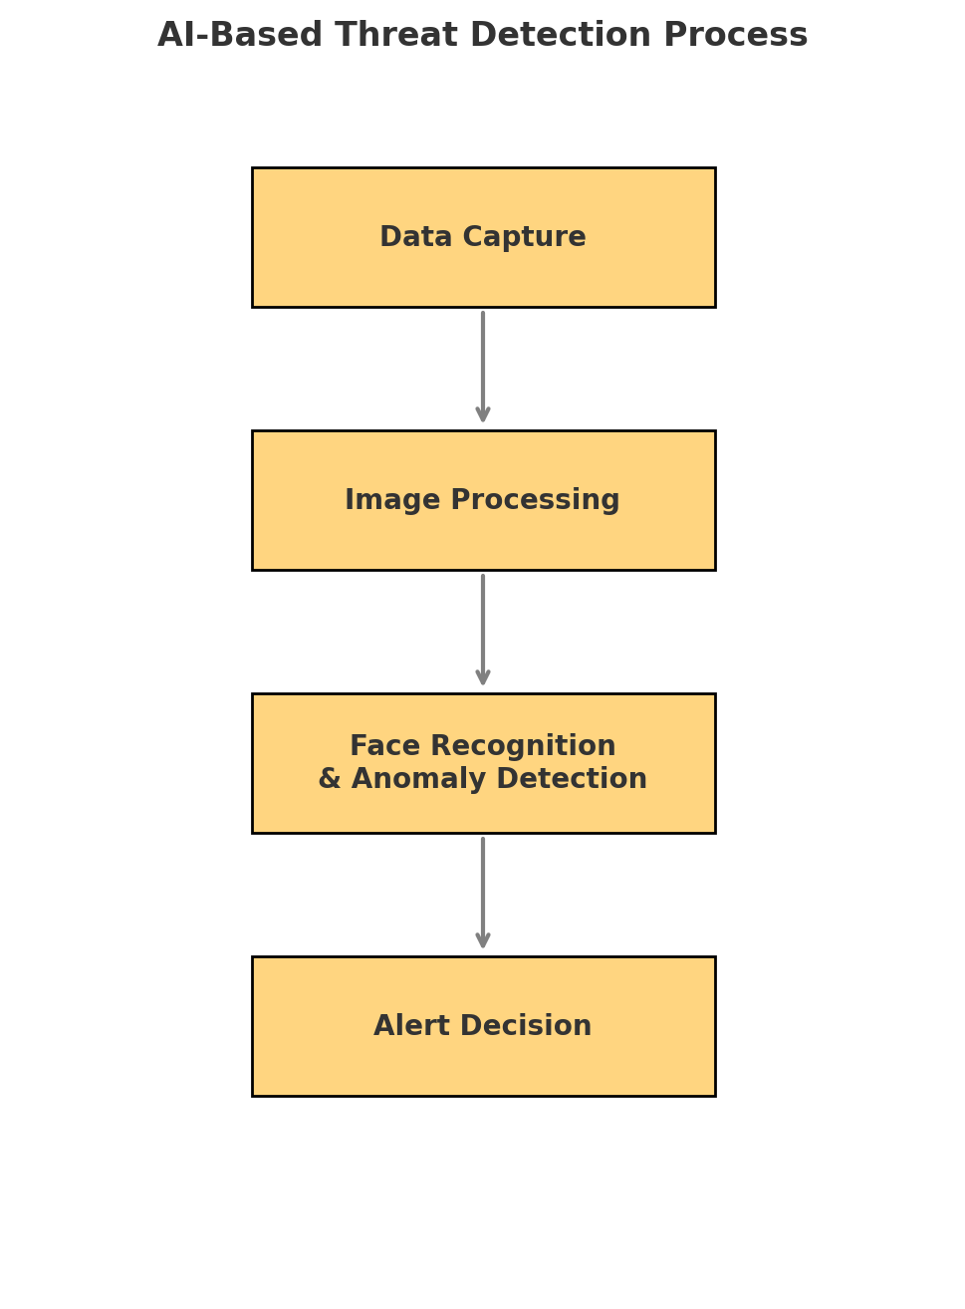
Process Flow: AI-Based Intruder Detection
Data Capture:
Sensors and cameras capture real- time data.
Image Processing:
Extracts features and pre-processes the data.
Face Recognition and Anomaly Detection:
Identifies authorized and unauthorized individuals.
Alert Detection:
Triggers the appropriate response based on the analysis.

Slide 8
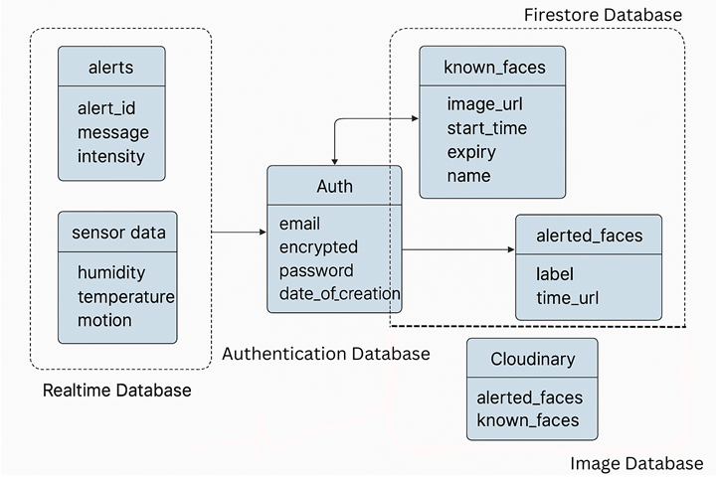
Design - 1: Database Design

Slide 9
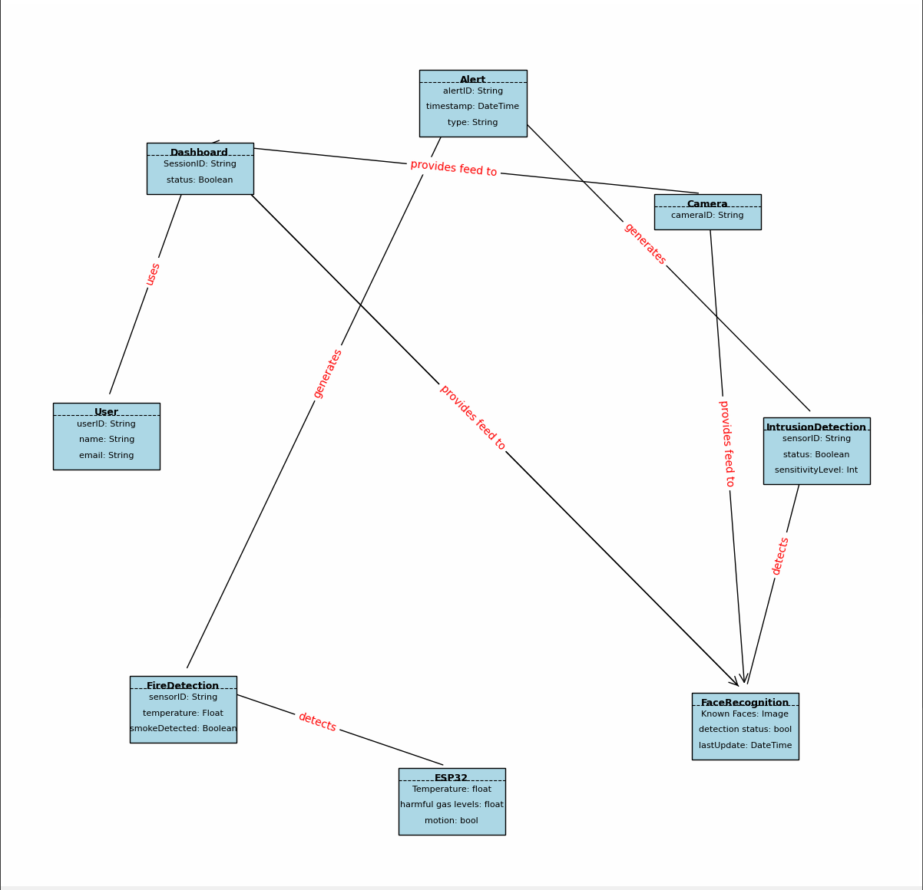
Design - 2: Class Diagram

Slide 10
Development: Web Dashboard
Live Video Feeds:
- Displays constant live streaming from the camera.
- Marks and highlights any unknown faces for quick identification.
Recent Activity Page:
- Captures and displays images of intruders.
- Shows a timeline with date and time for each detected event.
Home Alerts Page:
- Provides color-coded alerts for quick visualizations and notifies via phone if needed.
Manage Faces page:
- Allows uploading of new faces for future recognition.
- Option to notify the system in advance if a guest is expected.

Slide 11
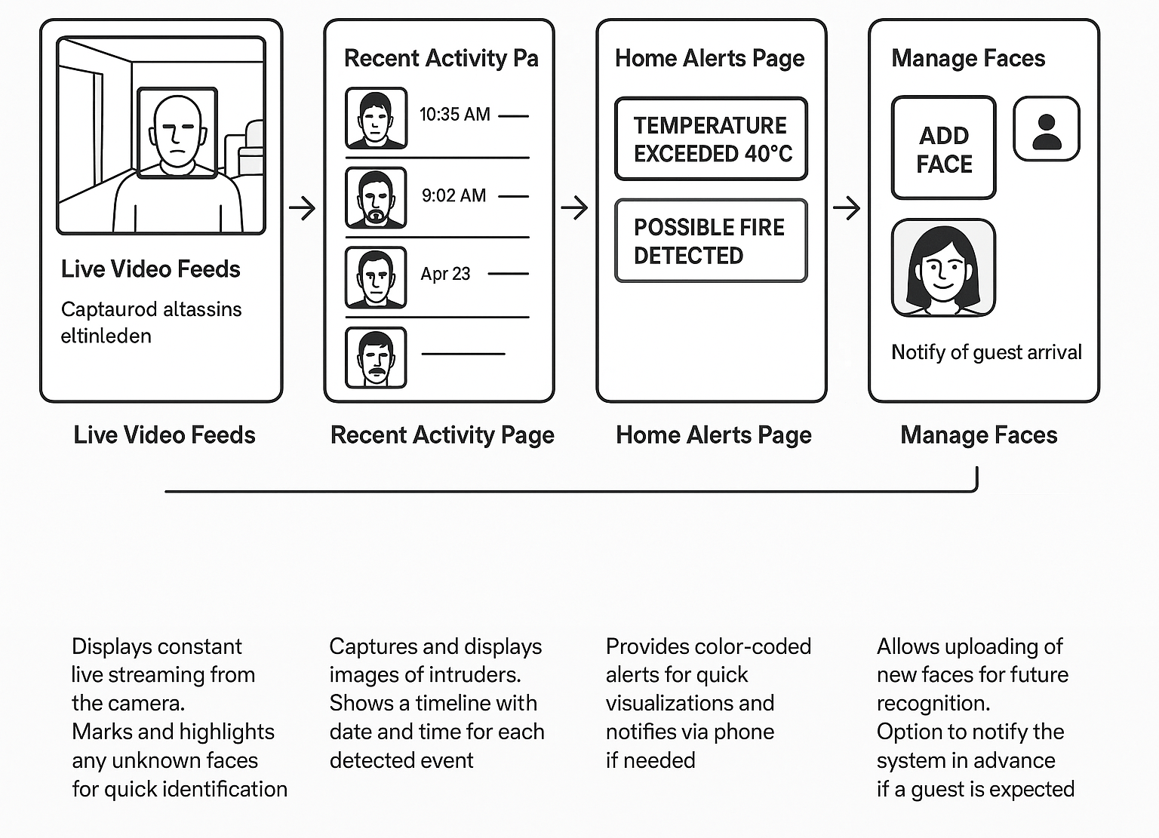
Design - 3: Dashboard Workflow

Slide 12
Expected Outcomes
Real-Time Alerts
Users receive immediate notifications for any detected intrusions.
User-Friendly Dashboard
The web interface is designed for easy navigation and management.
Secure Data Management
All data is stored securely with encryption and access controls.
Performance Optimization
The system is optimized for low latency and high efficiency.

Slide 13
Conclusion and Future Enhancements
Geo-Fencing and Auto Mode Switching
Automatically arm or disarm the system based on the user's location using GPS, reducing manual control.
Voice Assistant Integration
Connect with virtual assistants like Alexa, Google Assistant, or Siri for hands-free control and alerts.
LoRa or Zigbee Communication Use low-power wide-area networks like LoRa or Zigbee to increase range and reduce power consumption for sensors.

