Slide 1
PROJECT VIVA-VOCE · JUNE 2026
FRAME WARP_
Client-side frame reprojection for motion-to-photon latency mitigation in browser and cloud-streamed rendering.
381 ms
17 ms
→
FELT VIEW-DIRECTION LATENCY, SAME 160 MS NETWORK
ISAAC BENJAMIN DAVID · URK23AI1035
KARUNYA INSTITUTE OF TECHNOLOGY AND SCIENCES

Slide 2
02
THE PROBLEM
Every stage of the pipeline holds your input a little longer.
The display refreshes every 17 ms — but the pixels it shows reflect input from the past. In cloud streaming the frame must also survive encoding, a network round trip, and decoding.
→
→
→
→
→
→
INPUT
SIMULATE
RENDER
ENCODE
NETWORK
DECODE
DISPLAY
100–300 ms
For camera control it is directly felt: the view lags the hand — with measurable damage to player performance well below these figures.
MEASURED CLOUD-GAMING LATENCY IN PRIOR STUDIES
FRAME WARP
MOTION-TO-PHOTON LATENCY

Slide 3
03
THE INSIGHT
Two clocks. One warp.
Mouse input runs at hundreds of hertz even when frames don't. So render slow — and at every display refresh , shift the newest frame by the rotation that happened since it was drawn.
INPUT 125–1000 Hz
RENDER 30 FPS · stale
WARP every refresh
Same family as VR asynchronous timewarp and NVIDIA Reflex 2 Frame Warp — moved into the browser, over real video.
Δu = −Δyaw / fov_{x} Δv = Δpitch / fov_{y}
FRAME WARP
REPROJECTION

Slide 4
04
RELATED WORK
Everyone owns something this client doesn't.
VR REPROJECTION
CLOUD-GAMING RESEARCH
SERVER-SIDE COMPENSATION
Owns the GPU
Measures, doesn't remove
Owns the engine
Timewarp, async spacewarp — the compositor has the engine, depth, and undistorted frames. A browser video client has none of these.
Outatime speculates futures; Kahawai splits rendering. Both require engine integration and server compute.
A decade of studies decompose and quantify the latency — no term of the sum is eliminated.
The gap: nobody reprojects the video stream itself, on the client, with no engine access — that is where this project lives.
FRAME WARP
LITERATURE → GAP

Slide 5
05
SYSTEM
Three artefacts, one compositor.
01 · LOCAL DEMO
02 · CLOUD PIPELINE
03 · REPLAY INSTRUMENT
Shooting range
Split across a network
Deterministic replay
Three.js, 30 FPS source, 80 ms injected delay, reprojected to display rate. Press W — only the warp toggles. Live latency, CSV export.
Server streams WebRTC video; client warps the decoded stream with local input. Controlled one-way delay and jitter, both directions.
Headless, bit-reproducible re-runs of recorded input through the real pipeline logic. Same input, different pipeline — perfectly controlled.
39 UNIT TESTS
NO BUILD STEP · RUNS OFFLINE
EVERY FIGURE FROM CSV OR REPLAY
FRAME WARP
ARCHITECTURE

Slide 6
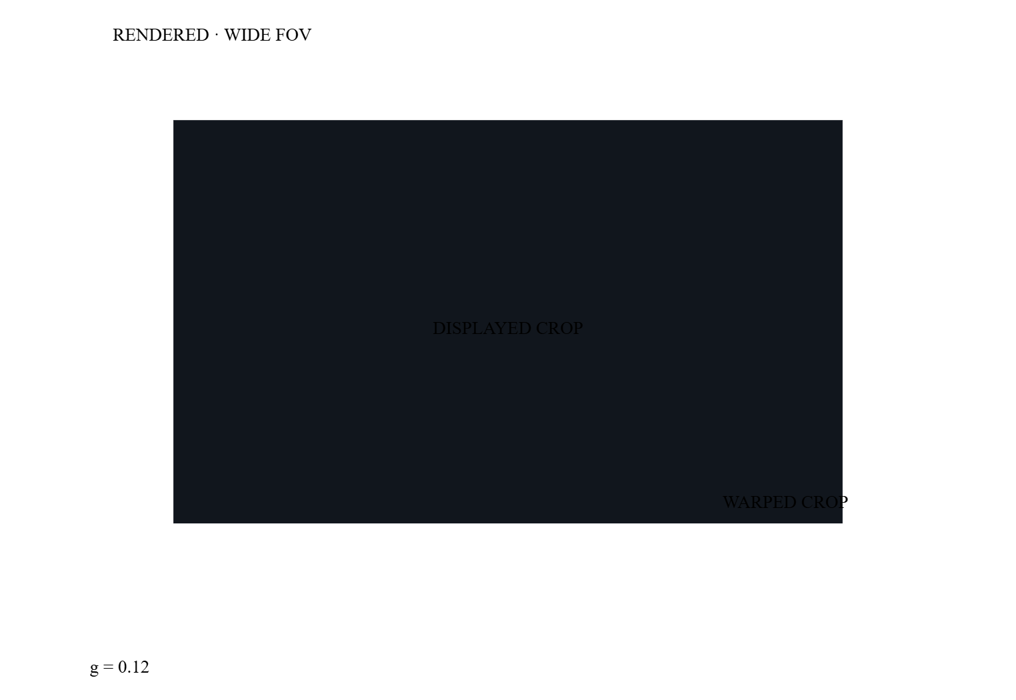
06
DESIGN · GUARD BAND
A shifted image needs pixels beyond its own edge.
Render a wider field of view than you display; show the central crop. The margin is the warp's range of motion.
sampleUV = g + (uv + Δ)·(1−2g)
12 %
16.98 °
MARGIN PER SIDE
MAX COMPENSABLE ROTATION
FRAME WARP
TAN(F_RENDER/2) = TAN(F_DISPLAY/2)/(1−2G)

Slide 7
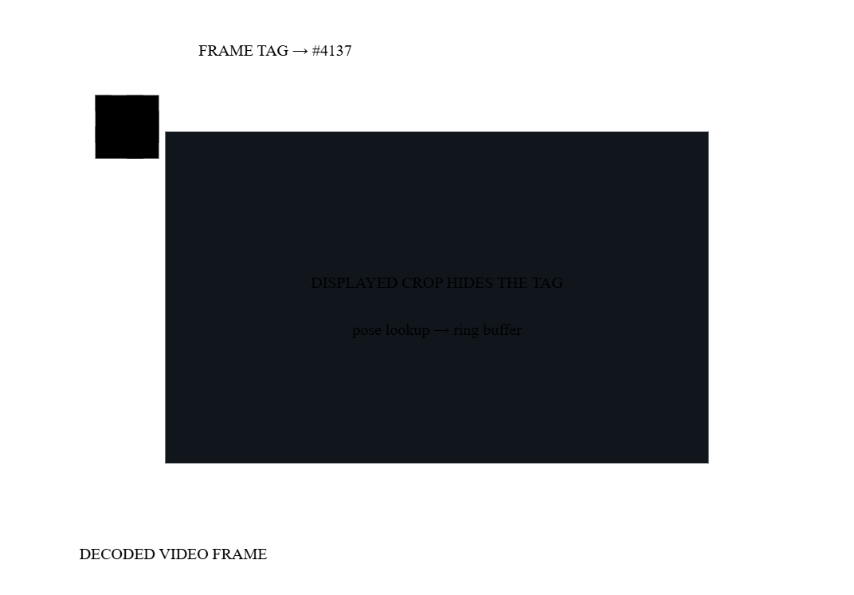
07
DESIGN · POSE SYNC
The frame carries its own ID — in its pixels.
To warp a decoded frame you must know the pose it was rendered with. Video and pose packets arrive by independent paths, and browser metadata can't match them exactly.
So the server bakes a 16-bit frame ID into a 4×4 cell grid in the corner — hidden inside the guard band. The client reads it back from the decoded video. Exact by construction.
PIXEL TAG · 100% EXACT
TIMESTAMPS · 99.5% CALM → 95% JITTER
FRAME WARP
FRAME-EXACT POSE SYNCHRONISATION

Slide 8
08
METHOD
Honest by construction.
HIT DETECTION THAT CAN'T FLATTER
ONE CLOCK, NO CROSS-MACHINE TIME
A click fires one ray from the orientation the screen is currently displaying — current pose with warp on, lagged pose with warp off — against identical targets. The outcome can differ only through the latency under test.
The client timestamps each input by sequence number; the server echoes which input each frame used. When the pixel tag resolves, now − sentAt(seq) measures the whole loop in the client's clock alone.
Measure rather than assert. State limits as precisely as gains. Every number that follows is a CSV export or an automated test.
FRAME WARP
MEASUREMENT DISCIPLINE

Slide 9
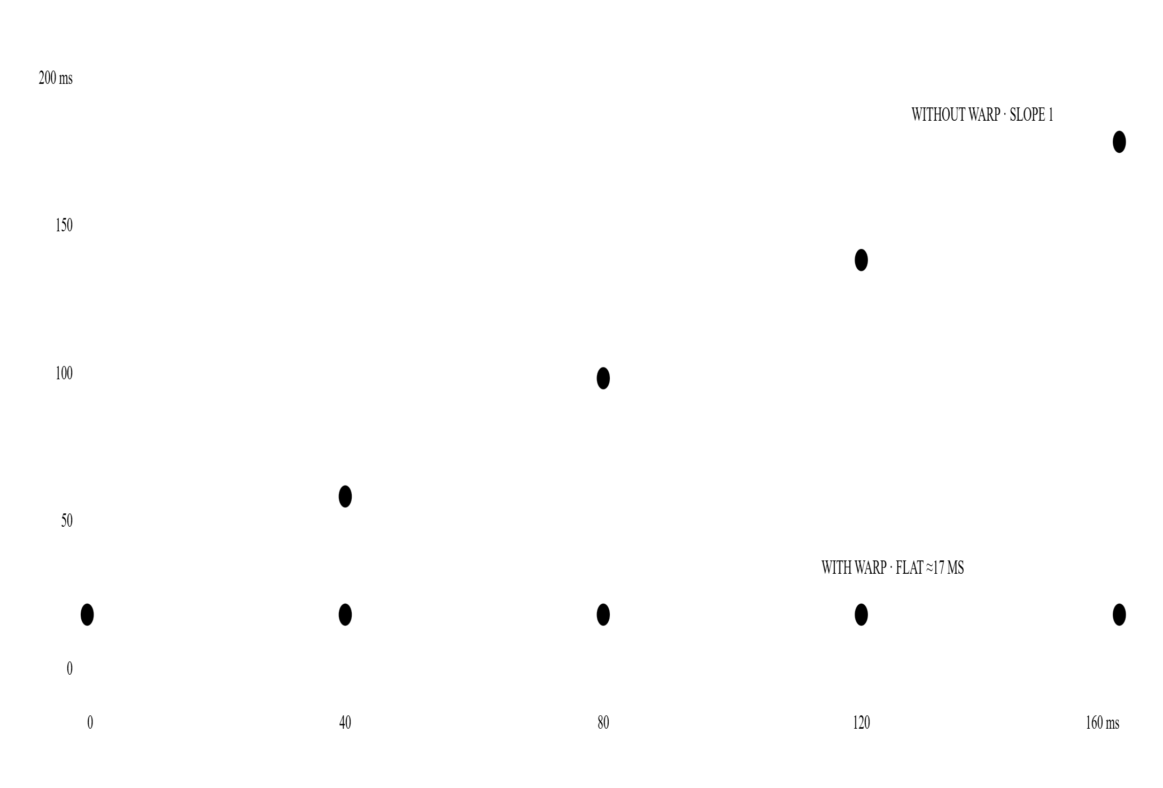
09
RESULTS · LOCAL
Tracking shots start hitting.
≈91 ms
VIEW STALENESS · WARP OFF
≈17 ms
ONE DISPLAY INTERVAL · WARP ON
Without warp, shots land where the aim was 91 ms ago — and miss. The replay instrument reproduces the relationship across the full delay range.
FIG 1 · VIEW-DIRECTION LATENCY VS INJECTED DELAY · REPLAY INSTRUMENT · 60 HZ
FRAME WARP
LOCAL DEMO

Slide 10
10
RESULTS · CLOUD
The network adds latency. The player doesn't feel it.
40 MS ONE-WAY
100 MS ONE-WAY
160 MS ONE-WAY
150 ms
264 ms
381 ms
17 ms
17 ms
17 ms
● WARP OFF · E2E
● WARP ON · VIEW DIRECTION
Real WebRTC, controlled one-way delay, measured end-to-end. No server change beyond a wider FOV and an in-band tag.
FRAME WARP
TABLE 1 · LOOPBACK, PER-MODE MEANS

Slide 11
11
ANALYSIS · JITTER
The subtraction cancels the age.
Δ = pose_{now} − pose_{frame}
However old the frame is — and however much that age varies — its pose is recovered exactly via the pixel tag, and the delta applied in full. Perceived rotation latency is independent of both the mean and the variance of frame age.
Under sinusoidal jitter (40–140 ms) the unwarped stream is visibly unstable; the warped view is indistinguishable from a calm network. Honest caveat: jitter widens the delta distribution — raising the odds of exhausting the margin.
FRAME WARP
§4.2 · JITTER IMMUNITY

Slide 12
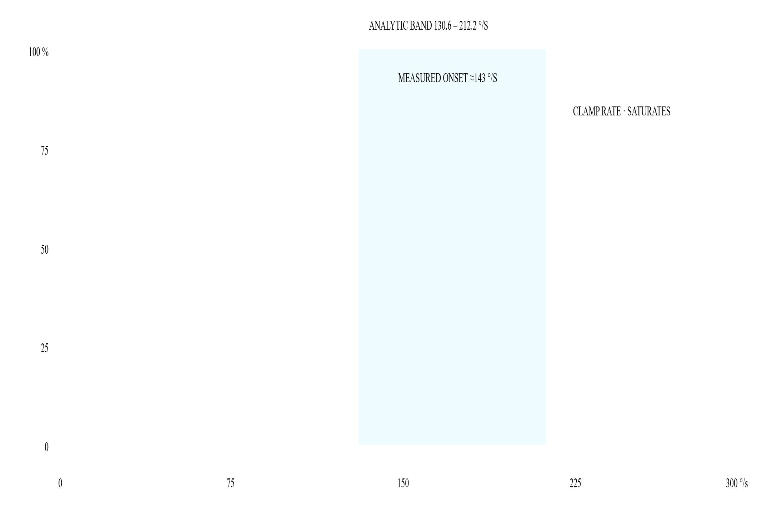
12
THEORY MEETS INSTRUMENT
The model predicts its own failure.
Spin fast enough and the guard band runs out. The analytic bound says clamping starts between 130.6 and 212.2 °/s ; the simulator measures onset at ≈143 °/s — inside the band, verified by an automated test.
The display-tick term in the bound was found by a failing test — the instrument corrected the theory.
FIG 2 · GUARD-BAND EXHAUSTION UNDER CONSTANT ANGULAR VELOCITY · Δmax = 16.98°
FRAME WARP
§4.3 / §6.3 · CLAMP ONSET

Slide 13
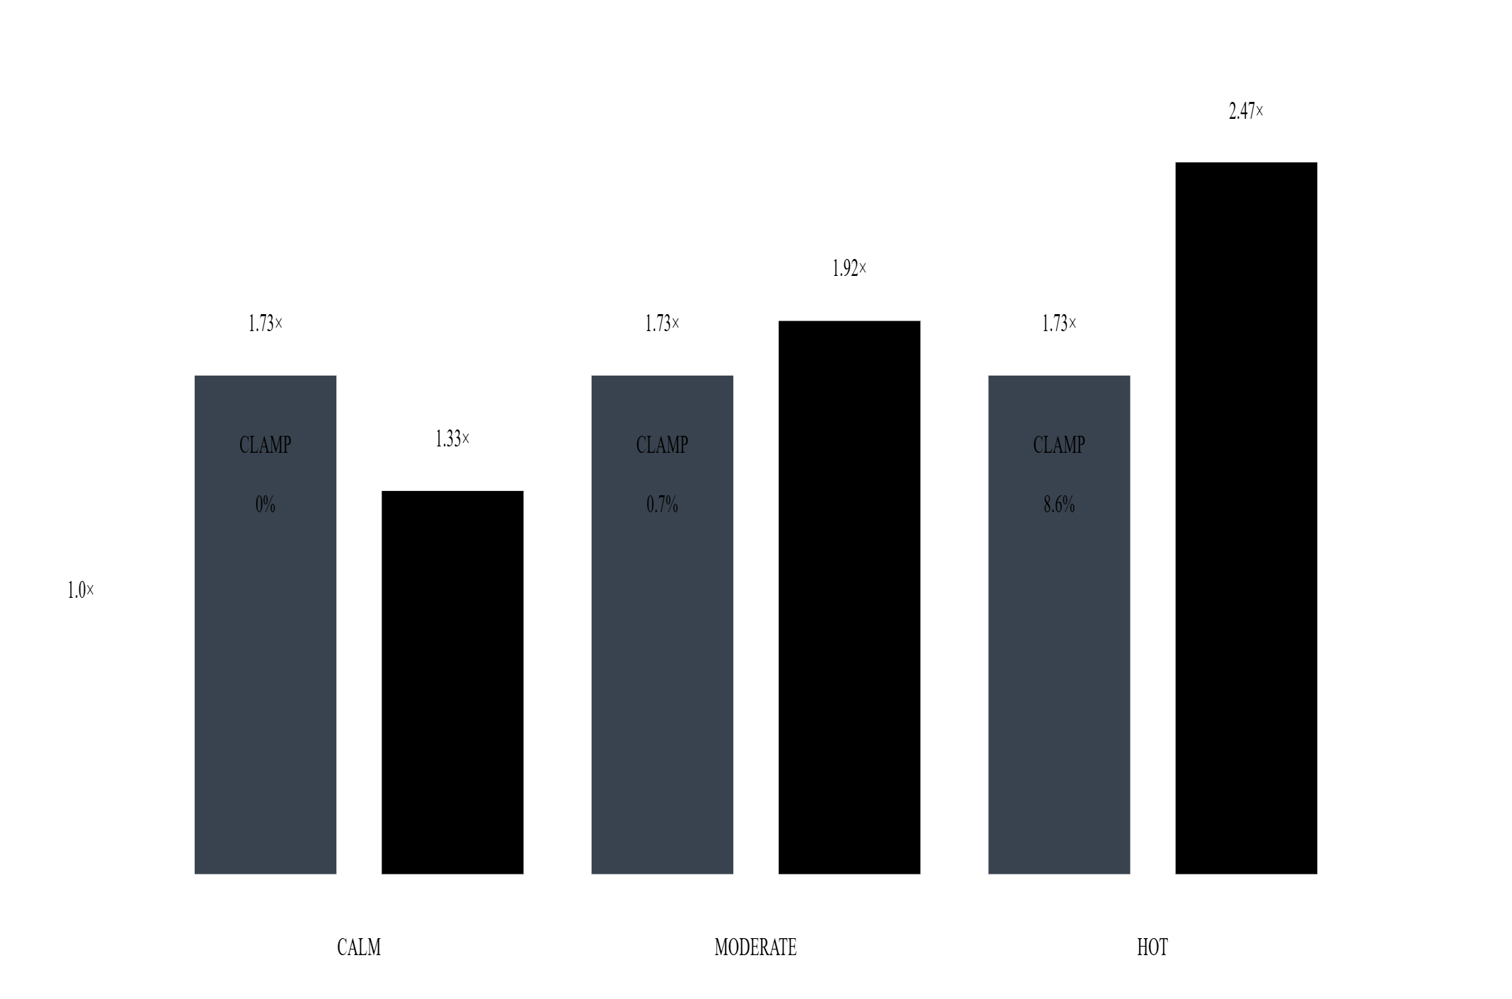
13
EXTENSION
Pay for the margin only when you move.
The fixed 12% band costs +73% rendered pixels, always — and aggressive motion still exhausts it (8.6% of ticks, errors to 17.6°).
Sizing the margin from the worst angular speed in the last 500 ms drops calm-input overhead to +33% and eliminates clamping on every trace.
FIG 3 · RENDERED-PIXEL COST, FIXED VS ADAPTIVE · ADAPTIVE CLAMP RATE: 0% ON ALL TRACES
■ FIXED 0.12
■ ADAPTIVE
–– 1.0× DISPLAY-ONLY
FRAME WARP
TABLE 2 · REPLAY BENCHMARK

Slide 14
14
LIMITS
Limits, stated as precisely as gains.
CAPABILITY
LOCAL
CLOUD
WHY
Rotation warp
YES
YES
Needs only the pose delta
Guard band
YES
YES
Server renders wide; client crops
Motion vectors
YES
NO
YUV 4:2:0 video has no channel for per-pixel velocity
De-ghosting clamp
YES
INERT
Without velocity, mathematically a no-op
Rotation only — no object motion, disocclusion, or parallax. The 17 ms figure is a proxy floor : mouse polling, GPU queueing and scanout are invisible to a browser. Absolute claims need hardware ground truth.
FRAME WARP
TABLE 3 · HONEST CAPABILITY TABLE

Slide 15
15
CONCLUSION
The latency the network adds doesn't have to be the latency the player feels.
NEXT · PHOTODIODE GROUND TRUTH
NEXT · CONTROLLED USER STUDY
NEXT · DEPTH-AWARE REPROJECTION
NEXT · TANGENT-EXACT REMAP
ISAAC · URK23AI1035
THANK YOU · QUESTIONS

