Slide 1
Malware detection on EMBER2024 Win64 PE files:
manual LightGBM tuning vs AutoML
Does a random train/test split overstate real-world performance, and does AutoML (FLAML, AutoGluon, H2O) protect against leakage and drift?
Isaac Benjamin David (URK23AI1035) | IA-3 Part B: AutoML | seed 42 throughout
Notes:
Hello. Our project detects Windows malware from static features of the executable, using the EMBER2024 Win64 data. We compare a LightGBM model that we tuned by hand with three AutoML tools: FLAML, AutoGluon and H2O. Our research question is whether the usual random train/test split overstates how well such a detector works on files that arrive later, and whether AutoML protects us from a leaky column or from drift.

Slide 2
Problem, data and a duplicate finding
Problem: static malware detection for Windows 64-bit PE files, before they run.
Why it matters: new malware keeps arriving; a score on old files can flatter a detector.
Data: EMBER2024 Win64, 2,568 static features in 12 families (imports, strings, headers, signatures, ...).
Duplicate finding: each weekly file repeats every sample, so 1,280,000 raw lines hold only 639,993 unique files (640,007 copies removed by sha256 before any split).
split | weeks | files | malware
train | 0-51 | 160,000 | 50.0%
test_random | 0-51 | 40,000 | 50.0%
test_future | 52-63 | 40,000 | 50.0%
test_random: same weeks as train (stratified by label x week).
test_future: 12 strictly later weeks.
Both are used only for final scoring, never for tuning or thresholds.
Source: reports/data_check.json, reports/tables/class_balance.csv
Notes:
A detector is only useful on files it has not seen yet. EMBER2024 gives weekly files with labels, so we can test on later weeks. First finding: every weekly file lists each sample twice. Of 1,280,000 raw lines only 639,993 are unique, so we de-duplicate by sha256 before splitting; otherwise copies of one file land in both train and test. We sample 160,000 training rows and two 40,000-row test sets: a random one from the same weeks, and a future one from later weeks. Classes are 50/50 by construction.

Slide 3
Method and pipeline
Raw data
64 weekly jsonl files
EMBER2024 Win64
De-duplicate
global sha256
(each file listed twice)
Fixed splits
train / test_random:
weeks 0-51
test_future: 52-63
Feature cache
2,568 float32
features per file
Step 5: deploy
FastAPI + Streamlit,
cost threshold,
model card
Step 4: evaluate
leakage, drift,
prevalence,
challenge, SHAP
Step 3: AutoML
FLAML, AutoGluon,
H2O; equal
time budget
Step 2: manual
LightGBM: grid,
random, Optuna
36 trials each
Test sets are scored once at the end; every table and figure is built by a script.
Source: docs/PLAN.md, run_all.py; the detailed diagram for the report is reports/figures/architecture.png
Notes:
The pipeline. Raw files are de-duplicated and split once with seed 42, and the splits are saved so every step uses the same rows. Step 2 tunes LightGBM by grid search, random search and Optuna, 36 trials each on the same folds. Step 3 gives each AutoML tool the same training split and time budget. Step 4 is the critical evaluation: leakage, drift, real-world prevalence, the challenge set and SHAP. Step 5 serves the chosen model through an API and a Streamlit app.

Slide 4
Step 2: manual LightGBM tuning (36 trials each)
method | trials | CV AUC | AUC random | AUC future | TPR@1%FPR future | search min
LightGBM default | - | 0.9968 | 0.9978 | 0.9967 | 95.1% | -
LogReg | - | 0.9842 | 0.9929 | 0.9297 | 81.7% | -
Grid search | 36 | 0.9977 | 0.9991 | 0.9980 | 97.4% | 113.3
Random search | 36 | 0.9977 | 0.9990 | 0.9980 | 97.5% | 89.2
Optuna (TPE) | 36 | 0.9978 | 0.9991 | 0.9981 | 97.6% | 74.3
Selected by CV AUC (never by a test score): Optuna (TPE).
Tuning beats defaults: TPR@1%FPR on test_future 95.1% -> 97.6%; the three tuners differ by at most 0.00015 AUC on test_future.
Source: reports/tables/tuning_summary.csv, reports/tuning_writeup.md
Notes:
Step 2. Equal budget means every tuner gets exactly 36 LightGBM configurations, scored on the same three cross-validation folds of a 60,000-row subset of train. Optuna (TPE) had the best CV AUC, 0.9978, so it became our tuned model, refit on all of train and scored once on each test set. Tuning lifts test_future true-positive rate at 1% false-positive rate from 95.1% to 97.6%. The three tuners end within 0.00015 AUC of each other, so the search method mattered far less than tuning at all.

Slide 5
Step 3: AutoML vs manual (20-minute budget per tool)
model | winner | wall min | AUC future | TPR@1%FPR | AUC vs tuned
FLAML | xgb limitdepth | 25.7 | 0.9976 | 96.5% | -0.00053 (worse)
AutoGluon | WeightedEnsemble L2 | 20.2 | 0.9980 | 97.6% | -0.00006 (tied)
H2O AutoML | StackedEnsemble BestOfFamily | 24.8 | 0.9970 | 96.1% | -0.00110 (worse)
Tuned LightGBM | LightGBM, 609 trees | 76.0 | 0.9981 | 97.6% | reference
LightGBM default | lightgbm | 0.4 | 0.9967 | 95.1% | -
Accuracy: AutoGluon tied with tuned LightGBM; FLAML, H2O AutoML slightly worse (paired bootstrap CI excludes 0).
Cost: AutoGluon 20.2 min vs 76.0 min for the selected manual search and refit; all three beat untuned LightGBM.
Source: reports/tables/automl_vs_manual.csv, automl_pairwise.csv; scores on test_future; AUC vs tuned = paired bootstrap, 95% CI; 16-core laptop
Notes:
Step 3. Each AutoML tool got the same training split, ROC-AUC as the metric, 16 threads on the laptop and a 20-minute budget. On test_future AUC, AutoGluon is statistically tied with our tuned LightGBM, and FLAML and H2O AutoML are slightly worse; no tool is more than 0.0011 AUC away. The big difference is cost: AutoGluon took 20.2 minutes against 76.0 for the manual search we selected and its refit, with no search space to design. Every winner is in effect one gradient-boosted tree model.

Slide 6
Research question: how much does a random split overstate?
tuned LightGBM on | AUC | FPR | malware caught | precision 50/50 | precision @1% malware
test_random (weeks 0-51) | 0.9991 | 0.95% | 98.6% | 99.0% | 51.2%
test_future (weeks 52-63) | 0.9981 | 1.23% | 97.9% | 98.8% | 44.7%
challenge set (814, all malware) | - | - | 53.7% | - | -
AUC hides it: gap 0.0010 [0.0007, 0.0014]; all tree models 0.0010 to 0.0014; LogReg 0.0632.
The base rate matters most: precision 99.0% at 50/50 vs 51.2% at 1% malware; future weeks cut it to 44.7% (121 false alarms per 10,000 files).
The hard tail is invisible to both test sets: only 53.7% of challenge-set malware is caught at this threshold (79.9% at the deployed, recall-oriented one).
Source: reports/tables/random_vs_future.csv, precision_both_sets.csv, challenge.csv; threshold = 1% FPR on TRAIN out-of-fold scores
Notes:
The research question. By AUC the random split barely overstates: the tuned model loses only 0.0010 AUC on the future weeks, and every tree model loses between 0.0010 and 0.0014; only logistic regression loses 0.0632. The real overstatement is elsewhere. At a threshold fixed on train, the false-positive rate rises on future files, and the 50/50 test mix hides the base rate: at 1% malware, precision is 44.7% on future files. On the challenge set, malware that antivirus engines first missed, the model catches only 53.7%.

Slide 7
Leakage: did AutoML fall for it? Yes, every tool
+ detection_ratio | AUC future clean -> leak | leak rank own / SHAP | dropped? | own validation AUC
Tuned LightGBM | 0.9981 -> 1.0000 | #1 / #1 | n/a | -
FLAML | 0.9980 -> 1.0000 | #2 / #1 | no | 1.0000
AutoGluon | 0.9980 -> 0.9999 | #1 / #1 | no | 1.0000
H2O AutoML | 0.9922 -> 1.0000 | #1 / #1 | no | 1.0000
4 of 4 models relied on the label leak; no tool dropped it or warned about it, and their own validation said the model was near-perfect.
Time leak (first_submission_date): test_future AUC moved by at most 0.0009: every future date lies past the training dates, and classes are 50/50 in every week.
Source: reports/tables/leakage.csv, automl_self_estimate.csv; Step 4 ran on a 4-core / 15.7 GiB RAM Linux VM, 600 s per AutoML run
Notes:
Leakage. We added detection_ratio, the share of antivirus engines that flagged the file, which is what the label is made from. Our tuned LightGBM and all three AutoML tools used it: 4 of 4 ranked it first by SHAP, test_future AUC went to about 1.0, and no tool dropped it or named it in a log. Their own validation also said 1.0. Only a human question about provenance catches this. The time leak, first_submission_date, moved AUC by at most 0.0009. These runs used a 600 s budget on a 4-core cloud VM.

Slide 8
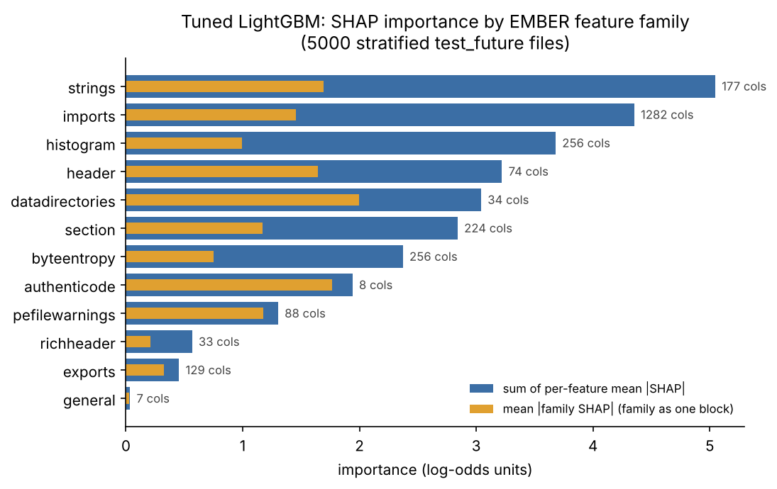
Explainability: what the tuned model looks at (SHAP)
Top families: strings 17%, imports 15%, histogram 13%.
Top features: header: coff.char.DLL; authenticode: latest_signing_time; datadirectories: EXPORT.size.
Time proxies are not a hidden leak: AUC gap 0.00101 with them, 0.00107 without.
Signatures are an attack surface: signed malware caught 83.7% vs 98.6% unsigned (test_future).
Source: reports/figures/shap_family_bar.png, tables/shap_*.csv, leakage.csv, bias_slices.csv
Notes:
SHAP on the tuned model. No family dominates: the top three are strings 17%, imports 15%, histogram 13% of the total. The three strongest single features are header: coff.char.DLL; authenticode: latest_signing_time; datadirectories: EXPORT.size. The COFF timestamp and signing-time columns matter, but removing them leaves the random-vs-future AUC gap about the same, 0.00101 versus 0.00107. Signature columns are also an attack surface: signed malware on test_future is caught 83.7% of the time, against 98.6% for unsigned malware.

Slide 9
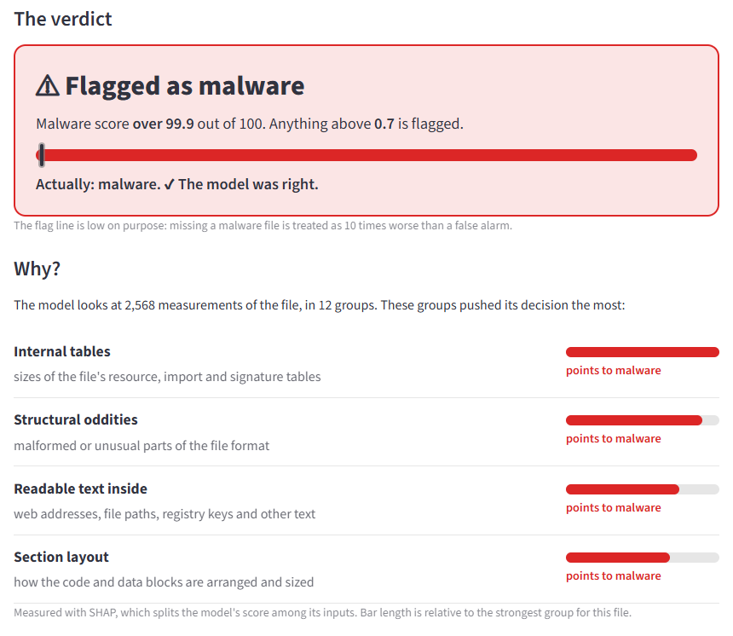
Step 5: deployment demo (FastAPI + Streamlit)
API: GET /health, POST /predict, POST /predict_batch, POST /predict_file.
App: one page: pick an example or upload a PE; shows the verdict and the top reasons (SHAP) in plain words.
Threshold 0.0069: missed malware costs 10x a false alarm, set on train out-of-fold scores.
On test_future: recall 99.5%, FPR 7.4%; at 1% malware ~12% precision, so triage, not blocking.
Source: reports/screenshots/a_malicious_correct.png, models/threshold.json, app/api.py, MODEL_CARD.md
Notes:
Deployment. The tuned LightGBM is served by a FastAPI service and a one-page Streamlit app that walks through the whole project; in its live demo you pick an example file or upload a program, and the page shows the verdict and, in plain words, which parts of the file pushed the decision. The threshold was chosen on train out-of-fold scores so that a missed malware costs 10 times a false alarm; on test_future that gives 99.5% recall at 7.4% false-positive rate, but at a realistic 1% malware share only about 12% of its alarms would be real malware. So it is a triage aid, not a blocker, and the app says so; the model card lists the limits.

Slide 10
Takeaways and limitations
Takeaways
Limitations
AutoGluon matched tuned LightGBM (AUC 0.9980 vs 0.9981) in 20.2 vs 76.0 min.
The random split overstates little by AUC (0.0010); the 50/50 test mix overstates a lot: precision 98.8% vs 44.7% at 1% malware on future files.
No AutoML tool caught the label leak.
The hard tail: 53.7% of challenge-set malware caught at 1% FPR (79.9% at the deployed threshold).
Static features only; packed or modified files can evade.
50/50 classes; real prevalence is unknown.
12 future weeks; one seed; no adversarial test.
Step 4 ran on a 4-core / 15.7 GiB cloud VM (600 s AutoML budget), Steps 2-3 on the 16-core laptop.
Source: reports/critical_eval.md, reports/limitations.md
Notes:
To sum up. AutoML matched or came close to manual tuning in a fraction of the time. The random split overstates mainly through the operating point and the 50/50 class mix, not through AUC. No tool protected us from a leaky column; that needs a person who asks where each column comes from. Our limits: static features only, 12 future weeks, one seed, no adversarial testing, and Step 4 ran on a smaller 4-core cloud VM. Thank you; we are happy to take questions.

