Slide 1
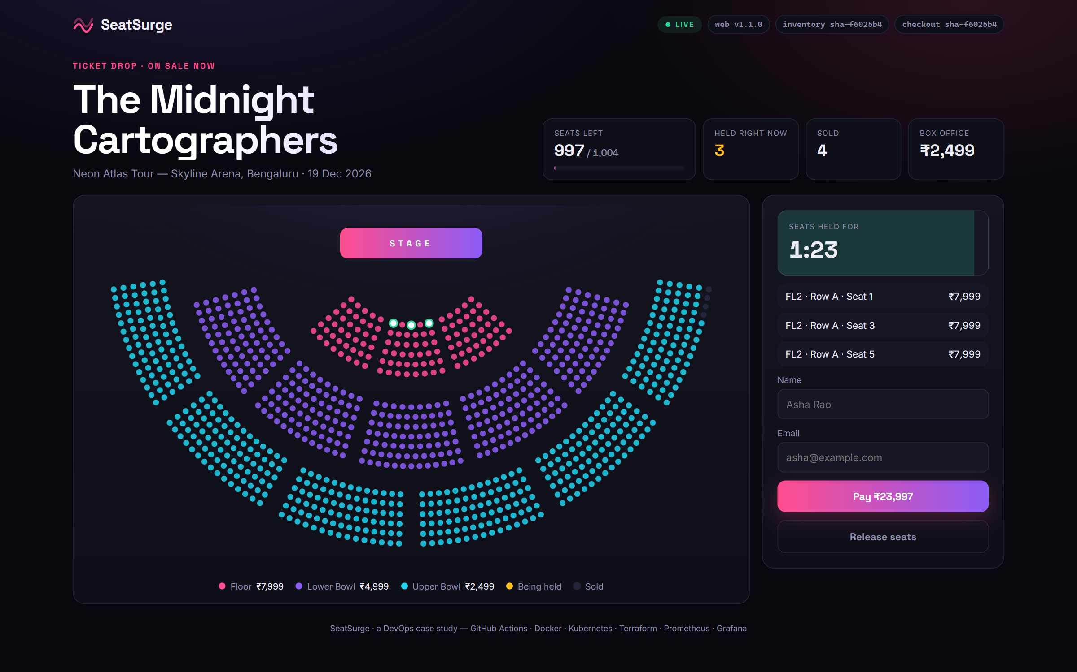
SeatSurge
DEVOPS (24DC2006) · SKILL-BASED CASE STUDY
A flash-sale concert-ticketing platform, and the DevOps pipeline that keeps it standing when every fan clicks “buy” at once
Isaac Benjamin David
B.Tech Semester VII · github.com/Turbo-Soggy/seatsurge
Notes:
Opening (30 s). SeatSurge is a ticketing system for a concert “ticket drop”: thousands of fans racing for the same seats in the first minutes of a sale. I built the app, but the subject of this project is everything around it: collaboration, CI/CD, containers, Kubernetes, infrastructure as code, monitoring and security. Everything you will see ran for real: real pull requests, real pipeline runs, real load tests.

Slide 2




A ticket drop breaks naive systems in four ways
Correctness under contention
Elasticity
Safe change
Visibility
Hundreds of fans click the same front-row seat within milliseconds. It must never sell twice.
Traffic goes from near zero to a stampede in seconds, then drops just as fast.
Bugs show up mid-sale. Fixes must ship with zero downtime and roll back instantly.
Operators need traffic, latency, sales and alerts live, not in a post-mortem.
Notes:
Four problems that map directly onto DevOps practices. Correctness is an application-design problem (atomic locks and a database constraint). Elasticity is solved by stateless services plus Kubernetes autoscaling. Safe change is the CI/CD pipeline with an approval gate, rolling updates and rollback. Visibility is Prometheus, Grafana, Loki and alerts.

Slide 3
Headline result: a release shipped mid-sale with zero errors
0 / 14,330
2 → 10
5 min 39 s
failed requests while v1.1.0 rolled out under 150 fans
inventory pods, scaled automatically by the HPA
from commit to verified on staging
23.5 ms
1,004
13
p95 latency during the surge and rollout
seats sold out (₹41,18,996), none sold twice
real defects caught by the pipeline and fixed via PRs
Measured on the project’s own GitHub Actions runs and k6 load tests (November 2026).
Notes:
The punchline first. While k6 drove 150 virtual fans at production, I approved release v1.1.0. 14,330 requests, zero failed. The event sold out mid-rollout with no seat sold twice, and the inventory service scaled from 2 to 10 pods. From commit to a verified staging deployment takes under six minutes. And the pipeline caught 13 real defects on the way. I’ll show those later, because that is the point of a pipeline.

Slide 4
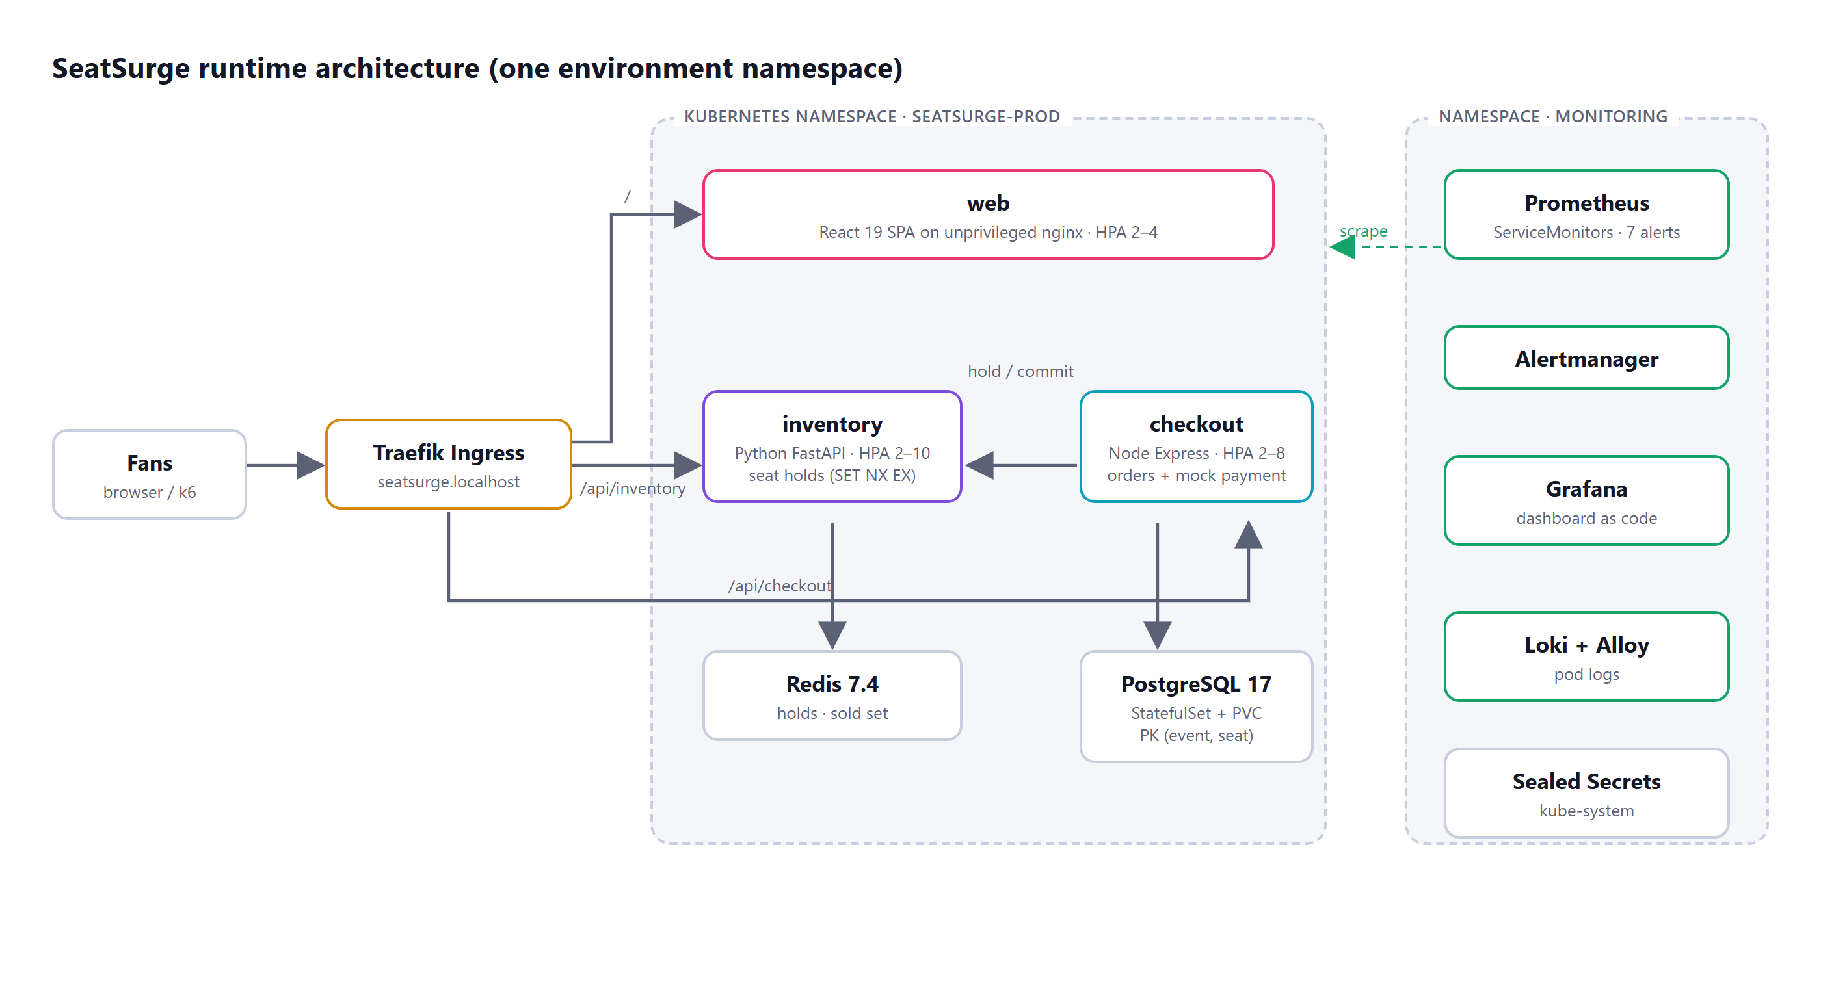
Three stateless services, two stateful stores
web
React 19 SPA on unprivileged nginx
inventory
FastAPI · atomic Redis seat holds
checkout
Express · Postgres orders, mock payments
state
Redis 7.4 (holds) · Postgres 17 (orders)
Notes:
Fans hit a Traefik ingress that routes / to the web app, /api/inventory to the Python service and /api/checkout to the Node service. All state lives in Redis and Postgres, which is what lets Kubernetes add and remove service pods freely. Monitoring runs in its own namespace: Prometheus scrapes both APIs, Grafana and Loki show metrics and logs, and Sealed Secrets handles the production password.

Slide 5




How a seat is sold exactly once
1 Hold
2 Pay
3 Commit
4 Expire
SET hold:<seat> NX EX 90. The first fan wins; the second gets HTTP 409.
Checkout re-reads the hold and charges the mock gateway (2 % declines).
Order insert in a transaction. PRIMARY KEY (event, seat) is the last line of defence.
Abandoned holds vanish after 90 s and seats return to sale automatically.
Proof under load: 679 hold collisions were rejected with 409 in the final load test, and the database never saw a duplicate seat.
Notes:
The correctness design. Redis SET with NX means only one fan can create the lock; EX gives it a 90-second time-to-live, so abandoned seats return to sale on their own. Multi-seat holds are all-or-nothing. The Postgres composite primary key is a second, independent guarantee. In the final load test 679 collisions were correctly rejected.

Slide 6
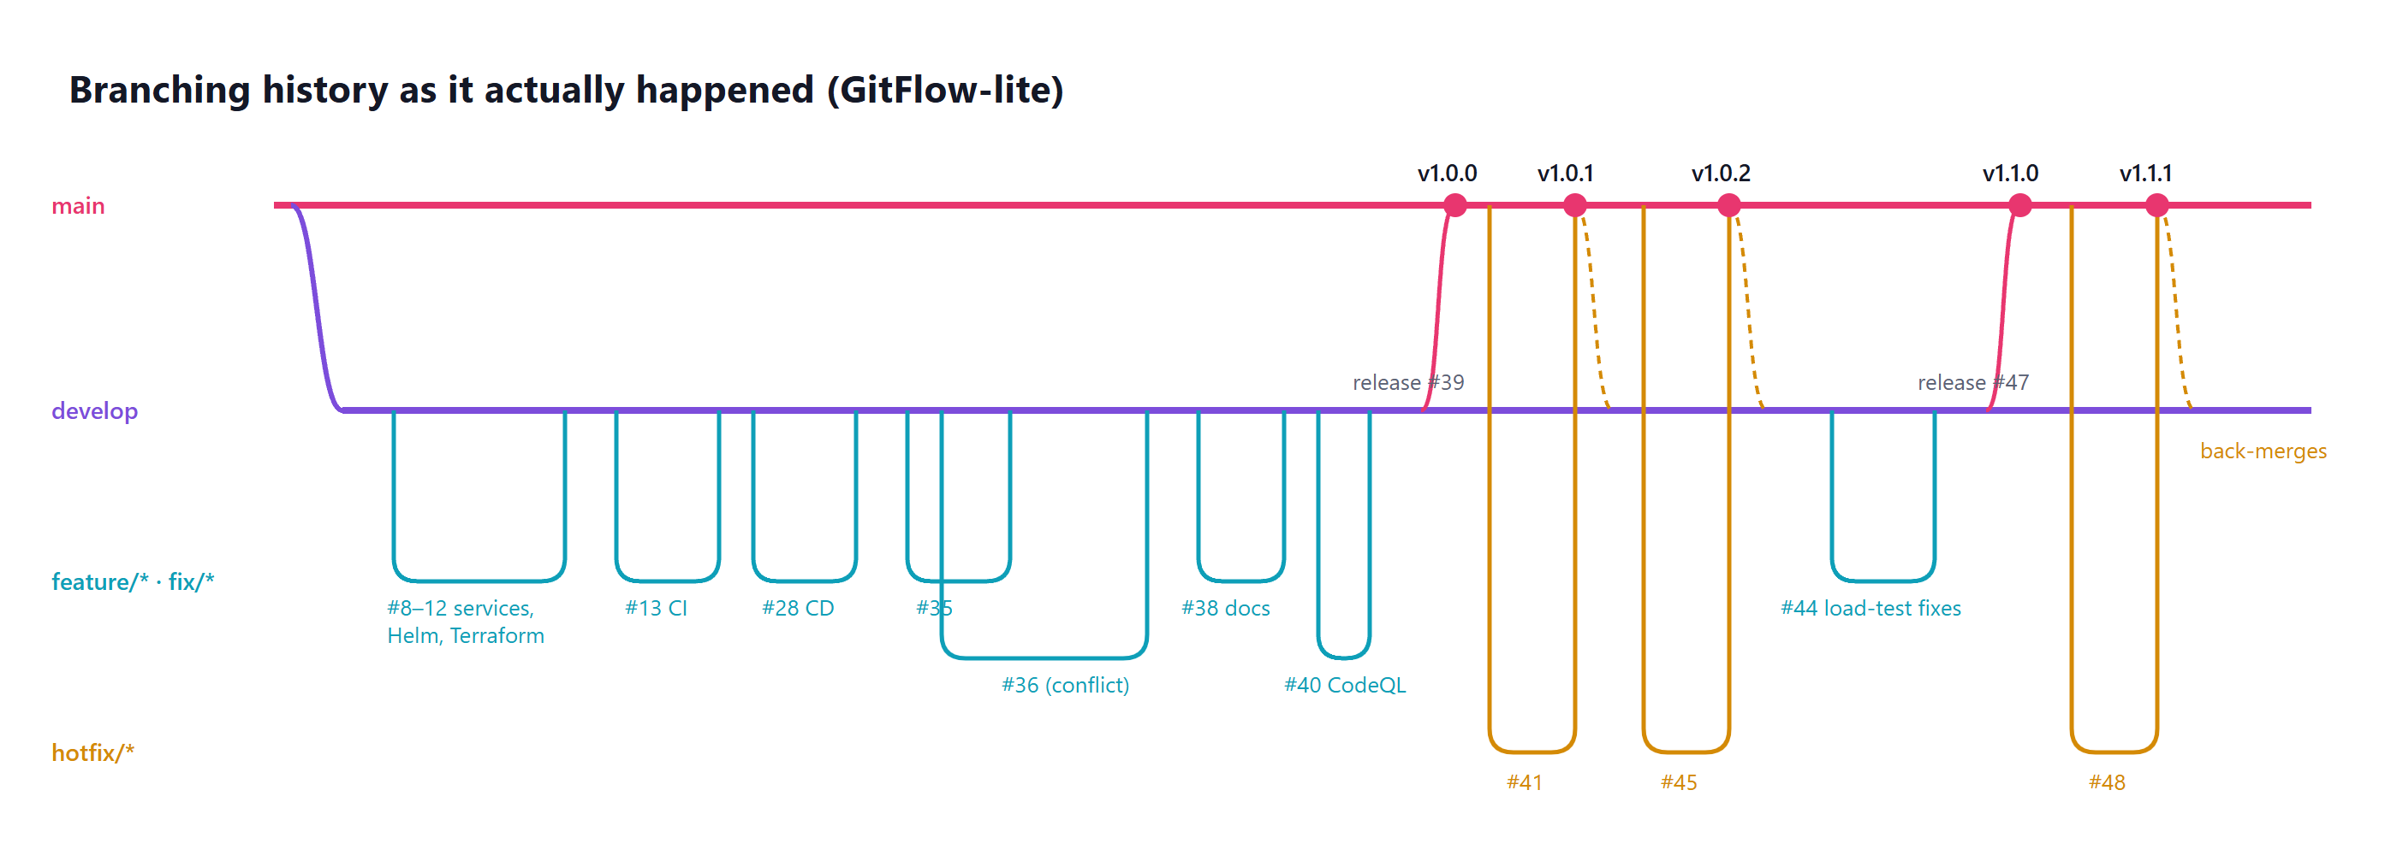
GitFlow-lite: every change through a reviewed, tested PR
20
11
5
18
PRs merged
issues, all closed by PRs
releases v1.0.0 → v1.1.1
Dependabot update PRs
Protected main and develop: PR required · 10 required checks on an up-to-date branch · conversations resolved · no force-push · CODEOWNERS · Conventional Commits
Notes:
Two long-lived branches: main is production, develop is integration. Features and fixes branch from develop and come back by squash-merged PR. Releases go develop → main by PR and get tagged. Hotfixes branch from main and are merged back into develop, which you can see three times on the diagram. Branch protection means nobody, including me, can merge without all ten checks passing on an up-to-date branch.

Slide 7

Merge conflict: resolved by intent, not by side
#35 shortened seat holds 120 s → 90 s
#36 made the API publish the hold policy so the UI stops hard-coding it
File | develop (#35) | branch (#36) | Resolution
values.yaml | holdTtlSeconds: 90 | comment + 120 | comment and 90
App.tsx copy | hard-coded “90 seconds” | {formatDuration(holdTtl)} | API-driven copy (renders “90 seconds”)
App.tsx fallback | — | DEFAULT_HOLD_SECONDS = 120 | 90: no textual conflict, but wrong
The lesson
The most important fix was on a line Git never flagged. Tests and CI re-validated the merge result before auto-merge.
Shared branch, so develop was merged in (not rebased) · pytest 17 ✓ · vitest 14 ✓ · documented in docs/merge-conflict-case-study.md
Notes:
Two branches both touched the seat-hold timeout. After #35 merged, GitHub blocked #36 with a conflict in two files. Taking “theirs” would have brought back the hard-coded text that #36 exists to remove; taking “ours” would have reverted the 90-second value. The right answer keeps both intents. And a fallback constant that merged cleanly was semantically wrong after #35. Git can’t see that; tests and reading the merged code can.

Slide 8
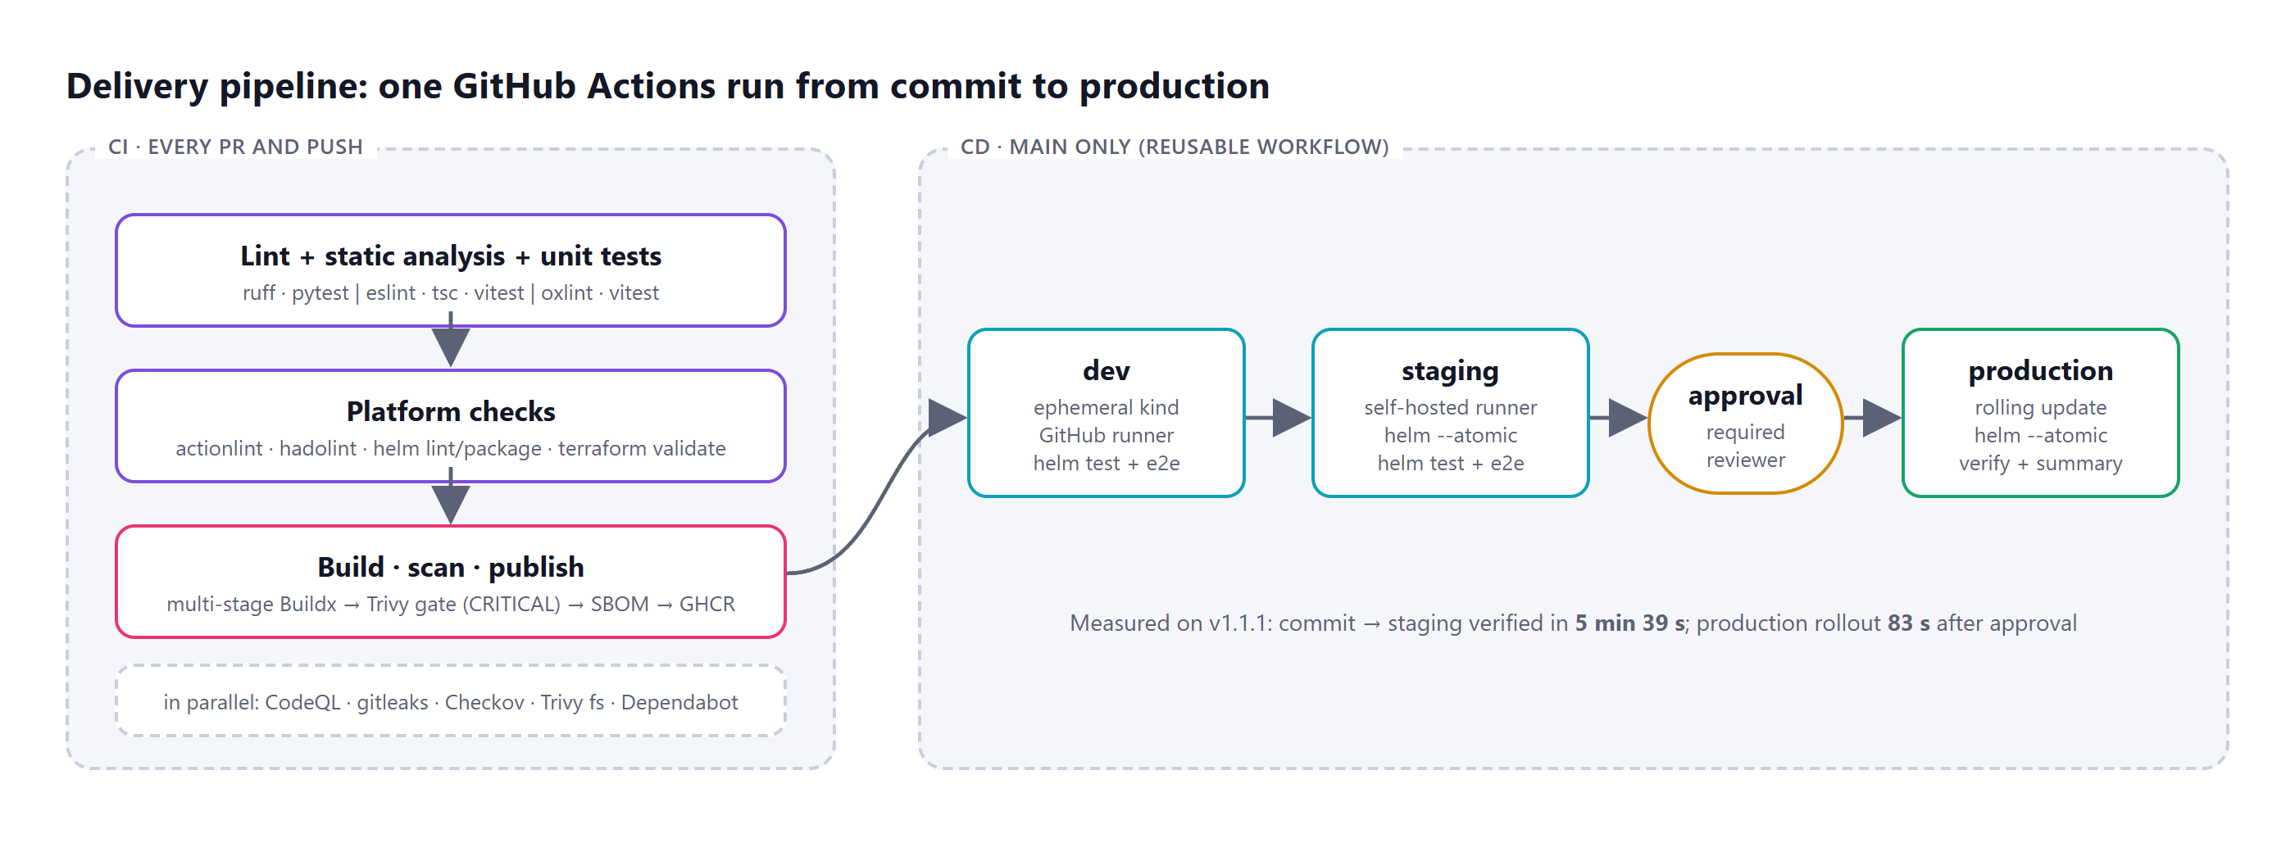
One pipeline from commit to production
ruff · eslint · oxlint · tsc · 49 unit tests · actionlint · hadolint · helm lint · terraform validate · Buildx · Trivy gate · SBOM · GHCR · CodeQL · gitleaks · Checkov
Notes:
CI runs on every PR and push: lint and type-check, 49 unit tests with coverage, workflow and Dockerfile linting, Helm and Terraform validation, then multi-stage image builds. Trivy fails the build on any fixable critical CVE, Syft writes an SBOM, and images go to GitHub Container Registry. CodeQL, gitleaks and Checkov run in parallel. CD is a reusable workflow that CI calls on pushes to main, so one run graph shows the whole path.

Slide 9
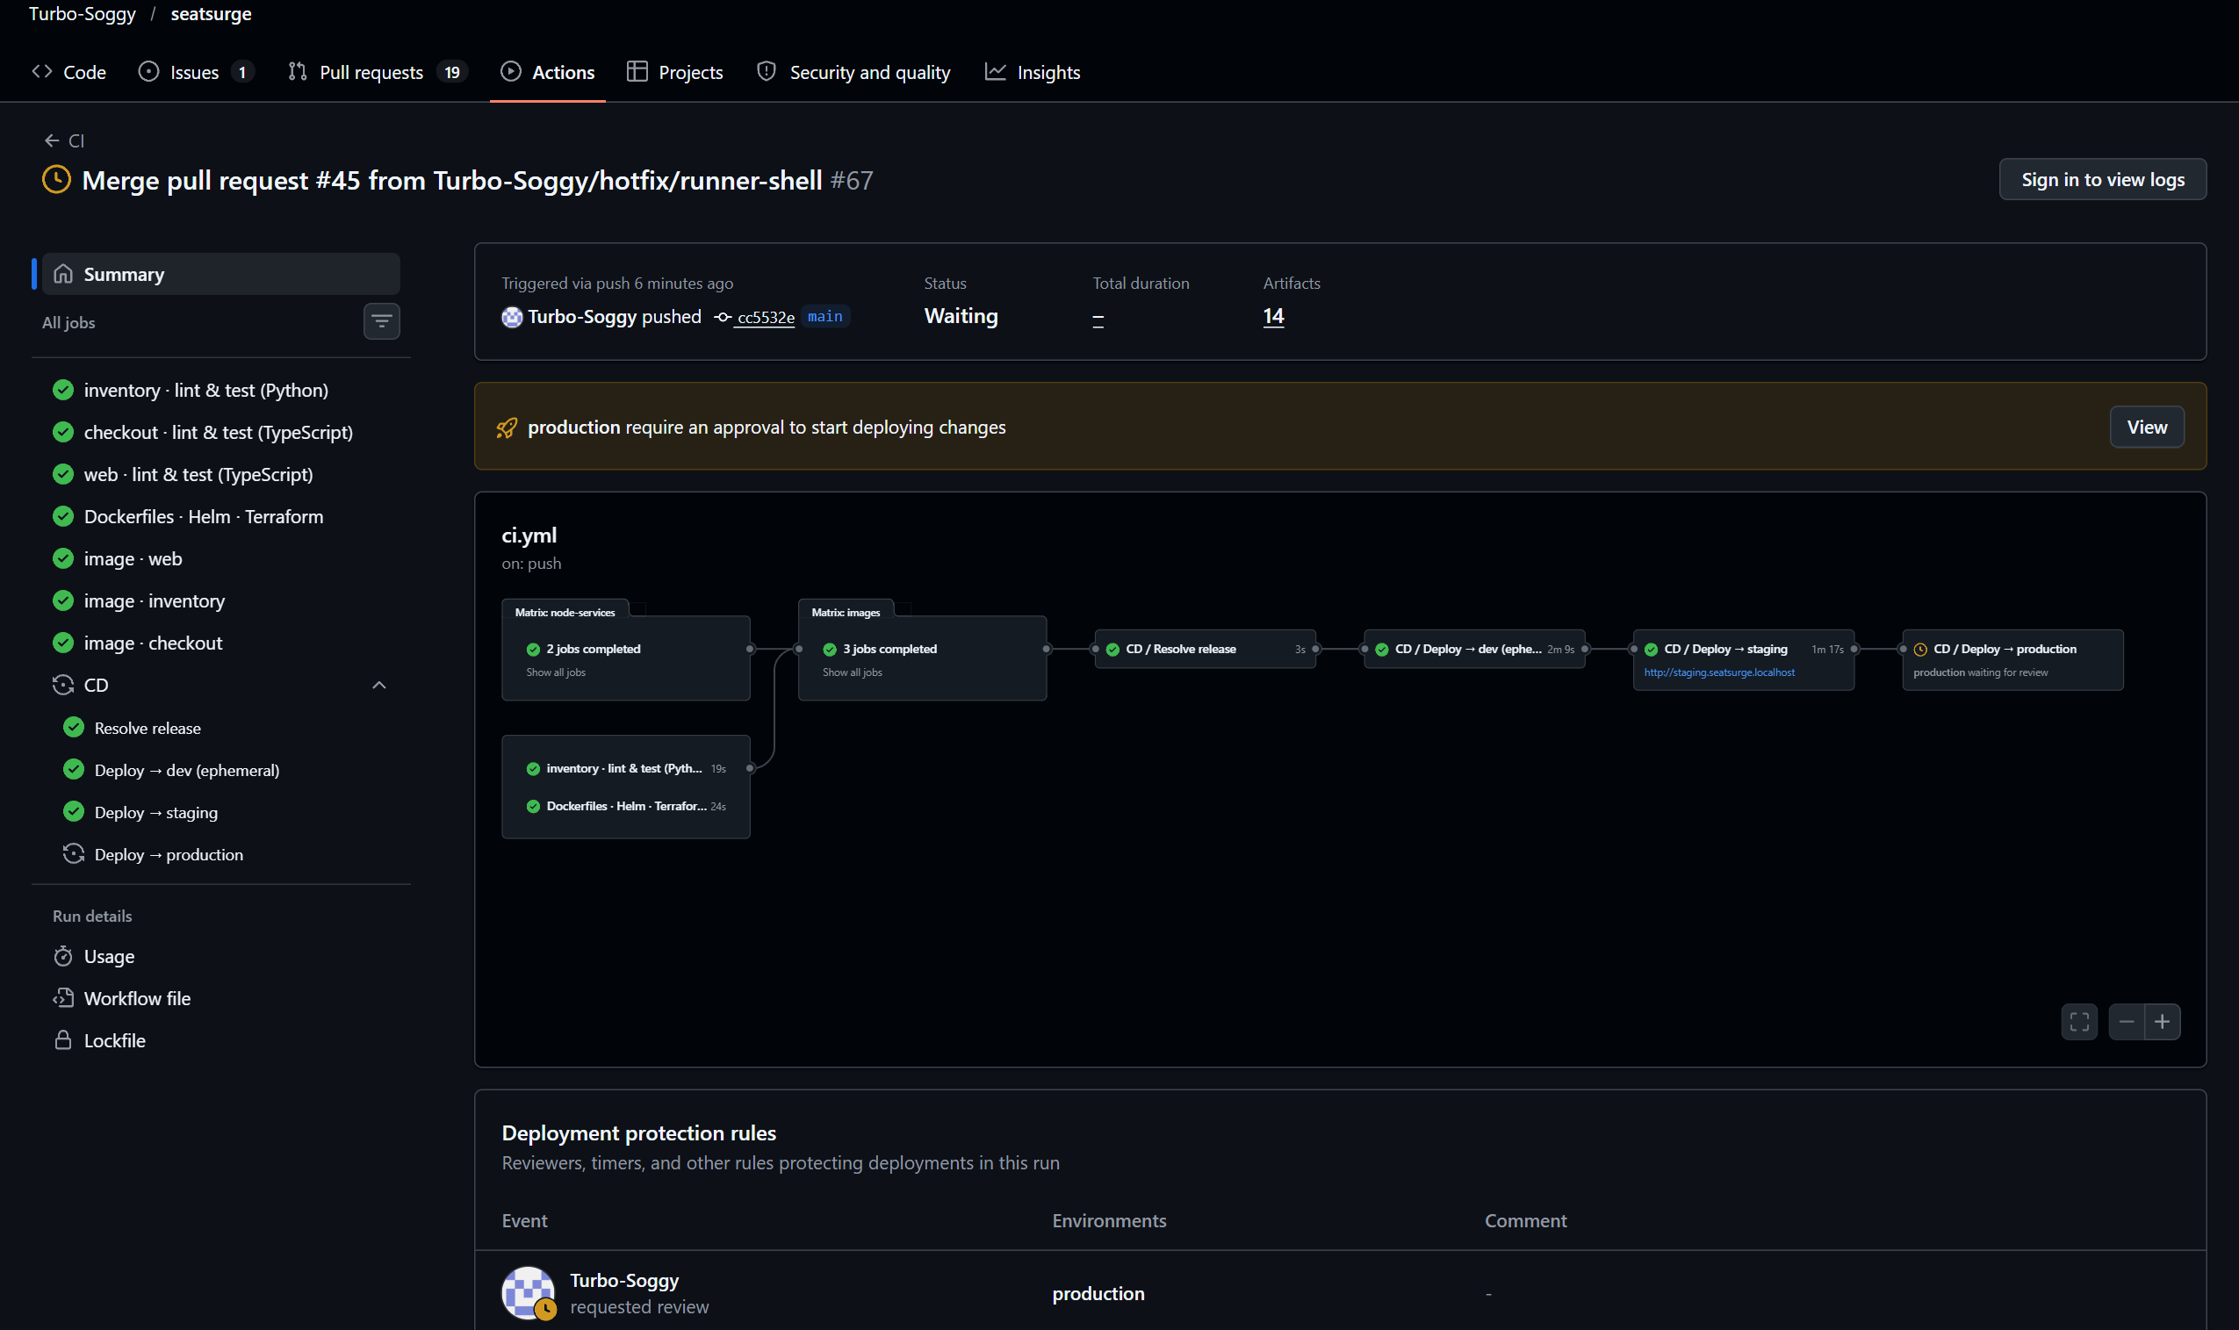
Delivery: dev → staging → human approval → production
Commit → staging verified: 5 min 39 s
Each stage: helm upgrade --atomic (auto-rollback) · helm test · end-to-end booking. Production needs a required reviewer.
Notes:
Dev is a throwaway kind cluster on a GitHub-hosted runner: install, helm test, book a seat end to end, destroy. Staging and production run on a self-hosted runner next to the long-lived cluster, with helm --atomic so a failed rollout rolls itself back. The production environment requires a reviewer, so the run pauses here until I approve. DEMO: this is where I approve live.

Slide 10



Small, non-root, tested-at-build-time images
Image | Build stages | Runtime base | User
inventory | builder → test (ruff + pytest) → runtime | python:3.13-slim | uid 10001
checkout | deps → build (lint, tsc, test, prune) → runtime | distroless nodejs24 | uid 65532
web | deps → build (vite) → runtime | nginx-unprivileged | uid 101
Tests run inside the build
No shell, numeric UIDs
Scanned and inventoried
An image cannot exist for code that fails its tests.
Distroless and unprivileged bases; Kubernetes can verify runAsNonRoot.
Trivy gate on CRITICAL CVEs; SPDX SBOM per image; pushed to GHCR.
Notes:
Every Dockerfile is multi-stage. The test stage runs the unit tests inside the build, so a failing test means no image. Runtime images contain no compilers or shells and run as numeric non-root users. Trivy found critical CVEs in older nginx-alpine and Debian 12 bases; I moved to patched bases rather than ignoring them.

Slide 11
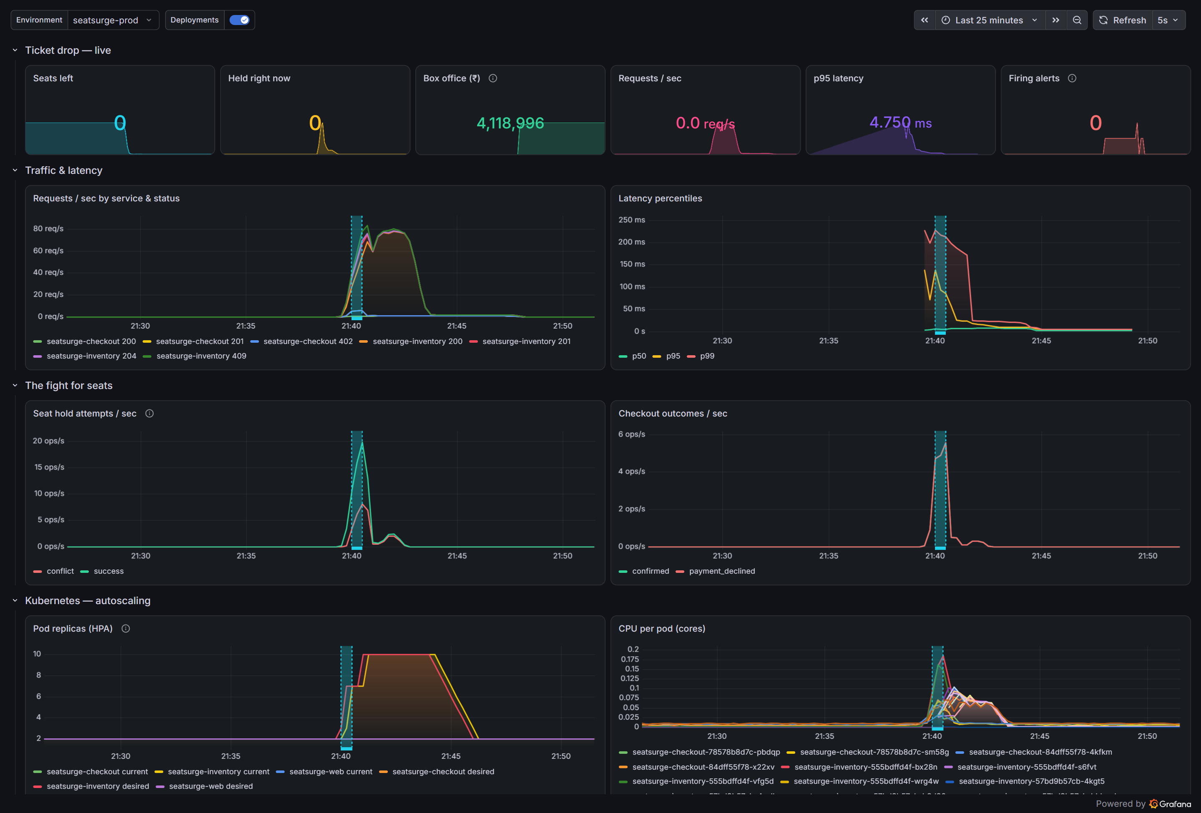
Autoscaling and a zero-downtime rolling update, live
0 failed
of 14,330 requests during the rollout
476 / 476
version probes returned HTTP 200
2 → 10
inventory pods (HPA on CPU)
~15 s
helm rollback and roll-forward
maxSurge 1 · maxUnavailable 0 · readiness probes · preStop drain · PodDisruptionBudgets
Notes:
This dashboard is from the real v1.1.0 release. The shaded band is the rollout: a new ReplicaSet replacing pods one at a time. Traffic and checkouts peak inside that band, and latency stays flat. The pod-replica panel shows the HPA taking inventory from 2 to 10 pods. A probe every half second saw the version switch with every response HTTP 200. Helm rollback on staging took about 15 seconds each way. DEMO: run scripts/demo.ps1 and approve production while it runs.

Slide 12
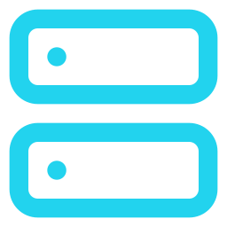

The whole platform is code: one terraform apply
Local platform (applied)
Azure module (validated in CI)
kind cluster: 1 control plane + 2 workers
Traefik ingress, metrics-server
Sealed Secrets controller
kube-prometheus-stack (Prometheus, Alertmanager, Grafana)
Loki + Grafana Alloy for logs
Dashboard shipped as a ConfigMap; chart versions pinned
AKS: Cilium, Entra ID RBAC, workload identity, 3 zones
Autoscaling app node pool (1–5 nodes)
ACR with AcrPull: no registry passwords
Key Vault + federated identity for checkout
Log Analytics + Container Insights
terraform validate on every PR; plan needs a subscription
Notes:
Infrastructure as code. The local module uses the kind, Helm and Kubernetes Terraform providers to build the cluster and every platform component, so a new machine goes from nothing to the full platform with one command. The Azure module targets AKS with no stored credentials anywhere: ACR pull through managed identity, Key Vault through workload identity. It is validated on every PR; applying it needs a subscription.

Slide 13
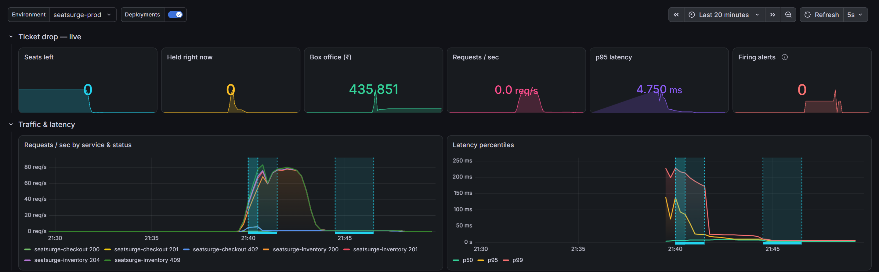
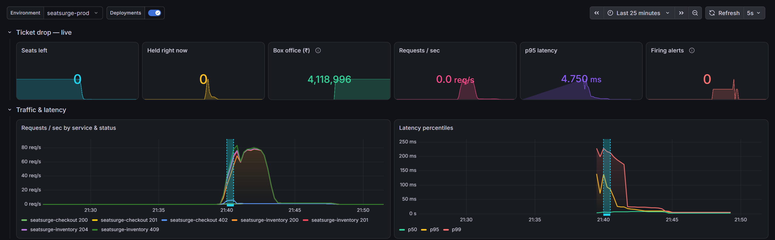
Observability that found its own bugs
BEFORE
Metrics
RED per route + business metrics (holds, orders, box office)
Dashboard as code
18 panels generated by generate.py
Logs
AFTER
JSON logs → Alloy → Loki, beside the metrics
7 alerts
error rate, p95, target down, frenzy, sold out, HPA maxed, crash loop
Notes:
Prometheus scrapes both APIs; Grafana shows request rate, errors and latency next to business numbers. Monitoring paid off: after a scale-down the box office showed ₹4,35,851 instead of ₹41,18,996, because it summed an in-process counter that disappears with each pod. It now reads Postgres at scrape time. The rollout marker was also firing on every autoscaling event; it now marks only new ReplicaSets.

Slide 14




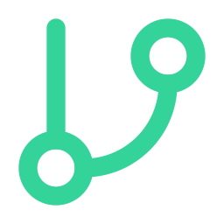

Security in every layer, with no plaintext secrets
Images
Code
Secrets in history
Trivy blocks fixable CRITICAL CVEs; 0 in shipped images
CodeQL for Python, JS/TS and workflows; findings block merge
gitleaks scans full history on every PR
Infrastructure
Supply chain
Secrets
Checkov on Terraform, Helm and Dockerfiles
All actions pinned to SHAs; SBOMs; Dependabot
SealedSecret in prod; Key Vault + workload identity on Azure
Notes:
Six layers. A notable moment: the trivy-action tag the pipeline used no longer resolved, a reminder that tags can move. CodeQL then flagged 14 actions on mutable tags, so every third-party action is now pinned to a commit SHA and Dependabot keeps those pins current. The production database password is a SealedSecret: encrypted with the cluster’s public key, safe to commit, and only the cluster can decrypt it.

Slide 15
13 real defects caught by the pipeline
1
Workflow YAML error stopped CI
→ actionlint added
2
trivy-action tag vanished
→ pinned by SHA
3
gitleaks false positive
→ narrow allowlist
4
pytest import path in CI
→ pythonpath config
5
14 actions on mutable tags
→ all SHA-pinned
6
Untrusted checkout in CD
→ reusable workflow
7
Log injection, assert side effect
→ code fixed
8
helm test --logs pod deleted
→ hotfix v1.0.1
9
Runner custom shell path
→ hotfix v1.0.2
10
Reset left stale orders → 409s
→ fix PR #44
11
Box office dropped on scale-down
→ DB-backed gauge
12
Unclosed file in generator
→ with-block
13
Smoke test broke on sold-out event
→ hotfix v1.1.1
Notes:
This is what a pipeline is for. None of these reached users: each was caught by a check, a deploy stage or monitoring, and each was fixed with a PR through the same gates. Three needed hotfixes on main, which exercised the hotfix-and-back-merge flow for real.

Slide 16
Rubric coverage
Criterion | Evidence
DevOps ecosystem, version control & collaboration | GitFlow-lite, 20 PRs, protected branches, merge-conflict case study, hotfix + back-merge, CODEOWNERS, Dependabot
CI/CD pipeline automation | Lint, static analysis, 49 tests, Trivy gate, SBOM, GHCR; dev → staging → approval → prod; 5 releases
Containerization & orchestration | Multi-stage non-root images; Deployments, Services, Ingress, HPA, PDB, StatefulSet; rolling update + rollback
IaC, cloud deployment & monitoring | Terraform (local + Azure AKS); Prometheus, Grafana, Loki, 7 alerts; SealedSecrets; 5 scanners
Documentation & presentation | README with diagrams, 5 docs, 22-page report, this deck, runbook linked from alerts
Notes:
A one-slide map from each rubric row to concrete evidence in the repository, so every claim can be checked by opening the link.

Slide 17
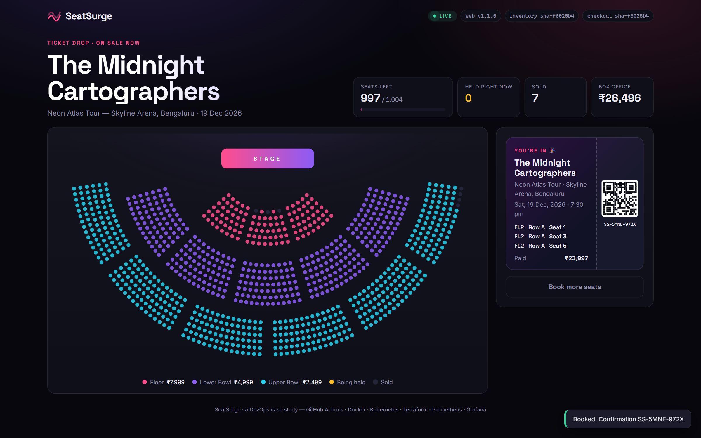
Live demo, then questions
Open a PR → watch CI · merge a release → approve production during a 150-fan load test · helm rollback
github.com/Turbo-Soggy/seatsurge
Notes:
Demo script (about 6 minutes): 1) Open a small PR (change a UI label) and show the checks starting. 2) Merge the open release PR into main, show the run graph through dev and staging, and stop at the approval gate. 3) Start scripts/demo.ps1 (k6, 150 fans), open Grafana and the app side by side, then approve production; point out the rollout band, the HPA scaling and the version chips changing with no errors. 4) helm rollback seatsurge -n seatsurge-staging, then helm history. Then questions.

