Slide 1


M.Tech/MCA Program
Advanced Industry Integrated Programs
Jointly offered by University and LTIMindTree
Review III
Authority-Aware and Evidence-Verified Retrieval-Augmented Generation for Reliable Legal Research over Indian Judicial Judgments
Tharuneesh G K
251011017
Rajalakshmi Engineering College
Knowledge partner | Implementation partner
Notes:
Title slide. Project: Authority-Aware and Evidence-Verified RAG for Indian judicial judgments (LEX-RAG).

Slide 2
Authority-Aware & Evidence-Verified RAG for Indian Judicial Judgments
Introduction
• Indian court judgments are long and complex, so finding the exact passage that answers a legal question takes hours.
• RAG (Retrieval-Augmented Generation) can search thousands of judgments, but a relevant passage is not always proof.
• A passage may only record what a party argued, not what the court decided, so evidence must be checked.
• LEX-RAG retrieves evidence, ranks it by court authority when court metadata exists, and verifies statements with NLI.
• Every answer is an exact, cited sentence from a judgment, or the system says "insufficient evidence".
Judgments
Retrieve
Rank
Verify
Evidence
Notes:
Explain the core problem in one line: finding a relevant passage is easy; proving a legal statement from it is the hard part.

Slide 3
Authority-Aware & Evidence-Verified RAG for Indian Judicial Judgments
Objectives
• Build a local, CPU-only legal research assistant for Indian judgment text (no paid AI API needed).
• Retrieve passages with keyword search (BM25, TF-IDF) and meaning-based search (MiniLM sentence embeddings).
• Rank evidence with Reciprocal Rank Fusion, a cross-encoder reranker and a court-authority bonus from real court metadata.
• Verify legal statements against the judgments with NLI: Supported, Contradicted, Mixed or Not established.
• Keep every result traceable (case ID, chunk ID, character offsets) and compare baseline vs proposed method.
Notes:
Five objectives map directly to the five modules on the next slide.

Slide 4
Authority-Aware & Evidence-Verified RAG for Indian Judicial Judgments
Modules
• Dataset Processing: load CSV/Parquet, remove duplicate text, split judgments into 180-word chunks with IDs.
• Hybrid Retrieval: basic mode = BM25 + TF-IDF; research mode = BM25 + MiniLM semantic search.
• Evidence Reranking: a cross-encoder rescores the top 24 candidates and drops weak matches.
• Authority-Aware Ranking: up to 15% bonus by court level (Supreme 1.0, High 0.8, District 0.6, Tribunal 0.5).
• Evidence Extraction: returns up to 4 source sentences with citation IDs, or abstains.
• Claim Verification: checks 1–3 statements with NLI over evidence windows; one extra search if not supported.
• Evaluation & Interface: Flask web app, baseline vs proposed comparison, review demo and JSON export.
Notes:
Basic mode works without any neural model; research mode adds MiniLM search, reranking and NLI.

Slide 5
Authority-Aware & Evidence-Verified RAG for Indian Judicial Judgments
Problem Statement
• Judgments are long, so manual searching and evidence checking are slow.
• Keyword-only search misses passages that use different legal wording for the same idea.
• Ranking by relevance alone ignores court hierarchy: a Supreme Court ruling and a tribunal order look equal.
• Some verifiers check only the first ~1,000 characters of retrieved text and miss evidence that appears later.
• Goal: traceable retrieval + authority-aware ranking + verification that reads the whole retrieved evidence.
Notes:
Stress the 1,000-character prefix limitation: it is the gap this project tests.

Slide 6
Authority-Aware & Evidence-Verified RAG for Indian Judicial Judgments
Methodology / Modeling Plan
• Step 1 – Preprocess: clean the judgment Text field and split it into overlapping chunks with case/chunk IDs.
• Step 2 – Retrieve: BM25 + TF-IDF (basic) or BM25 + MiniLM dense search (research mode).
• Step 3 – Fuse: combine the ranked lists with Reciprocal Rank Fusion (RRF, k = 60).
• Step 4 – Rerank: cross-encoder rescoring of the top 24 candidates.
• Step 5 – Authority: score × (1 + 0.15 × court weight), only when the court field is known.
• Step 6 – Evidence & NLI: cite source sentences; verify statements with MiniLM NLI on 190-token windows (≥ 0.80).
Text
Retrieve
RRF
Rerank
Authority
Evidence
NLI
Notes:
Walk through the six steps left to right using the chips at the bottom of the slide.

Slide 7
Authority-Aware & Evidence-Verified RAG for Indian Judicial Judgments
Data Preprocessing & EDA
• Dataset: ninadn/indian-legal (Hugging Face), 7,030 judgments with Text and Summary; only Text is searched.
• Download check: file size and column names verified; SHA-256 hash saved for reproducible runs.
• Deduplication: identical text within a case is removed using a SHA-256 fingerprint.
• Chunking: 180 words, 35-word overlap, ≤ 30 chunks per judgment; development index = 6,000 chunks / 286 cases.
• Metadata audit: this CSV has no court or date fields, so authority and date filters stay off for it.
• Fallback corpus: Sikkim High Court Parquet, 11,389 chunks / 2,219 cases, with court and date fields.
Text
Retrieve
RRF
Rerank
Authority
Evidence
NLI
Notes:
Be clear that the current CSV has no court/date fields, so authority ranking is shown on the Sikkim corpus or with metadata.

Slide 8
Authority-Aware & Evidence-Verified RAG for Indian Judicial Judgments
Approach / Algorithms / Tools
• Basic retrieval: BM25 + TF-IDF fused with Reciprocal Rank Fusion (RRF).
• Semantic retrieval: sentence-transformers/all-MiniLM-L6-v2 embeddings (384 dimensions).
• Reranking: cross-encoder/ms-marco-MiniLM-L6-v2.
• Verification: cross-encoder/nli-MiniLM2-L6-H768 (Entailment / Neutral / Contradiction).
• Authority: court-level weight × 0.15 bonus, taken from structured court metadata only.
• Tools: Python 3.12, Flask + Waitress, scikit-learn, PyTorch (CPU), Hugging Face Transformers, GitHub.
Notes:
All three models are small, public and pinned to exact revisions, so results are reproducible on a CPU laptop.

Slide 9
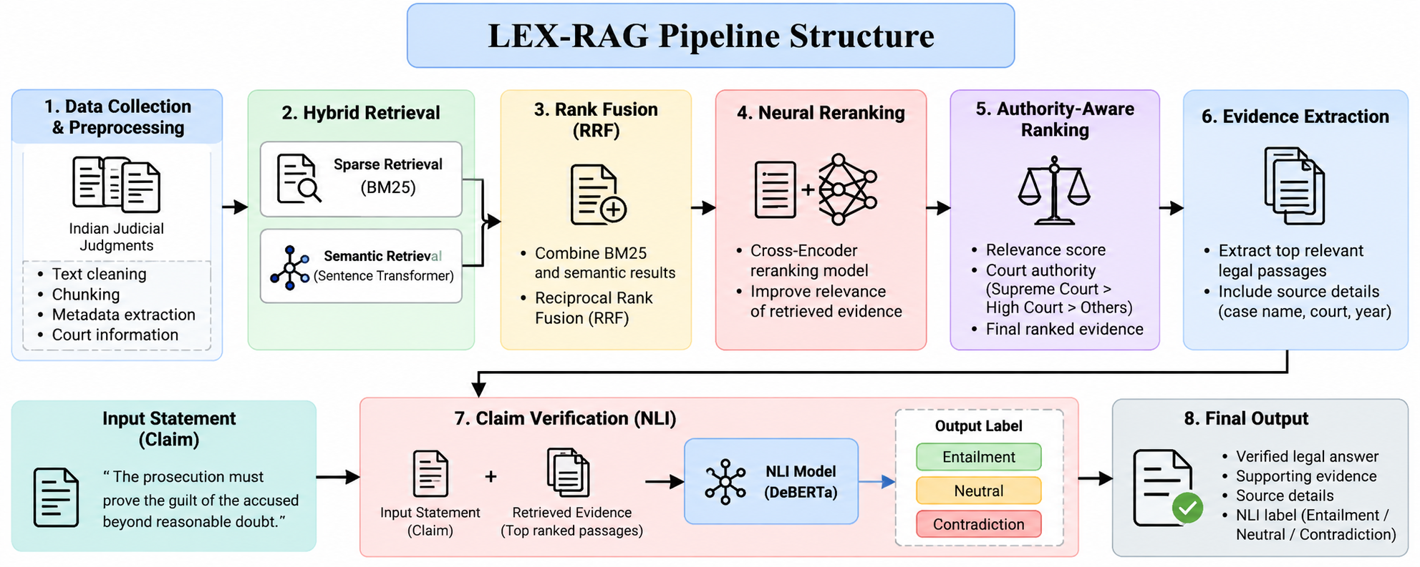
Authority-Aware & Evidence-Verified RAG for Indian Judicial Judgments
LEX-RAG Pipeline Structure
Text
Retrieve
RRF
(MiniLM)
Rerank
Authority
Evidence
NLI
Answers are source-extracted sentences; NLI (nli-MiniLM2-L6-H768) is a separate statement checker. Authority scoring needs real court metadata.
Notes:
The pipeline image originally named DeBERTa; the implemented NLI model is MiniLM (nli-MiniLM2-L6-H768), a CPU-friendly substitute.

Slide 10
Authority-Aware & Evidence-Verified RAG for Indian Judicial Judgments
Current Implementation Status
• Dataset connected: ninadn/indian-legal CSV, cached locally with its SHA-256 for offline runs.
• Basic mode: BM25 + TF-IDF + RRF with cited, source-extracted answers (working).
• Research mode: MiniLM semantic search + cross-encoder reranking on CPU (working).
• Claim checker: window-based NLI with one claim-focused re-search (working).
• Review demo: compares prefix-only, evidence-window and window + re-search verification side by side.
• Testing: 24 automated regression tests pass; model versions pinned in models/manifest.json.
Notes:
Everything listed is implemented and runs locally; 24 regression tests pass.

Slide 11
Authority-Aware & Evidence-Verified RAG for Indian Judicial Judgments
Project Plan / Milestones Progress
• Literature Survey & Research Gap — Completed
• Dataset Connection & Preprocessing — Completed
• Basic BM25 + TF-IDF + RRF Retrieval — Completed
• Research Semantic Retrieval & Neural Reranking — Completed
• NLI Statement Verification / Evidence Windows — Completed
• Authority-Aware Metadata Experiments — In Progress
• Baseline vs Proposed Evaluation — In Progress
• Final Testing, Results & Documentation — In Progress
Text
Retrieve
RRF
Rerank
Authority
Evidence
NLI
COMPLETED
IN PROGRESS
Notes:
Remaining work is evaluation on legally reviewed labels and richer court metadata.

Slide 12
Authority-Aware & Evidence-Verified RAG for Indian Judicial Judgments
Findings and Results
• Fair test: same claim, same retrieved passages, same NLI model and 0.80 threshold; only the evidence strategy changes.
• A = first 1,000 characters only · B = evidence windows across all passages · C = B + one re-search.
Claim tested | A: Prefix only | B: Evidence windows | C: Windows + re-search
Appellant claimed a deduction for municipal property taxes | Not established (0.017) | Supported (0.951) | Supported (no retry needed)
Property taxes are deductible from rental income (general rule) | Not established | Not established | Not established
Liability and charge co-exist and are co-extensive | Contradicted | Contradicted | Contradicted
Quantum computers are needed to compute property tax (nonsense) | Contradicted | Contradicted | Contradicted
Key takeaway: reading the whole evidence found support the 1,000-character prefix missed (0.017 → 0.951). Four illustrative examples, not an accuracy benchmark.
Notes:
The only change between A, B and C is how much evidence is checked. Do not present 0.951 as 95% accuracy; it is one uncalibrated NLI score.

Slide 13
Authority-Aware & Evidence-Verified RAG for Indian Judicial Judgments
Conclusion
• LEX-RAG links every answer and verified statement to an exact passage in a judgment, or abstains.
• Reading the whole retrieved evidence matters: in one test, prefix-only support was 0.017; window-based, 0.951.
• Authority-aware ranking uses only real court metadata, never courts merely cited inside a judgment.
• It is a legal research support tool, not a substitute for a lawyer's interpretation.
• Next: legally reviewed test set, threshold calibration, mixed-court data and Recall@5 / MRR / nDCG evaluation.
Notes:
End with the honest scope: a research support tool with a clear next evaluation step.

Slide 14
Authority-Aware & Evidence-Verified RAG for Indian Judicial Judgments
Acknowledgement
• I sincerely thank my project guide, faculty members and reviewers for their guidance and technical feedback.
• I thank Rajalakshmi Engineering College, LTIMindtree and the M.Tech Advanced Industry Integrated Program.
• I acknowledge the open-source community and the model and dataset providers used in this project.

Slide 15
Authority-Aware & Evidence-Verified RAG for Indian Judicial Judgments
References
• Lewis et al. (2020) — Retrieval-Augmented Generation for Knowledge-Intensive NLP Tasks.
• Robertson & Zaragoza (2009) — The Probabilistic Relevance Framework: BM25 and Beyond.
• Cormack, Clarke & Buettcher (2009) — Reciprocal Rank Fusion Outperforms Condorcet and Individual Rank Learning Methods.
• Reimers & Gurevych (2019) — Sentence-BERT: Sentence Embeddings using Siamese BERT-Networks.
• Wang et al. (2020) — MiniLM: Deep Self-Attention Distillation for Compression of Pre-Trained Transformers.
• Nogueira & Cho (2019) — Passage Re-ranking with BERT.
• Bowman et al. (2015) — A Large Annotated Corpus for Learning Natural Language Inference.
• Pipitone & Houir Alami (2024) — LegalBench-RAG: A Benchmark for RAG in the Legal Domain.
• Dataset — ninadn/indian-legal, Hugging Face.

Slide 16
M.Tech/MCA Program
Advanced Industry Integrated Programs
Jointly offered by University and LTIMindTree
Review III
Agentic AI-Based Credit Risk Assessment using Machine Learning and LangGraph
251011017
Rajalakshmi Engineering College
THARUNEESH G K
Knowledge partner | Implementation partner
Notes:
Title slide for the second project: CreditAgent AI.

Slide 17
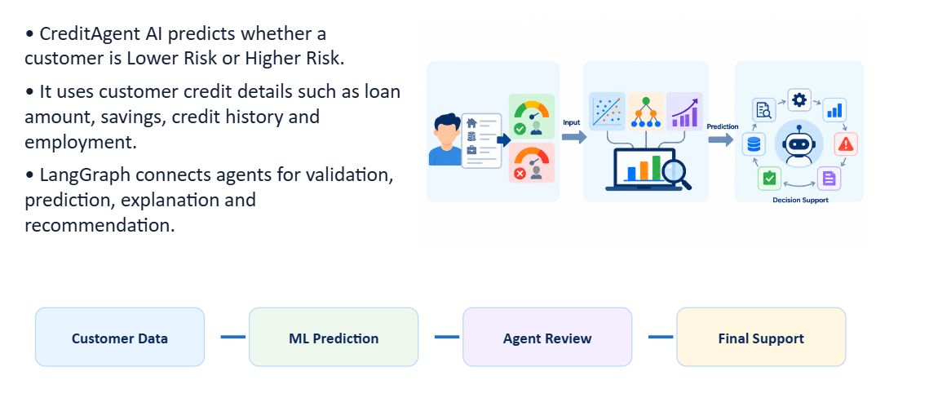
Agentic AI-Based Credit Risk Assessment – CreditAgent AI
Introduction
CreditAgent AI
CreditAgent AI predicts whether a customer is Lower Risk or Higher Risk.
It uses customer credit details such as loan amount, savings, credit history and employment.
LangGraph connects agents for validation, prediction, explanation and recommendation.
Customer Data → ML Prediction → Agent Review → Final Support
Notes:
In simple words: the system looks at a loan applicant's details and says Lower Risk or Higher Risk, then explains why.

Slide 18
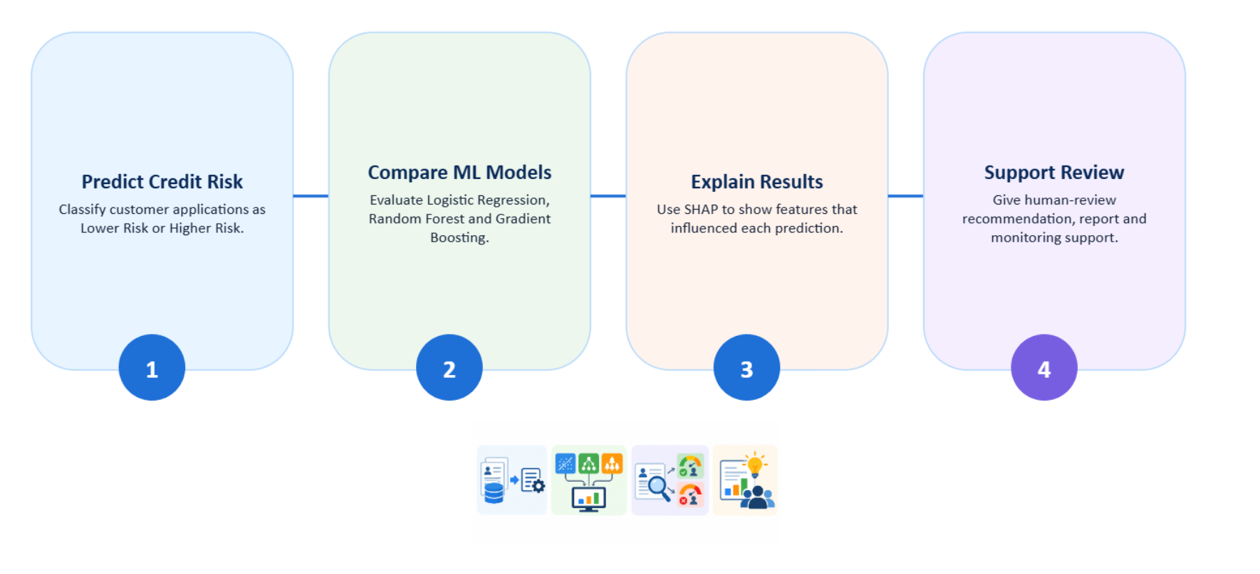
Agentic AI-Based Credit Risk Assessment – CreditAgent AI
Objective
CreditAgent AI
Predict Credit Risk: Classify customer applications as Lower Risk or Higher Risk.
Compare ML Models: Evaluate Logistic Regression, Random Forest and Gradient Boosting.
Explain Results: Use SHAP to show features that influenced each prediction.
Support Review: Give human-review recommendation, report and monitoring support.
Notes:
Four goals: predict risk, compare three ML models, explain each prediction with SHAP, and support a human reviewer.

Slide 19
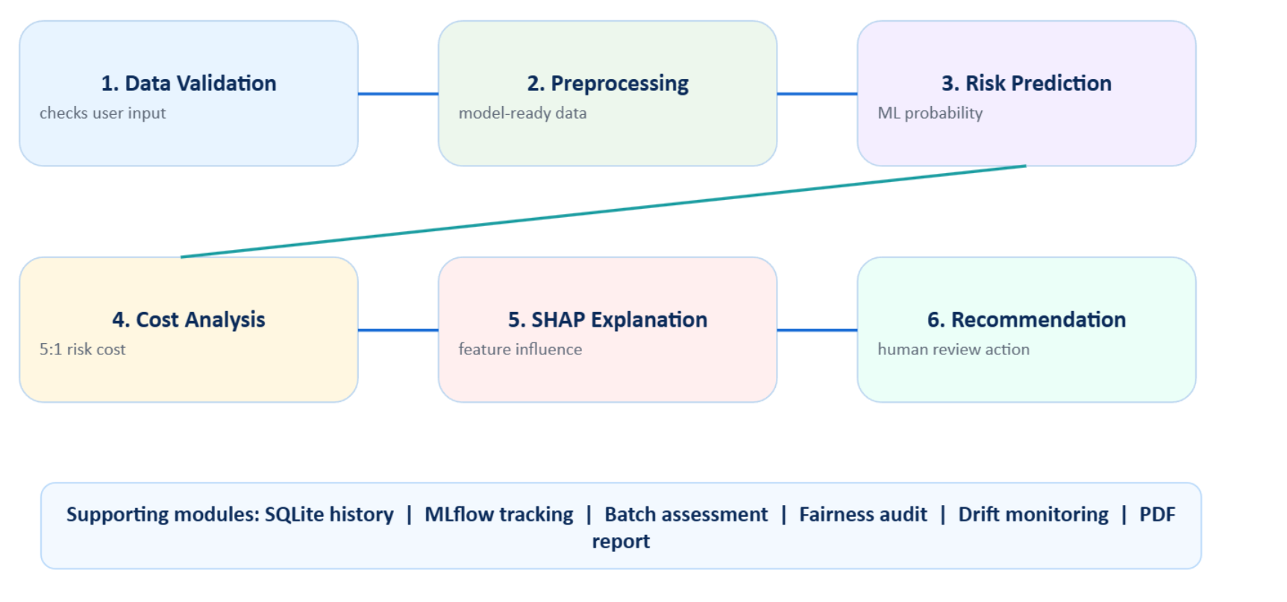
Agentic AI-Based Credit Risk Assessment – CreditAgent AI
Modules
1. Data Validation: checks user input
2. Preprocessing: model-ready data
3. Risk Prediction: ML probability
4. Cost Analysis: 5:1 risk cost
5. SHAP Explanation: feature influence
6. Recommendation: human review action
Supporting modules: SQLite history | MLflow tracking | Batch assessment | Fairness audit | Drift monitoring | PDF report
Notes:
Six agents run in order. Cost Analysis treats missing a risky customer as about 5 times worse than a false alarm (5:1 cost).

Slide 20
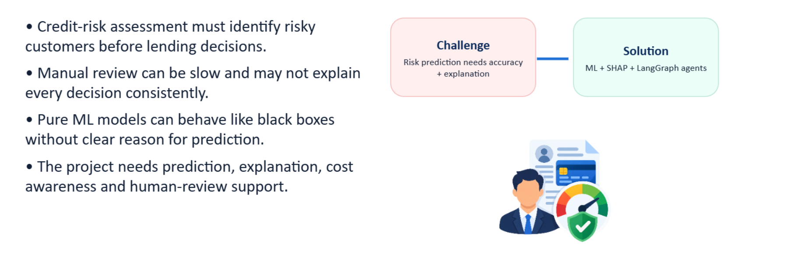
Agentic AI-Based Credit Risk Assessment – CreditAgent AI
Problem Statement
CreditAgent AI
Credit-risk assessment must identify risky customers before lending decisions.
Manual review can be slow and may not explain every decision consistently.
Pure ML models can behave like black boxes without clear reason for prediction.
The project needs prediction, explanation, cost awareness and human-review support.
Challenge: Risk prediction needs accuracy + explanation
Solution: ML + SHAP + LangGraph agents
Notes:
Problem: a model that only gives a score is hard to trust; lenders need the reason and a human check.

Slide 21
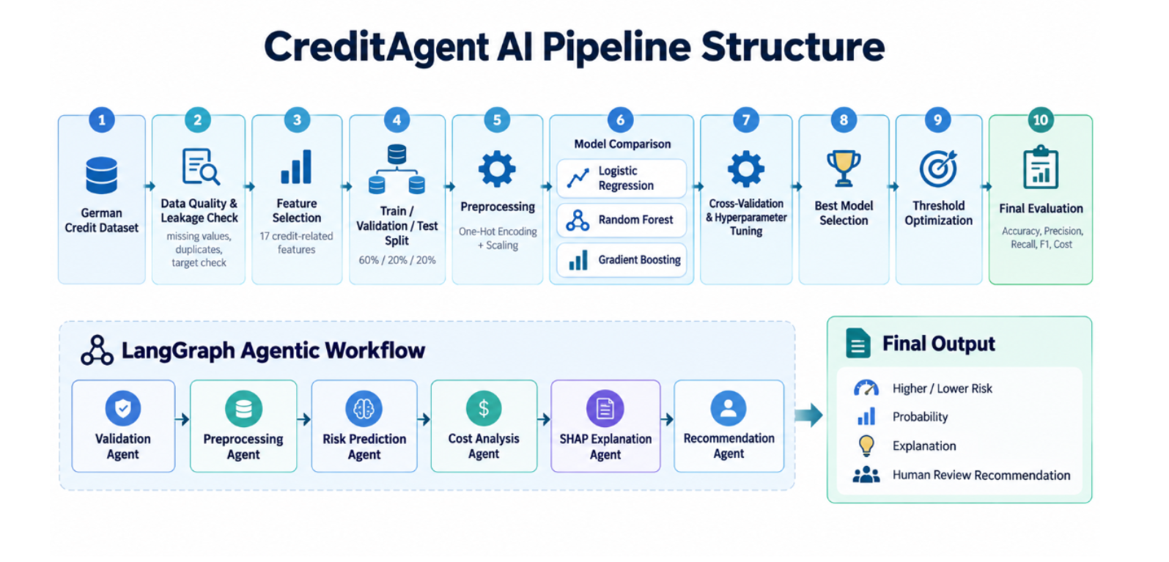
Agentic AI-Based Credit Risk Assessment – CreditAgent AI
Methodology
CreditAgent AI
Notes:
Top row: the ML pipeline from the German Credit data to final evaluation (60/20/20 split). Bottom row: the LangGraph agents that use the trained model.

Slide 22
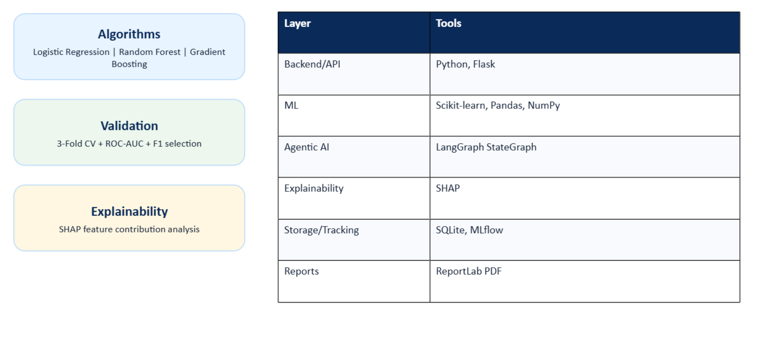
Agentic AI-Based Credit Risk Assessment – CreditAgent AI
Approach / Algorithms / Tools
CreditAgent AI
Algorithms
Logistic Regression | Random Forest | Gradient Boosting
Validation
3-Fold CV + ROC-AUC + F1 selection
Explainability
SHAP feature contribution analysis
Layer | Tools
Backend/API | Python, Flask
ML | Scikit-learn, Pandas, NumPy
Agentic AI | LangGraph StateGraph
Explainability | SHAP
Storage/Tracking | SQLite, MLflow
Reports | ReportLab PDF
Notes:
Three models are compared with 3-fold cross-validation; the best is chosen by ROC-AUC and F1. SHAP shows which features pushed a decision.

Slide 23
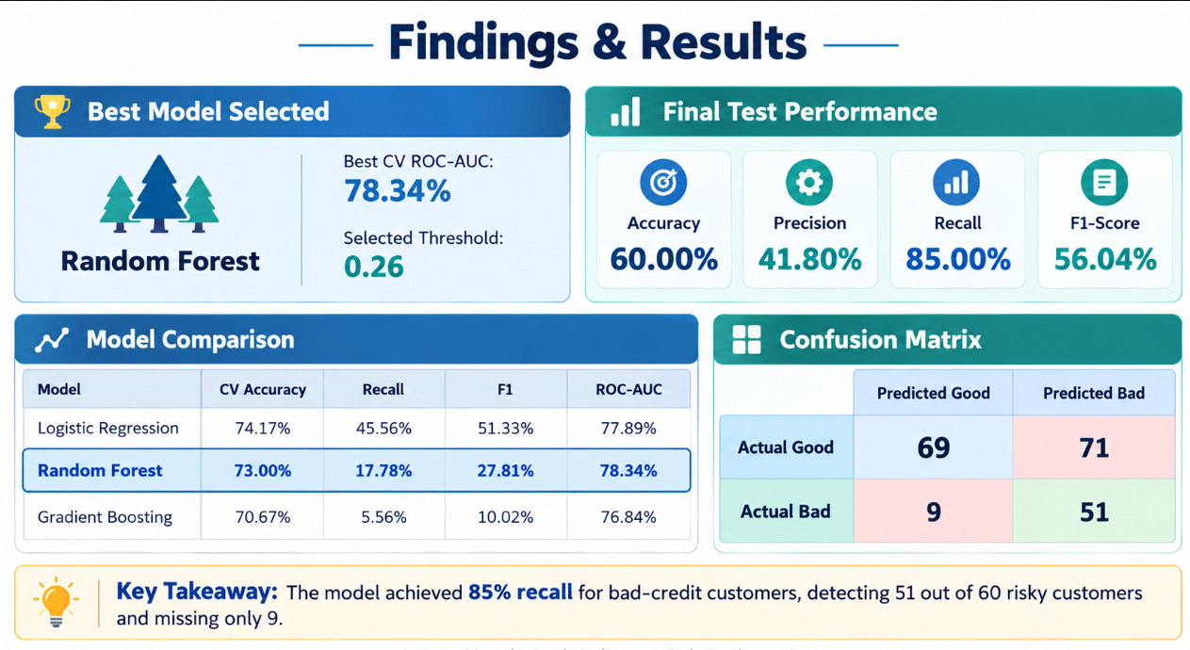
Agentic AI-Based Credit Risk Assessment – CreditAgent AI
Findings and Results
Note: the comparison table uses the default threshold. Lowering it to 0.26 raises recall to 85% (51 of 60 risky customers caught) but flags 71 good customers.
Notes:
Random Forest was best on ROC-AUC (78.34%). With the threshold lowered to 0.26 it catches 85% of risky customers, at 41.8% precision. This trade-off is deliberate because missing a bad loan costs more.

Slide 24
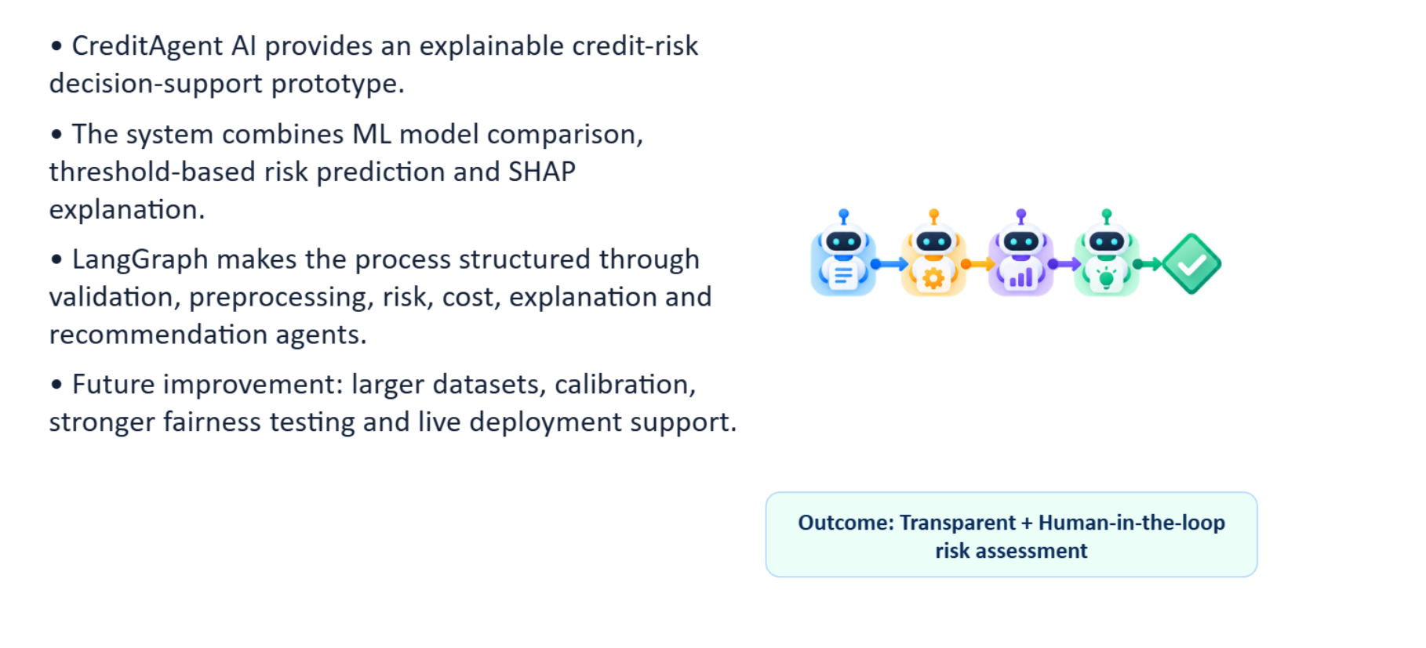
Agentic AI-Based Credit Risk Assessment – CreditAgent AI
Conclusion
CreditAgent AI
CreditAgent AI provides an explainable credit-risk decision-support prototype.
The system combines ML model comparison, threshold-based risk prediction and SHAP explanation.
LangGraph makes the process structured through validation, preprocessing, risk, cost, explanation and recommendation agents.
Future improvement: larger datasets, calibration, stronger fairness testing and live deployment support.
Outcome: Transparent + Human-in-the-loop risk assessment
Notes:
Summary: explainable, cost-aware, human-in-the-loop credit risk support. Next: more data, calibration, fairness testing.

Slide 25
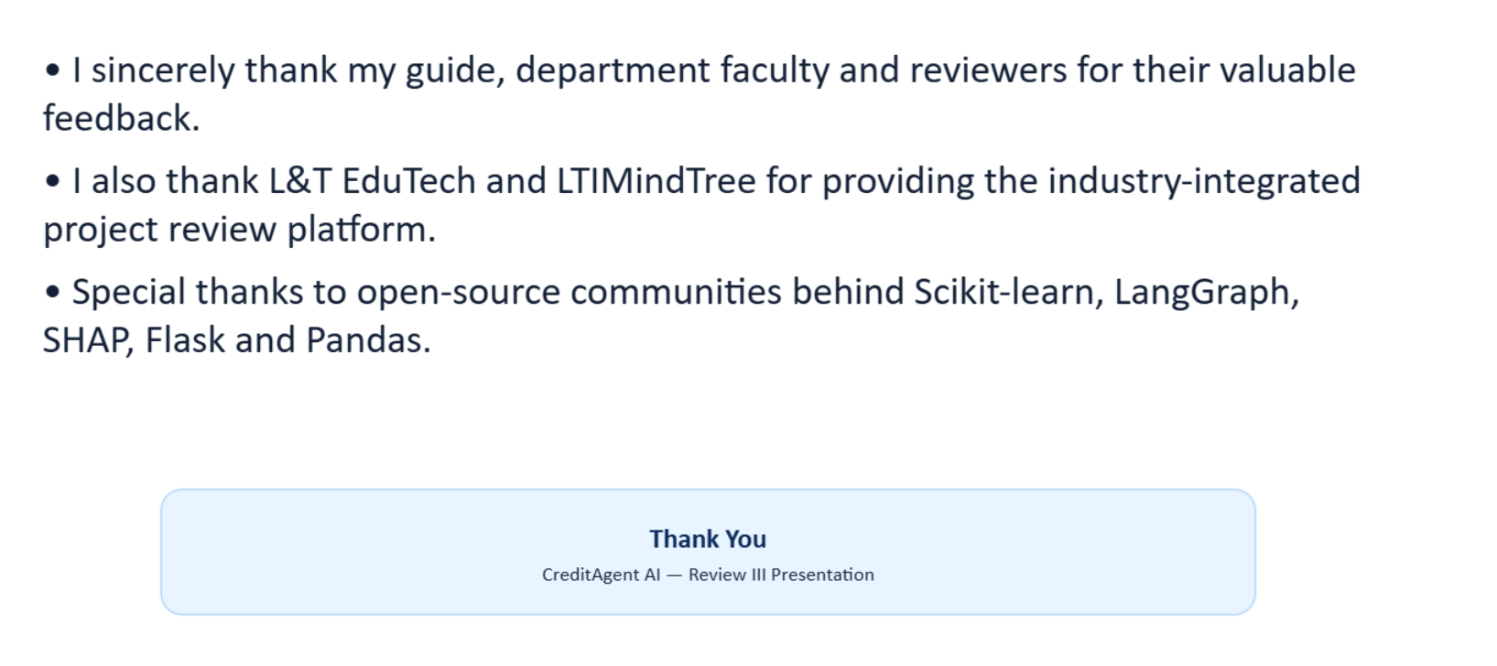
Agentic AI-Based Credit Risk Assessment – CreditAgent AI
Acknowledgement
CreditAgent AI
I sincerely thank my guide, department faculty and reviewers for their valuable feedback.
I also thank L&T EduTech and LTIMindTree for providing the industry-integrated project review platform.
Special thanks to open-source communities behind Scikit-learn, LangGraph, SHAP, Flask and Pandas.
Thank You — CreditAgent AI — Review III Presentation
Notes:
Thank the guide, faculty, L&T EduTech and LTIMindtree.

Slide 26
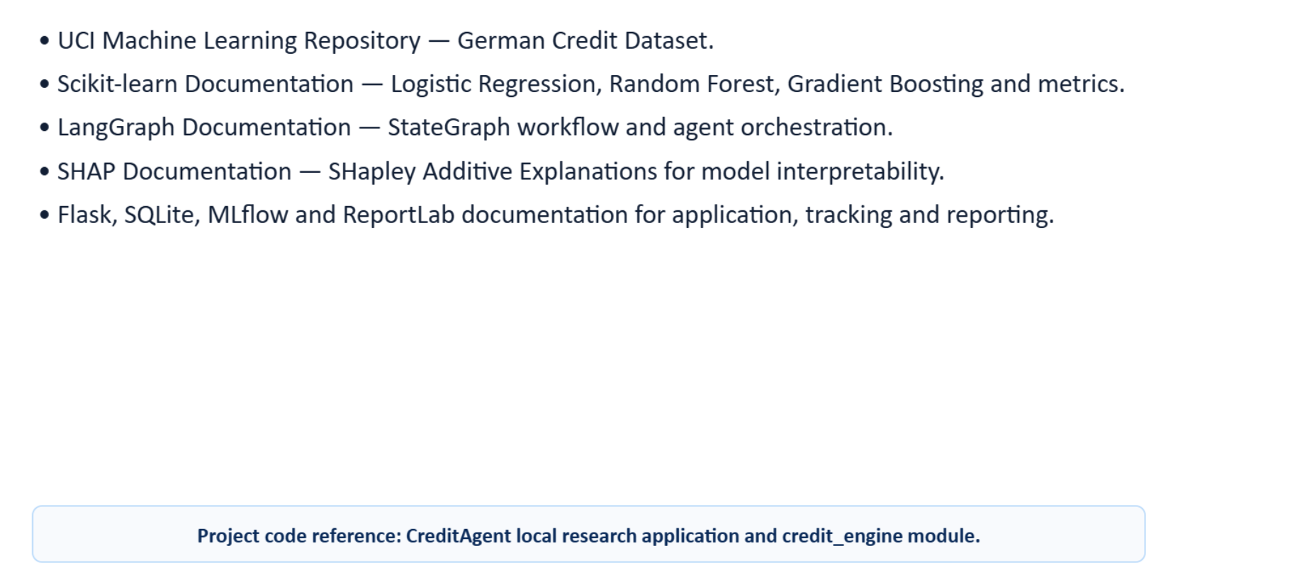
Agentic AI-Based Credit Risk Assessment – CreditAgent AI
References
CreditAgent AI
UCI Machine Learning Repository — German Credit Dataset.
Scikit-learn Documentation — Logistic Regression, Random Forest, Gradient Boosting and metrics.
LangGraph Documentation — StateGraph workflow and agent orchestration.
SHAP Documentation — SHapley Additive Explanations for model interpretability.
Flask, SQLite, MLflow and ReportLab documentation for application, tracking and reporting.
Project code reference: CreditAgent local research application and credit_engine module.
Notes:
Main sources: UCI German Credit dataset and the documentation of the libraries used.

