Slide 1


M.Tech/MCA Program
Advanced Industry Integrated Programs
Jointly offered by University and LTIMindTree
Review III
Authority-Aware and Evidence-Verified Retrieval-Augmented Generation for Reliable Legal Research over Indian Judicial Judgments
Tharuneesh G K
251011017
REC College
Knowledge partner | Implementation partner

Slide 2
Authority-Aware & Evidence-Verified RAG for Indian Judicial Judgments
Introduction
• Legal research is time-consuming because judicial judgments are lengthy and complex.
• Retrieval-Augmented legal research helps locate relevant evidence from large judgment collections.
• Relevance alone is not enough: legal evidence should also be traceable and checked against the source text.
• LEX-RAG combines evidence retrieval, authority-aware ranking and NLI-based statement verification for reliable Indian legal research.
Judgments
Retrieve
Rank
Verify
Evidence

Slide 3
Authority-Aware & Evidence-Verified RAG for Indian Judicial Judgments
Objectives
• Develop an AI-assisted legal research system for Indian judicial judgment text.
• Retrieve relevant legal passages using lexical and research-mode semantic retrieval.
• Improve evidence ordering using Reciprocal Rank Fusion, neural reranking and authority-aware scoring where valid court metadata exists.
• Verify legal statements against retrieved evidence using Natural Language Inference (NLI).
• Improve transparency through source traceability, evidence display and baseline-vs-proposed comparison.

Slide 4
Authority-Aware & Evidence-Verified RAG for Indian Judicial Judgments
Modules
• Dataset Processing Module — load, clean and chunk Indian legal judgment text.
• Hybrid Retrieval Module — BM25 + TF-IDF in basic mode; semantic retrieval is available in research mode.
• Evidence Reranking Module — refine top candidates using the optional neural research models.
• Authority-Aware Ranking Module — apply court-authority weighting only when explicit court metadata is available.
• Evidence Extraction Module — return source sentences/passages with traceability.
• Claim Verification Module — compare a supplied legal statement with retrieved evidence using NLI.
• Evaluation & Interface Module — compare methods and expose evidence, diagnostics and JSON export.

Slide 5
Authority-Aware & Evidence-Verified RAG for Indian Judicial Judgments
Problem Statement
• Indian legal judgments are long, making manual search and evidence checking slow.
• Keyword-only retrieval can miss relevant passages expressed with different legal wording.
• Pure relevance ranking does not automatically represent judicial authority.
• A retrieved or generated legal statement may be unsupported unless it is checked against the original judgment evidence.
• Therefore, the project focuses on traceable retrieval, authority-aware ranking and independent evidence verification.

Slide 6
Authority-Aware & Evidence-Verified RAG for Indian Judicial Judgments
Methodology / Modeling Plan
• Load the Indian legal dataset and preprocess the judgment Text field into searchable passages.
• Run BM25 + TF-IDF retrieval in basic mode; research mode adds semantic retrieval.
• Fuse candidate rankings with Reciprocal Rank Fusion (RRF) and optionally apply neural reranking.
• Apply authority-aware scoring only when the document has explicit, validated court metadata.
• Extract the strongest source evidence rather than presenting unsupported conversational legal advice.
• For statement checking, retrieve claim-specific evidence and run window-based DeBERTa NLI verification.
Text
Retrieve
RRF
Rerank
Authority
Evidence
NLI

Slide 7
Authority-Aware & Evidence-Verified RAG for Indian Judicial Judgments
Data Preprocessing & EDA
• Dataset loading — download/cache the Indian legal CSV and use the judgment Text field as the retrieval corpus.
• Text quality checks — inspect missing, very short, duplicated and noisy legal text.
• Chunking — divide long judgment text into smaller retrievable passages while preserving source traceability.
• Deduplication — avoid repeated text within a case/document where applicable.
• EDA — inspect document/chunk counts and text-length distribution before indexing.
• Metadata audit — identify whether court, title and decision-date fields are available before using authority or date filters.
Text
Retrieve
RRF
Rerank
Authority
Evidence
NLI

Slide 8
Authority-Aware & Evidence-Verified RAG for Indian Judicial Judgments
Approach / Algorithms / Tools
• Basic retrieval: BM25 + TF-IDF with Reciprocal Rank Fusion (RRF).
• Research retrieval: Sentence-Transformer semantic retrieval with neural reranking.
• Authority-aware method: relevance ranking plus a court-authority bonus from explicit metadata.
• Verification: token-bounded evidence windows + DeBERTa-based NLI (Entailment / Neutral / Contradiction).
• Dataset: ninadn/indian-legal from Hugging Face; Text is used for retrieval and the downloaded CSV is cached locally.
• Tools: Python, Flask, scikit-learn, Hugging Face Transformers, Sentence-Transformers and Git/GitHub.

Slide 9
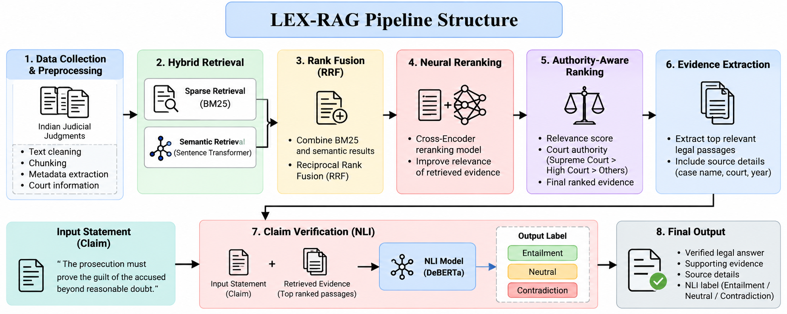
Authority-Aware & Evidence-Verified RAG for Indian Judicial Judgments
LEX-RAG Pipeline Structure
Text
Retrieve
RRF
Rerank
Authority
Evidence
NLI
Current prototype returns source-extracted evidence; NLI is a separate statement checker. Authority scoring requires validated court metadata.

Slide 10
Authority-Aware & Evidence-Verified RAG for Indian Judicial Judgments
Current Implementation Status
• Connected dataset: ninadn/indian-legal training CSV from Hugging Face, cached locally for repeatable/offline runs.
• The judgment Text field is indexed; the reference Summary field is not used as retrieval evidence.
• Basic mode implements BM25 + TF-IDF + RRF and returns source-extracted evidence with citations.
• Research mode adds semantic retrieval, neural reranking and a separate NLI statement checker.
• The review interface compares prefix-only verification, evidence windows and conditional re-search.
• Baseline-vs-proposed evaluation and broader authority-metadata experiments remain ongoing.

Slide 11
Authority-Aware & Evidence-Verified RAG for Indian Judicial Judgments
Project Plan / Milestones Progress
• Literature Survey & Research Gap — Completed
• Dataset Connection & Preprocessing — Completed
• Basic BM25 + TF-IDF + RRF Retrieval — Completed
• Research Semantic Retrieval & Neural Reranking — Completed
• NLI Statement Verification / Evidence Windows — Completed
• Authority-Aware Metadata Experiments — In Progress
• Baseline vs Proposed Evaluation — In Progress
• Final Testing, Results & Documentation — In Progress
Text
Retrieve
RRF
Rerank
Authority
Evidence
NLI
COMPLETED
IN PROGRESS

Slide 12
Authority-Aware & Evidence-Verified RAG for Indian Judicial Judgments
Conclusion
• LEX-RAG provides traceable legal research by connecting answers and statements to retrieved judicial evidence.
• The current prototype separates evidence retrieval from independent NLI verification to avoid overstating unsupported conclusions.
• Authority-aware ranking is applied only when reliable court metadata is available.
• The project is a legal research support system, not a substitute for professional legal interpretation.
• Next work focuses on larger evaluation sets, richer court metadata and quantitative baseline-vs-proposed analysis.

Slide 13
Authority-Aware & Evidence-Verified RAG for Indian Judicial Judgments
Acknowledgement
• I sincerely thank my project guide, faculty members and reviewers for their guidance and technical feedback.
• I thank REC College and the M.Tech Advanced Industry Integrated Program for providing the academic environment for this project.
• I acknowledge the open-source research community and model/dataset providers used for retrieval, re-ranking and verification experiments.

Slide 14
Authority-Aware & Evidence-Verified RAG for Indian Judicial Judgments
References
• Lewis et al. (2020) — Retrieval-Augmented Generation for Knowledge-Intensive NLP Tasks.
• Reimers & Gurevych (2019) — Sentence-BERT: Sentence Embeddings using Siamese BERT-Networks.
• Nogueira & Cho (2019) — Passage Re-ranking with BERT.
• He et al. (2021) — DeBERTa: Decoding-enhanced BERT with Disentangled Attention.
• Robertson & Zaragoza (2009) — The Probabilistic Relevance Framework: BM25 and Beyond.
• Malik et al. (2021) — ILDC for CJPE: Indian Legal Documents Corpus for Court Judgment Prediction and Explanation.
• Pipitone & Alami (2024) — LegalBench-RAG: A Benchmark for Retrieval-Augmented Generation in the Legal Domain.
• Dataset — ninadn/indian-legal, Hugging Face.

