Slide 1


M.Tech/MCA Program
Advanced Industry Integrated Programs
Jointly offered by University and LTIMindTree
Review II
Authority-Aware and Evidence-Verified Retrieval-Augmented Generation for Reliable Legal Research over Indian Judicial Judgments
T9969
THARUNEESH G K (251011017)
REC (2025-2027)
Knowledge partner | Implementation partner

Slide 2
Project Title - Calibri body 18
Introduction….
Legal research is time-consuming because judicial judgments are lengthy and complex.
Retrieval-Augmented Generation (RAG) helps retrieve relevant legal information efficiently.
Traditional legal RAG may retrieve less authoritative evidence or produce unsupported claims.
LEX-RAG improves reliability using authority-aware ranking and claim-level evidence verification.

Slide 3
Project Title - Calibri body 18
Objective….
Develop an AI-based legal research system for Indian judicial judgments.
Retrieve relevant legal evidence using hybrid retrieval techniques.
Improve evidence ranking using legal authority information.
Verify legal statements using claim-level NLI verification.
Improve the grounding and reliability of retrieved legal information.

Slide 4
Project Title - Calibri body 18
Module name
  Dataset Processing Module
  Hybrid Retrieval Module
  Evidence Reranking Module
  Authority-Aware Ranking Module
  Evidence Extraction Module
  Claim Verification Module
  Evaluation & Comparison Module
  User Interface Module

Slide 5
Project Title - Calibri body 18
Methodology/Modeling Plan…
Data Preparation: Load and preprocess Indian judicial judgment text.
Hybrid Retrieval: Retrieve relevant evidence using BM25 + semantic retrieval.
Rank Fusion: Combine retrieval results using Reciprocal Rank Fusion (RRF).
Evidence Reranking: Improve relevance using a neural reranking model.
Authority-Aware Ranking: Rank evidence using relevance + court authority.
Claim Verification: Verify legal statements using NLI-based evidence checking.

Slide 6
Project Title - Calibri body 18
Data preprocessing & EDA….
Dataset Loading: Load the Indian Legal judgment dataset.
Text Cleaning: Remove unnecessary spaces, symbols, and formatting noise.
Text Chunking: Split long judgments into smaller searchable passages.
Duplicate Handling: Remove duplicate or repeated text where applicable.
Dataset Analysis: Analyze the number and length of legal documents/chunks.
Quality Check: Identify missing, short, or noisy judgment text.

Slide 7
Project Title - Calibri body 18
Approach/Algorithms/Tools….
Sparse Retrieval: BM25 for keyword-based legal evidence retrieval.
Semantic Retrieval: Sentence Transformer for meaning-based retrieval.
Rank Fusion: Reciprocal Rank Fusion (RRF) to combine retrieval results.
Neural Reranking: Cross-Encoder to improve evidence relevance.
Authority Ranking: Court authority + relevance score for evidence prioritization.
Claim Verification: DeBERTa NLI for Entailment, Neutral, and Contradiction checking.
Tools: Python, Flask, Hugging Face, Scikit-learn, Git/GitHub.

Slide 8
Project Title - Calibri body 18
Project plan/milestones progress
Literature Survey & Research Gap – Completed
Dataset Collection & Preprocessing – Completed
Hybrid Legal Evidence Retrieval – Completed
RRF & Neural Reranking – Completed
Authority-Aware Ranking – Completed
NLI Claim Verification – Completed
Baseline vs Proposed System Evaluation – In Progress
Final Testing & Documentation – In Progress

Slide 9
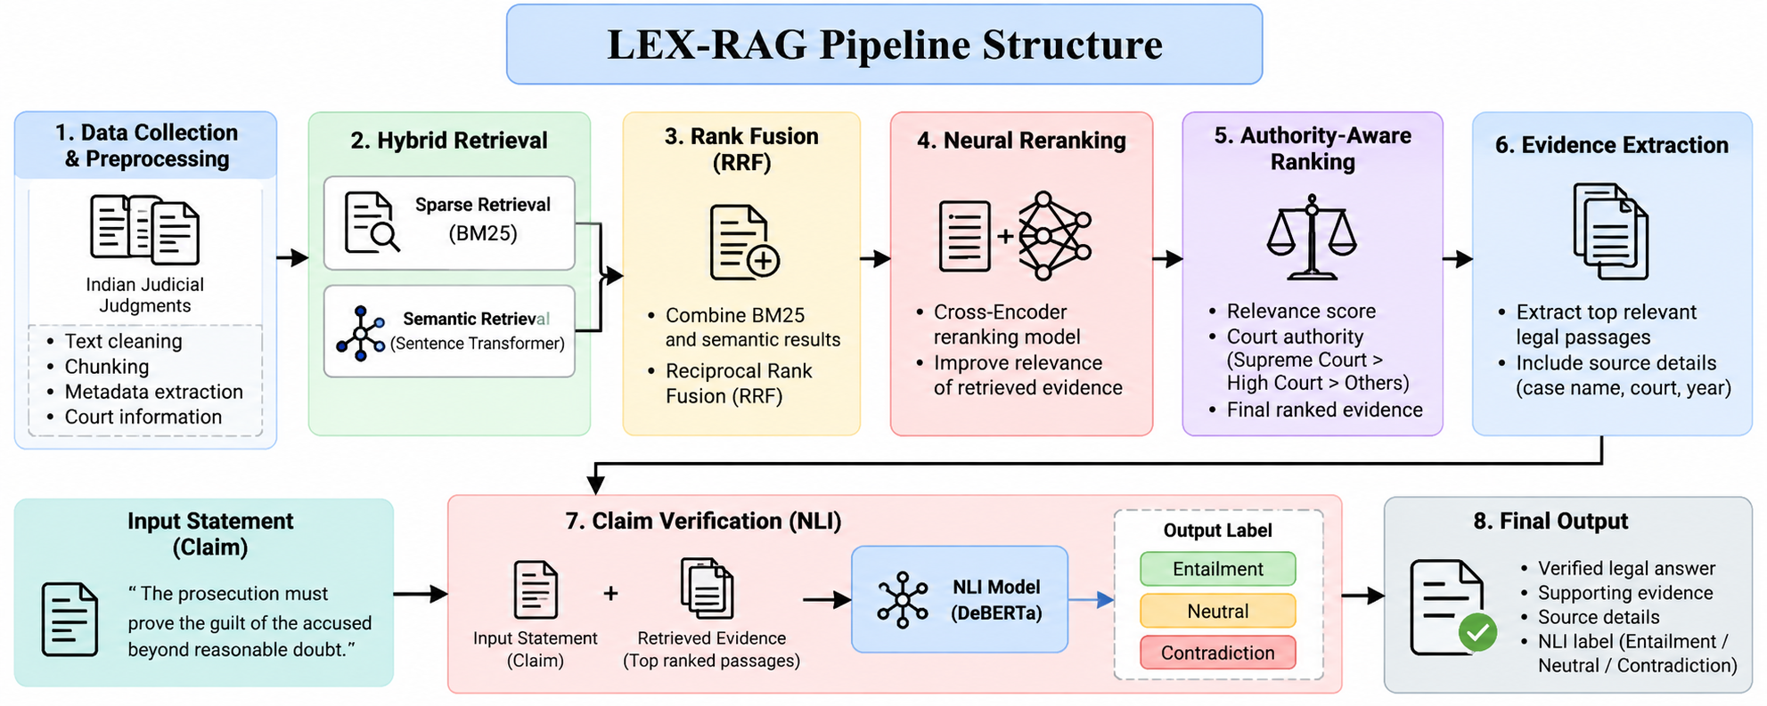
Project Title - Calibri body 18
Pipeline structure

Slide 10
M.Tech/MCA Program
Advanced Industry Integrated Programs
Jointly offered by University and LTIMindTree
Review II
CreditAgent AI: Agentic AI For Credit Risk Assessment
T9969
THARUNEESH G K (251011017)
REC (2025-2027)
Knowledge partner | Implementation partner

Slide 11
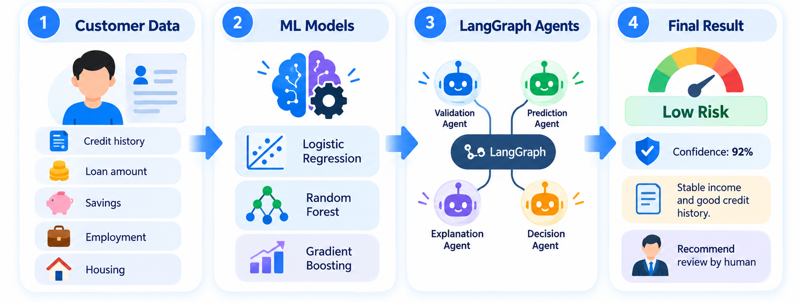
Project Title - Calibri body 18
Introduction….
Predicts Good or Bad Credit Risk using customer credit data.
Compares Logistic Regression, Random Forest, and Gradient Boosting.
Uses LangGraph agents for prediction, explanation, and human decision support.

Slide 12
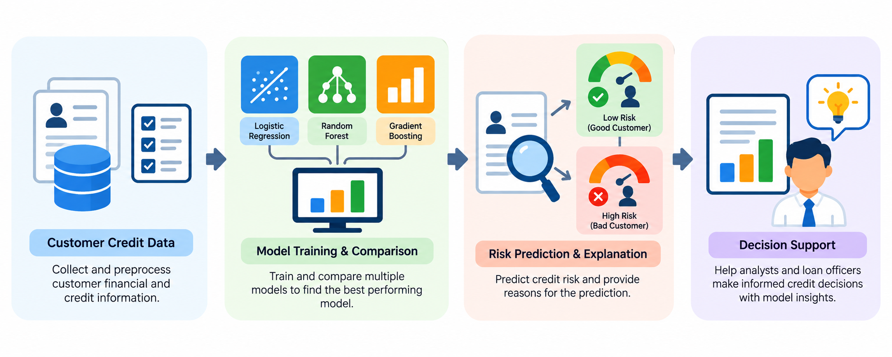
Project Title - Calibri body 18
Objective….
Predict credit risk using customer financial and credit information.
Compare multiple ML models and select the best-performing model.
Use LangGraph-based agents for prediction, explanation, and decision support.

Slide 13
Project Title - Calibri body 18
Module name
  Data Validation Module – Checks and validates customer credit inputs.
  Preprocessing Module – Converts customer data into model-ready format.
  Credit Risk Prediction Module – Predicts Higher Risk or Lower Risk using the selected ML model.
  Cost Analysis Module – Applies the 5:1 cost rule for missed bad-risk cases versus false alerts.
  SHAP Explanation Module – Identifies which customer features influenced the prediction.
  Recommendation Module – Gives the final recommendation for human credit review.

Slide 14
Project Title - Calibri body 18
Methodology/Modeling Plan…
Data Preparation – Load the German Credit dataset, remove duplicates, validate inputs, and select 17 prediction features.
Preprocessing – Apply One-Hot Encoding for categorical features and scaling where required.
Model Training – Train Logistic Regression, Random Forest, and Gradient Boosting models.

Slide 15
Project Title - Calibri body 18
Methodology/Modeling Plan….
Model Selection – Use 3-Fold Stratified Cross-Validation and select the best model mainly using ROC-AUC and F1-score.
Risk Evaluation – Optimize the decision threshold using validation data, then evaluate with Accuracy, Precision, Recall, F1, and cost-sensitive analysis.

Slide 16
Project Title - Calibri body 18
Data preprocessing & EDA….
Data Cleaning – Check for missing values, duplicates, and valid target values before training.
Feature Selection – Use 17 credit-related features and exclude age, personal_status_sex, and foreign_worker from prediction.
Encoding & Scaling – Apply One-Hot Encoding to categorical features and Standard Scaling for Logistic Regression numerical inputs.
EDA – Analyze dataset size, class distribution, feature types, and basic data quality before model training.
Data Split – Divide data into 60% training, 20% validation, and 20% testing using stratified sampling.

Slide 17
Project Title - Calibri body 18
Approach/Algorithms/Tools….
Approach – Build a credit-risk decision-support pipeline using Machine Learning + LangGraph-based Agentic AI.
Algorithms – Compare Logistic Regression, Random Forest, and Gradient Boosting, then select the best model using cross-validation.
Explainability – Use SHAP to identify which customer features increase or decrease the predicted credit risk.
Agentic Workflow – Use LangGraph for validation, preprocessing, risk prediction, cost analysis, SHAP explanation, and recommendation.
Tools – Python, Scikit-learn, Pandas, NumPy, LangGraph, SHAP, Flask, SQLite, and MLflow.

Slide 18
Project Title - Calibri body 18
Project plan/milestones progress
Dataset Preparation – Completed German Credit dataset loaded, validated, and cleaned.
Preprocessing & Model Development – Completed17 features prepared and Logistic Regression, Random Forest, and Gradient Boosting implemented.
Model Evaluation – Completed3-Fold Cross-Validation, threshold selection, Accuracy, Precision, Recall, F1, and cost-sensitive evaluation implemented.
Agentic AI Workflow – Completed LangGraph workflow with validation, preprocessing, risk prediction, cost analysis, SHAP explanation, and recommendation is implemented.
Application & Monitoring – Completed / In Progress Flask UI/API, SQLite assessment history, ML flow tracking, fairness audit, drift monitoring, batch processing, and PDF report support are included.

Slide 19
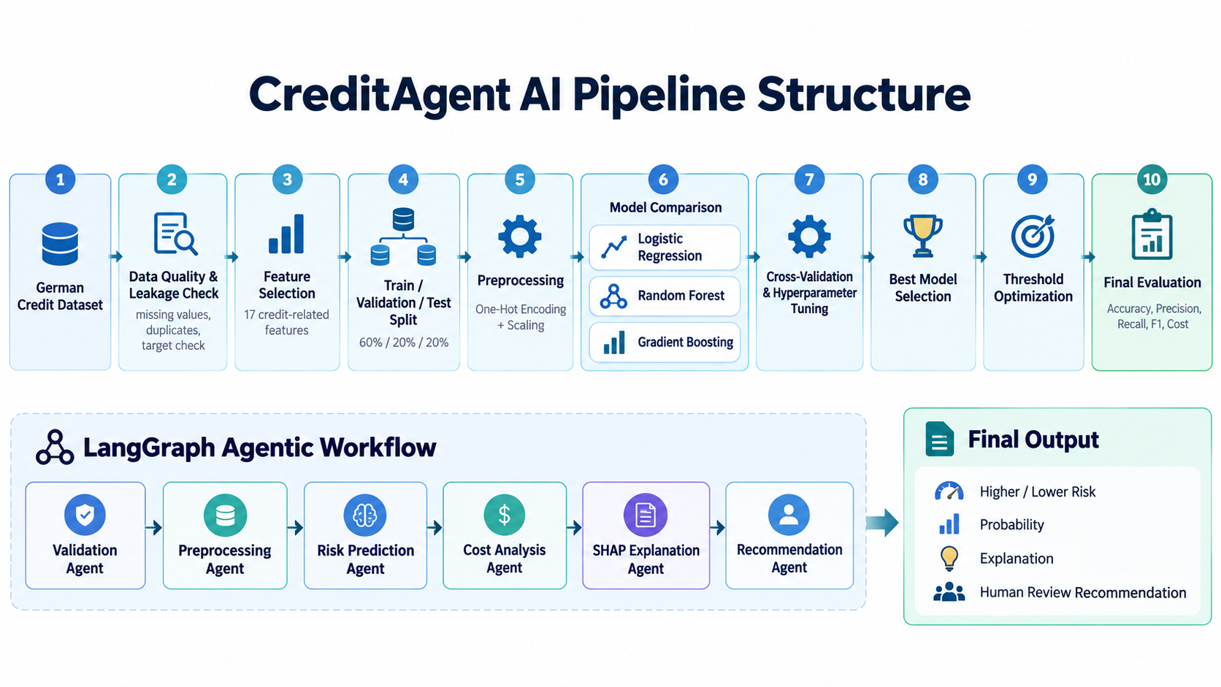
Project Title - Calibri body 18
Pipeline structure

