Slide 1
Determinants of Regional Unemployment in EU NUTS2 Regions
From Group 1107:
Radu Bogdan
Tulea Teodora Florina
Turcanu Teodor
Ticu-Jianu Eduard

Slide 2
1. Introduction
Regional unemployment differs across European Union regions, even within the same country. These disparities may be linked to differences in economic development, human capital, and regional structural characteristics.
The project aims to investigate whether unemployment differences across NUTS2 regions in Romania, Bulgaria and Poland can be explained by regional economic, educational, and demographic factors using a multiple linear regression model.

Slide 3
2. Literature Review
Previous studies show that regional unemployment differences are mainly related to economic development and labor market structure. Elhorst (2003) explains that unemployment disparities across regions are not random, but depend on local economic conditions and labor demand.
In Central and Eastern European countries, economic transition increased regional differences. The decline of traditional industries created structural unemployment in several regions, especially those that failed to attract new investment or adapt to new economic activities (Iancu, 2012).

Slide 4
2. Literature Review
Education is another key factor influencing unemployment. Human capital theory suggests that higher education improves employability and helps workers adapt to labor market changes (Mincer, 1974). Empirical studies show that regions with higher shares of tertiary-educated population usually have lower unemployment rates (Marelli et al., 2012).
Capital regions also tend to perform better on the labor market. According to economic geography literature, agglomeration effects lead to a concentration of jobs, investment, and infrastructure in capital cities (Krugman, 1991; Capello, 2014).

Slide 5
3. Methodology - Data and Sample
Unit of observations: NUTS2 regions
Sample: Romania (8 regions), Bulgaria (6 regions), Poland (16 regions)
Total obeservations: 30 NUTS regions (cross-sectional data)
Time coverage: year 2023
Method: Cross-sectional analysis using multiple linear regression (OLS)

Slide 6
3. Methodology - Variable Definiton
Variable | Type | Computation
UnemploymentRate% | dependent | No. of unemployed persons aged 15–74 divided by the active labor force in the same age group, expressed as a percentage
GDPperCapita_ PPS | independent | Computed as regional GDP at market prices divided by the resident population, adjusted using Purchasing Power Standards
TertiaryEducation % | independent | Share of the population aged 25–64 that has completed tertiary education (ISCED levels 5–8), expressed as a percentage

Slide 7
3. Methodology - Variable Definiton
Variable | Type | Computation
EmploymentRate % | independent | Calculated as the proportion of the population aged 20–64 employed, expressed as a percentage of the total population in this age group
PopulationDensity_ inh_km2 | independent | Calculated as the total resident population divided by the surface area of the region, expressed as inhabitants per square kilometer
Dummy_ CapitalRegion | independent | 1 = capital region (Bucharest-Ilfov, Sofia region, Warsaw region) 0 = non-capital region

Slide 8
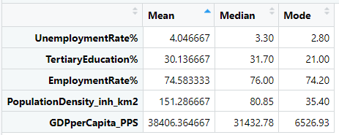
3. Methodology - Descriptive Statistics
The mean unemployment rate (4.05%) exceeds the median (3.30%), indicating that most regions have low unemployment, while a few regions with higher values increase the average.
Tertiary education and employment rates show relatively high median values, suggesting generally strong labor market participation, but with uneven distribution across regions.
GDP per capita and population density display large differences between mean and median, reflecting strong disparities between highly developed, urban regions and peripheral areas.
These descriptive patterns reveal regional heterogeneity and motivate the use of multiple linear regression to explain unemployment differences across regions.

Slide 9
3. Methodology - Regression Models Definition
Unemployment=
β0​+β1​GDP+β2​Education+β3​Employment+β4​Density+ϵ
GDP per capita is expected to be negatively related to unemployment, as more developed regions tend to generate higher labor demand.
Tertiary education is included to capture the role of human capital, as higher education levels improve employability and adaptability to labor market changes.
The employment rate reflects overall labor market performance and is expected to be strongly and negatively associated with unemployment.
Population density is included to account for urbanization effects, which may influence job availability and labor mobility.

Slide 10
3. Methodology - Regression Models Definition
Unemployment=
β0​+β1​GDP+β2​Education+β3​Employment+β4​Density+β5​Capital+ϵ
Capital regions often benefit from agglomeration economies, better infrastructure, and higher job concentration, which may lead to systematically different unemployment outcomes.
By including the dummy variable, the model tests whether capital regions exhibit distinct unemployment levels compared to other regions, after controlling for economic development, education, employment, and population density.

Slide 11
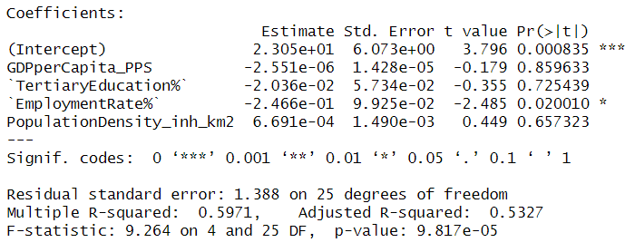
4. Results – Model 1 (without dummy)
The model is statistically significant overall (F-test, p < 0.001)
Employment rate has a negative and statistically significant effect on unemployment
GDP per capita, education and population densitiy are not statistically significant once labor market conditions are controlled for
Hence, regions with higher employment rate tend to have lower unemployment, holding other factors constant

Slide 12
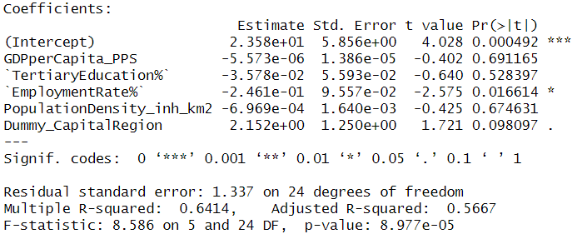
4. Results – Model 2 ( with Capital Dummy)
Including the dummy increases the adjusted R² (from 0.53 to 0.57)
Employment rate remains the most significant determinant of unemployment
The dummy is weakly significant in the standard model and highly significant when using robust standard errors
Therefore, capital regions exhibit structural differences in unemployment outcomes compared to non-capital regions, even after controlling for economic and labor market characteristics

Slide 13
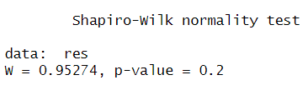
4.1. Model Diagnostics - Normality
p-value > 0.05
We do not reject the null hypothesis of normality
Therefore, the residuals are approximately normally distributed and normality assumption is satisfied

Slide 14

4.1. Model Diagnostics - Homoscedasticity
p-value > 0.05
We do not detect heteroscedasticity
It proves the variance of the residuals is constant across observations and homoscedasticity assumption is satisfied

Slide 15
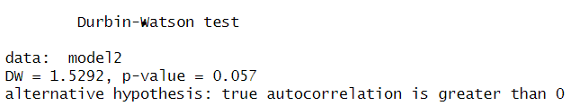
4.1. Model Diagnostics - Autocorrelation
DW slightly below 2
p-value slightly above 0.05
We have mild DW deviations, which is common in cross-sectional data.

Slide 16
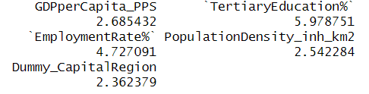
4.1. Model Diagnostics - Multicollinearity
All VIF < 10, one variables close to 6
Some correlation, expected in reginonal data, but no severe multicollinearity problem
This explains why GDP and Education are not significant, because their effects overlap with EmploymentRate.

Slide 17
5. Conclusions
Comparing the two models shows that including the capital region dummy improves the model’s explanatory power, indicating that regional unemployment differences are partly driven by structural factors specific to capital regions.
While several economic and educational variables are included, the results suggest that labor market conditions play a more central role in explaining unemployment disparities across regions.
Overall, the findings confirm that regional unemployment cannot be explained by a single factor, but by the combined effect of labor market performance and regional structural characteristics.

Slide 18
6. Limitations and Future Research
Limitations:
  Small sample size
  Cross-sectional data only
  Limited set of explanatory variables
Future Research:
  Include more regions and time periods
  Use panel data models
  Incorporate additional variables (e.g., FDI, industrial structure)

Slide 19
7. References
Elhorst, J.P. (2003). Regional Labour Market Analysis.
Iancu, A. (2012). Economic Transition and Regional Disparities.
Mincer, J. (1974). Schooling, Experience, and Earnings.
Krugman, P. (1991). Geography and Trade.
Capello, R. (2014). Regional Economics.
Marelli, E., et al. (2012). Education and Regional Unemployment.
Eurostat database.

